Slide 1
The Importance of Data
Manuel Aguilar

Slide 2
Problem
Are businesses making the best decision possible?
What should my working hours be ?
Am I making money ?
Am I losing money ?
Can I cut costs and be okay ?
How can I sell something?
At what price do I sell it?

Slide 3

Possible Solution
Data Science

Slide 4
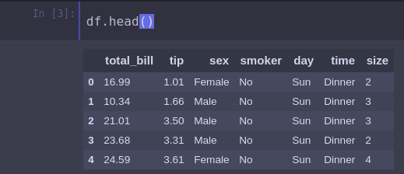
Practice

Slide 5
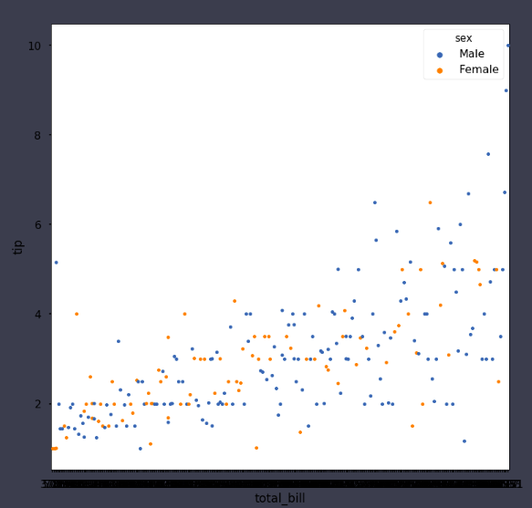
Distributions ?

Slide 6
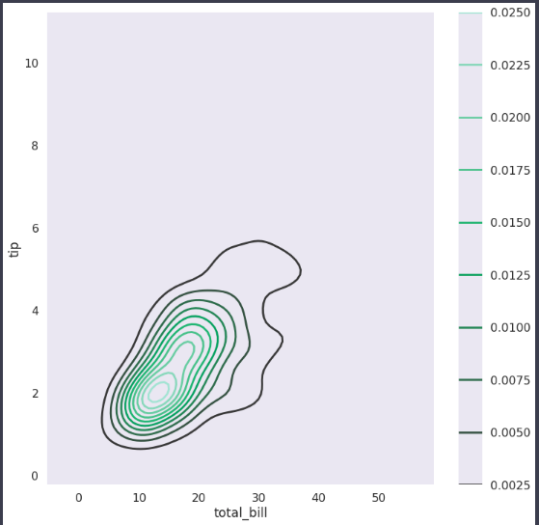
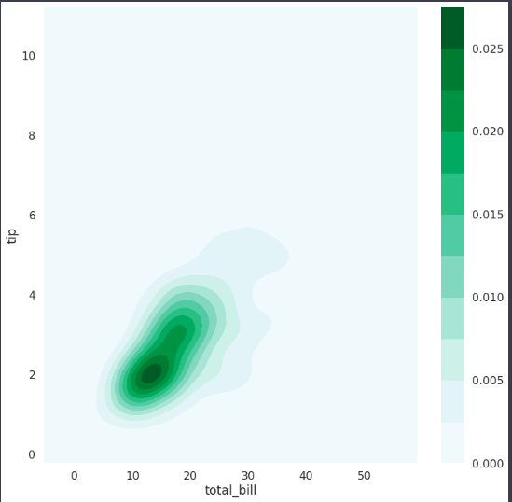
Density

Slide 7
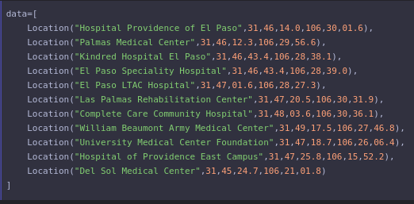
EPCC Project

Slide 8
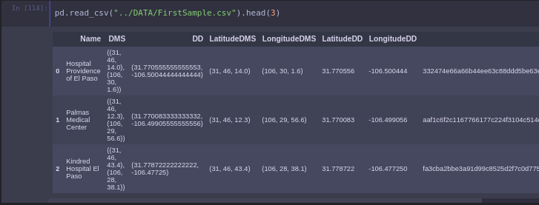
DATA

Slide 9
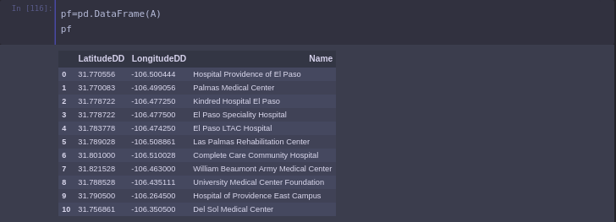
Get Ready

Slide 10
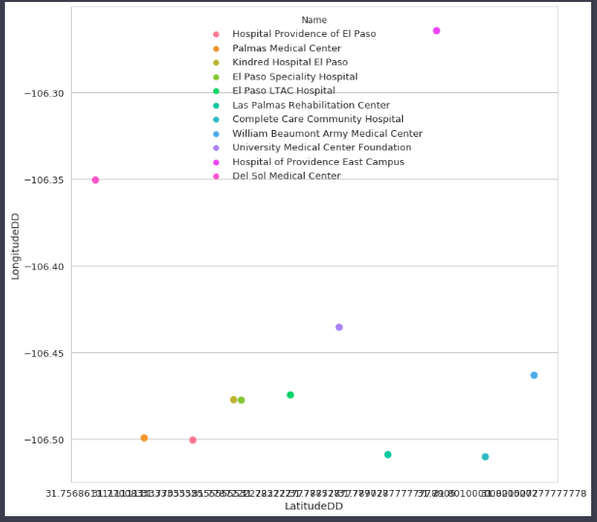
Visuals

Slide 11
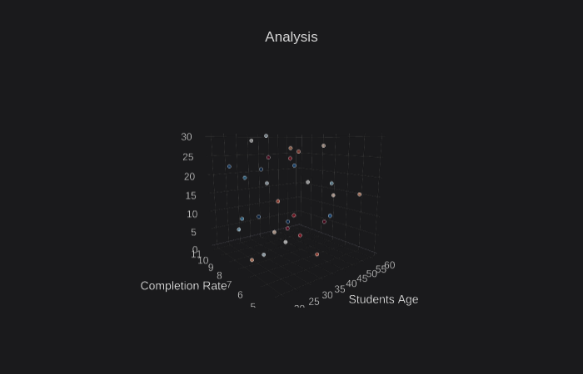
Conclusion

Slide 12
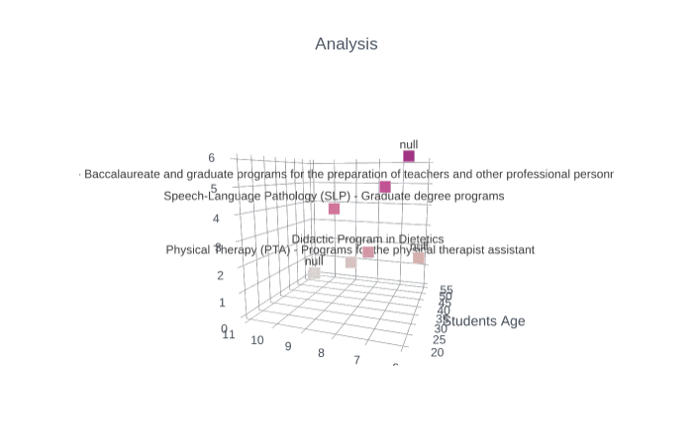
Conclusion

Slide 13
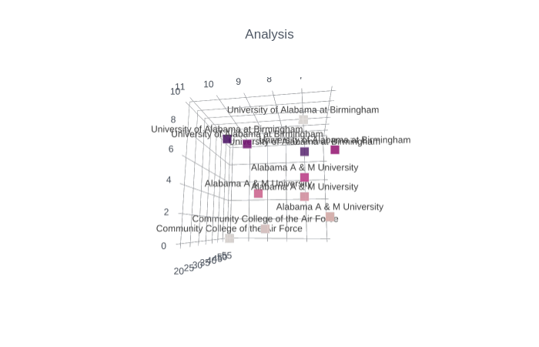
Conclusion

