Slide 1
DB Scan Clustering Method
* Gives -1 label to samples that do not fit in any clusters
Parameters:
1. eps: maximum distance between two points in the same cluster
2. min_samples: minimum number of samples contained by a single cluster
Output:
1. labels
2. cluster components
K-means Clustering Method
* Assigns all samples to a cluster
Parameters:
1. n_clusters: number of clusters
Output:
1. labels
2. cluster centers
Mini Batch K-means Clustering Method
* Assigns all samples to a cluster
Parameters:
1. n_clusters: number of clusters
2. batch_size: size of the mini batches used for computation
Output:
1. labels
2. cluster centers

Slide 2
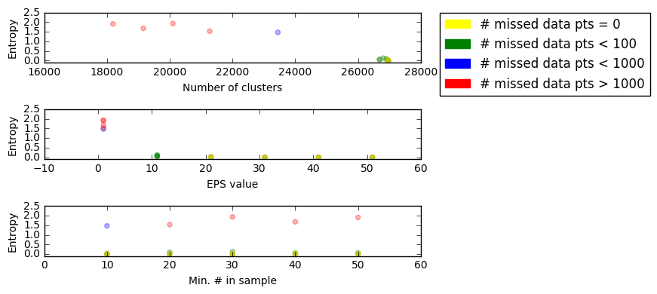
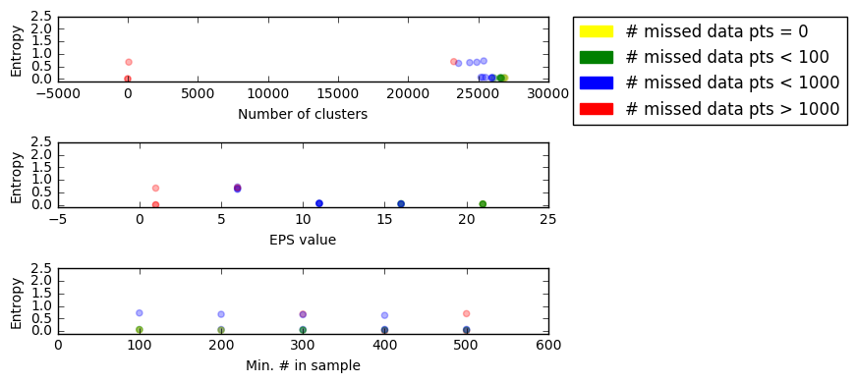
DB scan clustering over range of EPS and min_samples values

Slide 3
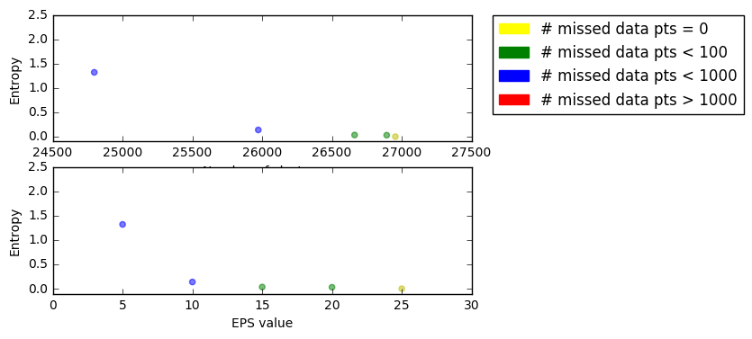
DB scan clustering over range of EPS with min_samples constant at 150

Slide 4
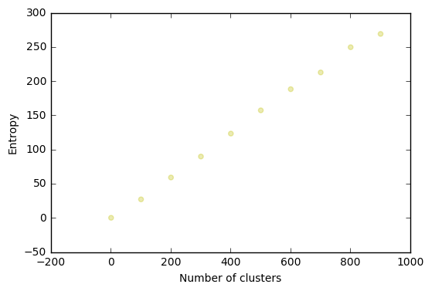
K-means clustering over range of number of clusters

