Slide 1



GROUP 3
THE CampusExpense Manager application

Slide 2

MEMBERS
01
NGUYEN MINH HIEU
02
NGUYEN TIEN MANH
03
BUI HOANG LONG
04
PHAM XUAN BACH

Slide 3
PROJECT OVERVIEW
BudgetWise Solutions is a small development team with limited experience in mobile app development. They have taken on a project to create a mobile application called "CampusExpense Manager," tailored for university students. The goal is to develop an easy-to-use app that helps students manage their expenses effectively while staying within their budgets. The CampusExpense Manager aims to simplify expense tracking for students, whether they are living on or off-campus.

Slide 4


OBJECTIVES OF THE APP
Simplify Expense Tracking
Effective Budgeting
Easy input of expenses with categories and descriptions
Quick search and filter functionality
Set monthly and category-specific budgets
Receive real-time notifications on budget usage
Gain Financial Insights
Enhance User Experience
Visualize spending trends and patterns
Generate detailed expense reports
Intuitive and user-friendly interface
Reliable performance, even offline

Slide 5

USER REQUIREMENTS
Expense Tracking
Budgeting
Ability to record daily expenses
Categorization of expenses (e.g., food, rent, transportation)
Search and filter functionality to analyze spending patterns
Set monthly and category-specific budgets
Receive timely budget alerts
Intuitive User Interface
Summary Reports
Easy-to-navigate design
Clear and concise information display
Generate detailed expense reports
Visualize spending trends and patterns

Slide 6


SYSTEMS INVESTIGATION AND RESEARCH
Research Phase:
To gain a comprehensive understanding of students' financial needs and preferences, we conducted a thorough research phase, including:
User Surveys and Interviews: We directly engaged with university students to gather insights into their spending habits, budgeting challenges, and desired features in a financial management app.
Competitive Analysis: We analyzed popular personal finance apps, such as Mint, PocketGuard, and YNAB, to identify their strengths, weaknesses, and unique selling points.

Slide 7
SYSTEMS INVESTIGATION AND RESEARCH
Key Insights from Research:
Simplicity and User-Friendliness: Students desire a straightforward and easy-to-use interface.
Real-time Tracking: The ability to track expenses in real-time, either manually or through automated imports.
Flexible Budgeting: Customizable budgets that adapt to changing financial situations.
Offline Functionality: The app should function without an internet connection, especially for students studying abroad or in areas with limited connectivity.
Security and Privacy: Strong security measures to protect sensitive financial information.
Community Features: Opportunities for peer-to-peer support, financial advice, and challenges.
Gamification: Incorporating gamification elements to motivate users and make financial management fun.

Slide 8
PROJECT SCOPE AND CONSTRAINTS
Project Scope
The CampusExpense Manager app will provide the following core functionalities:
Expense Tracking:
Manual input of expenses with categories and descriptions
Automatic categorization using machine learning (future enhancement)
Budgeting:
Set monthly and category-specific budgets
Receive real-time budget alerts and notifications
Reporting:
Generate detailed expense reports
Visualize spending trends and patterns
User-Friendly Interface:
Intuitive design with clear navigation
Personalized dashboard

Slide 9
PROJECT SCOPE AND CONSTRAINTS
Project Constraints
Limited Development Resources: The development team has limited experience in mobile app development and a small team size.
Tight Timeline: The project has a strict 12-week timeline.
Budget Constraints: Limited budget for development, testing, and marketing.
Offline Functionality: The app must function offline to accommodate users in areas with limited connectivity.
Platform Compatibility: The app must be compatible with both iOS and Android platforms.
Data Security: Robust security measures must be implemented to protect user data.
Performance Optimization: The app must perform efficiently, even on low-end devices.

Slide 10

TOOLS AND TECHNOLOGIES USED
01
02
03
04
SQLITE
ANDROID STUDIO
JAVA FOR ANDROID
FIGMA
Local database for offline data storage
Integrated development environment for Android app development
JAVA is a programming language which is used in Android App Development. The primary goals of JAVA is to be simple, object-oriented, robust, secure and high level.
A powerful design tool for creating user interfaces and prototyping

Slide 11
DEVELOPMENT METHODOLOGY
Agile Development has been chosen as the primary methodology for this project. This iterative approach aligns well with the dynamic nature of software development and the evolving requirements of our target audience.
Key Benefits of Agile Development:
Flexibility: Agile allows for adaptability to changing requirements and unforeseen challenges.
Rapid Iteration: Frequent iterations enable quick delivery of features and early feedback.
Collaboration: Strong collaboration between the development team and stakeholders.
Continuous Improvement: Continuous learning and improvement throughout the development process.

Slide 12
INITIAL DESIGN AND PROTOTYPING
User Research: Conducted interviews and surveys to understand user needs and pain points.
Wireframing: Created low-fidelity wireframes to visualize the app's basic structure and layout.
Prototyping: Developed high-fidelity prototypes using Figma to simulate the app's user interface and interaction.
User Feedback:
Conducted usability testing with a small group of students to gather feedback on the prototype.
Key feedback points:
Simplify the expense categorization process.
Improve the clarity of budget visualizations.
Enhance the overall app's visual appeal.

Slide 13
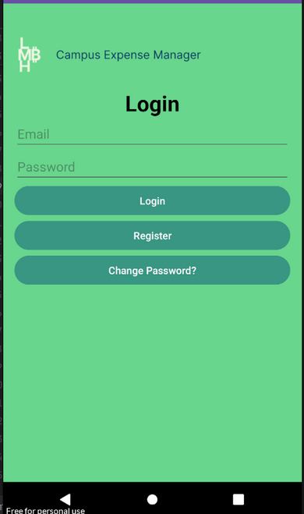
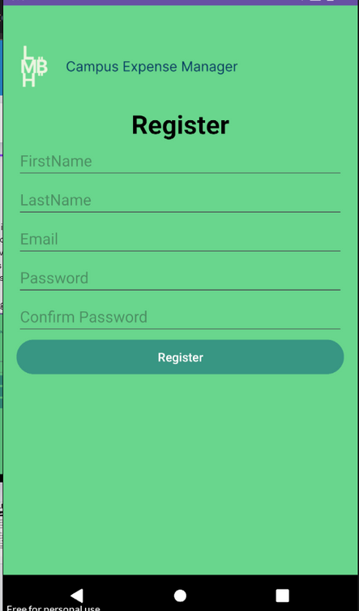
USER INTERFACE (UI) DESIGN
Design Principles:
Simplicity: A clean and minimalist design to reduce cognitive load.
Intuitiveness: Self-explanatory interface elements and a logical flow.
Consistency: Consistent use of typography, color palette, and iconography.
Accessibility: Adherence to accessibility guidelines to ensure inclusivity.
(UI) Design
Design Rationale:
Minimalistic Design: A clean and uncluttered interface reduces cognitive load and improves user experience.
Clear Call-to-Action Buttons: Prominent buttons encourage user interaction.
Error Handling: Informative error messages guide users to correct input mistakes.

Slide 14
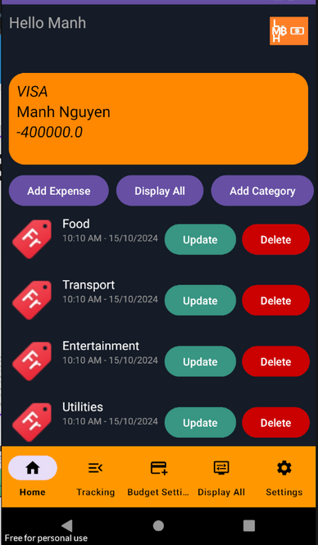
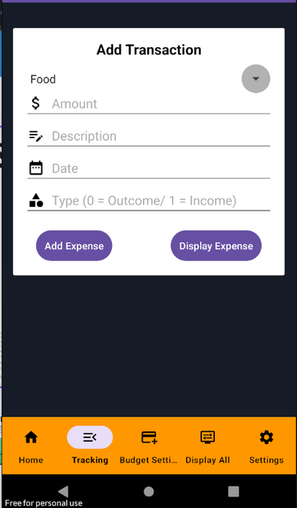
USER INTERFACE (UI) DESIGN
Home
Tracking expenses
Clear display of current budget and spending.
Quick access to expense tracking, budgeting, and reporting features.
Simple form for inputting expenses.
Categorization options for easy organization.

Slide 15

BACKEND ARCHITECTURE
OVERVIEW OF BACKEND CHOICES
SQLITE FOR USER DATA STORAGE
SCALABILITY SUPPORT
The application uses SQLite as the primary data storage solution on mobile devices. SQLite is a standalone, serverless, high-performance SQL database engine, renowned for its simplicity and ease of integration. Designed to be embedded in applications, SQLite eliminates the need for separate database server processes and complex configurations.
Choosing SQLite helps minimize reliance on external services, especially when the application needs to store and process data directly on the user's device
Local data storage: Spending data and related information such as spending categories, budgets, and reports will be stored directly on the mobile device in an SQLite database.
SQLite can store data in interconnected tables, supporting complex SQL queries to effectively manage user spending data.
Simple data management: SQLite is lightweight and easy to use, does not require a separate database server, which simplifies deployment and maintenance.
SQLite supports local data storage on mobile devices, helping applications operate smoothly even without an internet connection.
Expenditure data and related information will be stored in an SQLite database, and querying and updating data can be done quickly and effectively.
With the ability to process a moderate amount of data on the device, SQLite is very suitable for applications that need to store user information without requiring large-scale scalability or online synchronization.

Slide 16



CORE FEATURES IMPLEMENTED
User Registration and Authentication
Expense Tracking
Budget Setting
Functional requirements: User can create account using login and password name.
Fulfilling User Needs: The application provides an interface for authorized users to register and log in to personal accounts. The authentication process must be safe and secure, with users only able to access their spending data.
Functionality requirements: Users can add, edit, and categorize expenses (e.g., rent, food, transportation).
Meet user needs: Each expense must include information such as description, date, amount, and type of expense. Users must be able to easily edit information if needed.
Functional Requirement: Users can set up monthly budgets for different spending categories (e.g., food, shopping, bank payment, service bills, education).
Fulfilling User Needs: The application allows users to adjust the budget amount for each spending category and updates when there are changes.

Slide 17
CORE FEATURES IMPLEMENTED
Expense Overview
Recurring Expenses
Expense Reports
Functional Requirement: The app provides a monthly spending summary, including total spending, remaining budget, and spending allocation by category.
Fulfilling User Needs: Users can view total spending, compare it with the set budget, and check spending details by each category. Can also show spending trends over time
Functional Requirement: Users can add recurring expenses (for example, monthly rent) with start and end dates.
Fulfilling User Needs: Recurring expenses are automatically added to the user's budget every month, making expense management stable and easy.
Functional Requirement: Users can create detailed spending reports for specific time periods (e.g. monthly, yearly).
Fulfilling User Needs: The spending report will include spending allocation by categories, helping users easily evaluate their personal financial situation.

Slide 18
CORE FEATURES IMPLEMENTED
Expense Notifications
Functional Requirement: The application will send reminders or notifications when the user nears or exceeds the budget limit of each category.
Fulfilling User Needs: The notification feature helps users control spending more effectively, avoiding spending beyond the established budget.

Slide 19
ADDITIONAL FEATURES
EXPLANATION OF EXTRA FEATURES
PRIORITIZATION BASED ON USER FEEDBACK
MANUAL CATEGORIZATION
NOTIFICATIONS FOR HIGH SPENDING
Description: Users can create and categorize expenses into the categories they want, helping them customize spending tracking according to their personal needs.
Benefits: This feature helps users more closely control and classify spending easily, thereby making reasonable financial decisions.
Description: The app sends notifications when users near or exceed budget limits in important spending categories.
Benefits: Helps users identify and adjust spending promptly, thereby avoiding exceeding the budget and maintaining a stable financial situation.
These additional features were prioritized for development based on direct feedback from users during testing.
Manual Categorization and Notifications for High Spending are two special features most requested by users because they help them control spending and adjust budgets proactively.
These features not only meet current needs but also assist users in optimizing their budget and managing long-term personal finances.

Slide 20
DATA MANAGEMENT AND SECURITY
DESCRIPTION OF HOW DATA IS MANAGED AND SECURED
DATA MANAGEMENT
DATA SECURITY
User Data Management: User data, including personal information and expenses, is efficiently stored and managed in an SQLite database, ensuring quick processing and availability on mobile devices.
Data Synchronization: Firebase provides data synchronization across devices, ensuring users can access and update their information anytime and anywhere without losing data.
Authentication and Security with Firebase: Firebase Authentication is used to securely authenticate users. Each user can only access their own data after successfully logging in.
Data Encryption: Sensitive data, such as passwords and payment information, is encrypted to ensure that even if data is accessed improperly, personal information remains protected

Slide 21
DATA MANAGEMENT AND SECURITY
DESCRIPTION OF HOW DATA IS MANAGED AND SECURED
FIREBASE SECURITY FEATURES
DATA PRIVACY AND COMPLIANCE
Role-based Access Control: Firebase uses security rules based on roles, granting users access only to the resources they are authorized to view.
Data Protection During Transmission: Firebase ensures that data is encrypted during transmission, safeguarding user information from network attacks.
Regulatory Compliance: The app complies with data protection regulations like GDPR and other security standards to ensure user privacy.
User Rights for Data Access and Management: Users have the right to request access, modify, or delete their personal data at any time.

Slide 22

USER TESTING AND FEEDBACK
Summary of User Testing
The app was tested by a diverse group of university students, ranging from first-year to fourth-year, to ensure varied perspectives and use cases. A total of 40 students participated in the testing phase. They explored the app's key features, including user registration, expense tracking, budget setting, and notifications, to evaluate its usability and functionality.
Students were assigned specific scenarios, such as registering an account, adding expenses, generating reports, and responding to budget notifications. These scenarios allowed for comprehensive testing of the app’s functional requirements.
Vision

Slide 23
USER TESTING AND FEEDBACK
Feedback Overview
Positive Feedback:
Expense Tracking: Most students appreciated the straightforward process of logging expenses. The ability to edit and categorize expenses made the feature highly practical for everyday use.
Budget Setting: The budget feature was praised for helping students better manage their spending habits. They particularly liked the flexibility to adjust budget amounts as needed.
Expense Overview: The summary dashboard received positive remarks for its clear presentation of spending trends and category breakdowns, which made it easier to track finances.
Negative Feedback:
Recurring Expenses: Several students found the recurring expense setup confusing, especially when selecting start and end dates.
Notifications: While notifications were helpful, some students found them too frequent, which became annoying over time.
Navigation: First-year students struggled with navigating between features. They noted that the interface could be more beginner-friendly.

Slide 24
USER TESTING AND FEEDBACK
Usability Changes Based on Feedback
To address the issues raised during testing, several improvements were made:
Recurring Expenses: The recurring expense form was simplified by introducing preset durations (e.g., monthly, yearly), reducing the need for manual date selection.
Notification Frequency: A customizable notification setting was added, allowing users to control how often they receive alerts about budget thresholds.
Improved Navigation: Onboarding tutorials were introduced to guide first-time users through the app’s key features. Additionally, clearer icons and labels were added to improve overall navigation.
User Interface Enhancements: Key action buttons, such as "Add Expense" and "Set Budget," were repositioned for easier access. The interface was also decluttered by minimizing redundant options and prioritizing essential features.

Slide 25
CHALLENGES FACED
TECHNICAL DIFFICULTIES
Challenge:
system with these existing applications
can be complex and may lead to data compatibility issues.
Solution:
including data mapping and transformation processes.
Using middleware solutions helped facilitate
smoother integration.
TIME CONSTRAINTS
Challenge:
Increasing the risk of bugs and user dissatisfaction.
Solution:
Breaking the project into s maller, manageable sprints.
BUDGET CONSTRAINTS
Challenge:
Limited budgets can restrict the resources
available for development, testing, and implementation.
Solution:
They sought feedback to identify which features
Provided the most value, allowing for
Better allocation of resources.

Slide 26
QUALITY ASSURANCE AND TESTING
FUNCTIONAL TESTING
Objective: To verify that each feature of the application
functions according to the specified requirements.
Approach:
This phase is usually conducted by developers.
This helps identify issues arising from the combination of different modules.
This includes testing all functionalities in a staging environment that mimics production.
The changes do not introduce new bugs or affect existing functionalities.
USABILITY TESTING
Objective: To evaluate the application's user interface and overall user experience.
Approach:
Feedback is collected on ease of use, navigation, and overall satisfaction.
Identify potential usability issues.
which performs better in terms of user satisfaction and effectiveness.

Slide 27
QUALITY ASSURANCE AND TESTING
KEY RESULTS THAT ENSURED APP RELIABILITY AND STABILITY.
Improved Functionality
This ensured that all features operated seamlessly,
significantly enhancing the application's reliability.
Enhanced User Experience
Usability testing revealed that users found certain navigation paths confusing.
Based on this feedback, the team made significant
adjustments to the user interface, resulting in a more intuitive experience.
Post-implementation surveys showed a 30% increase in user satisfaction scores.

Slide 28
QUALITY ASSURANCE AND TESTING
KEY RESULTS THAT ENSURED APP RELIABILITY AND STABILITY.
Higher Stability
Regression testing helped identify vulnerabilities
that emerged during the addition of new features.
These issues were addressed before deployment,
leading to a more stable application with fewer
post-launch defects.
Enhanced User Experience
Usability testing revealed that users found certain navigation paths confusing.
Based on this feedback, the team made significant
adjustments to the user interface, resulting in a more intuitive experience.
Post-implementation surveys showed a 30% increase in user satisfaction scores.

Slide 29
RISK MANAGEMENT
IDENTIFIED RISKS
LIMITED MOBILE EXPERIENCE
DESCRIPTION: RISK OF SUBOPTIMAL PERFORMANCE ON MOBILE DEVICES, LEADING TO USER DISSATISFACTION.
IMPACT: COULD REDUCE ADOPTION RATES AND EFFICIENCY FOR MOBILE USERS.
2. SCOPE CREEP
DESCRIPTION: UNCONTROLLED EXPANSION OF PROJECT SCOPE DUE TO NEW FEATURE REQUESTS.
IMPACT: MAY CAUSE DELAYS AND INCREASED COSTS, COMPROMISING PROJECT OBJECTIVES.

Slide 30
RISK MANAGEMENT
MITIGATION STRATEGIES
LIMITED MOBILE EXPERIENCE
USER-CENTERED DESIGN: INVOLVED USERS IN THE DESIGN AND TESTING PHASES TO ENHANCE MOBILE USABILITY.
RESPONSIVE DESIGN: DEVELOPED THE APP TO ADAPT TO VARIOUS SCREEN SIZES, ENSURING FUNCTIONALITY ACROSS DEVICES.
PROTOTYPING AND TESTING: CREATED MOBILE PROTOTYPES AND CONDUCTED USABILITY TESTS TO IDENTIFY AND RESOLVE ISSUES EARLY.
PERFORMANCE OPTIMIZATION: FOCUSED ON REDUCING LOAD TIMES AND OPTIMIZING RESOURCE USE FOR MOBILE ACCESS.
SCOPE CREEP
CLEAR REQUIREMENTS DEFINITION: ESTABLISHED DETAILED PROJECT REQUIREMENTS TO GUIDE DEVELOPMENT.
CHANGE CONTROL PROCESS: IMPLEMENTED A FORMAL PROCESS FOR DOCUMENTING AND APPROVING CHANGES TO THE PROJECT SCOPE.
REGULAR STAKEHOLDER MEETINGS: CONDUCTED FREQUENT CHECK-INS TO ALIGN WITH STAKEHOLDERS AND MANAGE EXPECTATIONS.
FEATURE PRIORITIZATION: FOCUSED ON DELIVERING THE MOST CRITICAL FUNCTIONALITIES FIRST TO KEEP THE PROJECT ON TRACK.

Slide 31
PROJECT MANAGEMENT AND COLLABORATION
TOOLS USED
PROJECT MANAGEMENT SOFTWARE
TRELLO/JIRA: USED FOR TASK MANAGEMENT, WHERE TASKS ARE ORGANIZED INTO BOARDS OR SPRINTS. TEAM MEMBERS CAN ASSIGN, PRIORITIZE, AND TRACK TASK PROGRESS IN REAL TIME.
ASANA: EMPLOYED FOR TRACKING PROJECT MILESTONES AND DEADLINES, ALLOWING FOR EASY VISIBILITY INTO ONGOING TASKS AND RESPONSIBILITIES.
COMMUNICATION TOOLS
SLACK: UTILIZED FOR REAL-TIME COMMUNICATION, ENABLING QUICK DISCUSSIONS, FILE SHARING, AND INTEGRATION WITH OTHER TOOLS FOR NOTIFICATIONS AND UPDATES.
MICROSOFT TEAMS: USED FOR VIDEO CONFERENCING AND TEAM MEETINGS, FACILITATING COLLABORATION ACROSS DIFFERENT LOCATIONS.

Slide 32
PROJECT MANAGEMENT AND COLLABORATION
VERSION CONTROL SYSTEM
Git/GitHub: Implemented for source code management, allowing team members to collaborate on code, track changes, and manage different versions effectively.
Documentation Tools
Confluence/Google Docs: Used for creating and sharing project documentation, meeting notes, and design specifications, ensuring that all team members have access to up-to-date information.

Slide 33
PROJECT MANAGEMENT AND COLLABORATION
STRATEGies for Effective Collaboration
Agile Methodology
The team adopted Agile practices, breaking the project into smaller sprints. This allowed for iterative development, frequent reassessment of progress, and adaptation to changes based on feedback.
2. Regular Stand-Up Meetings
Daily stand-up meetings were held to discuss progress, address any roadblocks, and align on priorities. This quick check-in helped maintain focus and accountability.

Slide 34
PROJECT MANAGEMENT AND COLLABORATION
STRATEGies for Effective Collaboration
3. CLEAR ROLE DEFINITIONS
EACH TEAM MEMBER’S ROLE AND RESPONSIBILITIES WERE CLEARLY DEFINED FROM THE OUTSET, REDUCING CONFUSION AND ENSURING ACCOUNTABILITY FOR SPECIFIC TASKS.
4. COLLABORATIVE TOOLS INTEGRATION
INTEGRATION OF TOOLS (E.G., LINKING TRELLO WITH SLACK) ENABLED SEAMLESS UPDATES AND NOTIFICATIONS, KEEPING EVERYONE INFORMED ABOUT TASK STATUSES
WITHOUT EXCESSIVE MANUAL CHECKING.

Slide 35
PROJECT MANAPERFORMANCE EVALUATION CRITERIAGEMENT AND COLLABORATION
ALIGNMENT WITH USER REQUirements
Requirement Coverage: MEASURED BY THE PERCENTAGE OF USER REQUIREMENTS THAT WERE SUCCESSFULLY IMPLEMENTED. THIS INCLUDES BOTH FUNCTIONAL AND NON-FUNCTIONAL
REQUIREMENTS.
VALIDATION TESTING: CONDUCTED TO VERIFY THAT THE APPLICATION MEETS SPECIFIED REQUIREMENTS THROUGH USER ACCEPTANCE TESTING (UAT) AND FEEDBACK SESSIONS.
FUNCTIONALITY
FEATURE COMPLETENESS: EVALUATED BASED ON THE NUMBER OF IMPLEMENTED FEATURES COMPARED TO THE INITIAL PROJECT SCOPE. THIS INCLUDES CORE FUNCTIONALITIES LIKE EXPENSE SUBMISSION, APPROVAL WORKFLOWS, AND REPORTING CAPABILITIES.
ERROR RATE: MONITORED BY TRACKING THE NUMBER OF BUGS REPORTED DURING TESTING PHASES AND POST-LAUNCH. A LOWER ERROR RATE INDICATES HIGHER FUNCTIONALITY RELIABILITY.

Slide 36

SUMMARY OF USER REQUIREMENTS FULFILLMENT

Slide 37

User Registration & Authentication
Deployment Feature: Create an account and securely log in to access users' personal expense data
Users enter information fields
such as email, password, firstname,
lastname to register an account.
Users log in with their registered
email and password to log into the system.

Slide 38
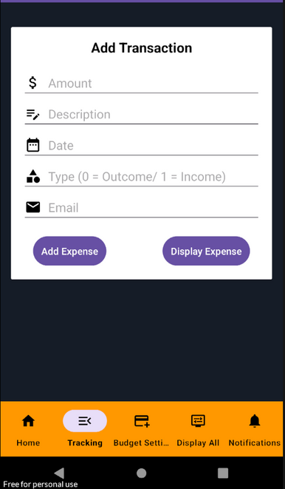
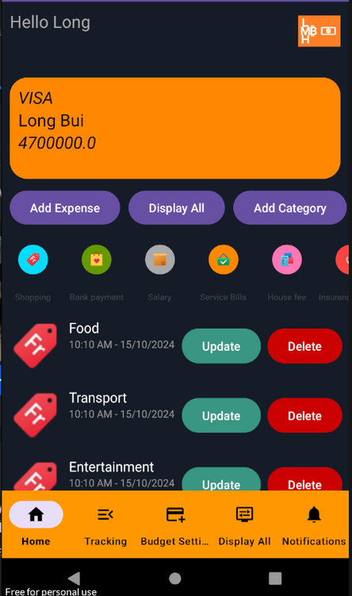
Expense Tracking
Deployment Feature: Set and adjust monthly budgets for categories (e.g., food, entertainment).
Users enter item quantity, description, data, type, email to add and adjust monthly budgets for categories (e.g. food, entertainment).
The spending items added by the user will be displayed on the home screen.

Slide 39
Lessons Learned
1. Skills Acquired
Technical Skills: Improved proficiency in mobile development frameworks and tools.
Design Skills: Gained experience in creating user-centered designs that prioritize usability.
2. Insights into Mobile Development
User Feedback: The importance of incorporating user feedback into the development process to refine features.
Testing: Understanding the necessity of thorough testing to ensure app stability and performance.
3. Understanding User-Centered Design
Empathy in Design: Recognizing the value of designing with the user’s perspective in mind.
Iterative Process: Learning that design is an iterative process, where continuous improvement is essential based on user interaction and feedback.

Slide 40
Feedback Analysis and Future Improvements
1. Feedback Review
Positive Feedback:
Users appreciated the intuitive design and ease of navigation.
The budgeting feature was highlighted as particularly useful.
Constructive Criticism:
Some users had trouble syncing data across multiple devices.
Requested more detailed analytics and reporting options.
2. Actions Taken Based on Feedback
Data Sync Improvements:
Implemented improvements to ensure seamless data syncing across all devices.
Advanced Reporting Features:
Introduced new analytics options to provide users with deeper insights into their spending habits.

Slide 41
Feedback Analysis and Future Improvements
3. Suggested Improvements for Future Updates
User Education:
Develop instructional videos or tutorials to help users maximize the app's features.
Customization Options:
Allow users to customize their dashboards to display information that best suits their needs.
Gather regular feedback:
Set up a system for ongoing user feedback to continually improve the app based on user needs.

Slide 42
Conclusion
In conclusion, our project successfully launched an app that meets all initial user requirements, featuring well-received elements like expense tracking, budgeting, and reporting that enhance user experience.
Our team's exceptional collaboration, commitment, and resilience allowed us to overcome challenges and adapt to feedback, ensuring a high-quality product.
We are grateful for the opportunity to present this project and extend our thanks to all stakeholders, mentors, and users for their valuable insights and support throughout this journey.

Slide 43

Thank for watching

