Slide 2
1 Word-level sequence-to-sequence model
Input : unnormalized text as an input text sequence of words x = [x1,x2,x3,...,xT] with length T
Output: sequence of words y = [y1,y2,y3,..,yL] with length L
y same meaning as x

Slide 3
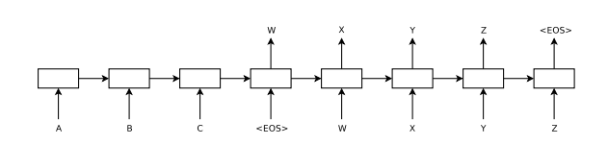
1 Word-level sequence-to-sequence model
Model based
1 consists of two parts : encoder and decoder
2 a cell : RNNs, GRU, LSTM

Slide 4
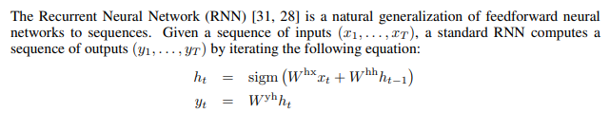
1 Word-level sequence-to-sequence model

Slide 5
1 Word-level sequence-to-sequence model
Attention mechanism
focus on importance words
đánh trọng số cho các từ đầu vào: attention weights
input của mỗi cell t gồm 3 thành phần: ht-1, xt và attention weights để tính ht.

Slide 6
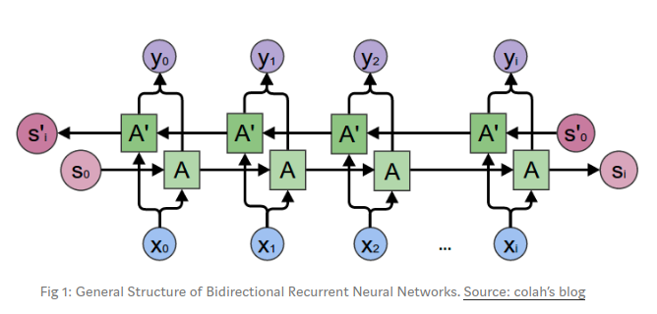
1 Word-level sequence-to-sequence model
Bi-direction model:
https://towardsdatascience.com/understanding-bidirectional-rnn-in-pytorch-5bd25a5dd66
1. gồm 2 encoder: forward RNN và backwork RNN độc lập với nhau
2

