Slide 1
✓
GOVERNANCE FOR AI-ASSISTED DEVELOPMENT
AI Harness
Ship faster with AI coding agents — without giving up
security, control, or visibility.
Security by default
Setup in minutes
Full data control
Token & cost visibility
Dau Sy Manh · standard-governance harness
Notes:
AI Harness is a governance layer for AI coding agents: keep the speed, regain security, control and visibility.

Slide 2
THE PROBLEM
AI agents are powerful. Ungoverned, they are a liability.
⚠
Destructive & unauthorized actions
✗
Prompt injection
An agent can delete files, force-push or drop a table — nothing stops it by default.
Instruction-overrides, jailbreaks and encoded payloads slip straight into the model.
$
Invisible token spend
●
No audit trail
Cost is unknown until the invoice — no per-project, per-member breakdown.
Who ran what, when and why? Without a record there is no accountability.
Most teams bolt AI onto their workflow with zero guardrails — and hope for the best.

Slide 3
WHAT IT IS
A governance layer that wraps your AI coding agent
AI Harness adds identity, policy, evaluation and audit around your agent — enforced by lifecycle hooks, driven by editable config, and recorded in an immutable ledger.
✓
⟳
Security
Easy setup
✓
Hooks beat conventions in prose
Block, scan, record
Install like a package
✓
Config lives in data, not code
✓
Deny-by-default for dangerous actions
●
$
✓
Honest about what is enforced where
Data & observability
Token & cost
One control plane
Budgets & visibility

Slide 4
01
Security enforced at the point of action
Every side-effect passes through policy before it happens — and is recorded after.
✗
Runtime guard
⚠
Prompt-injection scanner
Blocks destructive commands and high-risk tools by policy. Deny-by-default; 24 hardened patterns for RCE, disk-wipe and exfiltration.
Catches instruction-override, role-jailbreak and encoded payloads before they reach the model.
●
Secret scanner
✓
Immutable hash-chain ledger
Stops API keys and credentials leaking into prompts or output.
Every tool call appended to a tamper-evident audit trail — identity + input/output hash.
Every block shows WHAT triggered it and WHY it was stopped — not just a red mark.

Slide 5
02
Governance you install like a package
From zero to governed in an afternoon — Windows and macOS/Linux alike.
1
2
3
→
→
STEP 1
STEP 2
STEP 3
Install the bundle
Point it at your Portal
It syncs itself
One command drops in hooks, policies, the agent fleet and schemas — a versioned, hash-verified bundle.
A single config file plus a per-project key. No servers to stand up on your side.
Usage is re-derived from your session transcripts and pushed automatically — self-healing, no babysitting.
Token data is rebuilt from the transcripts every sync — a missed session-end hook can no longer lose data.

Slide 6
03
One control plane for every project, member & provider
The Control Portal turns raw telemetry into answers you can act on.
●
Multi-project & multi-member
$
Provider connections
Organize teams and projects; admin and member views with role-based access.
Connect multiple AI providers per project; keys encrypted at rest (BYOK).
✗
Security incidents
✓
Action log
See the redacted offending prompt and a plain-language reason for every block.
A queryable mirror of the hash-chained ledger — filter, sort, drill in.
Every metric, three windows:
Today
This month
All-time
Tokens, cost, prompts and blocks — by today, this month and all-time — at a glance.

Slide 7
04
Know your token spend before the invoice
Attribute usage, set limits, and catch overruns early.
$
Per-provider tokens & cost
▲
Budgets with alerts
See exactly which provider and connection consumed what.
Set token/cost limits per project or member, with alert thresholds.
⟳
Time-windowed
✓
BYOK, encrypted
Today, this month, all-time — spot spikes as they happen.
Bring your own keys; envelope-encrypted at rest, never echoed back.
3
5
2
BYOK
time windows
metrics tracked
sync modes: push & pull
your keys, encrypted

Slide 8
HOW IT WORKS
Enforced locally. Observed centrally.
✓
●
⟳
$
›
›
›
Agent + hooks
Local telemetry
Sync
Control Portal
Guard, scan & sample on every action
Ledger + usage in .harness
Rebuilt from transcripts, then pushed
Metrics, incidents, budgets
Local hooks are defense-in-depth; the true security boundary is enforced server-side at the gateway.
Same pipeline whether your code runs on a server or a laptop.

Slide 9
WHY TEAMS TRUST IT
Engineered on honest, enforceable principles
■
A real reference model
✓
Config, not hardcode
Identity, policy, runtime, evaluation, audit — a 7-layer model, not a bag of scripts.
Policies live in schema-validated YAML/JSON you can review and change without touching code.
●
Tamper-evident by design
⚠
No false safety
An append-only hash chain means the audit trail cannot be quietly rewritten.
We label what a local hook can and cannot guarantee — and where server-side enforcement is required.
The weakest layer sets the ceiling — so we make every layer count.

Slide 10
✓
GET STARTED
Start governing your AI
in an afternoon.
1
Install the standard-governance bundle into a project
2
Connect it to the Control Portal with one key
3
Watch security, data and token metrics light up
AI Harness · standard-governance v1.2.4
Secure by default · Easy to adopt · Fully observable

Slide 11
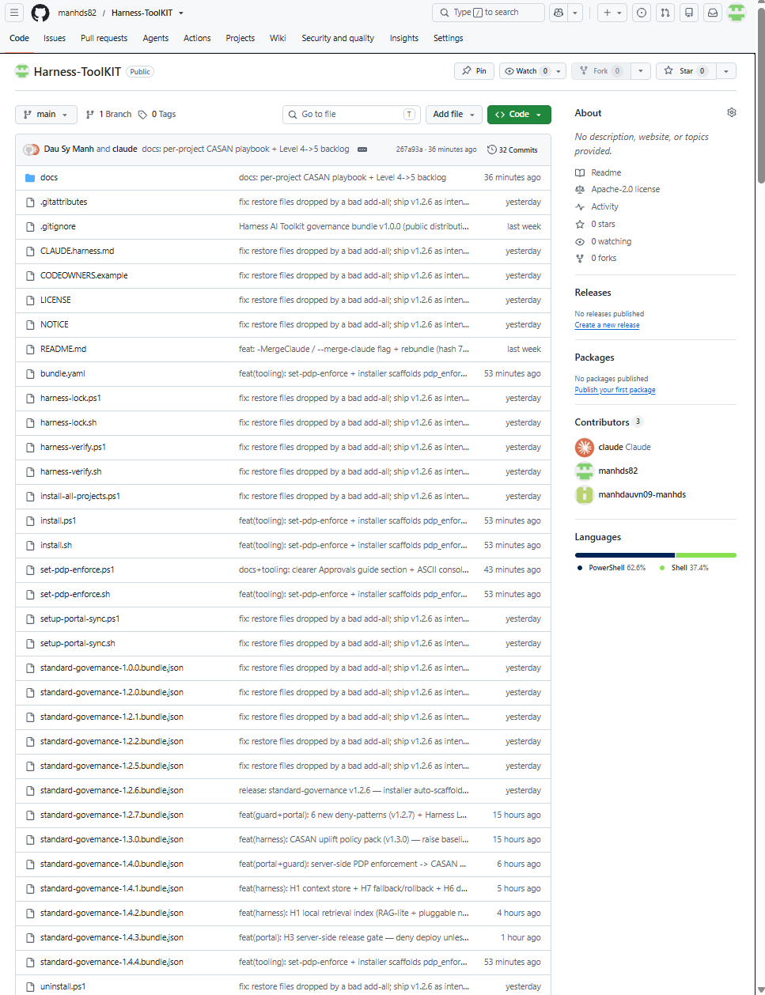
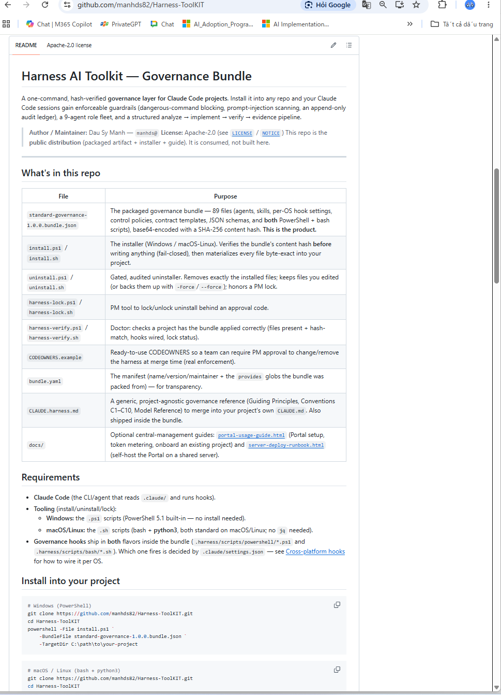
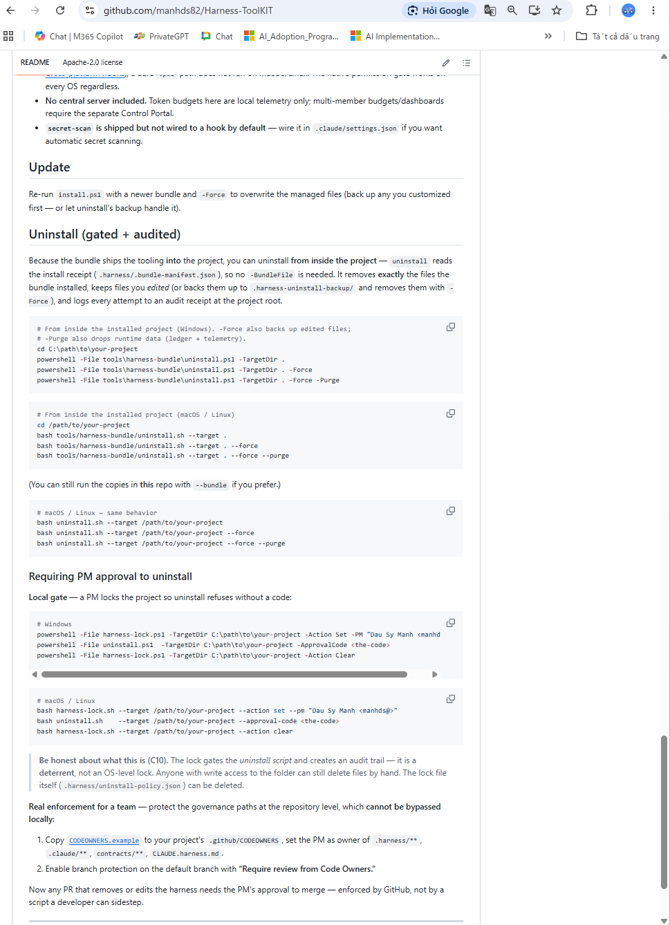
Apendix
1. Public Harness-ToolKIT for install
https://github.com/manhds82/Harness-ToolKIT

Slide 12
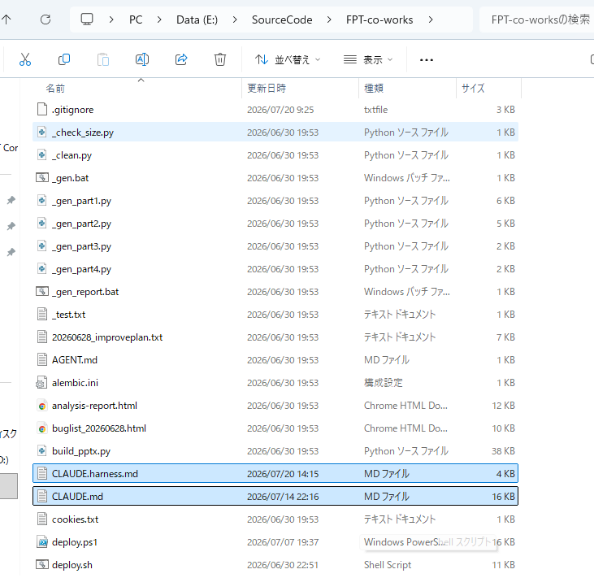
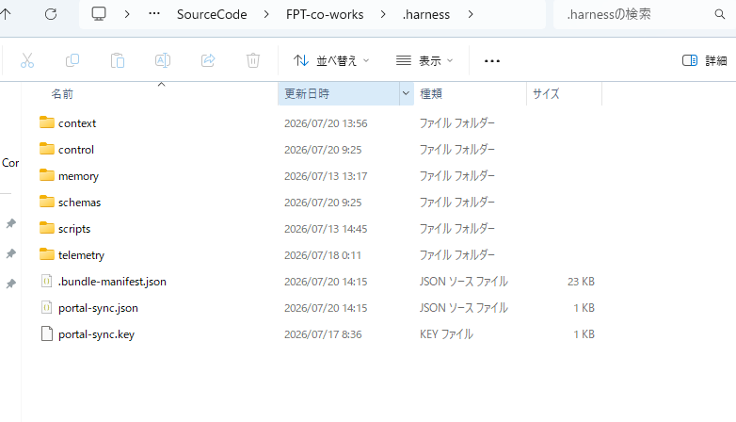
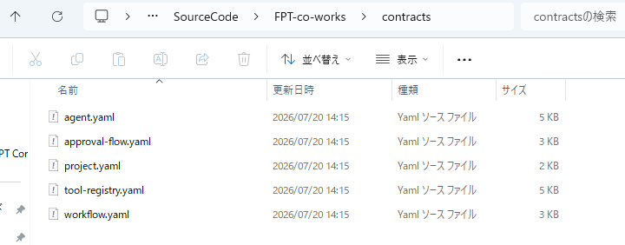
Apendix
2. Auto install and copy rule/harness into old/new project

Slide 13
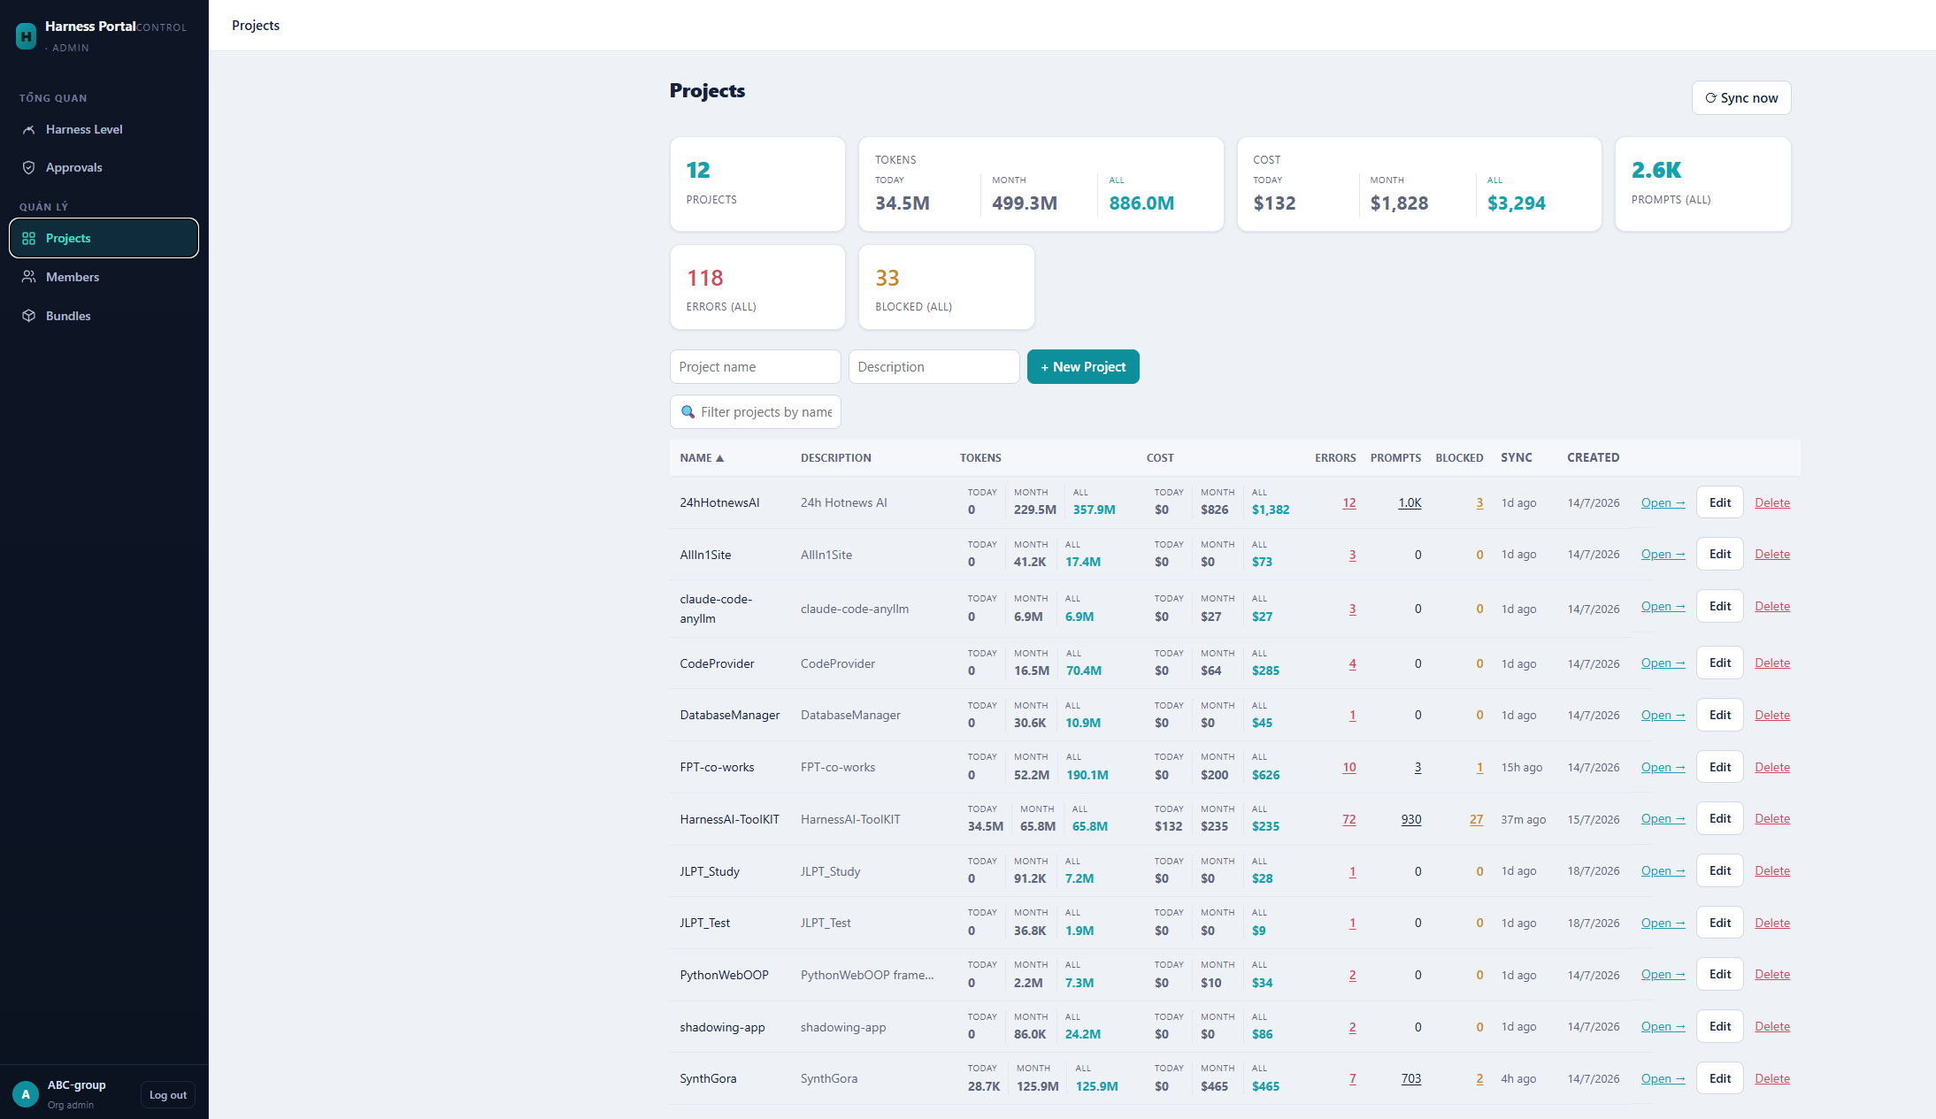
Apendix
3. Portal for control project data (1/7)

Slide 14
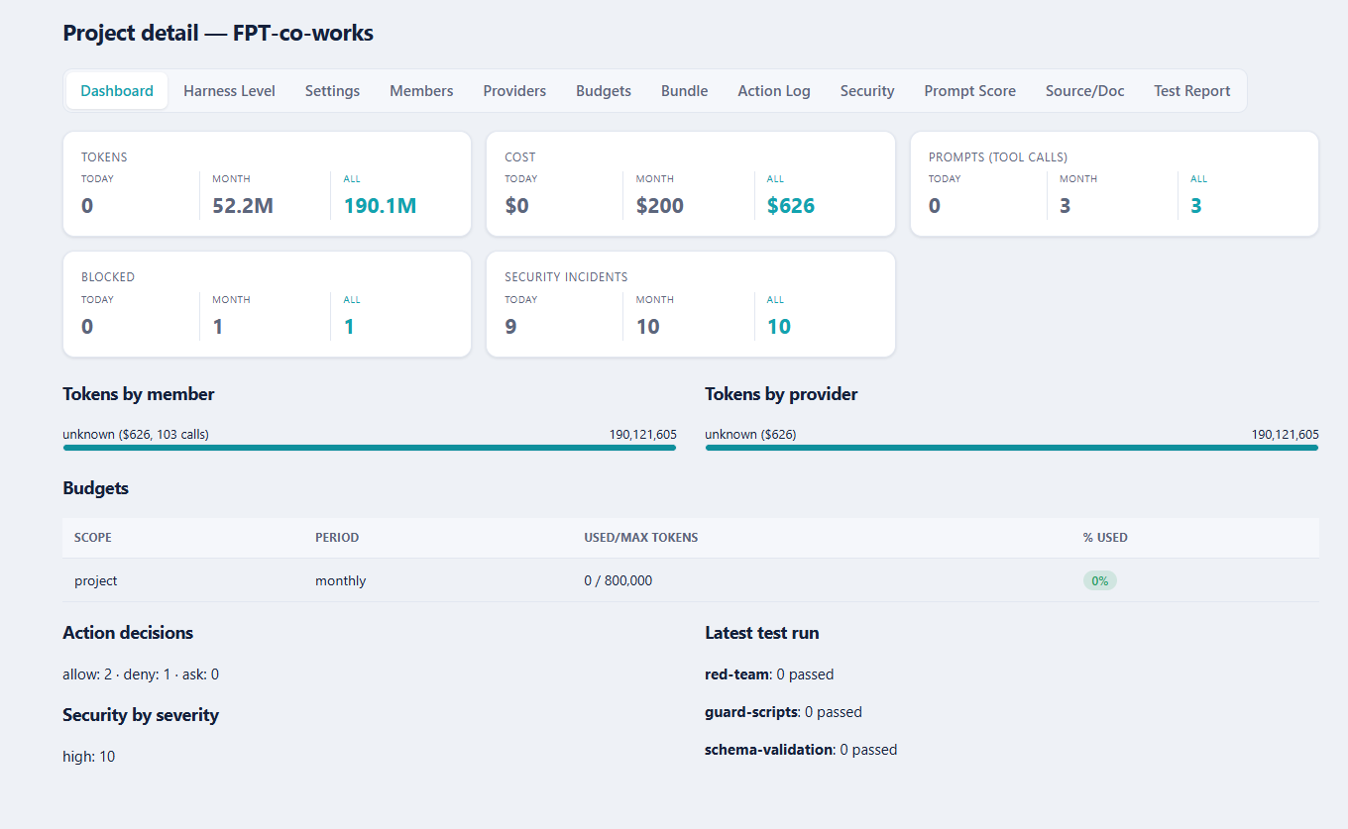
Apendix
3. Portal for control project data (2/7)

Slide 15
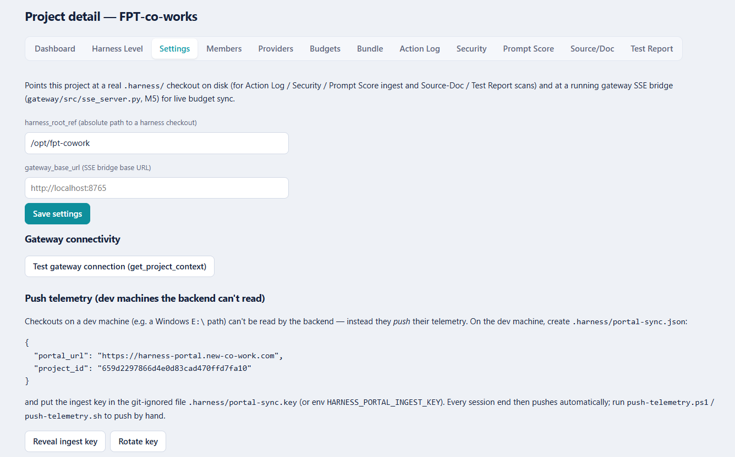
Apendix
3. Portal for control project data (3/7)

Slide 16
Apendix
3. Portal for control project data (4/7)

Slide 17
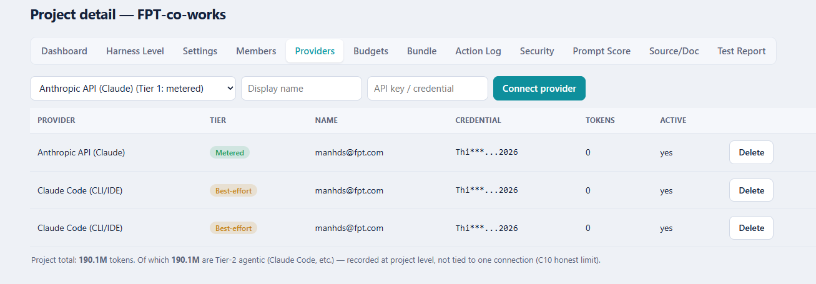
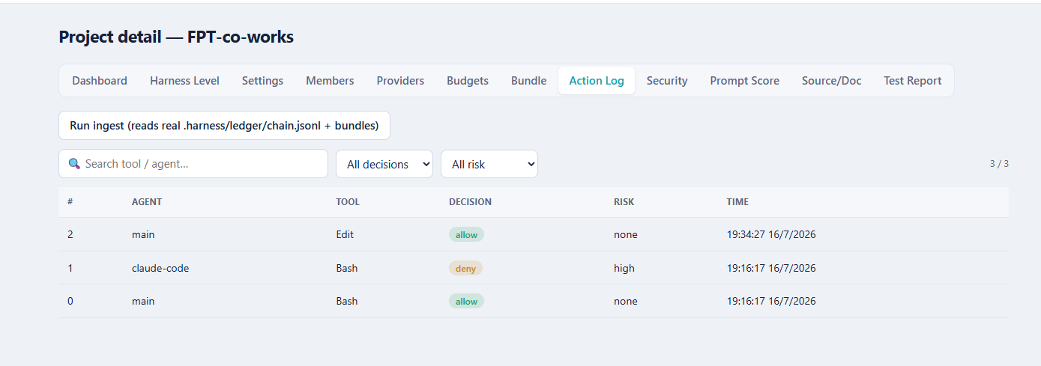
Apendix
3. Portal for control project data (5/7)

Slide 18
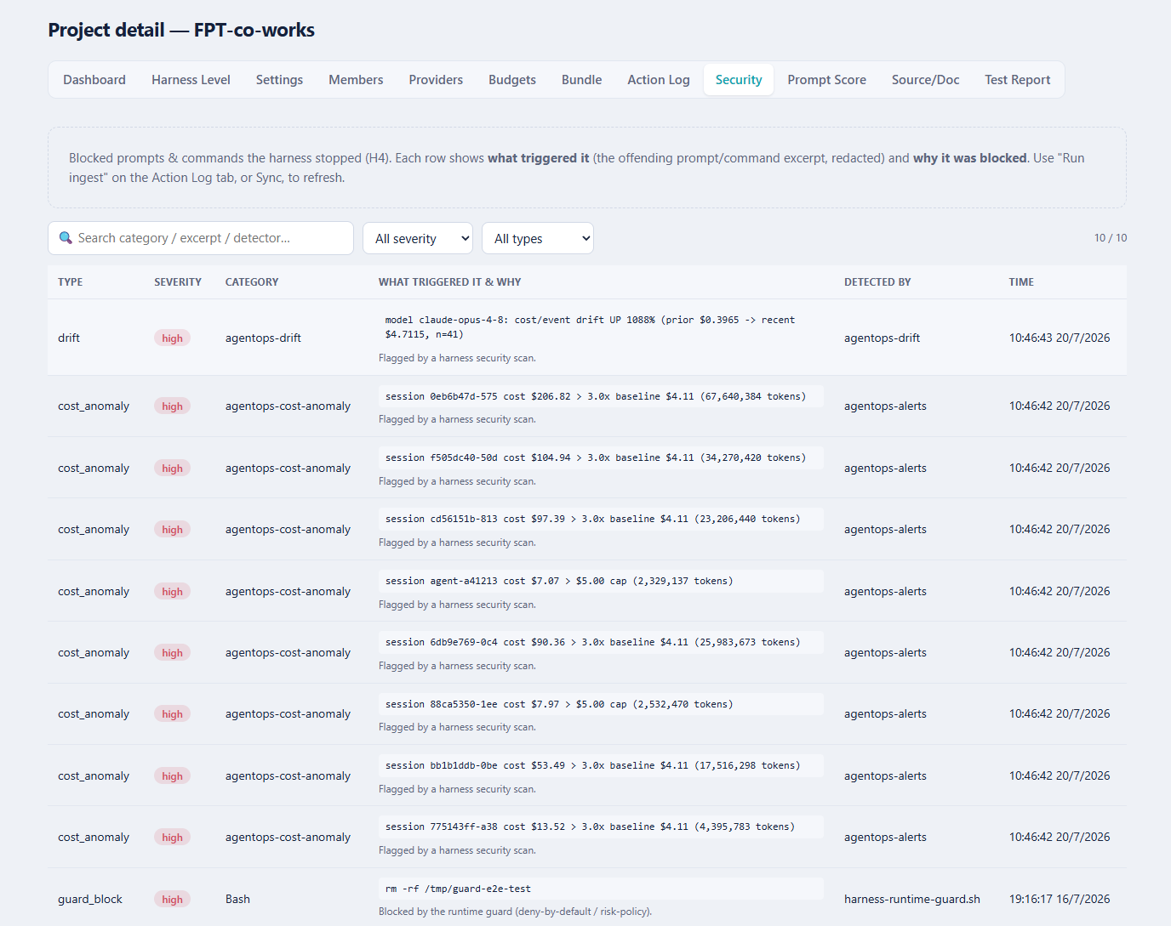
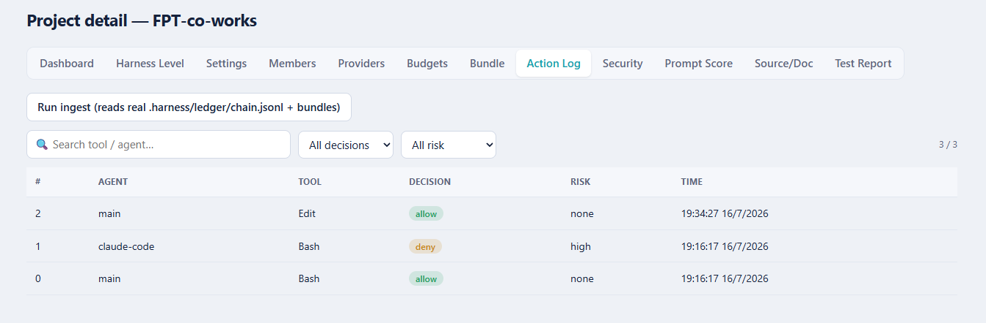
Apendix
3. Portal for control project data (6/7)

Slide 19
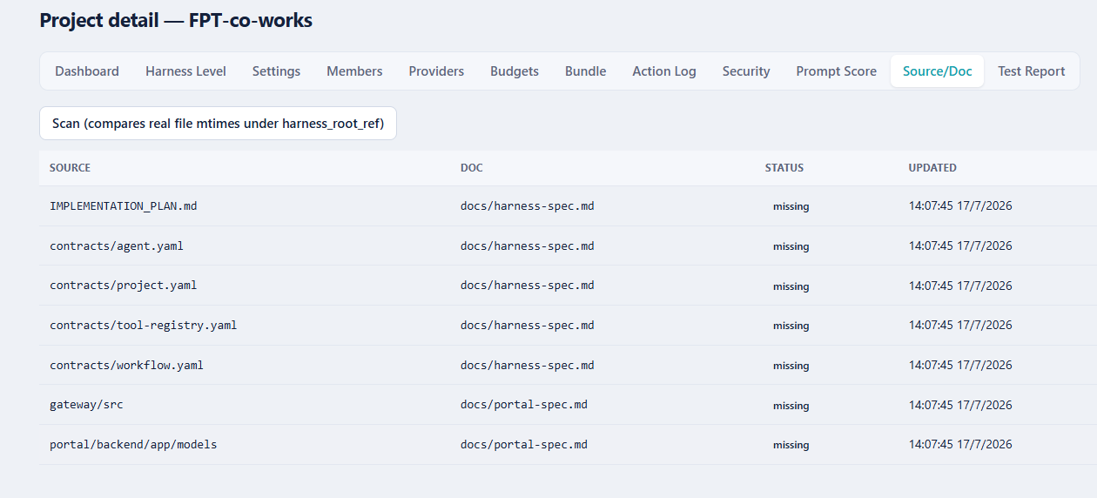
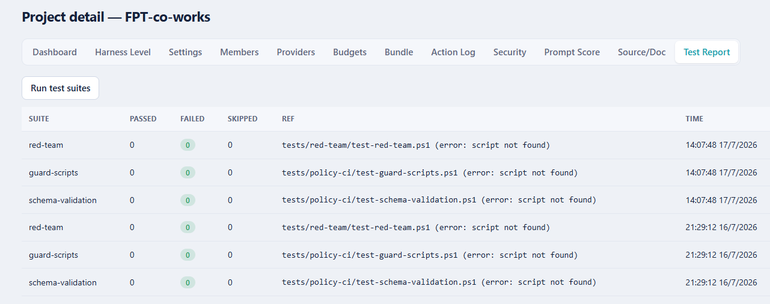
Apendix
3. Portal for control project data (7/7)

Slide 20
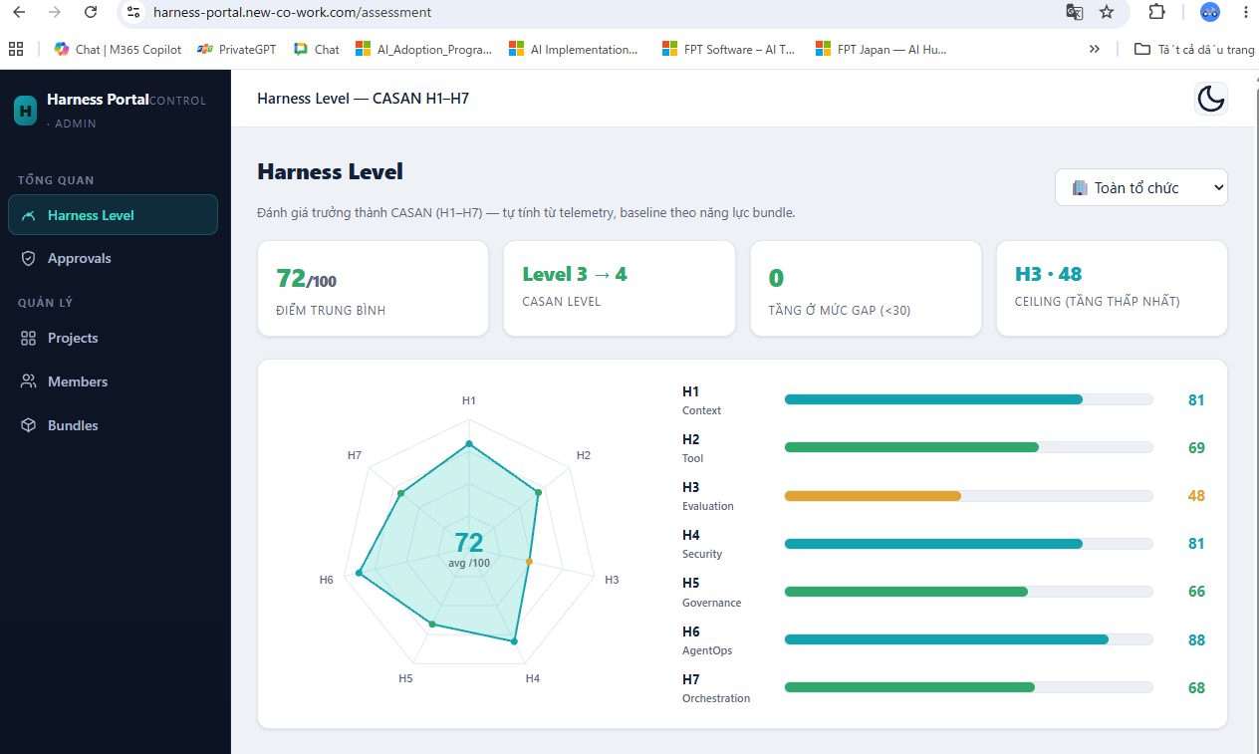
Apendix
4. Auto Harness Level Avaluate on portal (1/4)

Slide 21
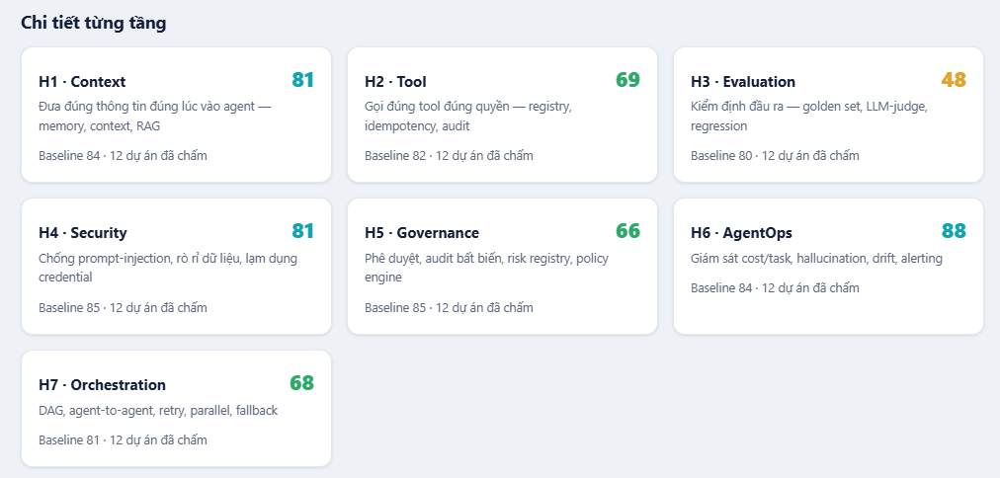
Apendix
4. Auto Harness Level Avaluate on portal (1/4)

Slide 22
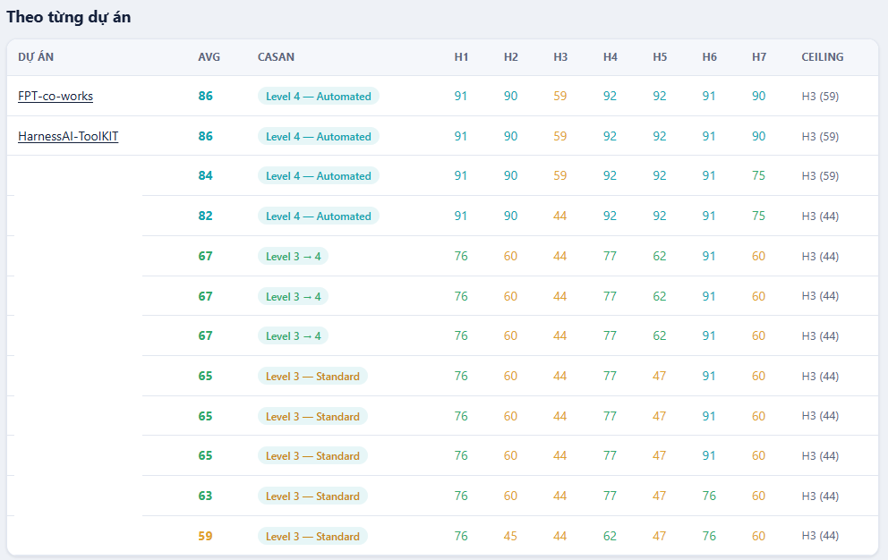
Apendix
4. Auto Harness Level Avaluate on portal (1/4)

Slide 23
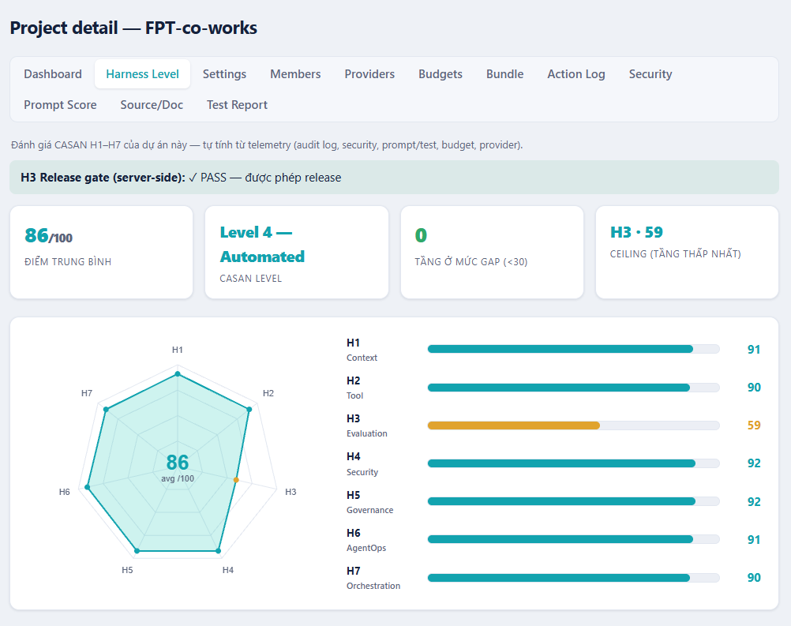
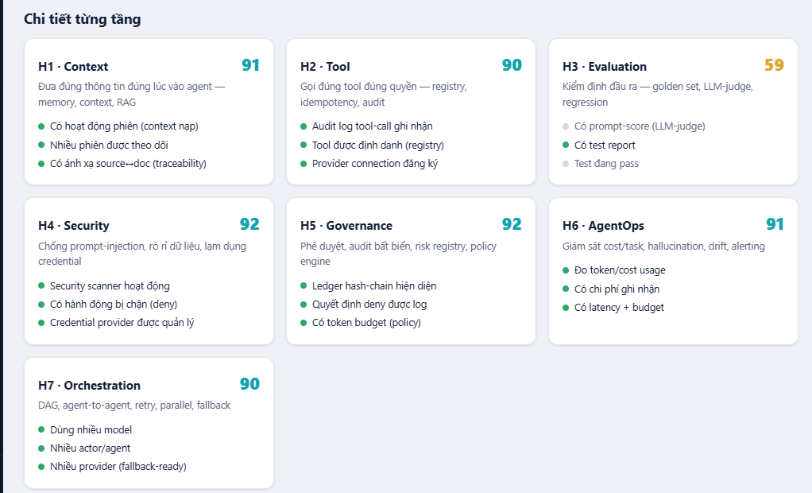
Apendix
4. Auto Harness Level Avaluate on portal (4/4)

