Slide 1
ADC output data reconstruction and FFT analyzation
Flying-Fish
Ver.01
IC 개발실, SoC, mducng
2021. 02. 06.

Slide 2
ADC output
Data processing
Signal reconstruction and FFT

Slide 3
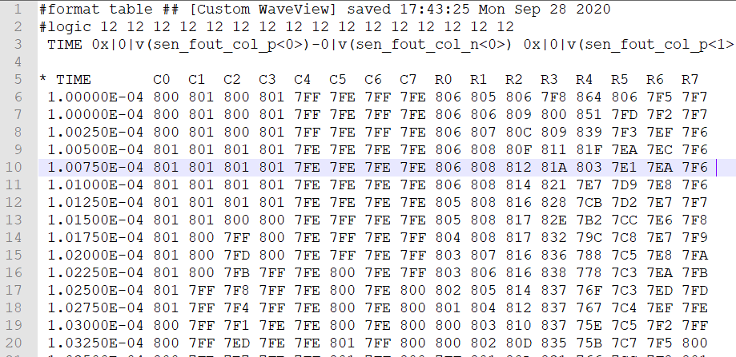
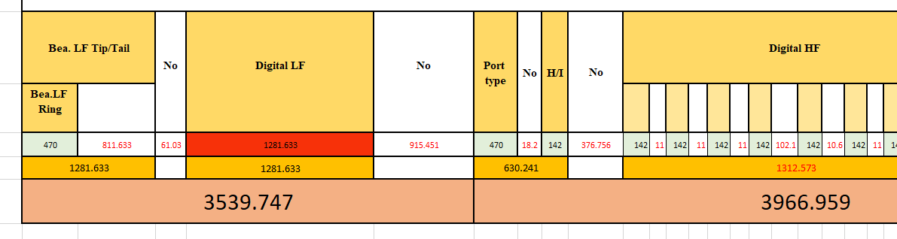
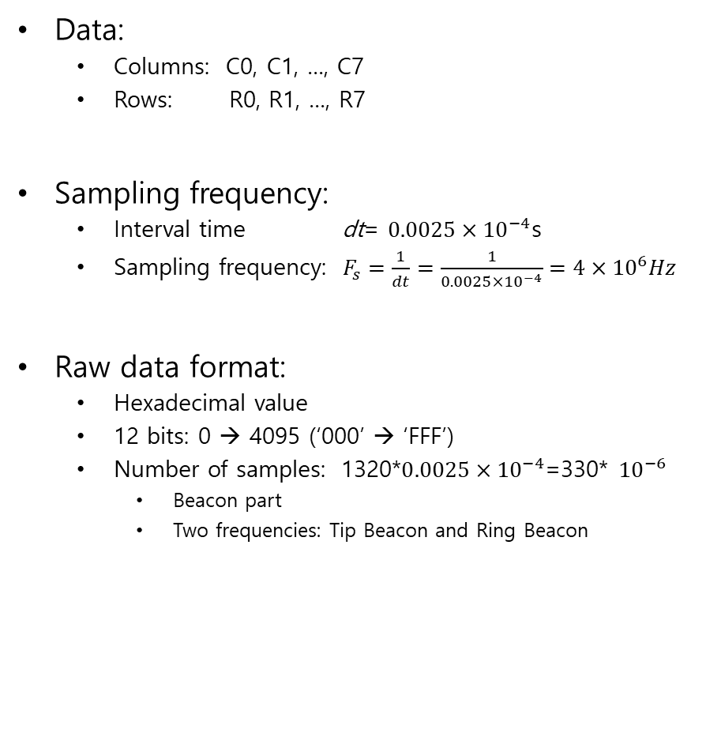
ADC output data
Data:
Columns: C0, C1, …, C7
Rows: R0, R1, …, R7
Sampling frequency:
Interval time dt= $0.0025×{10}^{−4}$s
Sampling frequency: $F_{s}=\frac{1}{dt}=\frac{1}{0.0025×{10}^{−4}}=4×{10}^{6}Hz$
Raw data format:
Hexadecimal value
12 bits: 0 → 4095 (‘000’ → ‘FFF’)
Number of samples: 1320*$0.0025×{10}^{−4}$=330* ${10}^{−6}$
Beacon part
Two frequencies: Tip Beacon and Ring Beacon
ADC outputs
from PJJ 수석님

Slide 4

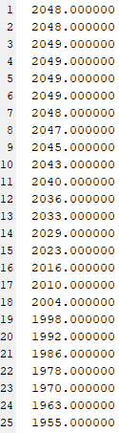
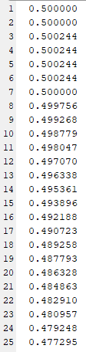
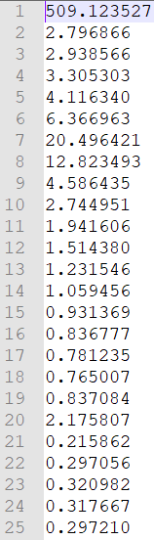
Data processing
Raw data:
Processed data:
Frequency data:
Scale
Subtract mean
Fs conversion
Hex-to-dec
FFT transform

Slide 5
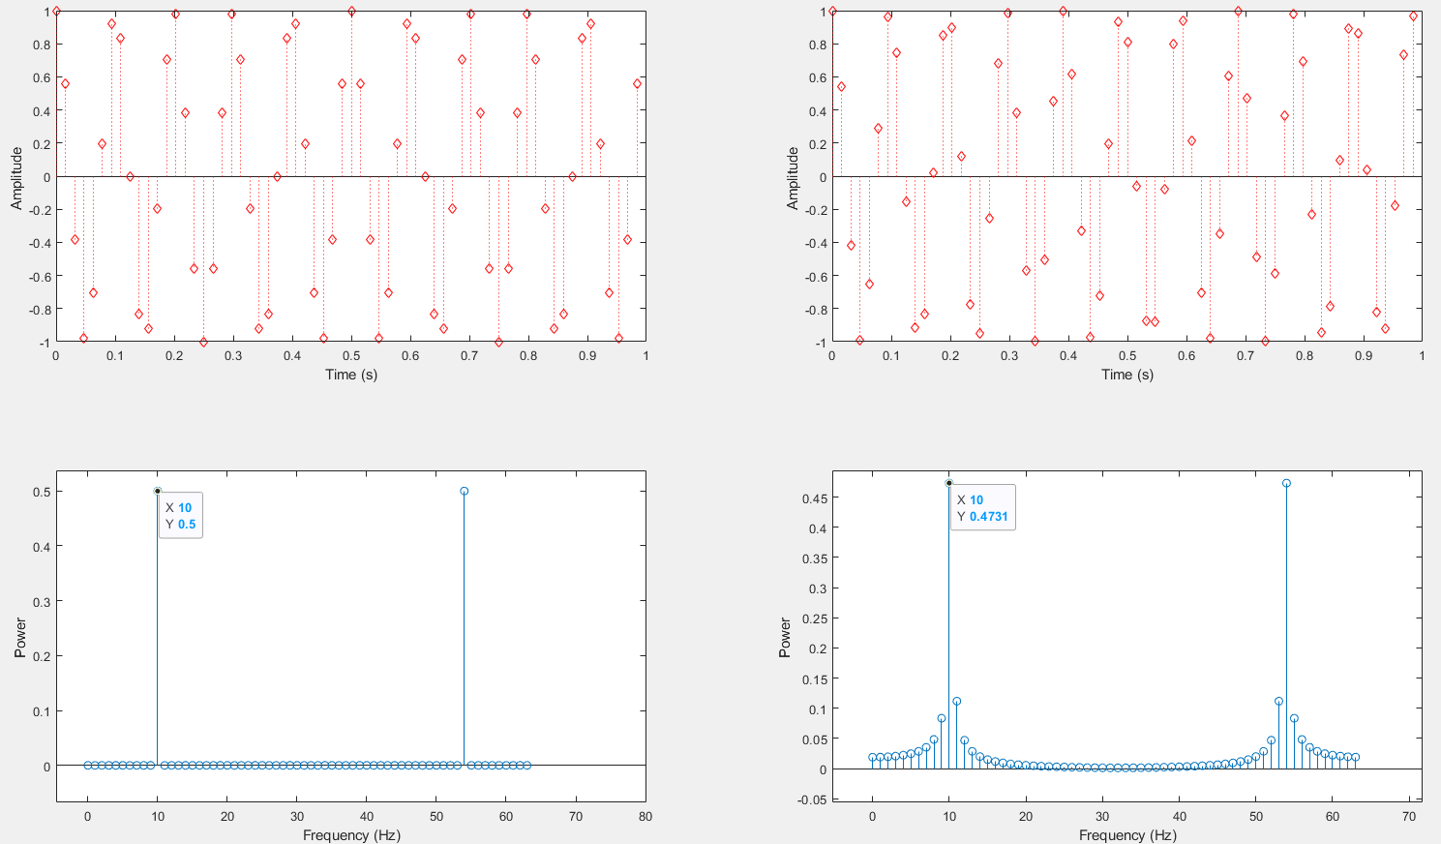
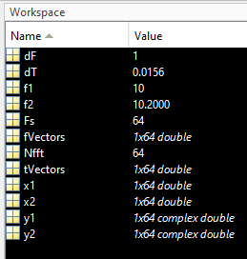
Signal reconstruction and FFT
Review of FFT transformation:
Consider a simple example
#Samples = 64
Nfft = 64
Fs = 64Hz
f1 = 10Hz
f2 = 10.2Hz
dF = Fs/Nfft =1Hz
f1=10Hz
f2=10.2Hz
Notes:
Code: file EVB_plotFFTData21.m, perfectFFTv1.m
We can see the power of f1 and f2 is small different because of f1 is in frequency interval 10Hz, f2 is between frequency 10Hz~11Hz.

Slide 6
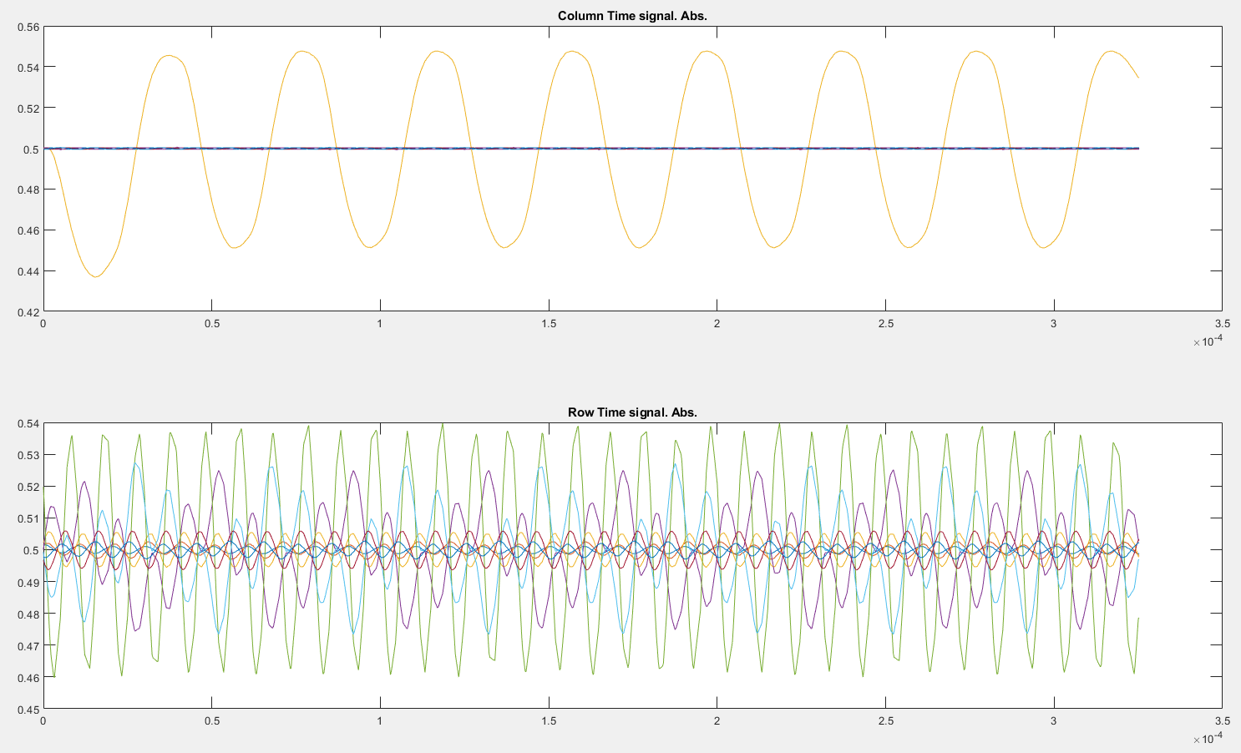
Signal reconstruction and FFT
All columns
All rows
Fs = 4MHz
#samples = 1320
Scale: 0 ~ 4095 → 0 ~ 1
Notes:
Code: file EVB_plotFFTData21.m

Slide 7
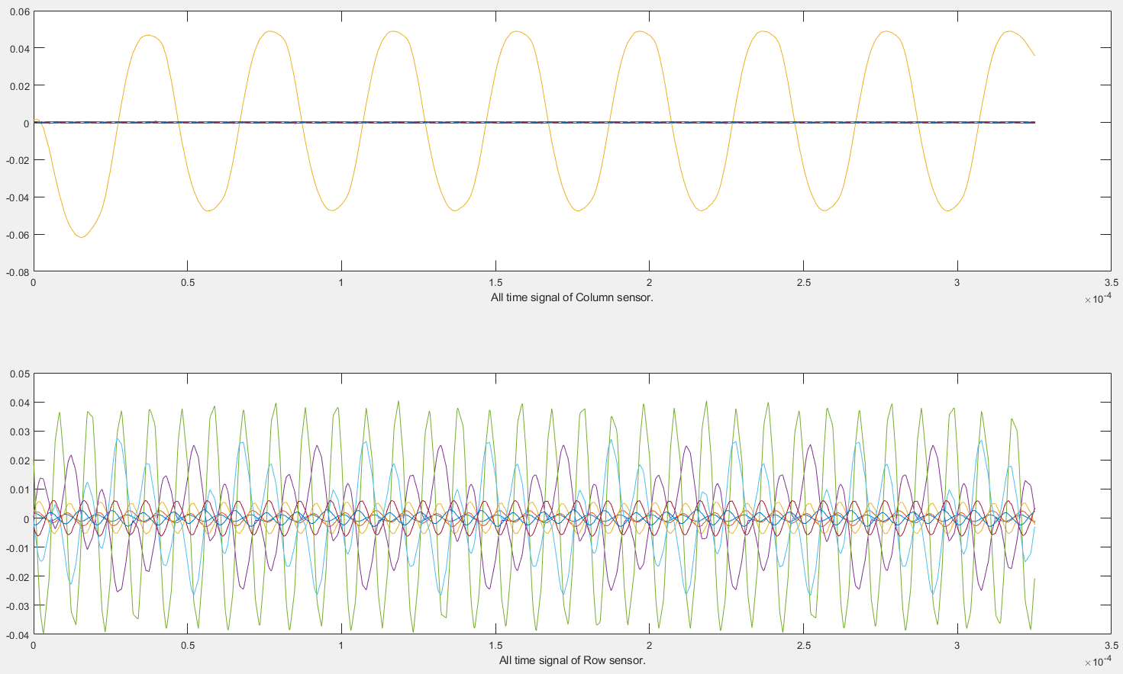
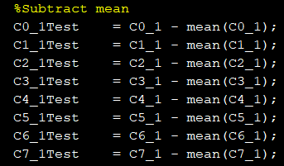
Signal reconstruction and FFT
All columns
All rows
Fs = 4MHz
#samples = 1320
Scale, subtract mean

Slide 8
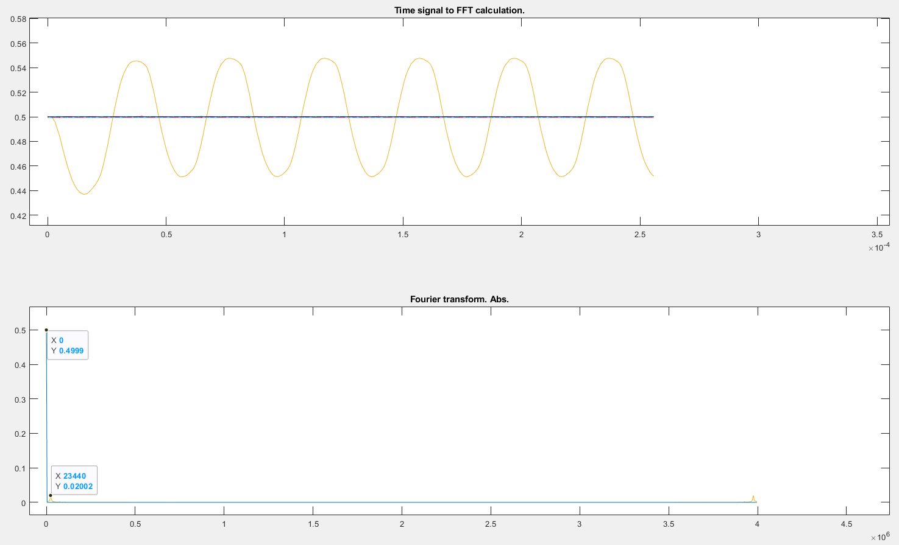
Signal reconstruction and FFT
All columns
no ‘subtract mean’
Fs = 4MHz
#samples = 1320
Nfft = 1024
Bin frequency = 4kHz

Slide 9
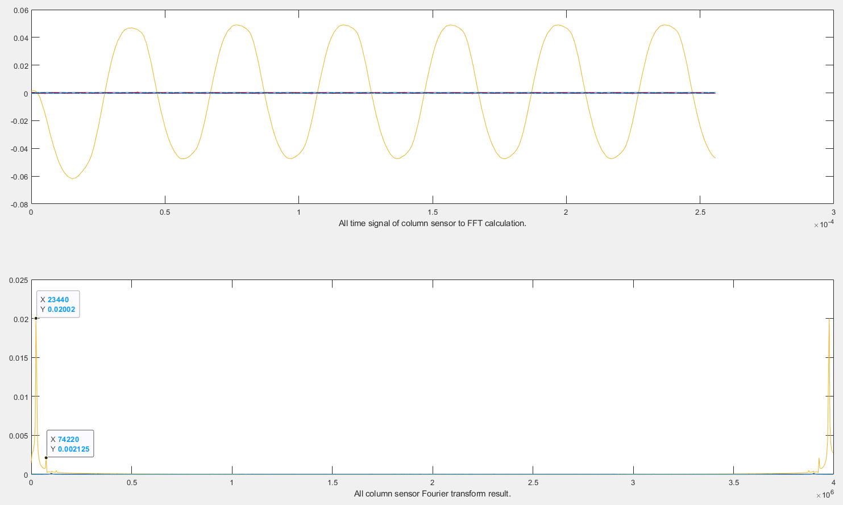
Signal reconstruction and FFT
All columns
Using ‘subtract mean’
Fs = 4MHz
#samples = 1320
Nfft = 1024
Bin frequency = 4kHz

Slide 10
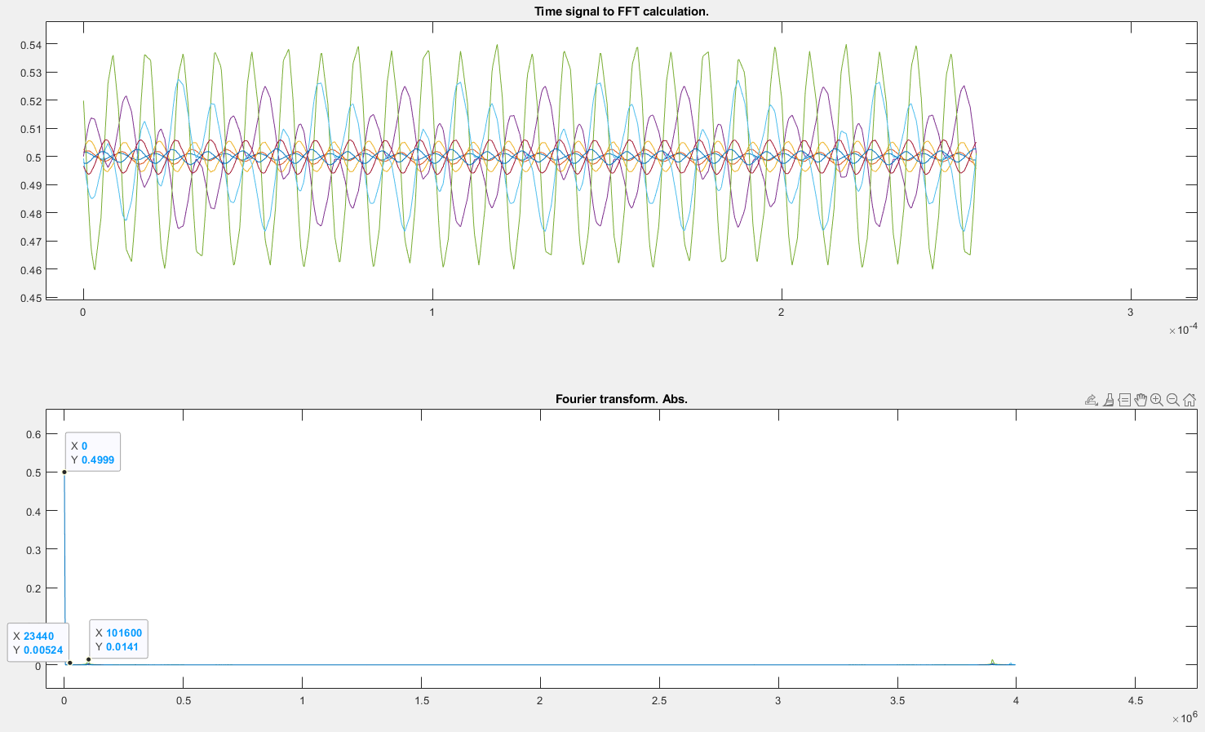
Signal reconstruction and FFT
All rows
no ‘subtract mean’
Fs = 4MHz
#samples = 1320
Nfft = 1024
Bin frequency = 4kHz

Slide 11
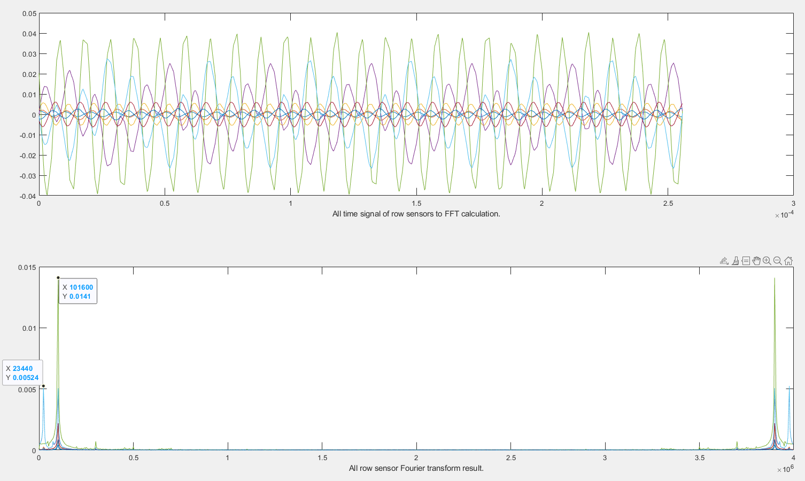
Signal reconstruction and FFT
All rows
Using ‘subtract mean’
Fs = 4MHz
#samples = 1320
Nfft = 1024
Bin frequency = 4kHz

Slide 12
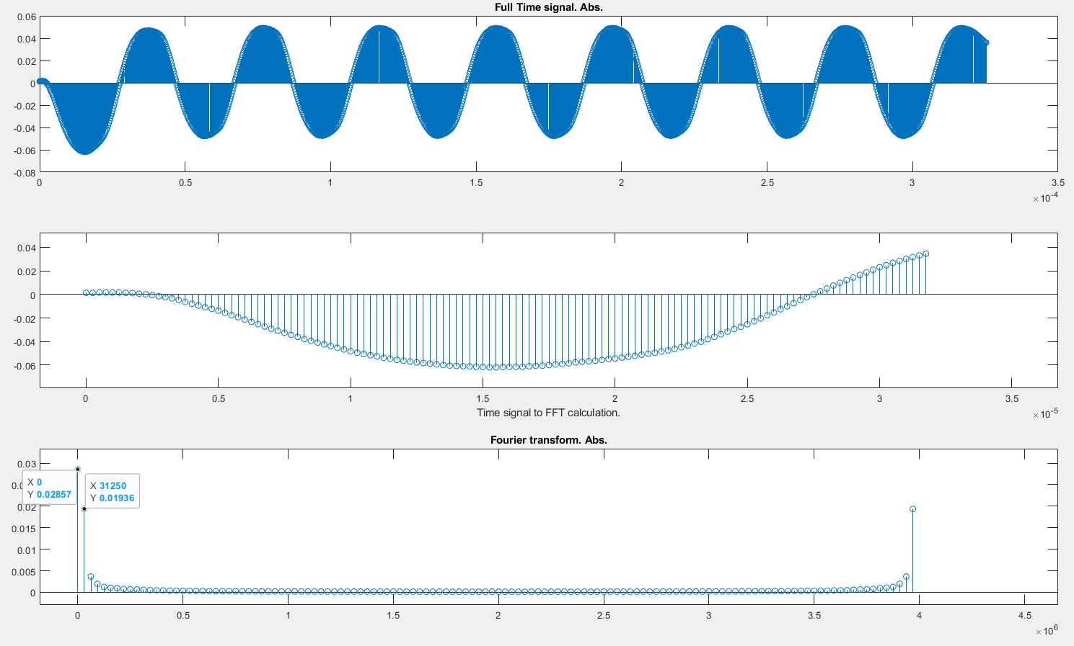
Signal reconstruction and FFT
Fs = 4Mhz
f1 = 23,440Hz
Fs = 4MHz
Nfft = 2^7
Bin frequency = 31,250Hz

Slide 13
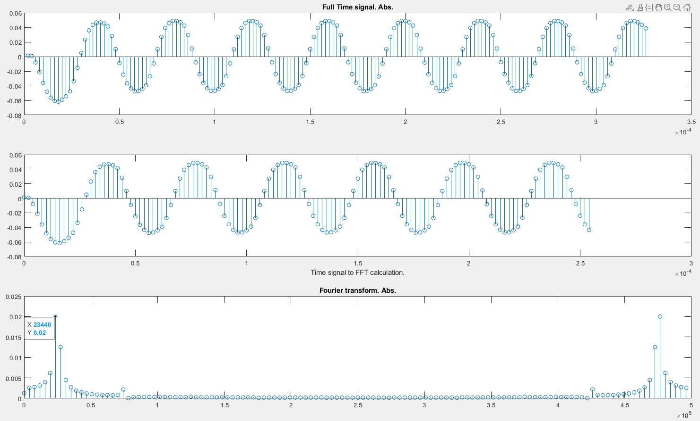
Signal reconstruction and FFT
Fs = 4Mhz
f1 = 23,440Hz
Using ‘Fs conversion’
Fs_new = Fs/8 = 500kHz
Nfft = 2^7
Bin frequency = 3,9kHz

Slide 15
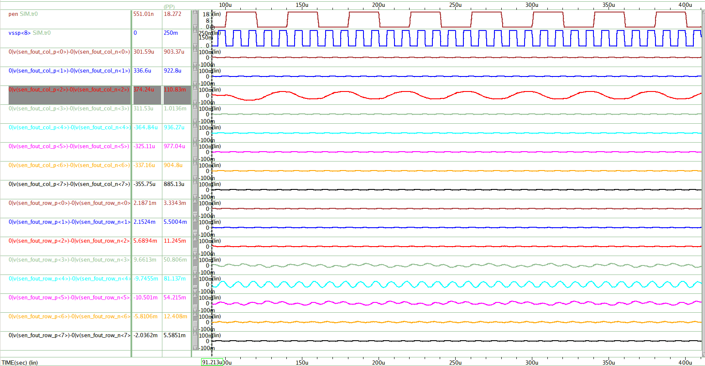
Active Pen Column Sensing (@1-Sensing Row Display Noise)
PEN Signal
- Vpp : 18V ~ 0V, 25KHz
- Tr=Tf=1us
- Position : C2 : R8
- Cc : 85fF
Display Noise
- Vpp : 250mV ~ 0V, 100KHz
- Tr=Tf=0.5us
- Position : Row<8>
LPF Cutoff Frequency
- 50KHz ( -3dB)
Pen Sensing Signal의 Display Noise 유입량
- 1-Sensing Row Display Noise < Full Panel Display Noise
- Column Sensing 1/10 이하, Row Sensing 1/2 이하

Slide 16
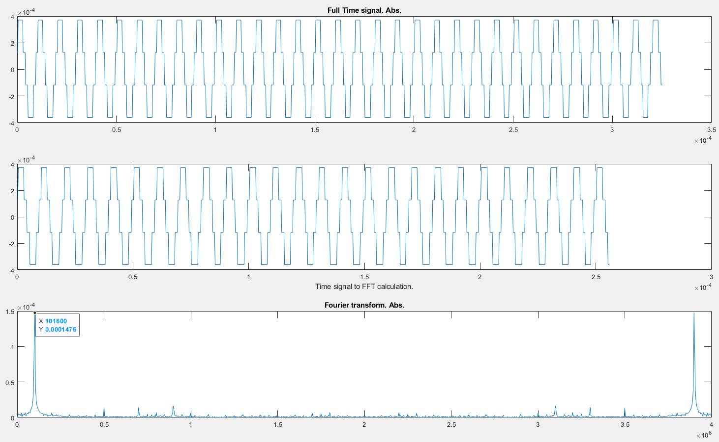
Signal reconstruction and FFT
C0

Slide 17
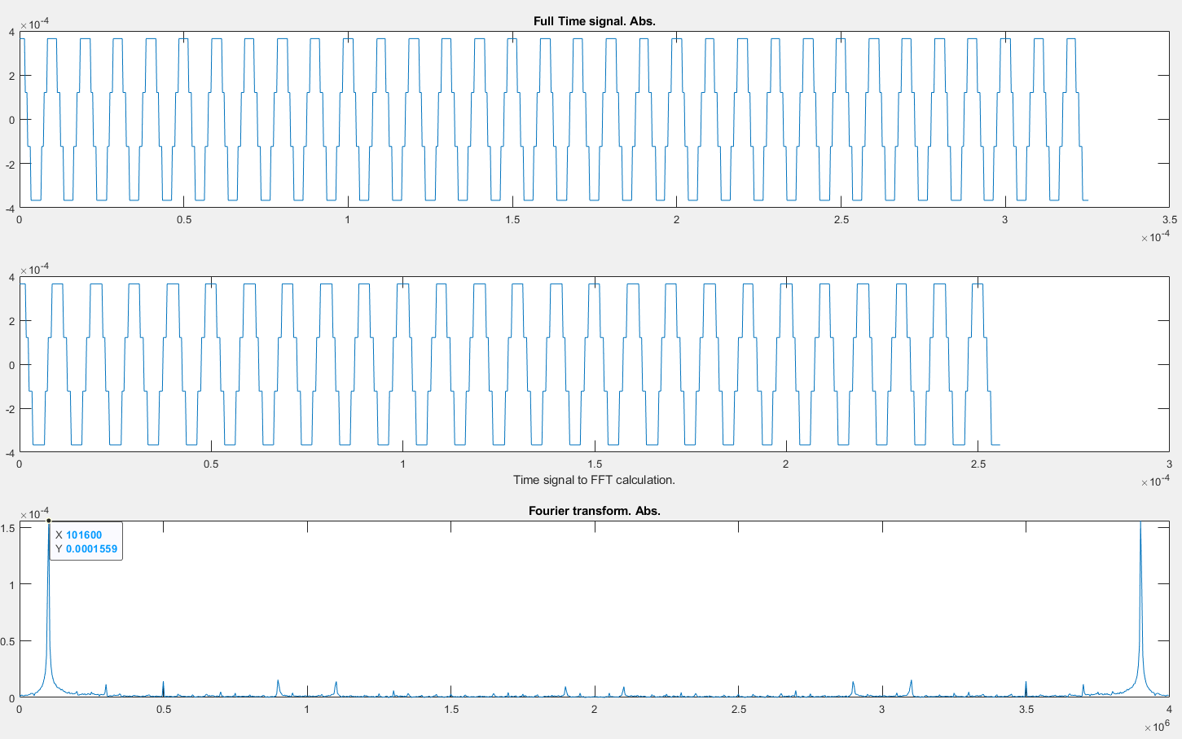
Signal reconstruction and FFT
C1

Slide 18
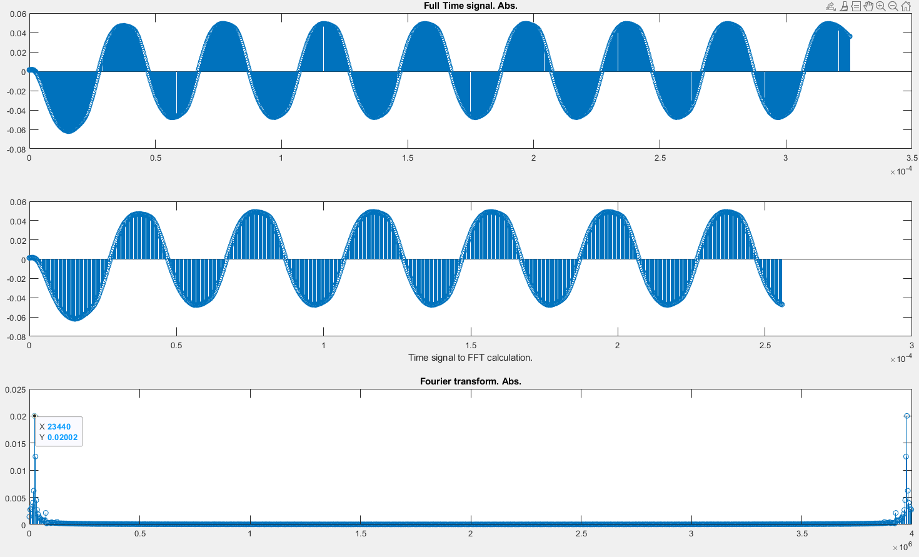
Signal reconstruction and FFT
C2

Slide 19
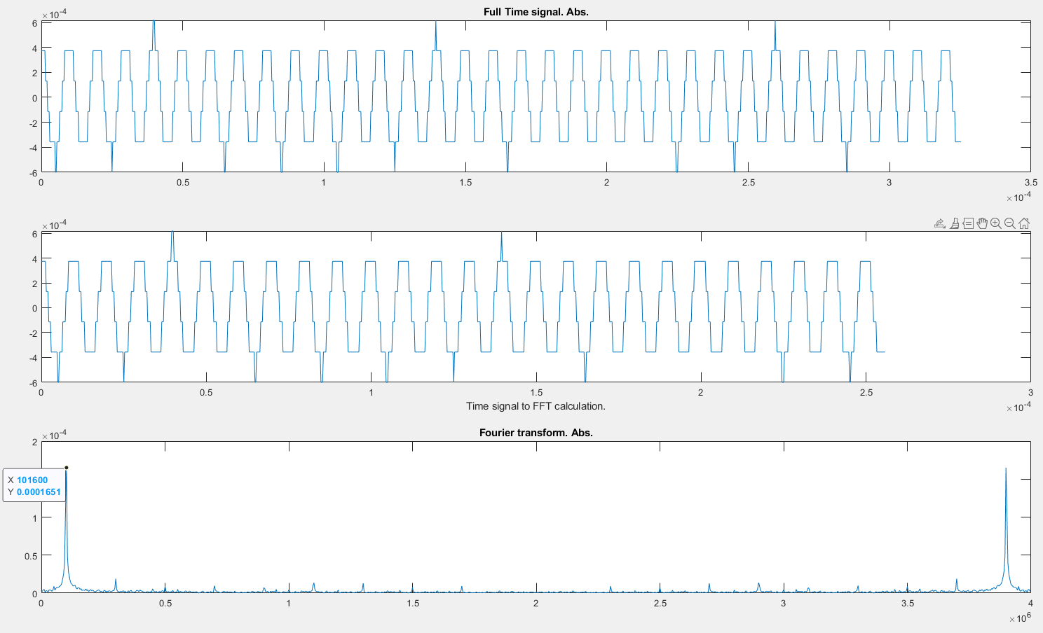
Signal reconstruction and FFT
C3

Slide 20
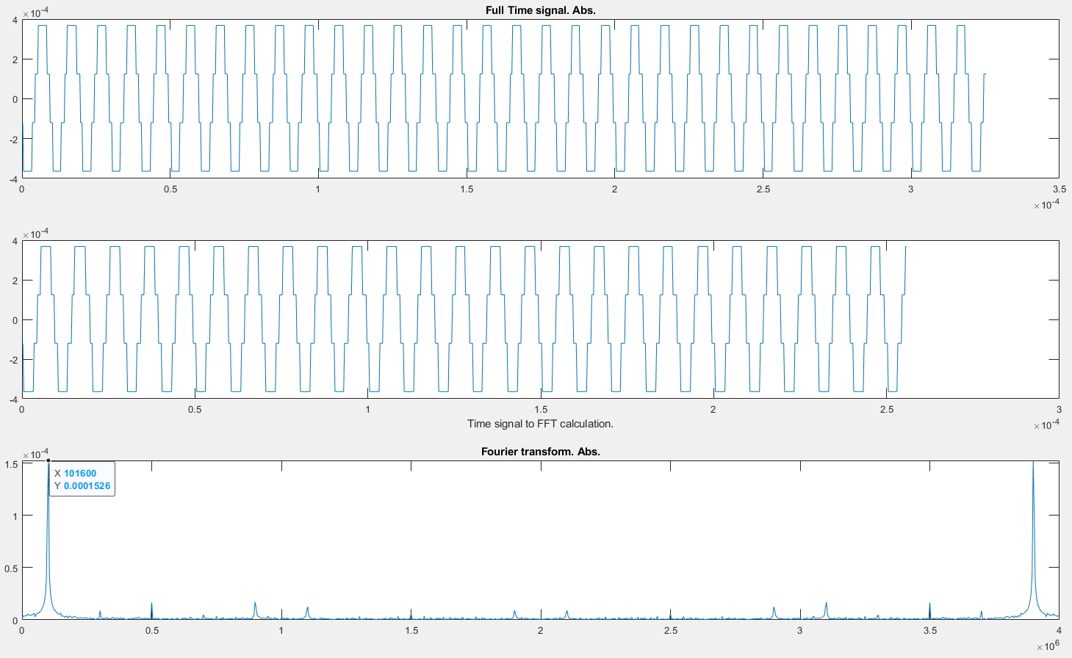
Signal reconstruction and FFT
C4

Slide 21
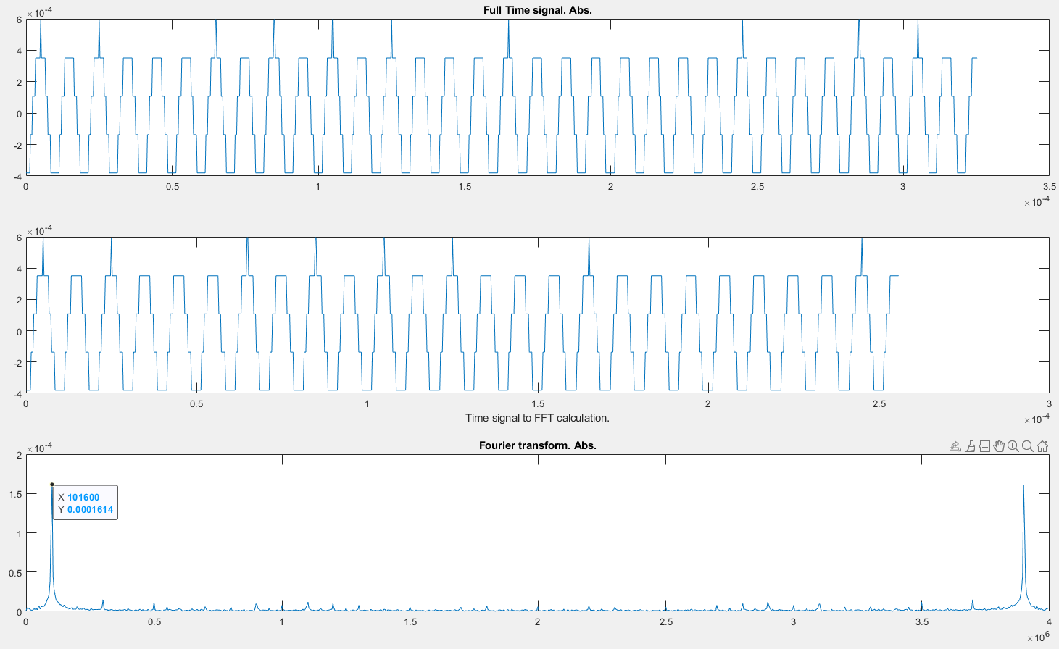
Signal reconstruction and FFT
C5

Slide 22

Signal reconstruction and FFT
C6

Slide 23
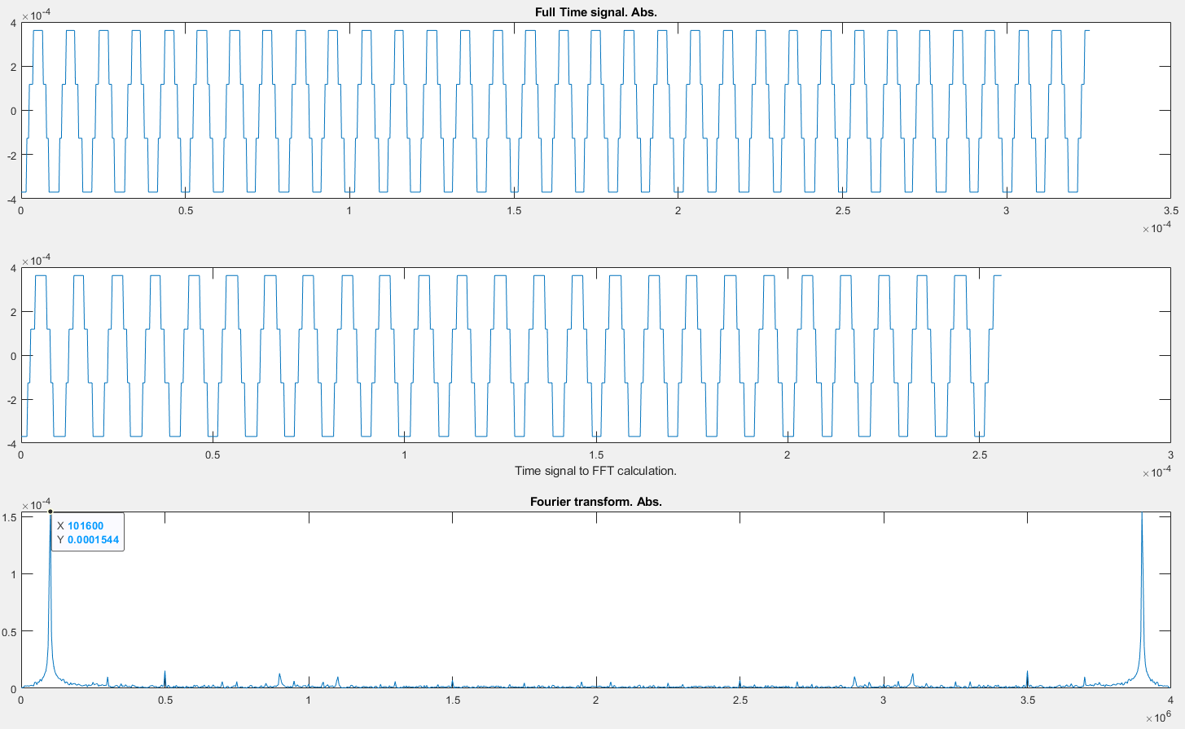
Signal reconstruction and FFT
C7

Slide 24
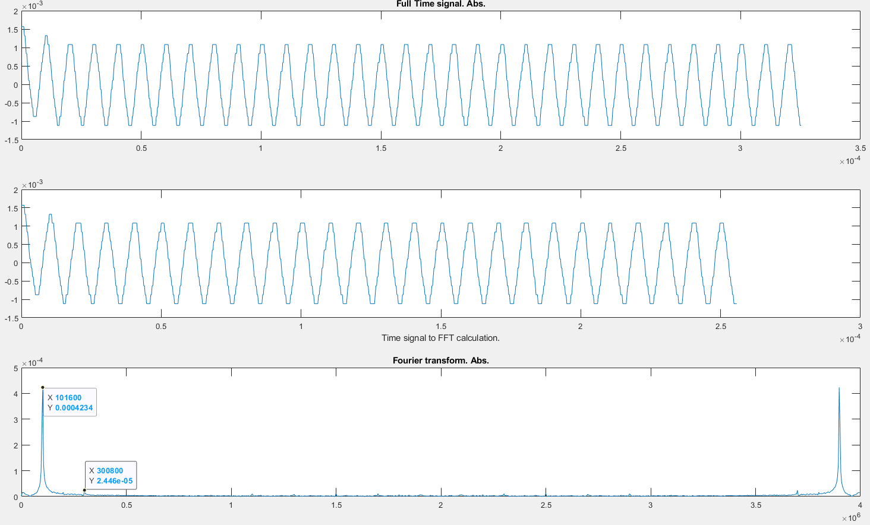
Signal reconstruction and FFT
R0

Slide 25
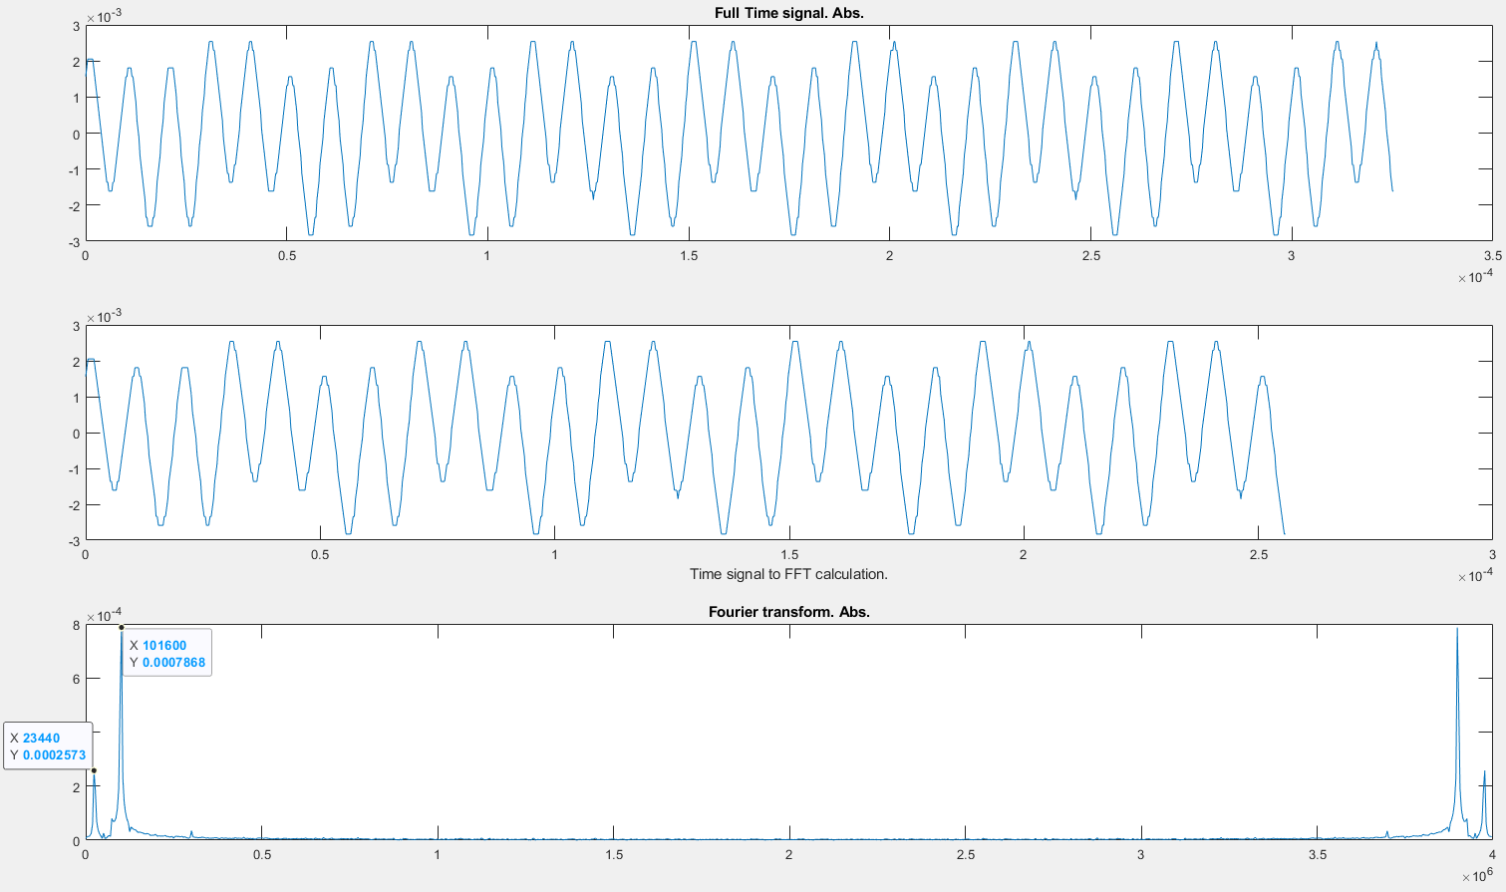
Signal reconstruction and FFT
R1

Slide 26
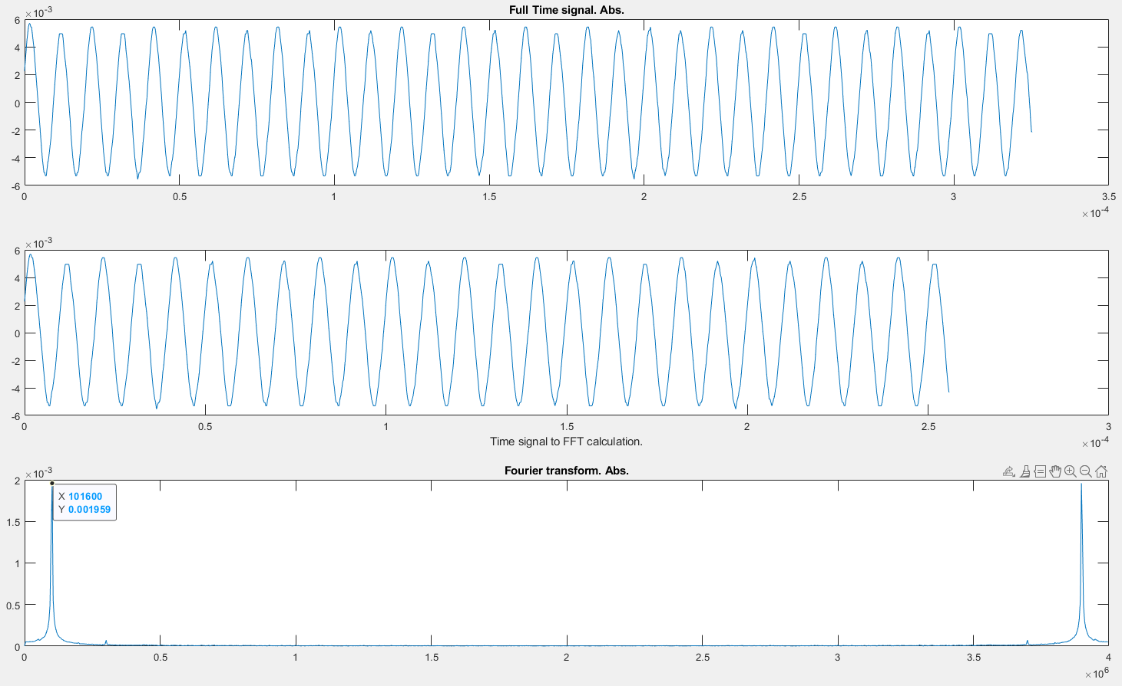
Signal reconstruction and FFT
R2

Slide 27
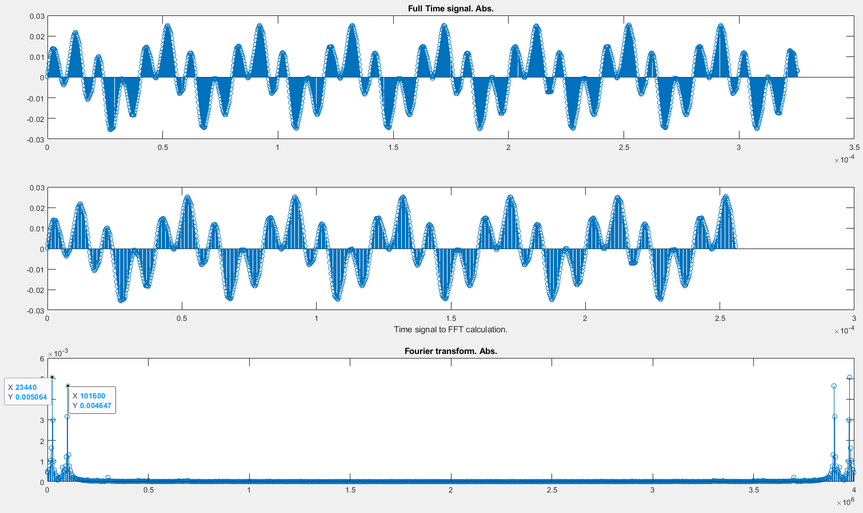
Signal reconstruction and FFT
R3

Slide 28
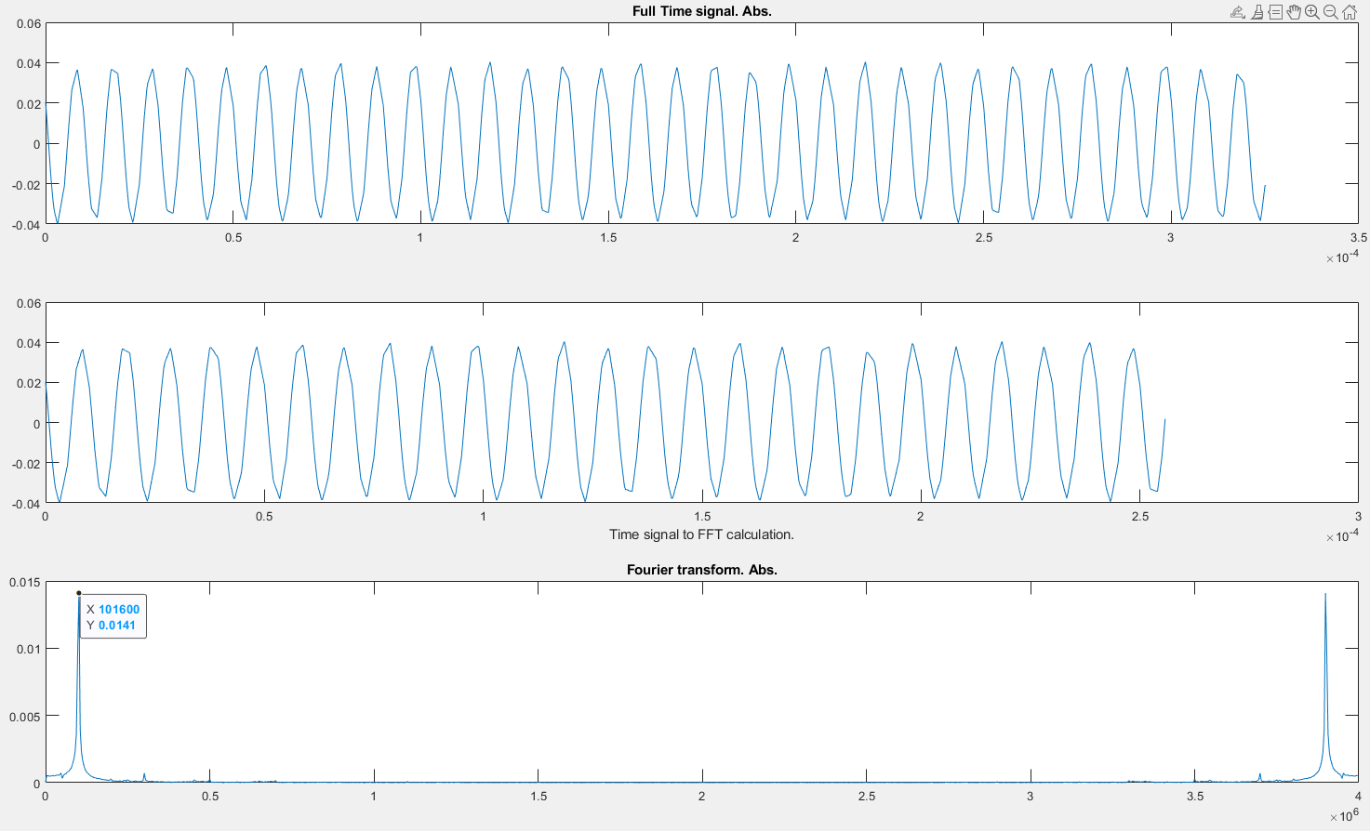
Signal reconstruction and FFT
R4

Slide 29
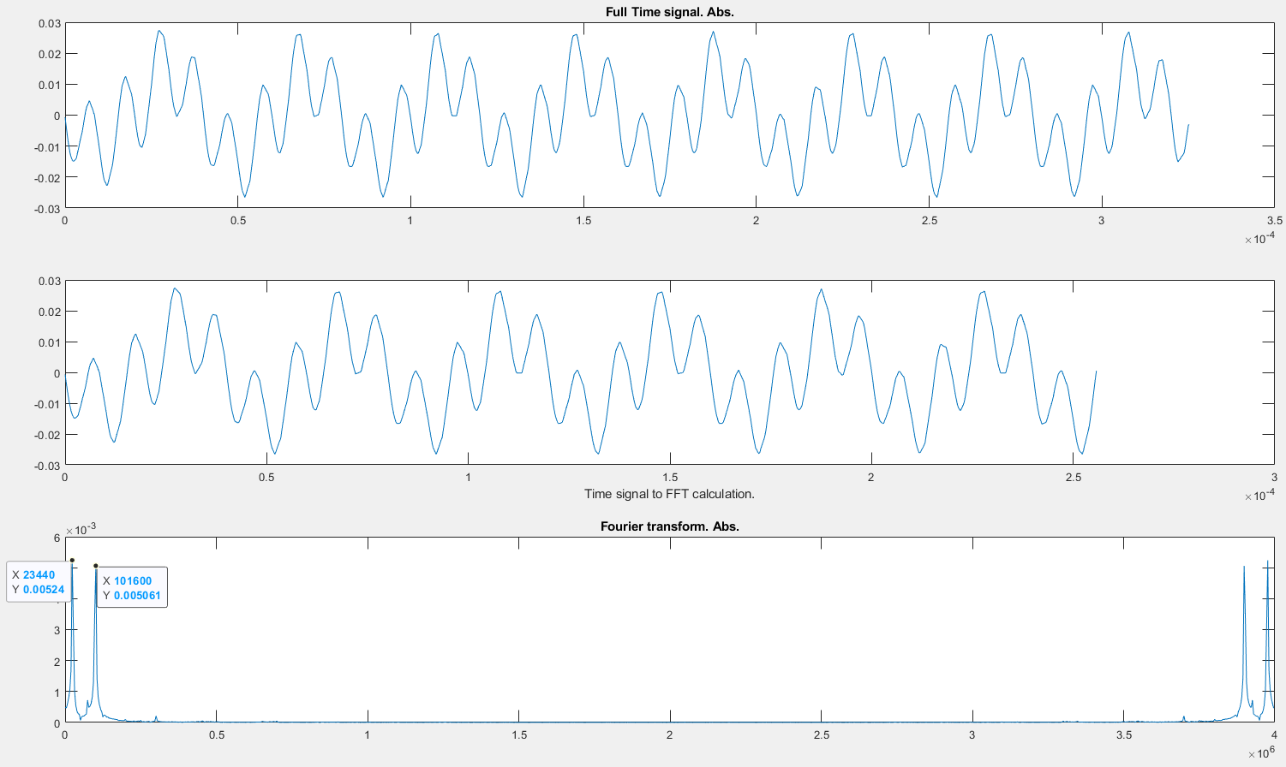
Signal reconstruction and FFT
R5

Slide 30
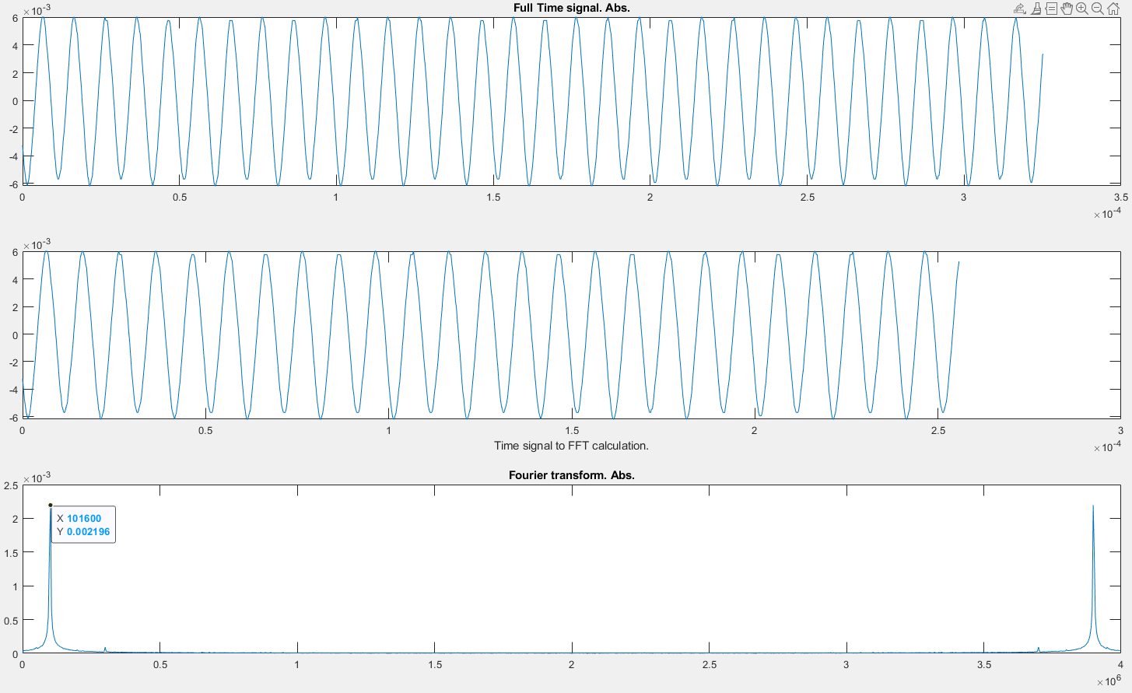
Signal reconstruction and FFT
R6

Slide 31
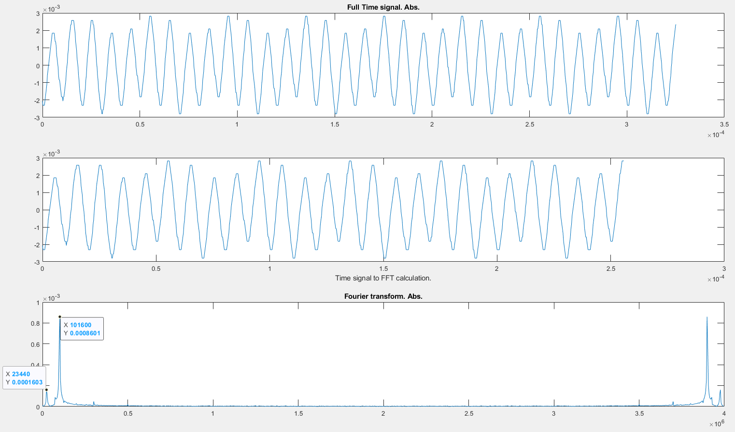
Signal reconstruction and FFT
R7

