Slide 1
ADC output data reconstruction and FFT analyzation
Flying-Fish
Ver.01
IC 개발실, SoC, mducng
2021. 02. 02.

Slide 2
ADC output
Data conversion
Signal reconstruction and FFT

Slide 3
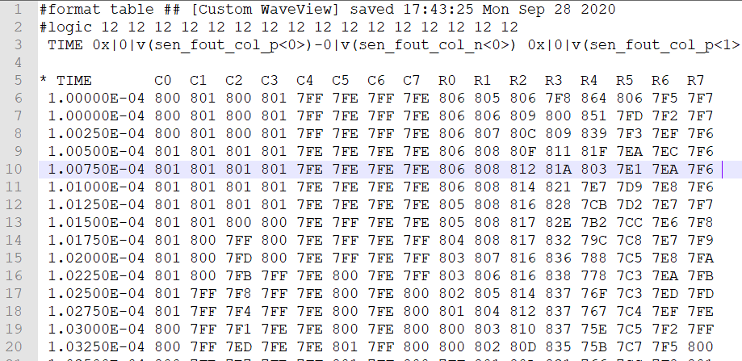

ADC output data
Data:
C0, C1, …, C7, R0, R1, …, R7
Sampling frequency:
Interval time dt= $0.0025×{10}^{−4}$s
$F_{s}=\frac{1}{dt}=\frac{1}{0.0025×{10}^{−4}}=4×{10}^{6}Hz$
Data format:
Hexadecimal value
12 bits: 0 → 4095 (‘000’ → ‘FFF’)
ADC outputs
from PJJ 수석님

Slide 4

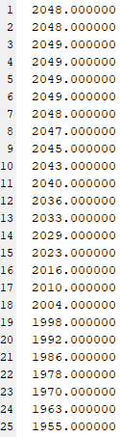
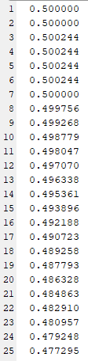
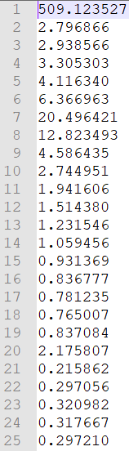
Data conversion
Data:
Hexadecimal
number
Real numbers
(with scale and subtract mean)
Frequency domain data
Hex-to-dec
fi() in MATLAB
FFT transform
fft() in MATLAB

Slide 5
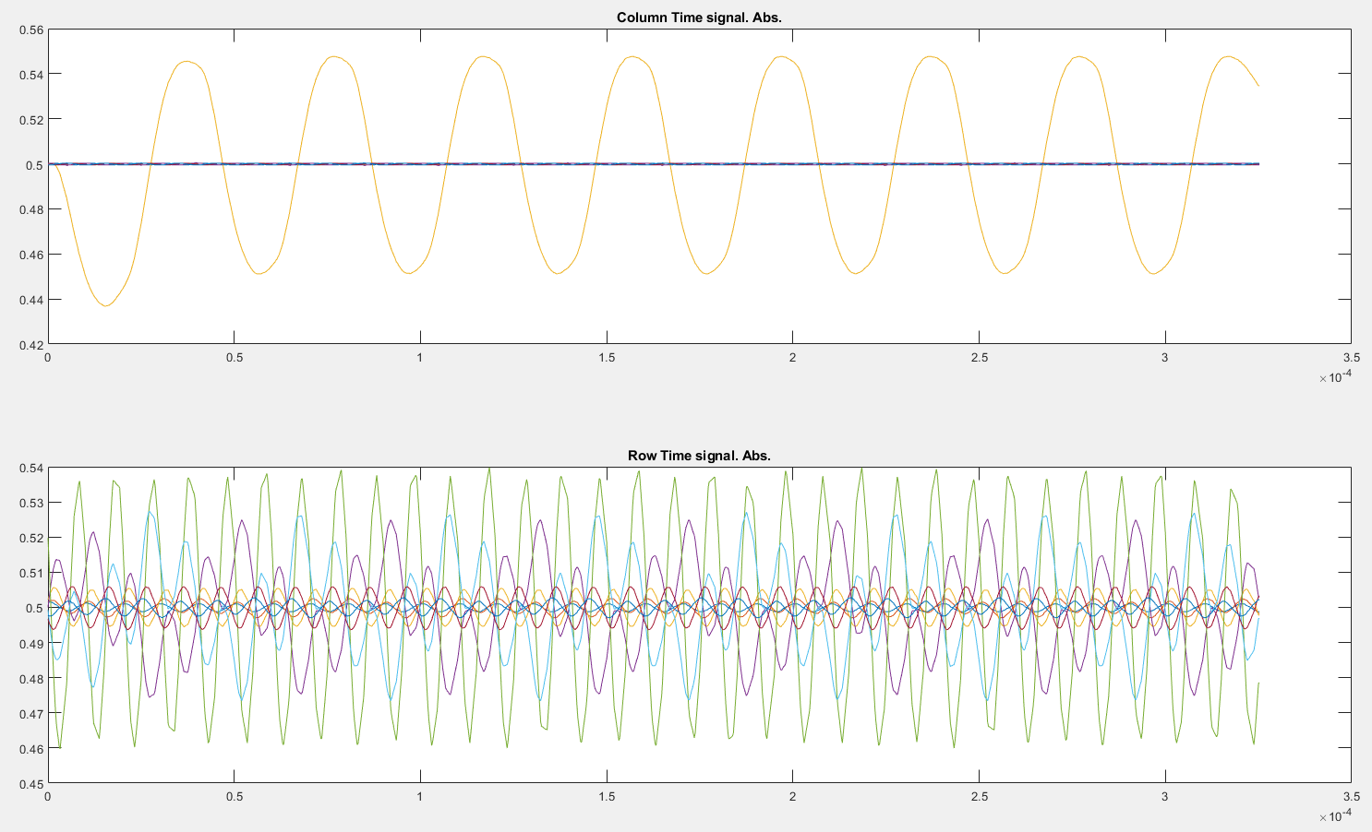
Signal reconstruction and FFT
All columns
All rows
Fs = 4MHz
#samples = 1320
Scale, but no subtract mean
Notes:
Code: file EVB_plotFFTData21.m

Slide 6
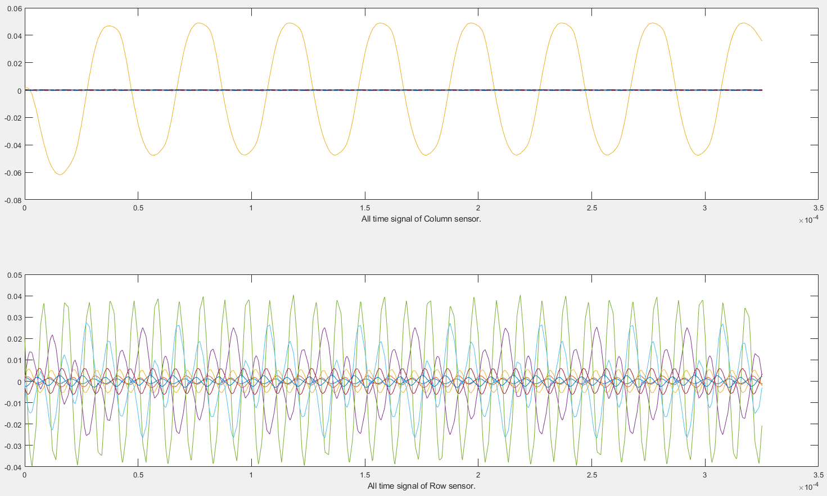
Signal reconstruction and FFT
All columns
All rows
Fs = 4MHz
#samples = 1320
Scale, subtract mean

Slide 7
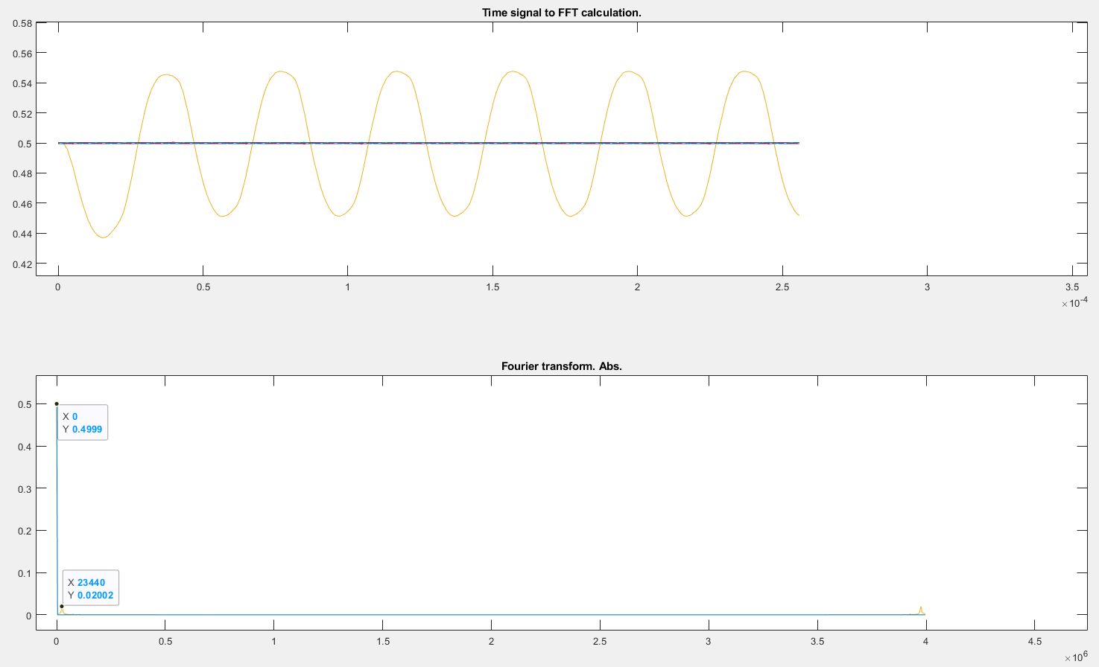
Signal reconstruction and FFT
All columns
Fs = 4MHz
#samples = 1320
Nfft = 1024
Bin frequency = 4kHz

Slide 8
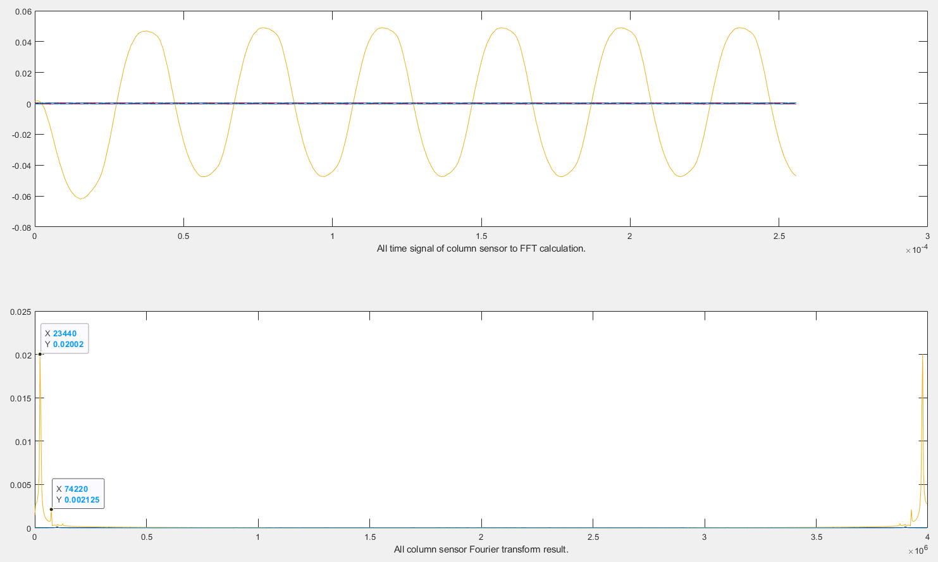
Signal reconstruction and FFT
All columns
Using ‘subtract mean’:
Fs = 4MHz
#samples = 1320
Nfft = 1024
Bin frequency = 4kHz

Slide 9
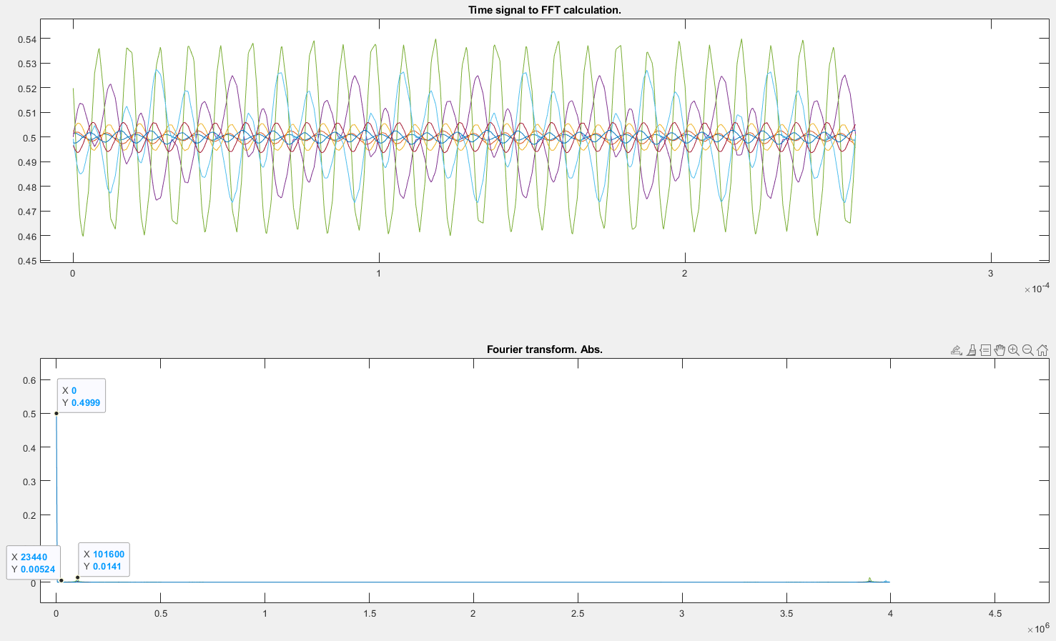
Signal reconstruction and FFT
All rows
Fs = 4MHz
#samples = 1320
Nfft = 1024
Bin frequency = 4kHz

Slide 10
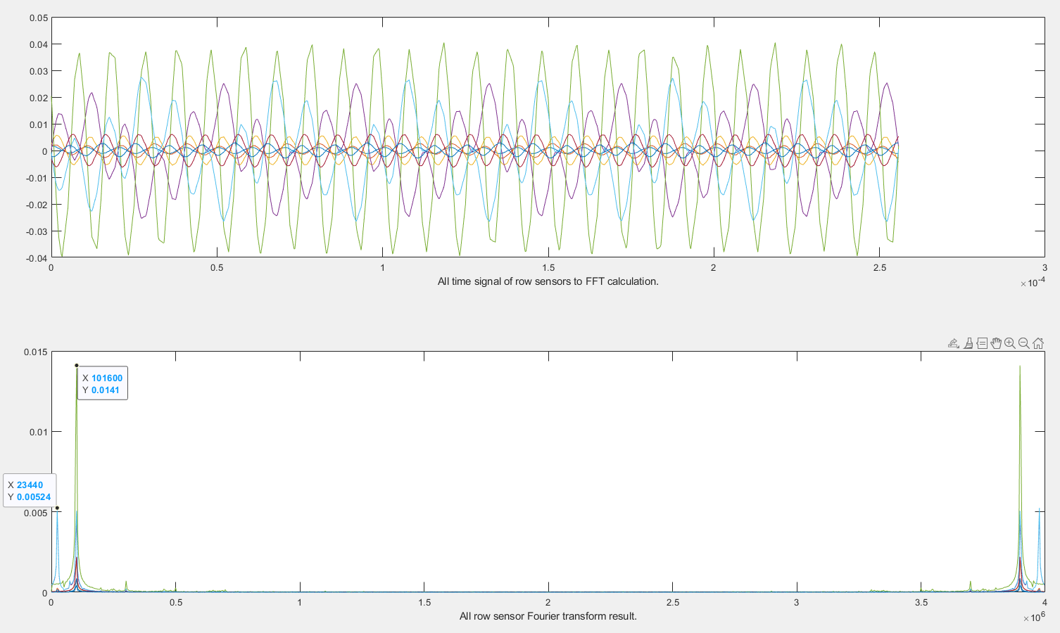
Signal reconstruction and FFT
All rows
Using ‘subtract mean’:
Fs = 4MHz
#samples = 1320
Nfft = 1024
Bin frequency = 4kHz

Slide 11
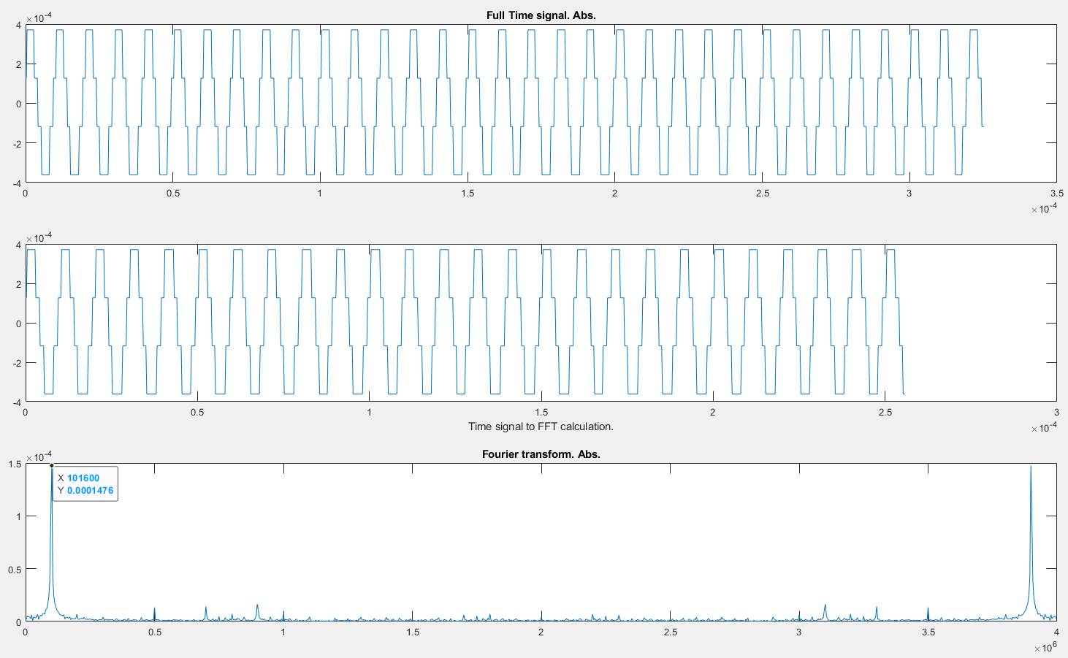
Signal reconstruction and FFT
C0

Slide 12
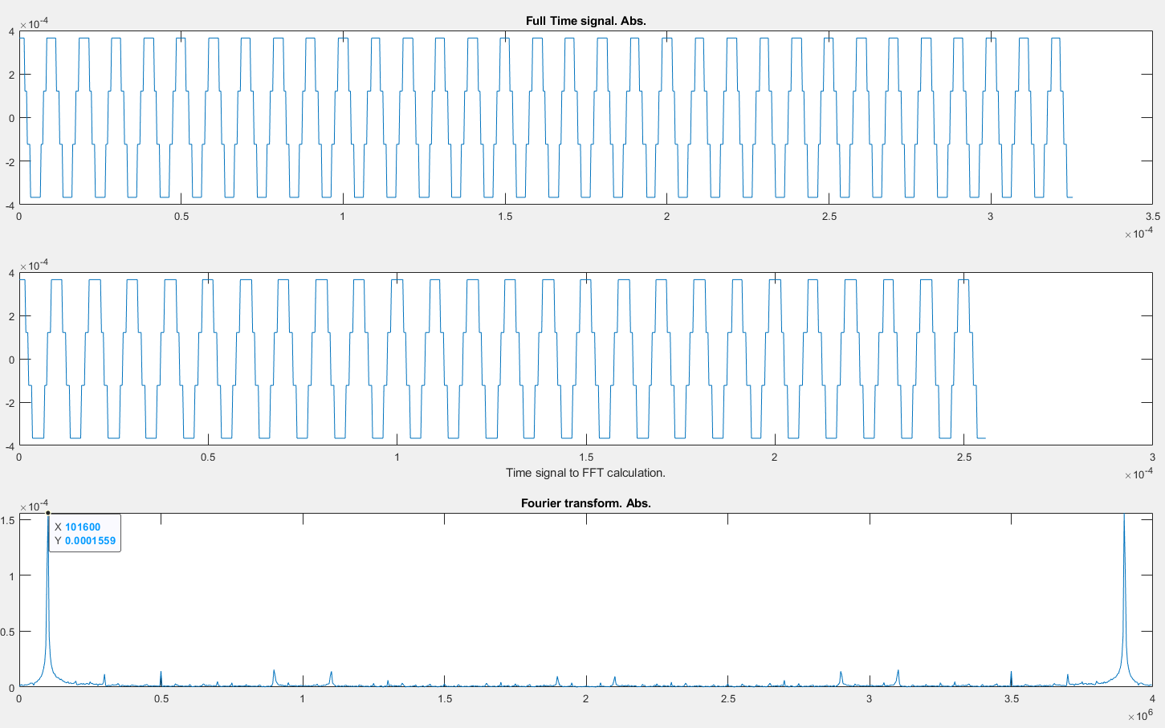
Signal reconstruction and FFT
C1

Slide 13
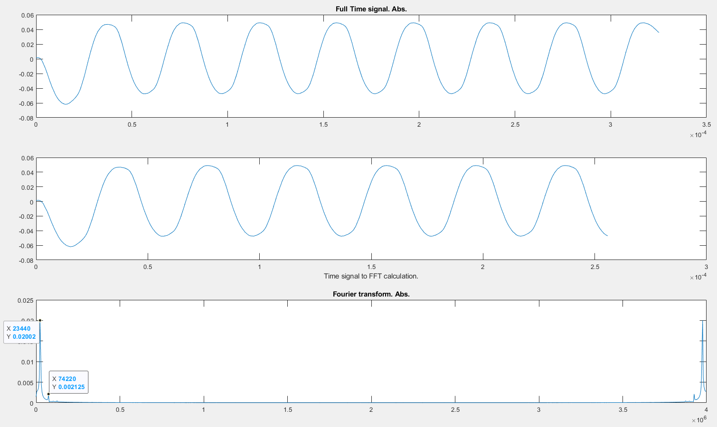
Signal reconstruction and FFT
C2

Slide 14
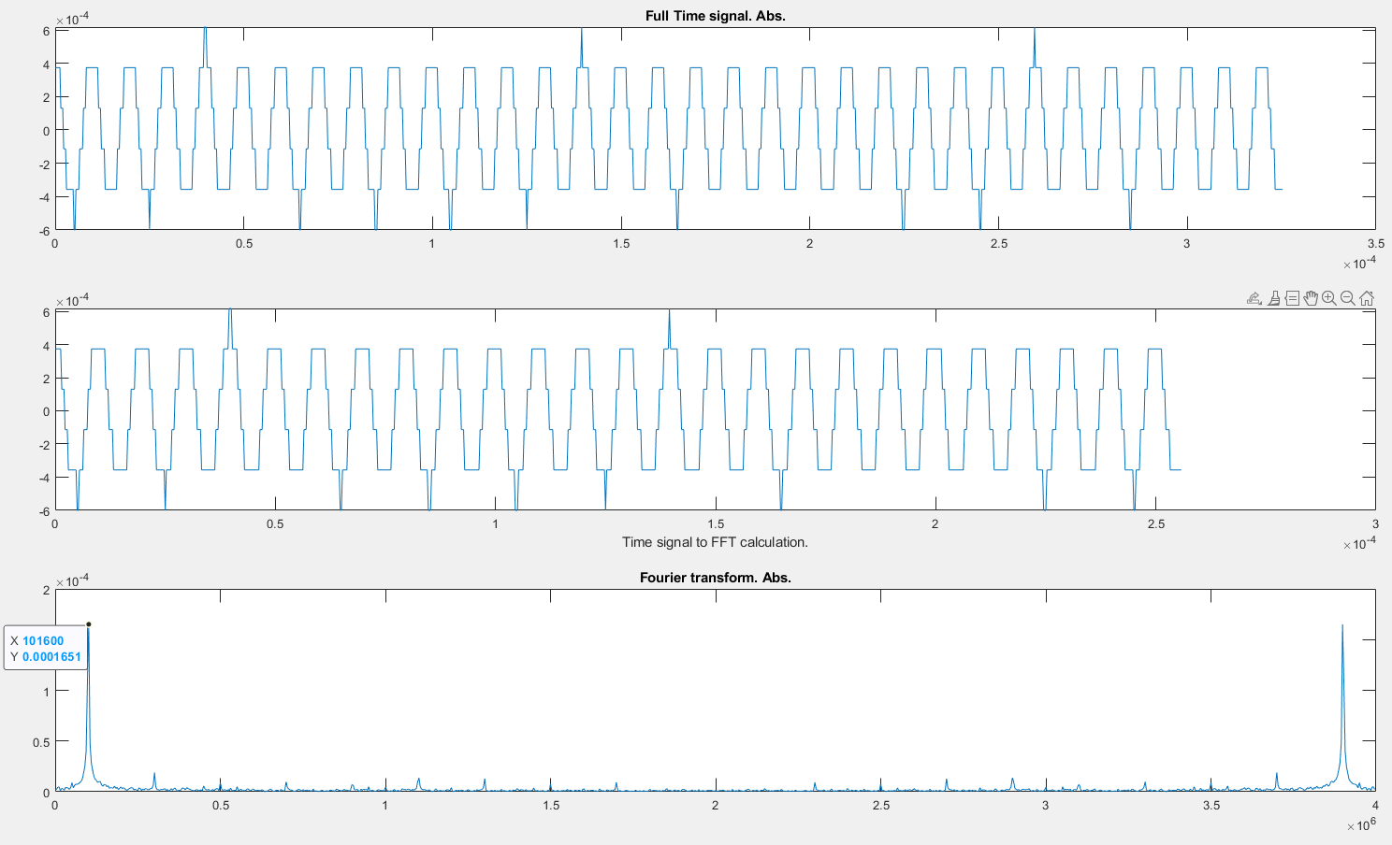
Signal reconstruction and FFT
C3

Slide 15
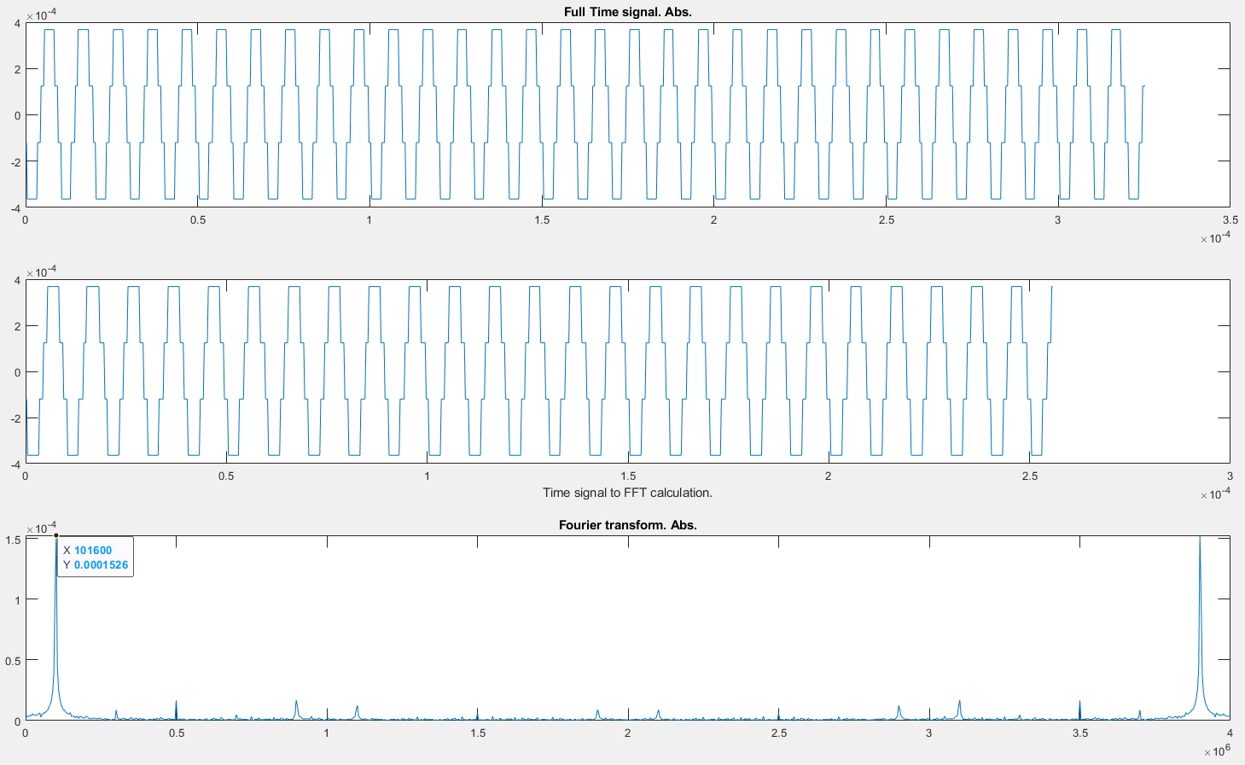
Signal reconstruction and FFT
C4

Slide 16
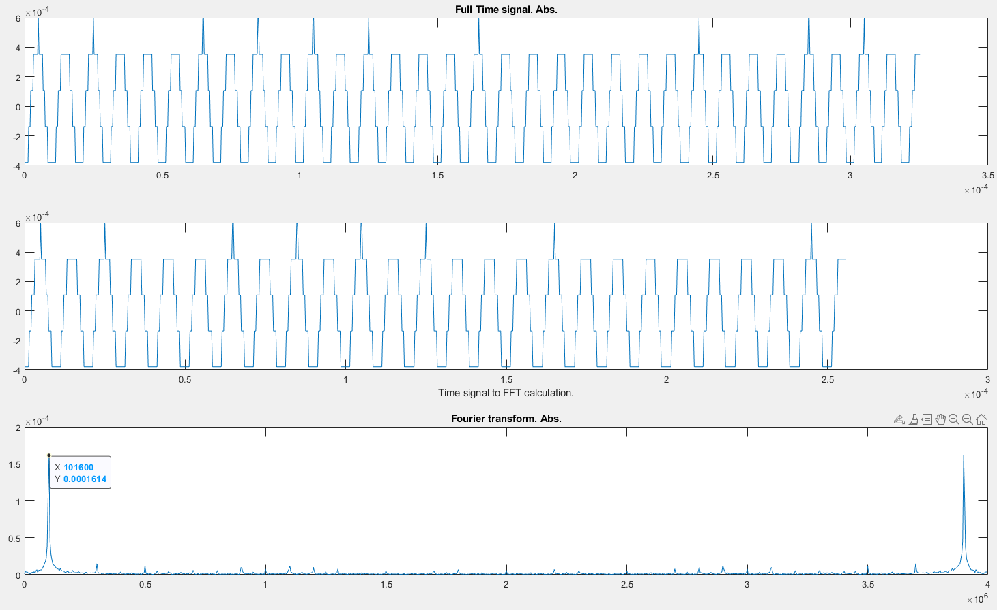
Signal reconstruction and FFT
C5

Slide 17

Signal reconstruction and FFT
C6

Slide 18
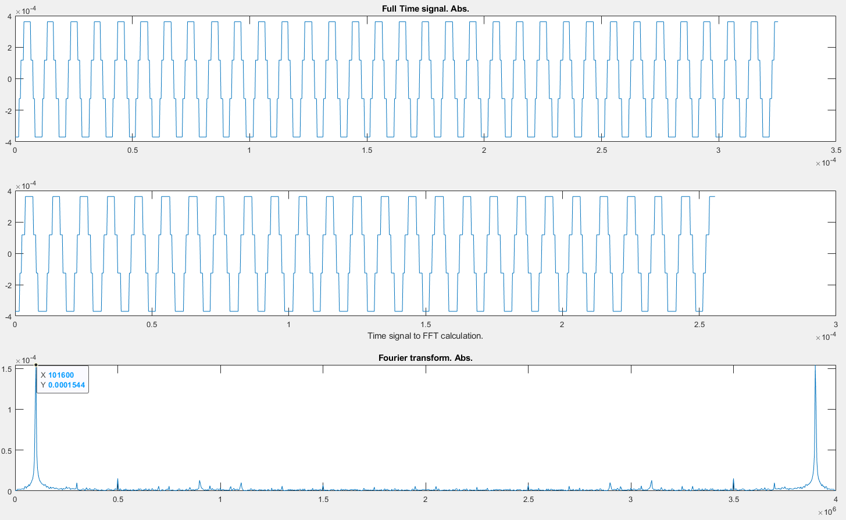
Signal reconstruction and FFT
C7

Slide 19
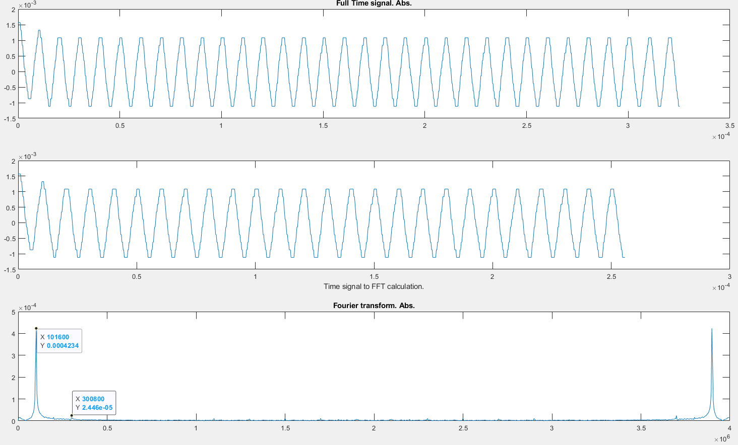
Signal reconstruction and FFT
R0

Slide 20
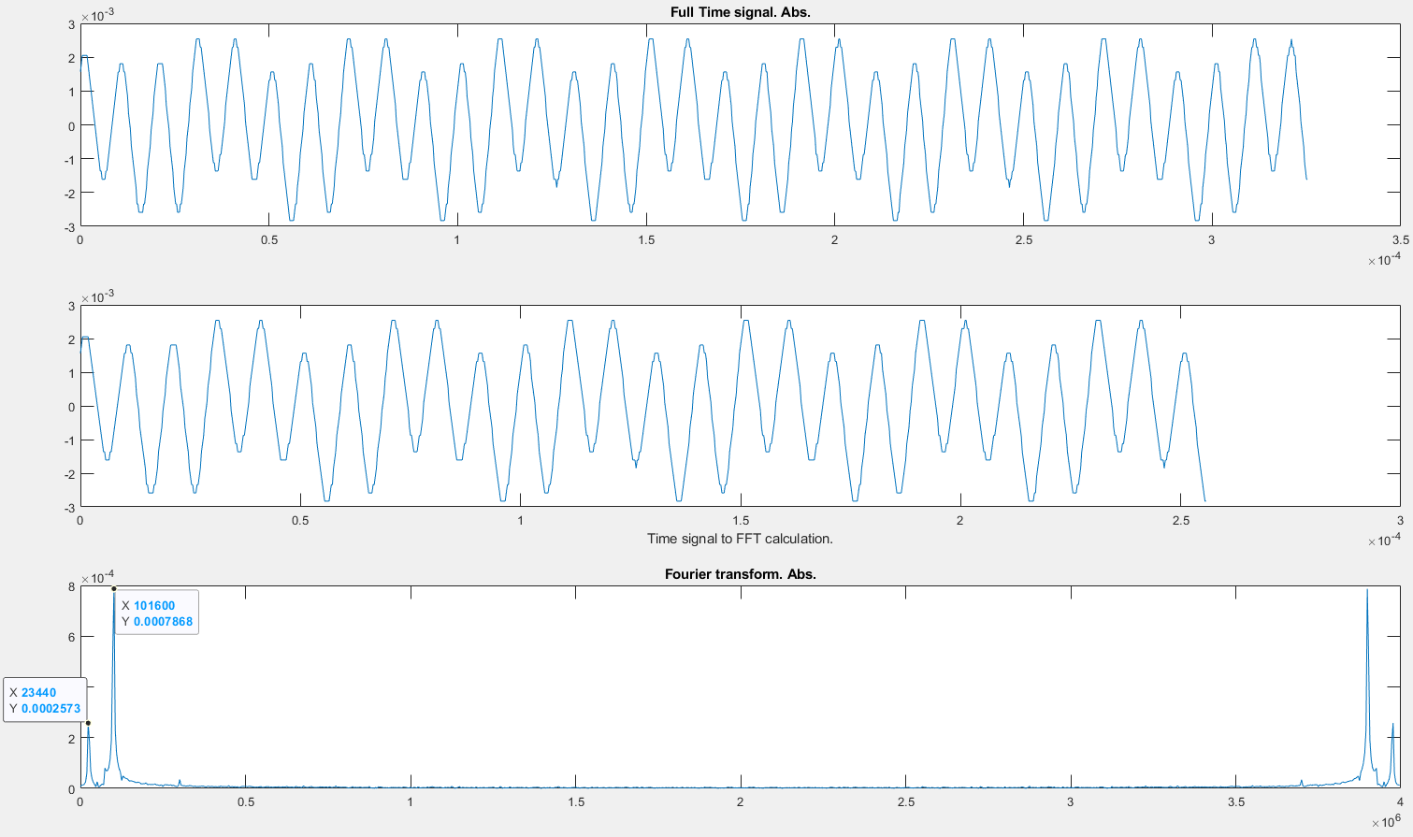
Signal reconstruction and FFT
R1

Slide 21
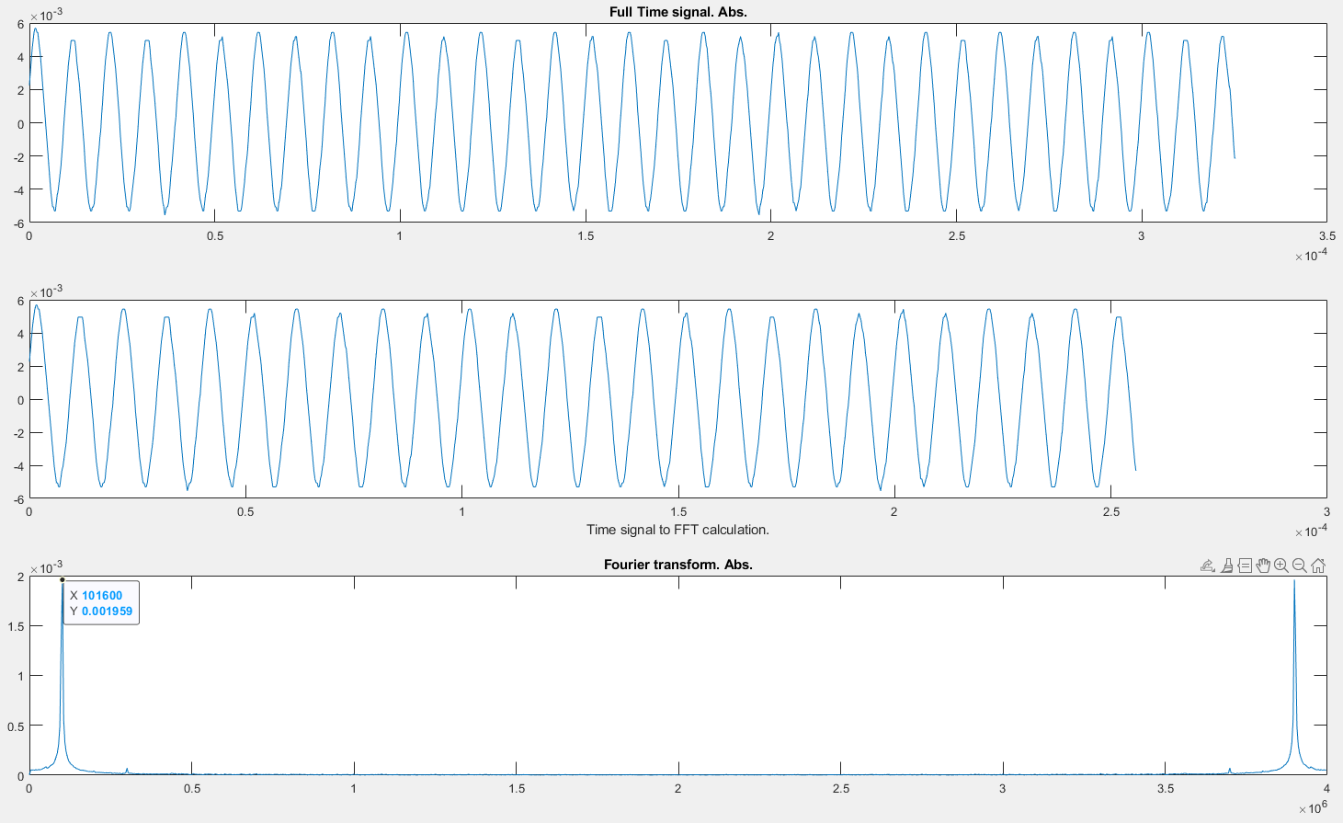
Signal reconstruction and FFT
R2

Slide 22
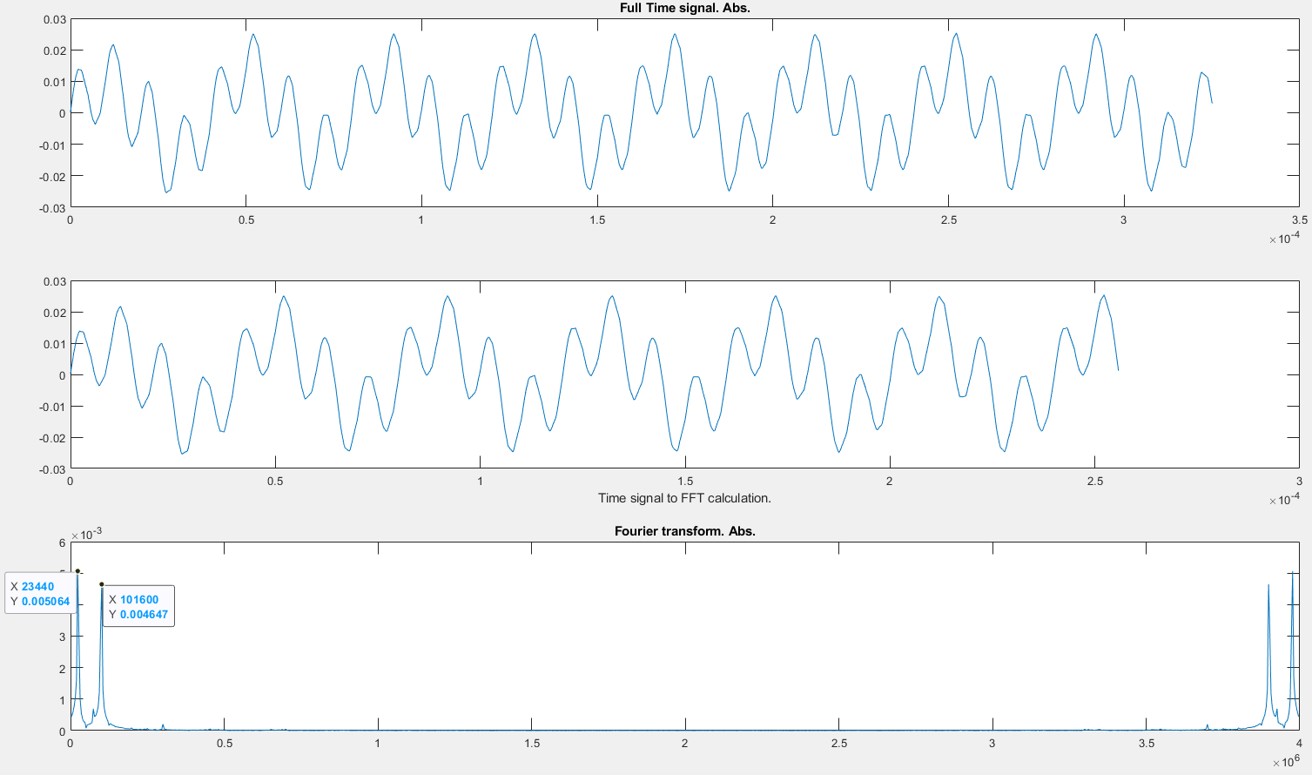
Signal reconstruction and FFT
R3

Slide 23
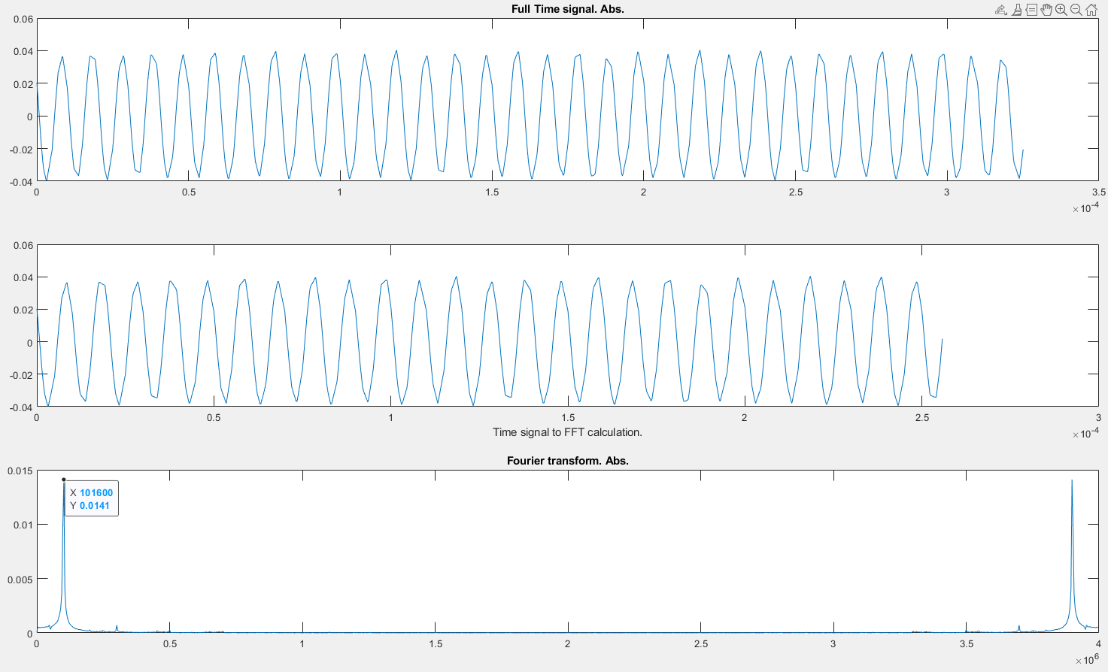
Signal reconstruction and FFT
R4

Slide 24
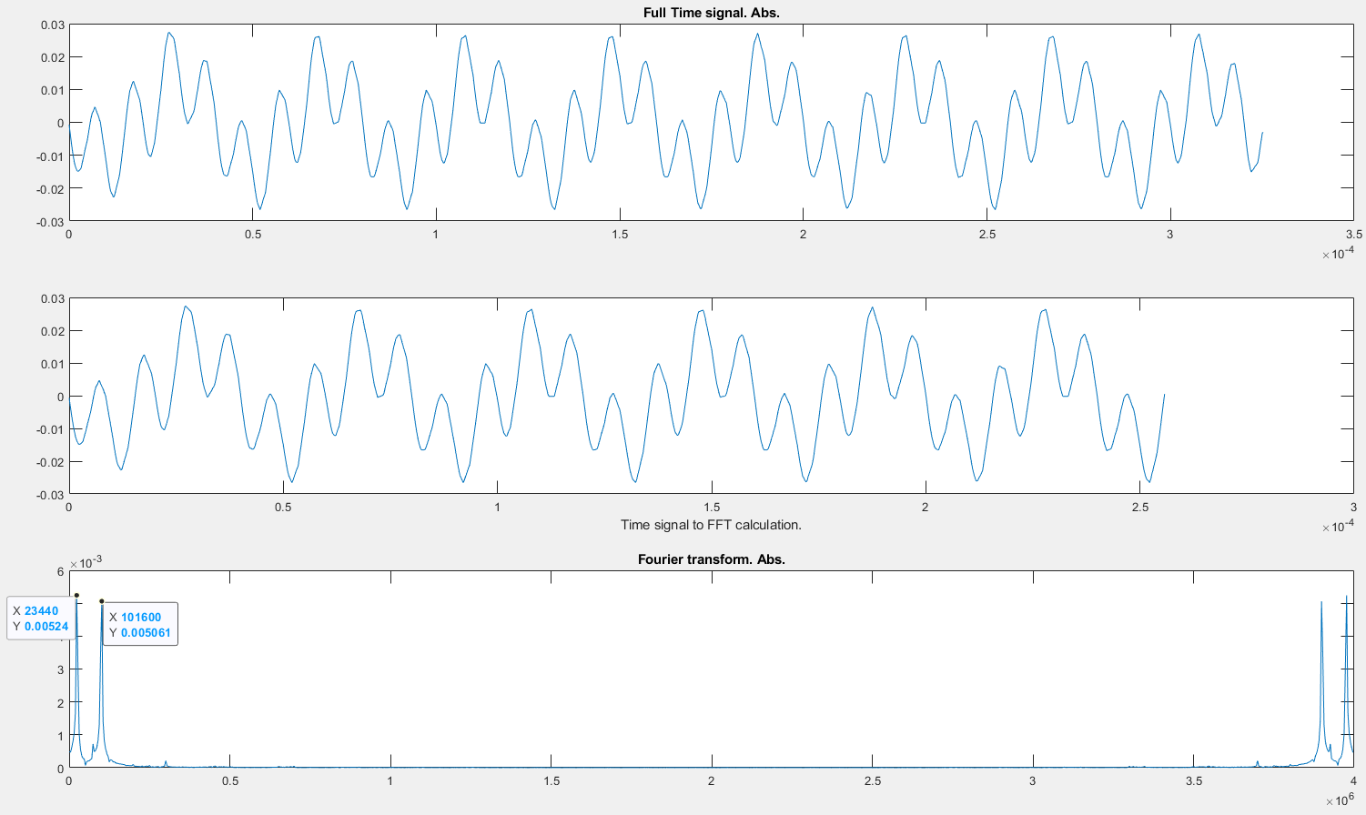
Signal reconstruction and FFT
R5

Slide 25
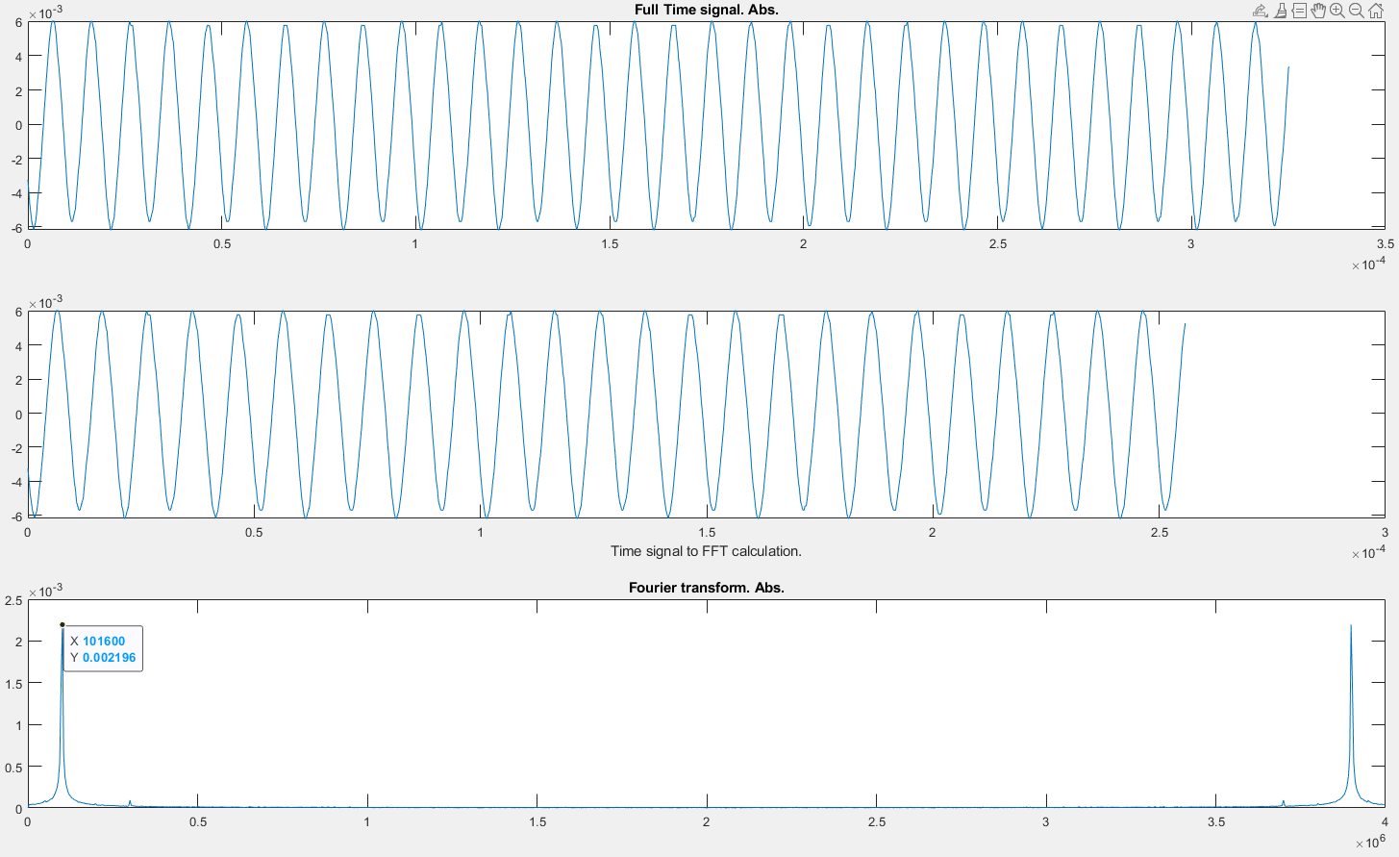
Signal reconstruction and FFT
R6

Slide 26
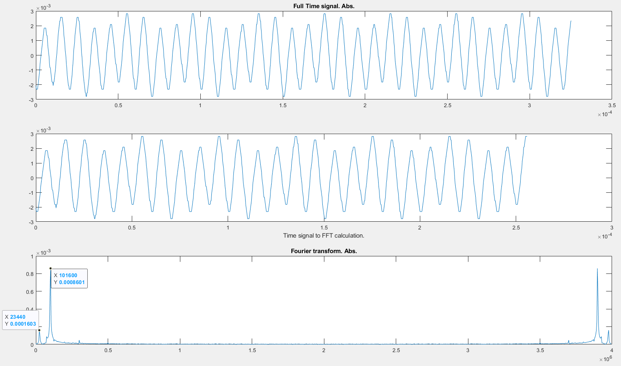
Signal reconstruction and FFT
R7

Slide 28
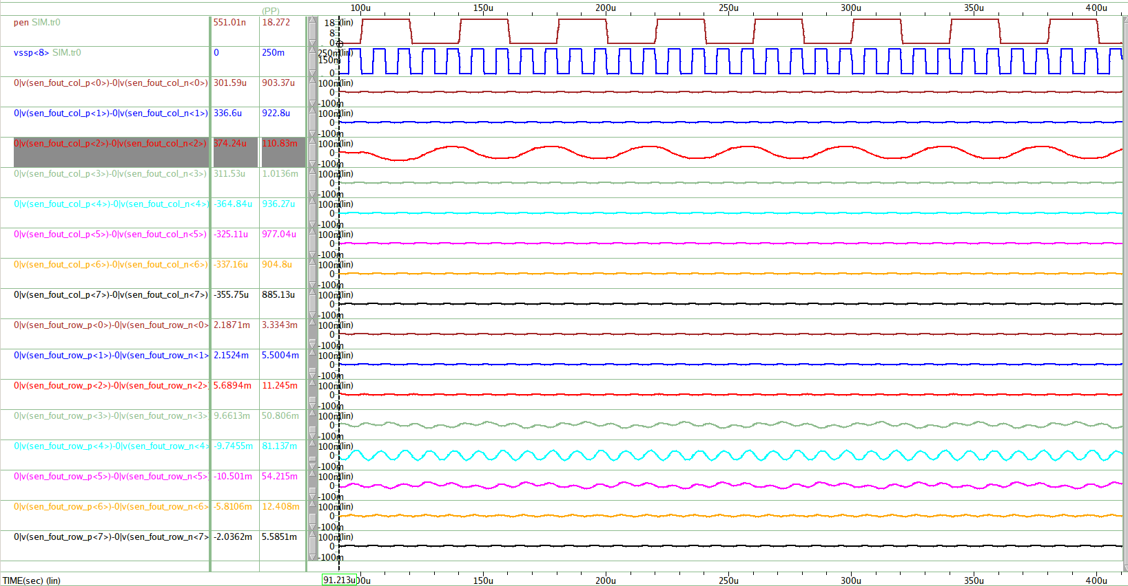
Active Pen Column Sensing (@1-Sensing Row Display Noise)
PEN Signal
- Vpp : 18V ~ 0V, 25KHz
- Tr=Tf=1us
- Position : C2 : R8
- Cc : 85fF
Display Noise
- Vpp : 250mV ~ 0V, 100KHz
- Tr=Tf=0.5us
- Position : Row<8>
LPF Cutoff Frequency
- 50KHz ( -3dB)
Pen Sensing Signal의 Display Noise 유입량
- 1-Sensing Row Display Noise < Full Panel Display Noise
- Column Sensing 1/10 이하, Row Sensing 1/2 이하

