Slide 1
ADC output data reconstruction and FFT analyzation
G2touch 개발센터
IC개발실 SoC팀, mducng
2020. 9. 24.

Slide 2
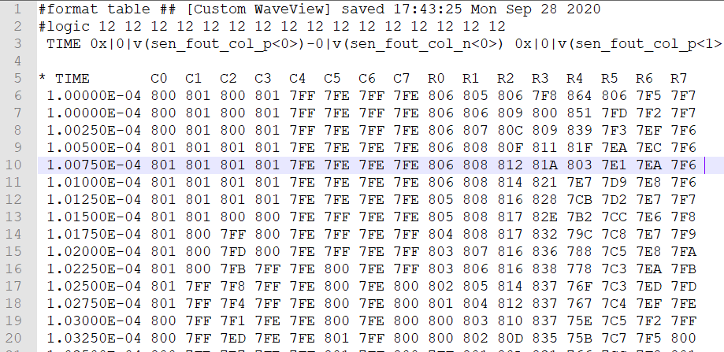

ADC output data
1
Data:
C0, C1, …, C7, R0, R1, …, R7
Sampling frequency:
Interval time = $0.0025×{10}^{−4}$s
$F_{s}=\frac{1}{0.0025×{10}^{−4}}=4×{10}^{6}Hz$
Data format:
Hexadecimal value
12 bits: 0 → 4095 (‘000’ → ‘FFF’)
ADC outputs
from PJJ 수석님
Notes:
>> help fi
fi Fixed-point numeric object

Slide 3

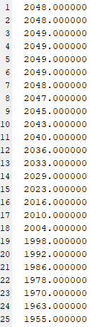
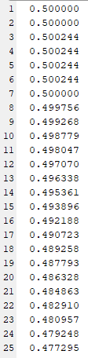
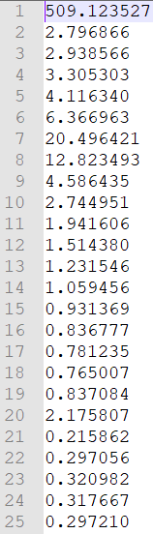
ADC output data conversion
2
Hexadecimal
number
Real numbers
(with scaling)
Frequency domain data
Data:
Hex-to-dec
fi() in MATLAB
FFT transform
fft() in MATLAB
Refer to attached folders.
scaling

Slide 4


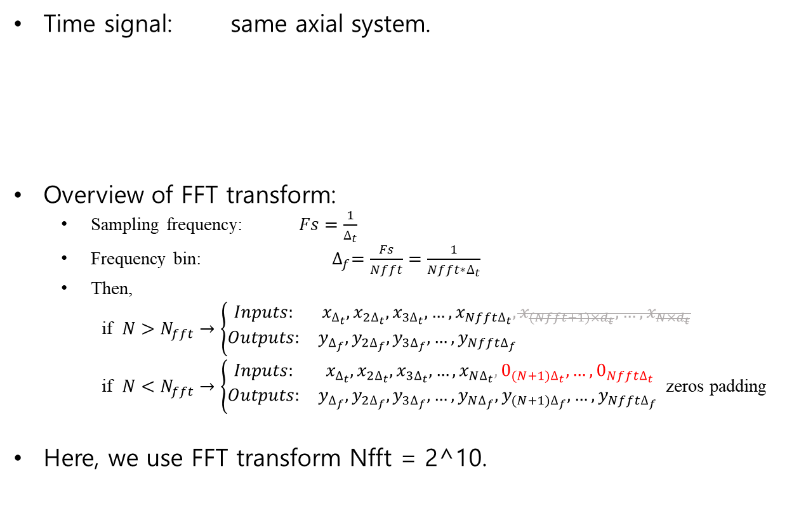
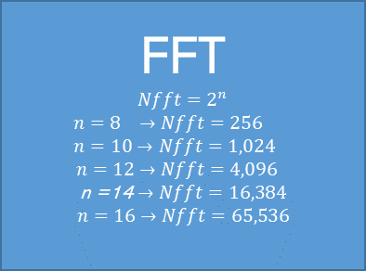
Signal reconstruction and FFT analyzation
3
Time signal: same axial system.
Overview of FFT transform:
Sampling frequency: $Fs=\frac{1}{∆_{t}}$
Frequency bin: $∆_{f}=\frac{Fs}{Nfft}=\frac{1}{{Nfft∗∆}_{t}}$
Then,
if $N>N_{fft}→\left\{\begin{matrix}Inputs: & x_{∆_{t}},x_{2∆_{t}},x_{3∆_{t}},…,x_{Nfft∆_{t}},x_{(Nfft+1){×d}_{t}},…,x_{N{×d}_{t}} \\ Outputs: & y_{∆_{f}},y_{2∆_{f}},y_{3∆_{f}}, …,y_{Nfft∆_{f}} \end{matrix}\right.$
if $N<N_{fft}→\left\{\begin{matrix}Inputs: & x_{∆_{t}},x_{2∆_{t}},x_{3∆_{t}},…,x_{N∆_{t}},0_{(N+1)∆_{t}},…,0_{Nfft∆_{t}} \\ Outputs: & y_{∆_{f}},y_{2∆_{f}},y_{3∆_{f}},…,y_{N∆_{f}},y_{(N+1)∆_{f}}, …,y_{Nfft∆_{f}} \end{matrix}\right.$ zeros padding
Here, we use FFT transform Nfft = 2^10.
Sampled
Time domain
Sampled
Frequency domain
FFT
$$Nfft=2^{n}$$
$$n=8 →Nfft=256$$
$$n=10→Nfft=1,024$$
$$n=12→Nfft=4,096$$
n =14 $→Nfft=16,384$
$$n=16→Nfft=65,536$$
$$x_{∆_{t}},x_{2∆_{t}},x_{3∆_{t}},…,x_{N∆_{t}}$$
where $∆_{t}$is Sampling interval
$$y_{∆_{f}},y_{2∆_{f}},y_{3∆_{f}},…,y_{Nfft∆_{f}}$$
where $∆_{f}$is Frequency bin.

Slide 5
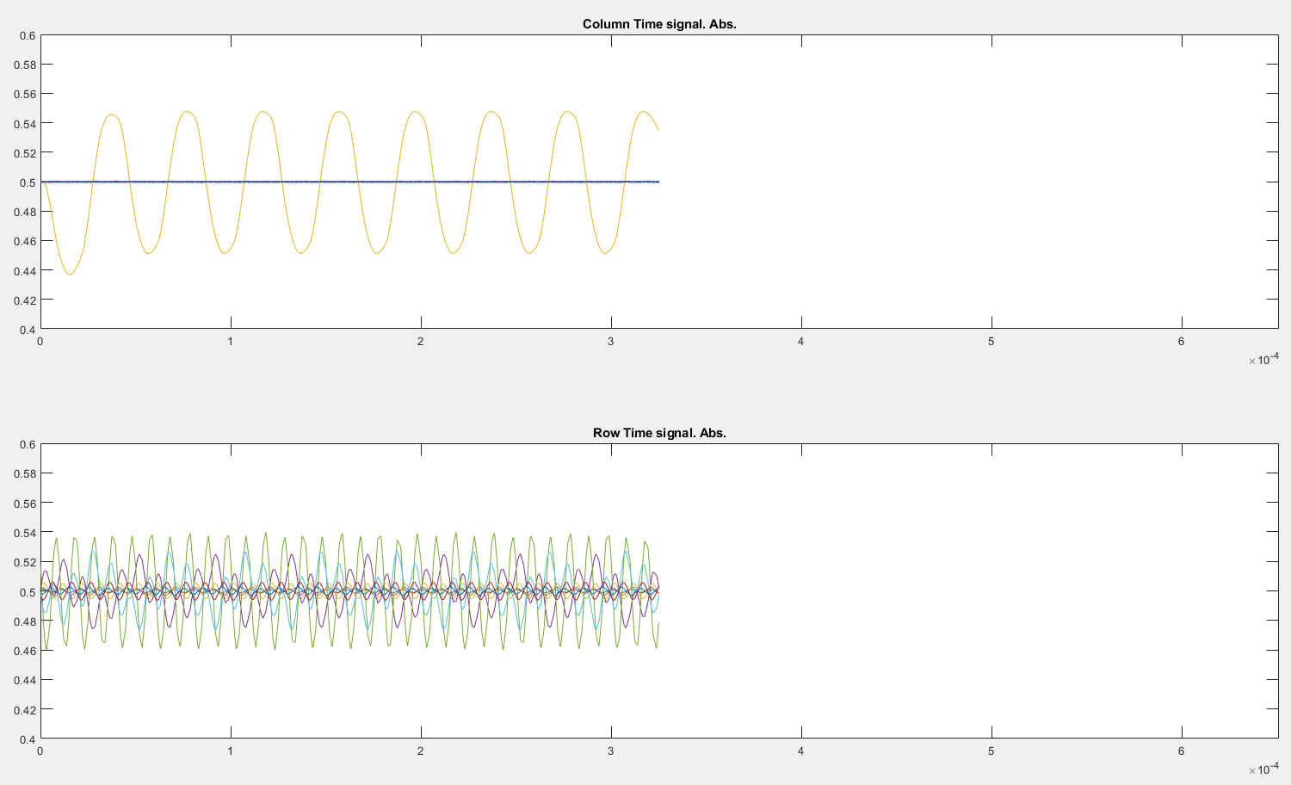
Signal reconstruction and FFT analyzation
3
All columns
All rows
Fs = 4MHz
#samples = 1320

Slide 6
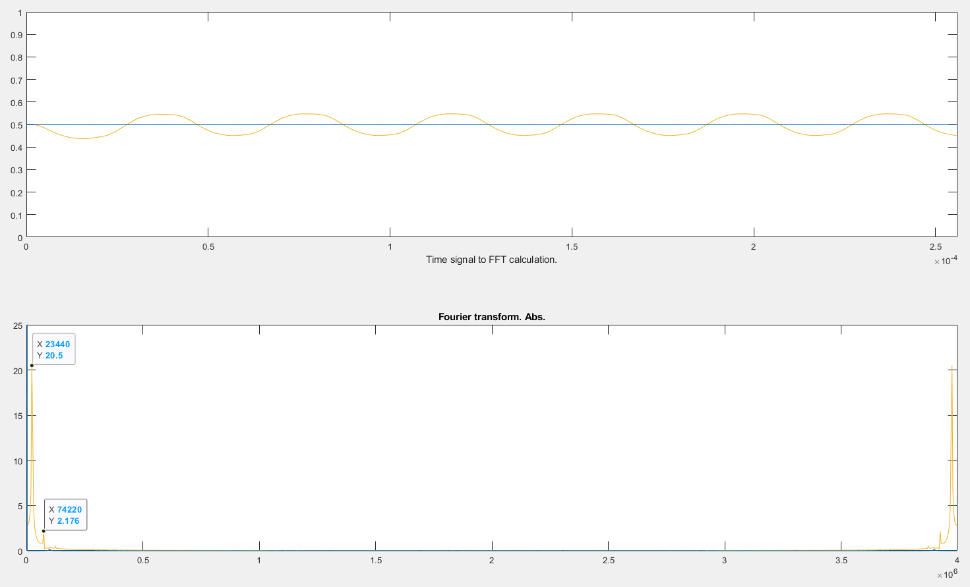
Signal reconstruction and FFT analyzation
3
All columns
All rows
Fs = 4MHz
#samples = 1320
Nfft = 1024
Bin frequency = 4kHz

Slide 7
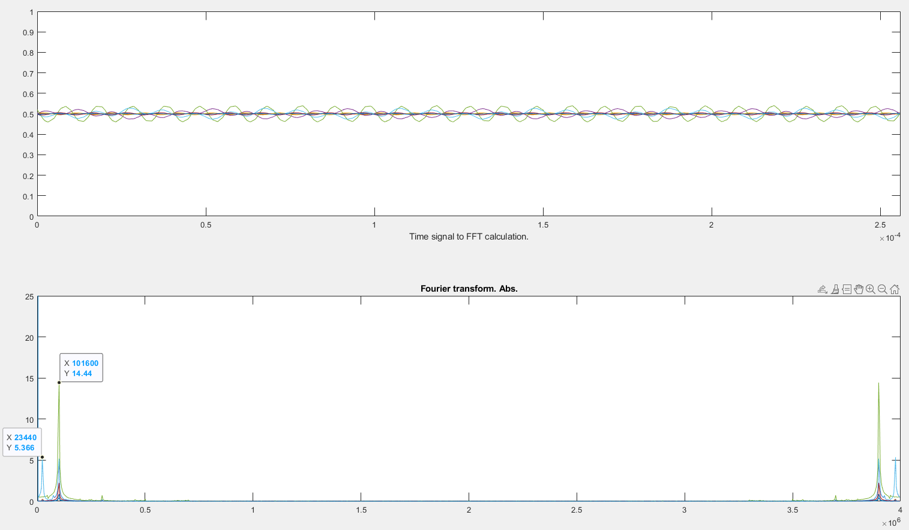
Signal reconstruction and FFT analyzation
3
All columns
All rows

Slide 8
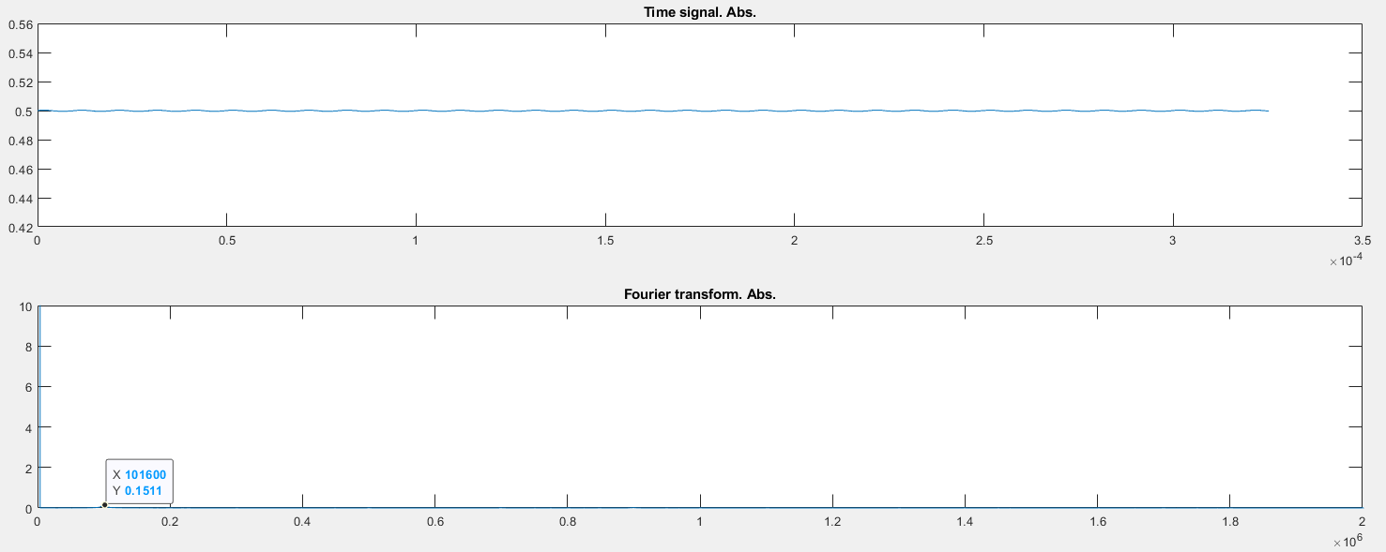
Signal reconstruction and FFT analyzation
3
C0

Slide 9
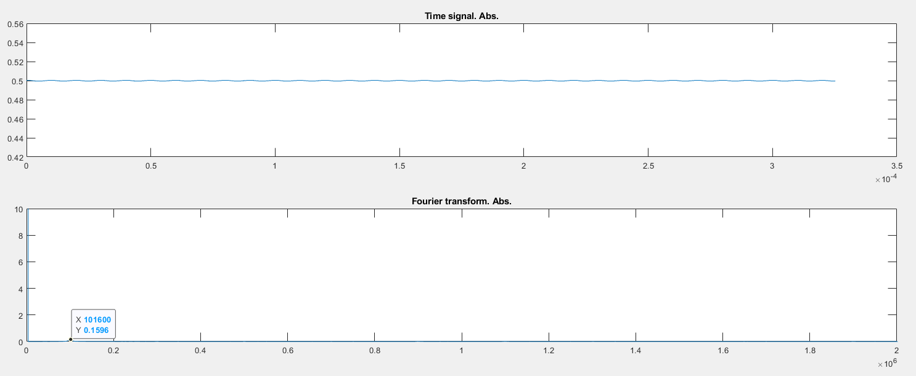
Signal reconstruction and FFT analyzation
3
C1

Slide 10
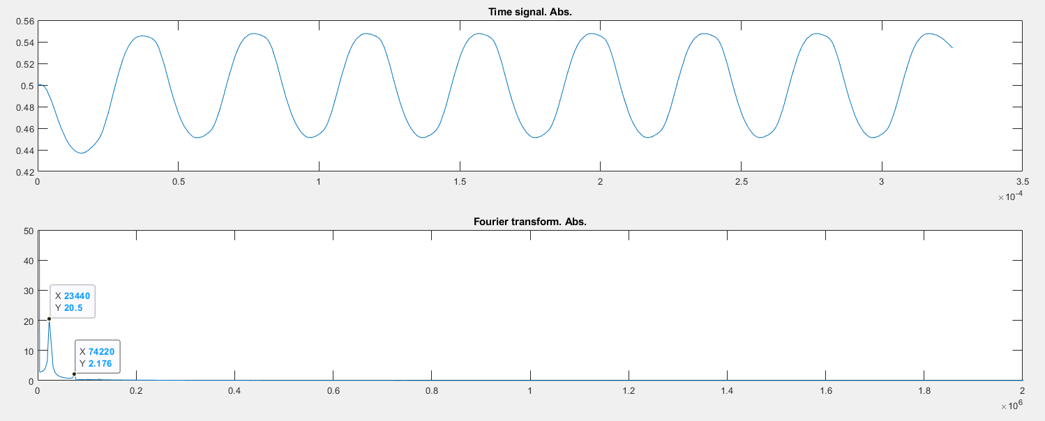
Signal reconstruction and FFT analyzation
3
C2

Slide 11
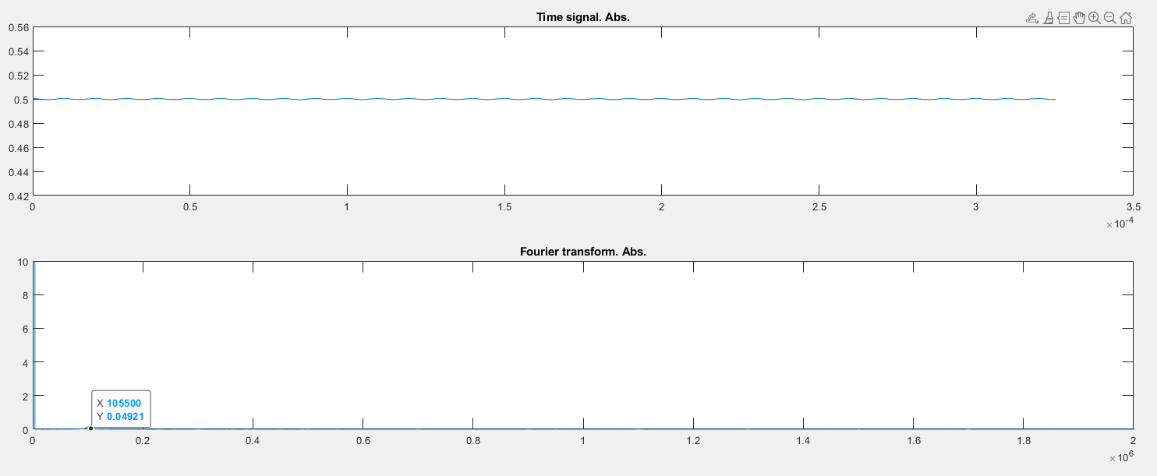
Signal reconstruction and FFT analyzation
3
C3

Slide 12
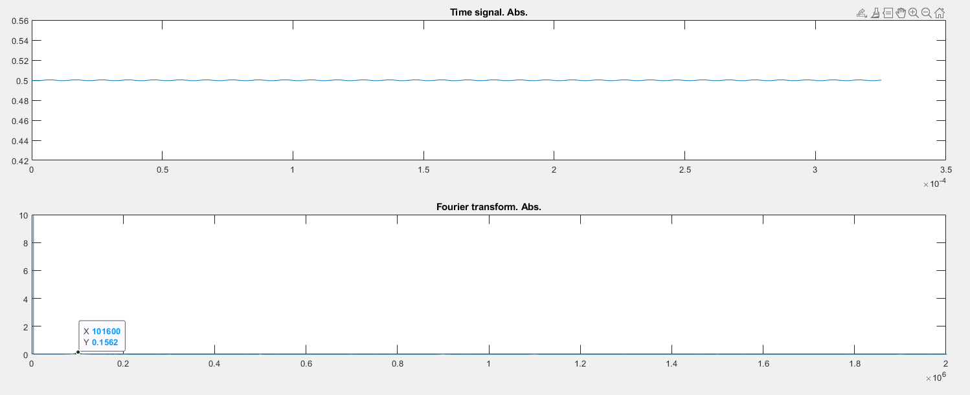
Signal reconstruction and FFT analyzation
3
C4

Slide 13
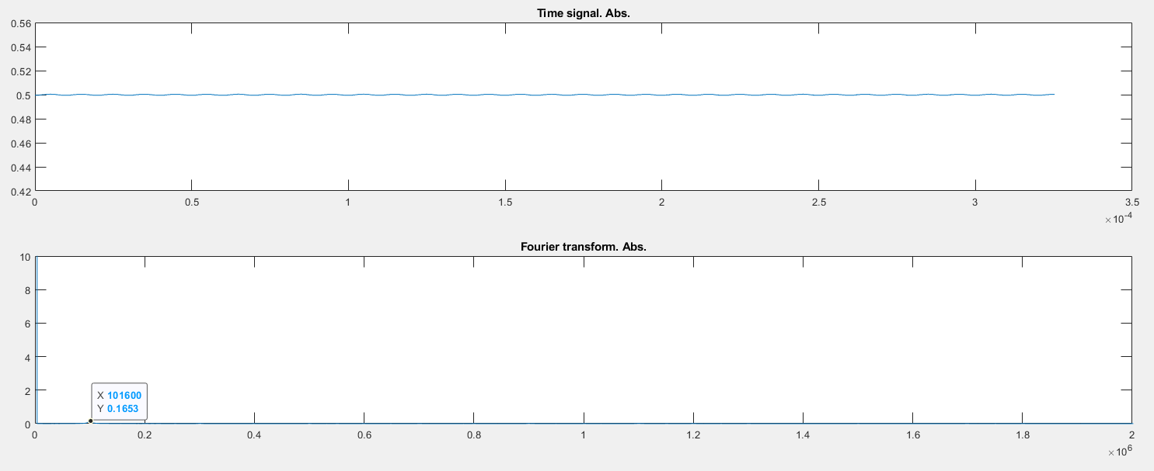
Signal reconstruction and FFT analyzation
3
C5

Slide 14
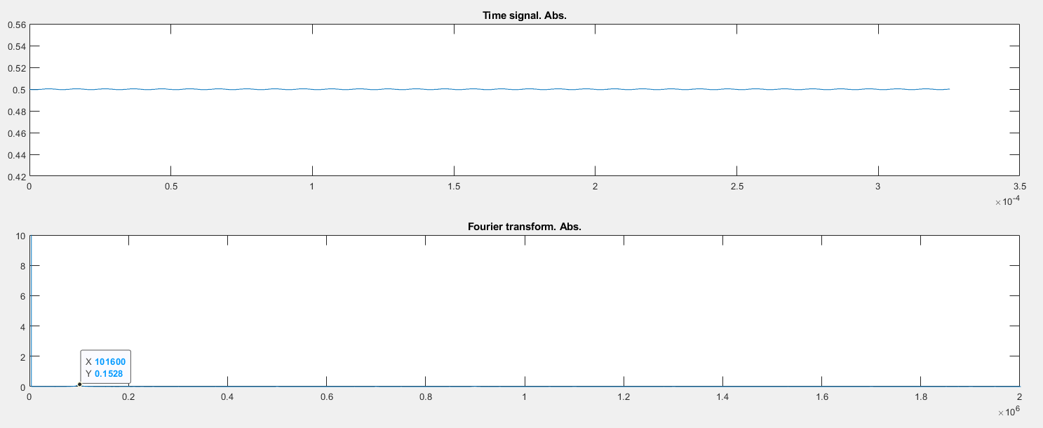
Signal reconstruction and FFT analyzation
3
C6

Slide 15
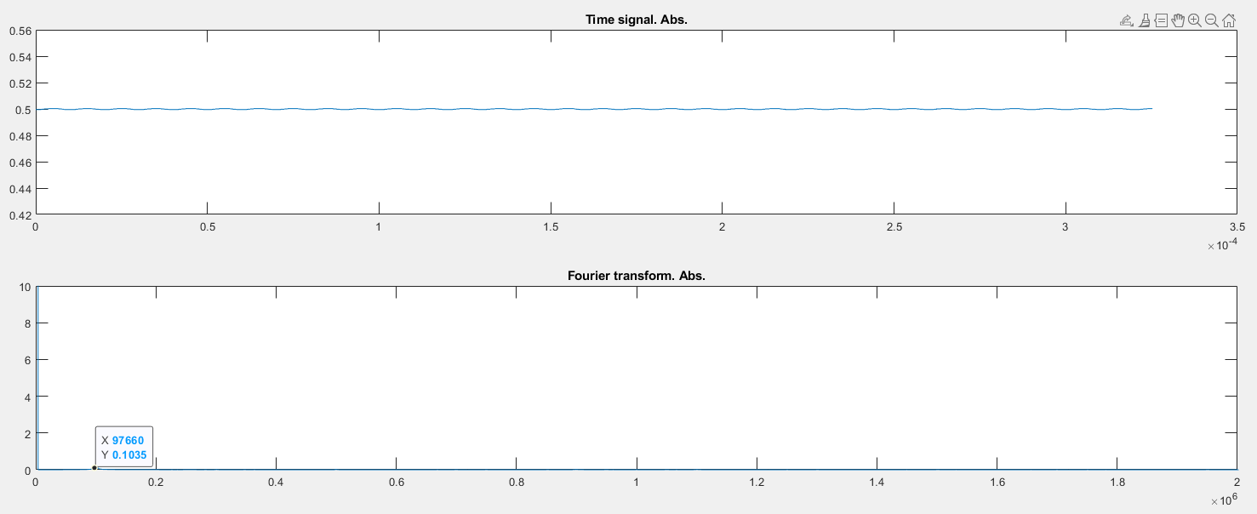
Signal reconstruction and FFT analyzation
3
C7

Slide 16
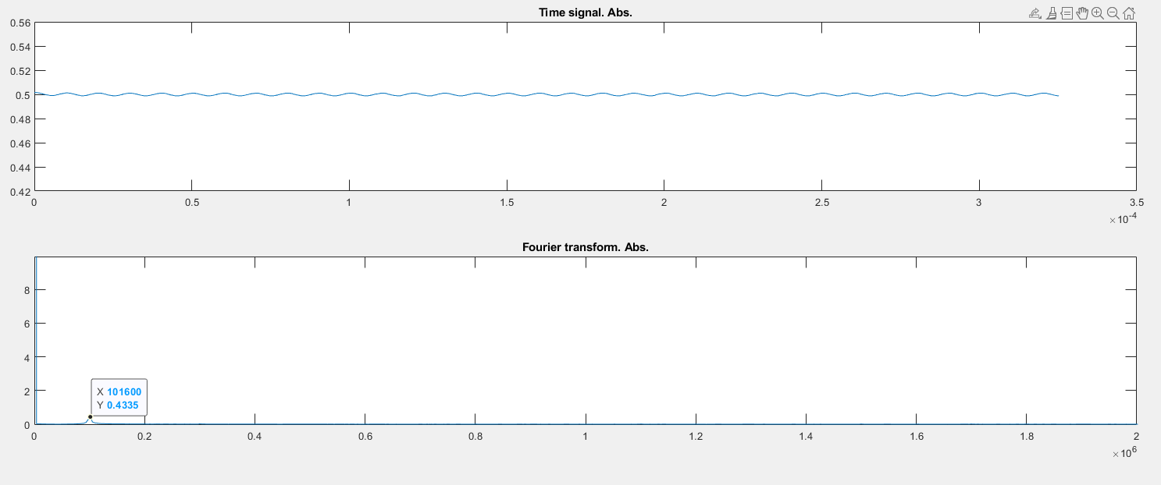
Signal reconstruction and FFT analyzation
3
R0

Slide 17
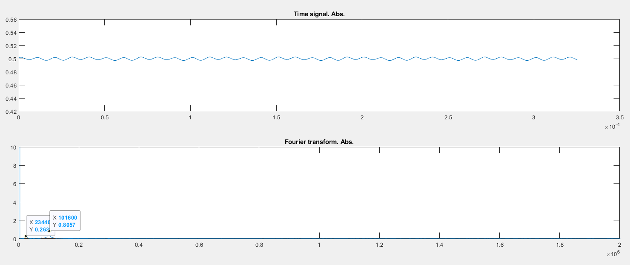
Signal reconstruction and FFT analyzation
3
R1

Slide 18
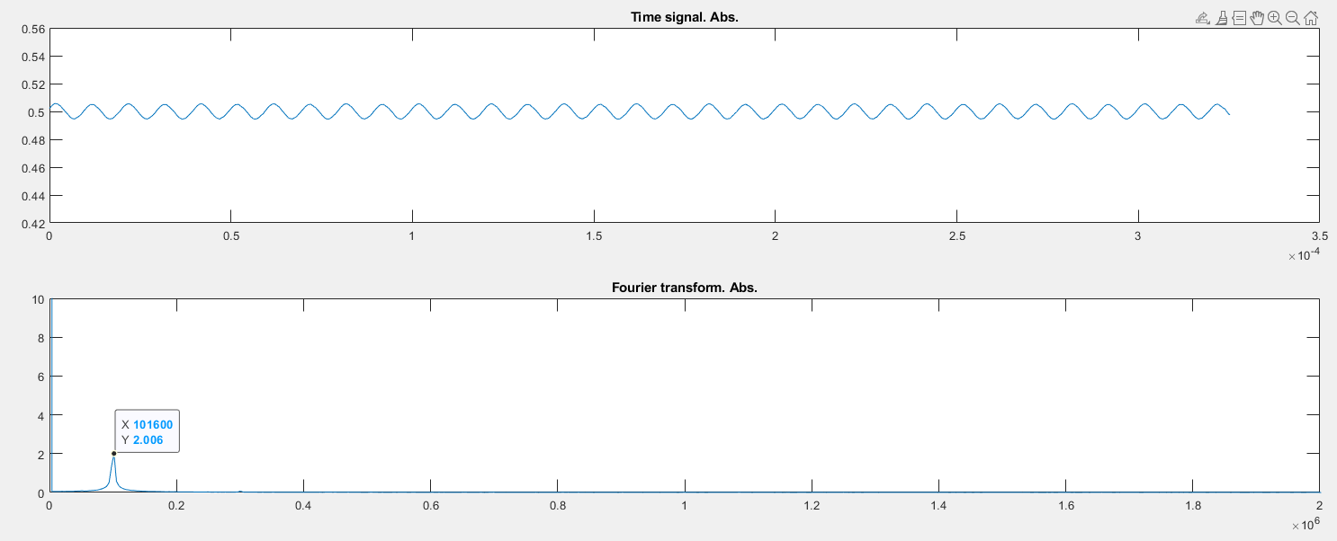
Signal reconstruction and FFT analyzation
3
R2

Slide 19
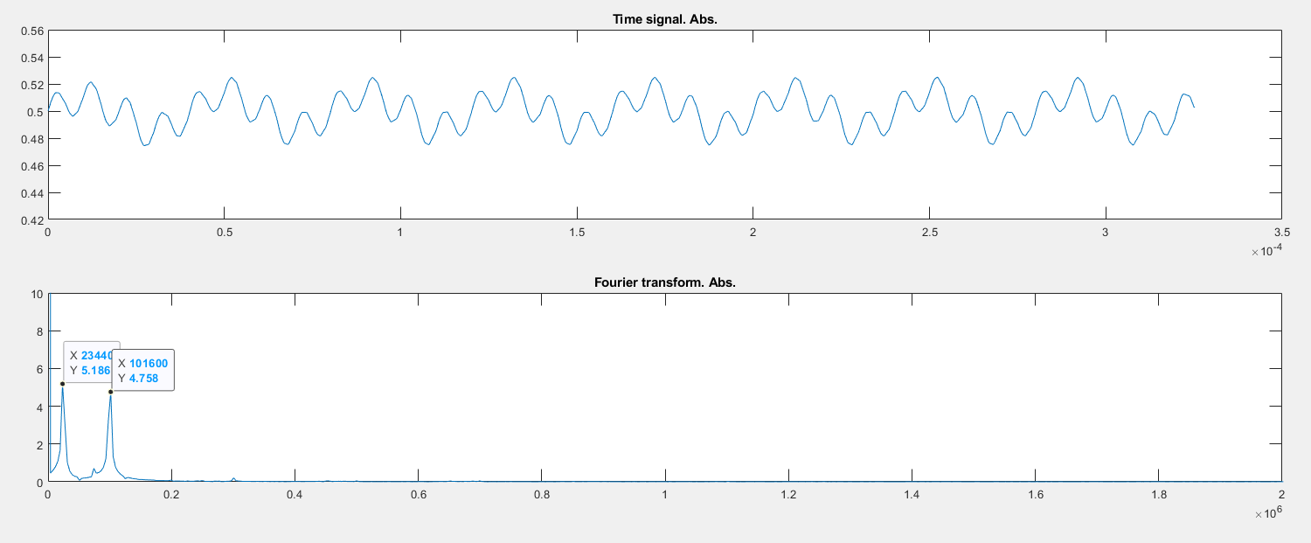
Signal reconstruction and FFT analyzation
3
R3

Slide 20
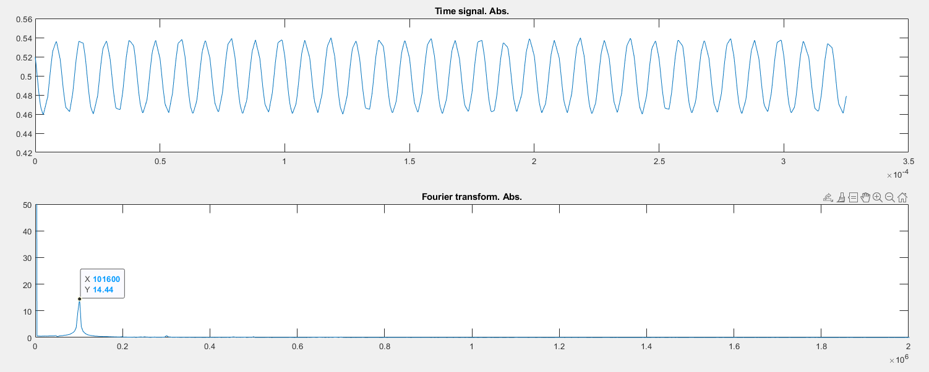
Signal reconstruction and FFT analyzation
3
R4

Slide 21
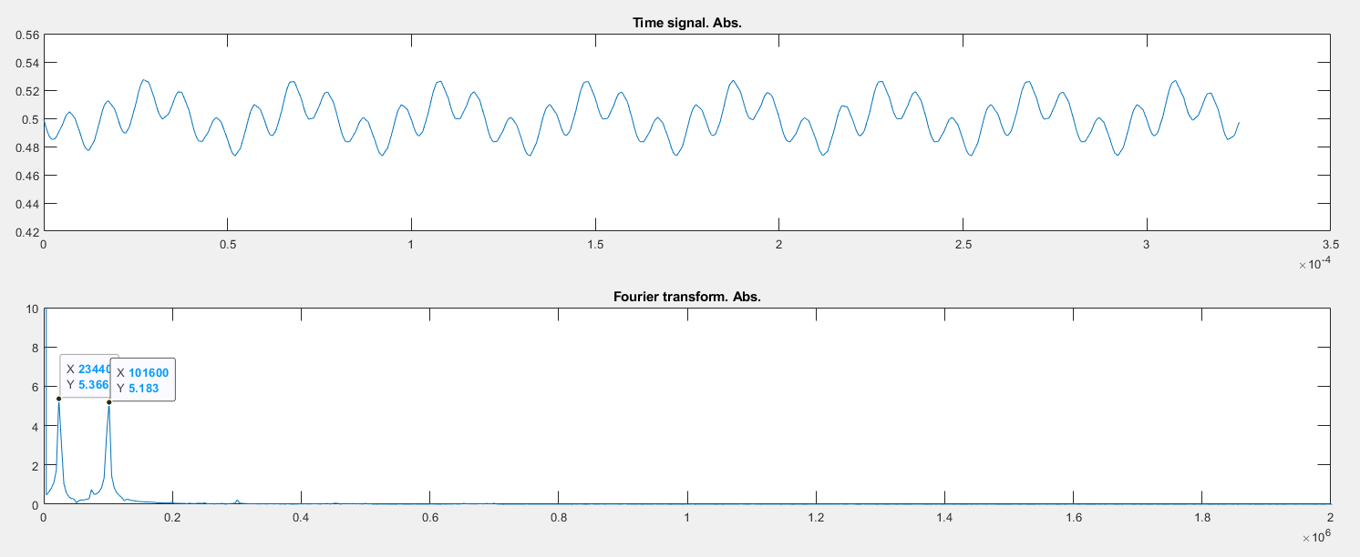
Signal reconstruction and FFT analyzation
3
R5

Slide 22
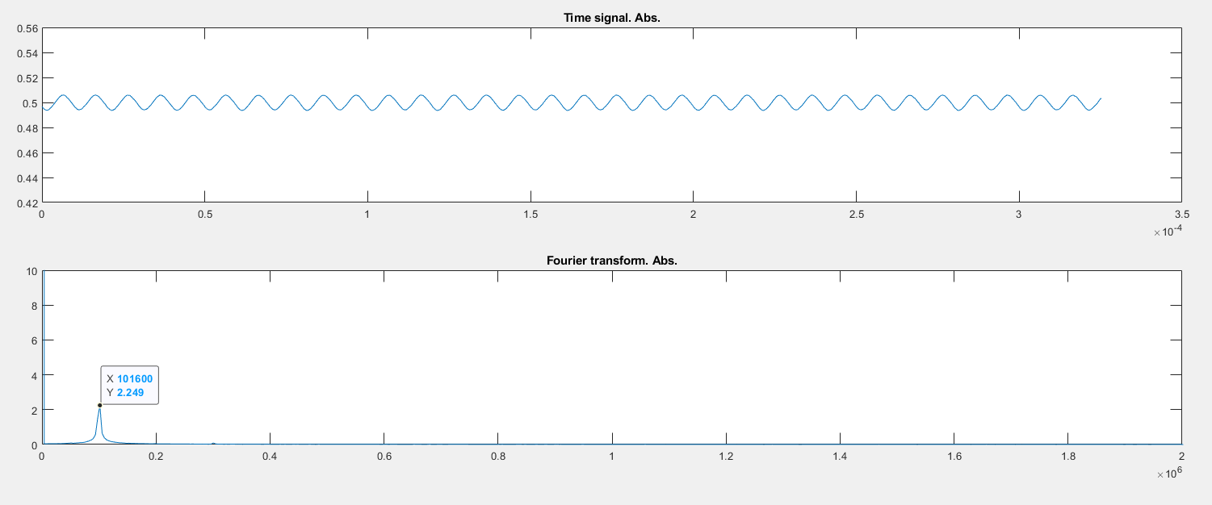
Signal reconstruction and FFT analyzation
3
R6

Slide 23
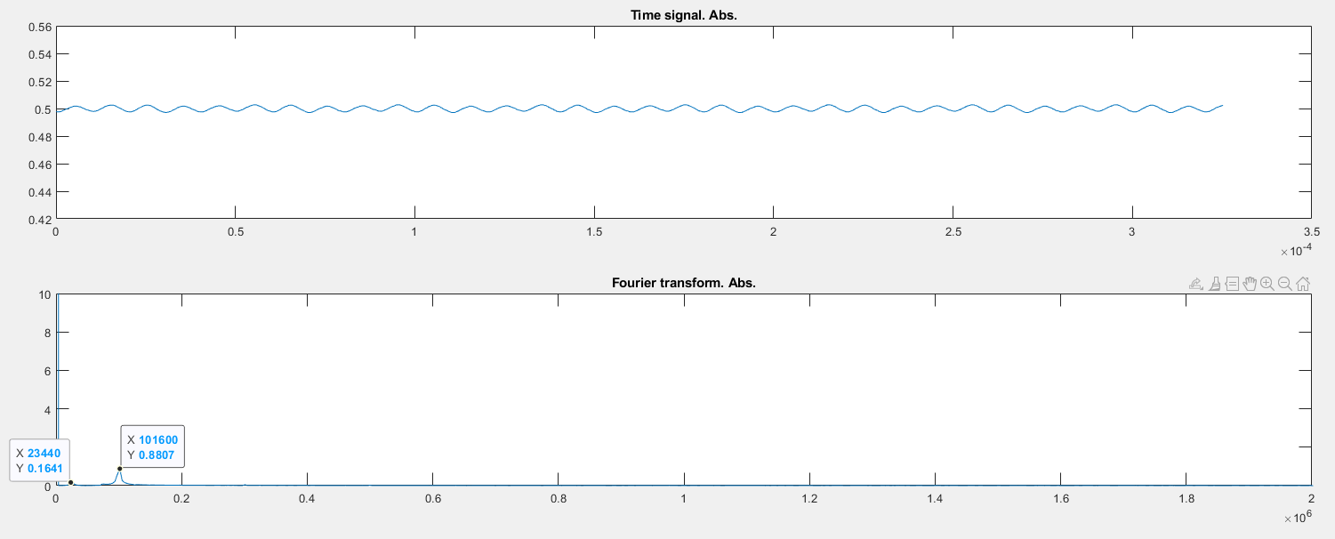
Signal reconstruction and FFT analyzation
3
R7

Slide 24
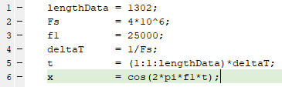
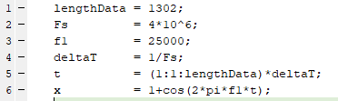
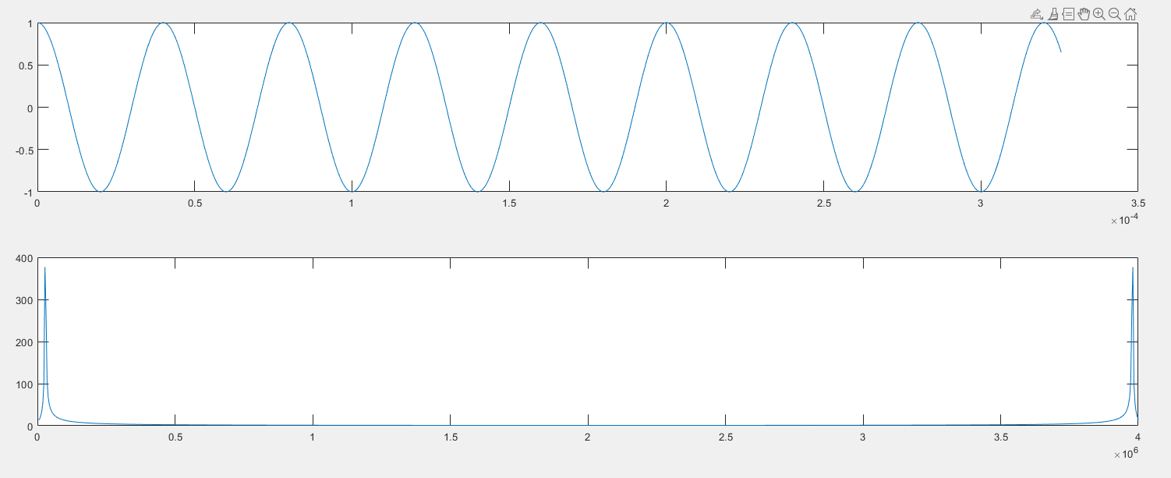
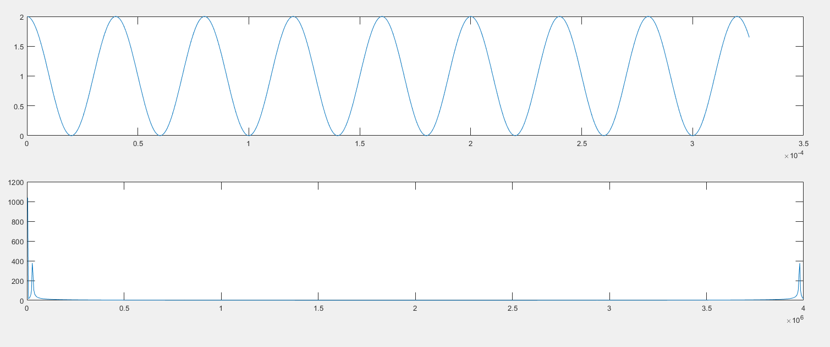
Summary
4
Reconstructed signal have no different to EVB_AFE_Simulation_200924.
FFT data are as expected.
One abnormal: FFT value for first frequency interval is higher than the FFT value of "the most occurring frequencies“. It comes from the existence of constant value, just ignore.
MATLAB simulation to confirm that phenomenon.

Slide 26
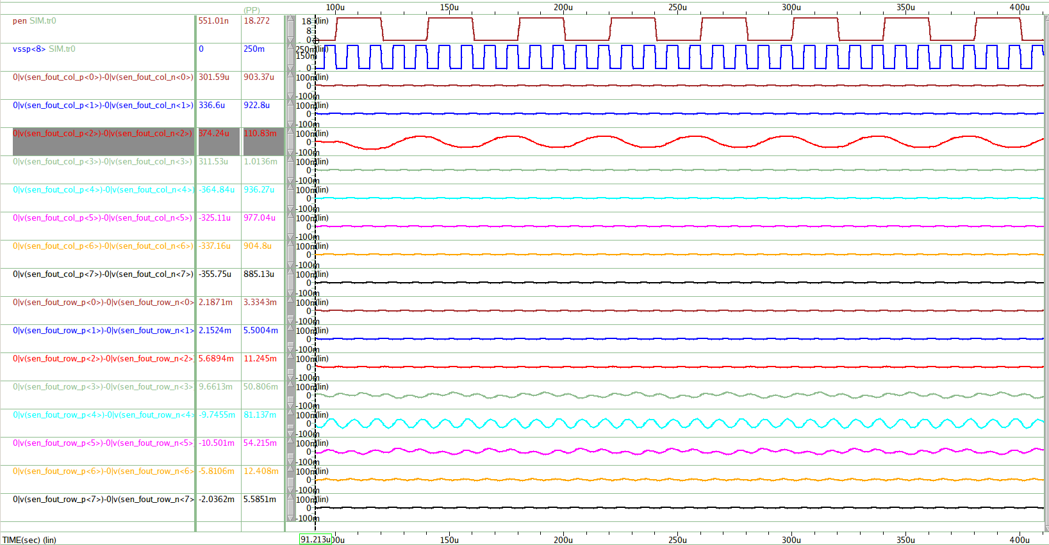
Active Pen Column Sensing (@1-Sensing Row Display Noise)
5
Vpp
Voltage
PEN Signal
- Vpp : 18V ~ 0V, 25KHz
- Tr=Tf=1us
- Position : C2 : R8
- Cc : 85fF
PEN
Display Noise
LPFOUT_COL<0>
LPFOUT_COL<1>
LPFOUT_COL<2>
PEN Out Signal
Display Noise
- Vpp : 250mV ~ 0V, 100KHz
- Tr=Tf=0.5us
- Position : Row<8>
LPFOUT_COL<3>
LPFOUT_COL<4>
LPFOUT_COL<5>
LPFOUT_COL<6>
LPFOUT_COL<7>
LPF Cutoff Frequency
- 50KHz ( -3dB)
LPFOUT_ROW<0>
LPFOUT_ROW<1>
LPFOUT_ROW<2>
LPFOUT_ROW<3>
PEN 신호 유입
LPFOUT_ROW<4>
Display Noise
LPFOUT_ROW<5>
PEN 신호 유입
LPFOUT_ROW<6>
LPFOUT_ROW<7>
LPFOUT : OUTP-OUTN Difference
Time
Pen Sensing Signal의 Display Noise 유입량
- 1-Sensing Row Display Noise < Full Panel Display Noise
- Column Sensing 1/10 이하, Row Sensing 1/2 이하

