Slide 1
ADC output data reconstruction and FFT analyzation
Flying-Fish
Ver.01
IC 개발실, SoC, mducng
2021. 02. 06.

Slide 2
ADC output
Signal reconstruction and FFT

Slide 3
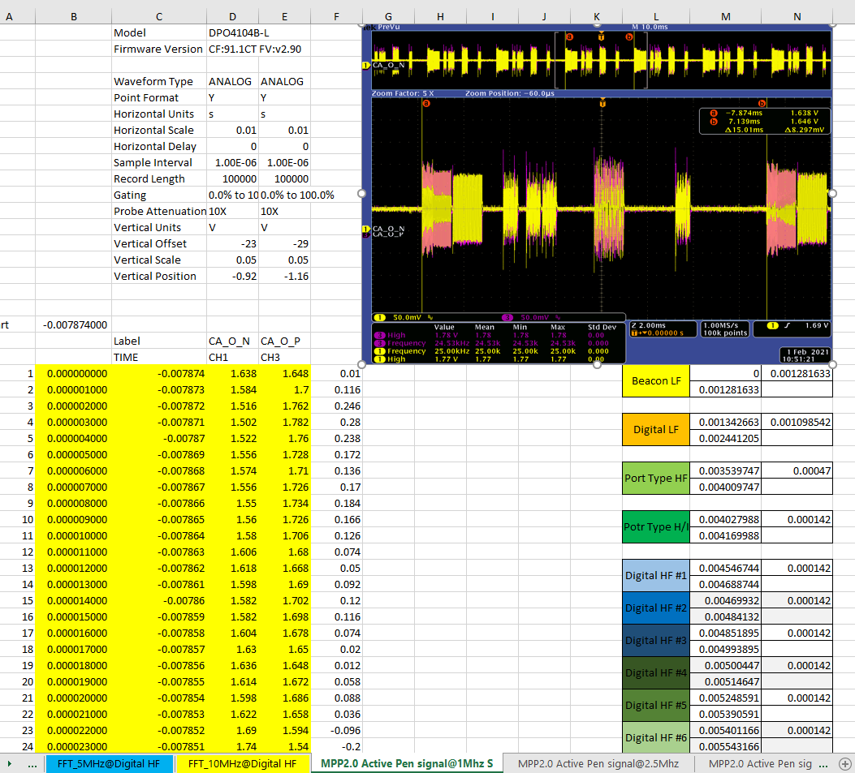
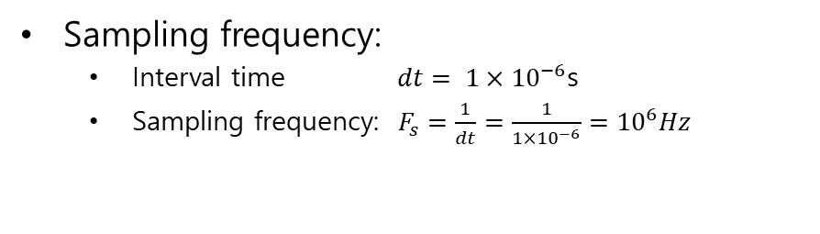
ADC output data
Sampling frequency:
Interval time $dt= 1×{10}^{−6}$s
Sampling frequency: $F_{s}=\frac{1}{dt}=\frac{1}{1×{10}^{−6}}={10}^{6}Hz$
ADC outputs
from 송혁재 수석님
http://192.168.10.74:8090/x/c4FdAQ

Slide 4
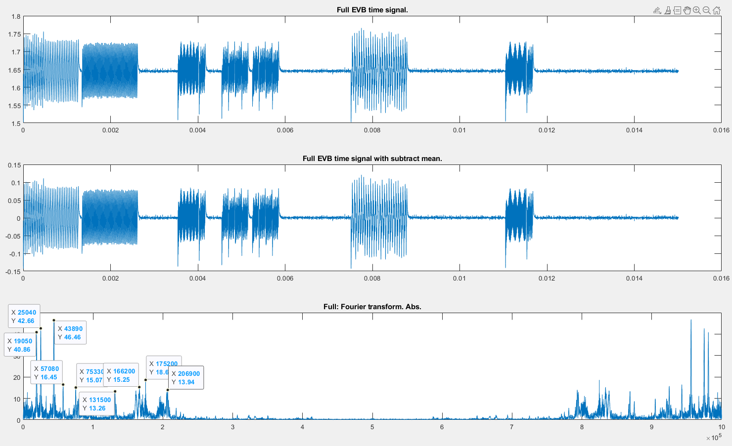
ADC output data
Reconstruct data from txt file

Slide 5
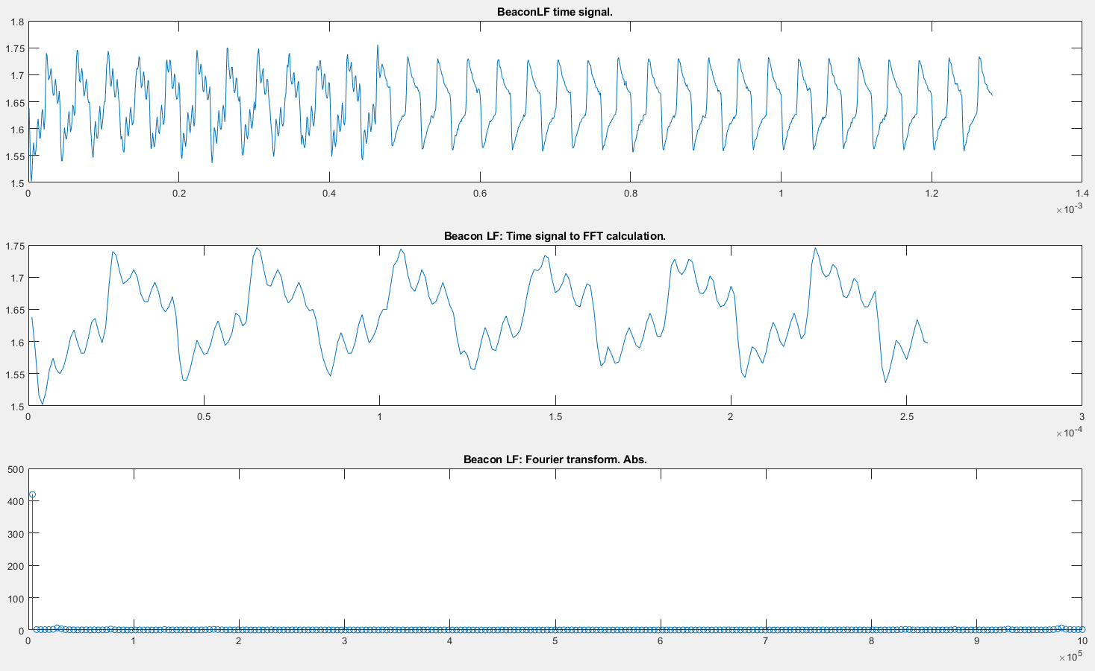
Beacon LF + Ring Beacon
Without ‘subtract mean’

Slide 6
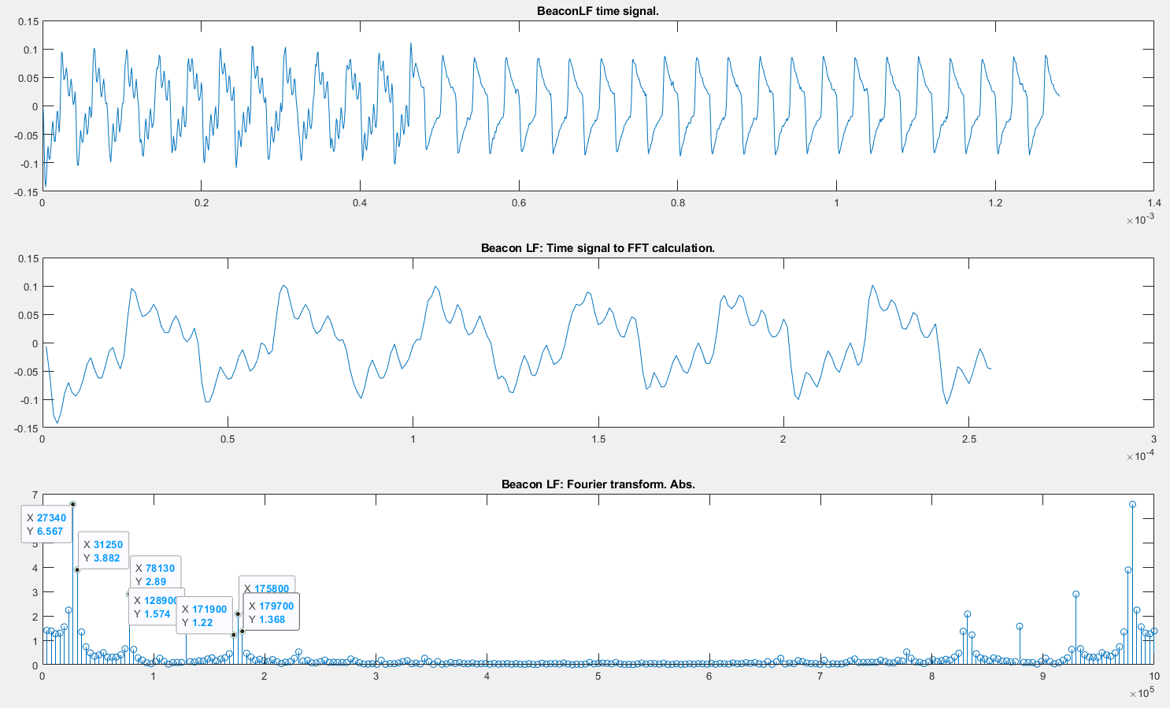
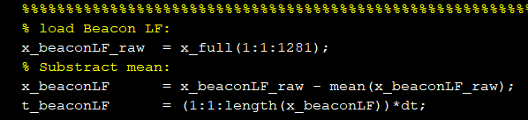
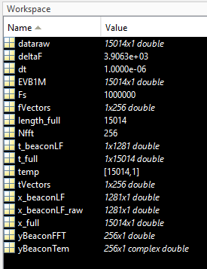
Beacon LF + Ring Beacon
With ‘subtract mean’

Slide 7
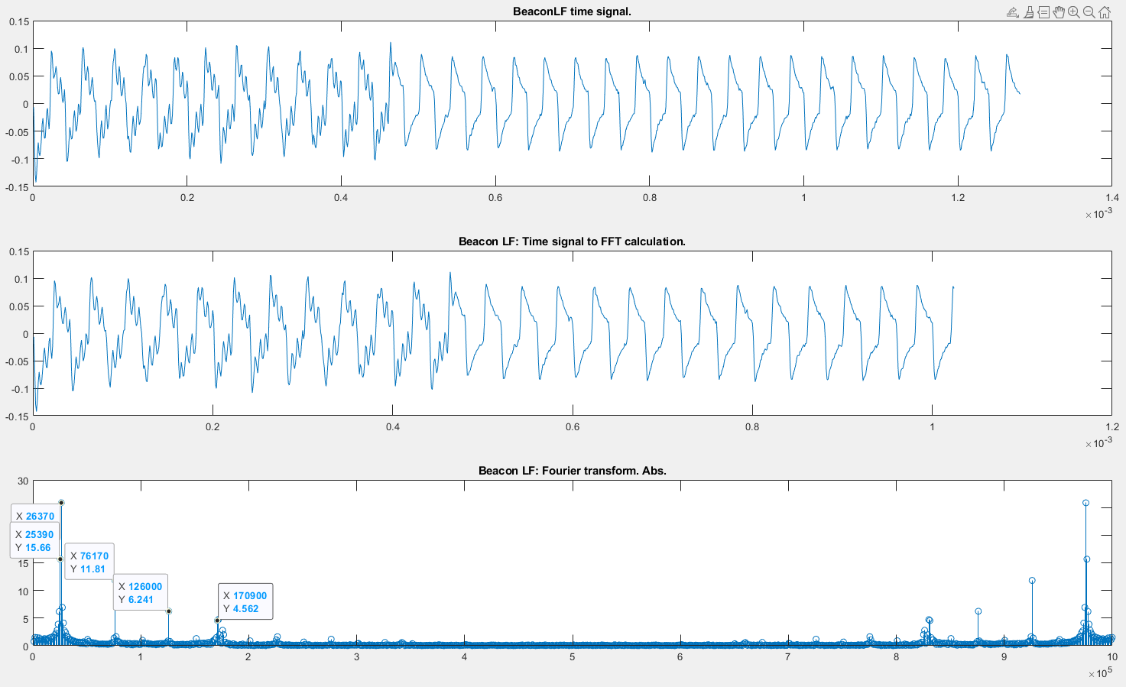
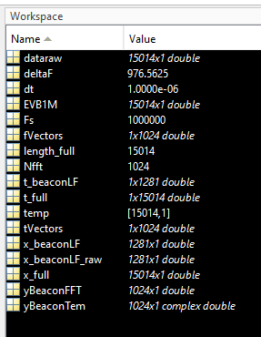
Beacon LF + Ring Beacon
With ‘subtract mean’

Slide 8
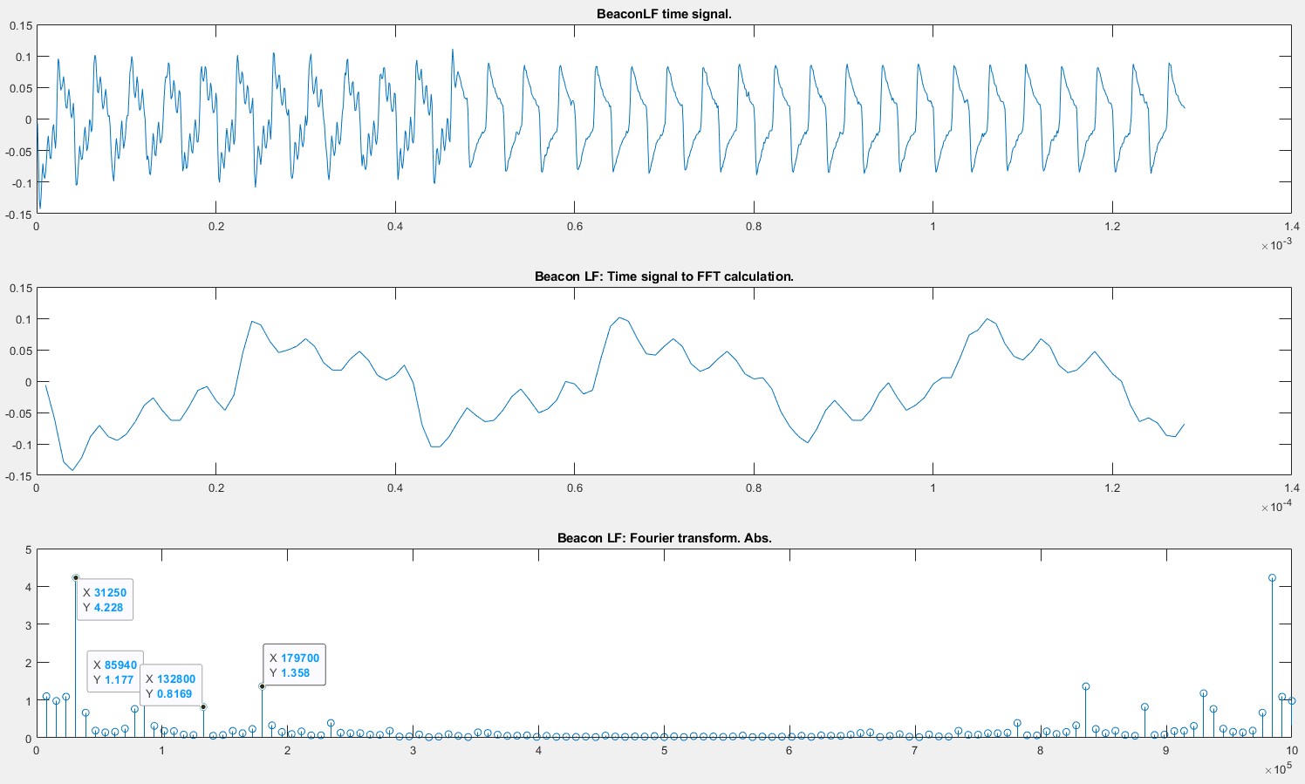
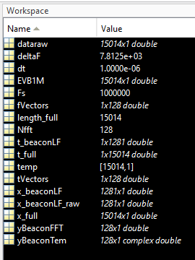
Beacon LF + Ring Beacon
With ‘subtract mean’

Slide 9
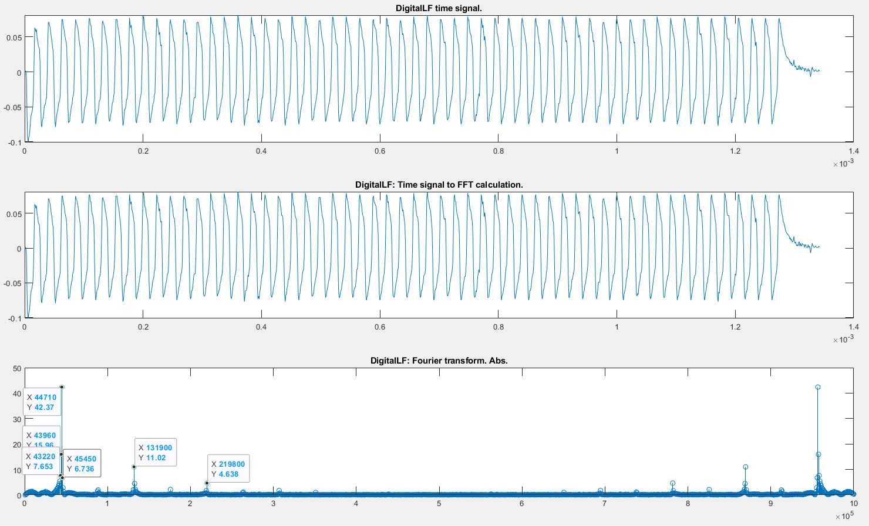
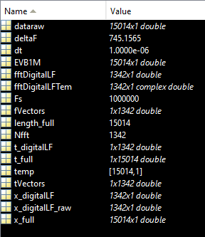
Digital LF
With ‘subtract mean’

Slide 10
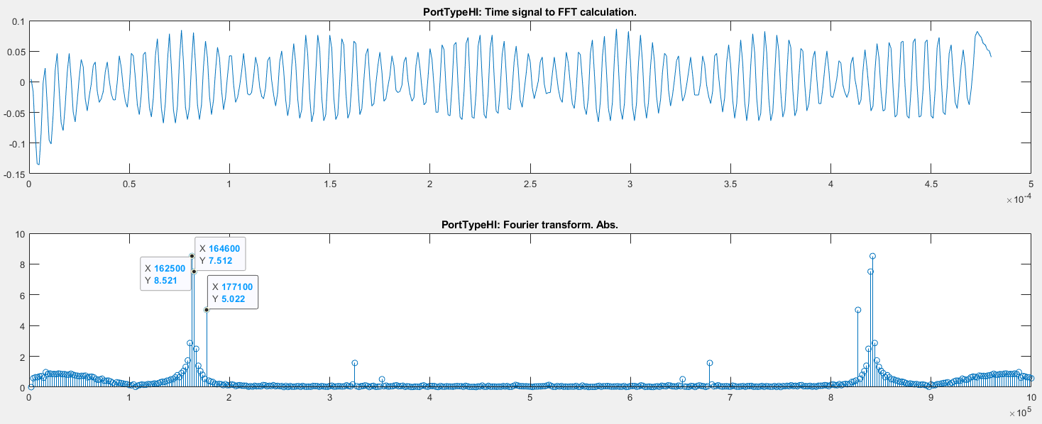
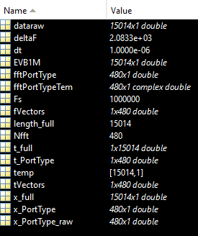
Port type HF
Tip port type
Ring port type

Slide 11
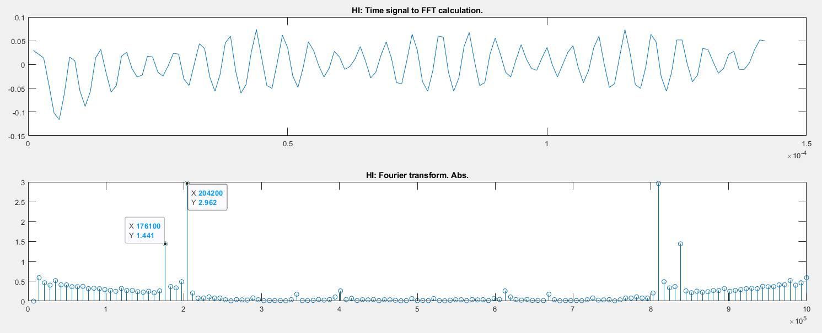
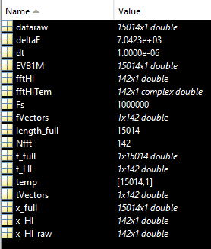
Port type HF
Hover
Ink

Slide 12
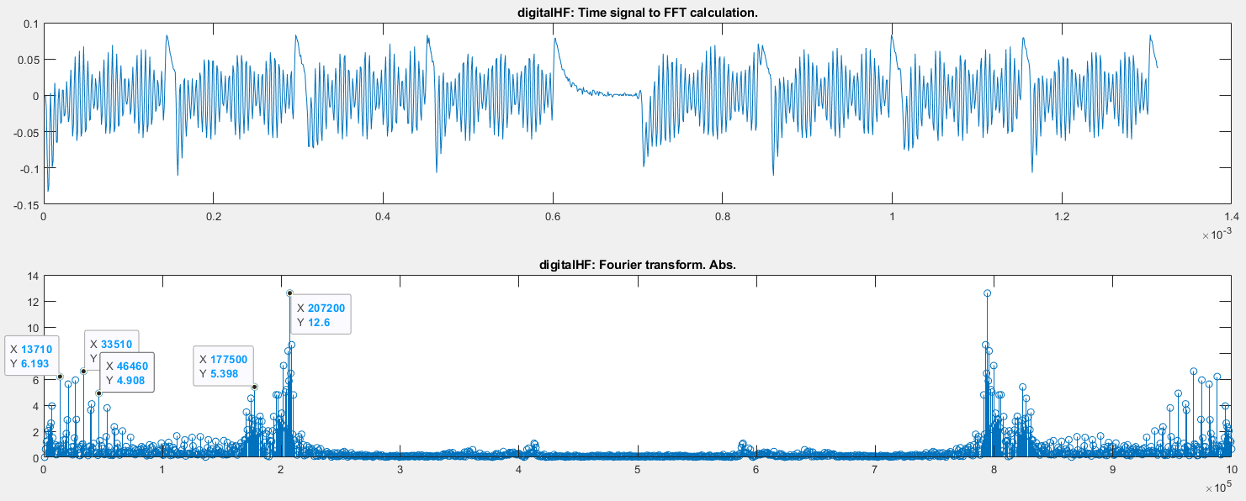
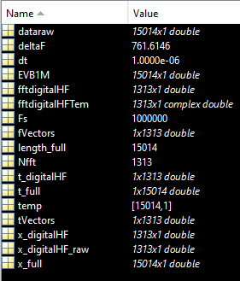
Digital HF
Full Digital HF part

Slide 13
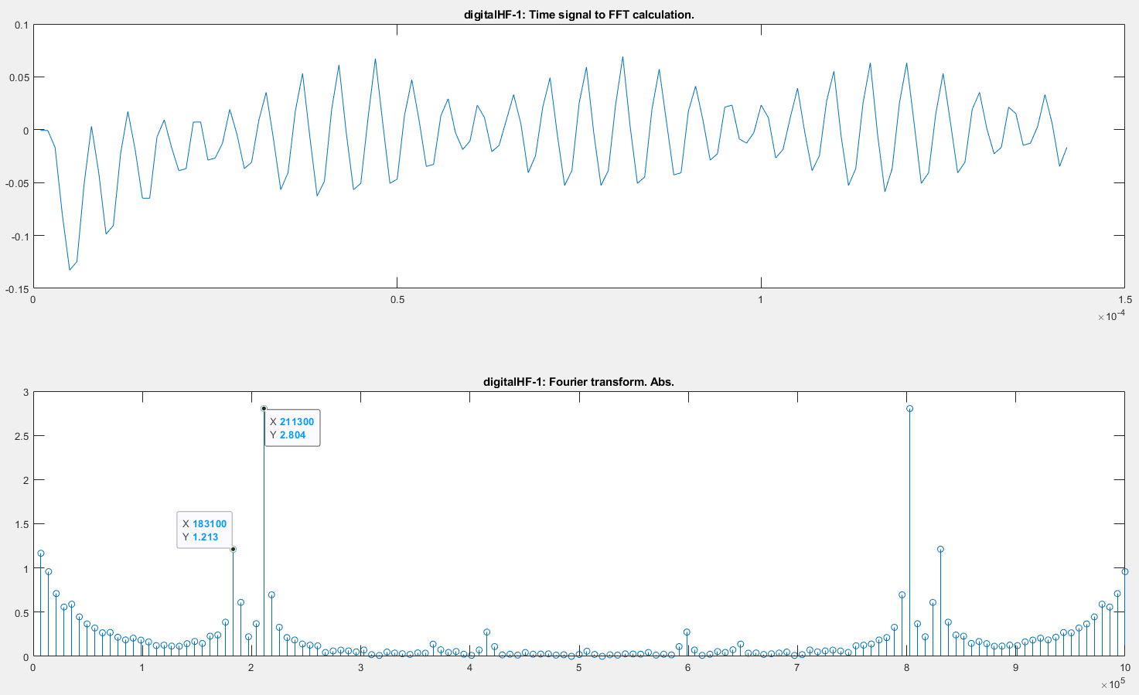
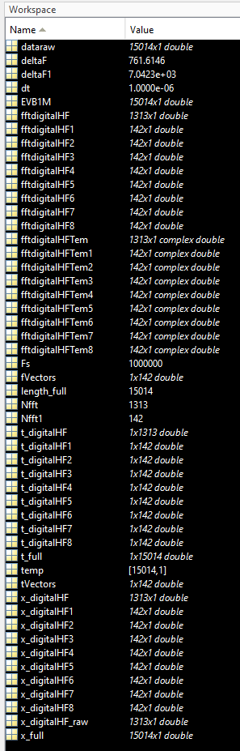
Digital HF
Bit symbol 1
Notes:
Simulation 142: OK. deltaF = 7042Hz
Checked 128: OK. deltaF = 7800Hz

Slide 14
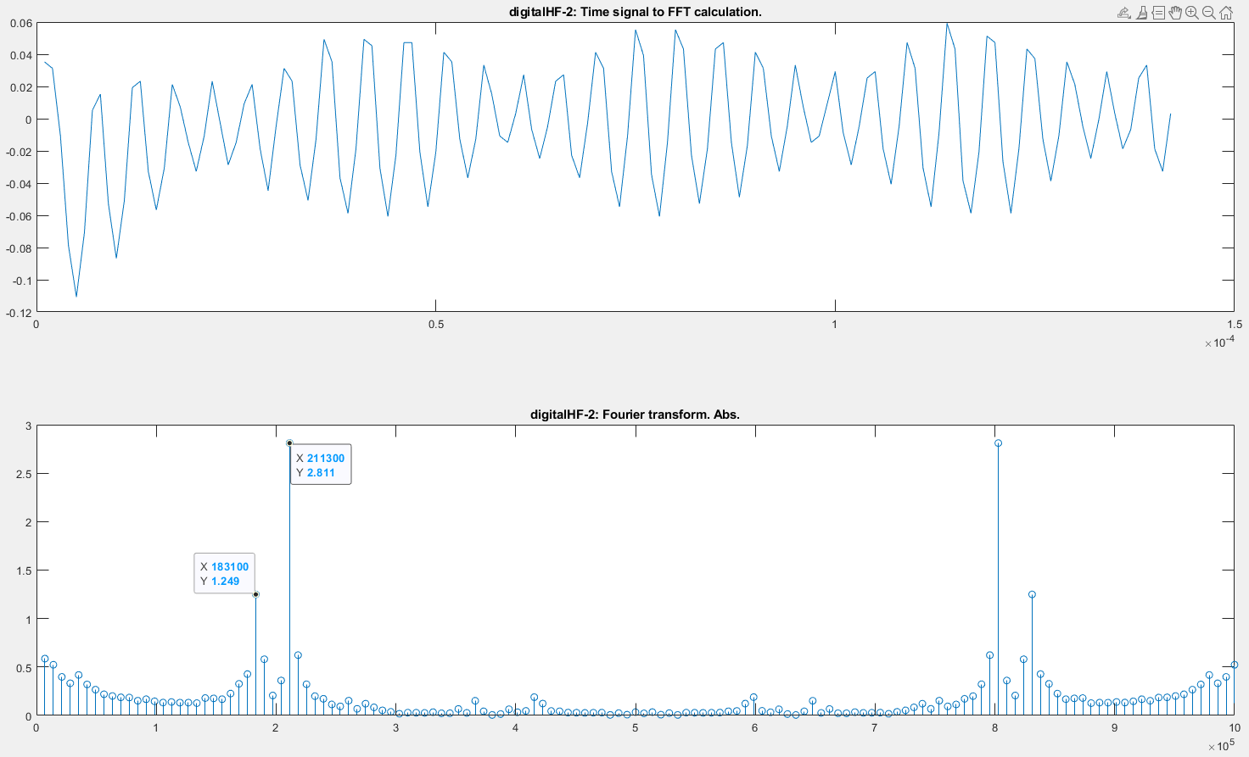
Digital HF
Bit symbol 2

Slide 15
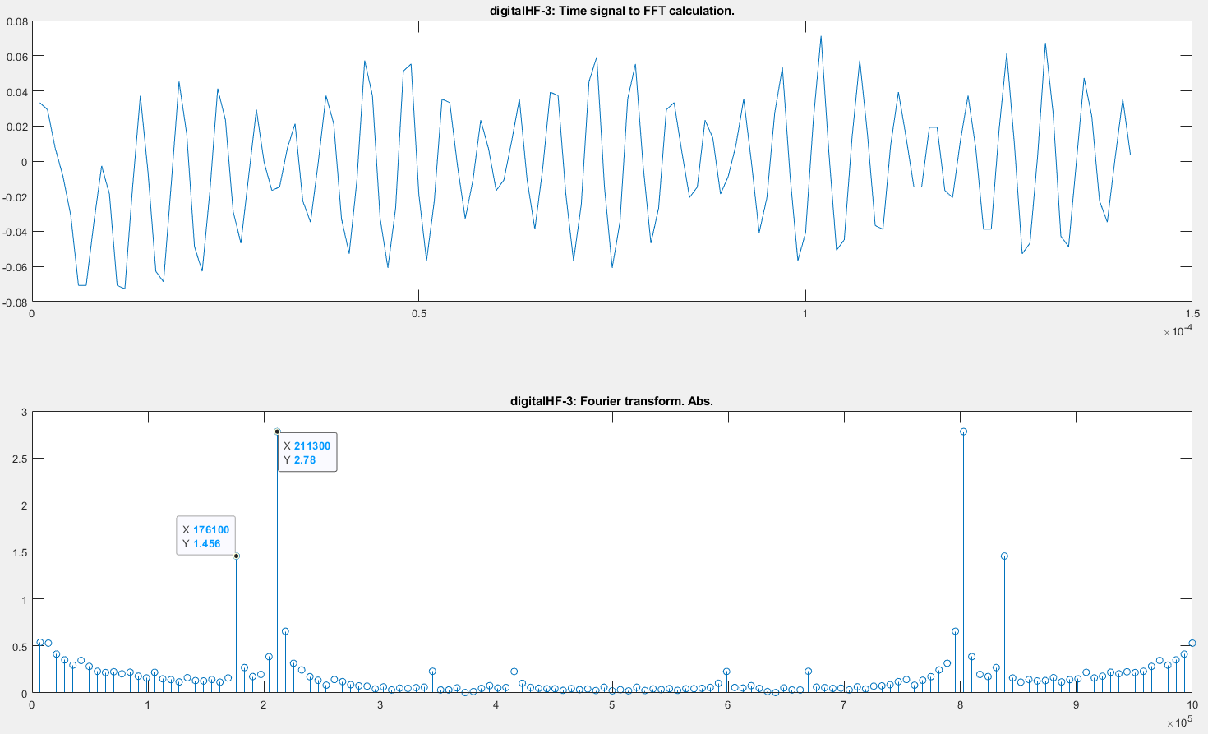
Digital HF
Bit symbol 3

Slide 16
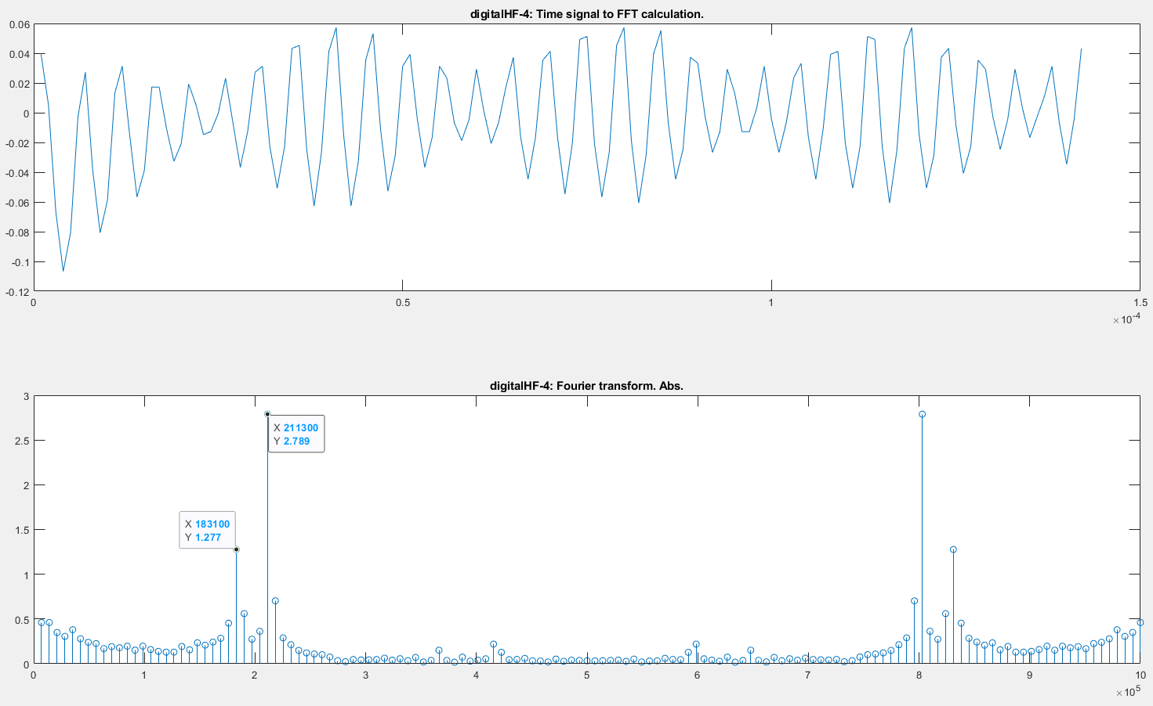
Digital HF
Bit symbol 4

Slide 17
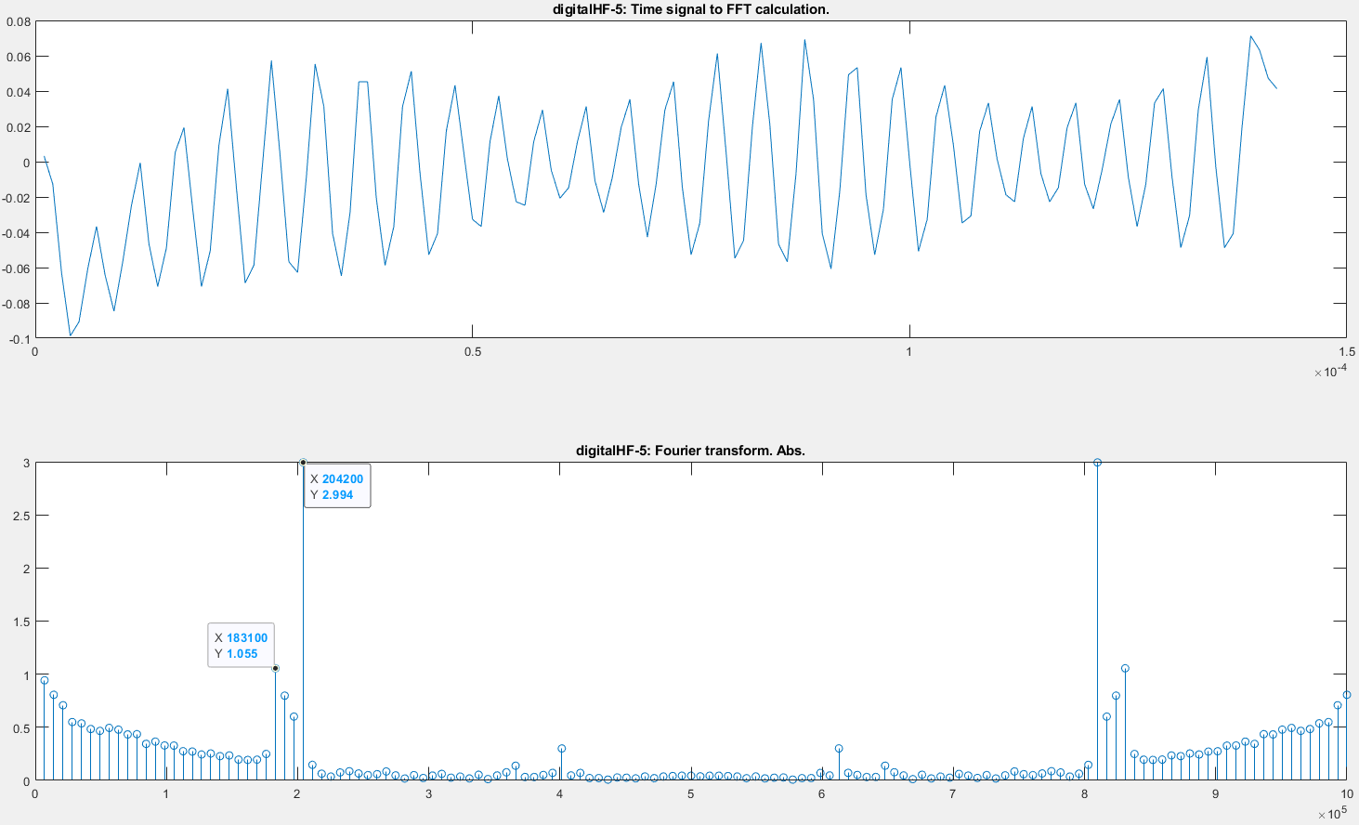
Digital HF
Bit symbol 5

Slide 18
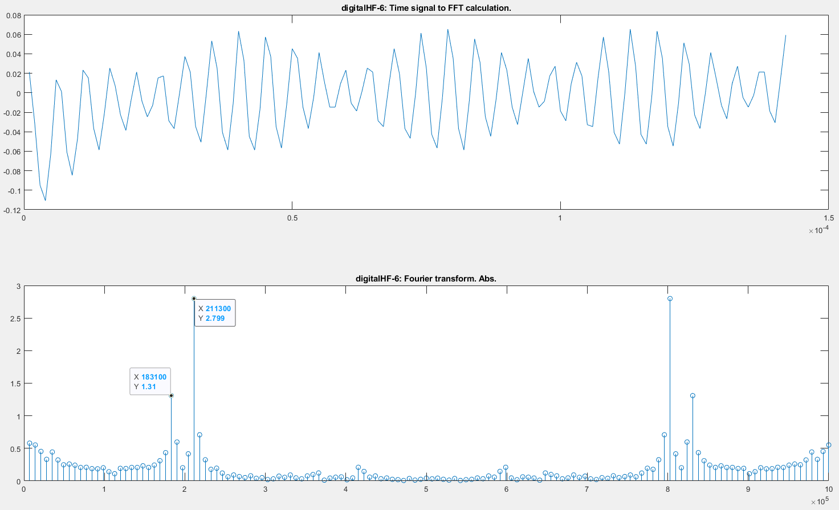
Digital HF
Bit symbol 6

Slide 19
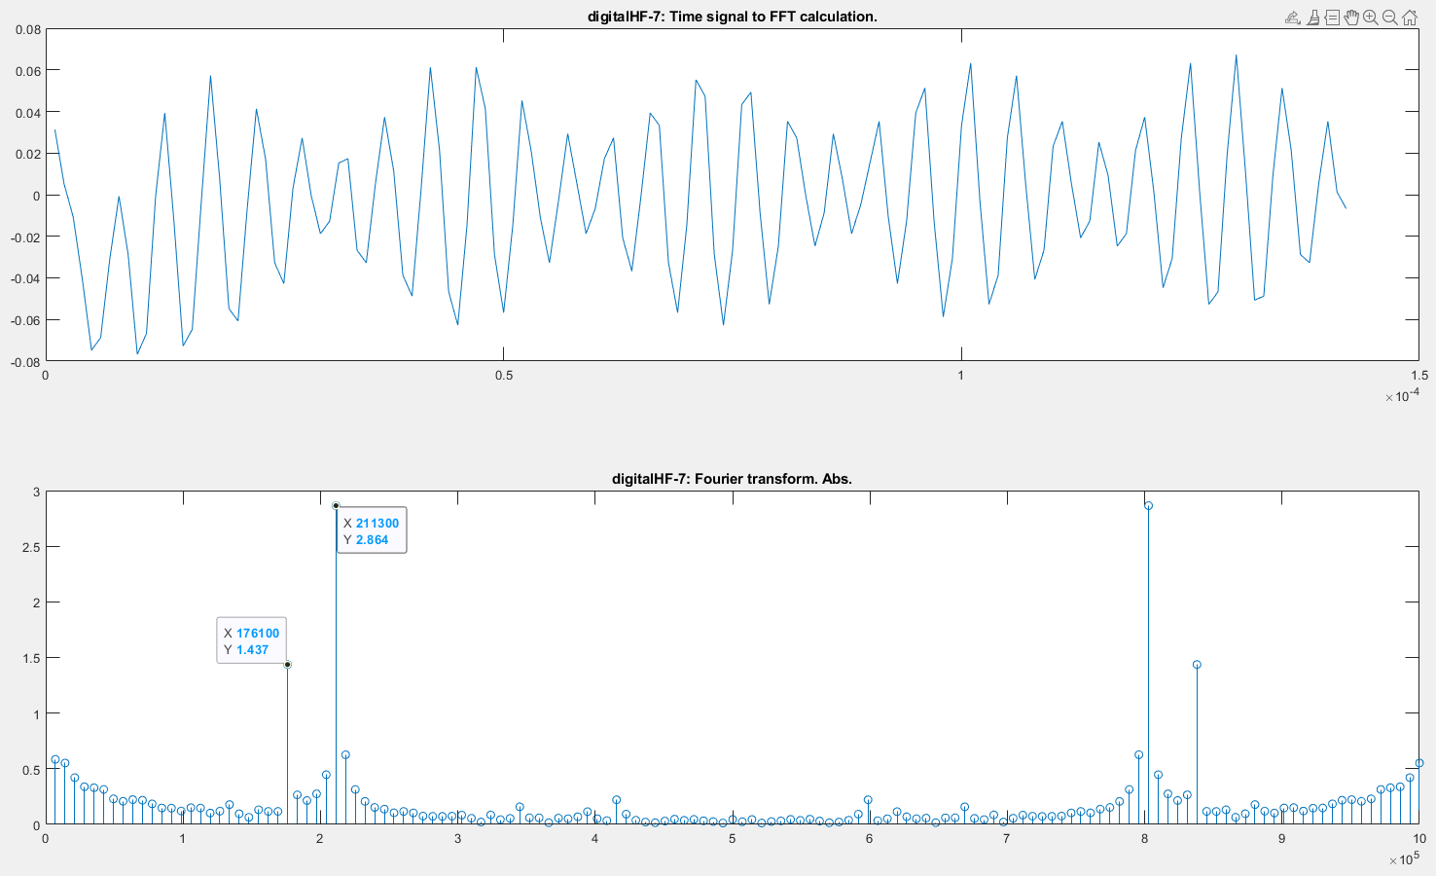
Digital HF
Bit symbol 7

Slide 20
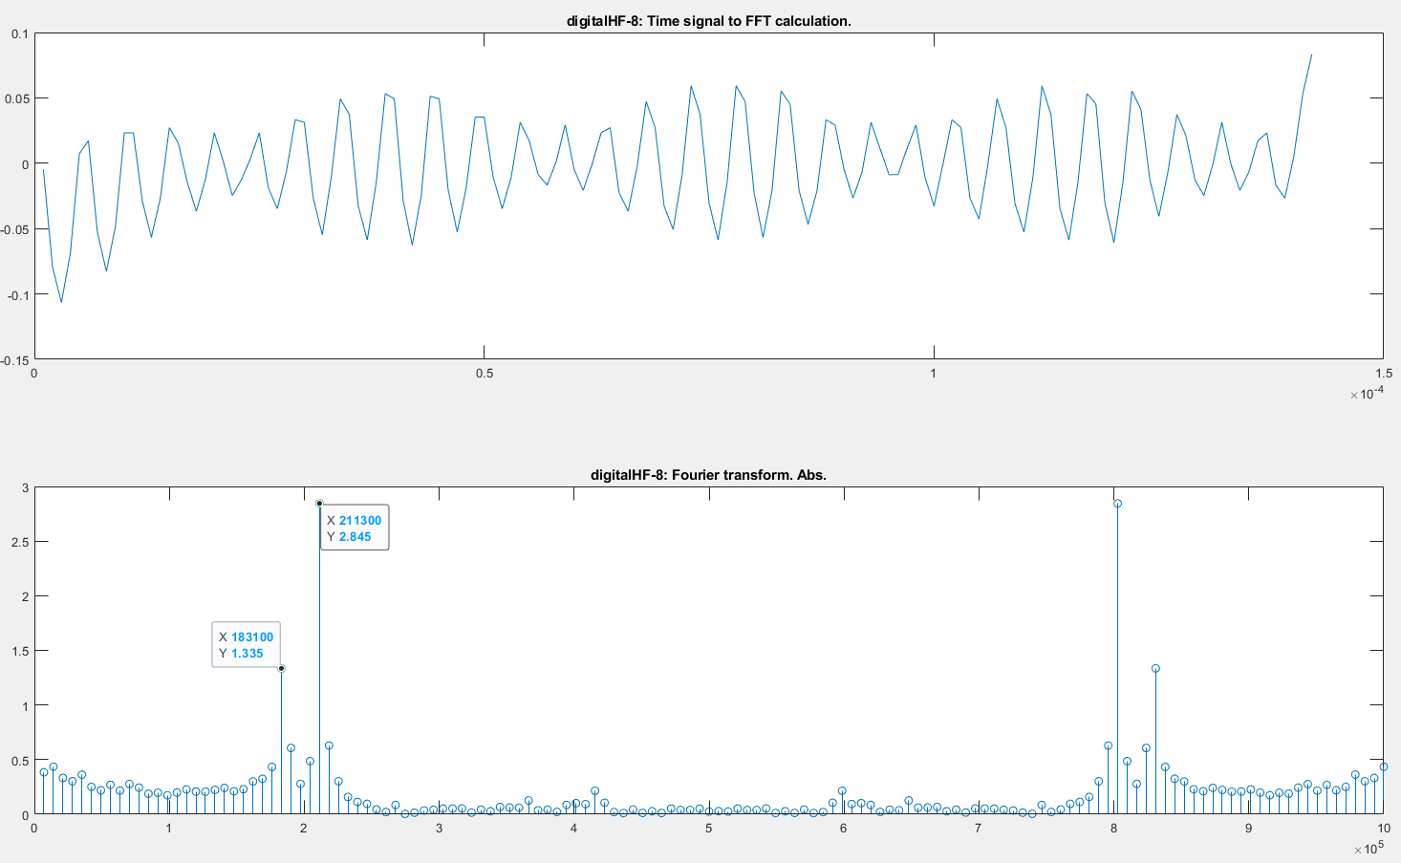
Digital HF
Bit symbol 8

Slide 21
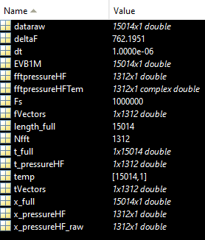
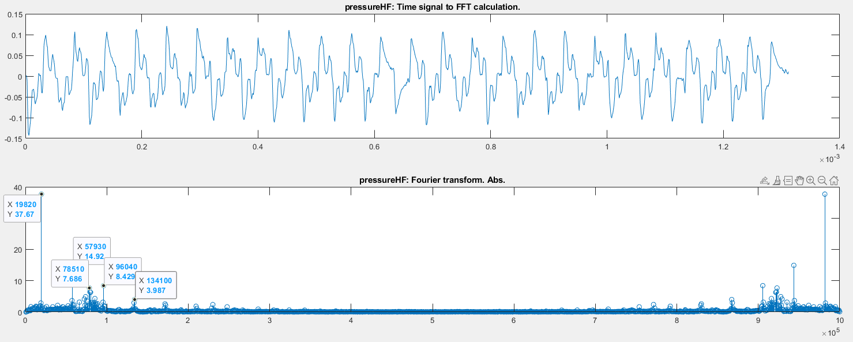
Pressure
Full pressure part

Slide 22
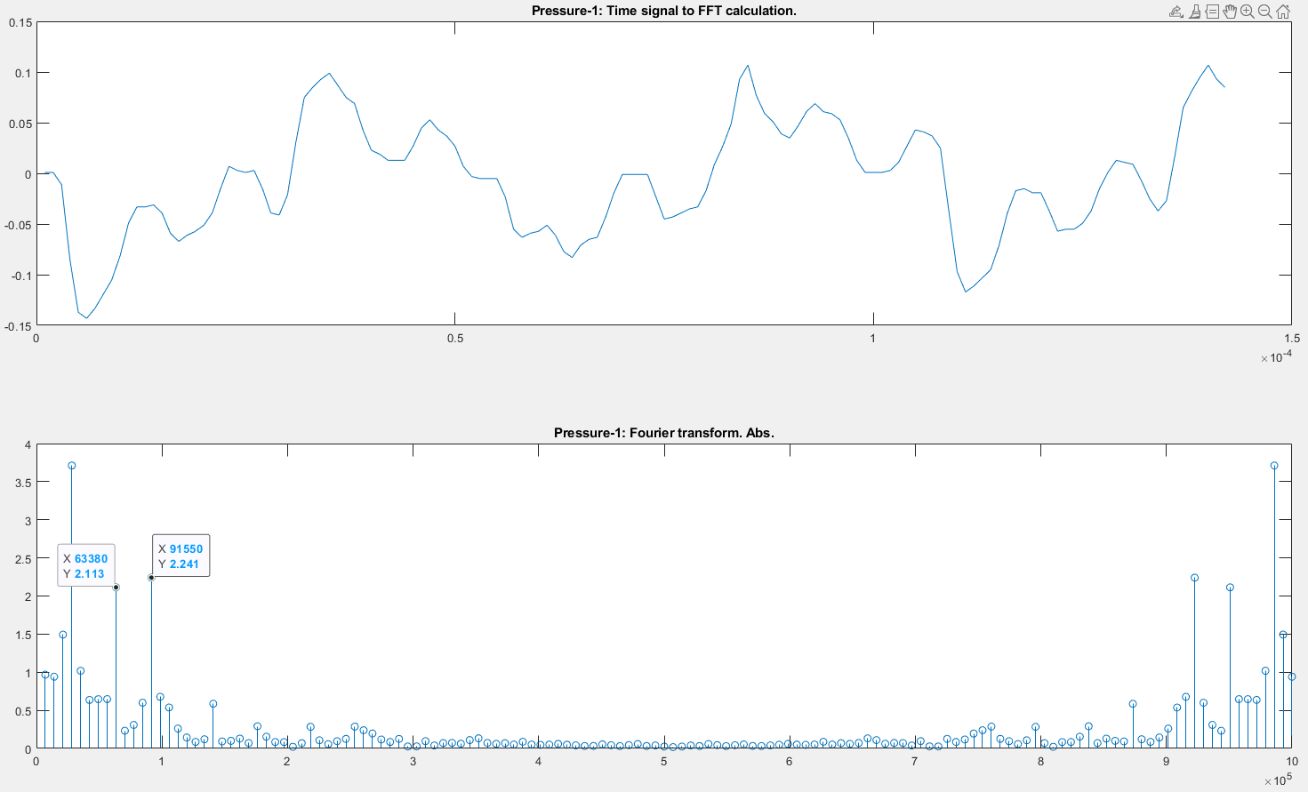
Pressure
Bit symbol 1

Slide 23
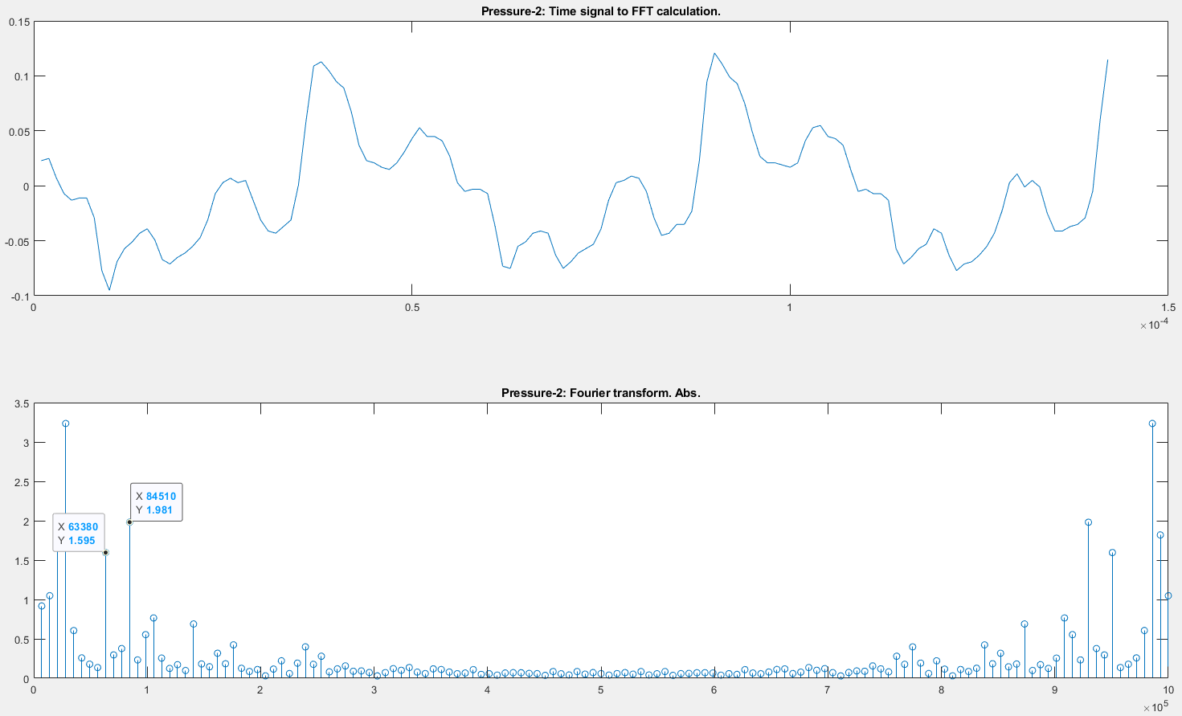
Pressure
Bit symbol 2

Slide 24
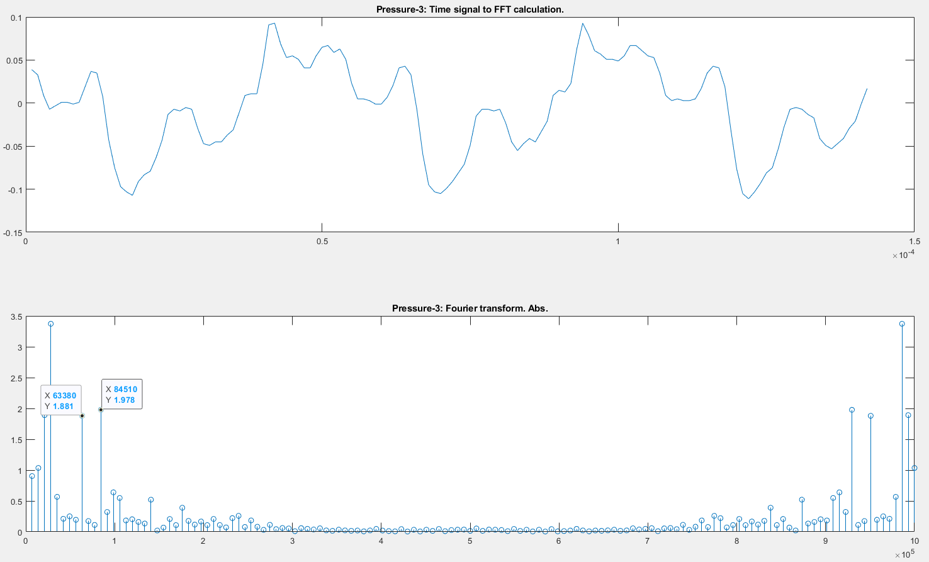
Pressure
Bit symbol 3

Slide 25
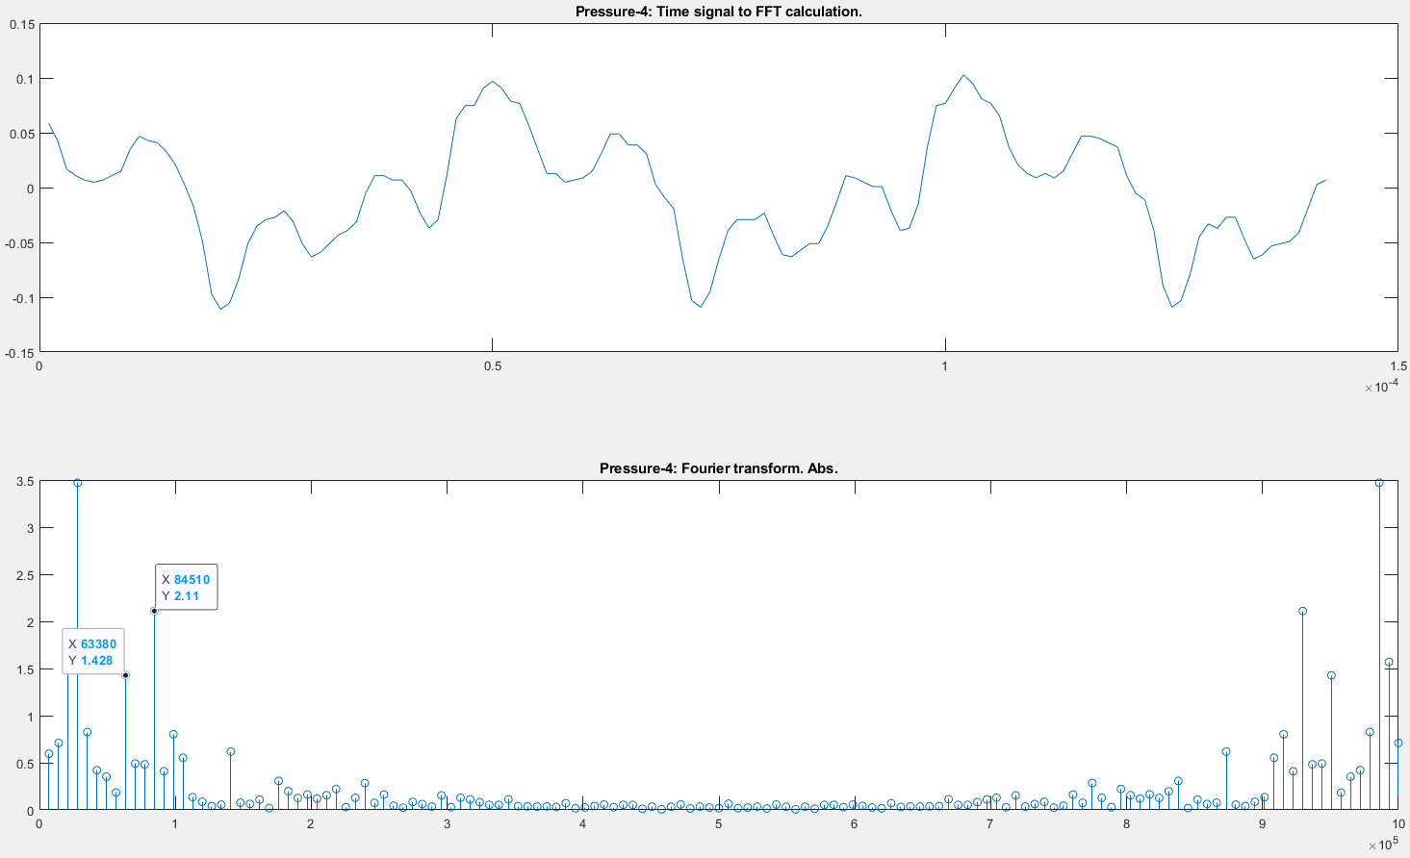
Pressure
Bit symbol 4

Slide 26
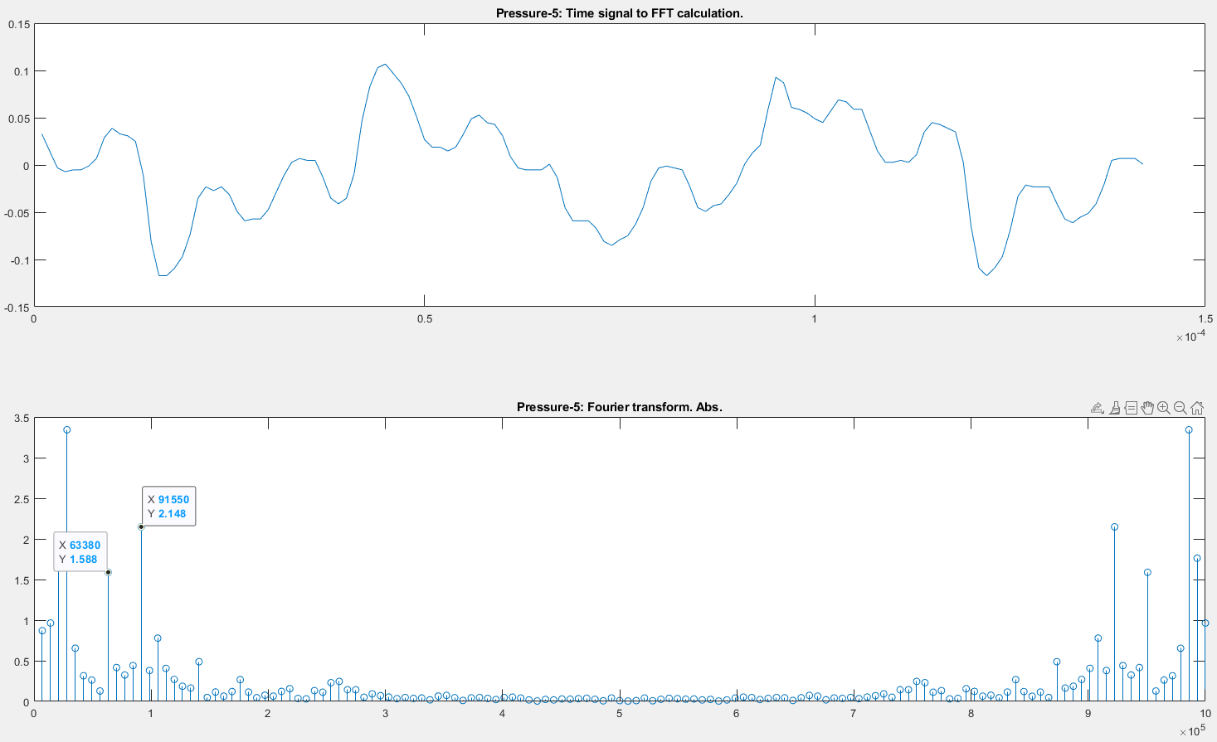
Pressure
Bit symbol 5

Slide 27
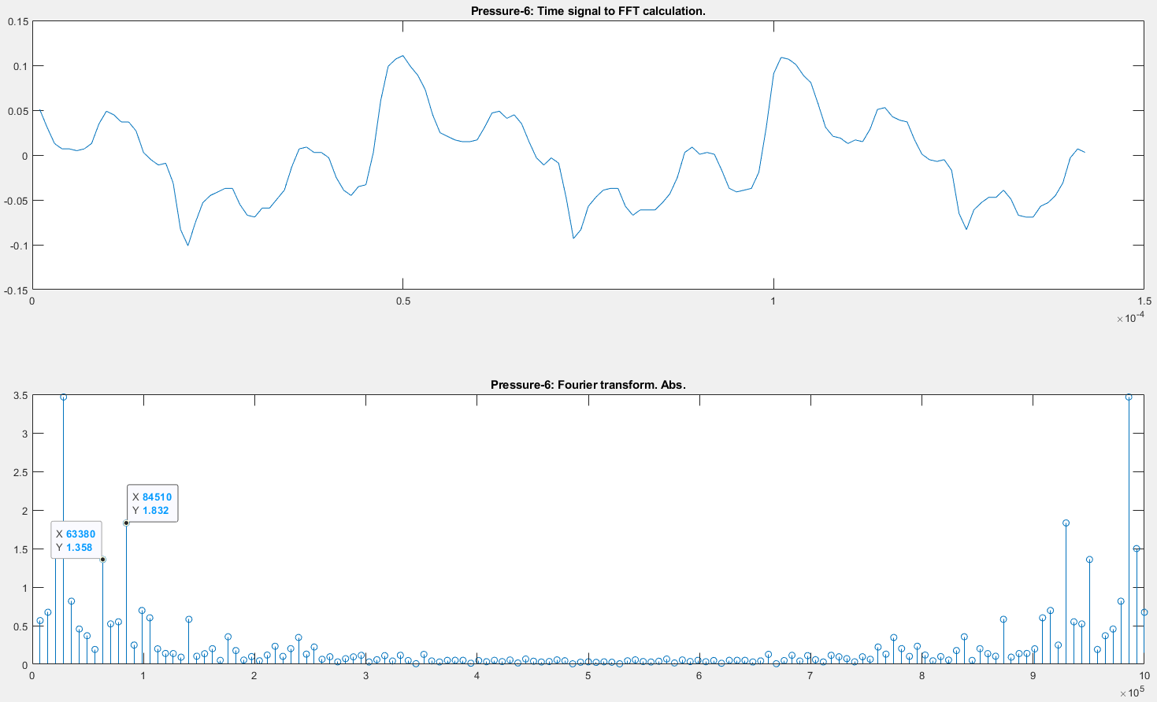
Pressure
Bit symbol 6

Slide 28
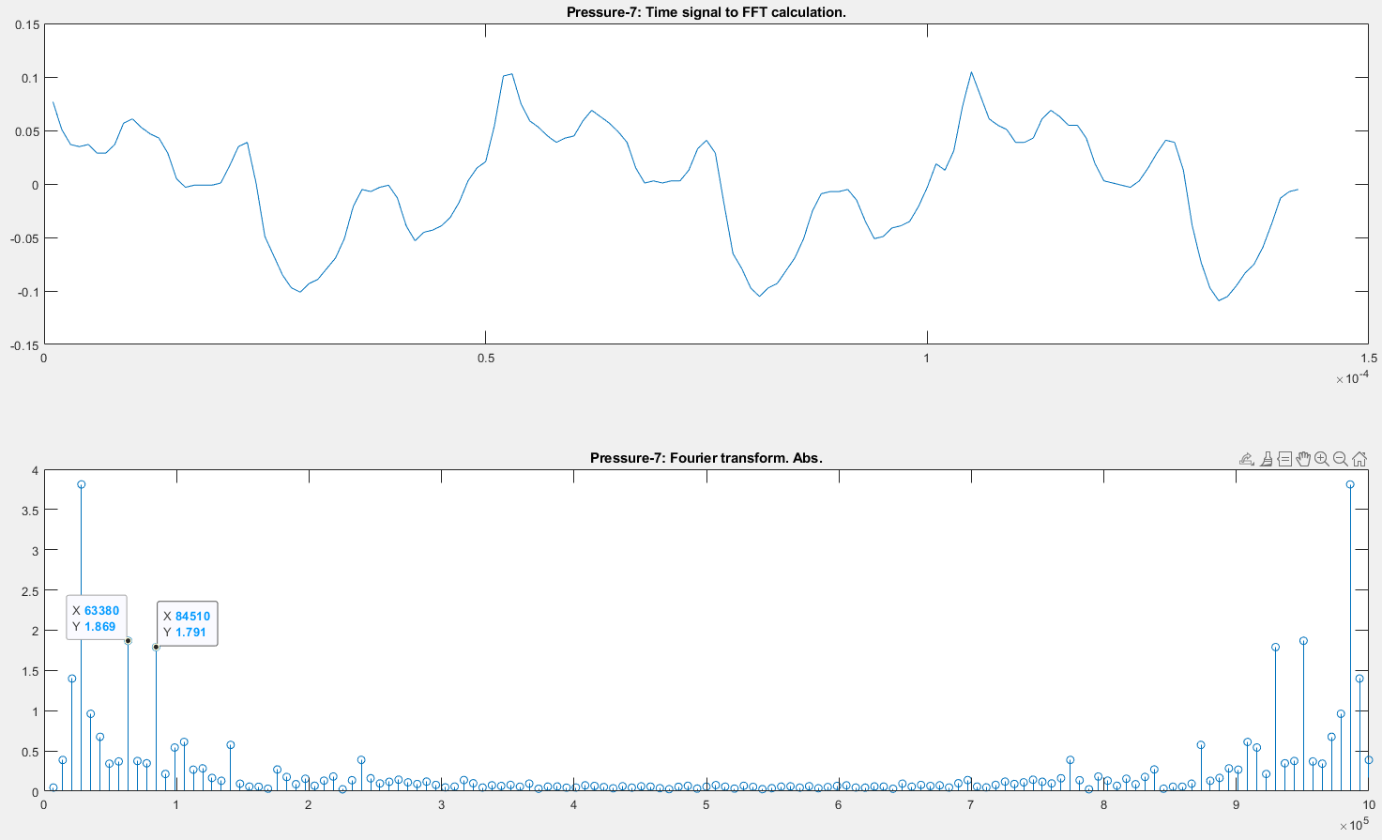
Pressure
Bit symbol 7

Slide 29
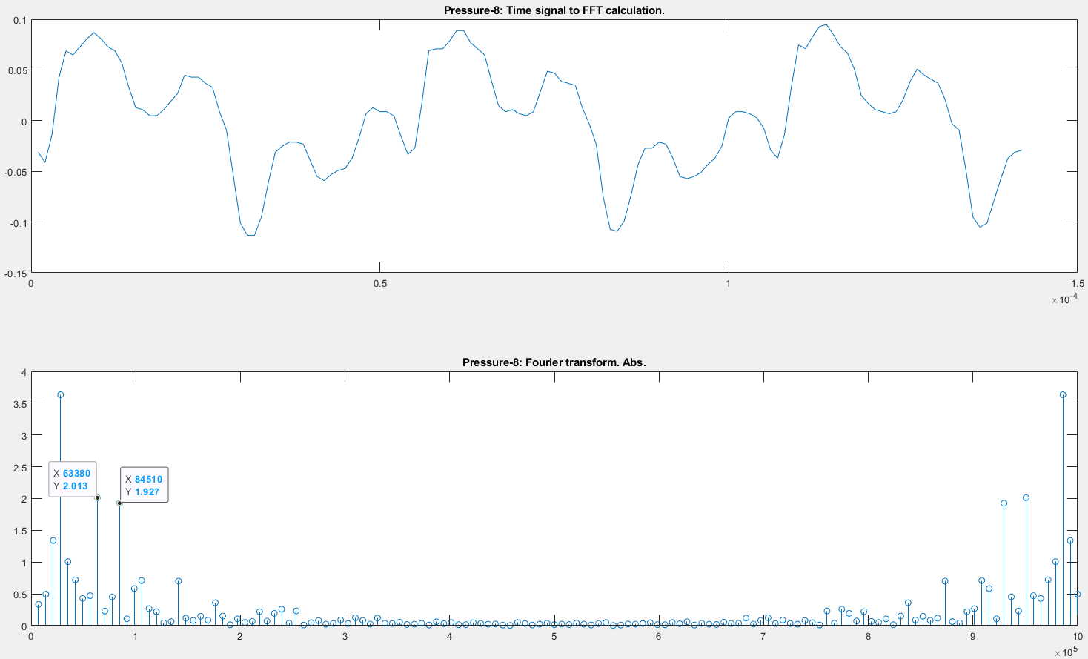
Pressure
Bit symbol 8

Slide 30
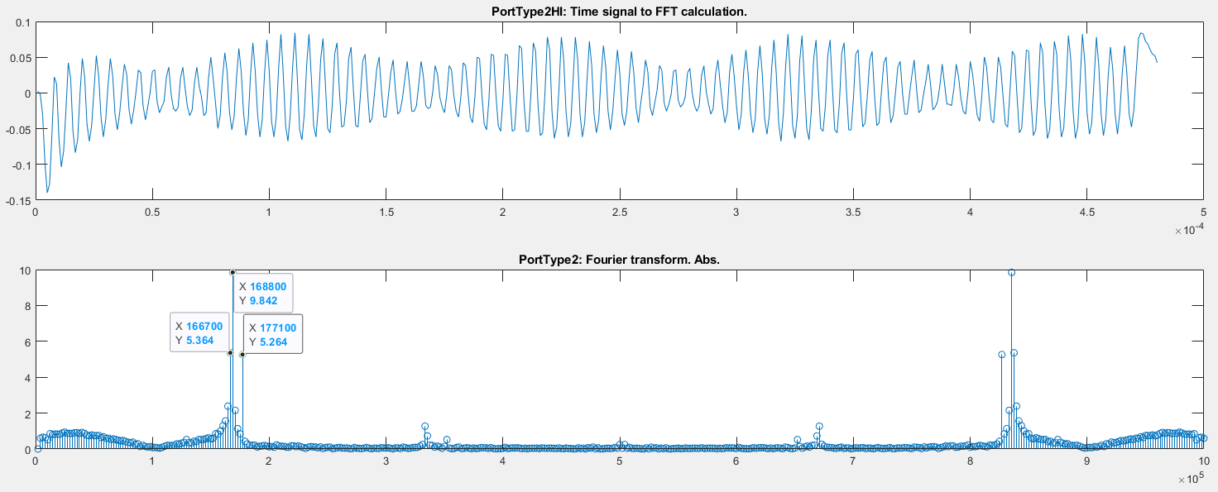
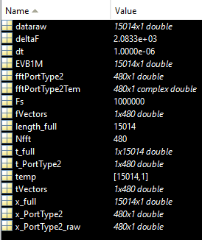
Port type HF 2
Tip port type
Ring port type

Slide 31
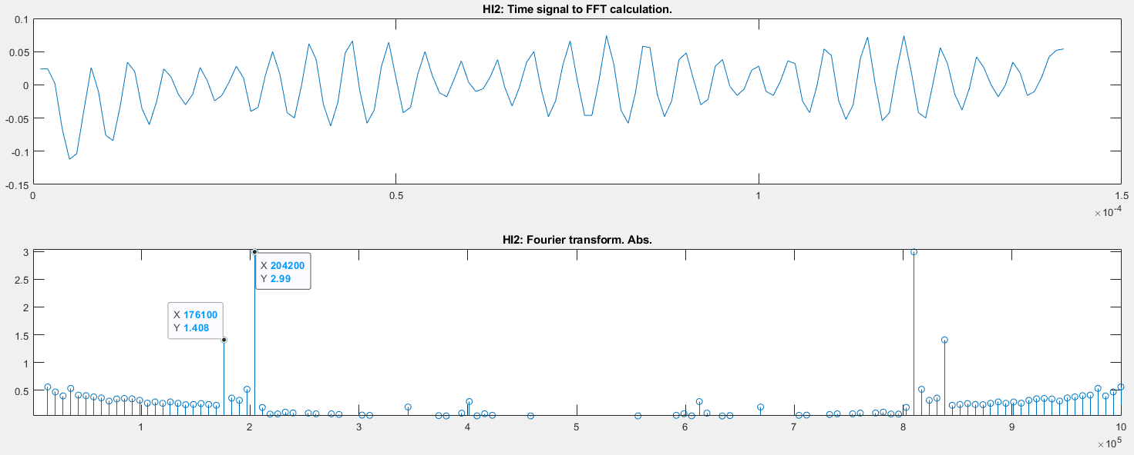
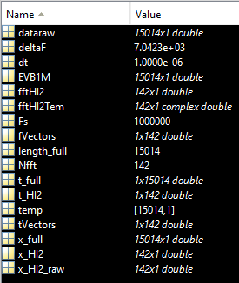
Port type HF 2
Hover
Ink

