Slide 1
ADC output data reconstruction and FFT analyzation
Flying-Fish
Ver.01
IC 개발실, SoC, mducng
2021. 02. 06.

Slide 2
ADC output
Data processing
Signal reconstruction and FFT

Slide 3
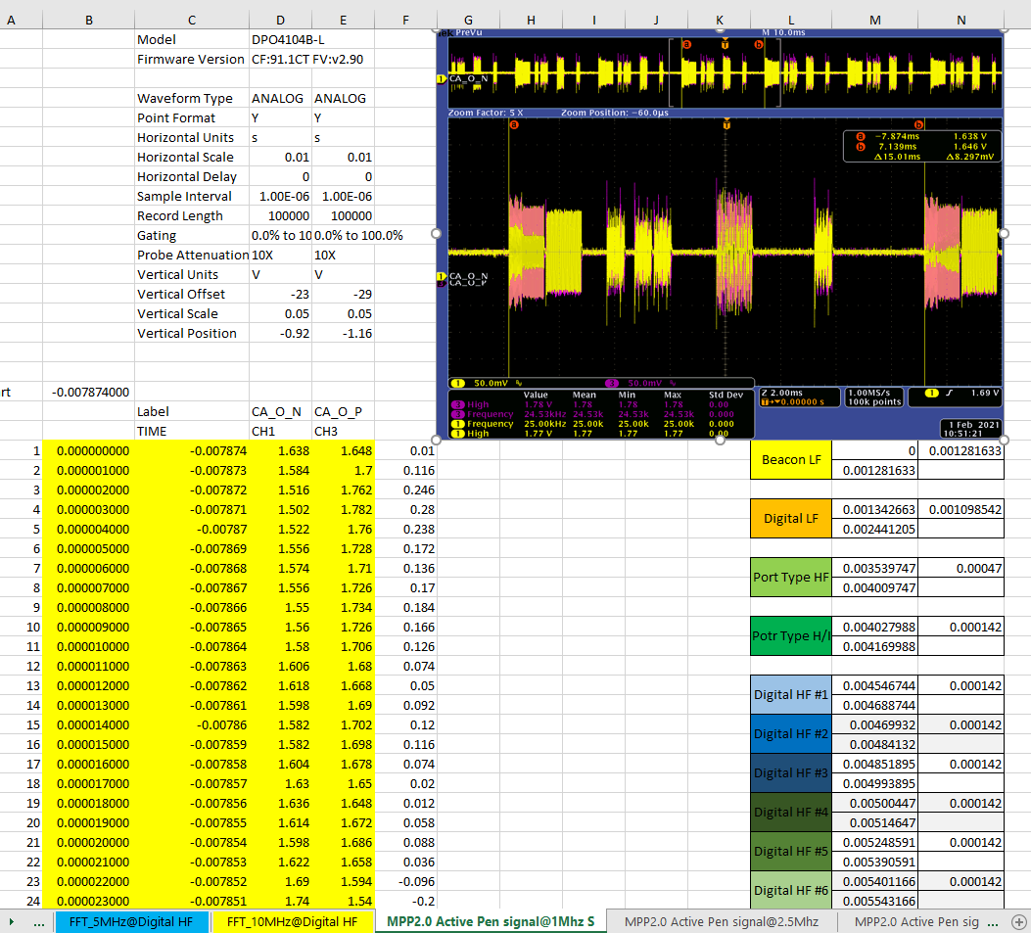
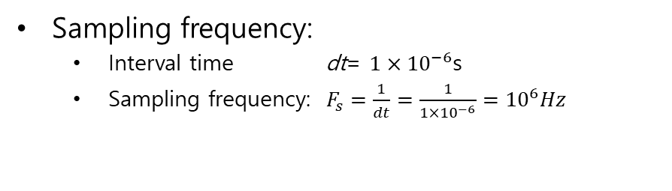
ADC output data
Sampling frequency:
Interval time dt= $1×{10}^{−6}$s
Sampling frequency: $F_{s}=\frac{1}{dt}=\frac{1}{1×{10}^{−6}}={10}^{6}Hz$
ADC outputs
from 송혁재 수석님
http://192.168.10.74:8090/x/c4FdAQ

Slide 4
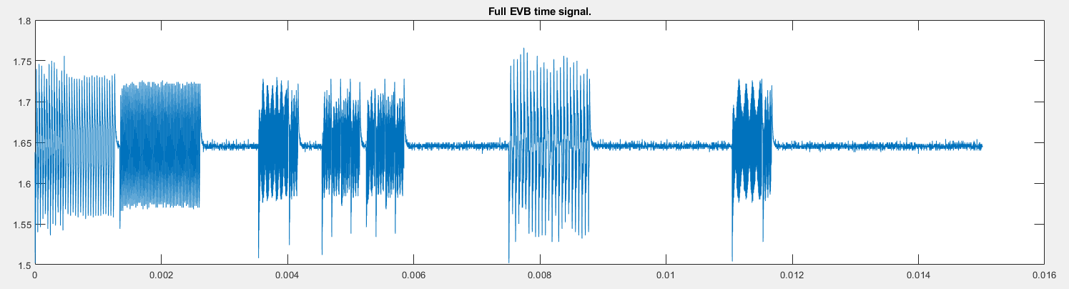
ADC output data
Reconstruct data
ADC outputs
from 송혁재 수석님
http://192.168.10.74:8090/x/c4FdAQ

Slide 5
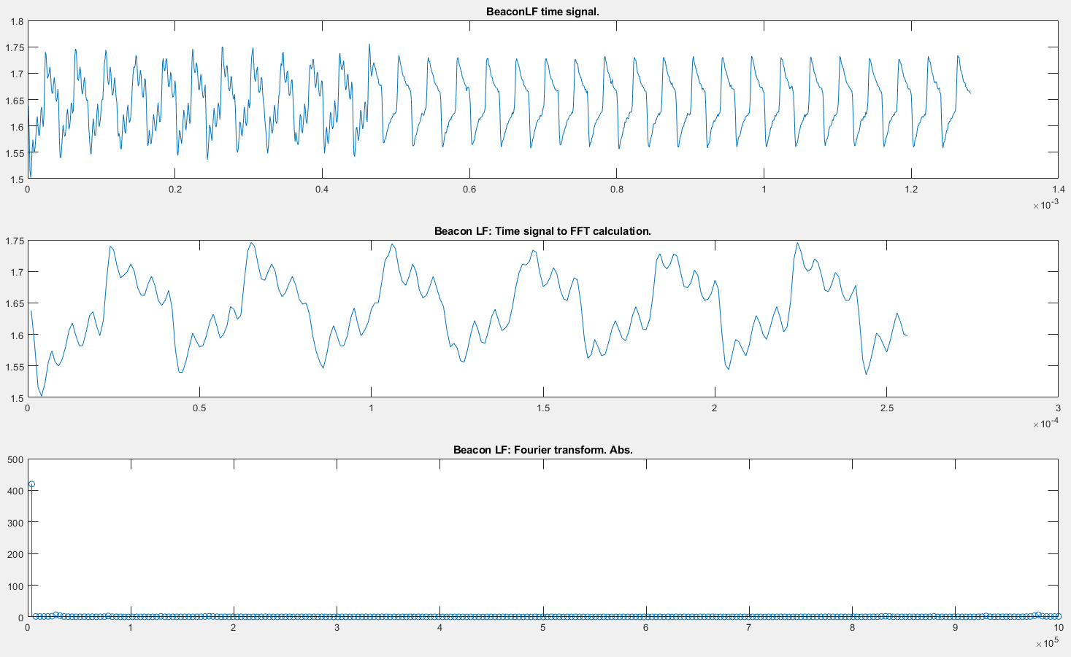
Signal reconstruction and FFT
Without ‘subtract mean’

Slide 6
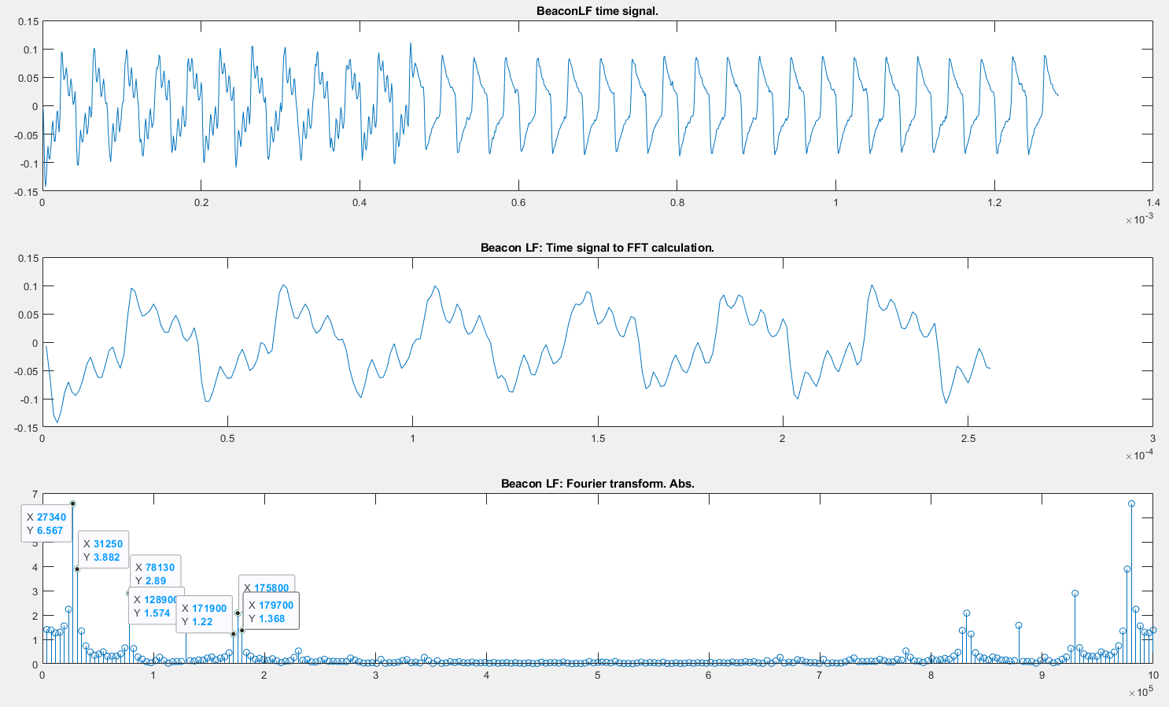
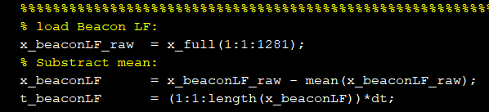
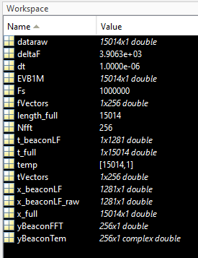
Signal reconstruction and FFT
With ‘subtract mean’

Slide 7
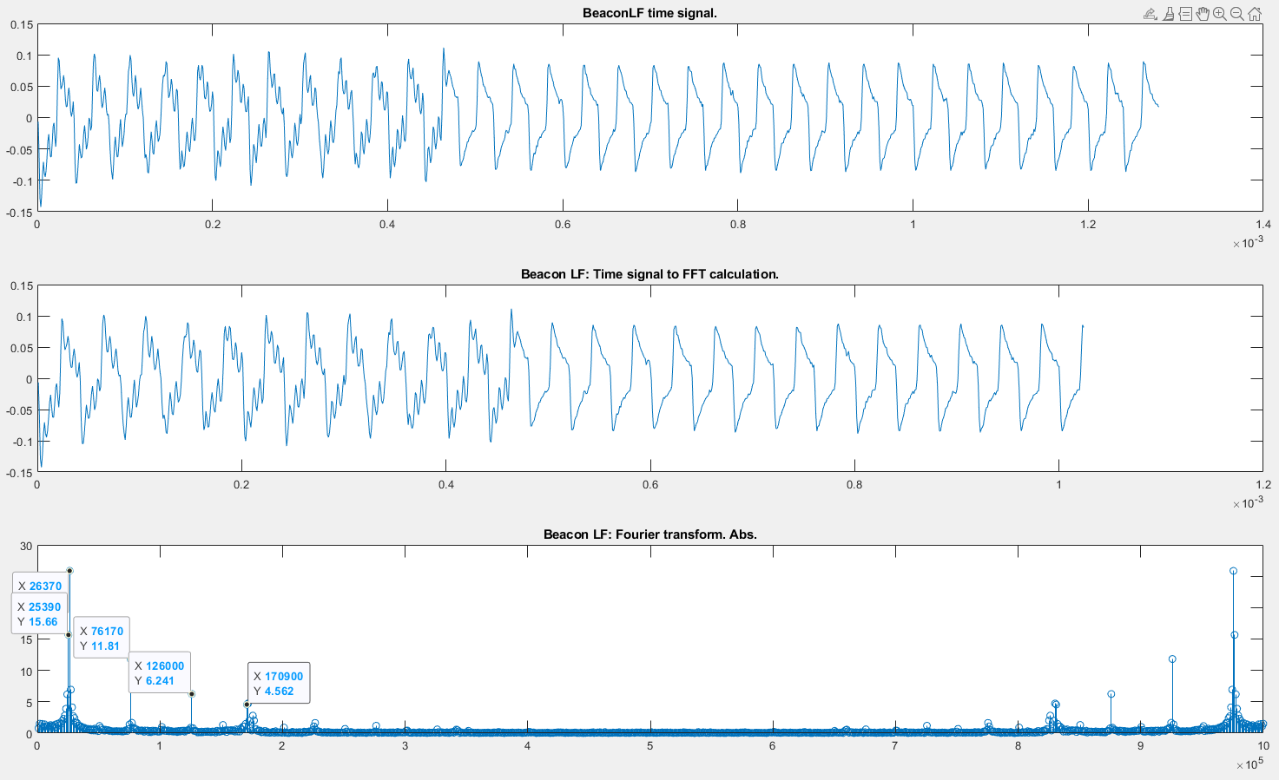
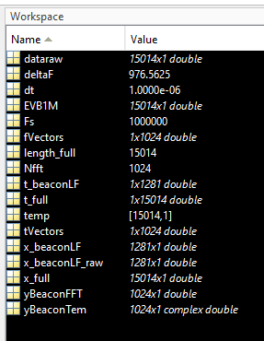
Signal reconstruction and FFT
With ‘subtract mean’

Slide 8
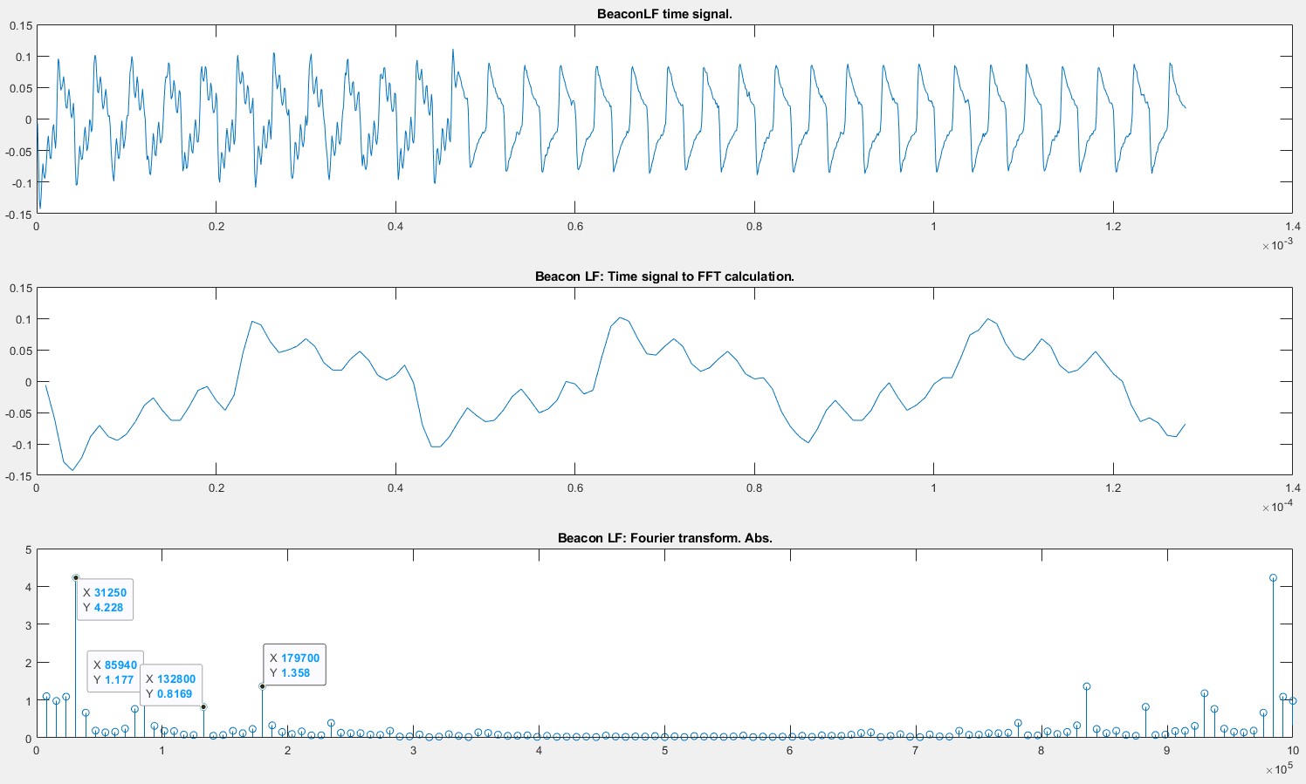
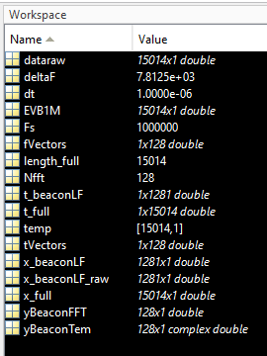
Signal reconstruction and FFT
With ‘subtract mean’

