Slide 1
Evaluation board
SNR calculation
Flying-Fish
Ver.01
IC 개발실
2021. 01. 25.

Slide 2
SNR definition

Slide 3

SNR definition
SNR: Signal-to-noise ratio $SNR=\frac{P_{signal}}{P_{noise}}$
SNR equation decibels (dB): $r=10\log_{10}\left(\frac{\sum_{i=1}^{n}{x_{i}^{2}}}{\sum_{i=1}^{n}{n_{i}^{2}}}\right)$
where x: signal, n: noise,
In MATLAB: $r = snr(x,n)$
Notes:
https://en.wikipedia.org/wiki/Signal-to-noise_ratio
https://www.mathworks.com/help/signal/ref/snr.html
https://www.mathworks.com/matlabcentral/answers/717213-signal-to-noise-ratio-snr

Slide 4
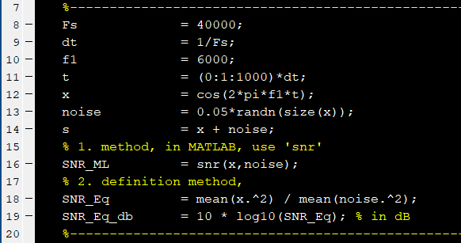
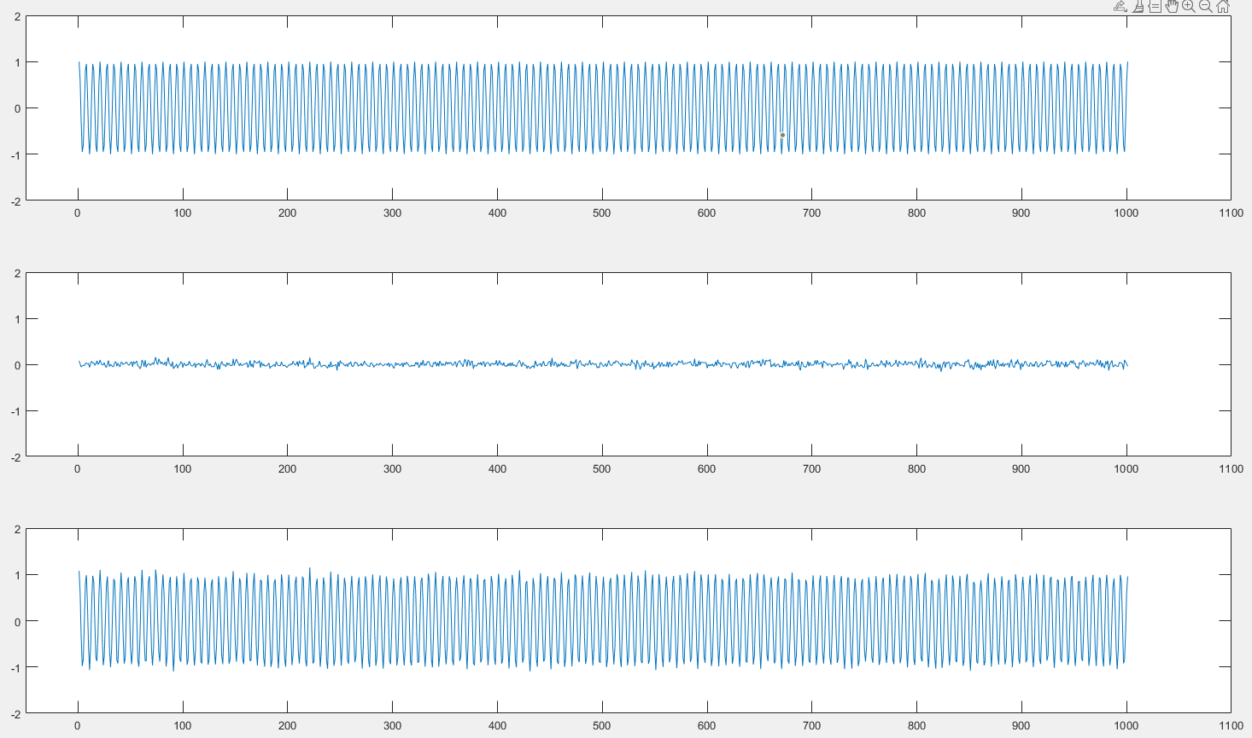

SNR definition
Example 1:

Slide 5
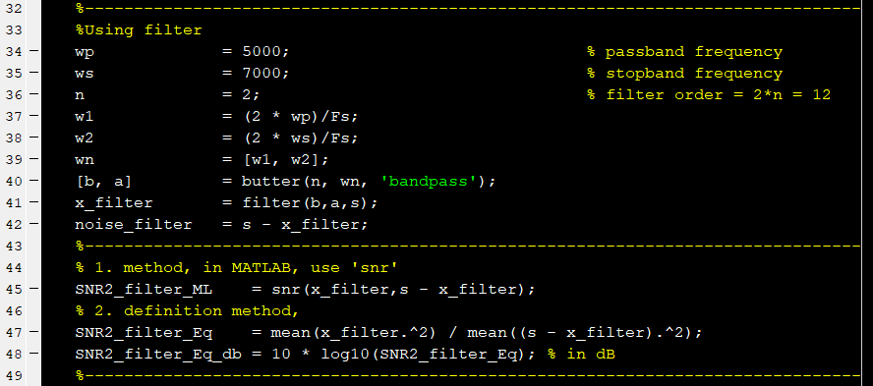
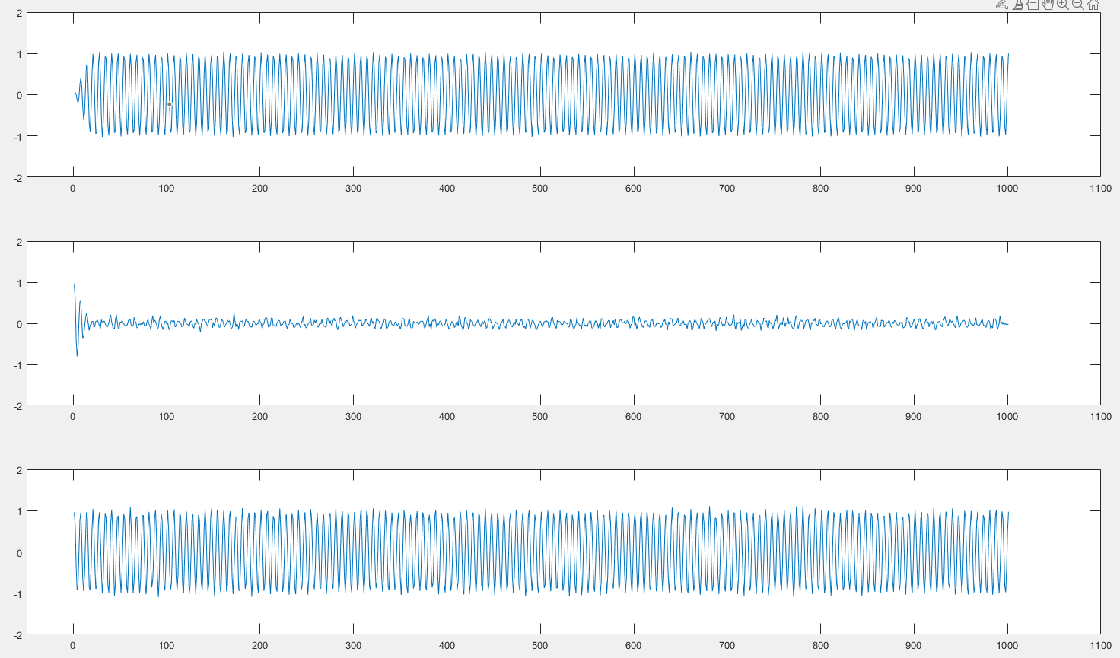

SNR definition
Example 2:

