Slide 1
Evaluation board
SNR calculation
Flying-Fish
Ver.01
SoC, mducng
2021. 03. 17.

Slide 2
SNR definition
SNR calculation for EVB

Slide 3

SNR definition
SNR: Signal-to-noise ratio $SNR=\frac{P_{signal}}{P_{noise}}$
SNR equation decibels (dB): $r=10\log_{10}\left(\frac{\sum_{i=1}^{n}{x_{i}^{2}}}{\sum_{i=1}^{n}{n_{i}^{2}}}\right)$
where x: signal, n: noise,
In MATLAB: $r = snr(x,n)$
Notes:
https://en.wikipedia.org/wiki/Signal-to-noise_ratio
https://www.mathworks.com/help/signal/ref/snr.html
https://www.mathworks.com/matlabcentral/answers/717213-signal-to-noise-ratio-snr

Slide 4
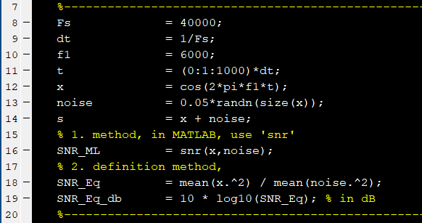
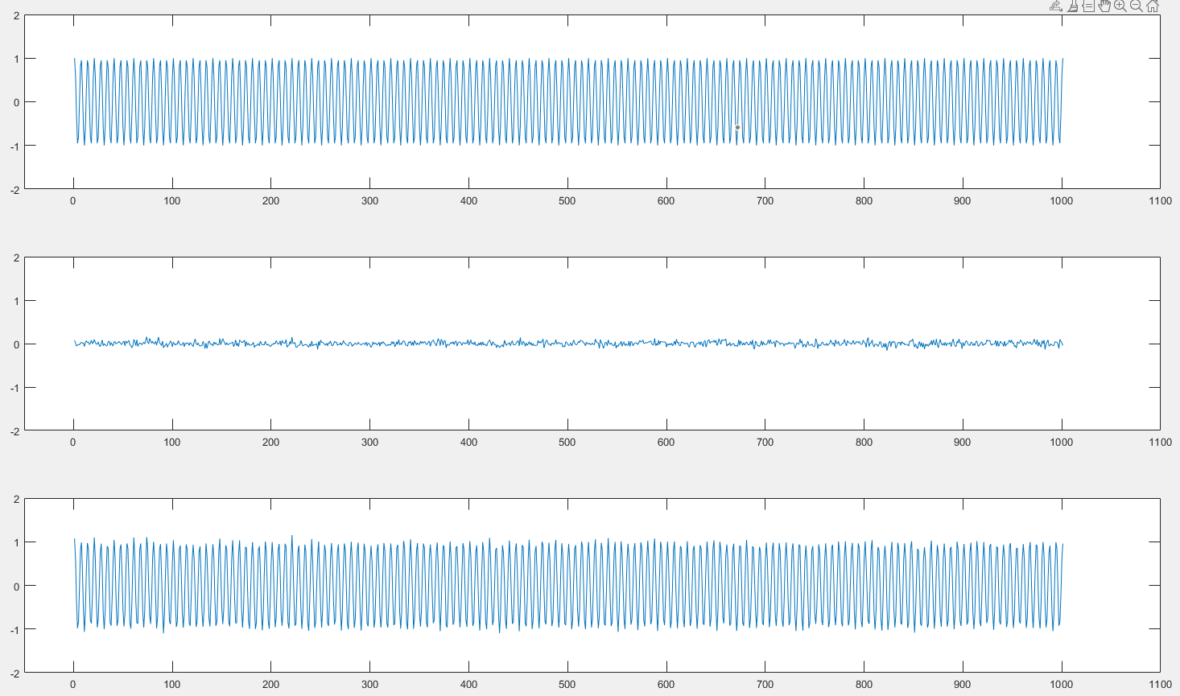

SNR definition
Example 1: a simple example with pre-defined noise and signal

Slide 5
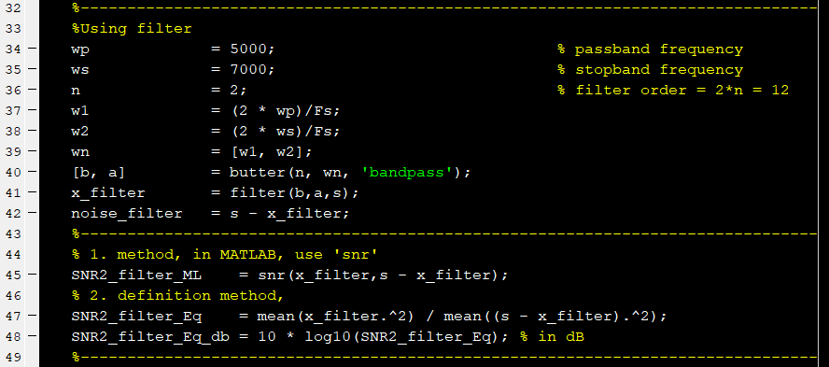
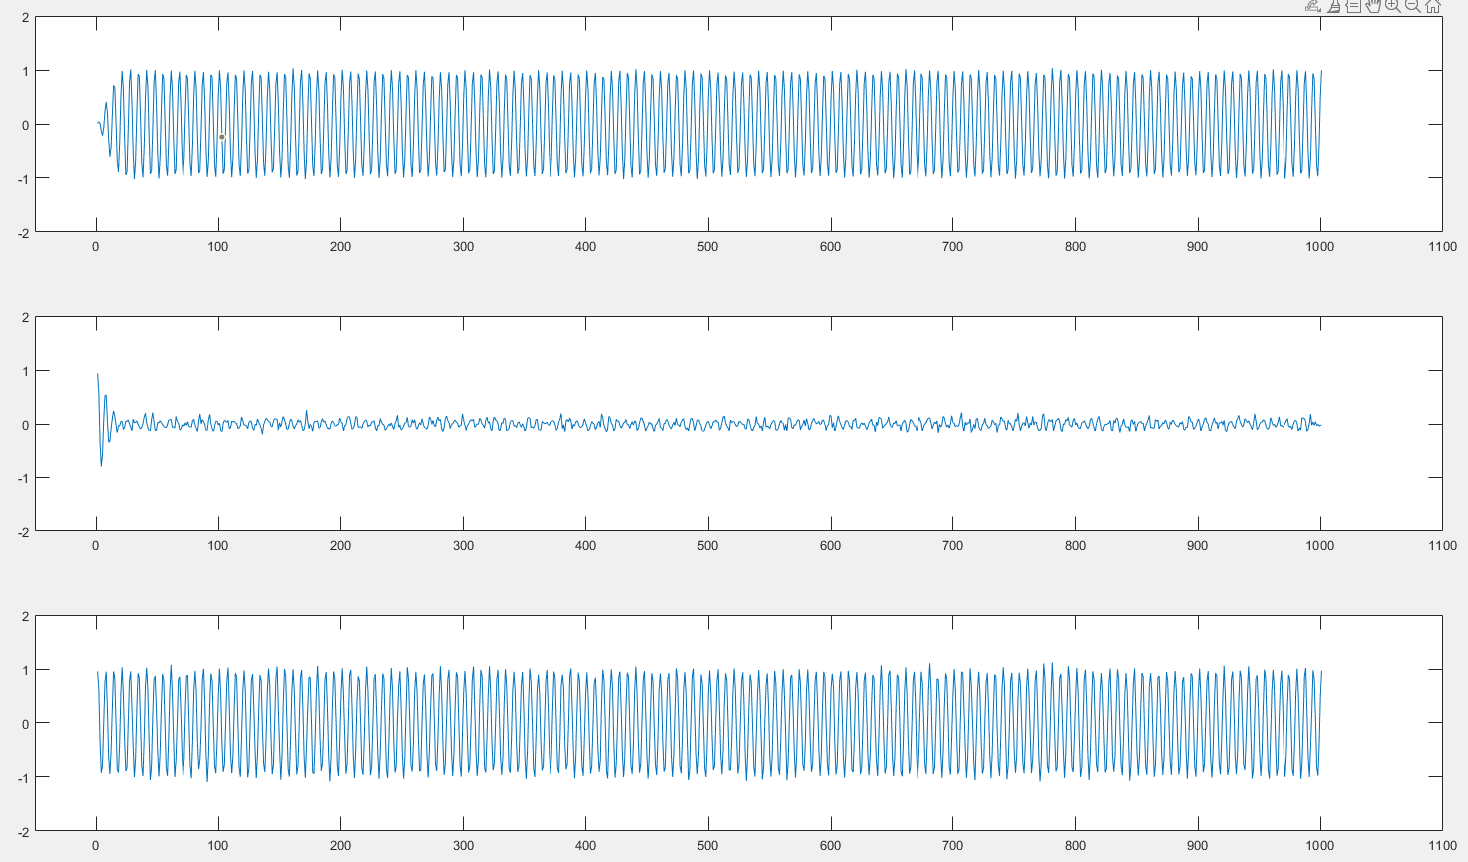

SNR definition
Example 2: using filter to estimate noise and signal

Slide 6
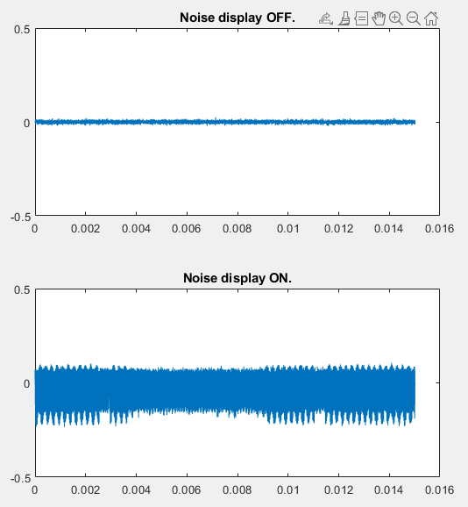

SNR calculation for EVB
In EVB
  Noise already know by measurement
  Noise display OFF
  Noise display ON
The method to calculate SNR:
  $$SNR_s = snr(s−n,n)$$

Slide 7
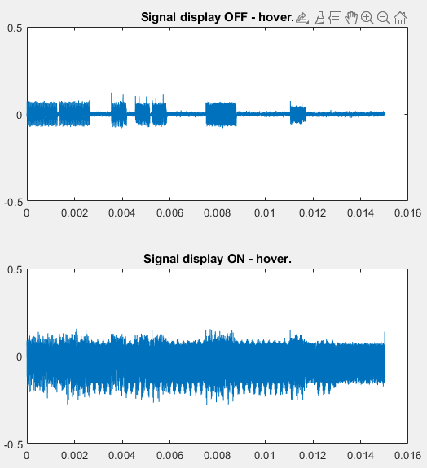
SNR calculation for EVB
Signal display OFF- hover mode
Signal display ON- hover mode
Display OFF-hover | Display ON-hover
12.7423dB | 3.0764dB

Slide 8
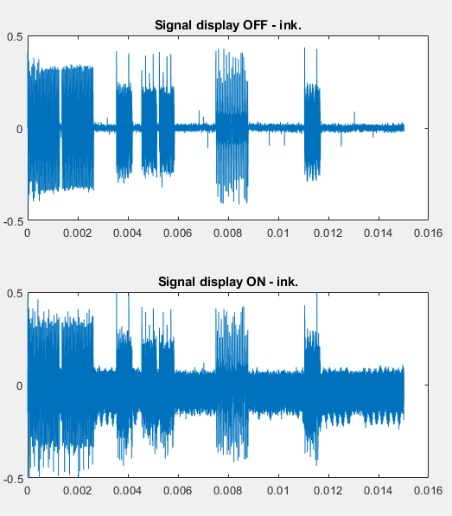
SNR calculation for EVB
Signal display OFF- ink mode
Signal display ON- ink mode
Display OFF-ink | Display ON-ink
24.9519dB | 7.0132dB

