Slide 1
visual-space memory task ISS Proyect
Manuel Hernández Nájera-Alesón

Slide 2
Visual-spatial memory
Defines our capability to interact with 2 or 3 dimensional environments.
Directly related with day-to-day activities.
Useful for high-risk and/or fast paced tasks
Fighter pilots

Slide 3


Unity/ C# approach
Visual framework built
Scene System
Object Architecture
User Friendly
Object Oriented
.NET
Previous Experience

Slide 4
Project overview
Calmed scene
Demanding task scene
File Reading
Port Communication

Slide 5
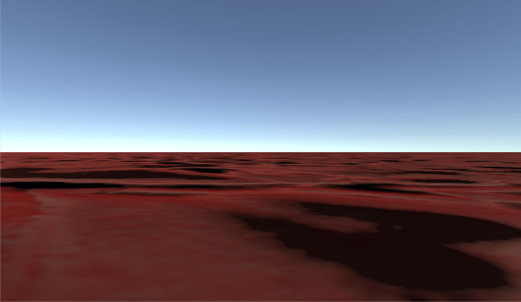
Calm/Rest scene
Music
Movement
Looking Around

Slide 6
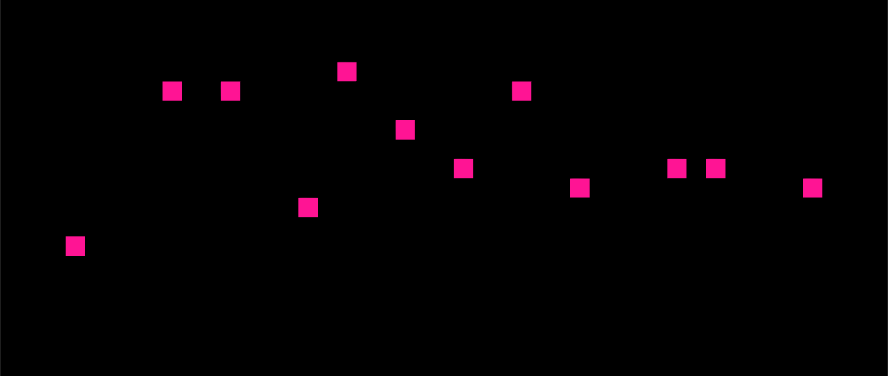

TASK SCENE
Number of squares played parametrized
$$N= \frac{T}{MCT}−IT$$
Squares placed through “Grid Algorithm”
Loud and streaky noises
Click detection
Distance calculation
Port communication

Slide 7
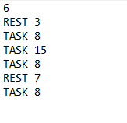
FILE reading
Programmable behaviour of the Simulation
Simple File Reading
Number of commands
COMMAND + seconds

Slide 8

Port communication
Multithread Program: Unity + Server
Another application runs a Client: Data Receiving
.NET Sockets

Slide 9
ISSUES / Drawbacks/ Unfinished parts

Slide 10


Thanks for the attention
Questions/Comments?
Manuel.hna@Gmail.com / manherna@ucm.es
https://www.github.com/manherna/ISS

