Slide 1
visual-space memory task iss Proyect
Manuel Hernández Nájera-Alesón
1

Slide 2
Visual-spatial memory
Defines our capability to interact with 2 or 3 dimensional environments.
Directly related with day-to-day activities.
Useful for high-risk and/or fast paced tasks
Fighter pilots

Slide 3

Unity approach
Visual framework built
Scene System
Object Architecture
User Friendly

Slide 4
Proyect overview
Calmed scene
Demanding task scene
File Reading
Port Comunication

Slide 5
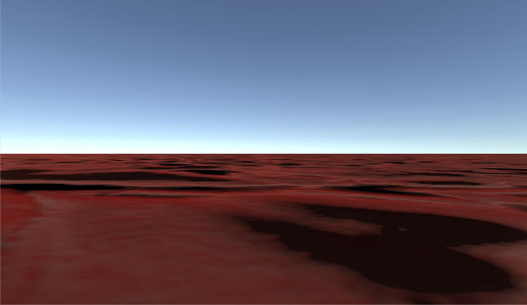
Calm/Rest scene
Music
Movement
Looking Around

Slide 6
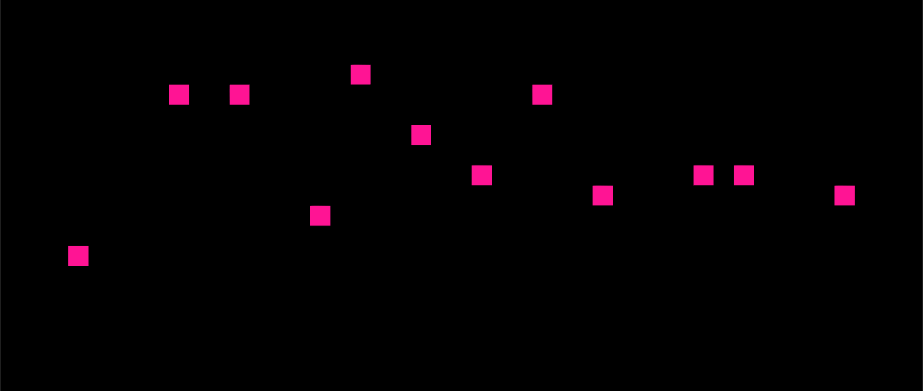
TASK SCENE
Pink squares placed through “Grid Algorithm”
Loud and streaky noises
Click detection
Distance calculation
Port communication

