Slide 1
Lecture 2
Message Passing
Using MPI
(Rauber Chapter 5, Foster Chapter 8)

Slide 2
Outline
Background
  The message-passing model
  Origins of MPI and current status
  Sources of further MPI information
Basics of MPI message passing
  Hello, World!
  Fundamental concepts
  Simple examples in Fortran and C
Extended point-to-point operations
  non-blocking communication
  modes
Advanced MPI topics
  Collective operations
  More on MPI data types
  Application topologies
  The profiling interface
Toward a portable MPI environment

Slide 3
The Message-Passing Model
A process is (traditionally) a program counter and address space
Processes may have multiple threads
  program counters and associated stacks
  sharing a single address space.
MPI is for communication among processes
  separate address spaces
Interprocess communication consists of
  Synchronization
  Movement of data from one process’s address space to another’s.

Slide 4
Types of Parallel Computing Models
Data Parallel
  the same instructions are carried out simultaneously on multiple data items (SIMD)
Task Parallel
  different instructions on different data (MIMD)
SPMD (single program, multiple data)
  not synchronized at individual operation level
SPMD is equivalent to MIMD since each MIMD program can be made SPMD (similarly for SIMD, but not in practical sense)
Message passing (and MPI) is for MIMD/SPMD parallelism. HPF is an example of a SIMD interface.

Slide 5
Message Passing
Basic Message Passing:
  Send: Analogous to mailing a letter
  Receive: Analogous to picking up a letter from the mailbox
  Scatter-gather: Ability to “scatter” data items in a message into multiple memory locations and “gather” data items from multiple memory locations into one message
Network performance:
  Latency: The time from when a Send is initiated until the first byte is received by a Receive.
  Bandwidth: The rate at which a sender is able to send data to a receiver.

Slide 6
Scatter-Gather
Scatter (Receive)
Gather (Send)
…
…
Message
Message
Memory
Memory

Slide 7
Basic Message Passing Issues
Issues include:
  Naming: How to specify the receiver?
  Buffering: What if the out port is not available? What if the receiver is not ready to receive the message?
  Reliability: What if the message is lost in transit? What if the message is corrupted in transit?
  Blocking: What if the receiver is ready to receive before the sender is ready to send?

Slide 8
Cooperative Operations for Communication
message-passing approach → cooperative exchange of data
data explicitly sent by one process and received by another
Advantage: any change in receiving process’s memory is made with receiver’s explicit participation
Communication and synchronization are combined
Push model (active data transfer)
Process 0
Process 1
Send(data)
Receive(data)

Slide 9
One-Sided Operations for Communication
One-sided operations b/w processes include
remote memory reads and writes
Only one process needs to explicitly participate
An advantage is that communication and synchronization are decoupled
One-sided operations are part of MPI-2.
Pull model (passive data transfer) for get
Process 0
Process 1
Put(data)
(memory)
(memory)
Get(data)

Slide 10
Collective Communication
More than two processes involved in communication
  Barrier
  Broadcast (one-to-all), multicast (one-to-many)
  All-to-all
  Reduction (all-to-one)

Slide 11
Barrier
Compute
Compute
Compute
Compute
Barrier
Compute
Compute
Compute
Compute

Slide 12
Broadcast and Multicast
Broadcast
Multicast
P1
P1
Message
Message
P0
P2
P0
P2
P3
P3

Slide 13
All-to-All
Message
Message
P0
P2
P1
P3
Message
Message

Slide 14
Reduction
sum ← 0
for i ← 1 to p do
sum ← sum + A[i]
A[0] + A[1]
A[0]
A[0] + A[1] + A[2] + A[3]
A[1]
A[2] + A[3]
A[2]
A[3]
P1
P1
A[1]
A[1]
P0
A[2]
P2
P0
A[2] + A[3]
P2
A[3]
A[3]
P3
P3

Slide 15
What is MPI?
A message-passing library specification (an API)
  extended message-passing model
  not a language or compiler specification
  not a specific implementation or product
For parallel computers, clusters, and heterogeneous networks
Full-featured
Designed to provide access to advanced parallel hardware for
  end users
  library writers
  tool developers
Portability

Slide 16
MPI Sources
Standard: http://www.mpi-forum.org
Books:
  Using MPI: Portable Parallel Programming with the Message-Passing Interface, by Gropp, Lusk, and Skjellum, MIT Press, 1994.
  MPI: The Complete Reference, by Snir, Otto, Huss-Lederman, Walker, and Dongarra, MIT Press, 1996.
  Designing and Building Parallel Programs, by Ian Foster, Addison-Wesley, 1995.
  Parallel Programming with MPI, by Peter Pacheco, Morgan-Kaufmann, 1997.
  MPI: The Complete Reference Vol 1 and 2,MIT Press, 1998(Fall).
Other information on Web http://www.mcs.anl.gov/mpi

Slide 17
MPI History
1990 PVM: Parallel Virtual Machine (Oak Ridge Nat’l Lab)
  Message-passing routines
  Execution environment (spawn + control parallel processes)
  No an industry standard
1992 meetings (Workshop, Supercomputing’92)
1993 MPI draft
1994 MPI Forum (debates)
1994 MPI-1.0 release (C & Fortran bindings) + standardization
1995 MPI-1.1 release
1997 MPI-1.2 release (errata) + MPI-2 release: create tasks, C++ & Fortran 90 bindings
2012 MPI-3 release: non-blocking collectives, p2p, RMA, MPIT

Slide 18
Why Use MPI?
MPI provides a powerful, efficient, and portable way to express parallel programs
MPI was explicitly designed to enable libraries…
… which may eliminate the need for many users to learn (much of) MPI
It’s the industry standard!

Slide 19
A Minimal MPI Program
In C:
#include "mpi.h"
#include <stdio.h>
int main(int argc,
char *argv[])
{
MPI_Init(&argc, &argv);
printf("Hello, world!\n");
MPI_Finalize();
return 0;
}
In Fortran:
program main
use MPI
integer ierr
call MPI_INIT( ierr )
print *, 'Hello, world!'
call MPI_FINALIZE( ierr )
end

Slide 20
Notes on C and Fortran
C and Fortran bindings correspond closely
In C:
  mpi.h must be #included
  MPI functions return error codes or MPI_SUCCESS
In Fortran:
  mpif.h must be included, or use MPI module (MPI-2)
  All MPI calls are to subroutines, with a place for the return code in the last argument.
C++ bindings, and Fortran-90 issues, are part of MPI-2.

Slide 21
Error Handling
By default, an error causes all processes to abort.
The user can cause routines to return (with an error code) instead.
  In C++, exceptions are thrown (MPI-2)
A user can also write and install custom error handlers.
Libraries might want to handle errors differently from applications.

Slide 22
Running MPI Programs
The MPI-1 Standard does not specify how to run an MPI program
(just as the Fortran standard does not specify how to run a Fortran program)
In general, starting an MPI program is dependent on the implementation of MPI you are using
  might require scripts, program arguments, and/or environment variables
mpirun <args> is part of MPI-2, as a recommendation, but not a requirement
  You can use mpirun/mpiexec for MPICH

Slide 23
Finding Out About the Environment
Two important questions that arise in a parallel program are:
  How many processes are participating in this computation?
  Which one am I?
MPI provides functions to answer these questions:
  MPI_Comm_size reports the number of processes.
  MPI_Comm_rank reports the rank, a number between 0 and size-1, identifying the calling process

Slide 24
Better Hello (C)
#include "mpi.h"
#include <stdio.h>
int main( int argc, char *argv[] )
{
int rank, size;
MPI_Init( &argc, &argv );
MPI_Comm_rank( MPI_COMM_WORLD, &rank );
MPI_Comm_size( MPI_COMM_WORLD, &size );
printf( "I am %d of %d\n", rank, size );
MPI_Finalize();
return 0;
}

Slide 25
Better Hello (Fortran)
program main
use MPI
integer ierr, rank, size
call MPI_INIT( ierr )
call MPI_COMM_RANK( MPI_COMM_WORLD, rank, ierr )
call MPI_COMM_SIZE( MPI_COMM_WORLD, size, ierr )
print *, 'I am ', rank, ' of ', size
call MPI_FINALIZE( ierr )
end

Slide 26
MPI Basic Send/Receive
We need to fill in the details in
Things that need specifying:
  How will “data” be described?
  How will processes be identified?
  How will the receiver recognize/screen messages?
  What will it mean for these operations to complete?
Process 0
Process 1
Send(data)
Receive(data)

Slide 27
What is message passing?
Data transfer plus synchronization
  if it is blocking message passing
Requires cooperation of sender and receiver
Cooperation not always apparent in code
Process 0
Data
May I Send?
Data
Data
Data
Data
Data
Data
Data
Data
Process 1
Yes
Time

Slide 28
Some Basic Concepts
Processes can be collected into groups.
Each message is sent in a context and must be received in the same context
  Tag relative to context (discussed later)
A (group, context) form a communicator.
A process is identified by its rank in the group associated with a communicator
There is a default communicator whose group contains all initial processes, called MPI_COMM_WORLD

Slide 29
MPI Datatypes
data in a message described by a triple
(address, count, datatype), where
An MPI datatype is recursively defined as:
  predefined, corresponding to a data type from the language (e.g., MPI_INT, MPI_DOUBLE_PRECISION)
  a contiguous array of MPI datatypes
  a strided block of datatypes
  an indexed array of blocks of datatypes
  an arbitrary structure of datatypes
There are MPI functions to construct custom datatypes, such an array of (int, float) pairs, or a row of a matrix stored columnwise

Slide 30
MPI Tags
Messages sent with an accompanying user-defined integer tag
  to assist the receiving process in identifying the message
Messages can be screened (filtered) at the receiving end
  by specifying a specific tag,
  or not screened by specifying MPI_ANY_TAG as the tag
Note: Some non-MPI message-passing systems have called tags “message types”. MPI calls them tags to avoid confusion with datatypes.

Slide 31
MPI Basic (Blocking) Send
MPI_SEND (start, count, datatype, dest, tag, comm)
message buffer is described by (start, count, datatype).
target process is specified by dest
  rank of target process in communicator specified by comm
When this function returns, the data has been delivered
  buffer can be reused
  but msg may not have been received by target process (yet)

Slide 32
MPI Basic (Blocking) Receive
MPI_RECV(start, count, datatype, source, tag, comm, status)
waits until a matching (on source and tag) message is received
  buffer can be used
source is rank in communicator specified by comm, or MPI_ANY_SOURCE
status contains further information
Receiving fewer than count occurrences of datatype is OK
  but receiving more is an error

Slide 33
Retrieving Further Information
Status is a data structure allocated in the user’s program.
In C:
  int recvd_tag, recvd_from, recvd_count;
  MPI_Status status;
  MPI_Recv(..., MPI_ANY_SOURCE, MPI_ANY_TAG, ..., &status )
  recvd_tag = status.MPI_TAG;
  recvd_from = status.MPI_SOURCE;
  MPI_Get_count( &status, datatype, &recvd_count );
In Fortran:
  integer recvd_tag, recvd_from, recvd_count
  integer status(MPI_STATUS_SIZE)
  call MPI_RECV(..., MPI_ANY_SOURCE, MPI_ANY_TAG, .. status, ierr)
  tag_recvd = status(MPI_TAG)
  recvd_from = status(MPI_SOURCE)
  call MPI_GET_COUNT(status, datatype, recvd_count, ierr)

Slide 34
Simple Fortran Example
program main
use MPI
integer rank, size, to, from, tag
integer count, i, ierr
integer src, dest
integer st_source, st_tag, st_count
integer status(MPI_STATUS_SIZE)
double precision data(10)
call MPI_INIT( ierr )
call MPI_COMM_RANK( MPI_COMM_WORLD,
+ rank, ierr )
call MPI_COMM_SIZE( MPI_COMM_WORLD,
+ size, ierr )
print *, 'Process ', rank, ' of ',
+ size, ' is alive'
dest = size - 1
src = 0
if (rank .eq. 0) then
do 10, i=1, 10
data(i) = i
10 continue
call MPI_SEND( data, 10, MPI_DOUBLE_PRECISION,
+ dest, 2001, MPI_COMM_WORLD, ierr)
else if (rank .eq. dest) then
tag = MPI_ANY_TAG
source = MPI_ANY_SOURCE
call MPI_RECV( data, 10, MPI_DOUBLE_PRECISION,
+ source, tag, MPI_COMM_WORLD,
+ status, ierr)
call MPI_GET_COUNT( status, MPI_DOUBLE_PRECISION,
st_count, ierr )
st_source = status( MPI_SOURCE )
st_tag = status( MPI_TAG )
print *, 'status info: source = ', st_source,
+ ' tag = ', st_tag, 'count = ', st_count
endif
call MPI_FINALIZE( ierr )
end

Slide 35
Why Datatypes?
Since all data is labeled by type, an MPI implementation can support communication between processes on machines with very different memory representations and lengths of elementary datatypes (heterogeneous communication)
Specifying application-oriented layout of data in memory
  reduces memory-to-memory copies in the implementation
  allows the use of special hardware (scatter/gather) when available

Slide 36
Basic C Datatypes in MPI
MPI Datatype | C datatype
MPI_CHAR | signed char
MPI_SHORT | signed short int
MPI_INT | signed int
MPI_LONG | signed long int
MPI_UNSIGNED_CHAR | unsigned char
MPI_UNSIGNED_SHORT | unsigned short int
MPI_UNSIGNED_INT | unsigned int
MPI_UNSIGNED_LONG | unsigned long int
MPI_FLOAT | float
MPI_DOUBLE | double
MPI_LONG_DOUBLE | long double
MPI_BYTE
MPI_PACKED

Slide 37
Tags and Contexts
Separation of msgs used to be accomplished by use of tags, but
  requires libraries to be aware of tags used by other libraries
  can be defeated by use of “wild card” tags
Contexts are different from tags
  no wild cards allowed
  allocated dynamically by the system when a library sets up a communicator for its own use
User-defined tags still provided in MPI for user convenience in organizing application
Use MPI_Comm_split to create new communicators

Slide 38
MPI is Simple
Many parallel programs can be written using just these six functions, only two of which are non-trivial:
  MPI_INIT
  MPI_FINALIZE
  MPI_COMM_SIZE
  MPI_COMM_RANK
  MPI_SEND
  MPI_RECV
Point-to-point (send/recv) isn’t the only way...

Slide 39
Introduction to Collective Operations in MPI
Collective ops are called by all processes in a communicator.
  No tags
  Blocking
MPI_BCAST distributes data from one process (the root) to all others in a communicator.
MPI_REDUCE/ALLREDUCE combines data from all processes in communicator and returns it to one process.
In many numerical algorithms, SEND/RECEIVE can be replaced by BCAST/REDUCE, improving both simplicity and efficiency.
Others:
  MPI_[ALL]SCATTER[V]/[ALL]GATHER[V]

Slide 40
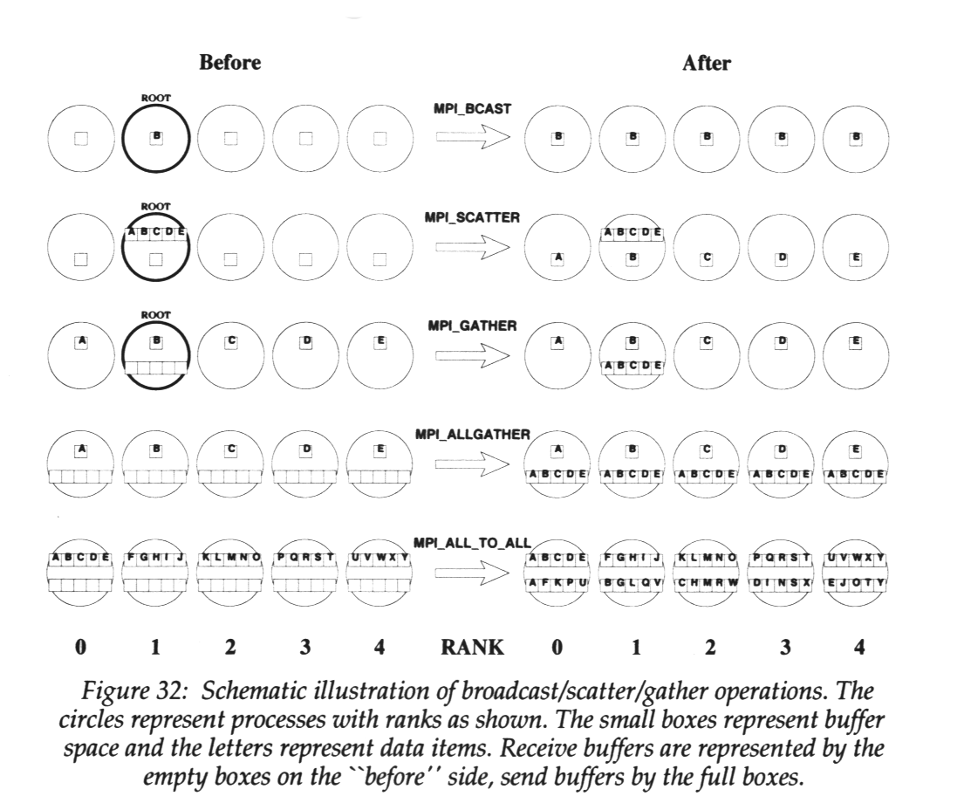
Collectives at Work
BCAST:
Scatter/Gather:
Allgather/All-to-all

Slide 41
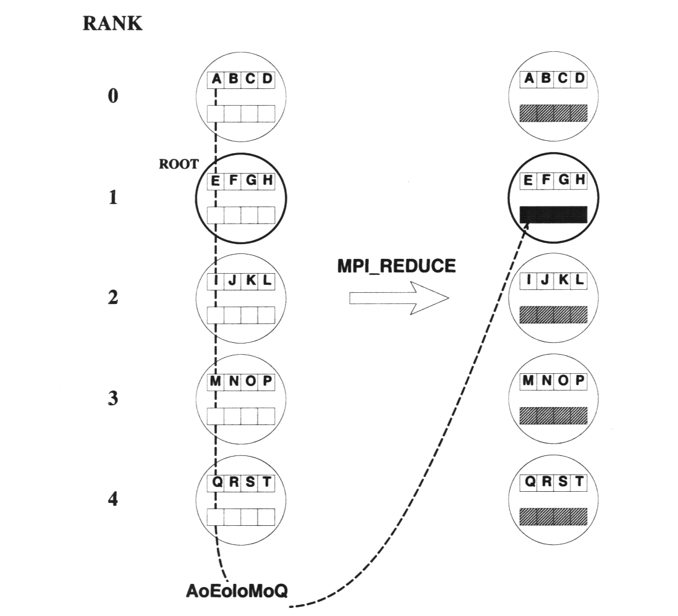
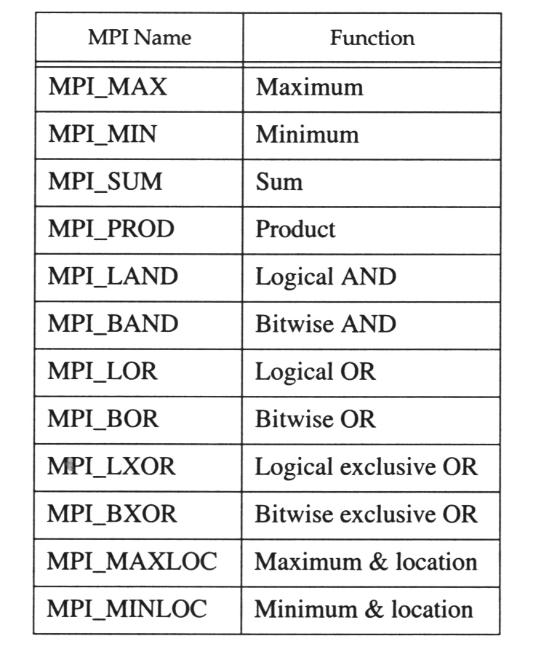
Collectives at Work (2)
Reduce:
Predefined Ops (assocociative & commutative) / user ops (assoc.)

Slide 42
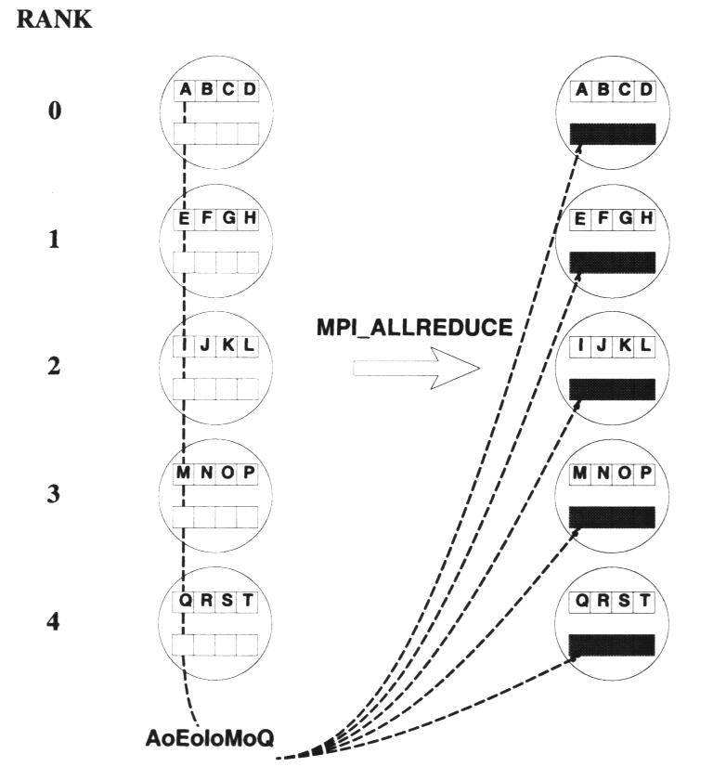
Collectives at Work (3)
Allreduce:

Slide 43
Example: PI in C
#include "mpi.h"
#include <math.h>
int main(int argc, char *argv[])
{
int done = 0, n, myid, numprocs, i, rc;
double PI25DT = 3.141592653589793238462643;
double mypi, pi, h, sum, x, a;
MPI_Init(&argc,&argv);
MPI_Comm_size(MPI_COMM_WORLD,&numprocs);
MPI_Comm_rank(MPI_COMM_WORLD,&myid);
while (!done) {
if (myid == 0) {
printf("Enter the number of
intervals: (0 quits) ");
scanf("%d",&n);
}
MPI_Bcast(&n, 1, MPI_INT, 0,
MPI_COMM_WORLD);
if (n == 0) break;
h = 1.0 / (double) n;
sum = 0.0;
for (i=myid+1; i<=n; i+=numprocs) {
x = h * ((double)i - 0.5);
sum += 4.0 / (1.0 + x*x);
}
mypi = h * sum;
MPI_Reduce(&mypi, &pi, 1,
MPI_DOUBLE, MPI_SUM, 0,
MPI_COMM_WORLD);
if (myid == 0)
printf("pi is approximately
%.16f, Error is %.16f\n",
pi, fabs(pi - PI25DT));
}
MPI_Finalize();
return 0;
}

Slide 44
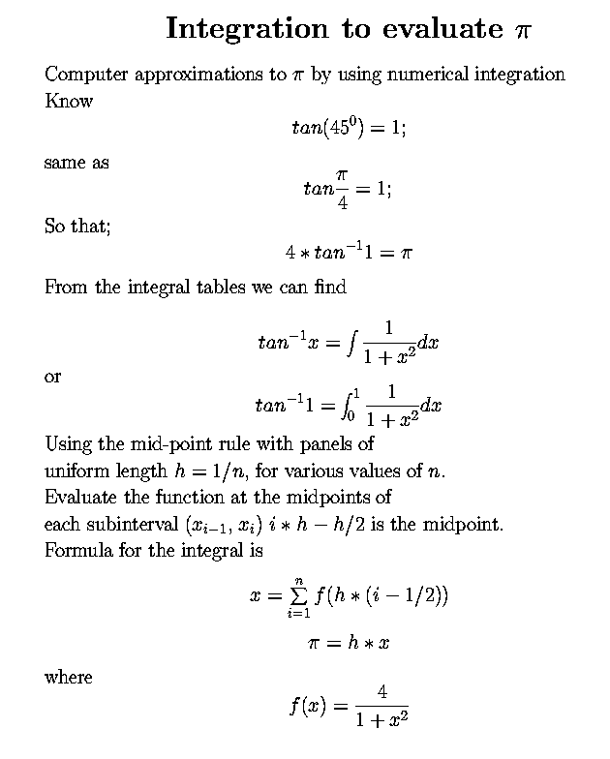
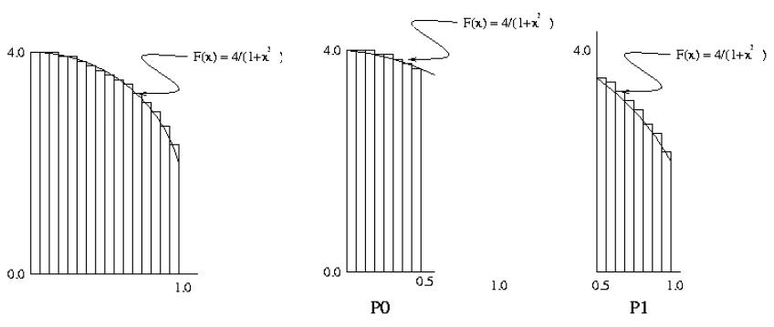
Approximation of Pi

Slide 45
Reduction
sum ← 0
for i ← 1 to p do
sum ← sum + A[i]
A[0] + A[1]
A[0]
A[0] + A[1] + A[2] + A[3]
A[1]
A[2] + A[3]
A[2]
A[3]
P1
P1
A[1]
A[1]
P0
A[2]
P2
P0
A[2] + A[3]
P2
A[3]
A[3]
P3
P3

Slide 46
Example: PI in Fortran
program main
use MPI
double precision PI25DT
parameter (PI25DT = 3.141592653589793238462643d0)
double precision mypi, pi, h, sum, x, f, a
integer n, myid, numprocs, i, ierr
c function to integrate
f(a) = 4.d0 / (1.d0 + a*a)
call MPI_INIT( ierr )
call MPI_COMM_RANK( MPI_COMM_WORLD, myid, ierr )
call MPI_COMM_SIZE( MPI_COMM_WORLD, numprocs, ierr )
10 if ( myid .eq. 0 ) then
write(6,98)
98 format('Enter the number of intervals: (0 quits)')
read(5,99) n
99 format(i10)
endif
call MPI_BCAST( n, 1, MPI_INTEGER, 0,
+ MPI_COMM_WORLD, ierr)
c check for quit signal
if ( n .le. 0 ) goto 30
c calculate the interval size
h = 1.0d0/n
sum = 0.0d0
do 20 i = myid+1, n, numprocs
x = h * (dble(i) - 0.5d0)
sum = sum + f(x)
20 continue
mypi = h * sum
c collect all the partial sums
call MPI_REDUCE( mypi, pi, 1, MPI_DOUBLE_PRECISION,
+ MPI_SUM, 0, MPI_COMM_WORLD,ierr)
c node 0 prints the answer
if (myid .eq. 0) then
write(6, 97) pi, abs(pi - PI25DT)
97 format(' pi is approximately: ', F18.16,
+ ' Error is: ', F18.16)
endif
goto 10
30 call MPI_FINALIZE(ierr)
end

Slide 47
Alternative 6 Functions for Simplified MPI
  MPI_INIT
  MPI_FINALIZE
  MPI_COMM_SIZE
  MPI_COMM_RANK
  MPI_BCAST
  MPI_REDUCE
What else is needed (and why)?

Slide 48
Sources of Deadlocks
Send a large message from process 0 to process 1
  If there is insufficient storage at the destination,
  send must wait for user to provide memory space (via a receive)
What happens with
Process 0
Send(1)
Recv(1)
Process 1
Send(0)
Recv(0)
This is called “unsafe” because it depends on the availability of system buffers

Slide 49
Some Solutions to the “unsafe” Problem
Order operations more carefully:
Process 0
Send(1)
Recv(1)
Process 1
Recv(0)
Send(0)
Use non-blocking operations:
Process 0
Isend(1)
Irecv(1)
Waitall
Process 1
Isend(0)
Irecv(0)
Waitall
How about races?
  Multiple recv processes w/ wildcard MPI_ANY_SOURCE

Slide 50
Optimization by Non-blocking Communication
Non-blocking operations work, but:
Process 0
Isend(1)
Irecv(1)
Waitall
Process 1
Isend(0)
Irecv(0)
Waitall
May want to reverse send/receive order: (Why?)
Process 0
Irecv(1)
Isend(1)
Waitall
Process 1
Irecv(0)
Isend(0)
Waitall

Slide 51
Communication and Blocking Modes
Communication modes:
  Std: init send w/o recv
  Ready: send iff recv ready
  Sync: see Std but send only completes if recv OK
  Buf: see Std but reserves place to put data
  MPI_Buffer_attach/detach
Nonblocking completed?
  MPI_Wait/Test
  MPI_Waitall/any/some
Send+Recv w/ same/diff buffer
  MPI_Sendrecv
  MPI_Sendrecv_replace
Send | Blocking | Nonblocking
Standard | MPI_Send | MPI_Isend
Ready | MPI_Rsend | MPI_Irsend
Synchronous | MPI_Ssend | MPI_Issend
Buffered | MPI_Bsend | MPI_Ibsend
Receive | Blocking | Nonblocking
Standard | MPI_Recv | MPI_Irecv

Slide 52
Communicators
Alternative to avoid deadlocks:
  Use different communicators
  Often used for different libraries
Group: MPI_Comm_group, MPI_Comm_incl
Context: for a group: MPI_Comm_create
How about multicast?

Slide 53
Toward a Portable MPI Environment
MPICH: high-performance portable implementation of MPI (1+2)
runs on MPP's, clusters, and heterogeneous networks of workstations
In a wide variety of environments, one can do:
  configure
  make
  mpicc -mpitrace myprog.c
  mpirun -np 10 myprog
  or: mpiexec –n 10 myprog
  to build, compile, run, and analyze performance
Others: LAM MPI, OpenMPI, vendor X MPI

Slide 54
Extending the Message-Passing Interface
Dynamic Process Management
  Dynamic process startup
  Dynamic establishment of connections
One-sided communication
  Put/get
  Other operations
Parallel I/O
Other MPI-2 features
  Generalized requests
  Bindings for C++/ Fortran-90; interlanguage issues

Slide 55
Profiling Support: PMPI
Profiling layer of MPI
Implemented via additional API in MPI library
  Different name: PMPI_Init()
  Same functionality as MPI_Init()
Allows user to:
  define own MPI_Init()
  Need to call PMPI_Init():
User may choose subset of MPI routines to be profiled
Useful for building performance analysis tools
  Vampir: Timeline of MPI traffic (Etnus, Inc.)
  Paradyn: Performance analysis (U. Wisconsin)
  mpiP: J. Vetter (LLNL)
  ScalaTrace: F. Mueller et al. (NCSU)
MPI_Init(…) {
collect pre stats;
PMPI_Init(…);
collect post stats;
}

Slide 56
When to use MPI
Portability and Performance
Irregular Data Structures
Building Tools for Others
  Libraries
Need to Manage memory on a per-processor basis

Slide 57
When not (necessarily) to use MPI
Regular computation matches HPF
  But see PETSc/HPF comparison (ICASE 97-72)
Solution (e.g., library) already exists
  http://www.mcs.anl.gov/mpi/libraries.html
Require Fault Tolerance
  Sockets
  will see other options (research)
Distributed Computing
  CORBA, DCOM, etc.
Embarrassingly parallel data division
  Google map-reduce

Slide 58
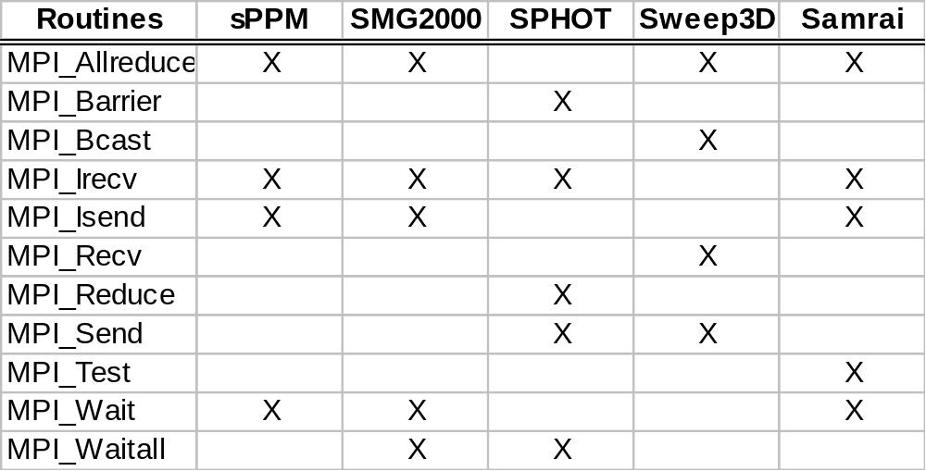
Is MPI Simple?
We said: Many parallel programs can be written using just these six functions, only two of which are non-trivial:
  MPI_INIT
  MPI_FINALIZE
Empirical study for large-scale benchmarks shows (IPDPS’02):
  MPI_COMM_SIZE
  MPI_COMM_RANK
  MPI_SEND
  MPI_RECV

Slide 59
Summary
parallel computing community has cooperated on development of
  standard for message-passing libraries
many implementations, on nearly all platforms
MPI subsets are easy to learn and use
Lots of MPI material available
Trends to adaptive computation (adaptive mesh refinement)
  Add’l MPI routines may be needed (even MPI-2 sometimes)

Slide 60
Before MPI-2
1995 user poll showed:
Diverse collection of users
All MPI functions in use, including “obscure” ones.
Extensions requested:
  parallel I/O
  process management
  connecting to running processes
  put/get, active messages
  interrupt-driven receive
  non-blocking collective
  C++ bindings
  Threads, odds and ends

Slide 61
MPI-2 Origins
Began meeting in March 1995, with
  veterans of MPI-1
  new vendor participants (especially Cray and SGI, and Japanese manufacturers)
Goals:
  Extend computational model beyond message-passing
  Add new capabilities
  Respond to user reaction to MPI-1
MPI-1.1 released in June 1995 with MPI-1 repairs, some bindings changes
MPI-1.2 and MPI-2 released July 1997
Implemented in most (all?) MPI libraries today

Slide 62
Contents of MPI-2
Extensions to the message-passing model
  Parallel I/O
  One-sided operations
  Dynamic process management
Making MPI more robust and convenient
  C++ and Fortran 90 bindings
  Extended collective operations
  Language interoperability
  MPI interaction with threads
  External interfaces

Slide 63
MPI-2 Status Assessment
All MPP vendors now have MPI-1. Free implementations (MPICH, LAM) support heterogeneous workstation networks.
MPI-2 implementations are in for most (all?) Vendors.
MPI-2 implementations appearing piecemeal, with I/O first.
  I/O available in most MPI implementations
  One-sided available in most (may still depend on interconnect, e.g., Infiniband has it, Ethernet may have it.)
  parts of dynamic and one-sided in LAM/OpenMPI/MPICH

Slide 64
Dynamic Process Management in MPI-2
Allows an MPI job to spawn new processes at run time and communicate with them
Allows two independently started MPI applications to establish communication

Slide 65
Starting New MPI Processes
MPI_Comm_spawn
  Starts n new processes
  Collective over communicator
    Necessary for scalability
  Returns an intercommunicator
    Does not change MPI_COMM_WORLD

Slide 66
Connecting Independently Started Programs
MPI_Open_port, MPI_Comm_connect, MPI_Comm_accept allow two running MPI programs to connect and communicate
  Not intended for client/server applications
  Designed to support HPC applications
MPI_Join allows the use of a TCP socket to connect two applications
Important for multi-scale simulations
  Connect multiple independent simulations, combine calculations

Slide 67
One-Sided Operations: Issues
Balancing efficiency and portability across a wide class of architectures
  shared-memory multiprocessors
  NUMA architectures
  distributed-memory MPP’s, clusters
  Workstation networks
Retaining “look and feel” of MPI-1
Dealing with subtle memory behavior issues: cache coherence, sequential consistency
Synchronization is separate from data movement

Slide 68
Remote Memory Access Windows and Window Objects
Process 0
Process 1
Get
Put
window
Process 2
Process 3
= address spaces
= window object

Slide 69
One-Sided Communication Calls
MPI_Put - stores into remote memory
MPI_Get - reads from remote memory
MPI_Accumulate – combined local/remote memory
  like reduction, need to specify “op”, e.g., MPI_SUM
All are non-blocking: data transfer is described, maybe even initiated, but may continue after call returns
Subsequent synchronization on window object is needed to ensure operations are complete, e.g., MPI_Win_fence

Slide 70
New in MPI-3
Non-blocking collectives
  MPI_Ibcast(&buf, 1, MPI_INT, 0, comm, &req)
  /* compute */
  MPI_Wait(&req, MPI_STATUS_IGNORE);
One-sided comm. Extensions: e.g., read-modify-write
Topological collectives
  network overlay graph: MPI_Cart/Graph_create()
  can be mapped to physical interconnect topology
  MPI_Neighbor_reduce/alltoall/gather()…
Hybrid programming: threads+MPI safety w/ PGAS, CUDA…
Tool support: MPIT interface
  Access to runtime internals (config, performance, debug)
    e.g. MPI rank but also to add performance counters…

