Slide 1
WEBSITE BÁN TRÀ SỮA
1.Le Duc Manh
2.Nguyen Van Duc

Slide 2




TECHNOLOGIES:
1. FrontEnd:

Slide 3



TECHNOLOGIES:
2. BackEnd:

Slide 4


TECHNOLOGIES:
3. Database & PTTKHT:

Slide 5


Slide 6
Project idea:
Milk tea is a favorite dish of Vietnamese youth. Currently, because of that, many milk tea shops have sprung up, business competition will be more difficult, there are some milk tea shops that do not guarantee safety because That's why young people are looking for reputable clean milk tea shops through the internet
That is why a milk tea shop cannot do without a website, the website not only introduces the store's milk tea products, but also affirms the store's brand and service.

Slide 7
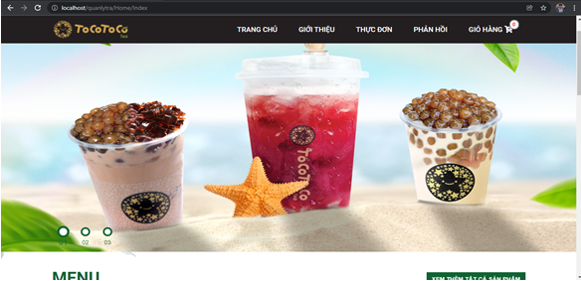
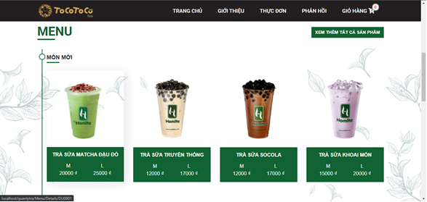
Home page interface
The home page interface of the milk tea shop website, where it shows all the news as well as the products sold by the store.
Notes:
Các nhà nông muốn hợp tác với chúng tôi phải đạt các yêu cầu về kiểm định chất lượng sản phẩm. Chính vì thế nên nguồn hàng luôn đảm bảo chất lượng cho người tiêu dùng và từ đó phát triển đưa ra trên toàn cầu. Nguồn hàng đảm bảo không gian lận thương mại. Nguồn gốc rõ ràng, đặt niềm tin của khach hàng lên hàng đầu.

Slide 8
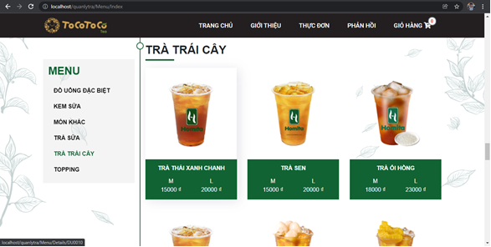
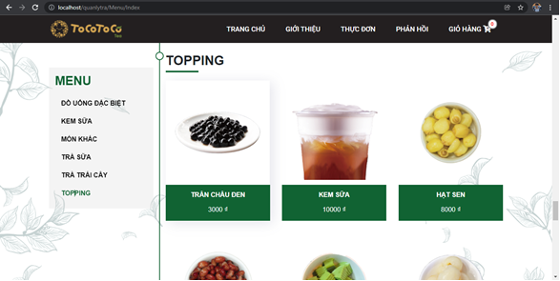
Product page interface
Display the shop's product types, prices, sizes...
Notes:
Website vừa cung cấp các dịch vụ để giải cứu nông sản cho nông dân, tránh bị chén ép giá cả. Vừa giới thiệu các nông sản để các bạn bè quốc tế, cùng với đó là các sản phẩm được “phát minh” như:

Slide 9
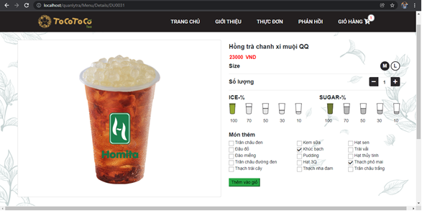
Product order page
When the customer clicks on the product, the product detail page will appear, and it will show the customer the price name as well as the parameters that the customer wants to choose about that product.

Slide 10
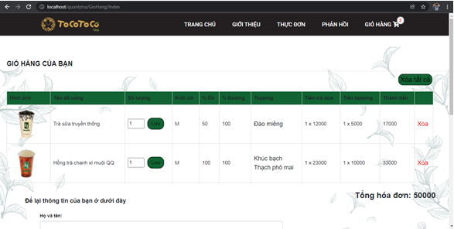
Shopping cart page
Display the information about the order, detailed price and the amount that the buyer has to pay

Slide 11
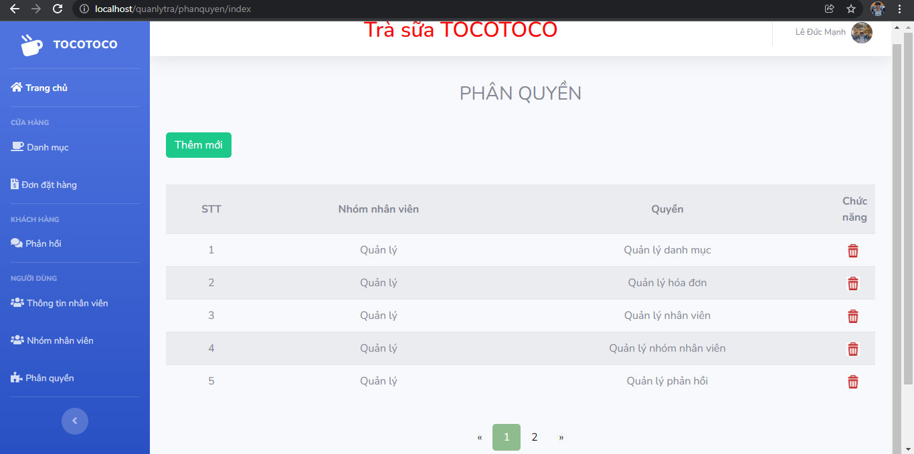
Admin page
Full admin functions such as viewing orders, feedback, staff management, ..

Slide 12
Future Upgrades

Slide 13
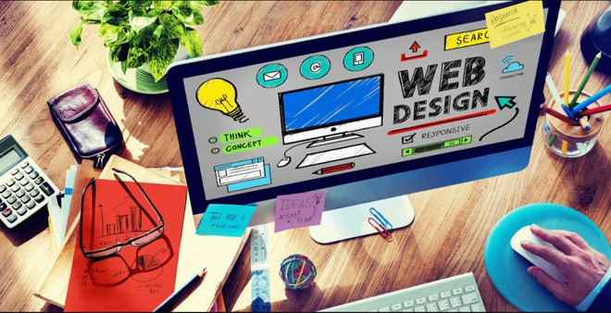
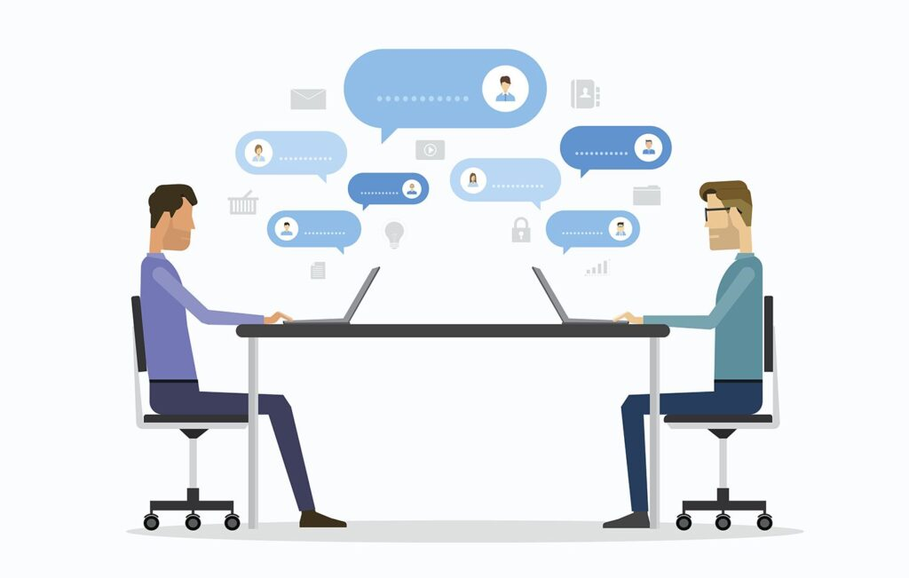
Development direction
Standard seo web design
Information exchange

Slide 14

Development direction
Enhance website security

Slide 15
Conclusion

Slide 16
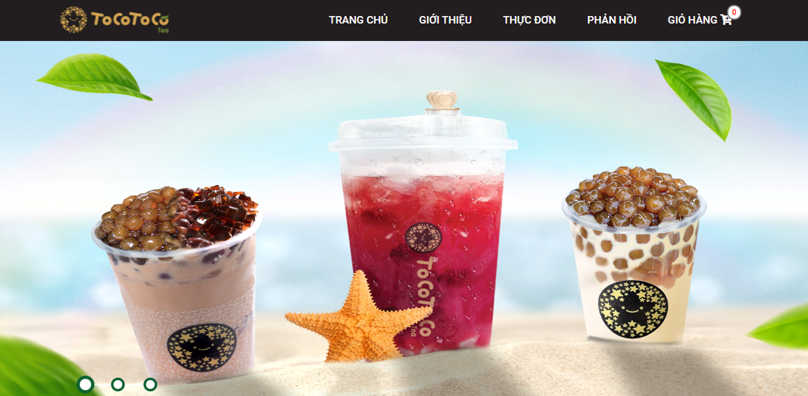
Conclusion
We have also approached and built a reliable website to introduce the service and image of the milk tea shop with a beautiful,user-friendly interface. So, hope you are interested and give it a try, the website that our team built is worth testing, you will not be disappointed.

Slide 17


