Slide 1
TMA FINAL REPORT

Slide 2
—Work Tracker Website
Nguyen Manh Toan
Intern batch 41

Slide 3
Table of contents
01
02
03
04
Requirement of Project
Key deliverables
Results Achieved
Demo
05
Lessons learnt

Slide 4
01
Requirement of Project

Slide 5
01. Requirement of Project
a. OBJECTIVE
Currently, there is a project that requires the development of a check-in website to control the entry times of each employee. The website needs to cater to at least two main user groups: employees and managers.
The website should ensure account security and provide essential features for a check-in website, including login, logout, check-in, and viewing check-in history. In addition, specific functions are also required for:
• Managers: additional functions for statistics and exporting to Excel, managing employee information, managing the company's branch, and tracking the work hours of all employees.

Slide 6
01. Requirement of Project
b. DESCRIPTION
Based on the previously mentioned objectives, I believe the system should have the following functions. The requirements are listed in order of priority, from top to bottom: The system consists of two main parts:
The website should ensure account security and provide essential features for a check-in website, including login, logout, check-in, and viewing check-in history. In addition, specific functions are also required for:
Non-functional requirements:
• The system must run smoothly and reliably.
• The manager's system should be user-friendly and easy to operate.
• User-friendly, responsive interface.
• Employees and managers can only check in when they are within the company's premises
For Employees:
• Login/Logout
• Check-in functionality
• View check-in history and export excel file.
For Managers:
• All employee features
• Management employees, employees workdays, branches, old employees

Slide 7
02
Key Deliverables

Slide 8
02. Key Deliverables
Figma Model
Full UseCase
Requirements document
Source Code

Slide 9
03
Results Achieved

Slide 10
03. Results Achieved
Login/Logout feature
Forgot password feature
Change password feature
Management personal information
Check in feature
Statistic personal workdays
Statistic employees workdays
Management employees
Management branches
Management old employees

Slide 11
04
Demo

Slide 12
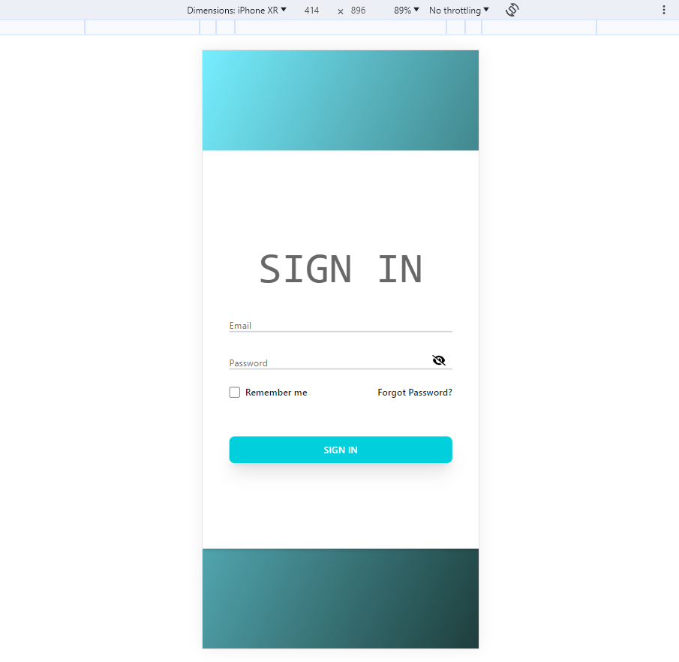
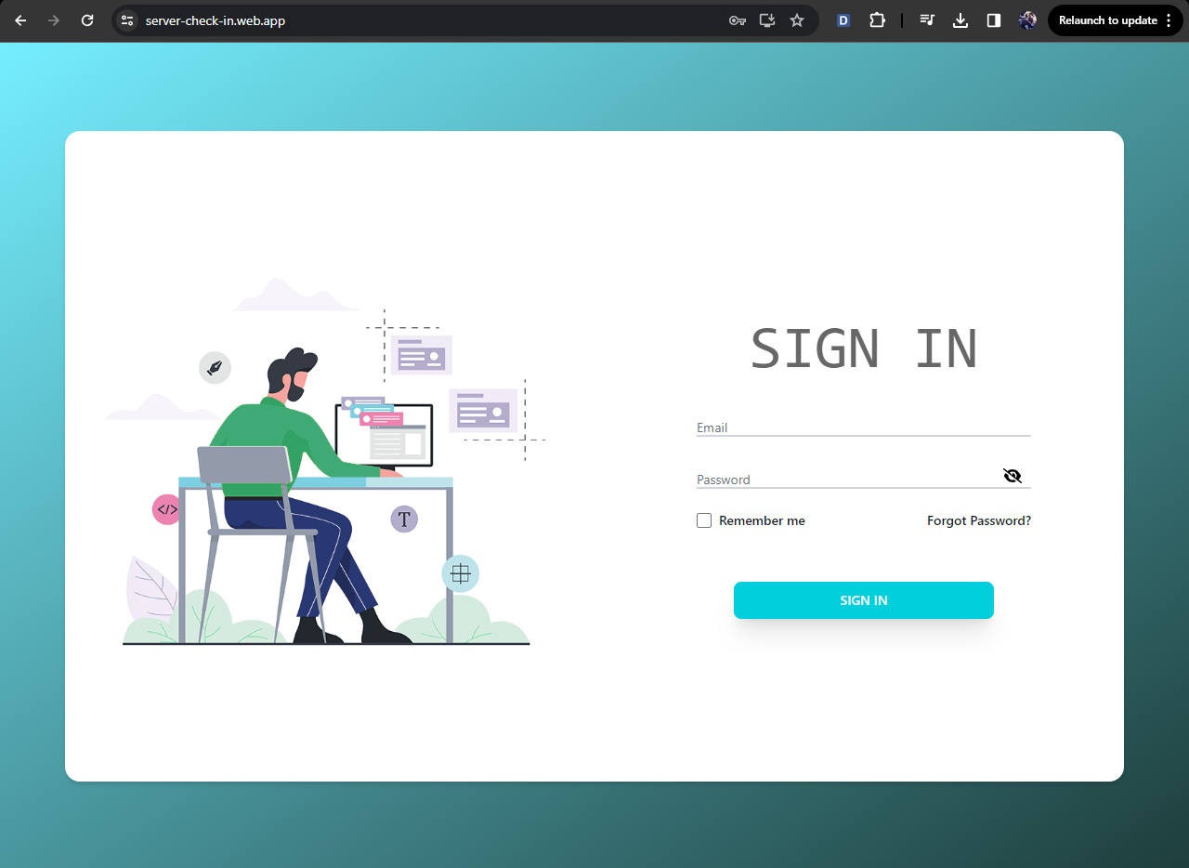
a. Demo -Login feature
The project utilizes the MERN stack for development, with user authentication functionality using tokens to verify users. These tokens will be stored in the client's browser's local storage.
Upon successful login, the user will be redirected to the homepage. In case of a failed login attempt, the user will receive a notification and will be required to log in again.
Figure login feature

Slide 13
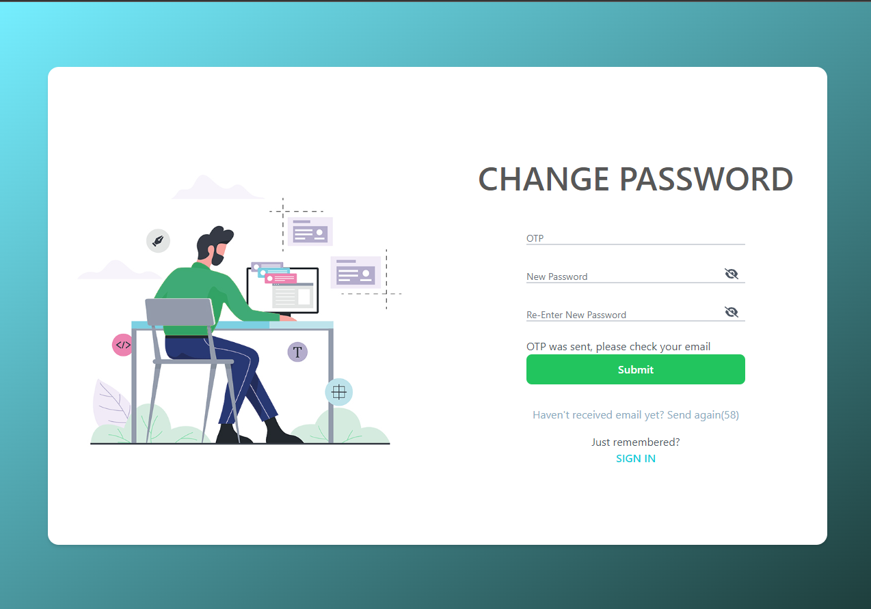
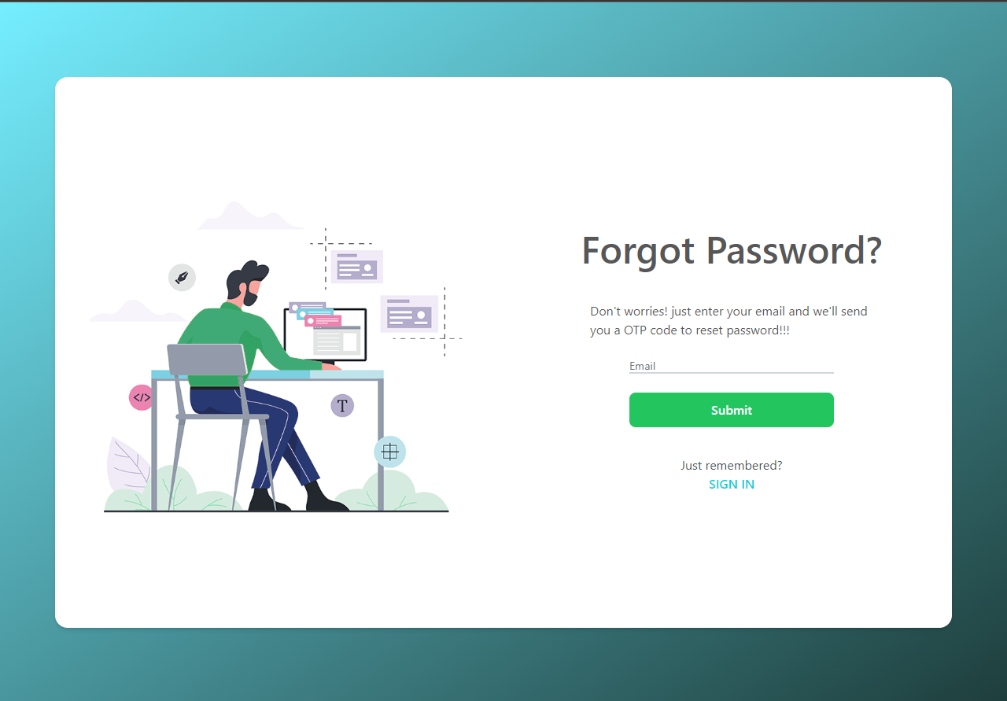
b. Demo -Forgot password feature
For the "Forgot Password" feature, the user needs to enter the email associated with their registered account.
The system will then verify if the email exists in the system. If the email is found in the system, an OTP (One-Time Password) will be sent to the user's email. The user is required to enter this OTP to reset their password.
Figure forgot password feature

Slide 14

c. Demo - Change password feature
Similar to the "Forgot Password" process, but this time the email is retrieved based on the user's token.
Change password feature

Slide 15
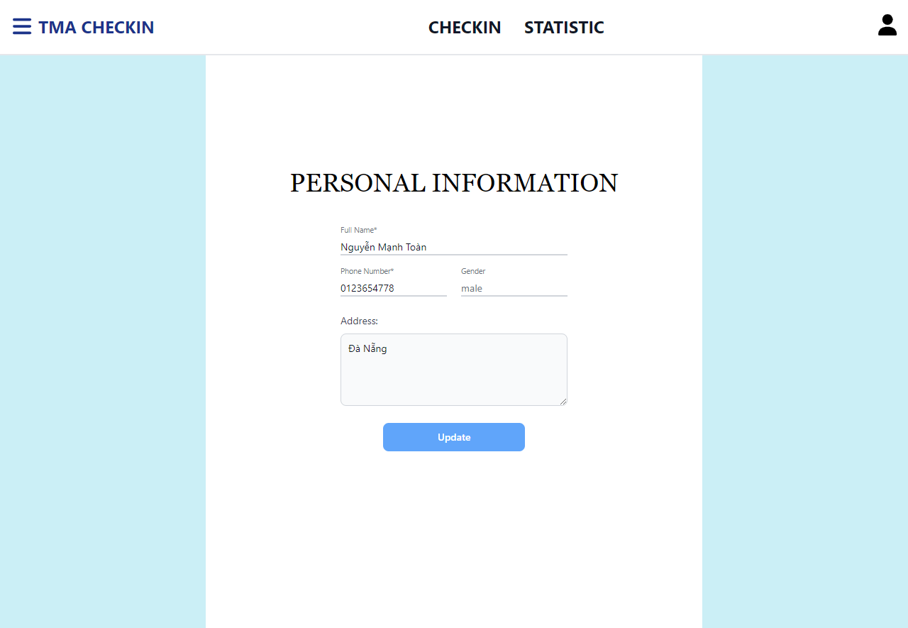
d. Demo -Management personal information
Users can access and update their personal information.
Management information feature

Slide 16
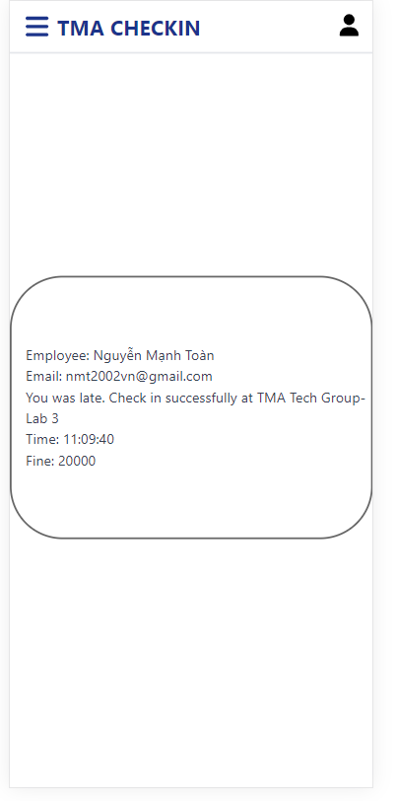
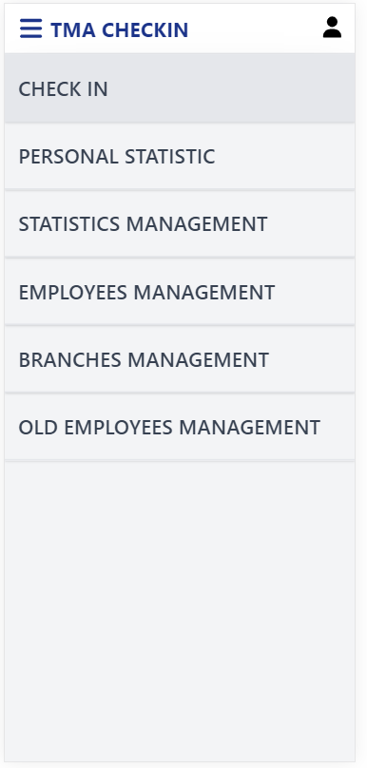
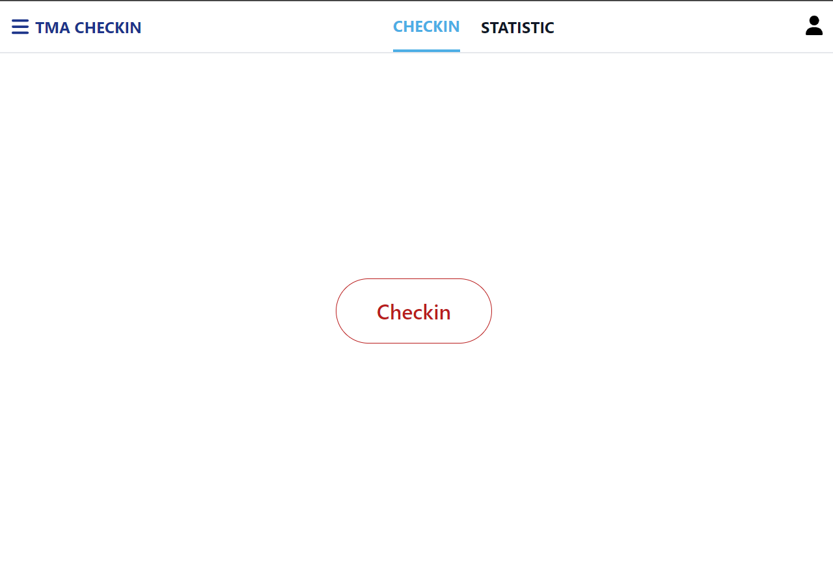
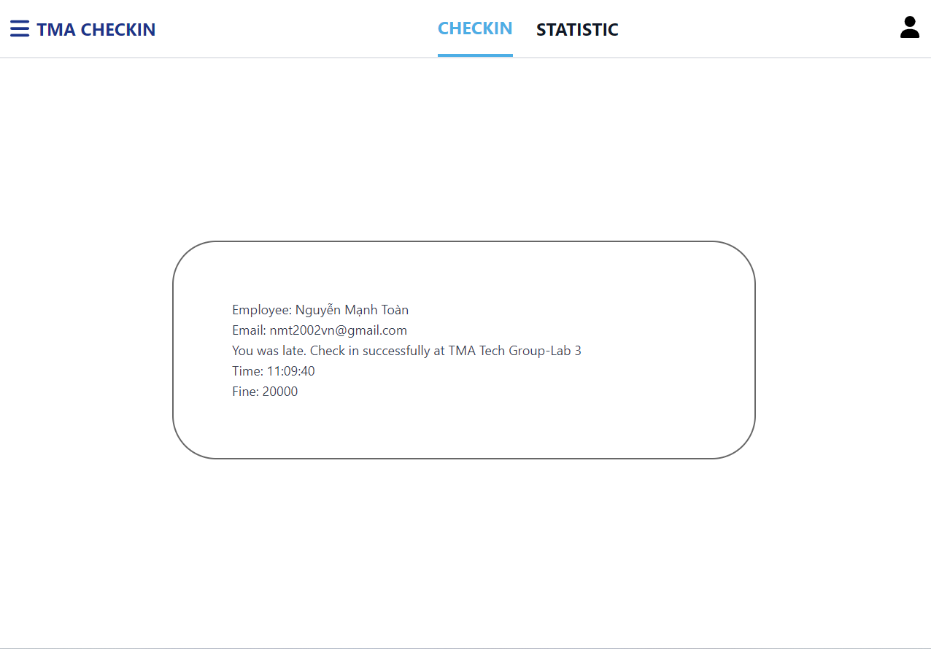
e. Demo -Check in feature
Users are required to check in within the vicinity of the company's branches, and the system will also calculate whether the check-in is late or not. If it's late, a penalty fee will be recorded.
Users are allowed to check in only once per day.
Check in feature

Slide 17
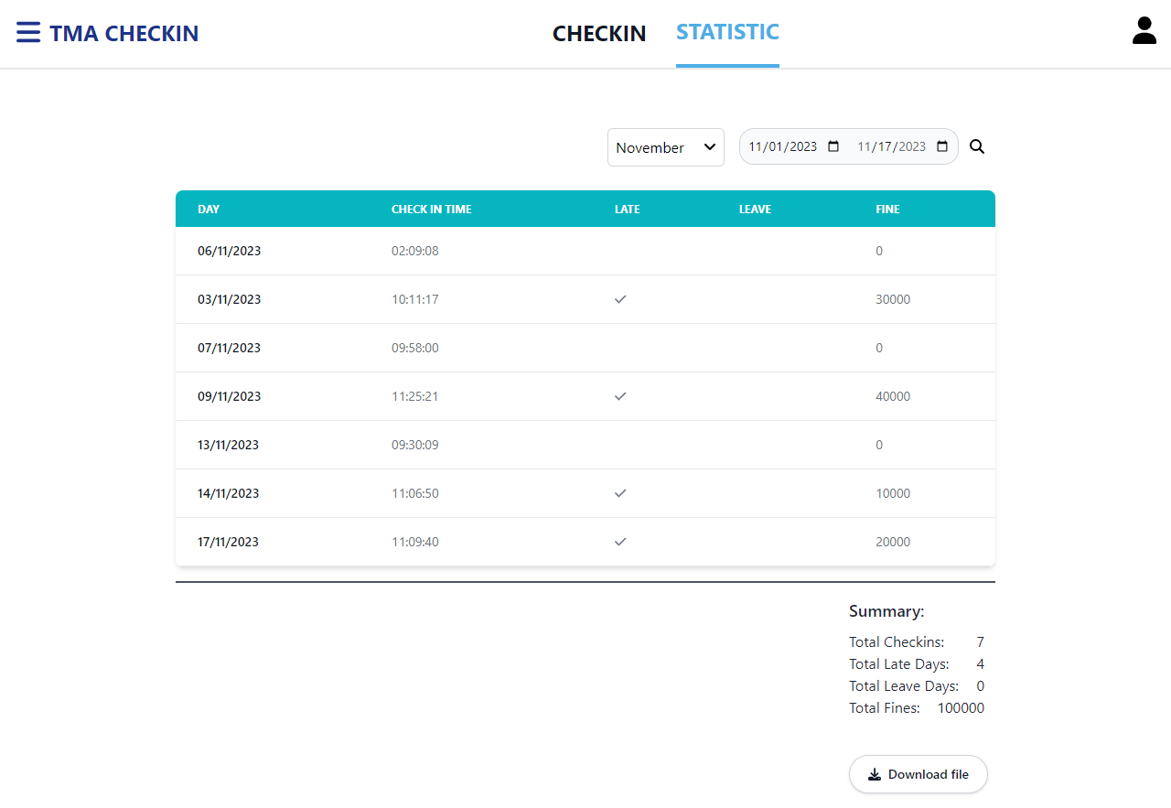
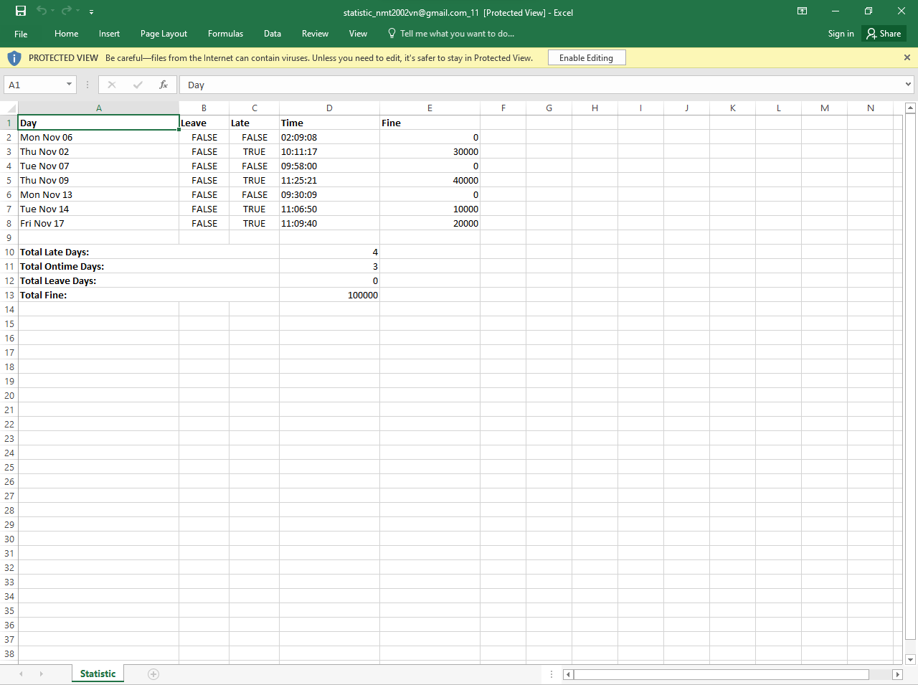
f. Demo - Statistic personal workdays
In the statistics feature, employees can view their check-in history for the last month.
A day off will be recorded when there is a scheduled workday, but the user does not check in on that particular day.
Additionally, this feature provides the following functionalities:
- Filtering by month
- Filtering by a specific time range
- Exporting data to an Excel file
Statistic feature

Slide 18
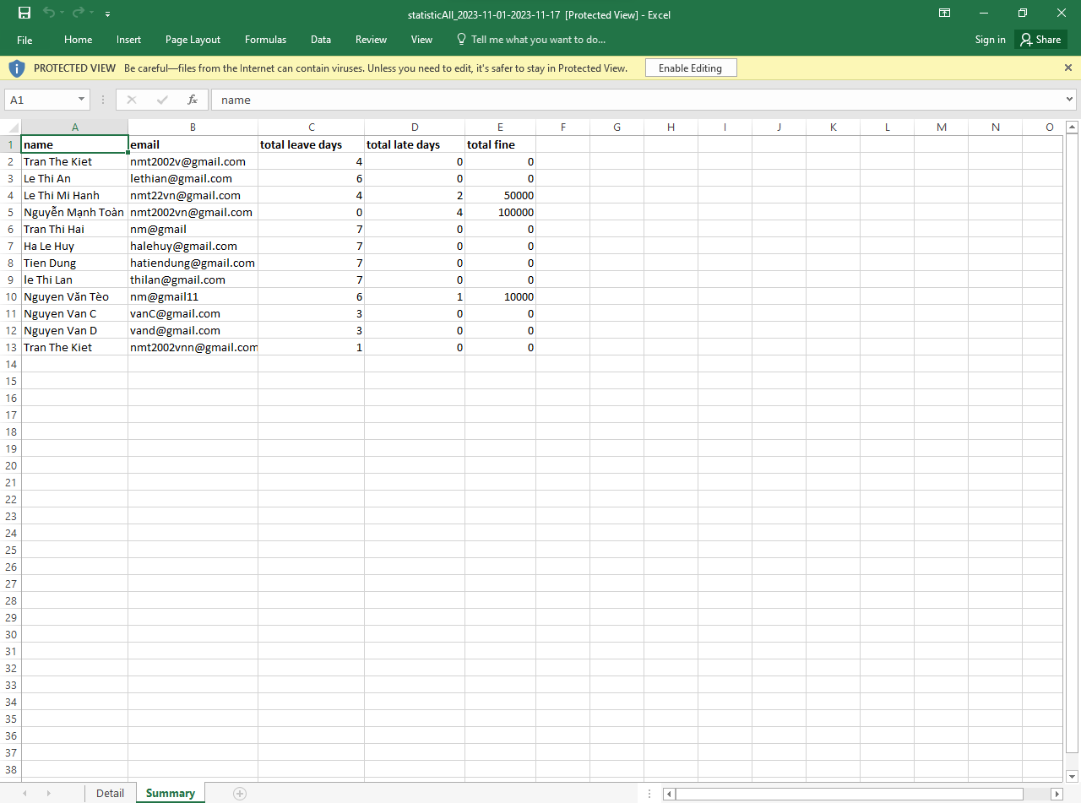
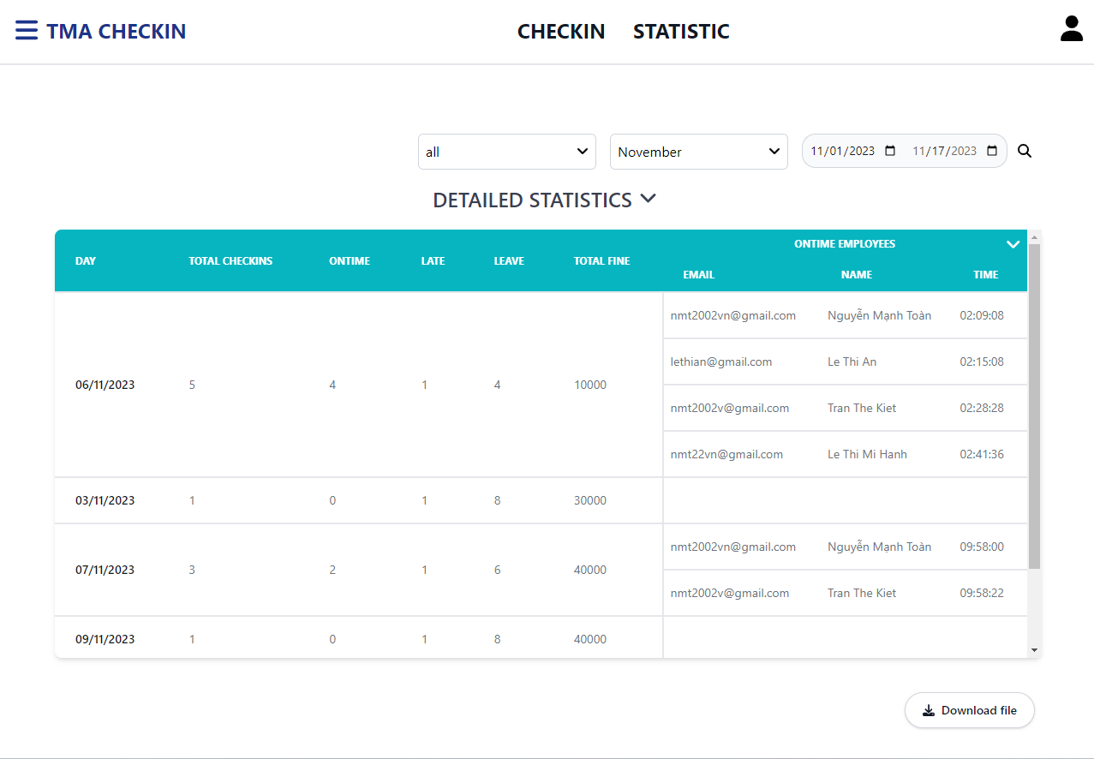
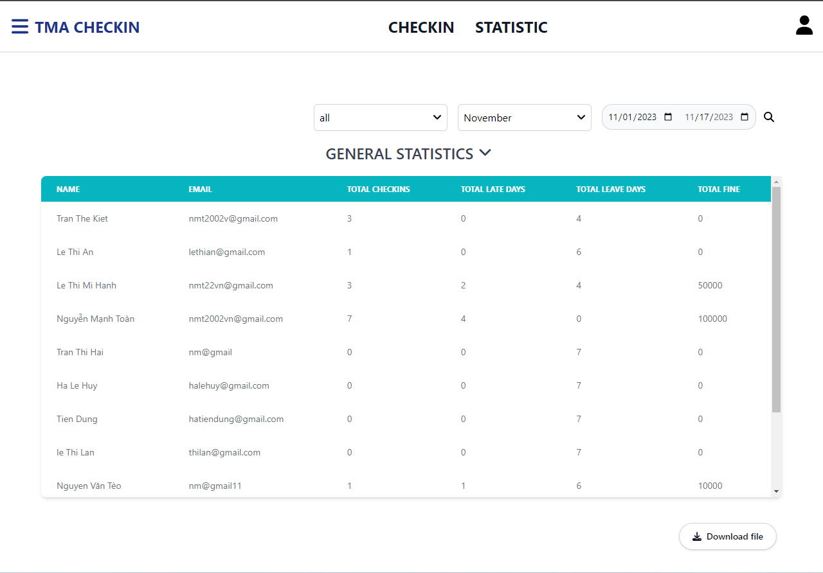
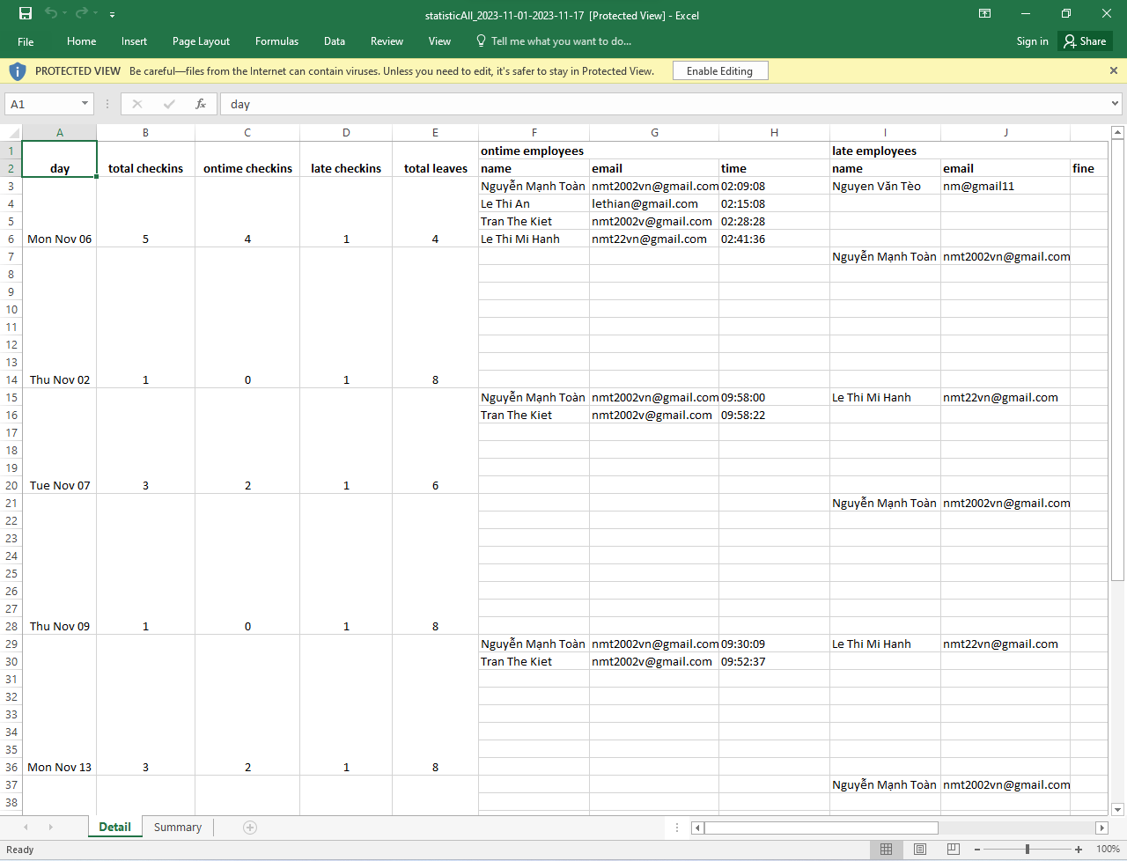
g. Demo - Statistic employees workdays
In the manager's statistics feature, managers can view the check-in history of all employees for a month.
The statistics can be done in two ways: daily statistics and employee-specific statistics.
Additionally, this feature provides the following functionalities:
- Individual employee-specific statistics (similar to daily statistics for individuals)
- Filtering by month and a specific time range
- Exporting data to an Excel file
Statistic employees workdays

Slide 19
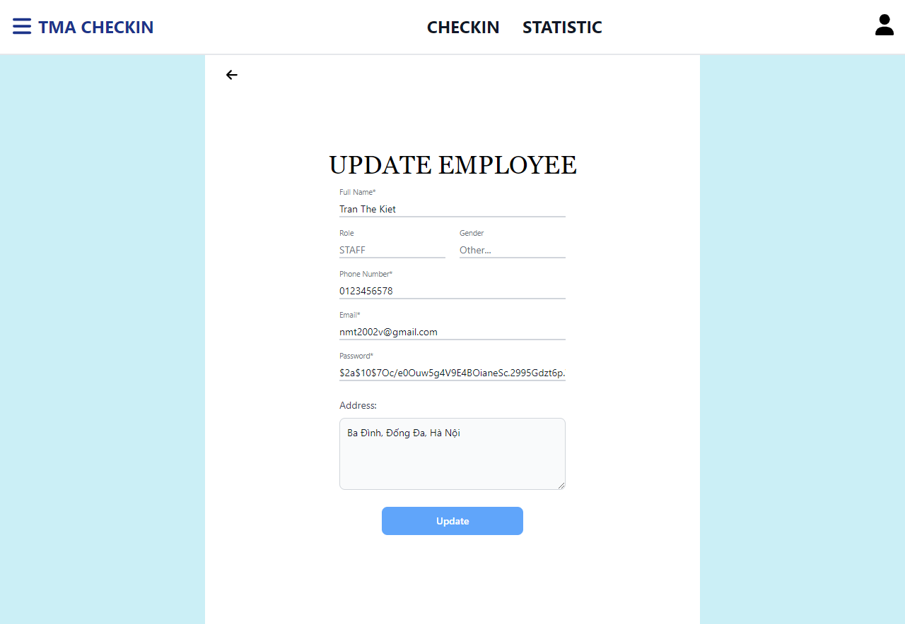
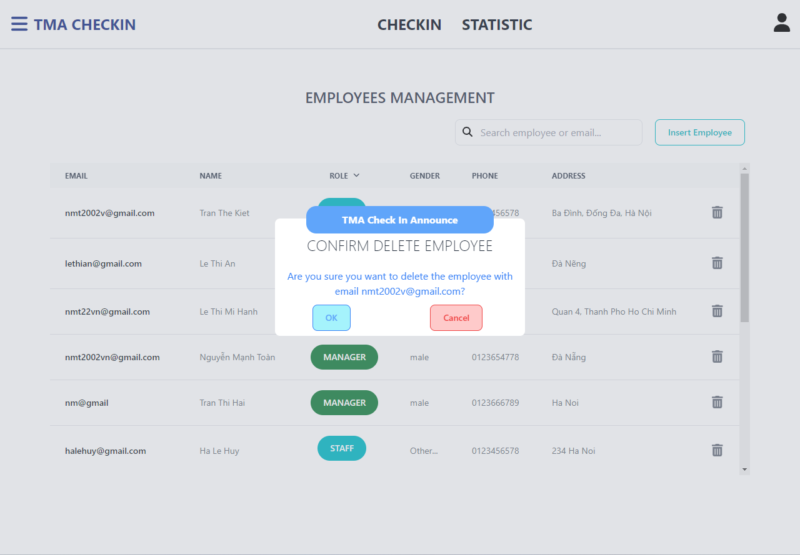
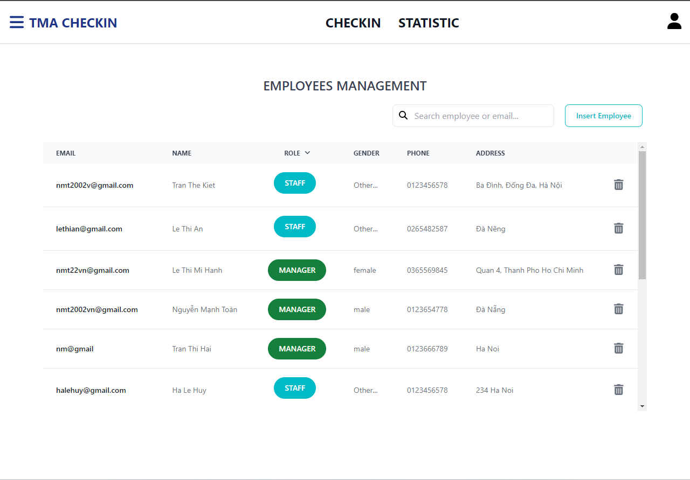
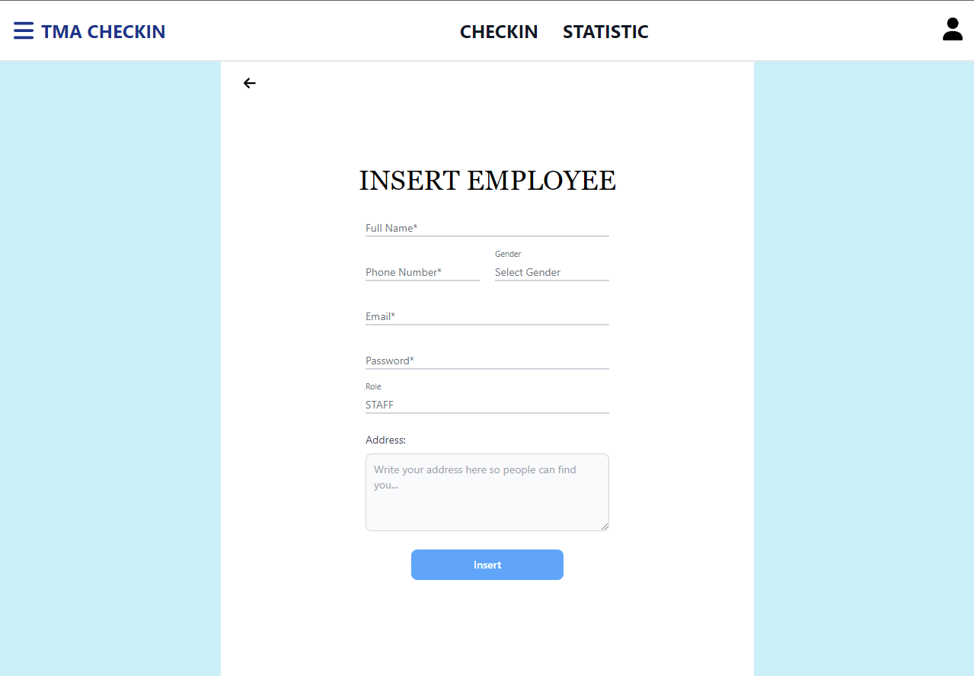
h. Demo - Management employees
This feature allows managers to perform tasks such as adding, editing, and deleting employees.
Additionally, this feature includes smaller functions such as:
- Searching by name or email.
- Filtering by employee role.
Management employees

Slide 20
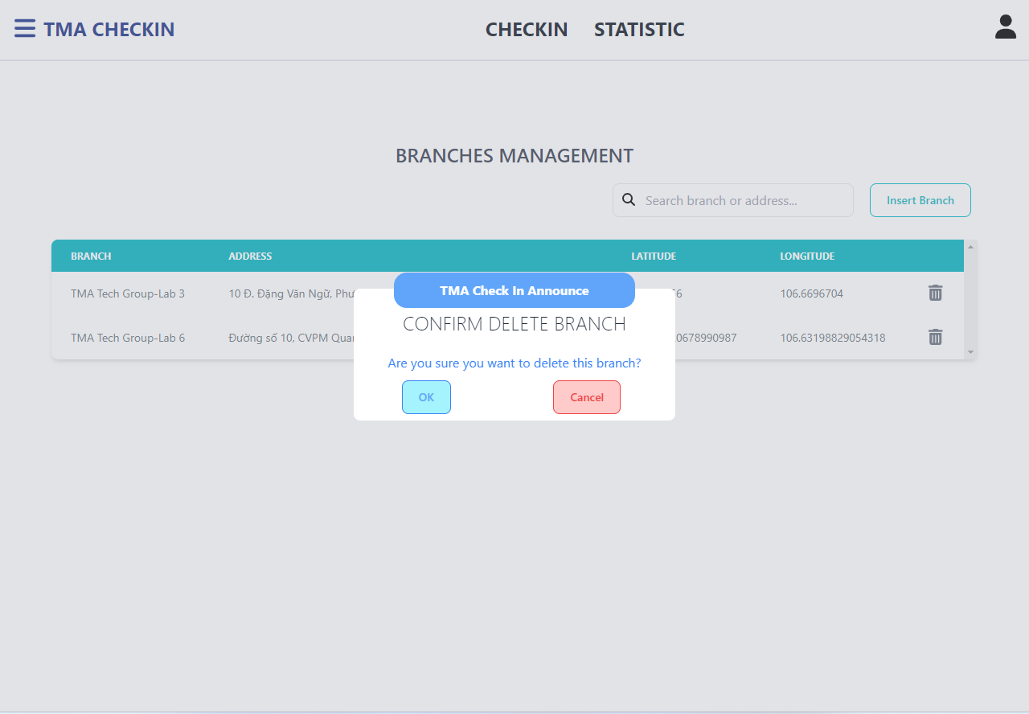
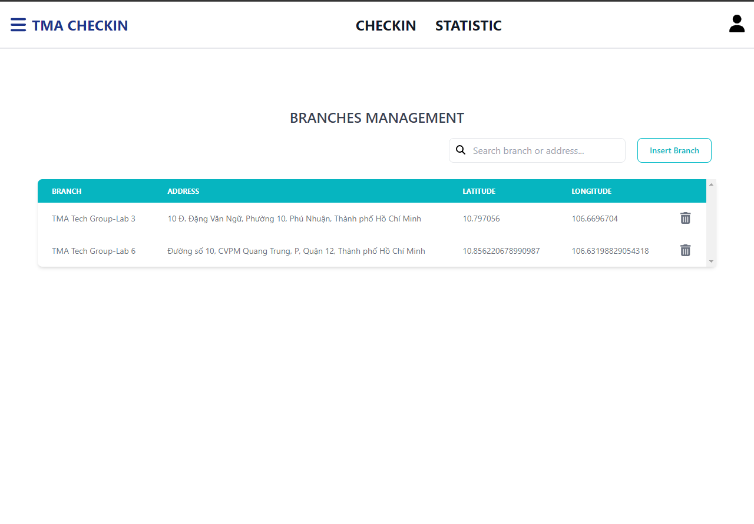
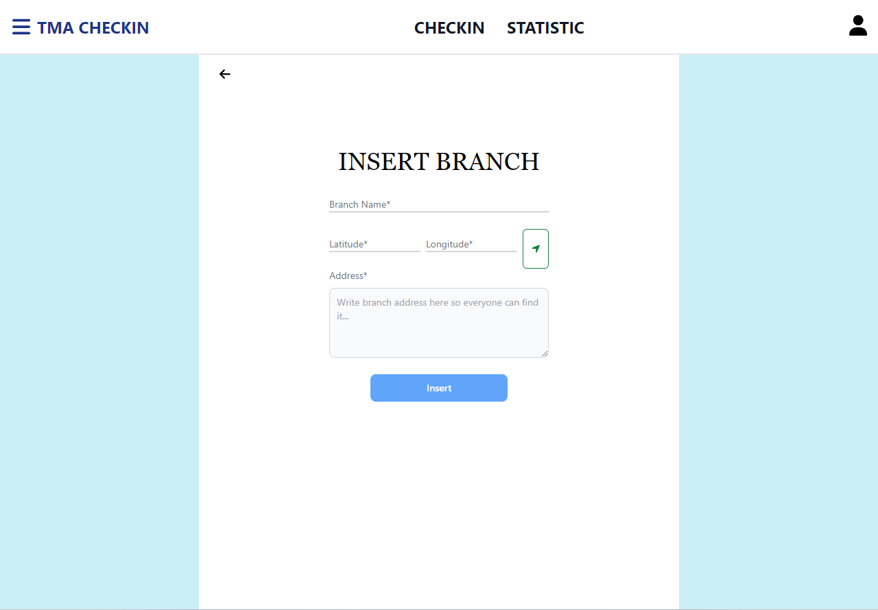
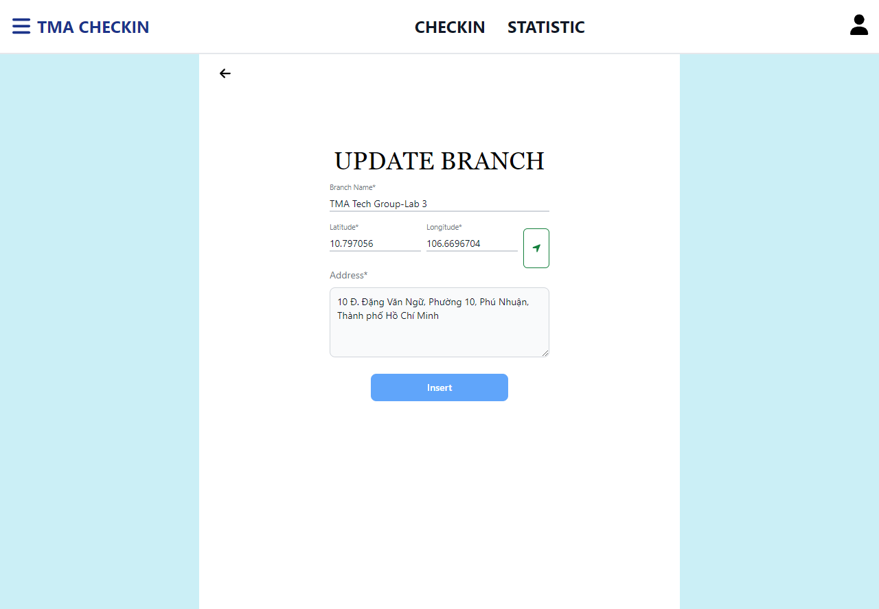
i. Demo - Management branches
Managers can use this feature to view, add, edit, and delete branches
Management branches

Slide 21
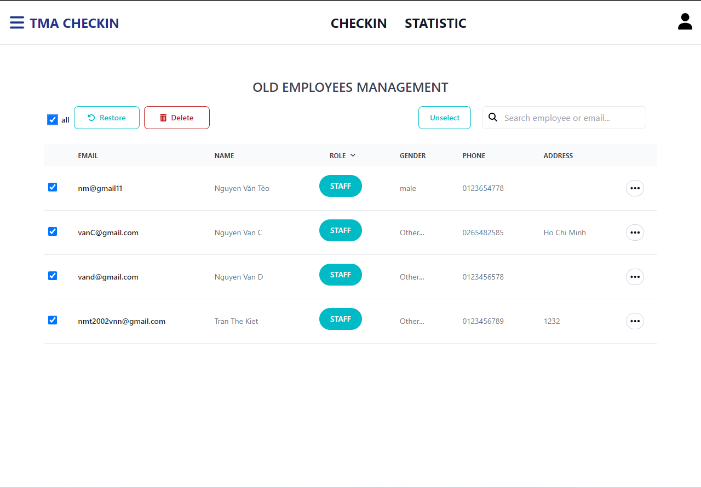
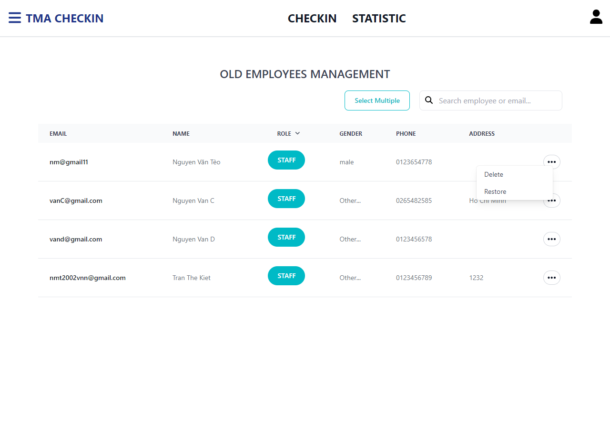
k. Demo -Management old employee
In this function, managers can use this function to view, permanently delete or restore employees who have been deleted in the employee management function.
Management Old Employees

Slide 22
05
Lessons learnt

Slide 23

05. Lessons learnt
a. Soft Skills
b. Knowledge

Slide 24
a. Lessons learnt - Soft Skills
- Communication skill
- Work etiquette
- Team work skill
- Information security

Slide 25
b. Lessons learnt - Knowledge
- Database: Learn how to use MongoDB and apply it to the implemented project
- Learn how to use Figma to create a mockup model for the project, thereby easily creating UI for the website
- Learn how to use NodeJS and ExpressJS, thereby creating a MERN stack project
- Deploy a complete project including client, server and database

Slide 26
Thanks
Do you have any questions?
nmt2002vn@gmail.com
+84 383 447 885
Thank you company for supporting me during my recent internship, I learned many things from the company. I hope to have the opportunity to cooperate with your company in the future.
Thanks and best regard.

