Slide 1
JavaScript Functions
Introduction to JavaScript Functions
By: Mehnaz Khan

Slide 2

What is a Function
A process, an activity, an operation, or a purpose where one thing depends on another.
a function takes something as input (cause, action, or condition) and produces a result (effect, outcome, or response).

Slide 3
What are Functions in JavaScript?
A function is a reusable block of code that performs a specific task.
Functions take inputs (parameters), process them, and return outputs.

Slide 4
Why Do We Need Functions?
Code reusability : Instead of writing the same code multiple times, use functions.
-Write once, use anywhere.
Better readability: Functions make code more structured and easier to understand.
Easier debugging: Fixing a function is easier than fixing scattered code.
Imagine a restaurant kitchen:
Instead of preparing each meal from scratch, chefs use predefined recipes (functions)!

Slide 5
Can you identify functions in daily life?
Think of one example from your daily life and explain how it works as a function!

Slide 6
Examples of Functions
Vending Machines: Insert money, press a button → You get a drink (Function process)
Mobile Apps: 'Login' button calls a function to check username & password.
ATMs: Enter PIN → A function checks if it's correct before allowing withdrawals.
Smart Assistants🗣️: Saying 'Hey Siri' or 'OK Google' calls a function to process voice commands.

Slide 7
Types of JavaScript Functions
Named Functions (functions declarations): Functions with a defined name.
function add(a, b) {
return a + b;
}
console.log(add(5, 3)); // Output: 8
name
keyword

Slide 8
Types of JavaScript Functions
2. Anonymous Functions (function expressions): Functions without a name, often assigned to variables. Created using only function keyword.
let multiply = function(a, b) {
return a * b;
};
console.log(multiply(4, 2)); // Output: 8

Slide 9
Types of JavaScript Functions
3. Arrow Functions: Shorter syntax using `=>`.
Removes the need for function keyword.
Uses => (arrow) for defining functions.
const divide = (a, b) => a / b;
console.log(divide(10, 2)); // Output: 5
const square = x => x * x;
console.log(square(2)); // Output: 4
If the function has only one expression and returns a value, you can omit the { } and return

Slide 10
Function Parameters & Arguments
Parameters: Placeholders for values that a function accepts.
function add(a,b) – a and b are the parameters
Arguments: Actual values passed to the function when calling it.
console.log(add(4,5)); 4 and 5 are the actual values passed to a and b
Default Parameters: Allow setting default values if no argument is provided.

Slide 11
Example📝
Example:
function greet(name = 'Guest') {
return 'Hello, ' + name + '!';
}
console.log(greet()); // Output: Hello, Guest!
console.log(greet('John')); // Output: Hello, John!
This defines a function named greet.
It takes one parameter called name.
The = 'Guest' part is a default parameter.
If no value is passed when calling the function, name will automatically be 'Guest’.
return 'Hello, ' + name + '!';
This returns a greeting message by concatenating strings:
"Hello, " + name + "!"

Slide 12
Return Values
Return Statement: Specifies the output of a function. Functions can accept parameters and return values.
Example:
function add(a, b) {
return a + b;
}
console.log(add(5, 3)); // Output: 8

Slide 13
Function Scope in JavaScript
JavaScript functions provide scope
Variables defined inside a function are local to that function. Variables declared with `var` inside a function are local to that function
Example:
function example() {
var localVar = 'I am local';
}
console.log(localVar);
// Error: localVar is not defined

Slide 14
Example: Scope Behavior
In Javascript there is no block-level scope with curly braces for var. Only function scope exists. If there's no wrapping function, variables become global
Variables inside if block or loops are not block-scoped:
if (true) {
var x = 10;
}
console.log(x); // Output 10 (Not limited to the if block!)
But, let and const are block-scoped
if (true) {
let x = 10;
const y = 20
}
console.log(x);
// Error: x is not defined
console.log(y);
// Error: y is not defined

Slide 15
So, var is function-scoped, not block-scoped,
and let is block-scoped
Let’s check an example:
First, we will create an HTML page with 5 buttons

Slide 16
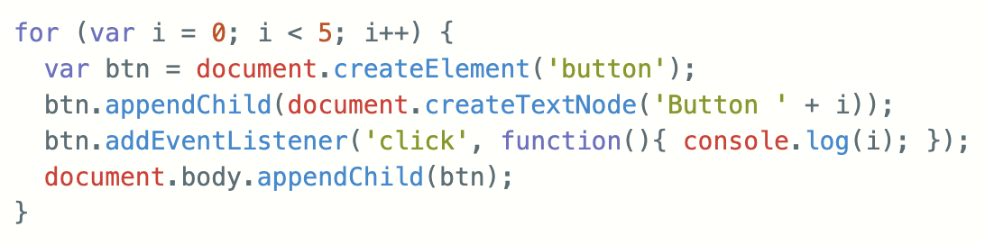
What does this code do?

Slide 17
var is function-scoped, not block-scoped. So all 5 buttons share the same i.
When you click any button, it prints 5 (after the loop ends, i = 5).
If we want each button click to print the corresponding value of i, then we should use let instead of var

Slide 18
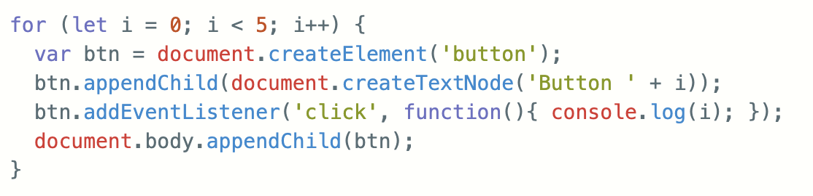
let is block-scoped — each loop iteration gets its own copy of i. Now each button remembers the correct value of i when it was created.
So clicking Button 0 prints 0, Button 1 prints 1, and so on.

Slide 19
Importance of Scope Control
Minimizing global variables is a good habit:
- Reduces conflicts between variable names
- Helps maintain code clarity
- Functions play a crucial role in encapsulating variables
- Always declare variables inside functions when possible

Slide 20
What is the output?
function setup() {
var temp = "I am local";
}
setup();
console.log(temp);

Slide 21
function setup() {
temp = "I am global now!"; // No 'var', 'let', or 'const' -becomes global!
}
setup();
console.log(temp);
// "I am global now!" (BAD!)
This can pollute the global scope and lead to conflicts.

Slide 22
Immediate Functions (IIFE)
Immediately Invoked Function Expressions
Functions that execute immediately upon definition
Helps create a local scope
Also called self-invoking/self-executing functions
Example:
(function() {
var temp = 'I am temporary';
console.log(temp);
})();
console.log(temp); // Error: temp is not defined

Slide 23
Why use Immediate Functions
Benefits and usage:
These functions help you wrap an amount of work you want to do without leaving any global variables behind. All the variables you define will be local to the self-invoking functions and you don’t have to worry about polluting the global space with temporary variables.
The question that arises here: aren’t the variables local in all functions? So why do Immediate functions get special credit for keeping variables local?

Slide 24
With a regular function declaration
function setup() {
var temp = "I am local";
}
setup();
console.log(temp);
// Error: temp is not defined (good!)

Slide 25
What happens now
function setup() {
temp = "I am global now!"; // No 'var', 'let', or 'const' -becomes global!
}
setup();
console.log(temp); // "I am global now!" (BAD practice)
This can pollute the global scope and lead to conflicts.

Slide 26
With immediate function- complete isolation
(function() {
temp = "I am safe inside!";
console.log(temp); // Works inside
})();
console.log(temp); // Error: temp is not defined (GOOD!)
Here, temp never leaks because:
The function executes immediately.
The variable exists only inside the immediate function.
Nothing from inside the function is accessible globally.

Slide 27
When is This Useful?
Avoiding accidental global variables
Encapsulating code to prevent conflicts (e.g., in libraries or modules)
Creating temporary variables that should disappear after execution
Avoiding name collisions in larger projects

Slide 28
Closures In Javascript
Closures: Functions that retain access to variables from their parent scope.
A closure is when a function "remembers" variables from its outer scope even after the outer function has finished executing

Slide 29
Simple Example of a Closure:
function outer() {
let count = 0;
function inner() {
count++;
console.log("Count:", count);
}
return inner;
}
const counter = outer(); // outer() runs and returns inner()
counter(); // Count: 1
counter(); // Count: 2
counter(); // Count: 3

Slide 30
outer() defines a local variable count and a function inner().
outer() returns inner() — but count is not lost.
Even after outer() is done, counter() still has access to count because of closure.
The inner function is the closure — because it "closes over" the count variable from its outer function (outer).

Slide 31
Hoisting in Javascript
Hoisting is JavaScript's behavior of moving declarations to the top of the current scope during the compilation phase, before code runs.
Function Declarations are Hoisted- i.e, we can call a function before its definition
Function Expressions are not hoisted

Slide 32
Example: Function Declarations are Hoisted
sayHi(); // This Works! Output: Hello
function sayHi() {
console.log("Hello");
}

Slide 33
Function Expressions are not hoisted
sayHi(); // Error: sayHi is not a function
var sayHi = function() {
console.log("Hello");
};
Only the variable sayHi is hoisted, not the function assigned to it. So when sayHi() is called, it's still undefined.

Slide 34
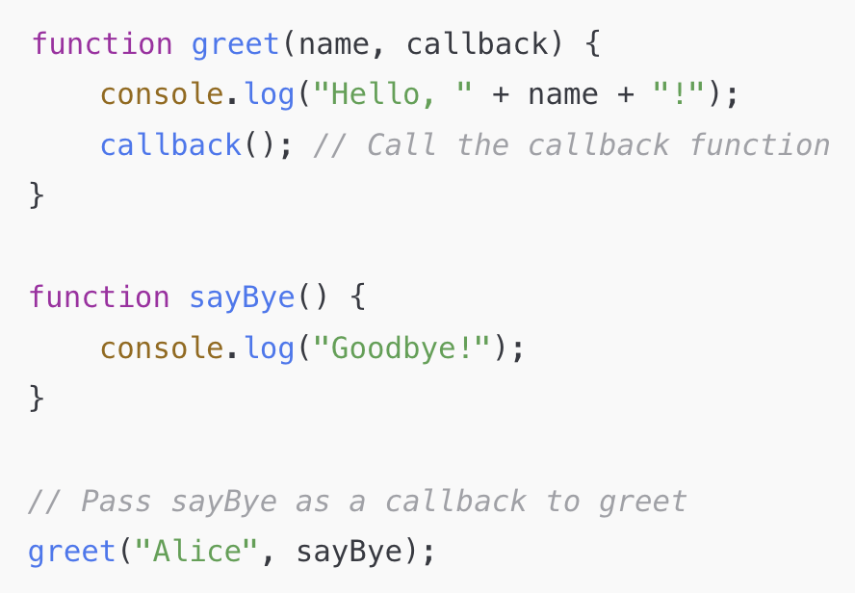
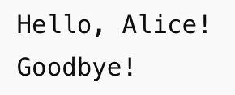
CallBack Functions
A callback is a function passed as an argument to another function, and it's called later.
Output

Slide 35
How it works
greet takes two parameters: name and callback
It prints the greeting, then calls the callback function
sayBye is passed in as a callback and runs after the greeting

Slide 36
Returning Functions
Functions can return other functions
Useful for closures
function outer() {
let count = 0;
function inner() {
count++;
console.log("Count:", count);
}
return inner;
}
const counter = outer(); // outer() runs and returns inner()
counter(); // Count: 1
counter(); // Count: 2
counter(); // Count: 3

Slide 37
Hands-On Challenge!
Write a function that:
Takes a person's name and age.
Returns whether they can legally drive.

Slide 38
Solution
function canDrive(name, age) {
return age >= 18 ? `${name} can drive!` : `${name} cannot drive yet`;
}
console.log(canDrive('Bob', 16));
Can be also written as:
return age >= 18 ? name + “ can drive!” : name + “cannot drive yet”;

