Slide 1
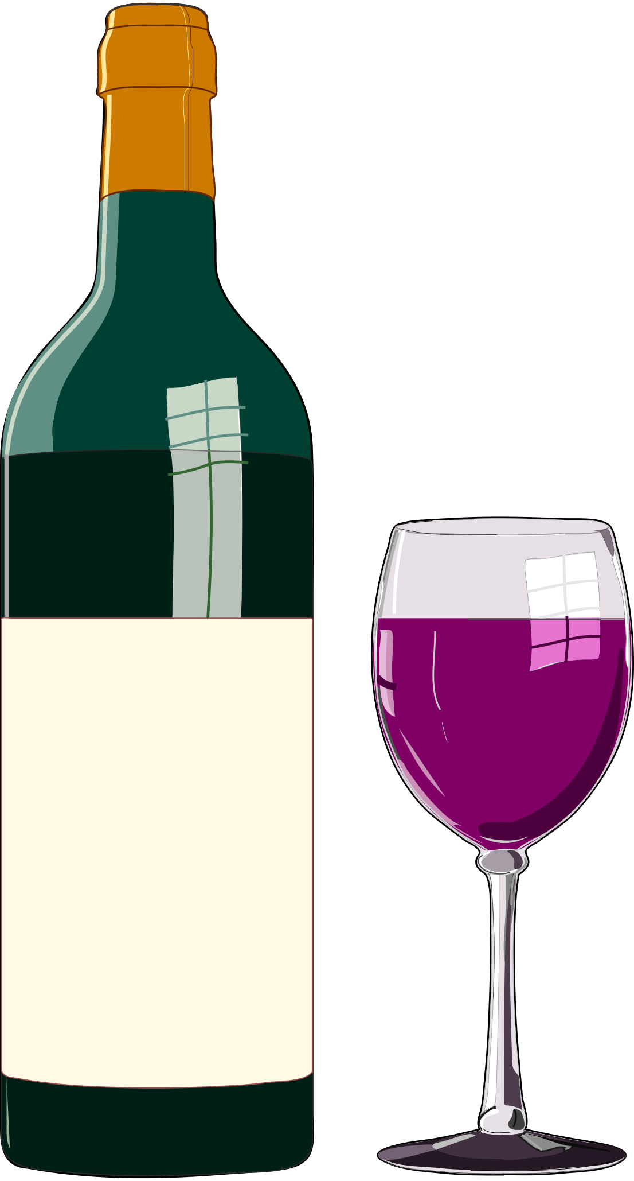
Wine Ratings
October 17, 2022

Slide 2
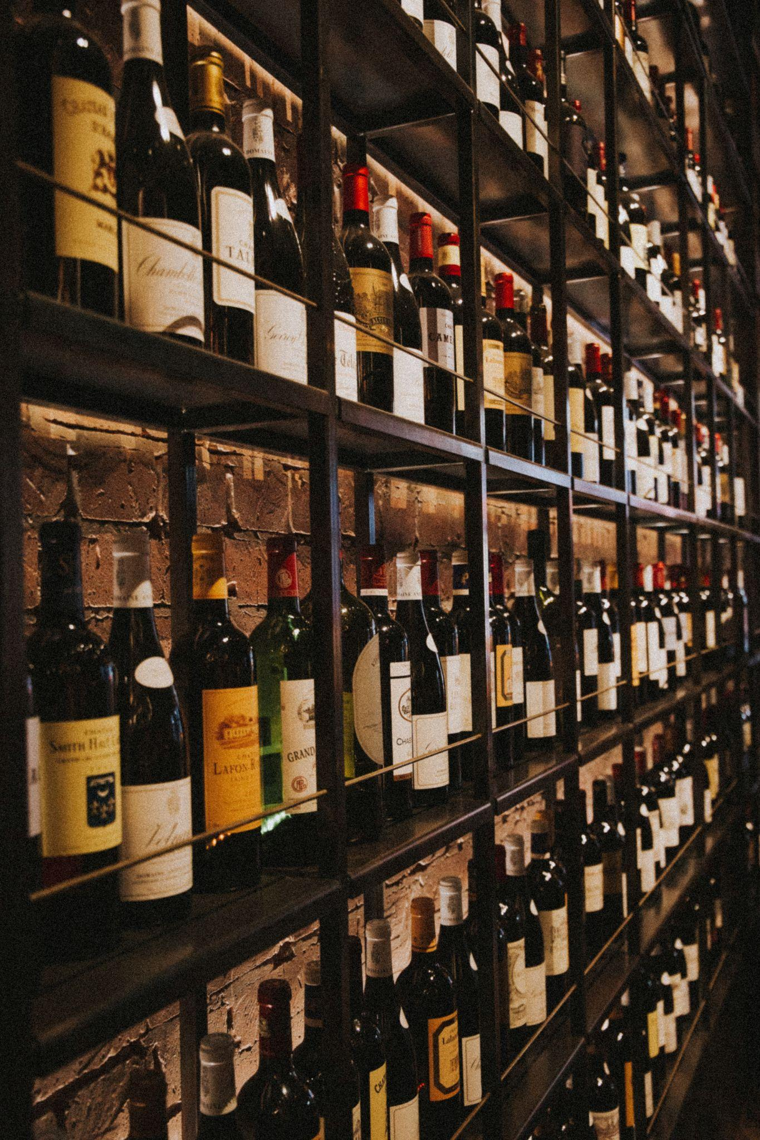
Overview
Ever looked at the never ending wall of wines at the grocery store for a bottle to bring to the party? Wine ratings can help!
As a consumer, wine ratings can help us gauge prices points– to pick the right one for the right event.
For businesses, wine ratings can help optimize and target sales/production.

Slide 3
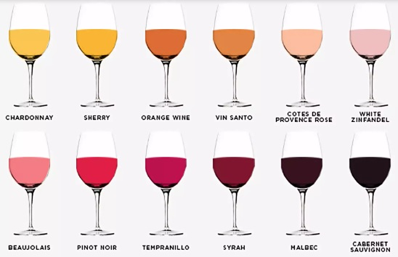
Research Question
Can different wine features (acidity, sugars etc.) be used to predict wine ratings? If so, how well?
What are the top 3 qualities of wine that contributes to predicting its ratings?

Slide 4
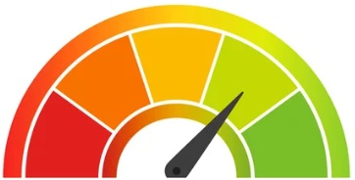
The Data
The data https://archive.ics.uci.edu/ml/datasets/wine.
There were 13 qualities (features) that contributed to the rating of the wine.
Ratings ranged from 3 (least favorable) to 9 (highly favorable).
Here’s what we did…

Slide 5
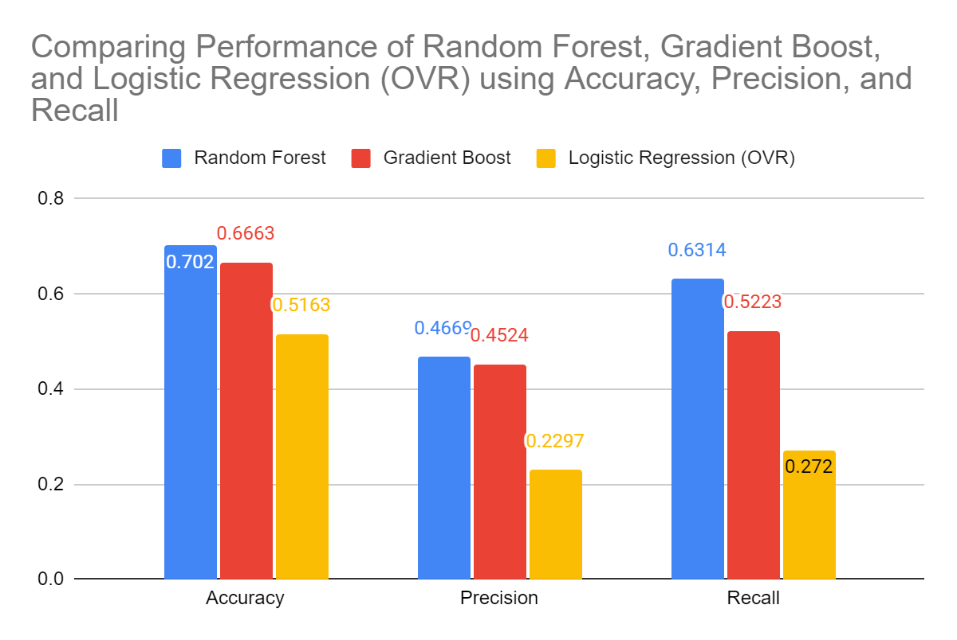
Model Construction and Comparison
Anomalous data points were located and reset to the mean data point.
Feature Engineering: Free Sulfur Dioxide and Total Sulfur Dioxide were combined due to similar covariance trends.
Random Forest, Gradient Boost, and Logistic Regression (OVR) was fitted to the data and measured for accuracy, precision, and recall.
Random Forest performed better than the rest in all 3 metrics.

Slide 6
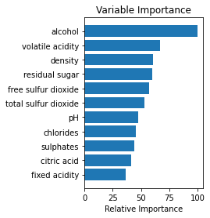
Model Selection and Potential Improvements
 | Random Forest | Gradient Boost | Logistic Regression (OVR)
Accuracy | 0.702 | 0.6663 | 0.5163
Precision | 0.4669 | 0.4524 | 0.2297
Recall | 0.6314 | 0.5223 | 0.272
Data was limited to ~200 data points. Adding more data and help boost performance metrics.
Perform more rigorous feature engineering. Creating more features instead of less features.
Top 3 feature importance in model predictions were Alcohol, Volatile Acidity, and Density

Slide 7
Conclusion and Recommendation
Random Forest model was selected amongst 2 other models. It was able to predict wine ratings with roughly 70% accuracy.
The use of this tool can help businesses optimize sales/production by giving them the ability to predict which how the wine will perform before it hits the shelves.
Recommendations…
We recommend adding more data points to train data better. Additionally, determining which top qualities will lead to higher rating wine.

