Slide 1


Raghu Engineering College (Autonomous)
Visakhapatnam
Department of CSE (AI/ML)
Farm2Home
"Fresh from the Farm, Straight to Your Home."
HEAD OF THE DEPARTMENT CSE(AI&ML)
PROJECT GUIDE
TEAM MEMBERS
Mr. K. Sandeep Kumar
Assistant Professor
25985A4205 – Chamarthi Manikanta
25985A4207 – Dadi Sai Dinendra
25985A4219 – Kudumula Sai Krishna
25985A4236 – Sunapathi Jaswanth
24981A422N – Meka Sri Kowshik
Dr. G. Sridevi
Notes:
Title slide: Farm2Home, Raghu Engineering College (Autonomous), Visakhapatnam. Department of CSE (AI/ML). Introduce the guide, the HOD and the five team members.

Slide 2








Abstract
Farm2Home is a frontend web marketplace that connects local farmers directly with consumers.
Why it was developed
What problem it solves
How it connects farmers and consumers
Middlemen and opaque pricing leave farmers with less value and give buyers little visibility into where produce comes from.
It offers a searchable catalogue with clear prices and farmer profiles, so consumers can see who grows each product.
Shoppers save favorites, manage a cart and follow a demo checkout. Farmers register through an online form.
TECHNOLOGIES USED
HTML5
CSS3
JavaScript
LocalStorage / SessionStorage
Modern Web Browser
Notes:
Abstract: what Farm2Home is, why it was built, the problem it solves, how it connects farmers and consumers, and the technologies used. It is a frontend-only academic prototype.

Slide 3





Project Content
Introduction
Problem Statement
Existing System
Farm2Home is an academic prototype of an online marketplace where consumers buy produce straight from local farmers.
Middlemen dominate agricultural sales, prices are opaque, and consumers cannot easily see who grows their food.
Traditional supply chains sell through intermediaries, so farmer details and price breakdowns stay hidden from buyers.
Proposed System
Project Scope
Main Features
A direct frontend marketplace with transparent pricing, farmer profiles, favorites and a complete cart flow.
Frontend-only prototype: browsing, filtering, cart, demo checkout and farmer registration. No backend, real payments or real login.
Search and filters, farmer directory and profiles, favorites, shopping cart, farmer registration and a light/dark theme.
Notes:
Project content: introduction, problem statement, existing system, proposed system, scope and main features.

Slide 4




Requirement Specifications
Hardware Requirements
Functional Requirements
Non-Functional Requirements
Desktop or laptop computer
Any system that can run a modern web browser and VS Code
Display for viewing the responsive interface
Browse and search the product catalogue
Filter by category, location, farming method, availability and price
View the farmers directory and farmer profiles
Save favorites and manage the shopping cart
Demo checkout and simulated order tracking
Farmer registration form
Responsive layout for different screen sizes
Simple and consistent navigation
Light and dark theme option
Browser-based data persistence
Runs fully in the browser with no backend
Modular, maintainable HTML, CSS and JS files
Software Requirements
HTML5
CSS3
JavaScript
Modern web browser
VS Code or equivalent editor
Local static server (VS Code Live Server)
Notes:
Hardware requirements are stated generally. Replace them with the exact values from the project documentation if the guide requires specific figures.

Slide 5





Objectives
01
02
03
04
Direct Connection
Transparent Pricing
Product Discovery
Farmer Visibility
Link farmers and consumers without middlemen.
Show clear product prices to every buyer.
Search, filter and sort the catalogue.
Display farmer profiles and farm details.
05
06
07
08
Cart Management
Wishlist
Responsive Design
Data Persistence
Add items and update the cart easily.
Save favorite products in one place.
Adapt the interface to different screens.
Keep data in the browser using web storage.
Notes:
Eight objectives: direct farmer-to-consumer connection, transparent pricing, product discovery, farmer information visibility, cart management, wishlist, responsive design and browser-based persistence.

Slide 6







Flow / Methodology
1
2
3
4
Discover
Explore Products
View Product Details
Add to Cart
Land on the home page and see featured categories.
Browse the catalogue; search and filter by category, location, method and price.
Open a product to see its details and farmer information.
Add items; quantities and totals update in the browser.
7
6
5
Demo workflow
Order Tracking
Order Confirmation
Checkout
Checkout, confirmation and tracking are simulated in the frontend. No real payment or delivery is processed.
Follow a simulated order timeline.
The demo order is placed and confirmed on screen.
Enter demo billing and delivery details.
Notes:
The shopping workflow: Discover, Explore Products, View Product Details, Add to Cart, Checkout, Order Confirmation, Order Tracking. The last three stages are demo/simulated.

Slide 7




System Architecture
EXECUTION ENVIRONMENT: MODERN WEB BROWSER
Presentation Layer: HTML5
Styling Layer: CSS3
Page structure: marketplace page plus templates for header, footer and views.
Stylesheets for layout, catalogue, cart, checkout, dashboard and responsive design.
Frontend-only
No backend, database server or API is used.
DOM updates
styles applied
User
Application Logic: JavaScript
Data stays in the browser.
Consumer / Farmer
Hash router, view renderers, event handlers, filtering and sorting, cart and favorites, demo auth and orders. Static product data in catalog.js.
DATA PERSISTENCE
LocalStorage
SessionStorage
Persistent browser data
Per-session browser data
Notes:
Architecture of the frontend-only application. HTML5 presents, CSS3 styles, vanilla JavaScript holds the logic, LocalStorage and SessionStorage persist data, and everything runs in a modern web browser. No backend, database or API exists.

Slide 8
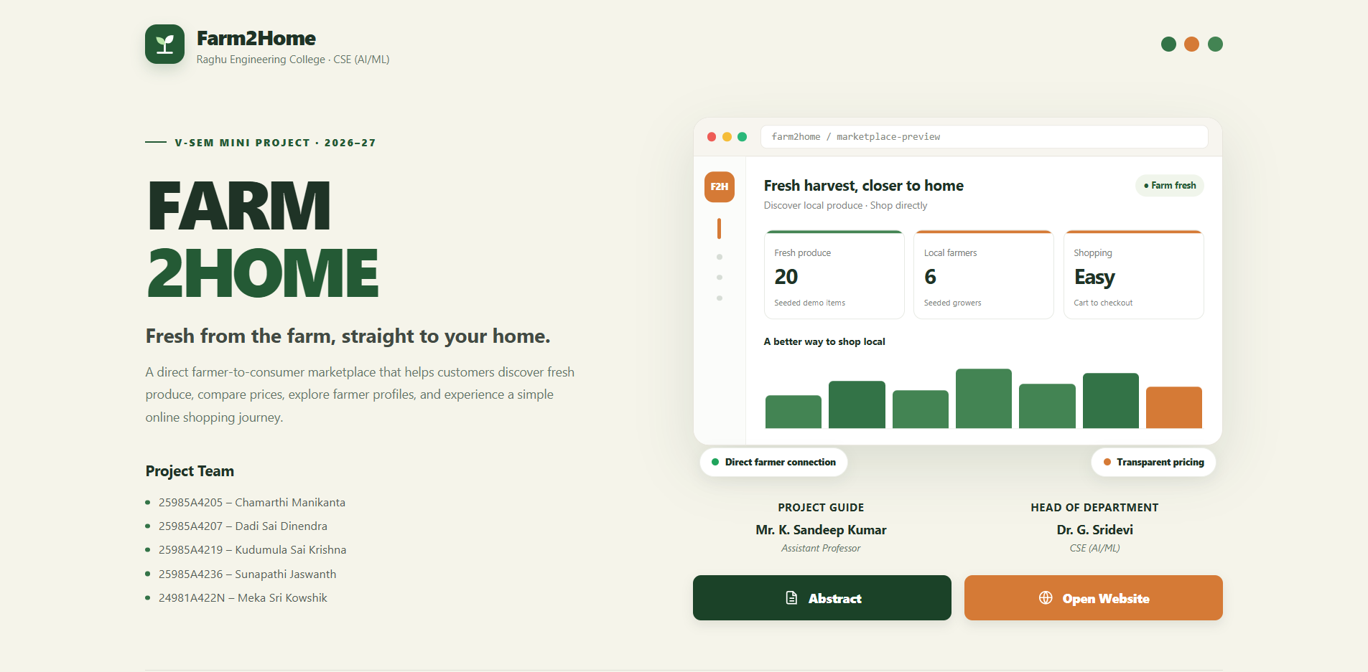

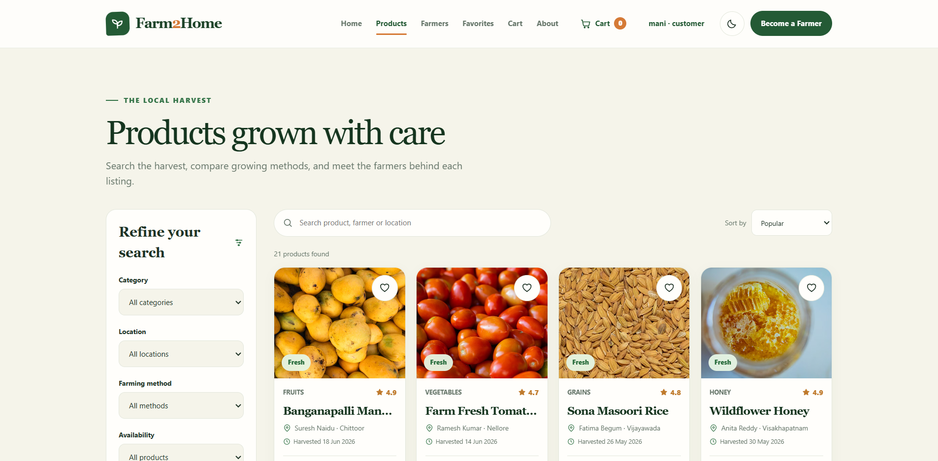
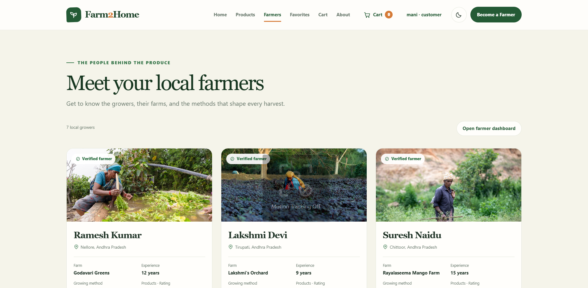
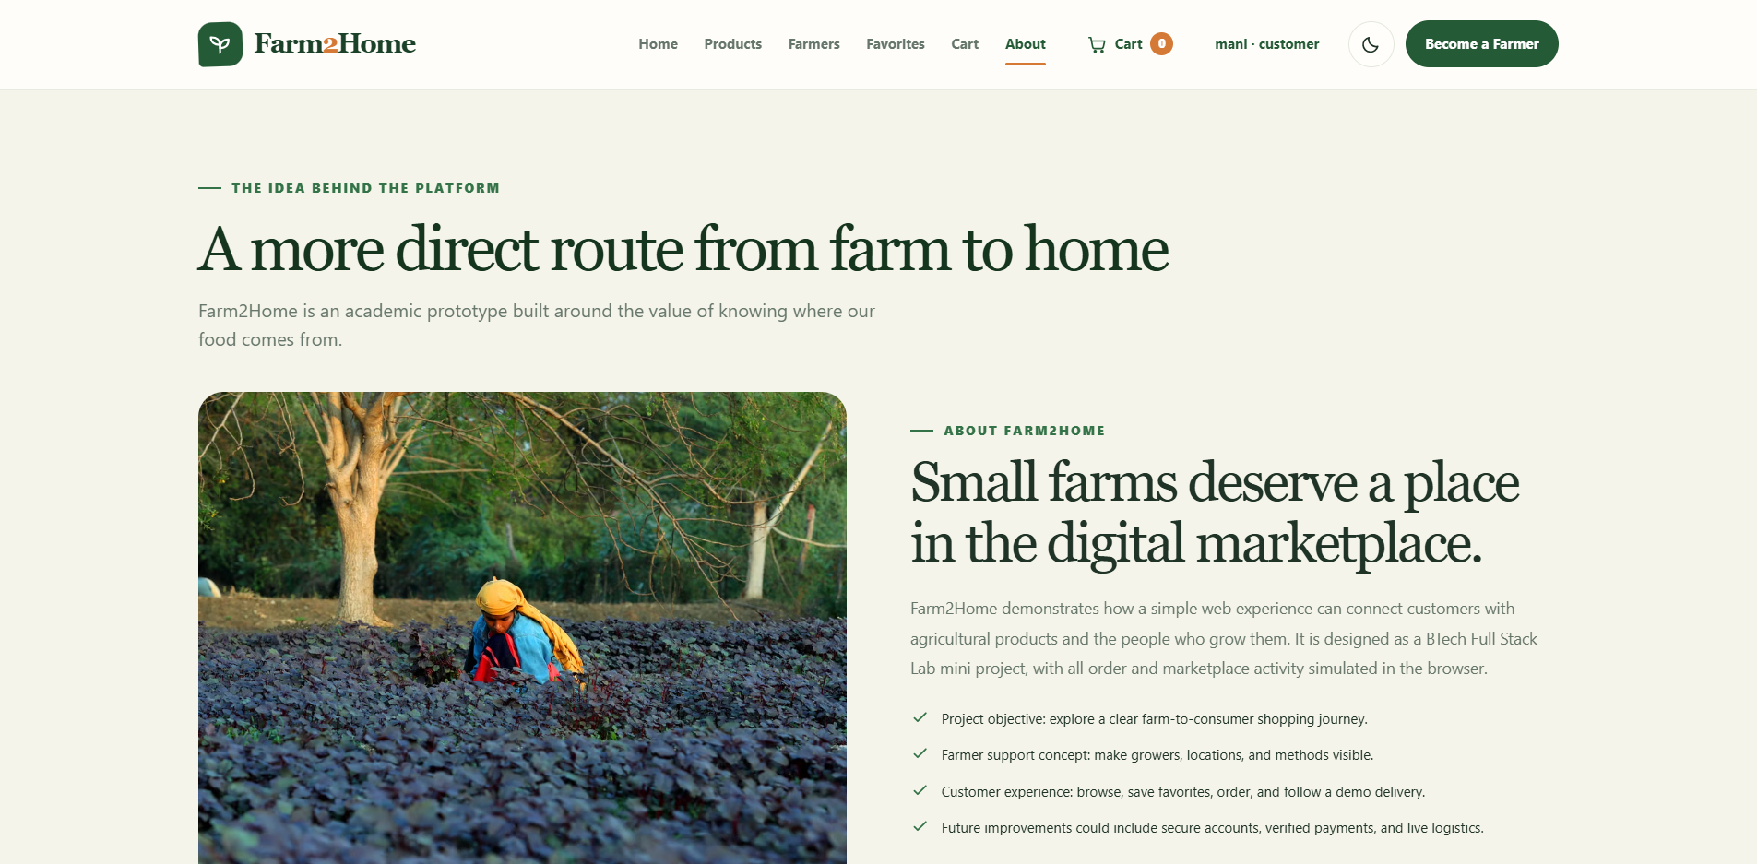
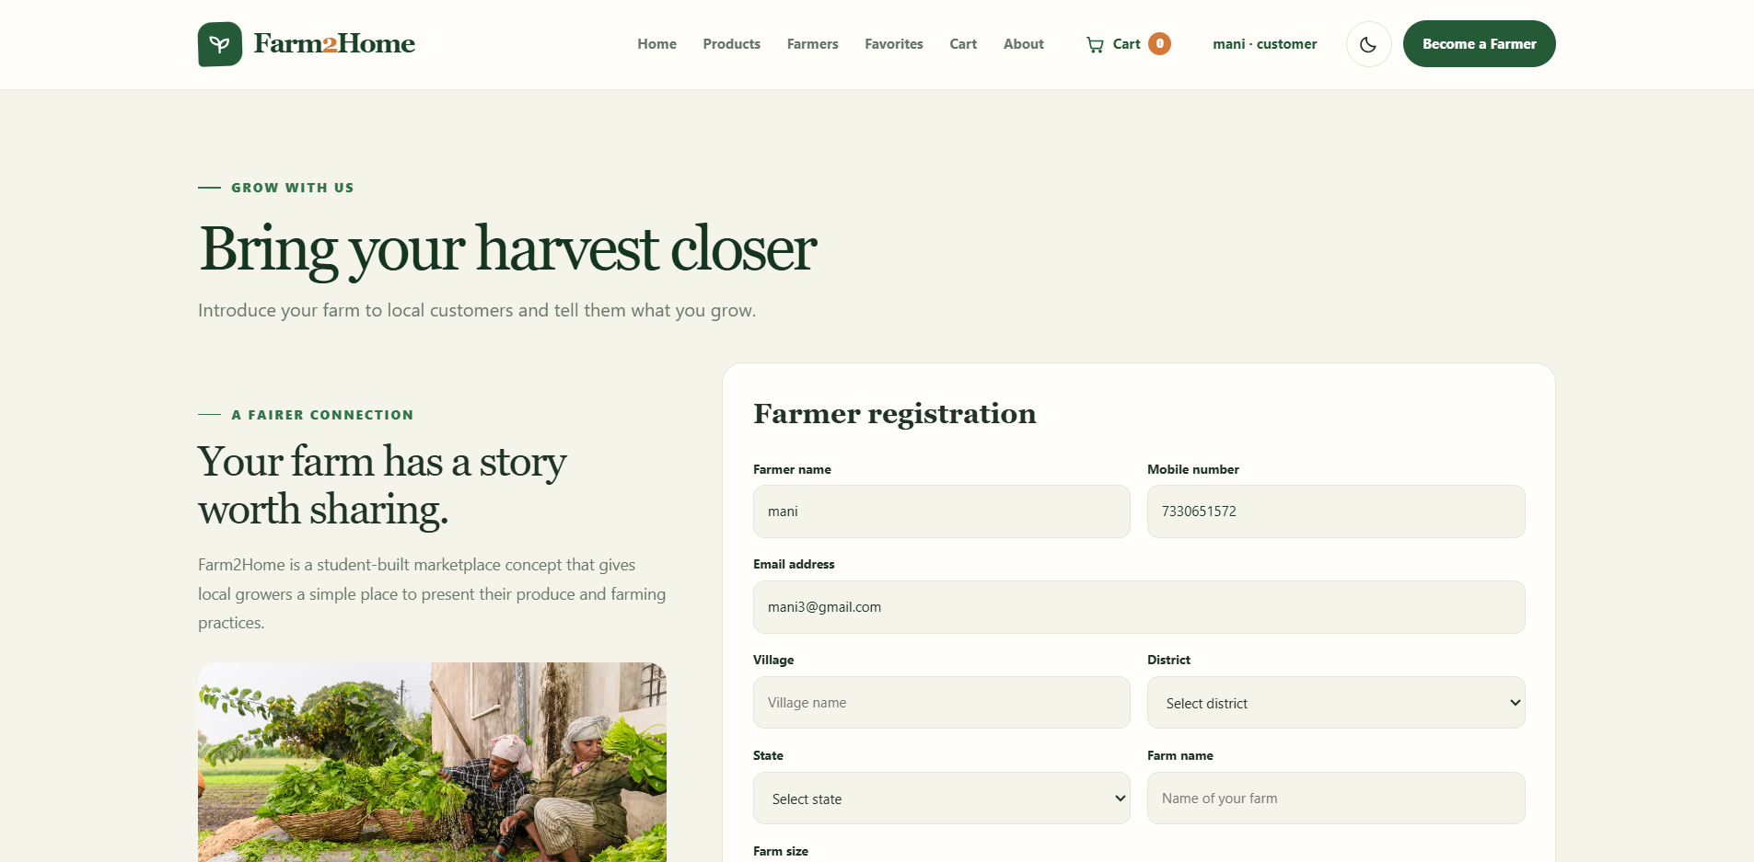
UI Designs: Website Screenshots
Project Showcase
Landing page with project team and options
Homepage
Hero section with shop and farmer actions
Product Catalogue
Search bar, filters and product cards
Farmers Directory
Local farmers with verified profiles
About Page
Platform idea and key points
Farmer Registration
Form for farmers to join the marketplace
Notes:
Actual screenshots of the Farm2Home interface: project showcase, homepage, catalogue, farmers directory, about page and farmer registration.

Slide 9
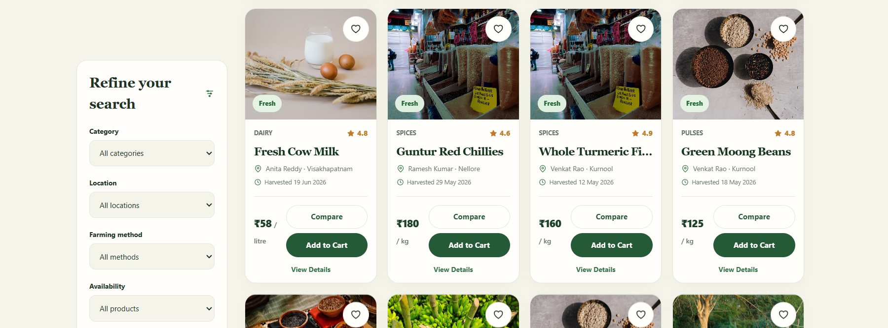
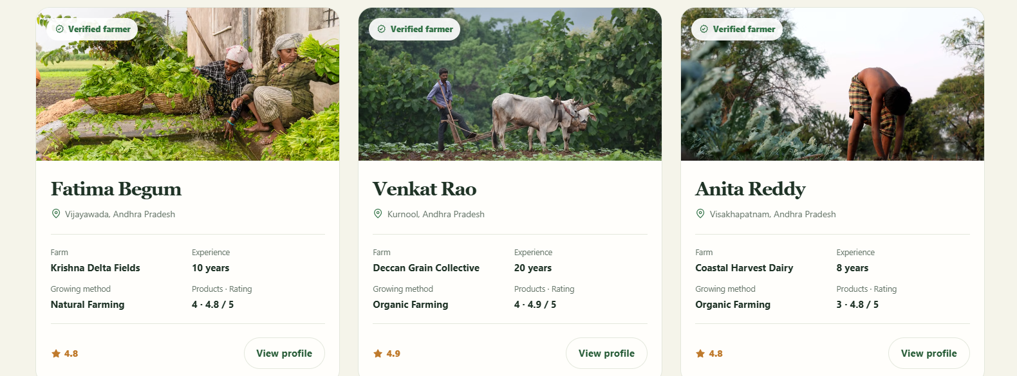
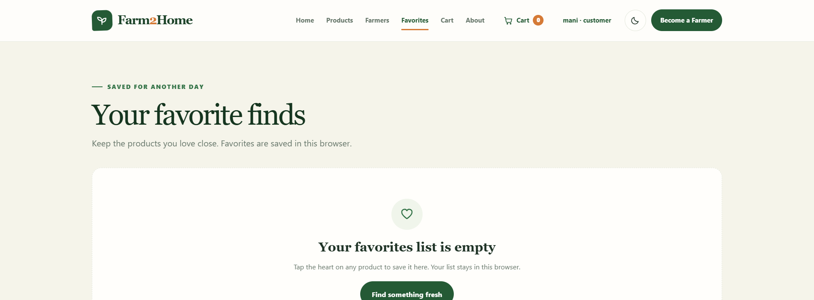
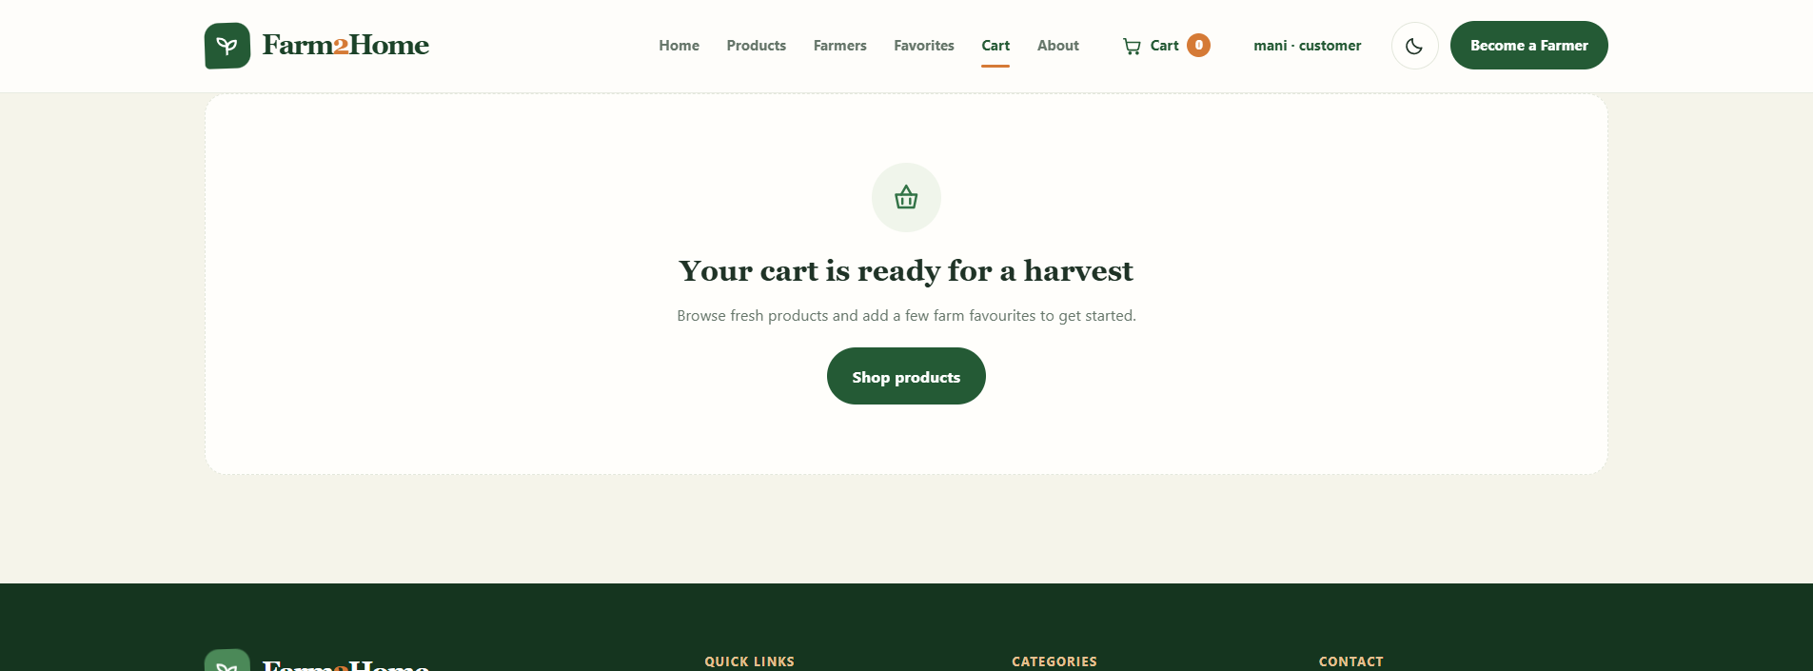
Output Screenshots
Search and filtering: Refine panel (category, location, method, availability, price) beside product cards with ratings and Add to Cart.
Farmer profiles: Verified farmer cards show farm, experience, growing method, rating and a View profile button.
Favorites page: Favorites page with empty state; items are saved in this browser.
Shopping cart page: Cart page with empty state and a Shop products button; header cart counter visible.
Notes:
Real outputs from the running website. Favorites and cart screenshots show the empty states as captured; the filters panel and farmer cards show working interface elements.

Slide 10
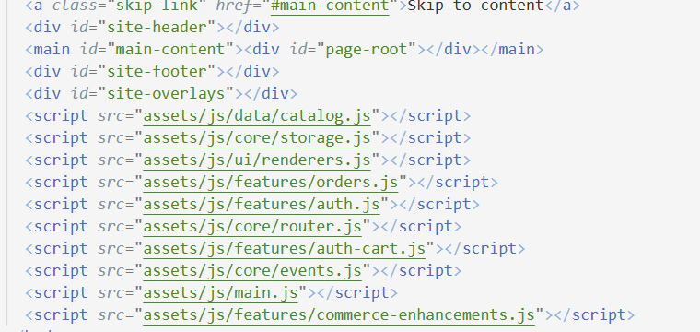
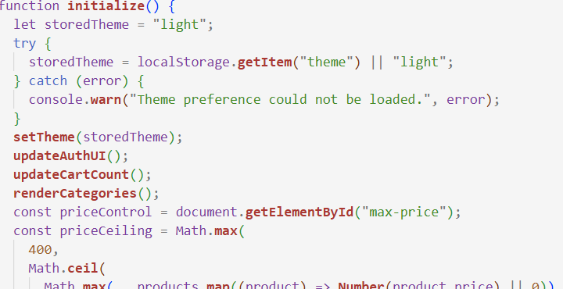
Output: Source Code Implementation
marketplace.html
Main page loads separate CSS files and modular JS scripts
assets/js/main.js
Bootstrap: theme read from LocalStorage, filters set up, hash routing
Project structure: assets/css (base, home, catalog, product, checkout, dashboard, responsive) · assets/js (core, data, features, ui) · pages · components
Notes:
Source code evidence from VS Code: the main page loads separate CSS and JS modules, and main.js initializes the theme from LocalStorage, filters and routing.

Slide 11
Results
Result | Status | Evidence
Product catalogue with search and filter controls | Implemented | Screenshots
Farmers directory and farmer profile cards | Implemented | Screenshots
Favorites page and shopping cart page | Implemented | Screenshots (empty states)
Farmer registration form | Implemented | Screenshot
Browser-based data persistence | Implemented | Source code (LocalStorage)
Responsive interface and light/dark theme | Implemented | Source code, theme toggle
Checkout, confirmation and order tracking | Demo / simulated | Source code structure
Limitations
Frontend-only prototype with no backend or database
Checkout and order tracking are simulated
Data is stored per browser, not shared across devices
Product catalogue is static data
No real authentication or payment gateway
The complete shopping workflow is demonstrated end to end as a frontend prototype.
Notes:
Results are limited to what the screenshots and source code support. Favorites and cart screenshots show empty states. Checkout and order tracking are demo flows.

Slide 12







Conclusion
IMPLEMENTED IN PROTOTYPE
Achievements
Technologies Learned
Benefits
Working frontend farm-to-consumer marketplace
Catalogue, filters, farmers, favorites, cart and registration
Demo shopping workflow
HTML5 page structure
CSS3 responsive styling
Vanilla JavaScript logic and routing
LocalStorage and SessionStorage
Farmers gain visibility
Consumers see prices and farm origin
Direct farmer-to-consumer connection
Current Limitations
Future Enhancements
PROPOSED, NOT IMPLEMENTED
Frontend-only, no backend
Checkout and tracking are simulated
Browser-only storage
Secure backend integration
Database integration
Real payment gateway
Real authentication
Live order tracking
Notes:
Conclusion: what was achieved and learned, benefits, current limitations, and proposed future enhancements. Future enhancements are not part of the current implementation.

Slide 13
THANK YOU
Farm2Home
"Fresh from the Farm, Straight to Your Home."
Raghu Engineering College (Autonomous), Visakhapatnam
Department of CSE (AI/ML)

