Slide 1

AI Enhanced GeoSpatial Tourism Recommendation
by
C.MANICHANDRIKA
Roll No. 224G1A0549
S.ANKITHA
Roll No. 224G1A0504
S.MANJUNATH REDDY
Roll No. 224G1A0552
Under the guidance of
Mr.G.Chinna Pullaiah ,M.Tech.,(Ph.D)
Assistant Professor
Department of Computer Science and Engineering
Srinivasa Ramanujan Institute of Technology
Autonomous
Rotarypuram Village, B K Samudram Mandal, Ananthapuramu – 515701.
Accredited by NBA & NAAC with “A” Grade,Affiliated to JNTUA,Ananthapuramu
2025-2026
A9
DEPT. OF COMPUTER SCIENCE AND ENGINEERING SRINIVASA RAMANUJAN INSTITUTE OF TECHNOLOGY 1

Slide 2

Contents
AI Enhanced Geospatial Tourism Recommendation System
Abstract
Introduction
Literature Survey
Existing System
Proposed System
Planning
Design
Implementation
Research Paper
References
GitHub Link
A9

Slide 3
Title of the Project
AI Enhanced Geospatial Tourism Recommendation System
Abstract
Tourism planning is often difficult due to the large number of destinations and lack of personalized recommendations. Traditional travel planning systems provide static information without considering user preferences, location proximity, or seasonal conditions.
This project presents an AI-Enhanced Geospatial Tourism Recommendation System that recommends travel destinations based on user preferences, travel month, and geographical proximity. The system uses geospatial calculations to identify nearby attractions and integrates artificial intelligence to generate travel insights and suggestions.
The application provides destination details, nearby attractions, accommodation suggestions, and AI-generated travel guidance. The system helps travelers plan trips more efficiently with personalized and intelligent recommendations.
A9

Slide 4
Introduction
Title of the Project
AI Enhanced Geospatial Tourism Recommendation System
Tourism plays an important role in cultural exchange and economic development. However, planning a trip requires gathering information from multiple sources such as travel websites, maps, and booking platforms.
Many travelers struggle to identify the best destinations based on their interests, travel season, and nearby attractions.
The proposed system addresses this problem by developing an intelligent tourism recommendation platform. It combines geospatial analysis, artificial intelligence, and a structured tourism dataset to help users discover suitable destinations and plan their trips efficiently.
A9

Slide 5
Title of the Project
AI Enhanced Geospatial Tourism Recommendation System
Literature survey for objectives
Author | Year | Methodology Used | Implementation | Limitations
Shrestha et al. | 2024 | Content-Based Image Recognition, CNN Models | Classified tourist attractions from uploaded images using deep learning and provided category-level suggestions. | No geospatial analysis; recommendations not personalized; limited to image-only inputs.
Alsahafi et al. | 2025 | NLP-Based Location Extraction and Similarity Matching | Extracted location names from text queries and recommended similar destinations using text similarity. | No visual input support; lacked interactive map visualization; recommendations not context-aware.
Kongpeng et al. | 2024 | GIS Mapping + K-Means Spatial Clustering | Used spatial clustering to group nearby tourist spots and suggested regions based on distance metrics. | Could not analyze user preferences; no AI-based recognition; system depended solely on coordinates.
Gupta et al. | 2024 | Hybrid Recommendation System (Content + Collaborative Filtering) | Provided personalized tourism recommendations using user behavior and destination metadata. | Lacked real-time identification of locations; did not integrate geospatial visualization; required large user-history datasets.
A9
DEPT. OF COMPUTER SCIENCE AND ENGINEERING
Srinivasa Ramanujan Institute of Technology
5

Slide 6
Existing System
Title of the Project
AI Enhanced Geospatial Tourism Recommendation System
Current travel platforms such as tourism websites and booking portals provide basic destination information but lack intelligent recommendation capabilities.
Limitations of existing systems:
• No personalized travel recommendations • Limited integration of nearby attractions • Lack of AI-generated travel guidance • Travelers must manually search multiple websites • Limited consideration of seasonal travel conditions
These limitations make travel planning time-consuming and inefficient.
A9

Slide 7
Proposed System
Title of the Project
AI Enhanced Geospatial Tourism Recommendation System
The proposed system provides an intelligent travel planning platform that recommends destinations based on user preferences and travel month.
Key features include:
• Destination recommendations based on travel month and interest • Geospatial analysis to find nearby attractions • AI-generated travel insights and itineraries • Accommodation suggestions for budget planning • Interactive map visualization of locations
The system improves travel planning by combining geospatial technology and artificial intelligence.
A9

Slide 8
Planning
Title of the Project
AI Enhanced Geospatial Tourism Recommendation System
The development of the system followed these stages:
Problem identification and requirement analysis
Dataset collection of tourism destinations
System design and architecture planning
Development of backend APIs and database
Development of frontend user interface
Integration of geospatial analysis and AI services
Testing and validation of system functionality
A9

Slide 9
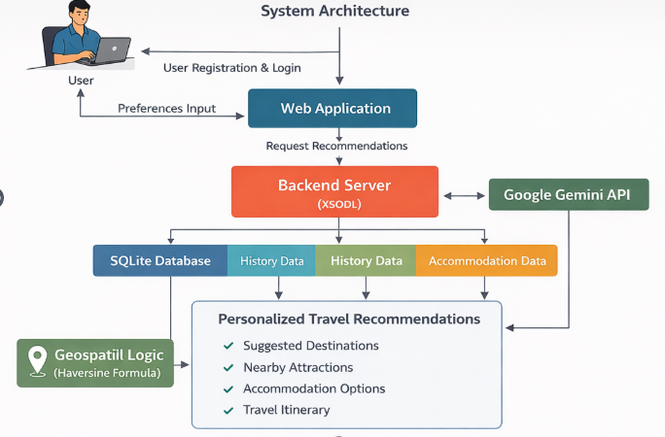
System Architecture
Title of the Project
AI Enhanced Geospatial Tourism Recommendation System
A9

Slide 10
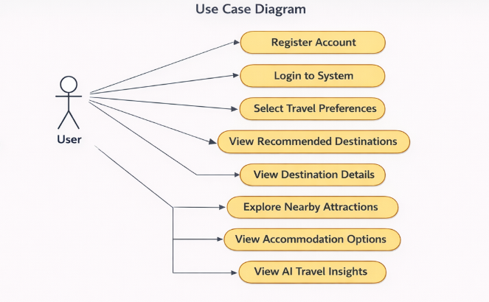
Usecase Diagram
Title of the Project
AI Enhanced Geospatial Tourism Recommendation System
A9

Slide 11
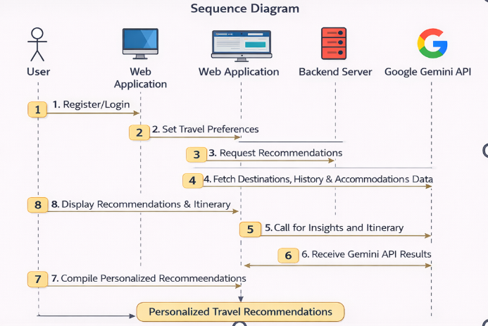
Sequence Diagram
Title of the Project
AI Enhanced Geospatial Tourism Recommendation System
A9

Slide 12
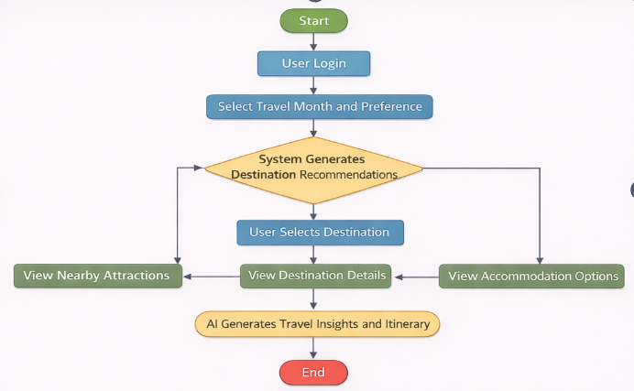
Activity Diagram
Title of the Project
AI Enhanced Geospatial Tourism Recommendation System
A9

Slide 13
Technology Stack
Title of the Project
AI Enhanced Geospatial Tourism Recommendation System
Frontend
React.js (TypeScript) – Used to build an interactive and responsive user interface
Tailwind CSS – Used for modern UI styling and responsive design
React Router – Handles navigation between pages such as planner, destination, and accommodations
Leaflet.js – Used for map visualization of tourist locations
Backend
Node.js – Server-side runtime environment
Express.js – Handles API routes and backend logic
TypeScript – Ensures better code structure and type safety
Database
SQLite Database – Lightweight relational database used to store:
User accounts
Tourist destinations
Travel history
Accommodation details
AI Integration
Google Gemini API – Generates AI-based travel insights including:
Recommended travel duration
Best activities
Travel tips
Travel itinerary suggestions
Geospatial Analysis
Haversine Formula Algorithm – Calculates geographical distance between tourist locations using latitude and longitude coordinates.
A9

Slide 14
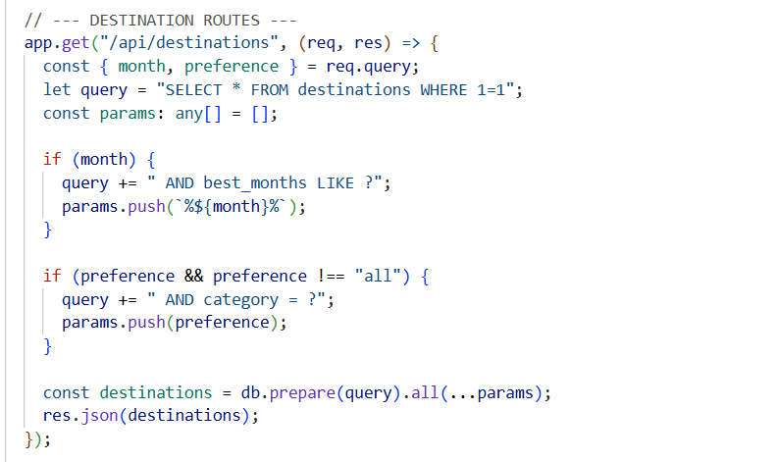
Implementation
Title of the Project
AI Enhanced Geospatial Tourism Recommendation System
Destination Recommendation Algorithm
A9

Slide 15
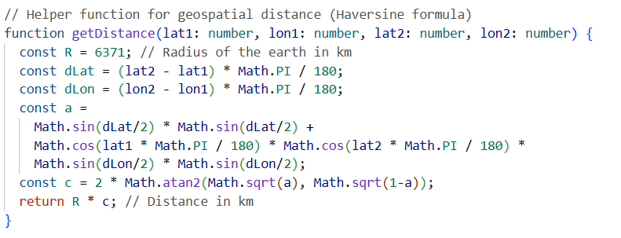
Implementation
Title of the Project
AI Enhanced Geospatial Tourism Recommendation System
Geospatial Distance Calculation (Haversine Formula)
A9

Slide 16
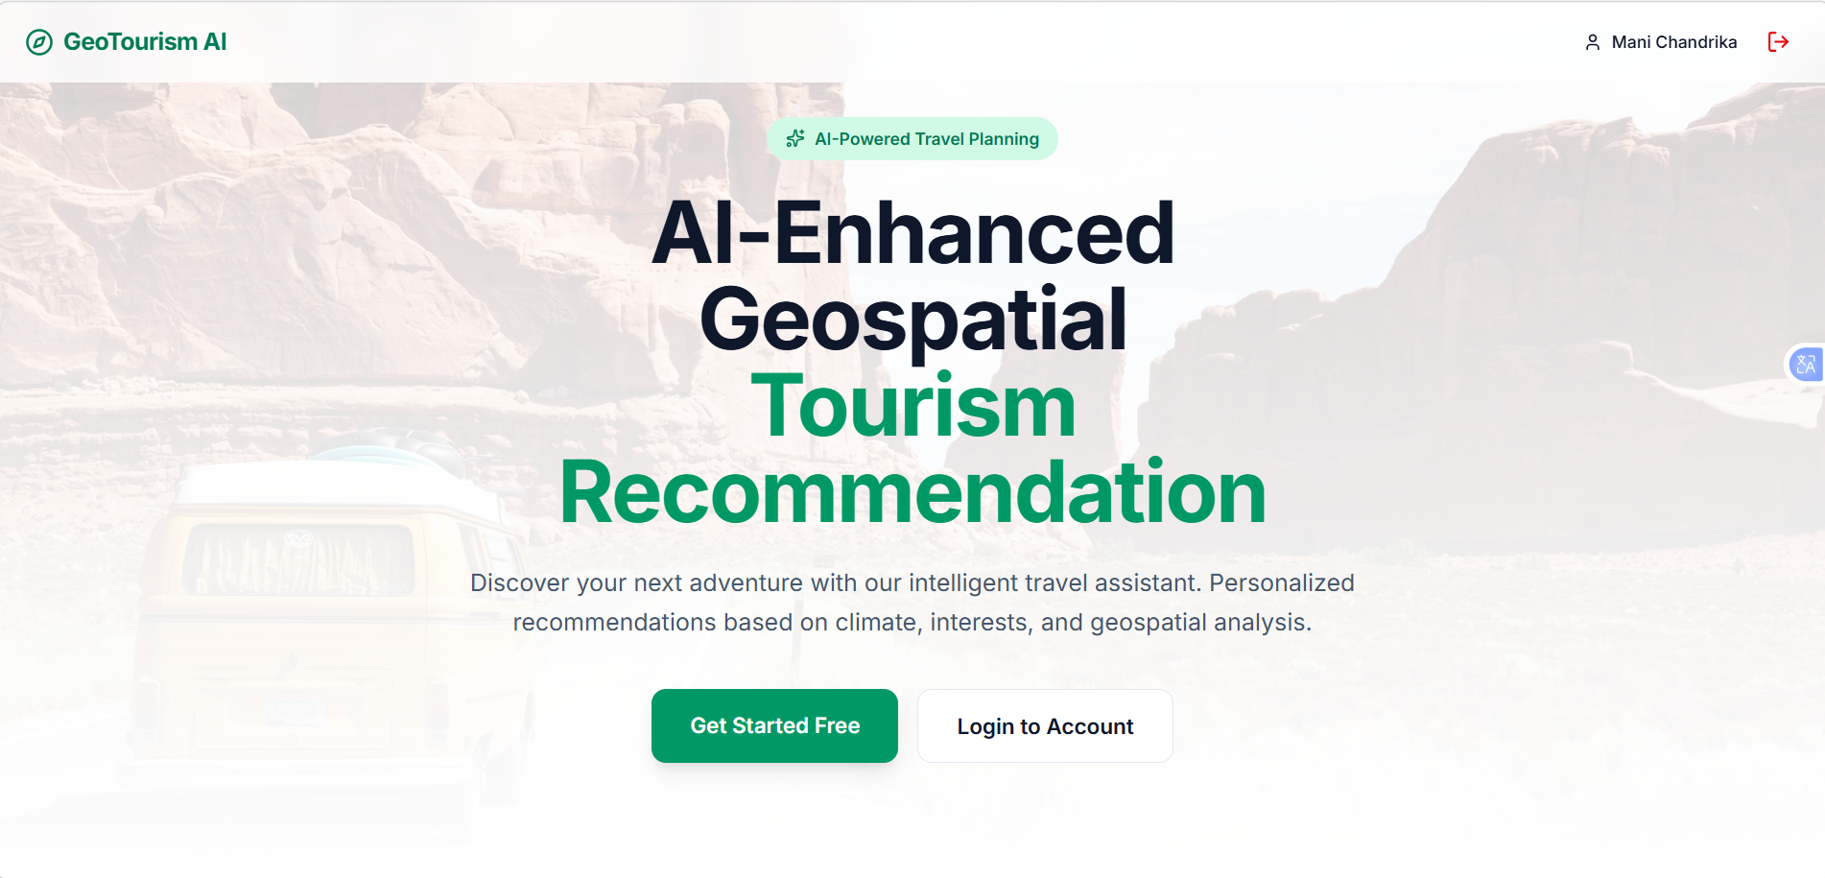
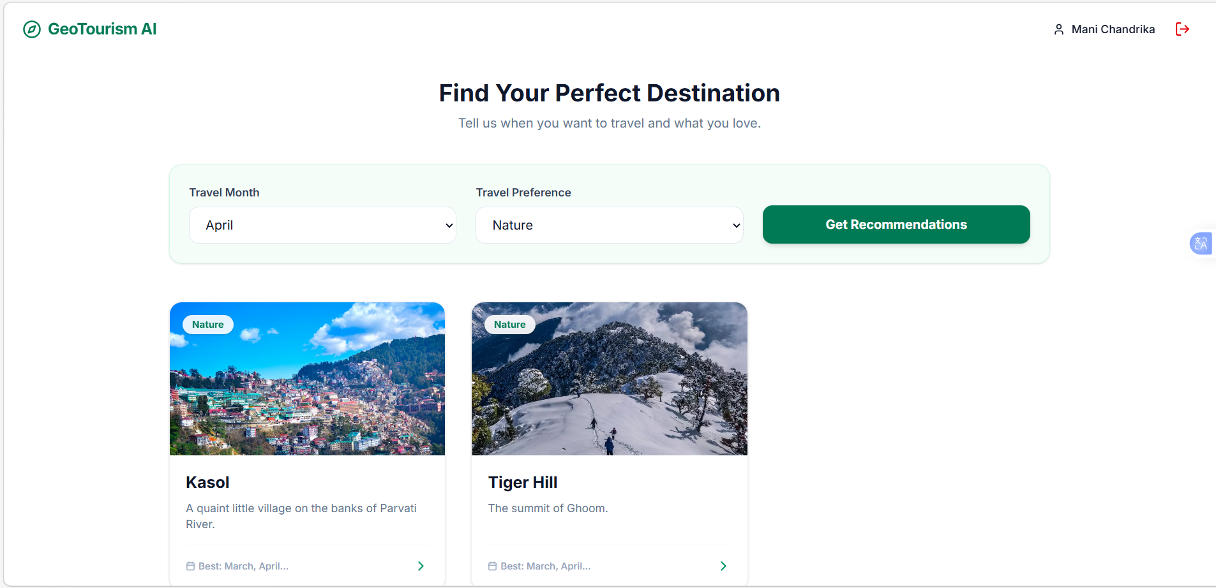
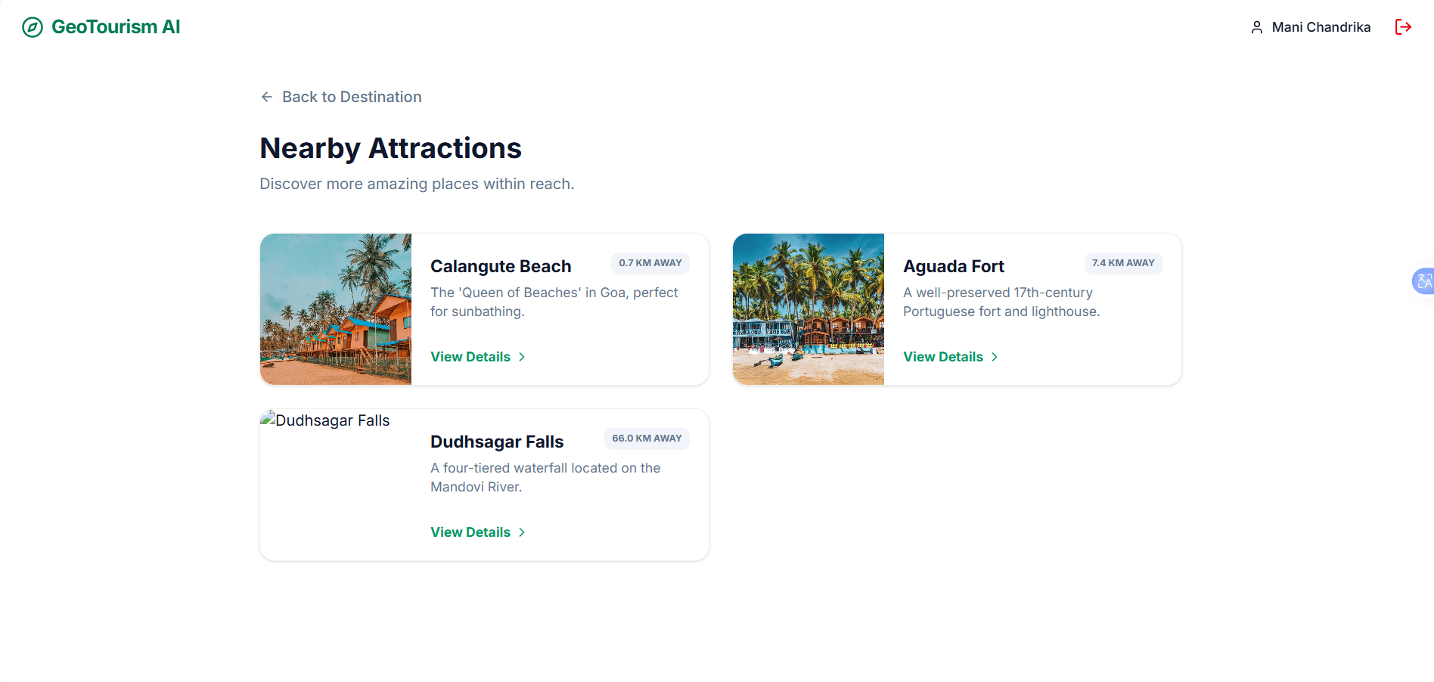
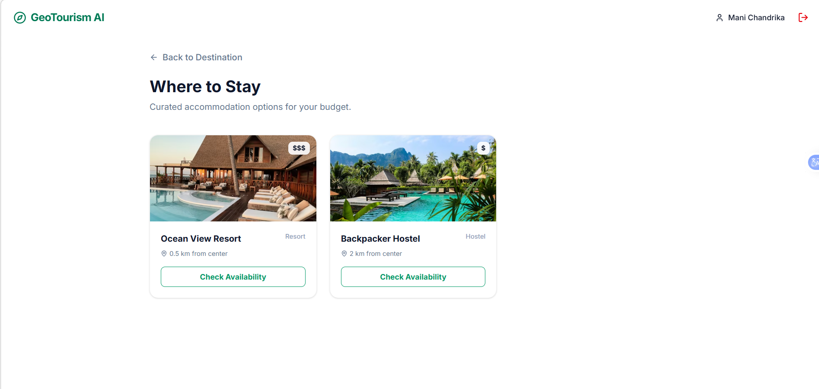
Implementation
Title of the Project
AI Enhanced Geospatial Tourism Recommendation System
A9

Slide 17
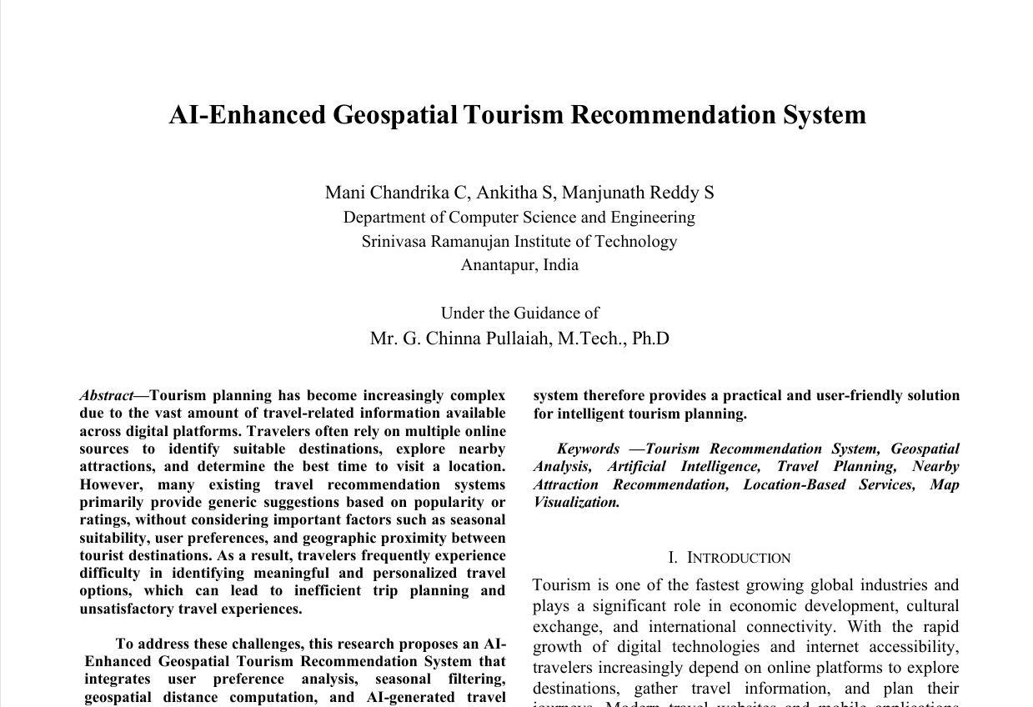
Research Paper
Title of the Project
AI Enhanced Geospatial Tourism Recommendation System
A9

Slide 18
References
Title of the Project
AI Enhanced Geospatial Tourism Recommendation System
Shrestha, Deepanjal, et al. "Personalized Tourist recommender system: a data-driven and machine-learning approach." Computation 12.3 (2024): 59.
Alsahafi, Raniah, Rashid Mehmood, and Saad Alqahtany. "A Machine Learning-Based Analysis of Tourism Recommendation Systems: Holistic Parameter Discovery and Insights." International Journal of Advanced Computer Science & Applications 16.1 (2025).
Kongpeng, Sumitra, and Anantaporn Hanskunatai. "Tourist Destination Recommendation System based on Machine Learning." Proceedings of the 2024 9th International Conference on Big Data and Computing. 2024.
Gupta, Keshav, et al. "Deep Learning Classifier to Recommend the Tourist Attraction in Smart Cities." 2024 2nd International Conference on Disruptive Technologies (ICDT). IEEE, 2024.
A9

Slide 19
Github Link
Title of the Project
AI Enhanced Geospatial Tourism Recommendation System
Link: github.com/mani-chandrika549/CSE-2022-2026-Batch-A9
A9

Slide 20
AI Enhanced Geospatial Tourism Recommendation System
Thank You!!!
A9

Slide 21
AI Enhanced Geospatial Tourism Recommendation System
Any Query?
A9

