Slide 1

AI-Enhanced Geospatial Tourism Recommendation System
by
C.ManiChandrika
Roll No. 224G1A0549
S.Ankitha
Roll No. 224G1A0504
S.Manjunath Reddy
Roll No. 224G1A0552
Under the guidance of
Mr.G.Chinna Pullaiah, M.Tech., (Ph.D)
Assistant Professor
Department of Computer Science and Engineering (AI&ML)
Srinivasa Ramanujan Institute of Technology
Autonomous
Rotarypuram Village, B K Samudram Mandal, Ananthapuramu – 515701.
2025-2026
A9

Slide 2
Contents
AI-Enhanced Geospatial Tourism Recommendation System
Title Justification
Abstract
Problem statement
Objectives of Project
Literature survey for objectives
Proposed Work -(Methods to be followed for proposed system)
References
GitHub Link
Queries
Srinivasa Ramanujan Institute of Technology

Slide 3
Title Justification
AI-Enhanced Geospatial Tourism Recommendation System
The title emphasizes “AI-Enhanced,” which accurately represents the system’s use of advanced machine learning, computer vision, and NLP models to analyze user inputs, identify tourist locations, and generate intelligent, data-driven recommendations.
The term “Geospatial” highlights the system’s reliance on GIS techniques, spatial clustering, and location-based context understanding key components that differentiate it from generic recommendation systems by focusing on geographical relationships between destinations.
The phrase “Tourism Recommendation System” clearly describes the primary purpose of the work: providing personalized and relevant travel suggestions by analyzing user preferences, proximity-based insights, and place similarities.
Srinivasa Ramanujan Institute of Technology

Slide 4
Abstract
AI-Enhanced Geospatial Tourism Recommendation System
This project presents an AI-Enhanced Geospatial Tourism Recommendation System designed to intelligently identify tourist places from user-uploaded inputs and deliver personalized travel suggestions across India. The system integrates computer vision, natural language processing, and machine learning models to recognize destinations and analyze contextual factors such as geographical proximity, cultural relevance, and user preferences. Geospatial analysis further enhances the system by mapping locations, understanding spatial relationships, and recommending similar or nearby attractions. The results are displayed with rich details including descriptions, images, and interactive map visualizations to support informed decision-making. This integrated approach improves the accuracy, relevance, and usability of tourism recommendations, creating a smart, AI-driven solution that enhances travel planning and enriches user experience.
Srinivasa Ramanujan Institute of Technology

Slide 5
Problem Statement
AI-Enhanced Geospatial Tourism Recommendation System
Existing tourism platforms often fail to automatically identify tourist spots from user-provided inputs such as images, text, or coordinates, making it difficult for travelers to receive context-aware information.
Many recommendation systems do not incorporate geospatial analysis, resulting in suggestions that ignore spatial proximity, regional features, cultural relevance, and geographical accessibility.
Current travel recommendation tools offer generic results that do not adapt to user preferences, contextual cues, or the characteristics of the input place, reducing the relevance and usefulness of recommendations.
Travelers lack a unified system that provides detailed destination information along with interactive map visualizations, making trip planning less efficient and less informative.
Srinivasa Ramanujan Institute of Technology

Slide 6
Objectives of Project
AI-Enhanced Geospatial Tourism Recommendation System
To automatically identify tourist locations from user-uploaded inputs such as images, text descriptions, or coordinates using AI techniques like computer vision and NLP.
To analyze the geographical and contextual features of identified locations through machine learning and geospatial processing to understand proximity, cultural relevance, and environmental characteristics.
To generate personalized tourism recommendations by suggesting similar or nearby destinations based on user preferences, spatial relationships, and contextual insights.
To provide an interactive and user-friendly interface that displays detailed information, images, and map visualizations of recommended places for enhanced decision-making and trip planning.
Srinivasa Ramanujan Institute of Technology

Slide 7
AI-Enhanced Geospatial Tourism Recommendation System
Literature survey for objectives
Author | Year | Methodology Used | Implementation | Limitations
Shrestha et al. | 2024 | Content-Based Image Recognition, CNN Models | Classified tourist attractions from uploaded images using deep learning and provided category-level suggestions. | No geospatial analysis; recommendations not personalized; limited to image-only inputs.
Alsahafi et al. | 2025 | NLP-Based Location Extraction and Similarity Matching | Extracted location names from text queries and recommended similar destinations using text similarity. | No visual input support; lacked interactive map visualization; recommendations not context-aware.
Kongpeng et al. | 2024 | GIS Mapping + K-Means Spatial Clustering | Used spatial clustering to group nearby tourist spots and suggested regions based on distance metrics. | Could not analyze user preferences; no AI-based recognition; system depended solely on coordinates.
Gupta et al. | 2024 | Hybrid Recommendation System (Content + Collaborative Filtering) | Provided personalized tourism recommendations using user behavior and destination metadata. | Lacked real-time identification of locations; did not integrate geospatial visualization; required large user-history datasets.
Srinivasa Ramanujan Institute of Technology

Slide 8
Proposed System
AI-Enhanced Geospatial Tourism Recommendation System
AI-Based Tourist Place Identification The system automatically identifies tourist locations from user inputs images, text descriptions or GPS coordinates using advanced computer vision models and NLP techniques to extract meaningful location information.
Geospatial Context Analysis A geospatial processing layer analyzes spatial relationships, proximity, regional characteristics and environmental context using GIS techniques and ML-based clustering to understand the location more accurately.
Intelligent Recommendation Engine The system recommends similar or nearby destinations by integrating AI predictions, geospatial distances, cultural similarity and user preference patterns, ensuring highly relevant and personalized travel suggestions.
Interactive Visualization and User Interface The platform displays detailed information, images, recommended destinations and interactive map visualizations, allowing users to explore locations easily and make informed travel decisions.
Srinivasa Ramanujan Institute of Technology

Slide 9
References
AI-Enhanced Geospatial Tourism Recommendation System
Shrestha, Deepanjal, et al. "Personalized Tourist recommender system: a data-driven and machine-learning approach." Computation 12.3 (2024): 59.
Alsahafi, Raniah, Rashid Mehmood, and Saad Alqahtany. "A Machine Learning-Based Analysis of Tourism Recommendation Systems: Holistic Parameter Discovery and Insights." International Journal of Advanced Computer Science & Applications 16.1 (2025).
Kongpeng, Sumitra, and Anantaporn Hanskunatai. "Tourist Destination Recommendation System based on Machine Learning." Proceedings of the 2024 9th International Conference on Big Data and Computing. 2024.
Gupta, Keshav, et al. "Deep Learning Classifier to Recommend the Tourist Attraction in Smart Cities." 2024 2nd International Conference on Disruptive Technologies (ICDT). IEEE, 2024.
Srinivasa Ramanujan Institute of Technology

Slide 10
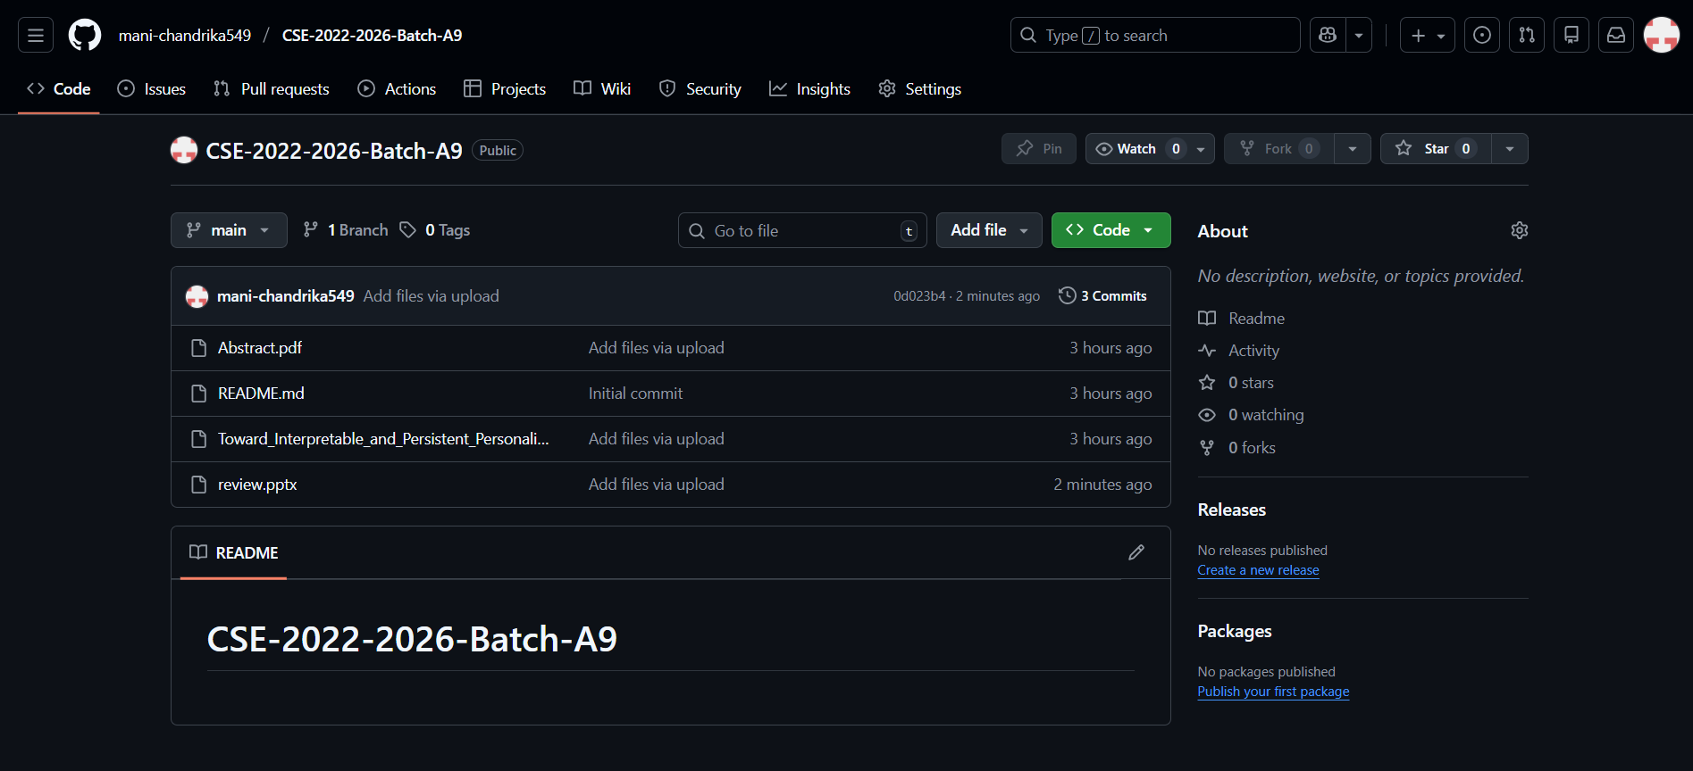
Git Hub Dashboards of each student
AI-Enhanced Geospatial Tourism Recommendation System
Link: https://github.com/mani-chandrika549/CSE-2022-2026-Batch-A9
Srinivasa Ramanujan Institute of Technology

Slide 11
Any Queries?
AI-Enhanced Geospatial Tourism Recommendation System
Srinivasa Ramanujan Institute of Technology

