Slide 1
Version Control Systems

Slide 2
What is VCS?
Is the management of changes to documents, computer programs, large websites and other collection of information.
Version control systems are a category of software tools that help a software team manage changes to source code over time.
Version control software keeps track of every modification to the code in a special kind of database.

Slide 3
Types of Version Control
There are two types of Version Control System
  Centralized Version Control System (CVCS)
  Distributed Version Control System (DVCS)

Slide 4
Centralized VCS
Uses a central server to store all files and enables team collaboration. It works on a single repository to which users can directly access a central server.
Based on the idea that there is a single “central” copy of your project somewhere (probably on a server), and programmers will “commit” their changes to this central copy.

Slide 5
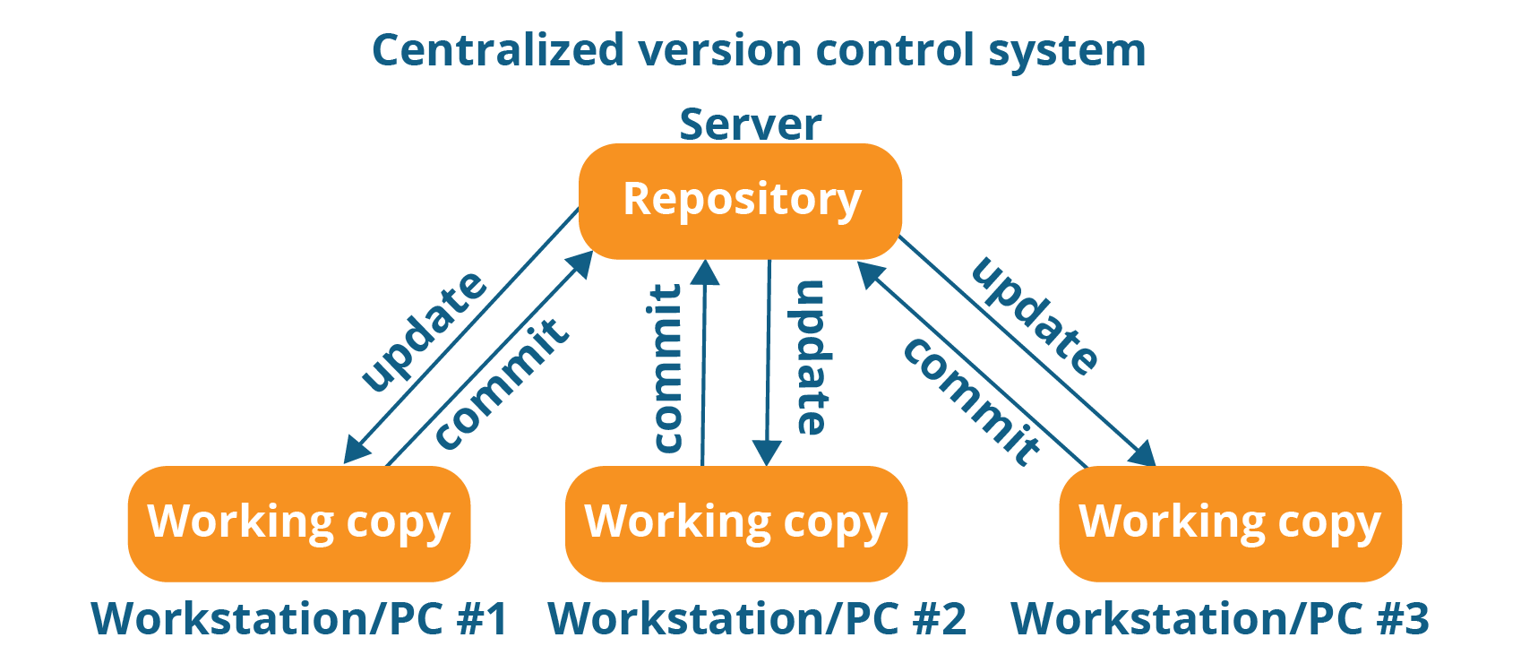
Centralized VCS

Slide 6
Centralized VCS
Every programmer can extract or update their workstations with the data present in the repository or can make changes to the data or commit in the repository. Every operation is performed directly on the repository.
It has some Drawbacks.
  It is not locally available; meaning you always need to be connected to a network to perform any action.
  Since everything is centralized, in any case of the central server getting crashed or corrupted will result in losing the entire data of the project.

Slide 7
Distributed VCS
These systems do not necessarily rely on a central server to store all the versions of a project’s files.
Every developer “clones” a copy of a repository and has the full history of the project on their own hard drive.
This copy (or “clone”) has all of the metadata of the original.

Slide 8
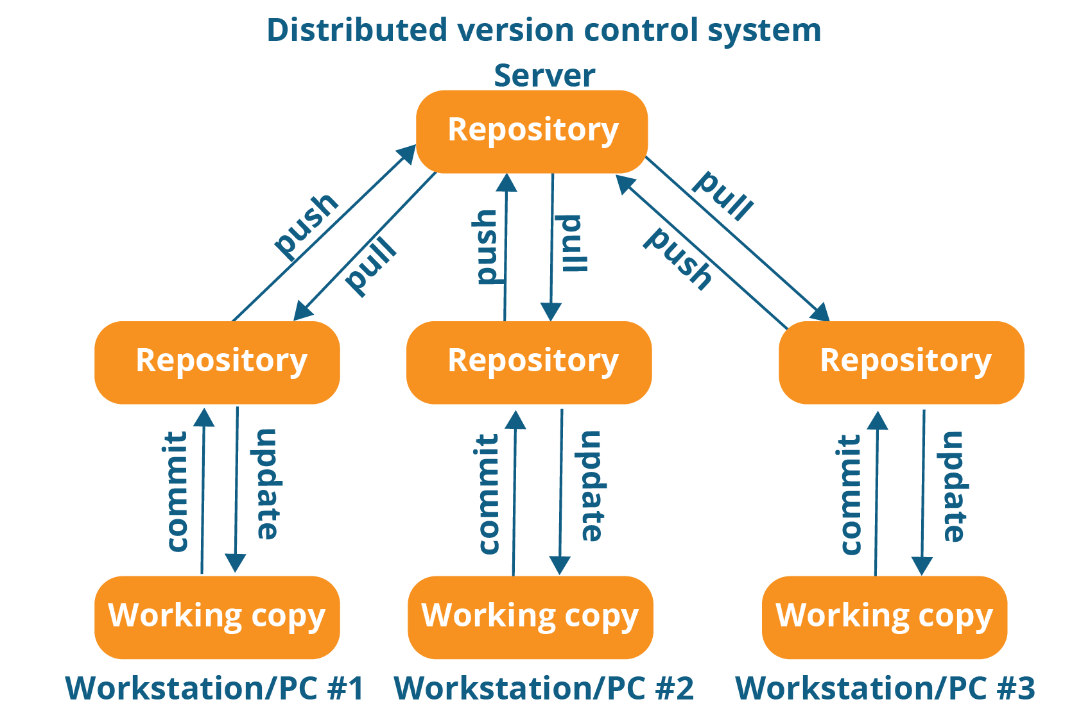
Distributed VCS

Slide 9
Distributed VCS
They can update their local repositories with new data from the central server by an operation called “pull” and affect changes to the main repository by an operation called “push” from their local repository.
All operations (except push & pull) are very fast because the tool only needs to access the hard drive, not a remote server. Do not always need an internet connection.
Committing new change-sets can be done locally without manipulating the data on the main repository. Once you have a group of change-sets ready, you can push them all at once.

Slide 10
Distributed VCS
Every developer or contributor has a full copy of the project repository, they can share changes with one another if they want to get some feedback before affecting changes in the main repository.
If the central server gets crashed at any point of time, the lost data can be easily recovered from any one of the contributor’s local repositories.

Slide 11
Features of GIT
Free and open source
  Git is released under GPL’s (General Public License) open source license. You don’t need to purchase Git. It is absolutely free.
Scalable
  Git is very scalable. So, if in future , the number of collaborators increase Git can easily handle this change

Slide 12
Features of GIT
Reliable
  Since every contributor has its own local repository, on the events of a system crash, the lost data can be recovered from any of the local repositories.
Secure
  Git uses the SHA1 to name and identify objects within its repository.
  Every file and commit is check-summed and retrieved by its checksum at the time of checkout.
  The Git history is stored in such a way that the ID of a particular version.

Slide 13
Features of GIT
Easy Branching
  Branch management with Git is very simple. It takes only few seconds to create, delete, and merge branches.
  Feature branches provide an isolated environment for every change to your codebase.
Distributed development
  Git gives each developer a local copy of the entire development history, and changes are copied from one such repository to another.
  These changes are imported as additional development branches, and can be merged in the same way as a locally developed branch.

Slide 14
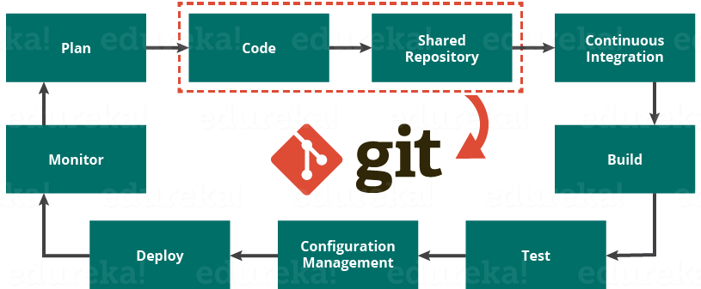
Git in DevOps Cycle

Slide 15
Install Git
Download Git from
https://git-scm.com/download/win/
https://www.atlassian.com/git/tutorials/install-git#windows
$ git config --global user.name “Manimaran"
$ git config --global user.email “mani043@gmail.com"

Slide 16
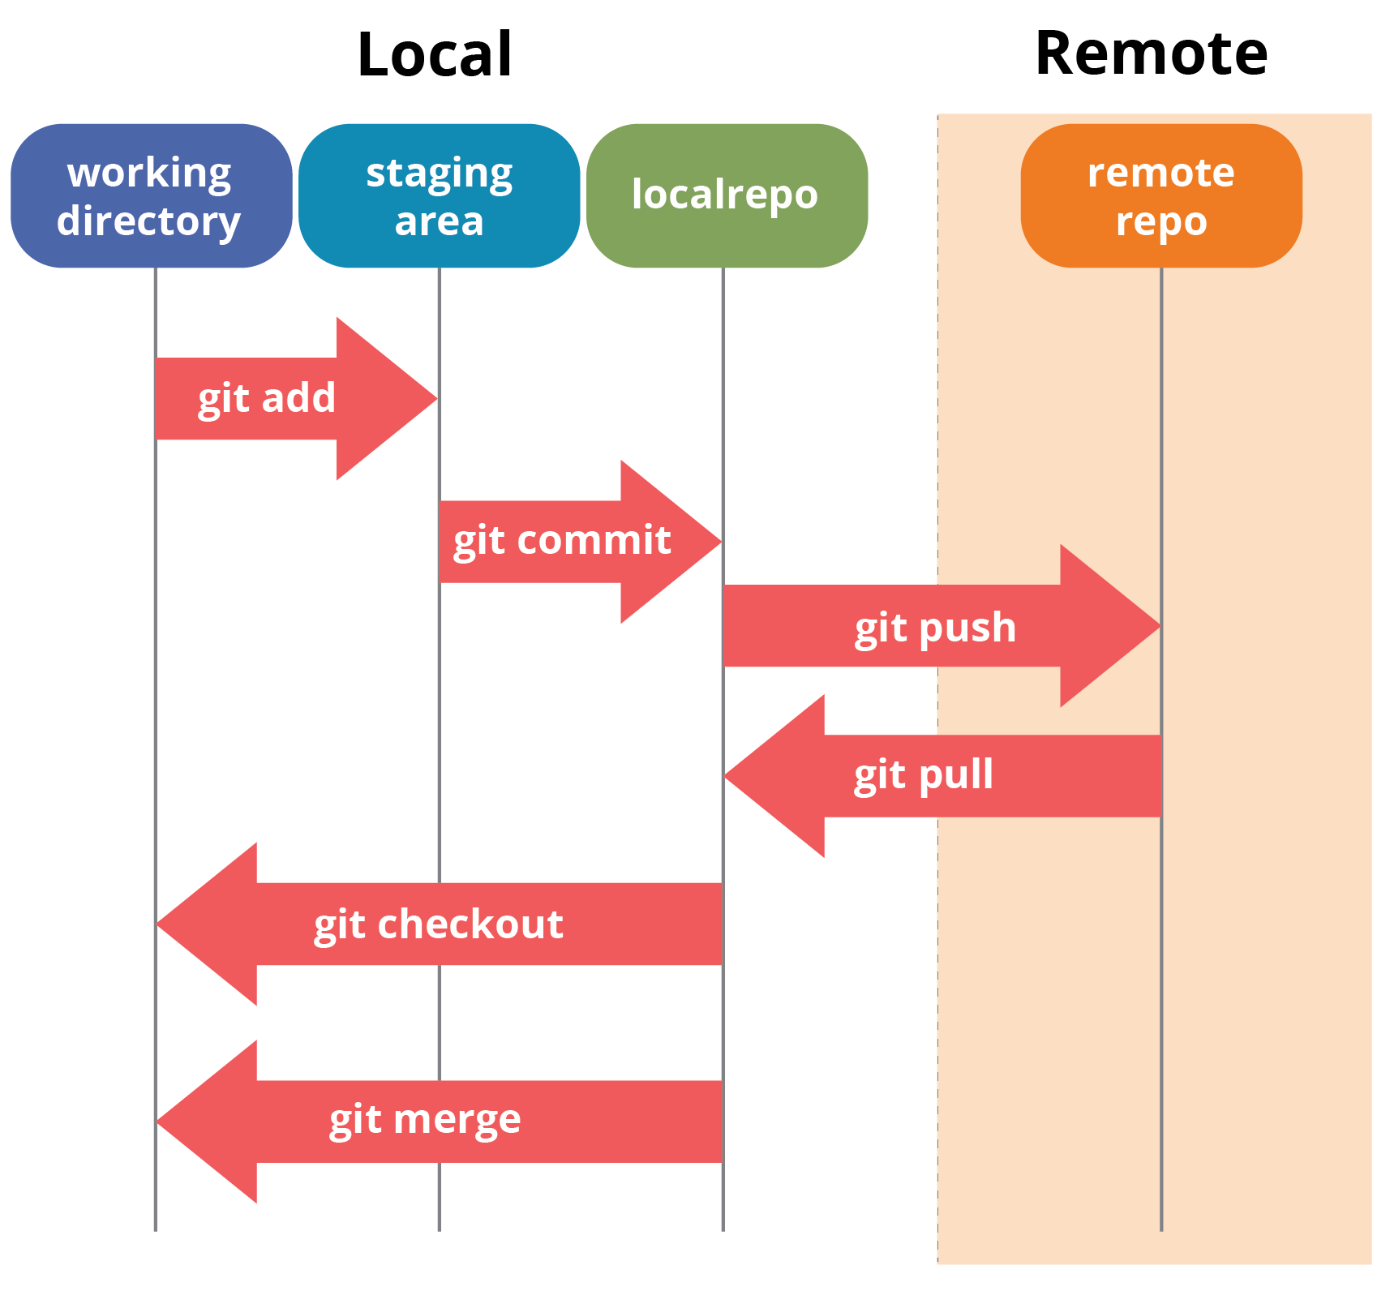
Git Architecture

Slide 17
Git Operations and Commands
Initialize
Add
Commit
Pull
Push

Slide 18
git clone
git clone is primarily used to point to an existing repo and make a clone or copy of that repo at in a new directory, at another location.
The original repository can be located on the local filesystem or on remote machine accessible supported protocols.
git clone https://github.com/mani-demo/mydemo.git

Slide 19
git init
creates an empty Git repository or re-initializes an existing one. It basically creates a .git directory with sub directories and template files.
Running a git init in an existing repository will not overwrite things that are already there. It rather picks up the newly added templates.
git init

Slide 20
Git status
The git status command lists all the modified files which are ready to be added to the local repository.
git status

Slide 21
Git Add
This command updates the index using the current content found in the working tree and then prepares the content in the staging area for the next commit.
Before running the commit command, you must use the add command to add any new or modified files to the index. For that, use the commands below:
git add <directory> or git add <file>
Adding all newly created files
git add -A

Slide 22
Git Commit
It refers to recording snapshots of the repository at a given time.
Committed snapshots will never change unless done explicitly.

Slide 23
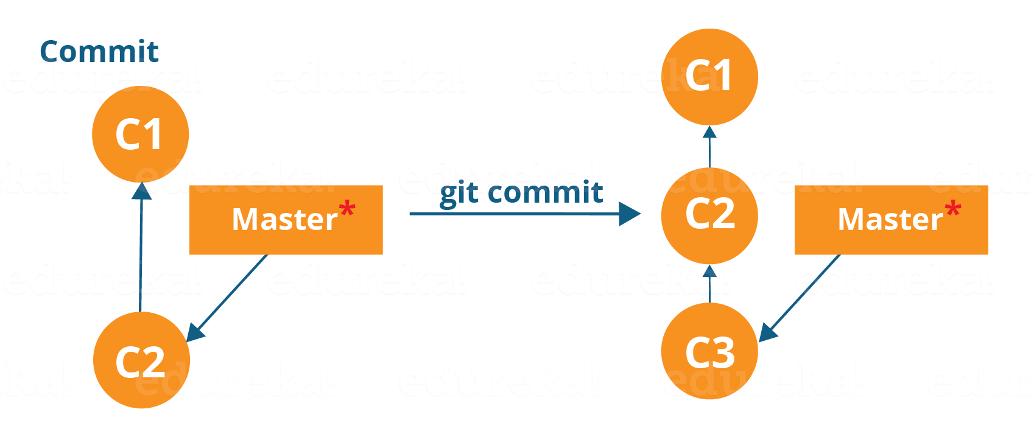
Git Commit

Slide 24
Git Commit
git commit -m “<message>”
Commit a snapshot of all the changes in the working directory at once, use the command below
  git commit -a

Slide 25
Git Pull
The git pull command fetches changes from a remote repository to a local repository.
It merges upstream changes in your local repository, which is a common task in Git based collaborations
git remote add origin <link of your central repository>

Slide 26
Git Pull
Copy all the files from the master branch of remote repository to your local repository.
  git pull origin master or <branch_name>

Slide 27
Git Push
Use of git push is to publish your local changes to a central repository.
Local commits and are ready to share them with the rest of the team, you can then push them to the central repository by using the following command.
  git push <remote>
  git push origin master

Slide 28
Branching
Branches in Git are nothing but pointers to a specific commit.
Git generally prefers to keep its branches as lightweight as possible.
  git branch <branch-name>
  git checkout <branch_name>

Slide 29
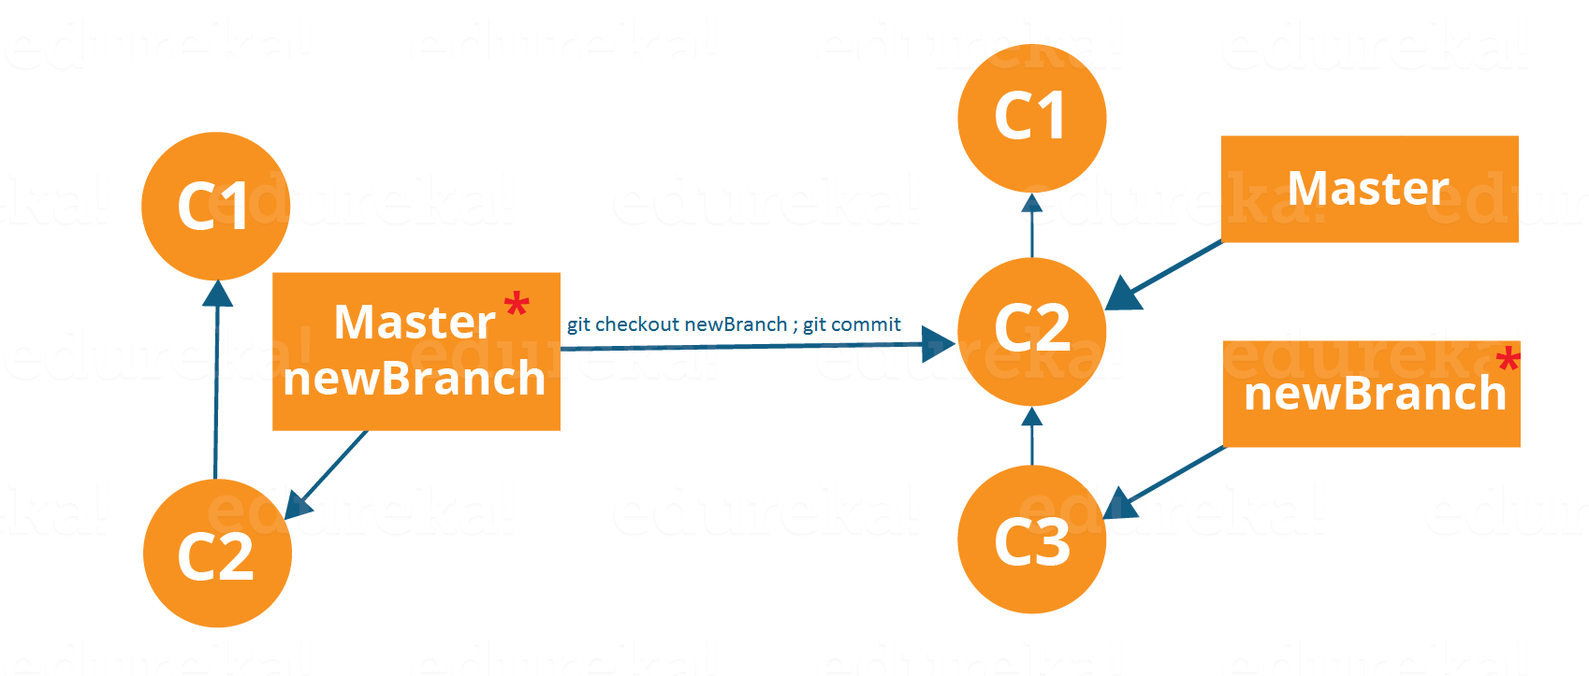
Branching

