Slide 1
Advanced C
Day1

Slide 2
Run-time storage organization
Code space
• fixed size
• statically allocated (link time)
Data space
• fixed-sized data may be statically allocated
• variable-sized data must be dynamically allocated
• some data is dynamically allocated in code
Control stack
• dynamic slice of activation tree
• return addresses
• may be implemented in hardware

Slide 3
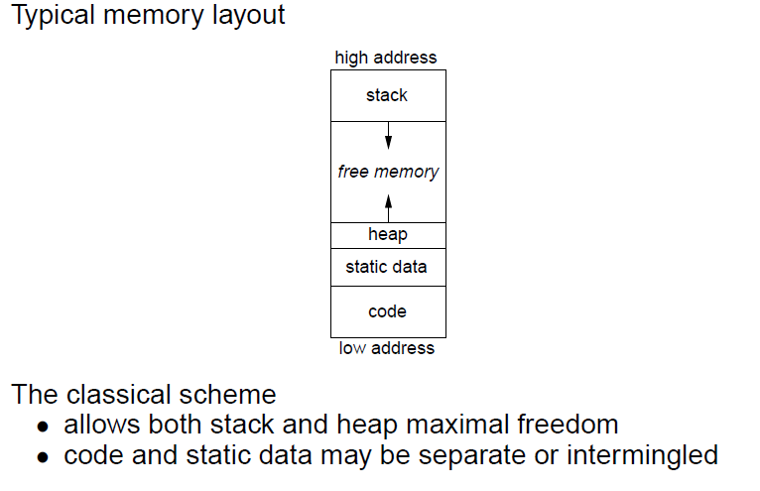
Run-time storage organization

Slide 4
Memory layout of a program
int g_a;
void fun1()
{ printf("i am fun1\n");}
void main()
{
int l_a;
static int ls_a;
char *l_p1="hello world";
char *l_p2="world india";
void (*fp)()=fun1;
printf("address of global variable =%p\n",&g_a);
printf("address of local variable =%p\n",&l_a);
printf("address of local static variable =%p\n",&ls_a);
printf("address in pointer variable =%p\n",l_p1);
printf("address in pointer variable =%p\n",l_p2);
printf("address of functuon fun1 =%p\n",fp);
P=malloc(200)
}
Data
Code
Stack
Free
space
heap

Slide 5
Storage classes
Static variables:
• addresses compiled into code (relocatable)
• (usually) allocated at compile-time
• limited to fixed size objects
• control access with naming scheme
Global variables:
• almost identical to static variables
• layout may be important (exposed)
• naming scheme ensures universal access
Link editor must handle duplicate definitions

Slide 6
Storage classes
Procedure local variables
Put them on the stack
• if sizes are fixed
• if lifetimes are limited
• if values are not preserved
Dynamically allocated variables
Must be treated differently
• call-by-reference, pointers, lead to non-local lifetimes
• (usually) an explicit allocation
• explicit or implicit deallocation

Slide 7
Function call
A function call is simply translated to a CALL instruction.
Register allocation is performed on a single-function body.
C-call functions - caller saves
Std-call functions – callee saves
This-call functions – C++ style functions

Slide 8
Call Stack
The return address is stored on the stack.
The registers' content is stored on the stack before the call and
is restored (in registers) after the call.
Parameters and return value are also passed on the stack.
Local array/records are also typically allocated on the stack.
Finally, non-local variables can be allocated on the stack

Slide 9
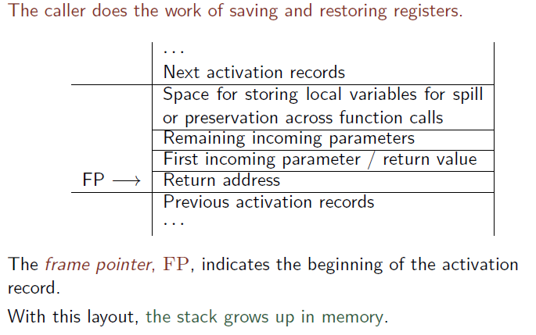
Caller-Saves: Activation-Record Layout

Slide 10
Prologue, Epilogue and Call Sequence
The code of a function starts with a prologue, that (i) retrieves
parameters from the stack and places them in variables (registers),
and (ii) may save the registers to be preserved.
The code of a function ends with an epilogue that places the return
value back on stack, and may restore in registers the values saved in
the prologue, and then returns control to the calling function.
A CALL instruction is replaced with a call sequence, which places
arguments on stack, saves the registers to be preserved, saves the
return address, calls the function and moves the returned value from the stack to a variable (register), restores the saved registers.

Slide 11
prologue
save registers, state
store FP
set new FP
extend basic frame (for local data)
initialize locals
fall through to code

Slide 12
epilogue
store return value
2. restore state
3. cut back to basic frame
4. restore parent’s FP
5. jump to return address

Slide 13
Prologue, Epilogue and Call Sequence
Consider call x := CALL f (a1; : : : ; an).
Assume that RO : : : Rk are used for local variables.
framesize is the size of the current activation record.
M[FP + 4 m + 4] := R0
M[FP + 4 m + 4 (k + 1)] := Rk
FP := FP + framesize
M[FP + 4] := a1
M[FP + 4 n] := an
M[FP] := returnaddress
LABEL function-name
parameter1 := M[FP + 4]
parametern := M[FP + 4 n]
code for the function body
M[FP + 4] := result
x := M[FP + 4]
FP := FP - framesize
R0 := M[FP + 4 m + 4]
Rk := M[FP + 4 m + 4 (k+1)]

