Slide 1
Binary Tree Delete

Slide 2
Deletion from a Binary Search Tree
An important function for maintaining a binary search tree is to delete a specific node from the tree.
The method to delete a node depends on the specific position of the node in the tree.
The algorithm to delete a node can be subdivided into different cases.

Slide 3
Case I – Deletion Of The Leaf Node
If the node to be deleted is a leaf, you only need to set appropriate link of its parent to null, and do away with the node that is to be deleted.
For example, to delete a node containing 1 in the following figure, we have to set the left pointer of its parent (pointing to 1) to null.
The following diagram illustrates this.

Slide 4
Case I – Deletion Of The Leaf Node
2
2
p
1
3
null
3

Slide 5
Case II – Deletion Of a Node With a Single Child
If the node to be deleted has only one child, you cannot simply make the link of the parent to nil as you did in the case of a leaf node.
Because if you do so, you will lose all of the descendants of the node that you are deleting from the tree.
So, you need to adjust the link from the parent of deleted node to point to the child of the node you intend to delete. You can subsequently dispose of the deleted node.

Slide 6
Case II – Deletion Of a Node With a Single Child
5
5
Node to be deleted
3
4
Node to be deleted
3
4
2
2
To delete node containing the value 3, where the right subtree of 3 is empty, we simply make the link of the parent of the node with the value 3 (node with value 5) point to the child of 3 (node with the value 2).

Slide 7
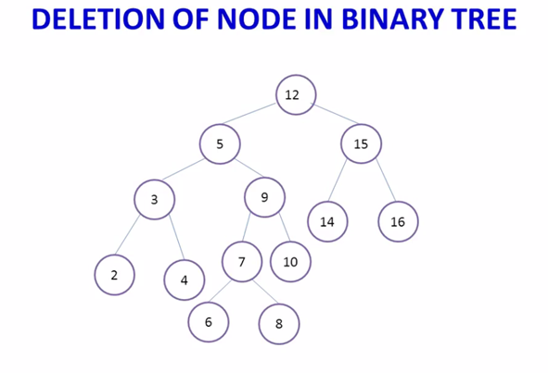

Slide 8
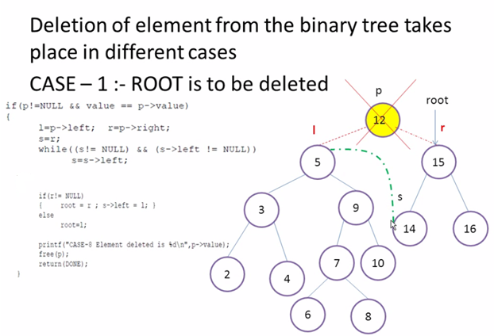

Slide 9
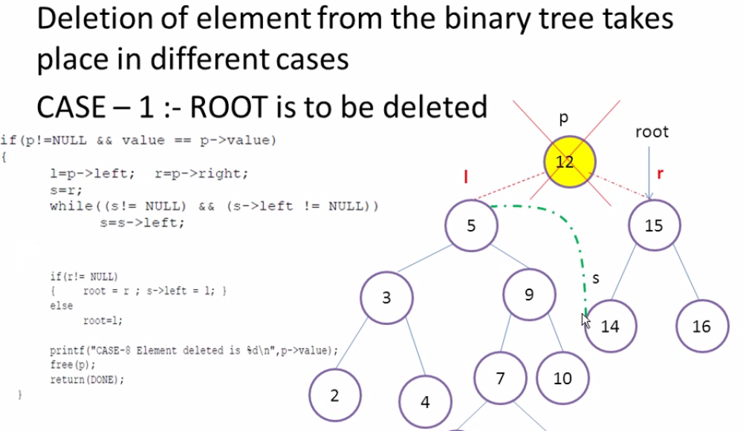

Slide 10
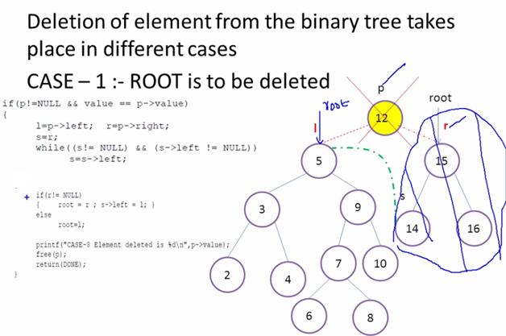

Slide 11
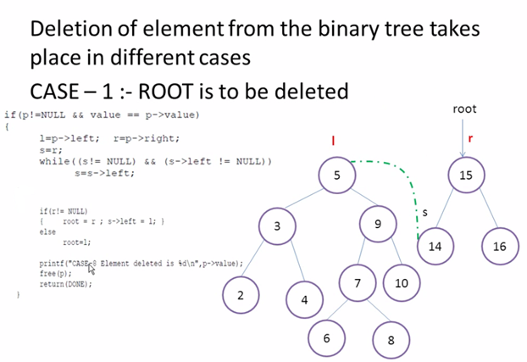

Slide 12
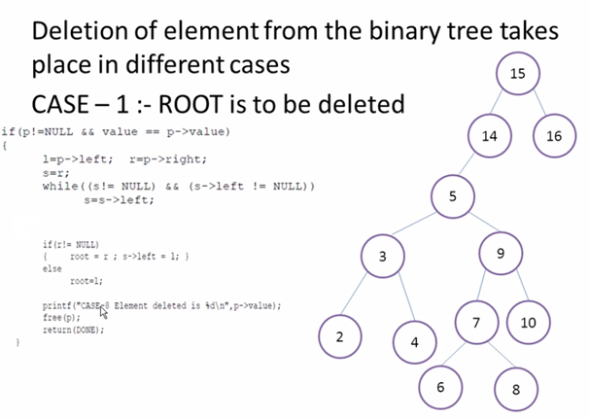

Slide 13
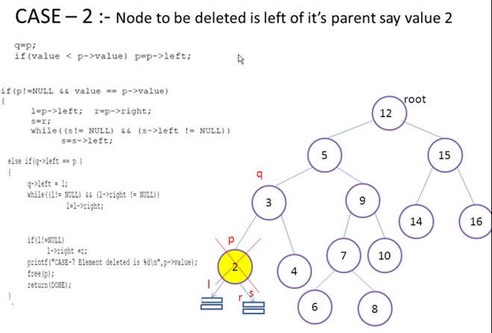

Slide 14

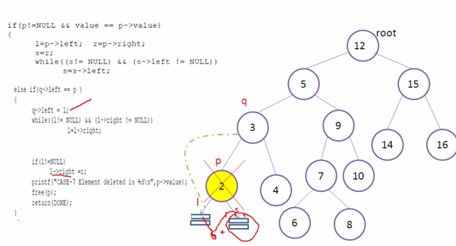

Slide 15
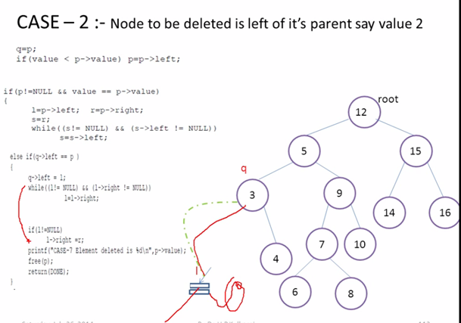

Slide 16
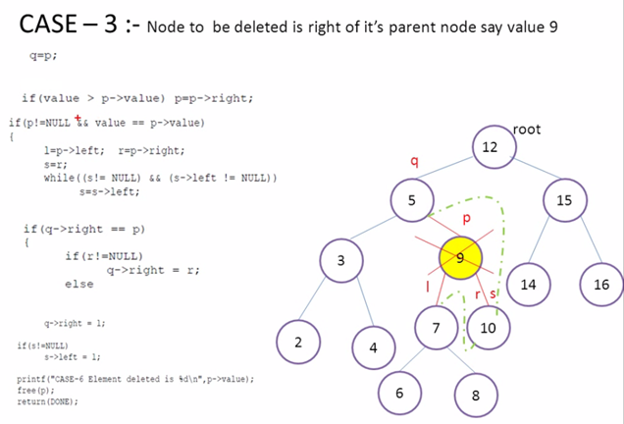

Slide 17
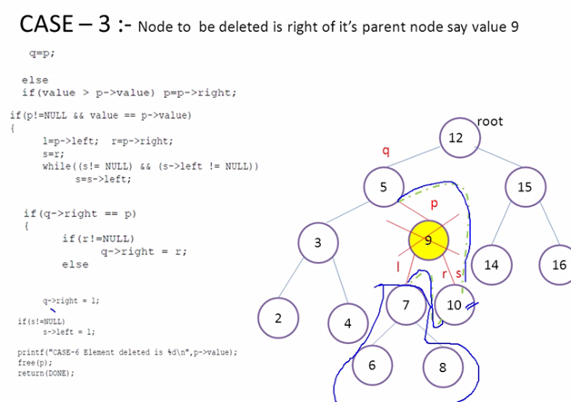

Slide 18
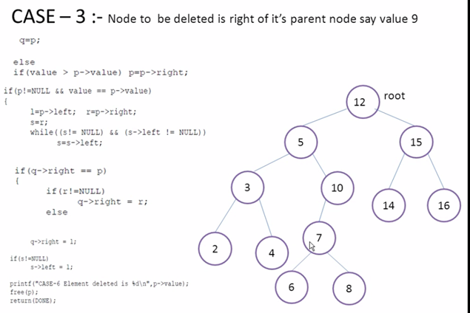

Slide 19
