Slide 1


Landscape Level Impact Assessment
Mid-Term Presentation
COD 310
Presented By: Mani Sarthak
Supervisor: Prof. Aaditeshwar Seth
Dept. of Computer Science Engineering,
IIT Delhi

Slide 2
Overview
Work done till now
Website hierarchy: how the data is organized?
Summary of data organisation​
Cracking the POST method request​
Result
How is data fetched finally?​
Challenges faced
Analysing the data ​
Resources

Slide 3
Work done till now
Automating the data scrapping process for the website indiawris.gov.in
Analysing the data ie. Density, correctness, level-wise analysis.

Slide 4
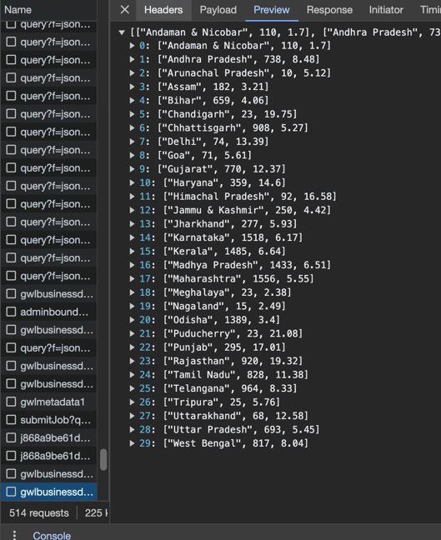
Website hierarchy: how the data is organized?
State level

Slide 5
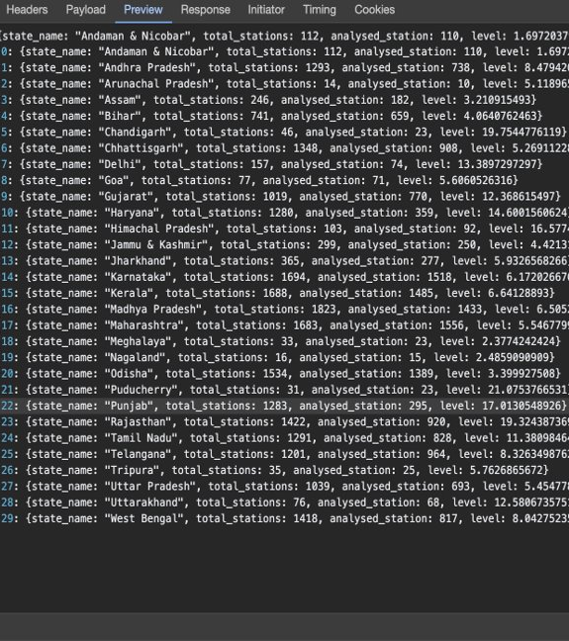
Website hierarchy: how the data is organized?
State level (with finer details)

Slide 6
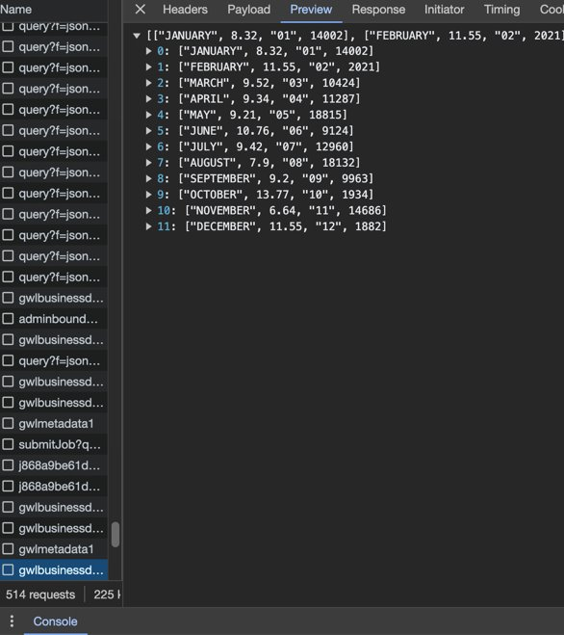
Website hierarchy: how the data is organized?
Month wise

Slide 7
Summary of data organiSation
Upon opening the website, all information is arranged in two types of hierarchy, state-wise and year-wise (12 most recent months).
All important information is contained in the fetch requests with the name `gwlbusinessdata`.
The method for fetching the `gwlbusinessdata` is using POST method.
To automate the process of scrapping, we need to crack the headers of the POST request !
Final organization: year → state → district → seasonally and yearly

Slide 8
Cracking the POST method request
Used browsers like Chrome Canary and Firefox that allow for better inspection methods.
Used the web apps like POSTMAN, HTTP Toolkit, etc.
Analysed JavaScript and website HTML code to see which things are triggered when the download button is clicked.
Used apps like Wireshark to track the requests sent to the website.
Based on my knowledge of working on websites, I created a small request parsing script using sockets to get the data directly.
Tried getting data from the selenium library using Chromedriver.

Slide 9
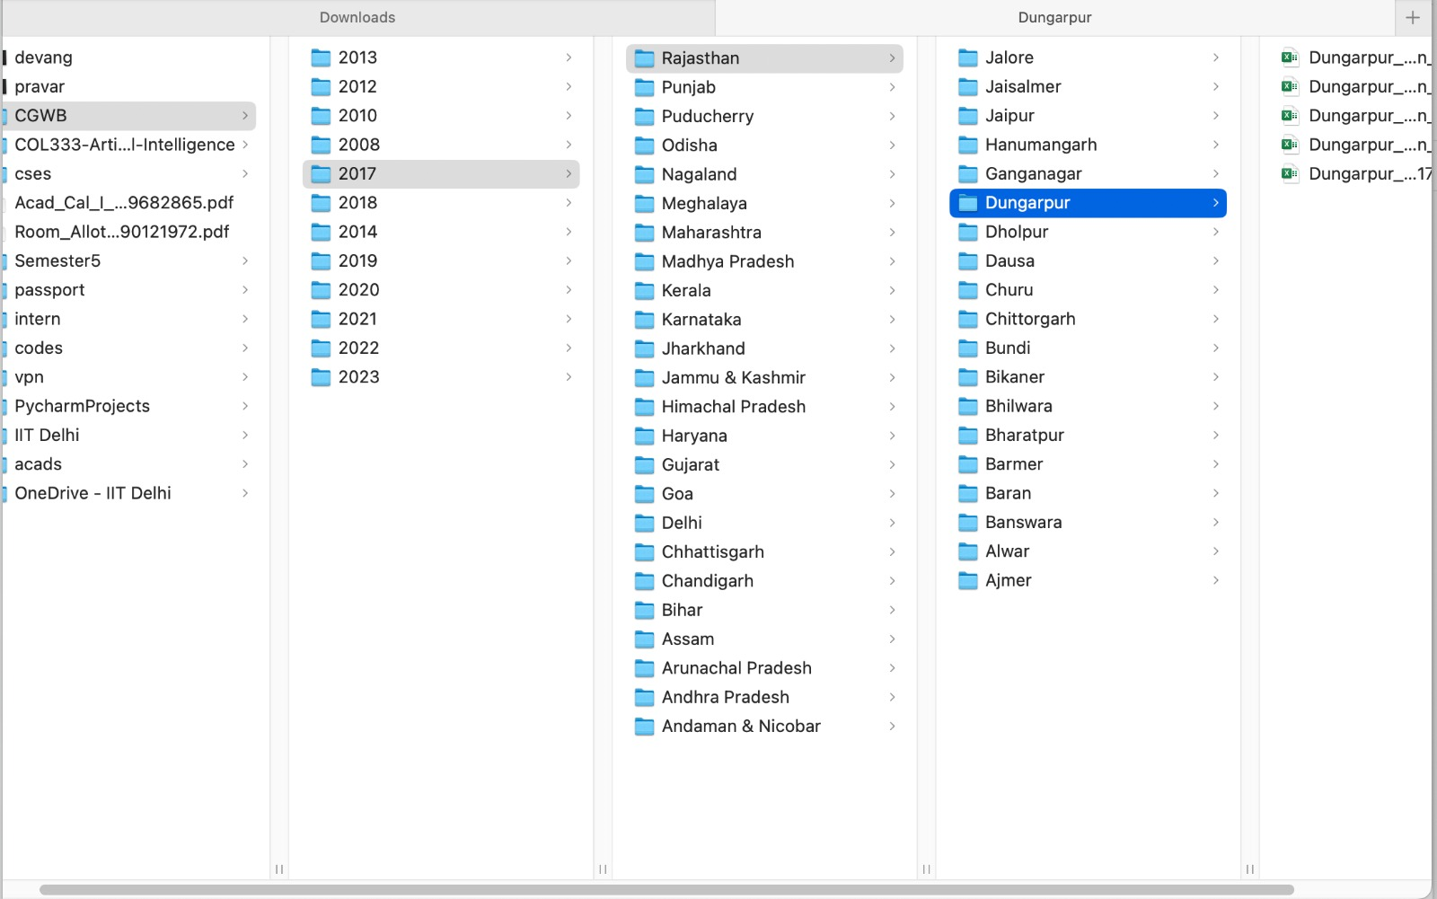
Result: Process automated totally!​

Slide 10
How is data fetched finally?
Copied the POST method request using cURL.
Now, the python requests library can retrieve data from the website.
After that, parsing and organising the data in excel (or CSV) was easy.
The data from the website didn’t have the lat-long along with the station_id.
A new script to fetch the lat-long and then integrate it with the previously fetched data.
Final data format → (well_name, well_id, water_level, lat, long).

Slide 11
Challenges faced while fetching
The time for fetching a single year (500+ districts * 5 datasets/district) is around 7 hours if the program runs continuously.
The sever is slow and takes much more time to fetch the data.
The server breaks the connection and blocks the IP if many requests are fetched from a single host. Either change the location or hotspot to change the IP.
Implementation: Running the scripts on six different hosts , which are coordinating among them for getting yearwise data.

Slide 12
Analysing the data
The data obtained can be obtained from the website in many different levels like day-wise, month-wise, season-wise, year-wise.
Of them, day-wise and month-wise data are very sparse.
The stations measured are changing over the years (are decreasing too in some states).
In a given year, during the seasons, some wells are measured, and some are not.
States themselves have changed and so have districts over the years, eg. Telangana.

Slide 13
resources
All the scripts are maintained on my GitHub.
The data downloaded is here.

Slide 14
THANK YOU
Questions?

