Slide 1
2023EV134 – ABRASIVE WATER JACKET MACHINING PROCESS
(Assignment series – 75)
Submitted by;
SURIYA KUMAR G
201AU128

Slide 2
INTRODUCTION
• When specially shaped features must be obtained on hard- materials, well-established and innovative technologies may cooperate for generating better results in terms of performance, quality and resource saving.
• Conventional Milling:- • Milling is the machining operation in which a workpiece is fed past a rotating cylindrical tool with multiple cutting edge and This milling is the multipoint cutting process.
• The material is remove in the form of small chips, The chip thickness is minimum at start of cut and maximum at the end.
• There is less friction involved and consequently less heat generate on the contact surface of cutter and workpiece .

Slide 3
ABRASIVE WATER JACKET MILLING PROCESS
Abrasive Waterjet Milling process is a water-driven grinding process. A narrow, high-pressure jet of water carries particles of garnet abrasive at speeds ranging from 1,000 to 2,400 feet per second. This garnet does the cutting of Workpiece. Abrasive Waterjet machining often finds work cutting hard steels, Titanium alloys, aerospace alloys, and other materials that are difficult to machine through conventional mechanical cutting process such as Grinding, Drilling, Boring etc. There is “No heat affected zone’’ form during AWJM process and this process can able to cut Workpiece up to 200 mm thickness.

Slide 4
Up Milling ( Conventional Milling)
1) In Up Milling cutter rotate against the of Feed.
2) Chip thickness is minimum at the start of cut and maximum at the end of cut.
3) In Up milling tool wear is more because tool moves against the feed.
4) Due to upward force by tool, high strength fixture required to hold the workpiece.

Slide 5
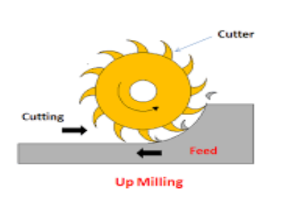
Up Milling ( Conventional Milling)

Slide 6
Down Milling ( Climb Milling )
1) In Down Milling cutter rotate in the direction of Feed .
2) Chip thickness is maximum at the start of cut and minimum at end of cut. 3) In Down milling Tool wear is less because tool moves toward the feed direction .
4)Down word force act on workpiece hence Normal Fixture required to hold the workpiece.

Slide 7
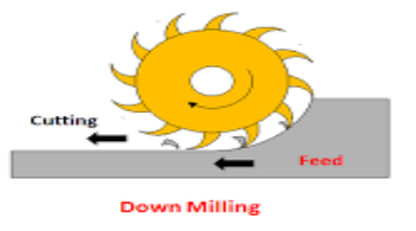
Down Milling ( Climb Milling )

Slide 8
CONTINEOUS Chip evaluation
1) Continuous chip occur during machining of ductile material.
2) High rake angle of tool, High cutting speed, Small depth of cut and minimum friction between tool and workpiece are responsible for Continuous chip formation.
3) Crater wear occur due continuous chip .
4) Better surface finish occur due to continuous chip formation

Slide 9
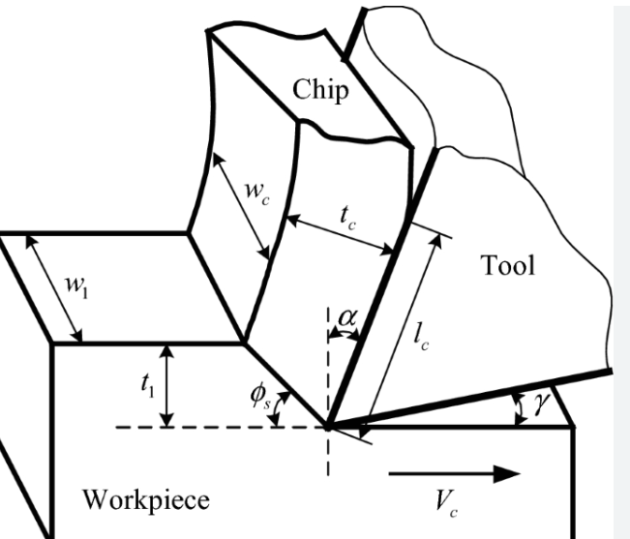
CONTINUES CHIP EVALUVATION

Slide 10
CONTINUES CHIP EVALUVATION
1)Segmented chip occur during machining of Brittle & Hard material .
2) Low rake angle of tool, Low cutting speed, high depth of cut and maximum friction between tool and workpiece are responsible for segmented chip formation.
3) Tearing of tool take place due to Segmented chip formation .
4) Poor surface finish & excessive wear occur due to segmented chip formation

Slide 11
Abrasive Waterjet milling with Masks
• The most used strategy exploits the protective action of custom-shaped masks, since it achieves better geometric characteristics.
• The mask has an aperture that coincides with the zone to be milled, This way the jet erodes only this portion.
• A hard metal mask is used indeed for overcoming the edge-rounding problem: it allows separating the areas to be machined from the ones to be preserved, thus resulting in sharp edges at the pocket top.
• The application of a mask over the workpiece allows avoiding the negative effects of the jet motion when changing feed direction that induce high acceleration forces and cause under- or over erosion on the part.

Slide 12
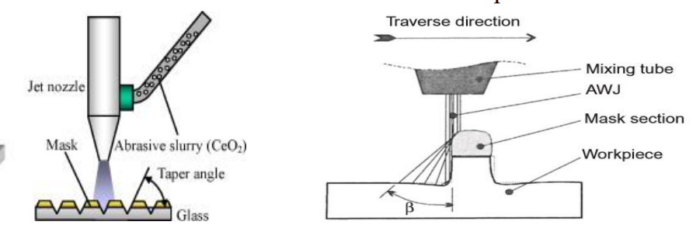
Abrasive Waterjet milling with Masks

Slide 13
AWJ milling strategies
• Both the achieved waviness and surface roughness must be investigated when assessing the quality of the AWJ milling process in terms of produced surface .
• The focus is always to obtain pockets with a shape that is as close as possible to the designed one.
To achieve a constant pocket depth, a constant surface exposure time to the jet is required, These aspects are extensively analyzed together with the effects of three different milling strategies .

Slide 14
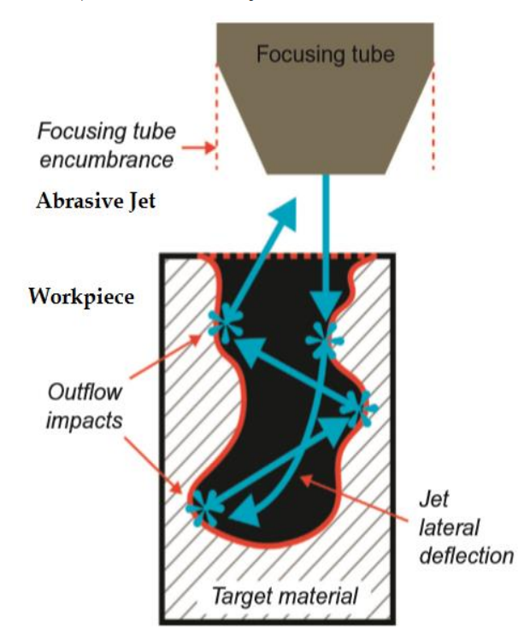
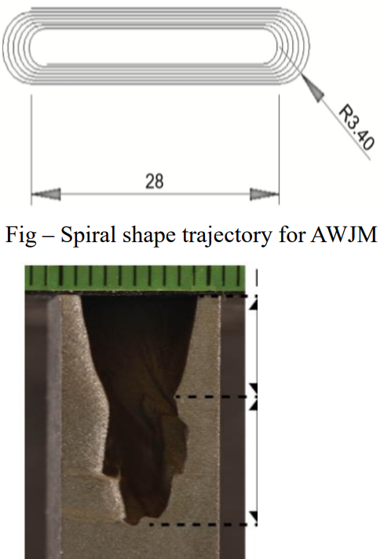
AWJM cycle

Slide 15
AWJM cycle
• Coming back to the AWJM operation, particular attention has to be paid not only to the process parameters, i.e., water pressure, abrasive size, mass flow rate, and cutting head feed rate, but also to the geometrical ones.
• Waterjet trajectory and distance between each parallel track (pitch) are two geometrical characteristics that must be carefully selected due to their influence on the final product.
• Single AWJ pass exploiting the jet erosion power is adopted in the following for creating the target depth, by selecting a suitable combination of process parameters and trajectory design.

Slide 16
Conventional Milling Cycle
The pocket roughed through AWJM must be finally machined using conventional Milling.
• The first aspect to consider regards the optimal pocket shape. The pocket that shows the best surface regularity together with the highest depth allowing the tool to work in a pure contouring fashion must be preferred.
• The efficiency of the AWJM roughing operation is investigated in terms of total production time saving.
• The analysis is conducted comparing the machining time of the operation starting from the bulk material and the one starting from the AWJM roughed pocket.
• The final target is to find the break-even condition, in terms of total machining time, between the workpiece entirely machined with cM and the one machined by adopting the hybrid strategy AWJM.

Slide 17
CONCLUSION
• Hybrid manufacturing can help to solve advanced manufacturing challenges such as the deep pocket manufacturing in difficult-to-cut materials like titanium, Inconel and other alloys.
• The conjunct use of Abrasive Waterjet Milling (AWJM) and can be integrated in a single hybrid approach to tackle the limited machinability of these materials with standard cutting technologies by increasing the overall process capability.
• Eventually, the overall hybrid process chain layout must be designed in order to evaluate all the other aspects such as the workpiece loading and unloading time on the machines

Slide 18
THANK YOU

