Slide 1
Order Management System
Design AND Implementation

Slide 2
INTRODUCTION
Brief About Me
Professional Experience
Educational Background
Awards & Certifications
Professional Achievements: (Objective, role, outcome, learned)
Data Ingestion System
POC on Pricing Service
Return on Investment Analytics

Slide 3
PROBLEM UNDERSTANDING
Design Order Management related RESTful APIs that orchestrates among multiple enterprise systems.
Upstream System that exists that will be using the REST APIs:
UI website will call your REST APIs to accomplish:
Get a price quote for a given product
Submit an order to purchase the product
Downstream Systems will get response from:
Product Catalog system
Tax Calculation system
Order system
Email system

Slide 4
Use cases
Price Quote for a Product
Submit an Order to purchase product
Product Catalog System
Dynamic Tax calculation System
Generate Invoice
Email Invoice to Customers
High Availability of the System

Slide 5





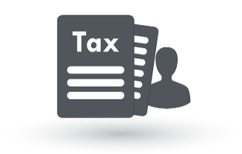







DESIGN
Registration Service (Eureka)
UI Web Service (Not Implemented)
Product Catalog Service
Pricing Service
Tax Computation Service
Order Service
Billing Service
Mailing Service
Products DB
Front End
Orders DB
Billing DB
JMS
Back End

Slide 6
Assumptions
Content type of Request and Response body are application/json
All the microservices are developed in single project – for time being
Each microservice can maximum interacts with single database
Communication b/n microservices is only with Eureka Registry Service
Basic Authentication implemented – due to time constraints
UI is assumed as built & can able to call backend REST API services.

Slide 7
Tech stack used
Spring Boot – for REST microservices
H2 – In Memory Database
JSON – for Exchanging Data
Embedded Tomcat – for running microservices
Spring Data JPA – for Data Access Layer
Eureka – Service Discovery
ActiveMQ – for messaging Queue
Spring Messaging JMS – to send/receive from Queue
Spring Mail – for Emailing Service
Thymeleaf – for templates

Slide 8
Microservice | Purpose | End Point | HTTP Method | Request Body | Response Body | Return Codes
Product Catalog Service | Add Product | /products/v1/add | POST | product | product | 200 – product object 404 - Product Already Exists: {product name}
 | Get Product | /products/v1/get?id=1 | GET | - | product | 200 – product object 404 – No product found: {id}
 | Get Product Type | /products/v1/type/{product Type} | GET | - | products | 200 – list of product object 404 – product type not found: {product type}
 | List Products | /products/v1/list | GET | - | products | 200 – list of product object 404 – No products found
Tax Compute Service | Define Tax | /tax/v1/define | POST | tax | tax | 200 – tax object 404 – product type not found: {product type}
 | List Taxes | /tax/v1/list | GET | - | taxes | 200 – tax object 404 – No taxes found
 | Compute Tax | /tax/v1/compute?productId=1&location=IND | GET | - | decimal | 200 – decimal of computed tax 404 – product not found: {product id}
Pricing Service | Get Price Quote | /pricing/v1/pricequote?productid=1&location=IND | GET | - | decimal | 200 – amount quoted for product 404 – No product found: {id}
Order Service | Add Order | /order/v1/add | POST | order | order | 200 – order object 404 – No products found: {id}
 | Get Order | /order/v1/getDetails?orderId=1 | GET | - | order | 200 – order object 404 – No Order found: {order id}
Billing Service | Generate Bill | /billing/v1/generateBill | POST | billing | invoice | 200 – invoice object 404 – No products found: {product id} 404 – No Taxes found for product type : {product type} 404 – No Order found: {order id}
 | Get Existing Bill | /billing/v1/getBill?orderId=1 | GET | - | invoice | 200 – invoice object 404 – No Order found: {order id}
Mailing Service | Send Email | /mailing/v1/sendMail | POST | mail | mail | 200 – mailing object 404 – Unable to send Mail :{mail id}

Slide 9
service Discovery & monitoring
Eureka – Inbuilt Spring Cloud Server
Provides:
Load Balancing
Service Discovery
Monitoring Services
All the services are developed independently and are loosely coupled
Services are discovered in Eureka server: (http://localhost:1111/)
Each Service is registered in Eureka and informs where it lives (host, port, node)

Slide 10
Functional flow
Get a Price Quote
Pricing Service is Invoked
Get the product service from Registration Service
Find Product Service Node from Load Balancer
Returns the Base Price of the Product
Get the Tax Compute Service from Registration Service
Find the Tax Compute Service Node from Load Balancer
Get the Tax for the given Product
Compute the price quote from Base Price & Taxes
Product Service
1
4
3
Pricing Service
2
Registration Service
5
7
6
8
Tax Compute Service
Return Codes:
200 – price quote of the product
404 – Product Not Found
Compute Price

Slide 11
Functional flow
Submit an Order
Generate Bill
9
Send Message to Queue
1
8
10
2
Order Service
Product Service
Pricing Service
Mailing Service
3
4
7
11
Create an Order
5
Compute Bill
6
Billing Service
Send Mail

Slide 12
Functional flow
Pricing Service interacts with Product Catalog Service & Tax Compute Service from Eureka Service Registry.
Tax Compute Service interacts with Product Catalog Service
Billing Service interacts with Order Service, Tax Service, Product Catalog Services
Billing Service sends the invoice to ActiveMQ using Spring JMS Template
Mailing Service receives messages from ActiveMQ and process it

Slide 13
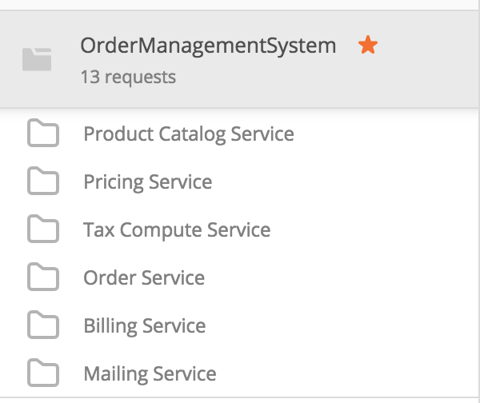
Live demo
Start ActiveMQ
Start Registry Service
Start all other Microservices
Postman Requests
Generate Invoice and Demo Email of Invoice
Source Code Functional Flow

Slide 14
Q & A ?
Questions ?

