Slide 1
BP Monitoring Management System Developed in PHP & MySQL

Slide 2
Introduction
Scope of the Project
The objective of this application is to develop a system that effectively manages the data related to the Blood Pressure monitoring. The purpose is to maintain a centralized database of all BP monitoring related information. The goal is to support various functions and processes necessary to manage the data efficiently.
Existing System
This existing system is not providing secure registration and profile management of all the users properly. This system is not providing on-line Help. This system doesn’t provide tracking of users activities and their progress. This manual system gives us very less security for saving data and some data may be lost due to mismanagement.

Slide 3
Proposed System
The development of this new system contains the following activities, which try to automate the entire process keeping in the view of database integration approach. This system maintains user’s personal, and contact details. This system will provide on line help and search capabilities. User friendliness is provided in the application with various controls provided by system rich user interface. Authentication is provided for this application only registered users can access. Blood pressure monitoring information files can be stored in centralized database which can be maintained by the system. This system provides the users to manage the blood pressure monitoring data systematically. This system basically lessens the manual work and improves the quality of maintaining records and other information related to the blood pressure monitoring. One of the solutions that we are going to discuss here to speed up the database response by using MySQL database and to reduce the time complexity by using multi-user environment. Multi-user environment reduces burden with effortless maintenance.

Slide 4
Project Modules
The system after careful analysis has been identified to be presented with the One module.
In this project we use PHP and MySQL database and it has one modules i.e.
User

Slide 5
User Module
User Registration: In this section, the user can register himself. A one-time registration is required for every user.
User login: In this section, users can log in with a valid email id and password.
Dashboard: In this section, the User can view the total listed family members and total BP records count.
Family Members: In this section, the user can add, edit and delete the family members.
BP: In this section, the user can add, edit and delete the family member BP details.
Reports: In this section, the User can generate the b/w dated report of a particular family member.
User can also update their profile, change their password and recover their password.

Slide 6
Requirement Specification
Hardware Configuration:
Client Side
Server Side
RAM | 512 MB
Hard Disk | 10GB
Processor | 1.0 GHz
RAM | 1 GB
Hard Disk | 20GB
Processor | 2.0GHz

Slide 7
Continue.....
Software Requirement:
Client Side
Server Side
Web Browser | Google Chrome or any compatible browser
Operating System | Windows or any equivalent OS
Web Server | APACHE
Server side Language | PHP5.6 or above version
Database Server | MySQL
Web Browser | Google Chrome or any compatible browser
Operating System | Windows or any equivalent OS

Slide 8
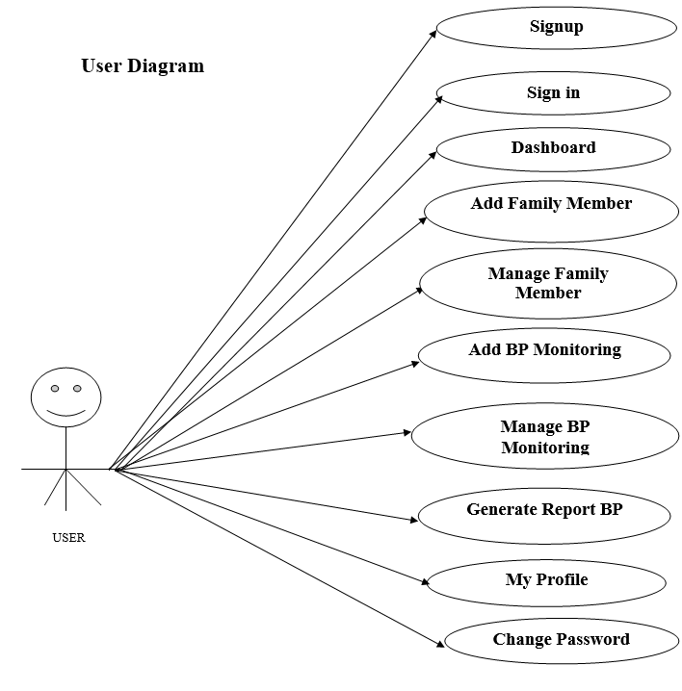
Use Case Diagram
Notes:
USECASE DIAGRAM: A Use case is a description of set of sequence of actions. Graphically it is rendered as an ellipse with solid line including only its name. Use case diagram is a behavioral diagram that shows a set of use cases and actors and their relationship. It is an association between the use cases and actors. An actor represents a real-world object. Primary Actor – Sender, Secondary Actor Receiver.

Slide 9
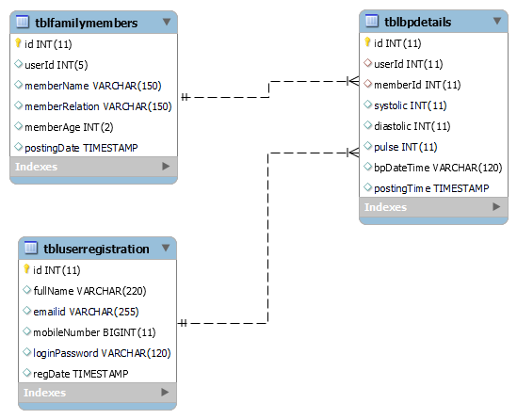
Class Diagram
Notes:
Class Diagram:
A description of set of objects that share the same attributes operations, relationships, and semantics

Slide 10
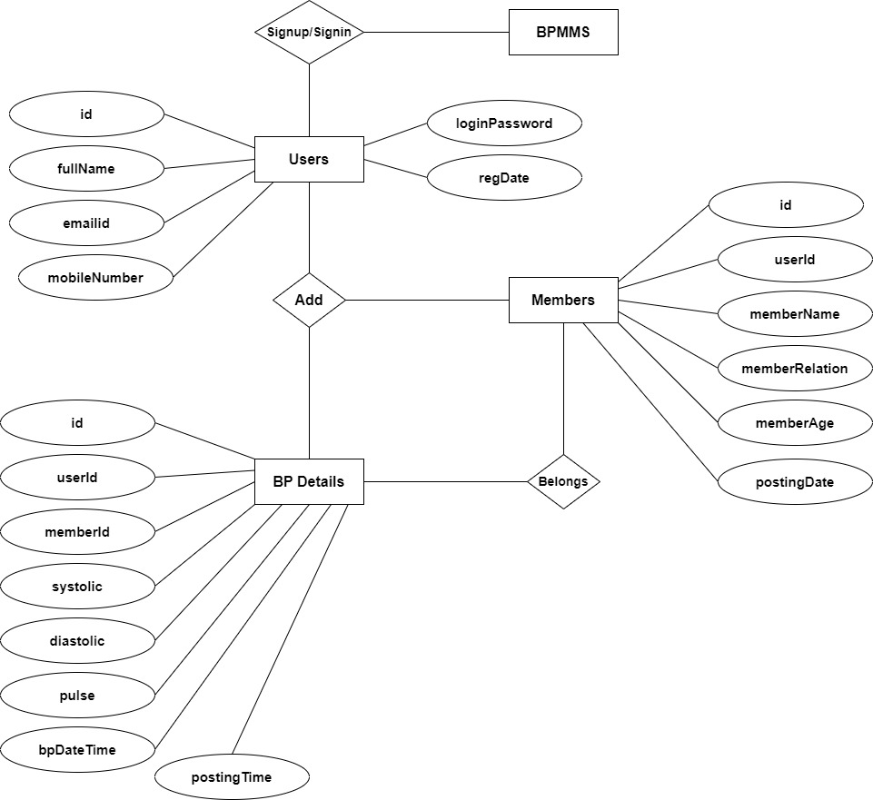
ER Diagram

Slide 11
Data Flow Diagram
A data flow diagram is graphical tool used to describe and analyze movement of data through a system. These are the central tool and the basis from which the other components are developed. The transformation of data from input to output, through processed, may be described logically and independently of physical components associated with the system.
These are known as the logical data flow diagrams. The physical data flow diagrams show the actual implements and movement of data between people, departments and workstations.

Slide 12
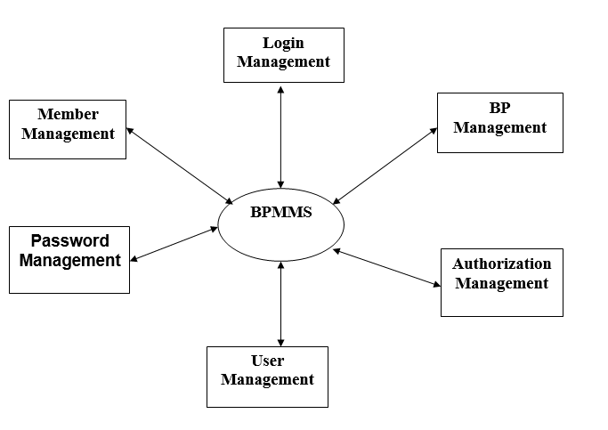
Continue……
Zero Level

Slide 13
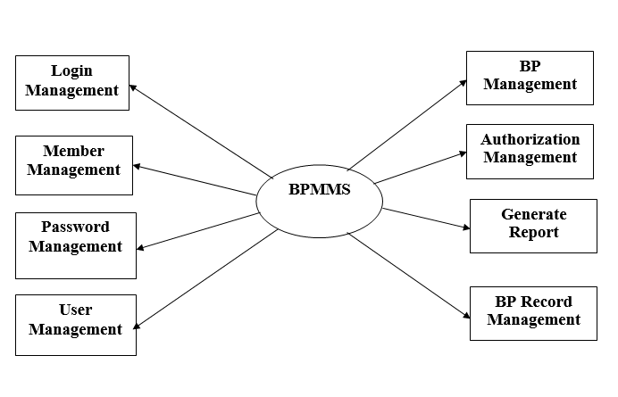
Continue…..
First Level

Slide 14
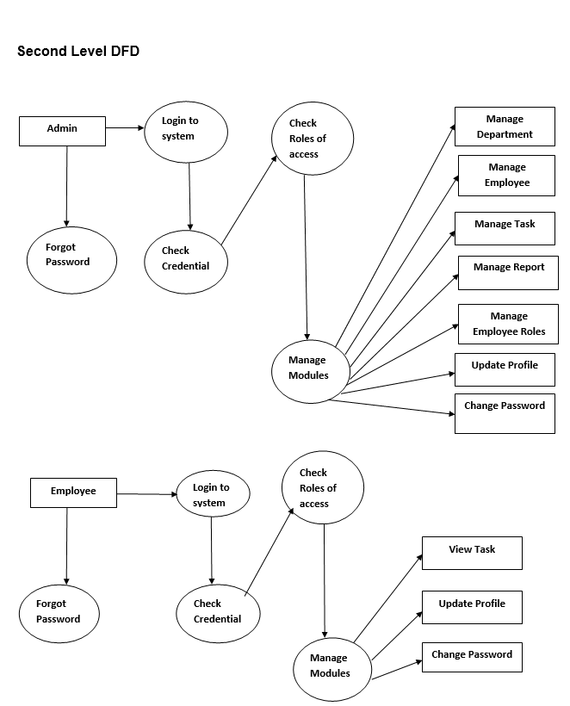
Continue….

Slide 15
Implementation and System Testing
After all phase have been perfectly done, the system will be implemented to the server and the system can be used.
System Testing
The goal of the system testing process was to determine all faults in our project .The program was subjected to a set of test inputs and many explanations were made and based on these explanations it will be decided whether the program behaves as expected or not. Our Project went through two levels of testing
Unit testing
Integration testing

Slide 16
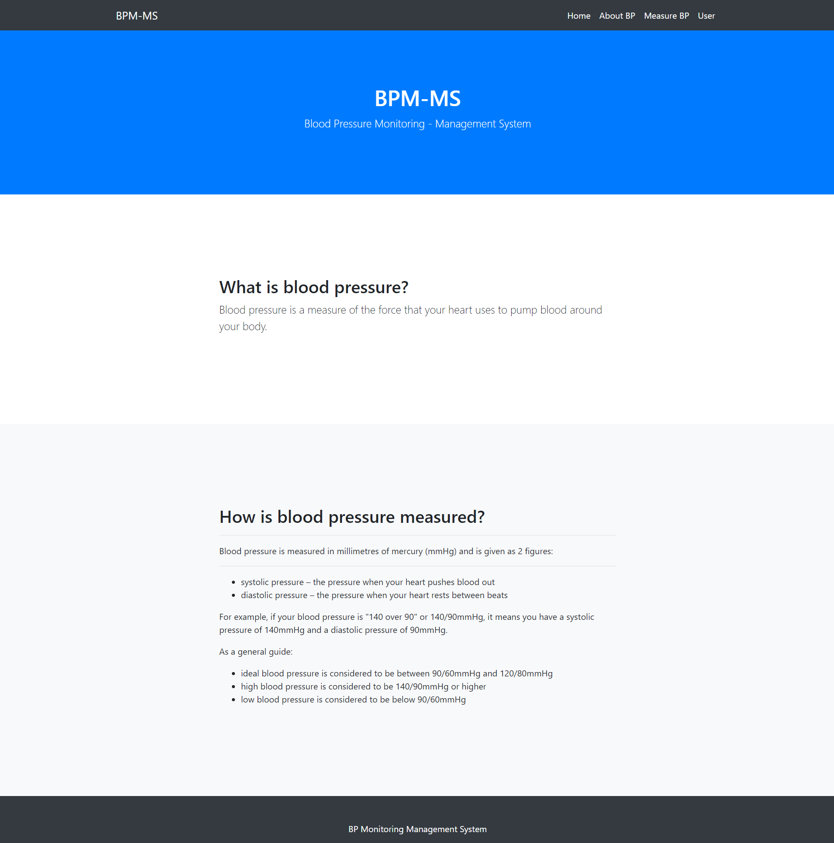
Project Screens

Slide 17
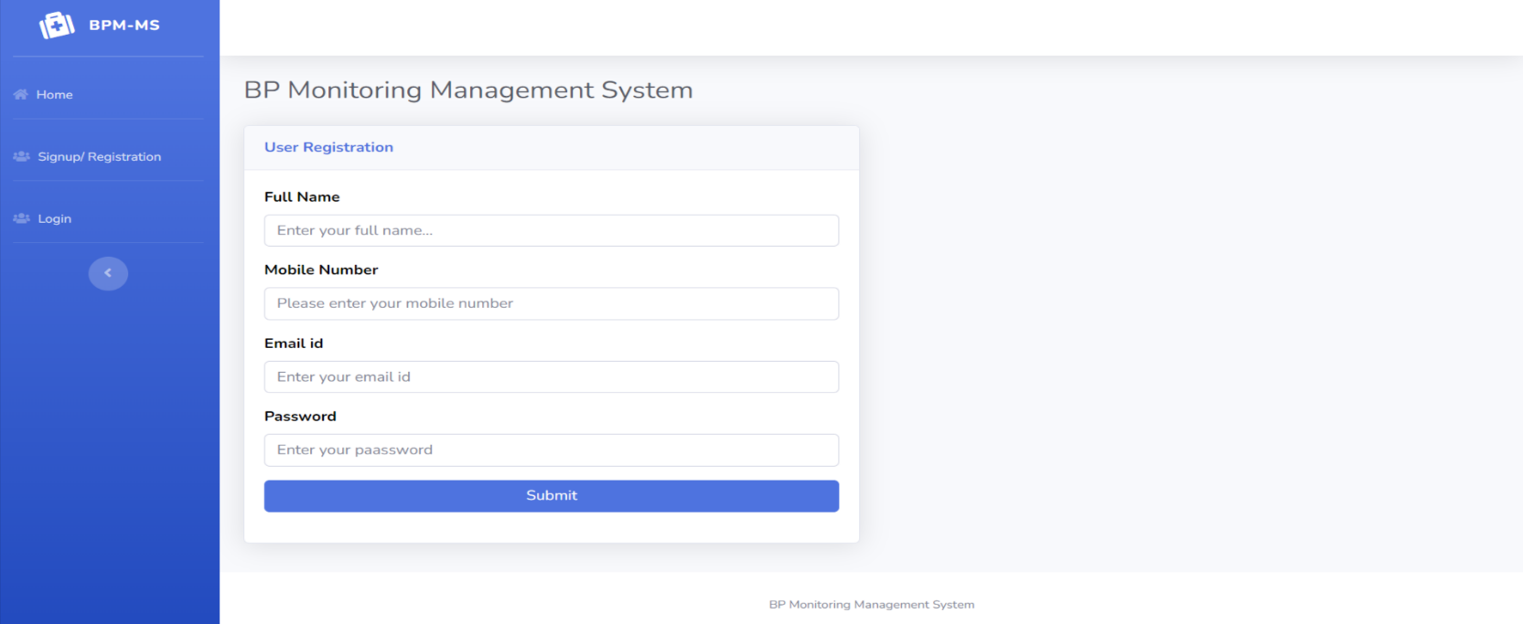
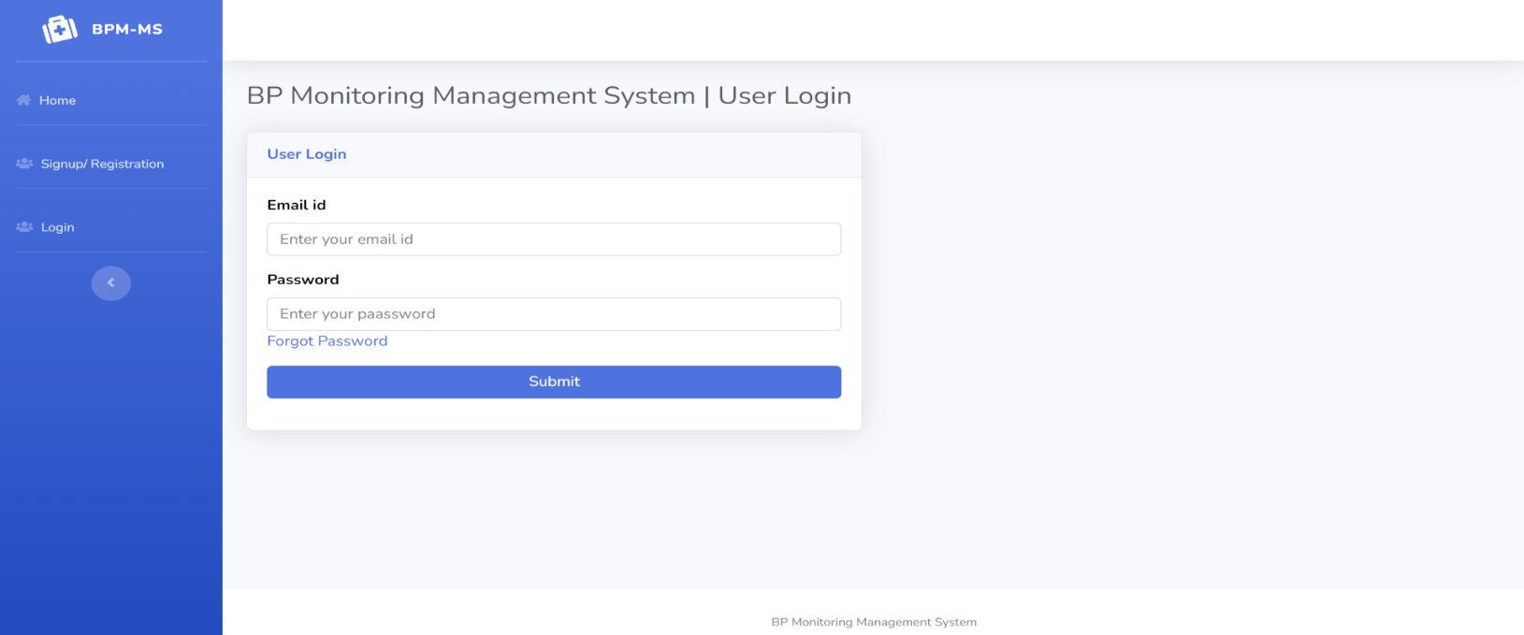

Slide 18
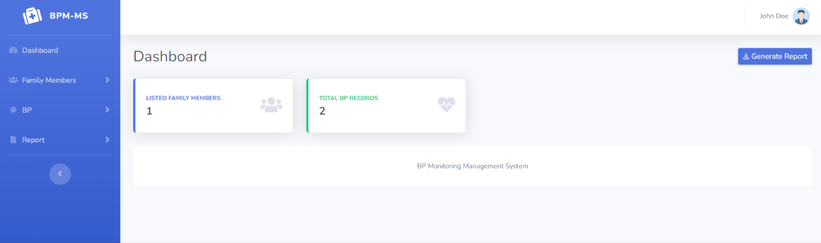
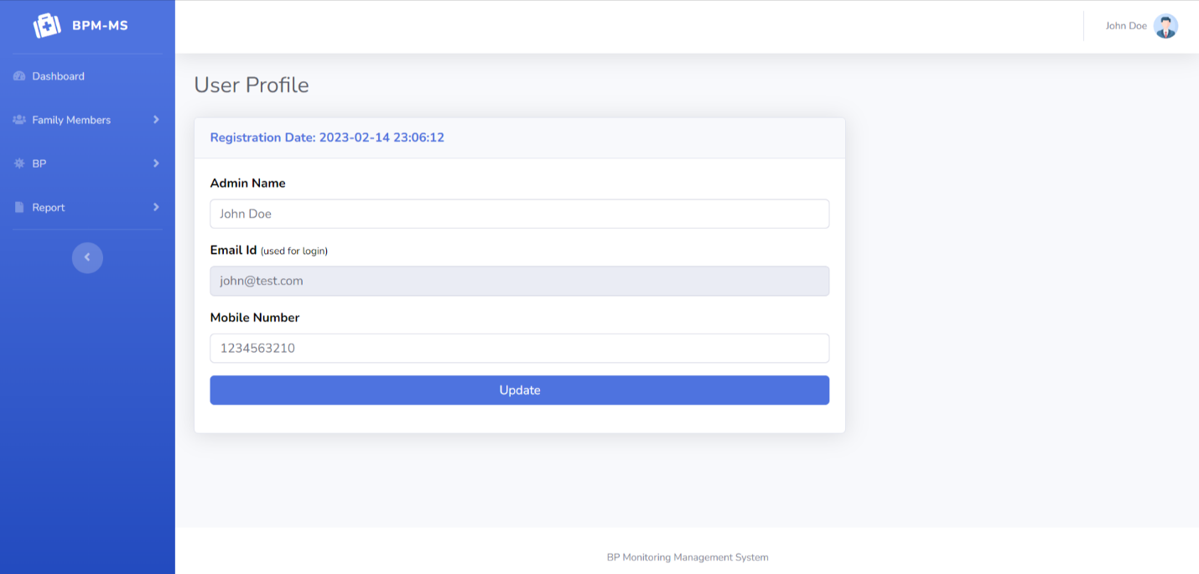

Slide 19



Slide 20
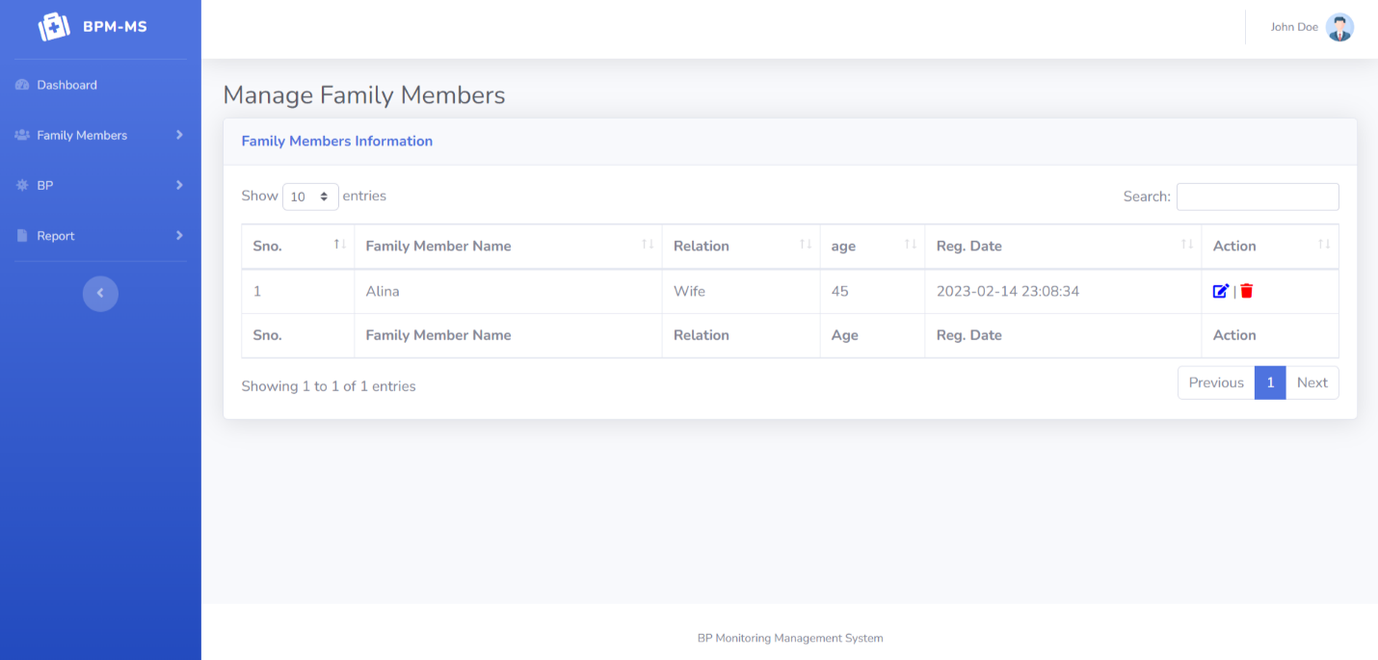


Slide 21
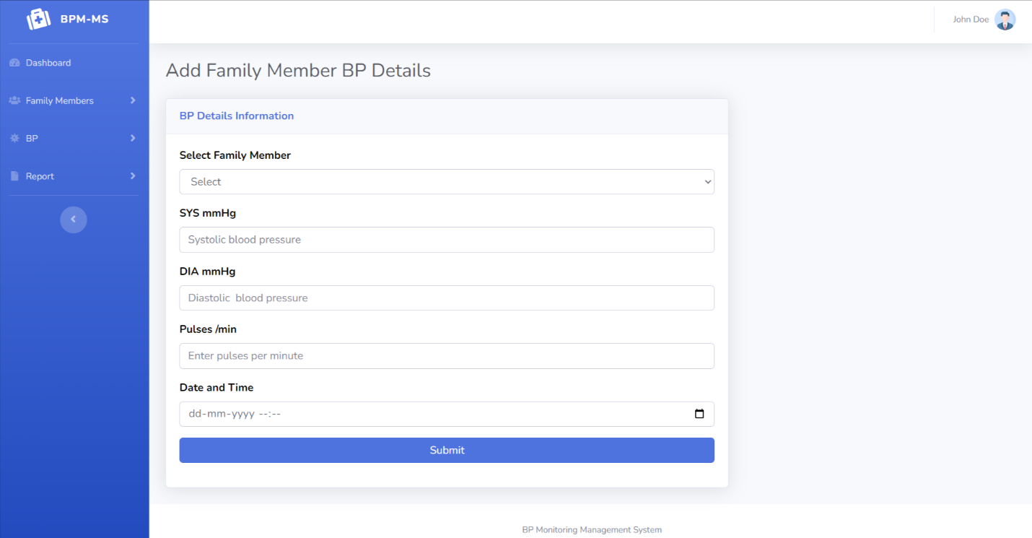
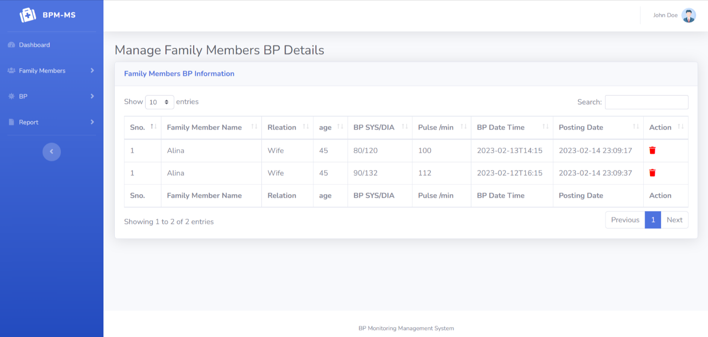

Slide 22
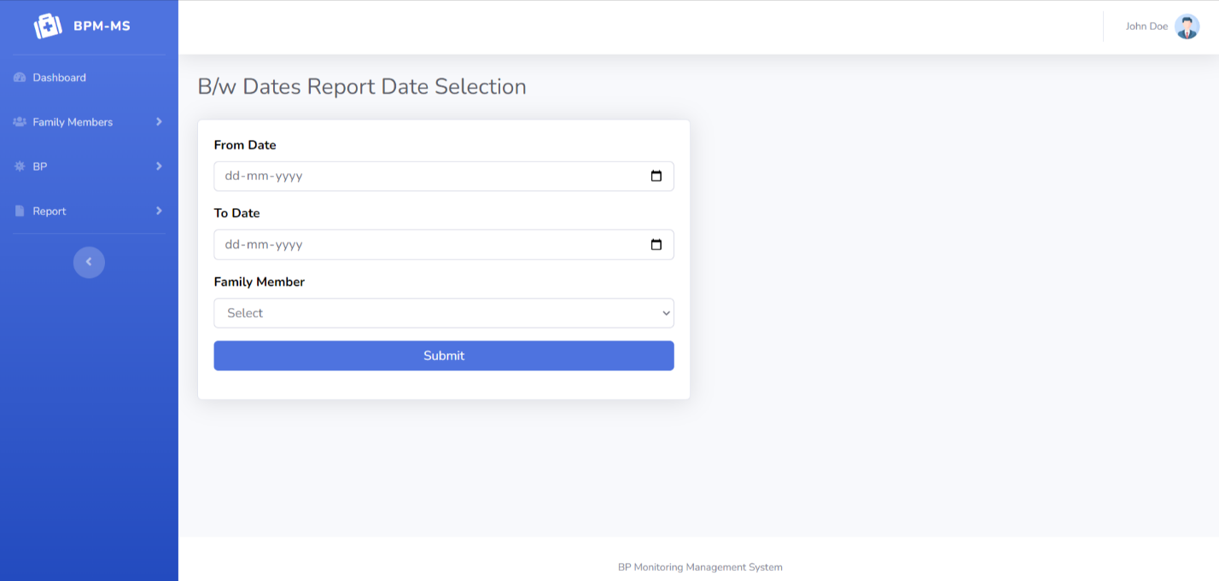
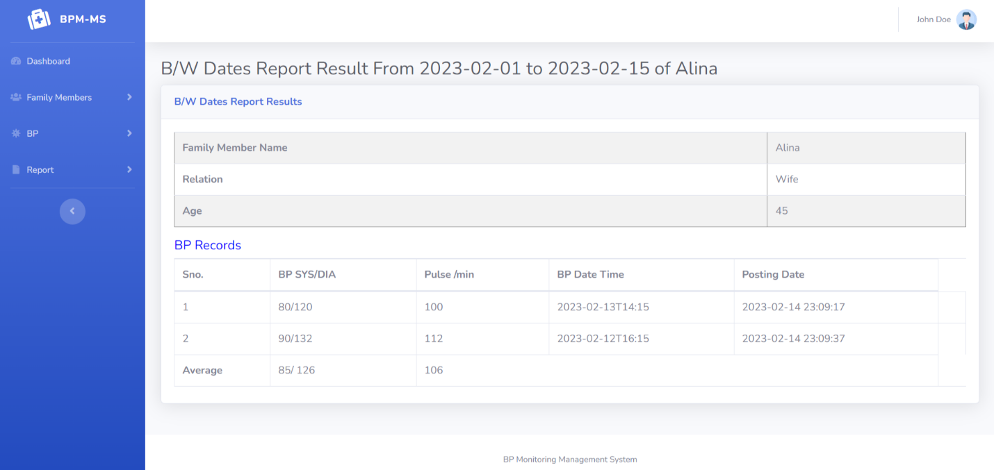

Slide 23
Conclusion
The “Blood Pressure Monitoring Management System” was successfully designed and is tested for accuracy and quality. During this project we have accomplished all the objectives and this project meets the needs of the organization. One of the solutions that we are going to discuss here to speed up the database response by using MySQL database and to reduce the time complexity by using multi-user environment. Multi-user environment reduces burden with effortless maintenance.
GOALS ACHIVIED
Reduced entry work.
Easy retrieval of information.
Reduced errors due to human intervention.
User friendly screens to enter the data.
Portable and flexible for further enhancement.
Web enabled.
Fast finding of information request

Slide 24
Refrences
www.w3schools.com
php.net
en.wikipedia.org/wiki/PHP
www.hotscripts.com/category/php/
www.apache.org
www.mysql.com/click.php?e=35050

Slide 25
Thank You

