Slide 1
University of Maryland College Park
Information Challenge 2022
Paycheck protection program: Analysis
Team – IC22-052
Team members:
Manikanta Koneru
Jayasree Karthik Nandula

Slide 2
Contents:
Introduction
Exploratory data analysis
Model build:
Decision tree
Random forest
Feature selection
References
Conclusion

Slide 3




Introduction:
U.S. Small Business Administration:
A United States government agency that provides support to entrepreneurs and small businesses.
Paycheck protection program:
An SBA-backed loan that helps businesses keep their workforce employed during the COVID-19 crisis.
Periodical release of data by SBA on 11.5 million approved applications, of which some applications were later on removed from the database.
Goal: through data analysis, develop an understanding of why these loans might have been removed.
Exploratory data analysis
Model build & validation
Further analysis
Scope of enhancement

Slide 4
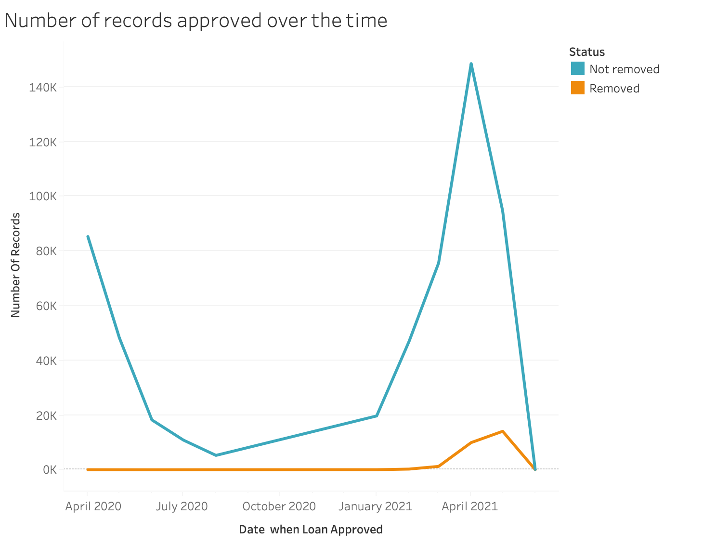
The Consolidated Appropriations Act, 2021 (CAA) extended the Paycheck Protection Program (PPP) through March 31, 2021. However, the PPP funds have been exhausted, meaning the PPP program is no longer available as of May 31, 2021. The amount of funds made available in the third round totaled $284 billion. Maximum loans of $10 million were available to first-draw borrowers, and loans up to $2 million were offered to second-draw, small business owners.
Exploratory data analysis:
Plot: Loan approval date vs no. of applications (Time series graph)
Reference: https://www.investopedia.com/your-guide-to-the-paycheck-protection-program-ppp-and-how-to-apply-4802195#:~:text=Round%20three%20funding%20of%20%24284,rounds%20of%20PPP%20loan%20funding.

Slide 5
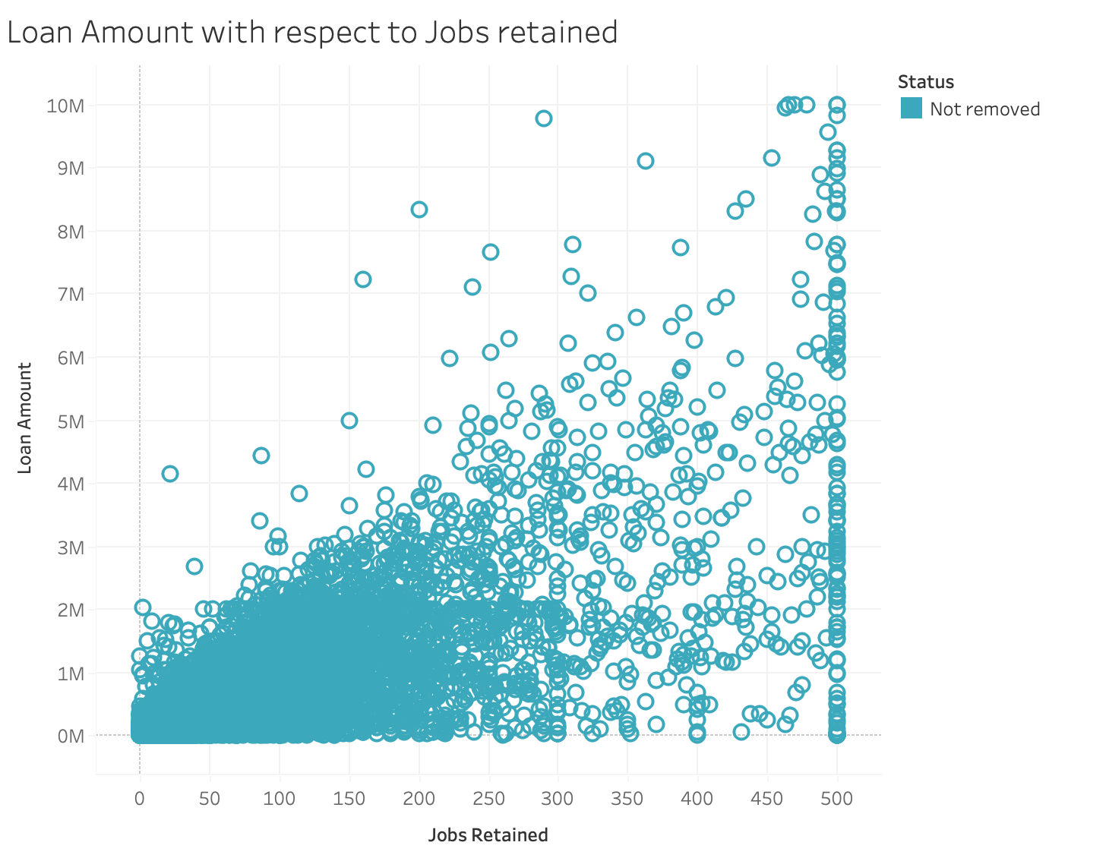
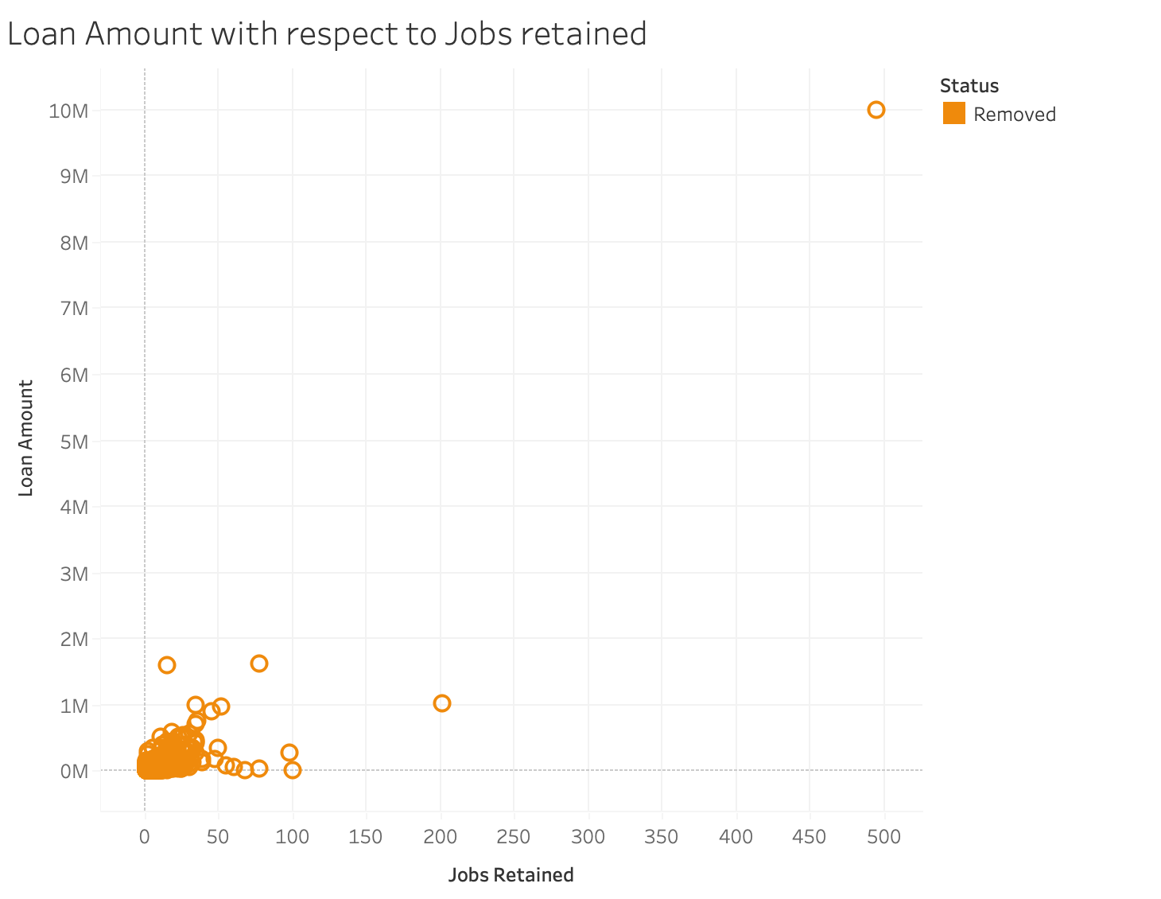
Exploratory data analysis:
Plots: Jobs retained vs loan amount requested – Full data & removed data
The Georgia loans of $14.4 billion as of June 27 — represent about 55% of the 278,000 active small businesses in the state, according to the National Federation of Independent Business.
About 18,300 companies in the state received loans of between $150,000 and $10 million, and another 139,000 state-based businesses obtained loans of less than $150,000, according to the SBA.
The loans helped companies retain more than 800,000 jobs.
Notes:
<1M loans related article

Slide 6
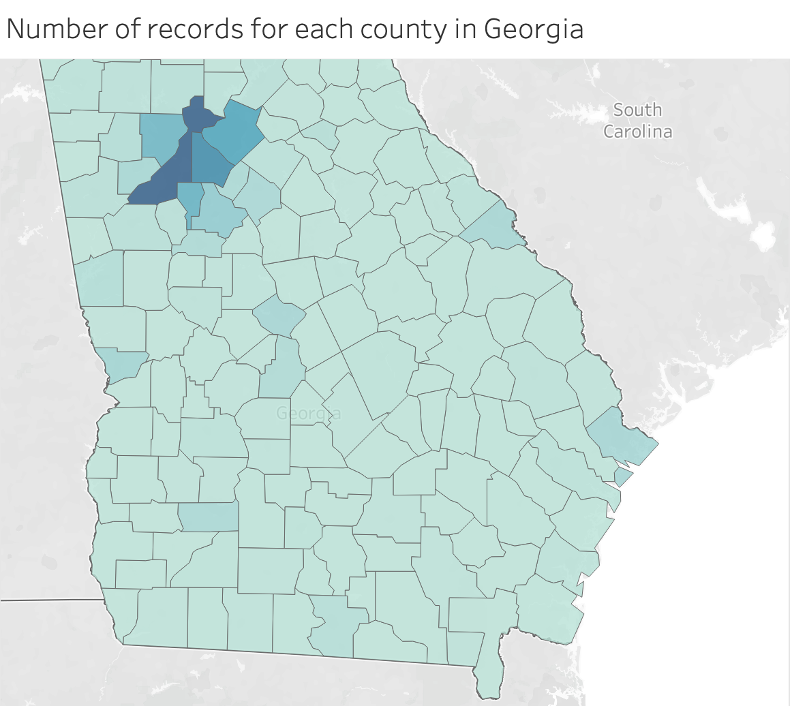
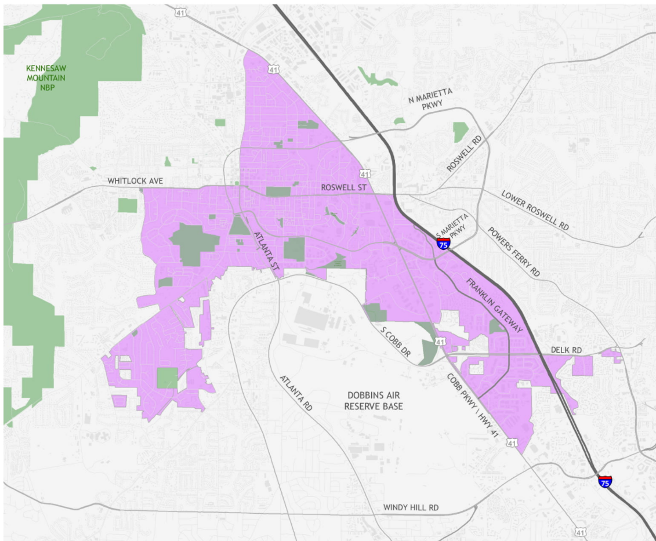
Georgia: Counties with most applications
Historically Underutilized Business zones in pink
COBB
GWINNETT
Counties in Georgia with highest number of applications: Fulton, Dekalb, Gwinnett, Clayton, Cherokee, Cobb
Counties characterized by many small businesses
Highest no. of PPP applications from these counties as affected by COVID19
FULTON
DELKAB
CLAYTON
CHEROKEE

Slide 7
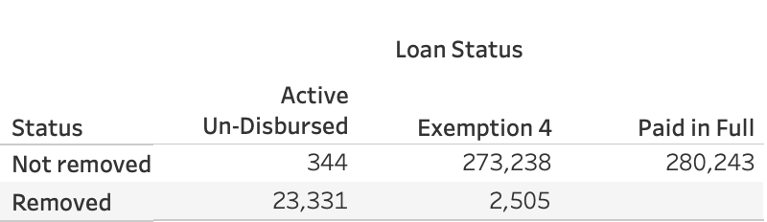
Applications breakdown w.r.t Loan status:

Slide 8
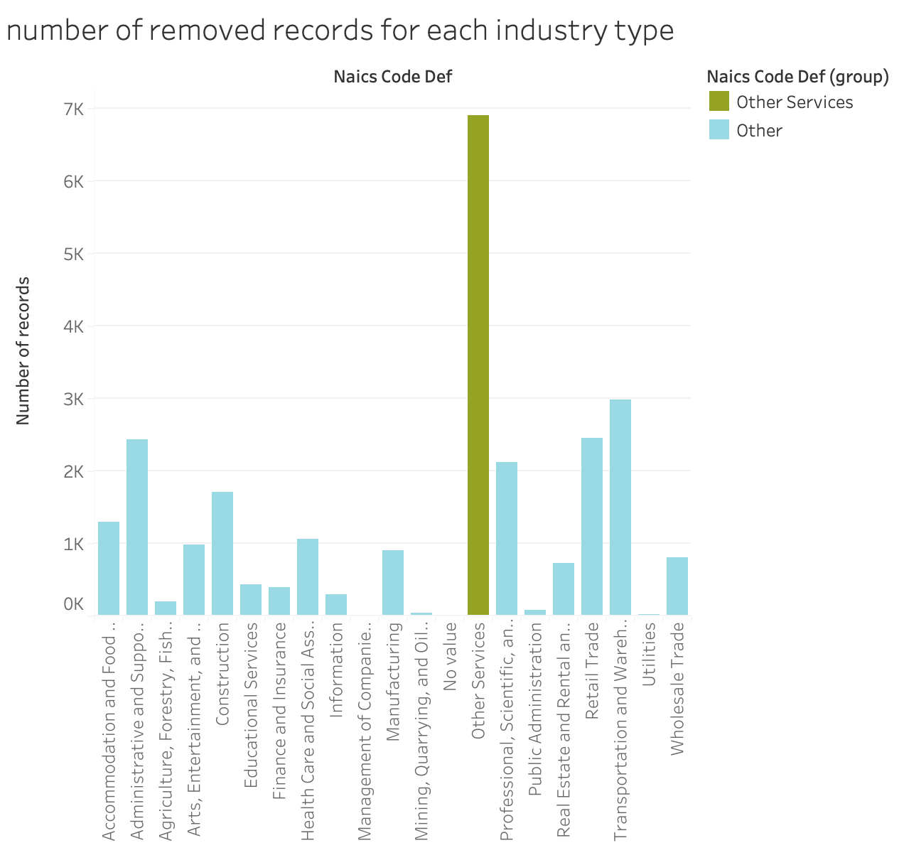



Analysis on industry type vs number of applications
Data set: Applications removed from database:
Plot: Industry vs no. of applications
Observation: Highest number of applications filed from the industry ‘Other services’

Slide 9
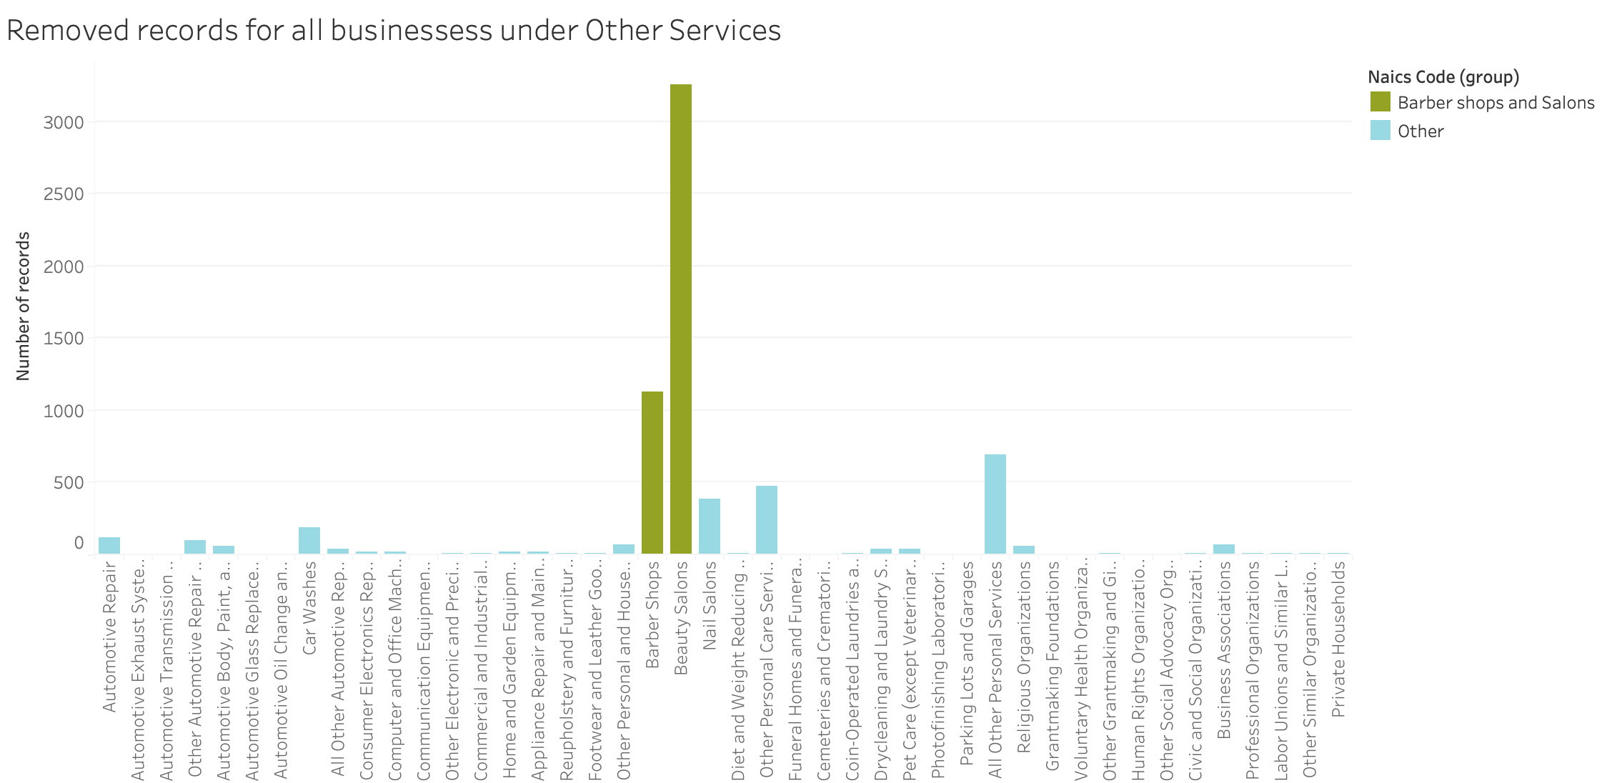

Analysis on industry type (continued):
Data set: applications removed from database:
Plot: industry vs no. of applications
Observation: highest number of applications filed from salons and barber shops
Notes:
Solo propreitorship

Slide 10
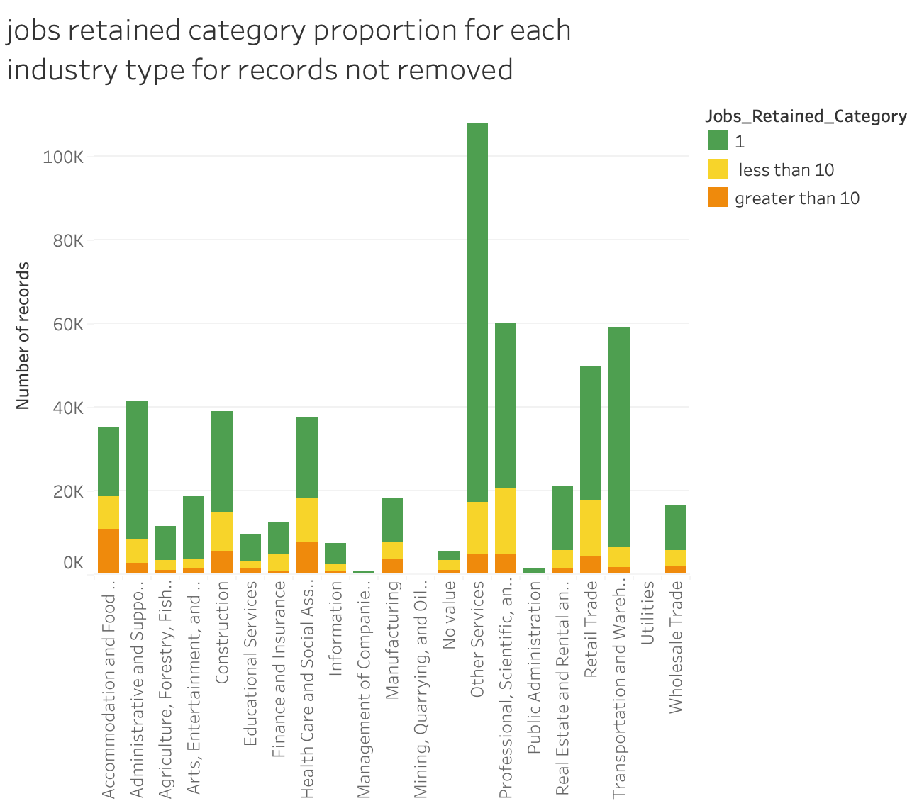

Analysis on industry and jobs retained:
Data set: full data set
Plot: industry vs no. of applications, category as no. of jobs retained
Observation: no. of jobs retained are 1 majorly from the applications from ‘other services’industry. other industry applications are also considerably high.

Slide 11
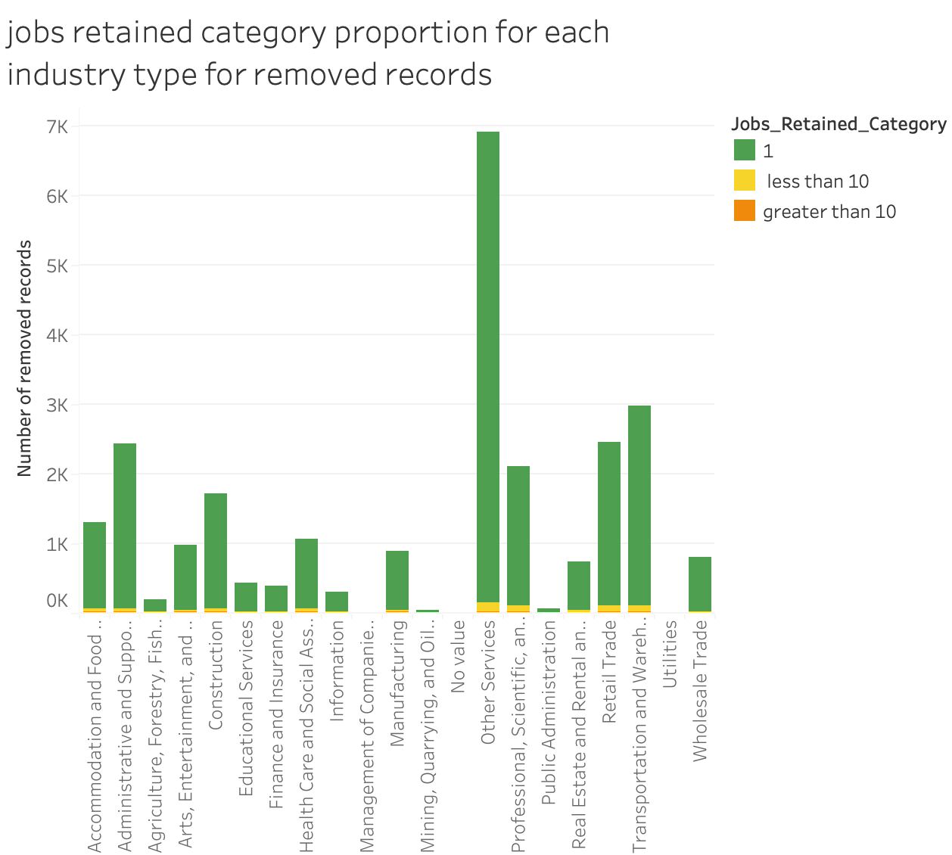


Analysis on industry and jobs retained:
Dataset: Removed applications from database
Plot: Industry vs total number of applications with category as no. of jobs retained.
Observation: Across all of the industries, most of the number of jobs retained =1.
One job is saved for each of the applications in ‘Other services’ industry

Slide 12
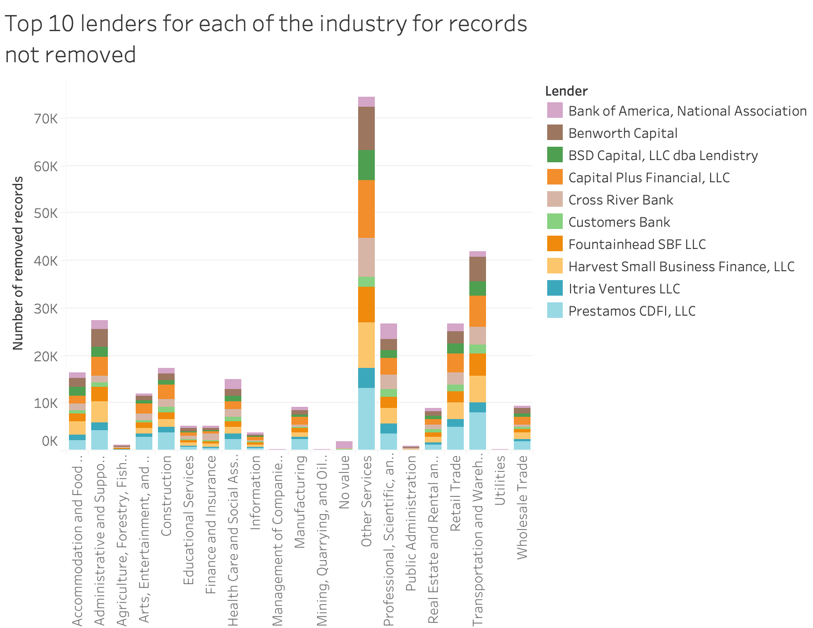
Analysis on Industry vs lender:
Dataset: Full dataset
Plot: Industry vs no. of applications, categorized by lender
Filter: Loan status: Exempt 4 (disbursed but not paid in full or charged off ) and paid in full
Observation: Top 10 lenders are as listed.
Major lenders:
Benworth Captial
Capital Plus Financial LLC
Prestamos CDFI LLC

Slide 13
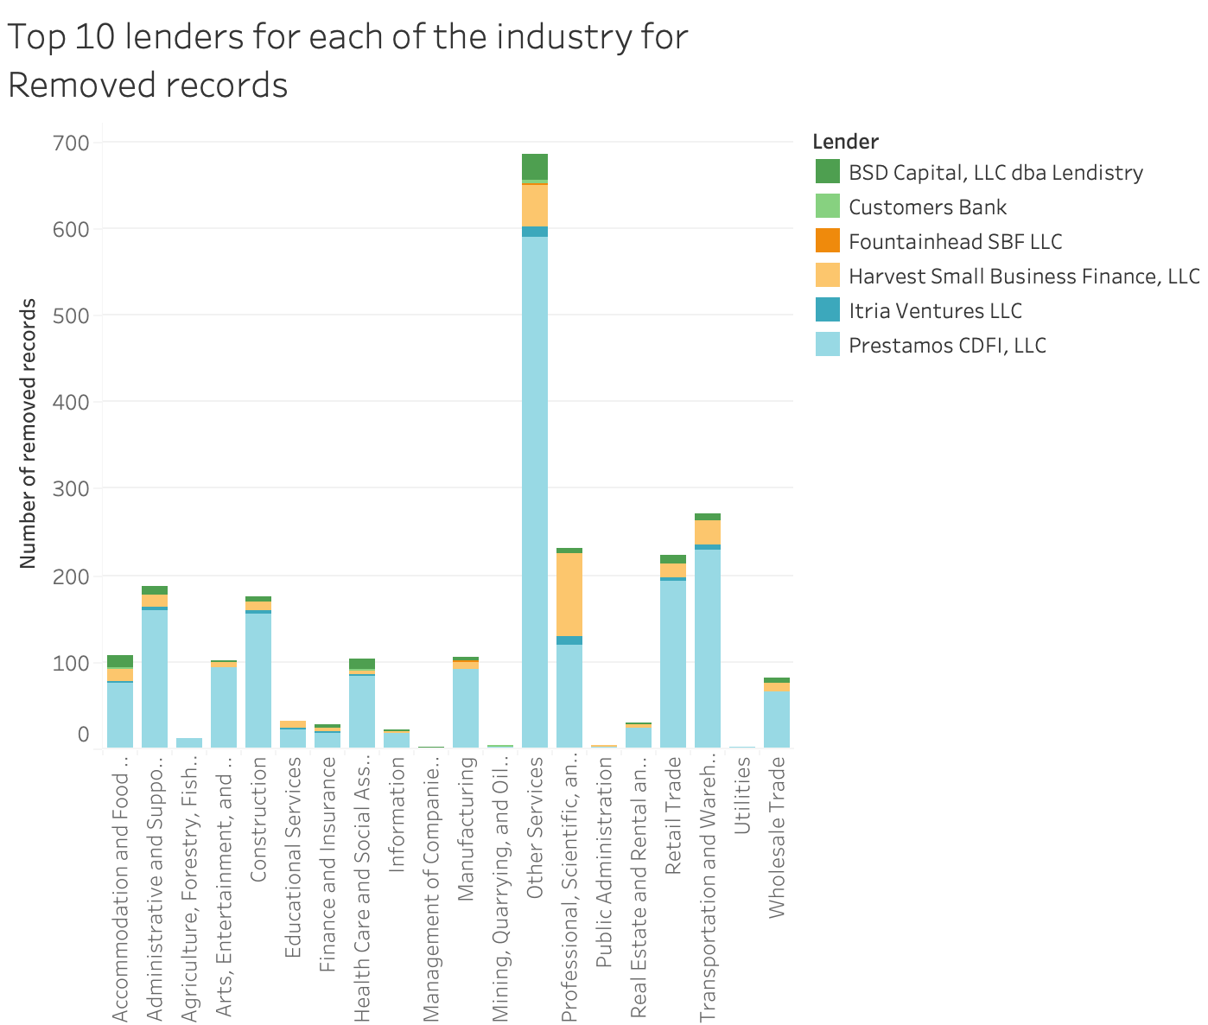
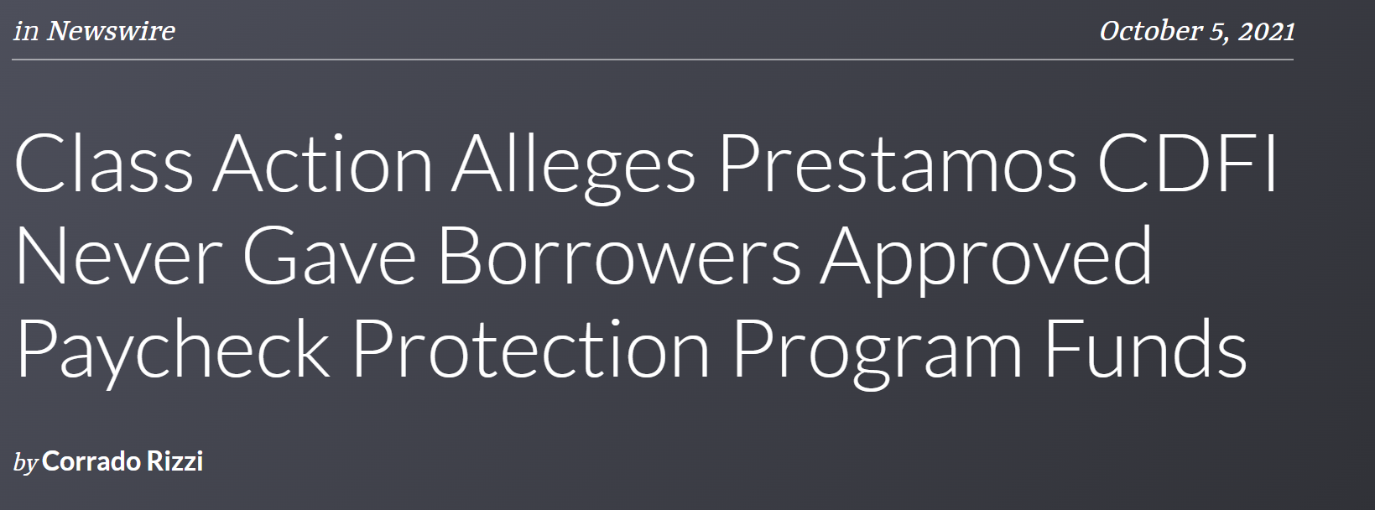
Analysis on Industry vs lender (continued):
Dataset: Applications removed from database
Plot: Industry vs no. of applications categorized by lenders
Filter: Loan status as Exempt 4 (disbursed but not paid in full or charged off)
Major lender: Prestamos CDFI LLC
Notes:
Exempt category only observed for slides 10 and 11

Slide 14
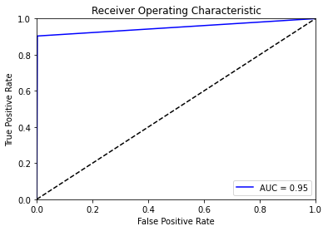
Machine learning: Decision tree
Predictive model to traverse from observations (branches) to conclusions about the item’s target value(leaf node).
White-box model, works well on large datasets, little data preparation, in-built feature selection
Accuracy & error rate computed through confusion matrix
Test data | Predicted
Actual | Category | Not removed | Removed
 | Not removed | 165059 | 341
 | Removed | 755 | 6994

Slide 15
Machine learning: Random forest
Ensemble learning method – builds multitude of decision trees at training time.
Output for classification -> class selected by most trees.
Bagging(reduces overfitting), ranking of variable importance, reduces variance, improves accuracy
Test data | Predicted
Actual | Category | Not removed | Removed
 | Not removed | 165154 | 246
 | Removed | 712 | 7037

Slide 16
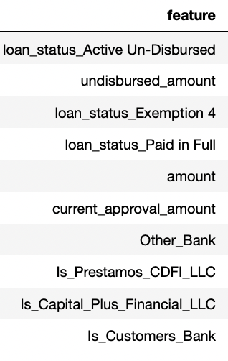
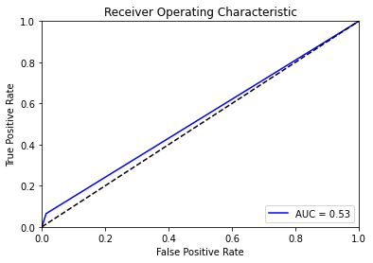
Feature importance:
Bias observed in the data due to the fields ‘Loan Status’, ‘undisbursed amount’:
Due to possible bias, explored model excluding top 3 features. Resulting model is just as good as random guessing.

Slide 17
Literature survey - evidence
References:
https://data.onlineathens.com/paycheck-protection-program-loans/
https://www.cnn.com/projects/ppp-business-loans/states/ga
https://opendata.atlantaregional.com/datasets/ppp-loans-georgia-1/explore
https://www.sba.gov/sites/default/files/2021-03/BorrowerApplication2483ARPrevisions%20%28final%203-18-21%29-508.pdf
https://www.sba.gov/sites/default/files/2020-07/PPP%20Results%20-%20Sunday%20FINAL.pdf
https://www.womply.com/blog/are-ppp-loans-public-information-what-data-is-available/
https://www.bizjournals.com/atlanta/news/feature/on-leadership/2021
https://www.forbes.com/advisor/business-loans/how-many-jobs-were-saved-because-of-ppp-loans/
https://www.justice.gov/archives/oip/foia-guide-2004-edition-exemption-4
https://projects.propublica.org/coronavirus/bailouts/faq
https://www.forbes.com/sites/brockblake/2021/04/06/why-ppp-loan-applications-are-getting-stuck-and-how-to-keep-yours-moving/?sh=2e86468e4872
https://data.onlineathens.com/paycheck-protection-program-loans/

Slide 18
Conclusion:
Majority of applications from removed dataset are:
Solo proprietorship (no. of jobs retained =1)
Barber shops & salons from other services industry
Fraudulent lender activity by Prestamos CDFI LLC
Insufficient documentation by applicants
Applicants withdrawing or canceling
Fraudulent activity by applicants (requesting loans when not in need or incorrect details)
Considering additional important demographic information from the PPP application form could help us uncover better insights.
Ex: gender, ethnicity etc.

