Slide 1
MANIKANDAN E
2019202028 (Regular)
Guide
MS.S.KANIMOZHI
Teaching Fellow

Slide 2
Digital Project Documentation
Domain : Mobile application
Consider the last 10 years in MCA department, Every year 100 students are doing final year project but no get more then mark.
Students are putting at least 3 months to do the R&D, But after the academic the that work is not exposed to outer world.
Even some of the project are so great but they are as a students project without any feature steps in it.
From this MCA Projects WIKIPEDIA Keep documenting the project with pdf document, links and video demo.

Slide 3
PROJECT FLOW
Student upload the project details with doc
Store the Information to the backend DB
If any want the project then we can search the project name inside application
Compress the video, image and pdf in frentend

Slide 4

Modules
> Project list and details
. Review comments
. Review rating
> Upload project
> feeds
> Profile

Slide 5
1.Project list and details

Slide 6
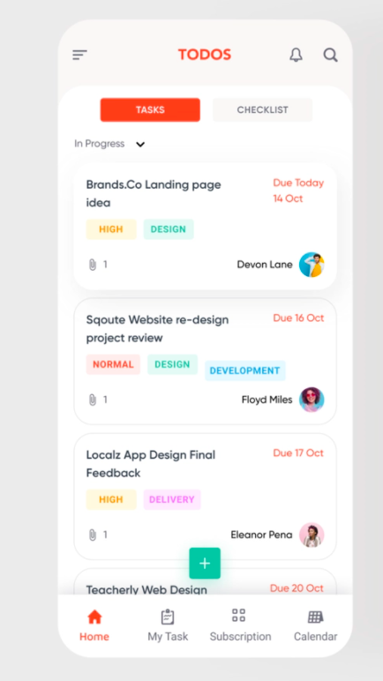
PROJECTS
PROJECTS
In this module, show all projects item and user can search the project name.
Search

Slide 7
2.Upload project

Slide 8
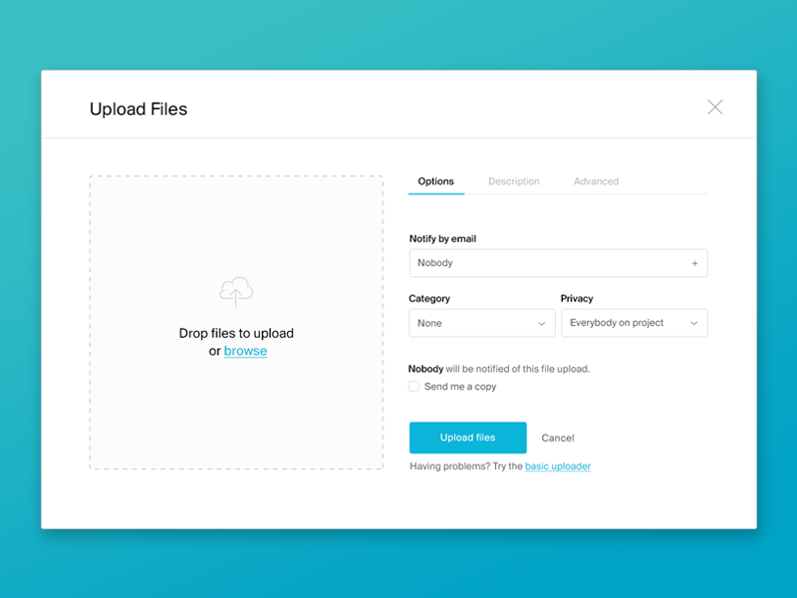
For upload project
> For upload a project you need
to create a profile first.
> After that you can upload the
Text, document and links.

Slide 9
3. Feeds

Slide 10

Feeds means,
Shows Recent activity in the department.
Upcoming events also listed here.
Any circular also notify using notification Like exam time table, any event changes ( latest)

Slide 11
4.Profile

Slide 12

Profile screen show the current profile of the user like student,
Teaching follo, Assistant professor,
Professor and Head of the department (HOD)

Slide 13
Description text
Document like pdf, doc, ect…
Reference link
Demo video
Information Data Types

Slide 14
Title text
Year like 2001, 2002, ect…
Project domain
Best and Average projects
Suggestion projects
Best review projects
Most commented projects
Worst review projects
Data
Retrieval

Slide 15

Analysis the current year project
Project Mark = 35%
Current year student review mark = 30%
Description text = 5%
Ppt and other docs = 5%
Demo video = 5%
Problem solved = 5%
Project goal achievement percentage= 5%
Problem solution = 5%
Real world usage (like publish the paper or live the app in playstore, ect..)= 5%
Analysis

Slide 16
COMPRESSION
Videos
Images
PDFs

Slide 17
Video and Image compression
> Video and Image occupies the large amount of space in the database and also consumes the user's internet also.
> Before uploading the video and image into the server, compress in the frontend itself and we send that to the backend.
> Compression also reduce the size of the file it help as to store more data in the database.
> We also upload the video to youtube so that people from outside also can see the project details

Slide 18
References
https://markgituma.medium.com/asynchronous-video-compression-and-upload-in-react-native-d7f74ea03f75
https://www.npmjs.com/package/react-native-video-processing
https://www.youtube.com/watch?v=HRjgeT6NQJM&feature=youtu.be&ab_channel=ShahenHovhannisyan
https://github.com/JohnProg/Blog-App
https://www.youtube.com/watch?v=GTOatl1E8QE&ab_channel=GeekyAnts

