Slide 1
ANDROID DEVELOPMENT FUNDAMENTALS SKILLING Coursecode:15CS3113 Submitted by G.MANIKANTA- 160030370 K.SIVA NANDINI- 160030574 P.RUKMINI- 160031083

Slide 2
Movie Information System
We usually come across movie information websites where users are allowed to access the whole details of a movie. This information is provided by admin. The admin will retrieve the full details of any new released movie including its show timings in particular theatres. Here we develop an app that automatically allows users to get the complete details of movie in more efficient manner.

Slide 3
Modules:
Our project includes two modules:
1.Admin: Admin can log into app by making sign in so that user can edit and insert all the details of movies.
2.User: user can easily get the details of movie and he also give rating for any movie. They may comment on a movie provided in the system.

Slide 4
Features
The main features of this project are:
Information about movie names and cast &crew of movie
Maintain movie rating
Maintain show timings

Slide 5
ANDROID INTRODUCTION
World is contracting with the growth of mobile phone technology. As the number of users is increasing day by day, facilities are also increasing. Starting with simple regular handsets which were used just for making phone calls, mobiles have changed our lives and have become part of it. Now they are not used just for making calls but they have innumerable uses and can be used as a Camera , Music player, Tablet PC, T.V. , Web browser etc . And with the new technologies, new software and operating systems are required.

Slide 6
Activities
1.Login Screen:
Validation for user(name and password)
Validation for admin(name and password)
2.Inserting :
To insert movie name cast and crew of movie by admin
To insert show timings
To insert Reviews and ratings

Slide 7
Category activity:
Buttons will be displayed for above functions while clicking a button next activity.java (Information activity) displayed.
Information activity:
After inserting data by admin,user can enter through his login and view details by view info method.
Based on category,user can view all details of movie.

Slide 8
MODULE DESCRIPTION
MODULE 1:
Log in screen: Validation for user(user and user )
Validation for admin(admin and admin)
Verifies credentials and navigates to next page.
MODULE 2:
Inserting:
To insert movie name, cast and crew of movie rating,timings,theatres by admin

Slide 9
MODULE 3:
Category activity:
Buttons will be displayed for above functions while clicking a button next activity.java (Information activity) displayed.
→MODULE 4:
Information activity:
After inserting data by admin,user can enter through his login and view details by view info method. Based on category,user can view all details of movie.

Slide 10
MAIN­ACTIVITY.JAVA
package vij.klu.projectapp;
import android.content.Intent;
import android.support.v7.app.AppCompatActivity;
import android.os.Bundle;
import android.view.View;
import android.widget.Button;
Public class MainActivity extends AppCompatActivity{ @Override
protected void onCreate(Bundle savedInstanceState) {
super.onCreate(savedInstanceState);
setContentView(R.layout.activity_main);
Button btn=(Button)findViewById(R.id.info);
btn.setOnClickListener(new View.OnClickListener() {
@Overrid
public void onClick(View view) {
Intent intent=newIntent(MainActivity.this,LoginScreen.class)
startActivity(intent);
}
});
}}

Slide 11
LOGINSCREEN.JAVA
package vij.klu.projectapp;
import android.content.Intent;
import android.support.v7.app.AppCompatActivity;
import android.os.Bundle;
import android.view.View;
import android.widget.Button;
import android.widget.EditText;
public class LoginScreen extends AppCompatActivity {
EditText e1,e2;
Button b1;
@Override
protected void onCreate(Bundle savedInstanceState) {
super.onCreate(savedInstanceState);
setContentView(R.layout.activity_login_screen);
e1= (EditText) findViewById(R.id.loginid);
e2= (EditText) findViewById(R.id.pass);
b1= (Button) findViewById(R.id.button);

Slide 12
b1.setOnClickListener(new View.OnClickListener() {
@Override
public void onClick(View view) {
String id=e1.getText().toString();
String password=e2.getText().toString();
if(id.equals("admin") &&password.equals("admin"))
{
Intent intent=new Intent(LoginScreen.this,Inserting.class);
startActivity(intent);
}
if(id.equals("user")&&password.equals("user"))
{
Intent intent=new Intent(LoginScreen.this,CategoryActivity.class);
startActivity(intent);
}
Intent intent=getIntent();
}
});
}
}

Slide 13
INSERTING.JAVA
package vij.klu.projectapp;
import android.content.Intent;
import android.support.v7.app.AppCompatActivity;
import android.os.Bundle;
import android.view.View;
import android.widget.Button;
import android.widget.EditText;
import android.widget.RatingBar;
import android.widget.Toast;
public class Inserting extends AppCompatActivity {
DataBaseHelpermyDb;
Button btn;
EditTextmname;
EditText cast;

Slide 14
EditText time;
EditTextth;
EditTextcat,Rating;
@Override
protected void onCreate(Bundle savedInstanceState) {
super.onCreate(savedInstanceState);
setContentView(R.layout.activity_inserting);
myDb = new DataBaseHelper(this);
mname = (EditText) findViewById(R.id.name);
cast = (EditText) findViewById(R.id.cast);
Rating=(EditText)findViewById(R.id.r1);

Slide 15
time = (EditText) findViewById(R.id.Timings);
th = (EditText) findViewById(R.id.Theatre);
cat = (EditText) findViewById(R.id.category);
btn = (Button) findViewById(R.id.insert);
AddData();
Intent intent=getIntent();
}
public void AddData() {
btn.setOnClickListener(new View.OnClickListener() {
@Override
public void onClick(View view) {
booleanisInserted = myDb.insertData(mname.getText().toString(),
cast.getText().toString(),Rating.getText().toString(),time.getText().toString(),th.getText().toString(),cat.getText().toString() );
if(isInserted == true)
Toast.makeText(Inserting.this,"Data Inserted",Toast.LENGTH_LONG).show();
else
Toast.makeText(Inserting.this,"Data not Inserted",Toast.LENGTH_LONG).show();
}
});
}
}

Slide 16
CATEGORY.JAVA
public class CategoryActivity extends AppCompatActivity {
@Override
protected void onCreate(Bundle savedInstanceState) {
super.onCreate(savedInstanceState);
setContentView(R.layout.activity_category);
Button btn1=(Button)findViewById(R.id.button1);
Button btn2=(Button)findViewById(R.id.button2);
Button btn3=(Button)findViewById(R.id.button3);
Button btn4=(Button)findViewById(R.id.button4);
Button btn5=(Button)findViewById(R.id.button5);

Slide 17
btn1.setOnClickListener(new View.OnClickListener() {
@Override
public void onClick(View view) {
Intent intent=new Intent(CategoryActivity.this,InformationActivity.class);
startActivity(intent);
}
});
Intent intent=getIntent();
}
}

Slide 18
INFORMATIONACTIVITY.JAVA
public class InformationActivity extends AppCompatActivity {
DataBaseHelpermyDb;
Button btn;
@Override
protected void onCreate(Bundle savedInstanceState) {
super.onCreate(savedInstanceState);
setContentView(R.layout.activity_information);
myDb = new DataBaseHelper(this);
btn = (Button)findViewById(R.id.button6);
viewAll();
Intent intent=getIntent();
}

Slide 19
public void viewAll() {
btn.setOnClickListener(new View.OnClickListener() {
@Override
public void onClick(View v) {
Cursor res = myDb.getAllData();
if (res.getCount() == 0) {
// show message
showMessage("Error", "Nothing found");
return;
}
StringBuffer buffer = new StringBuffer();
while (res.moveToNext()) {

Slide 20
buffer.append("MovieName:" + res.getString(0) + "\n");
buffer.append("castcrew:" + res.getString(1) + "\n");
buffer.append("Rating:" + res.getString(2) + "\n");
buffer.append("Timings:" + res.getString(3) + "\n");
buffer.append("Theatre:" + res.getString(4) + "\n");
buffer.append("Category:" + res.getString(5) + "\n\n\n\n");
}
showMessage("Data", buffer.toString());
}
});}
public void showMessage(String title,String Message){
AlertDialog.Builder builder = new AlertDialog.Builder(this);
builder.setCancelable(true);
builder.setTitle(title);
builder.setMessage(Message);
builder.show();
}
}

Slide 21
DATABASEHELPER.JAVA
public class DataBaseHelper extends SQLiteOpenHelper {
public static final String DATABASE_NAME = "Movie.db";
public static final String TABLE_NAME = "TYPE";
public static final String COL_1 = "MovieName";
public static final String COL_2 = "castcrew";
public static final String COL_3 = "Rating";
public static final String COL_4 = "Timings";
public static final String COL_5 = "Theatre";

Slide 22
public static final String COL_6 = "Category";
public DataBaseHelper(Context context) {
super(context, DATABASE_NAME, null, 1);
}
@Override
public void onCreate(SQLiteDatabasedb) {
db.execSQL("create table " + TABLE_NAME +" (MovieNameTEXT,castcrewTEXT,Rating INTEGER ,Timings TEXT,TheatreTEXT,Category TEXT)");
}
@Override
public void onUpgrade(SQLiteDatabasedb, int oldVersion, int newVersion) {
db.execSQL("DROP TABLE IF EXISTS "+TABLE_NAME);
onCreate(db);
}

Slide 23
public booleaninsertData(String MovieName,Stringcastcrew ,String Rating,StringTimings,StringTheatre,String Category) {
SQLiteDatabasedb = this.getWritableDatabase();
ContentValuescontentValues = new ContentValues();
contentValues.put(COL_1,MovieName);
contentValues.put(COL_2,castcrew);
contentValues.put(COL_3,Rating);
contentValues.put(COL_4,Timings);
contentValues.put(COL_5,Theatre);
contentValues.put(COL_6,Category);
long result = db.insert(TABLE_NAME,null ,contentValues);
if(result == -1)
return false;
else
return true;
}

Slide 24
public Cursor getAllData() {
SQLiteDatabasedb = this.getWritableDatabase();
Cursor res = db.rawQuery("select * from "+TABLE_NAME ,null);
return res;
}
public booleanupdateData(String id,Stringname,Stringsurname,String marks) {
SQLiteDatabasedb = this.getWritableDatabase();
ContentValuescontentValues = new ContentValues();
contentValues.put(COL_1,id);
contentValues.put(COL_2,name);
contentValues.put(COL_3,surname);
contentValues.put(COL_4,marks);
db.update(TABLE_NAME, contentValues, "ID = ?",new String[] { id });
return true;
}
public Integer deleteData (String id) {
SQLiteDatabasedb = this.getWritableDatabase();
return db.delete(TABLE_NAME, "ID = ?",new String[] {id});
}
}

Slide 25
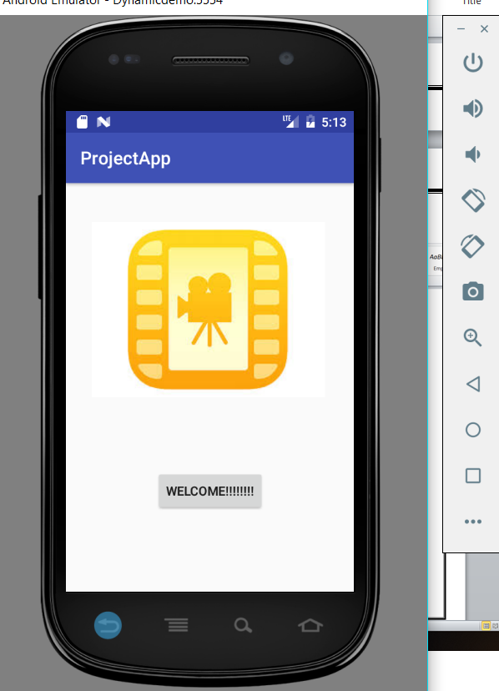
OUTPUT SCREEN-SHOTS

Slide 26
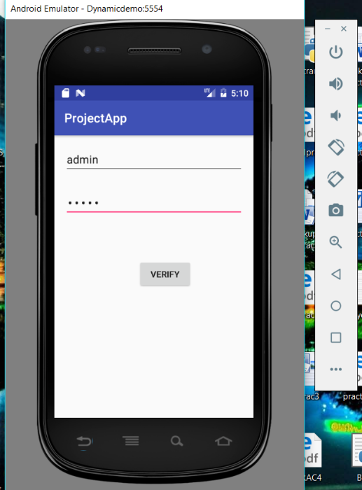

Slide 27
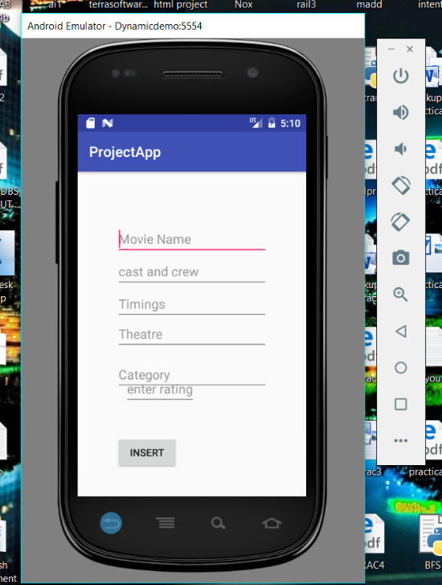

Slide 28
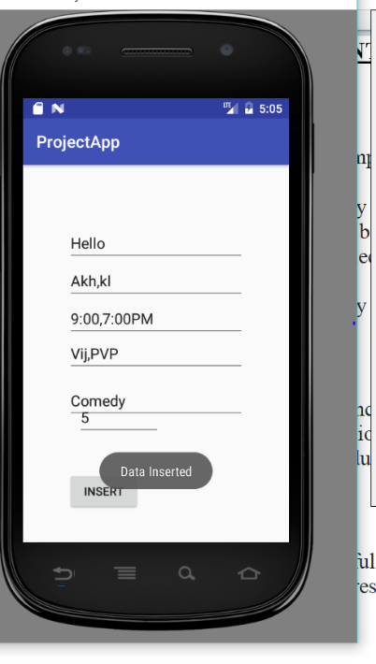

Slide 29
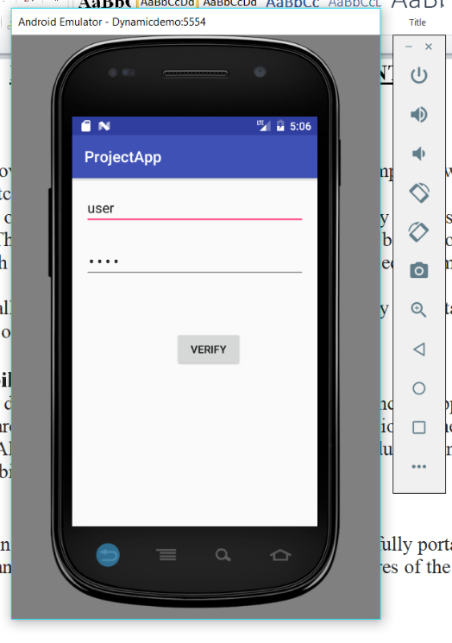

Slide 30
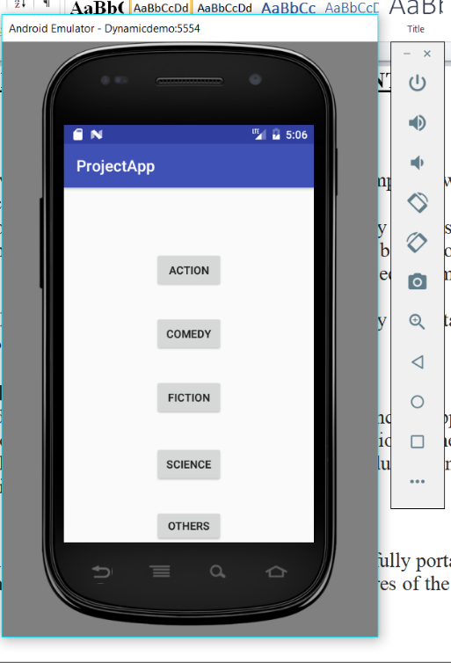

Slide 31
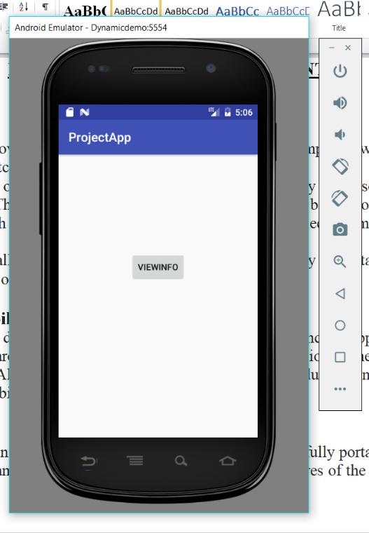

Slide 32
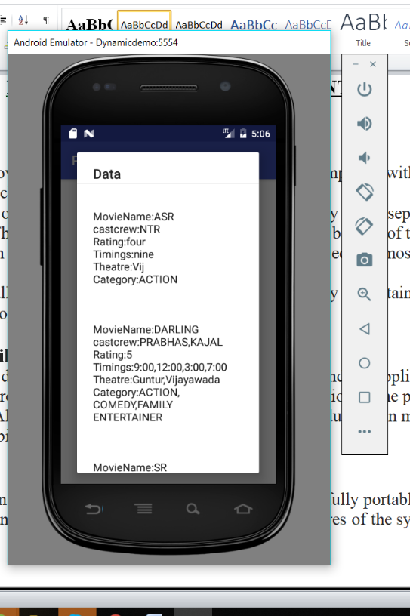

Slide 33
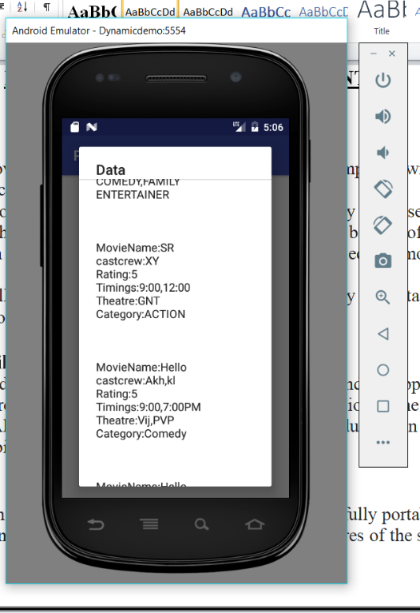

Slide 34
CONCLUSION
By using this Movie Information App users can know the best movie available and also ratings of each movies. So, we can say that it is really useful for movie lovers who want to know all details like cast crew, timings and theatres. So this app has good future scope in application world with few more enhancements of this project.

