Slide 1


Slide 2
What we are?
Sai Sri Infra Solutions- Started in 2017
Our MOTO is to ‘Serve All to the BEST’
Started with facility services like house keeping in 2017
Later we added more services to our catalogue
Experience- done almost 235+
Notes:
1. About us, compay name, estazblished, services offered, how can u refer us, clients,

Slide 3
Our services
ACP sheet works
  Front elevation ACP sheet fixing
  Front elevation glass fixing
  glass partition works
  ACP board fixing
Aluminium partition works
  Office partitioning
  Cabins and cubical works
Notes:
1. About us, compay name, estazblished, services offered, how can u refer us, clients,

Slide 4
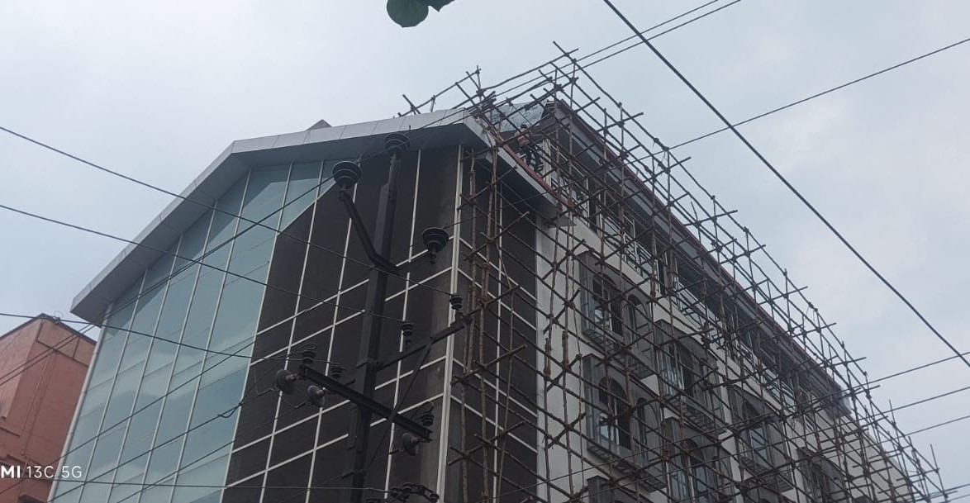
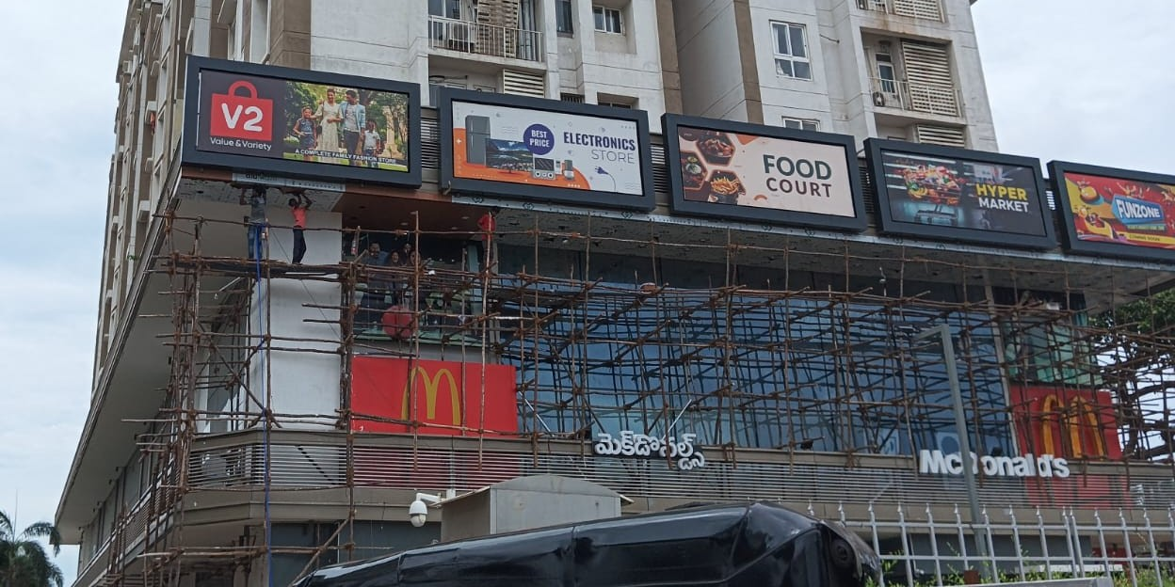
ACP sheet fixing
Notes:
1. About us, compay name, estazblished, services offered, how can u refer us, clients,

Slide 5
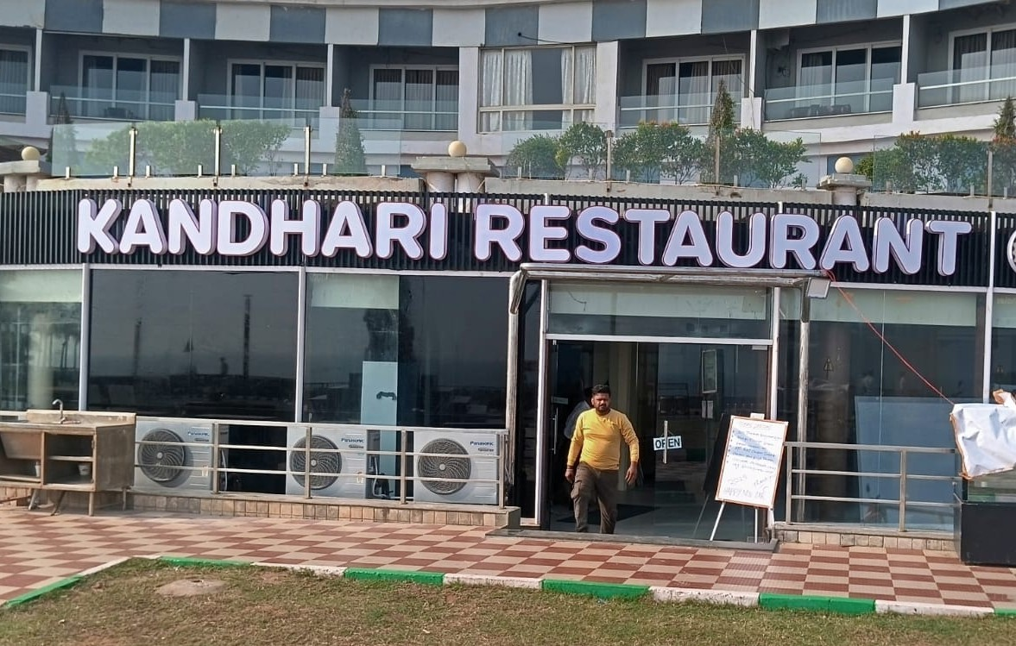
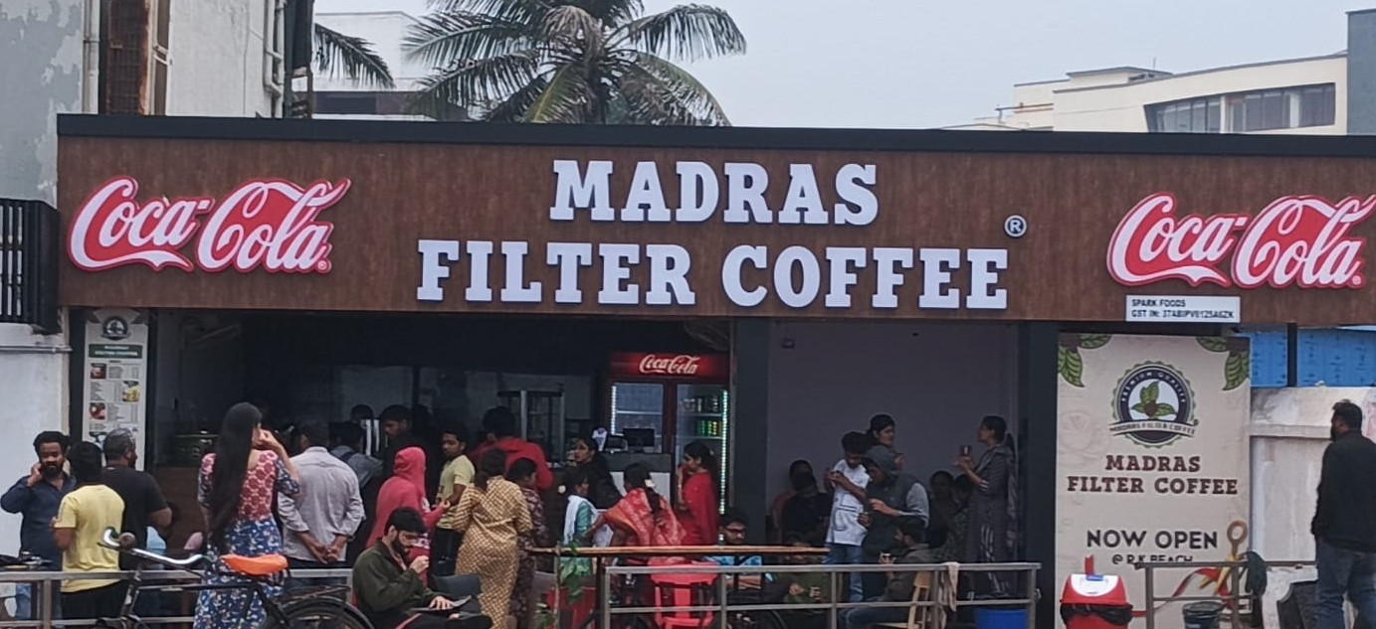
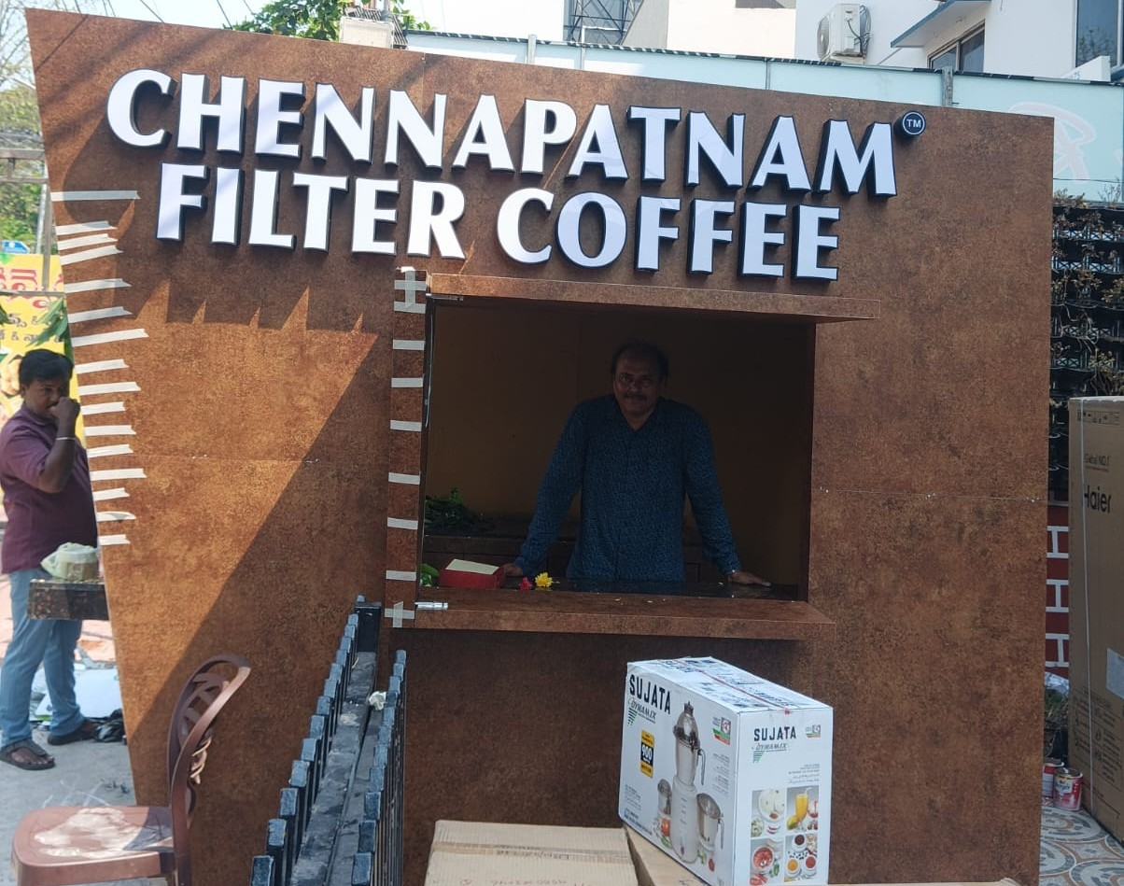
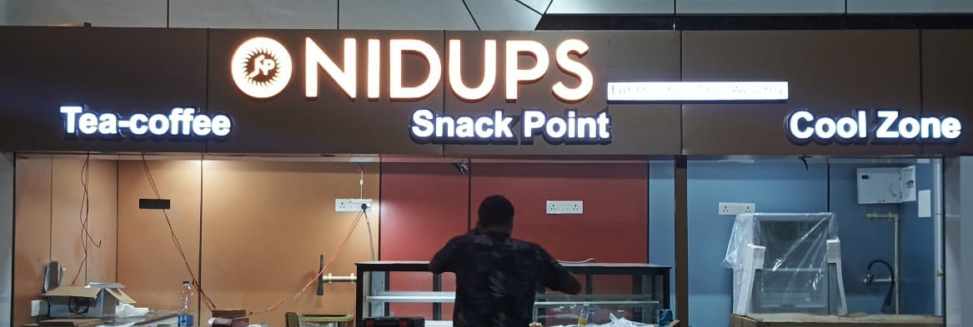

Slide 6
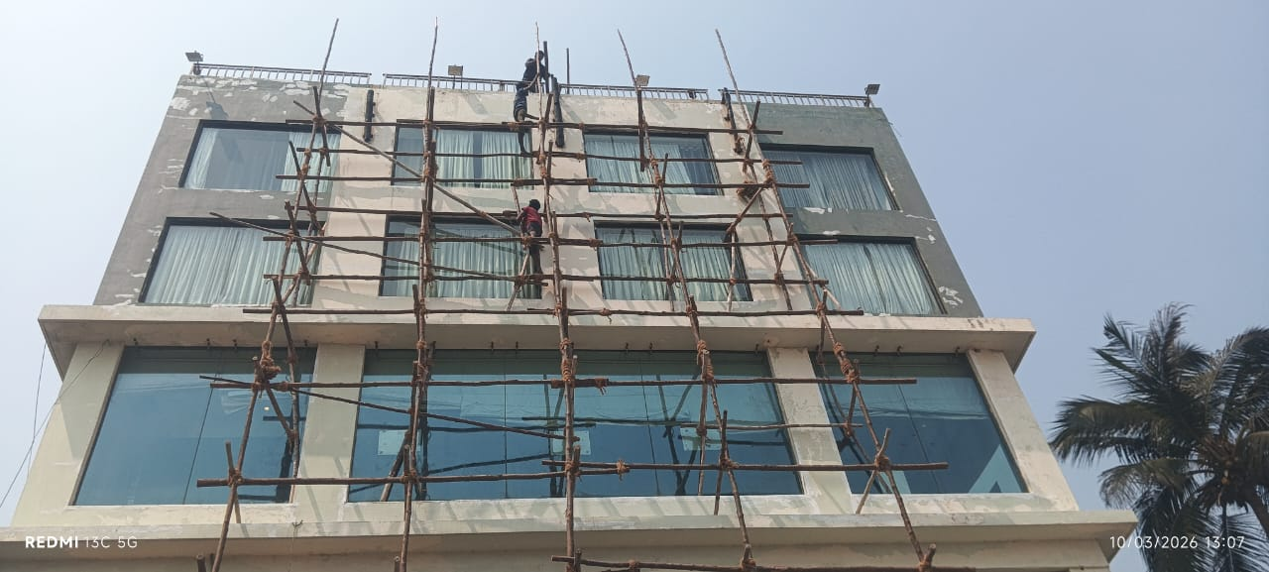
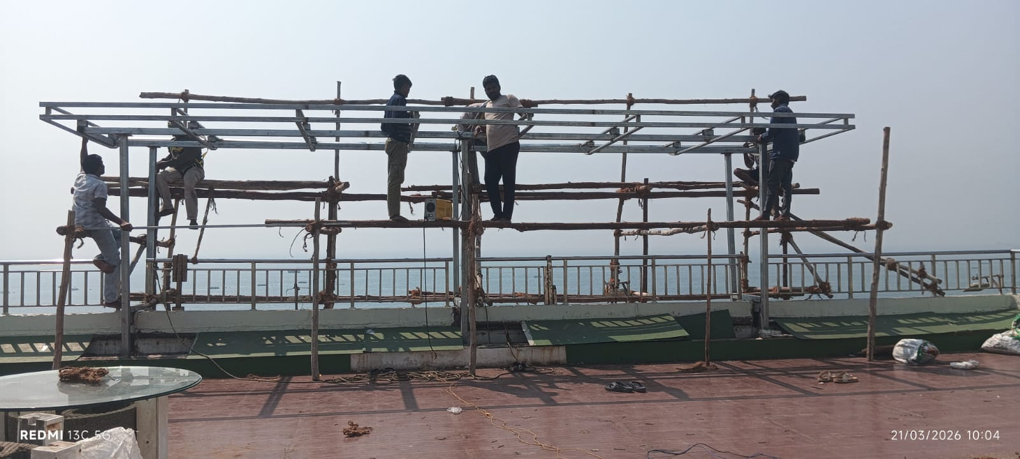
ACP sheet and Aluminium lowers works
Notes:
1. About us, compay name, estazblished, services offered, how can u refer us, clients,

Slide 7
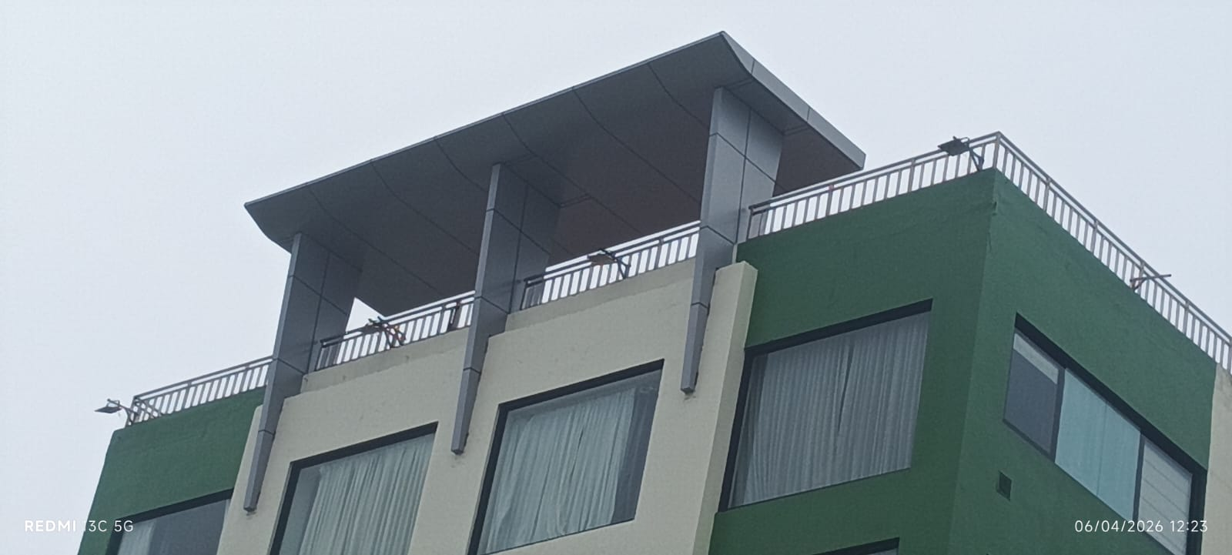

Slide 8
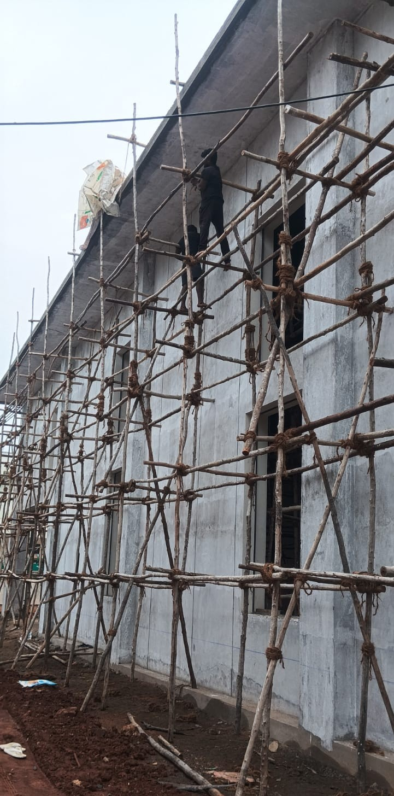

Slide 9
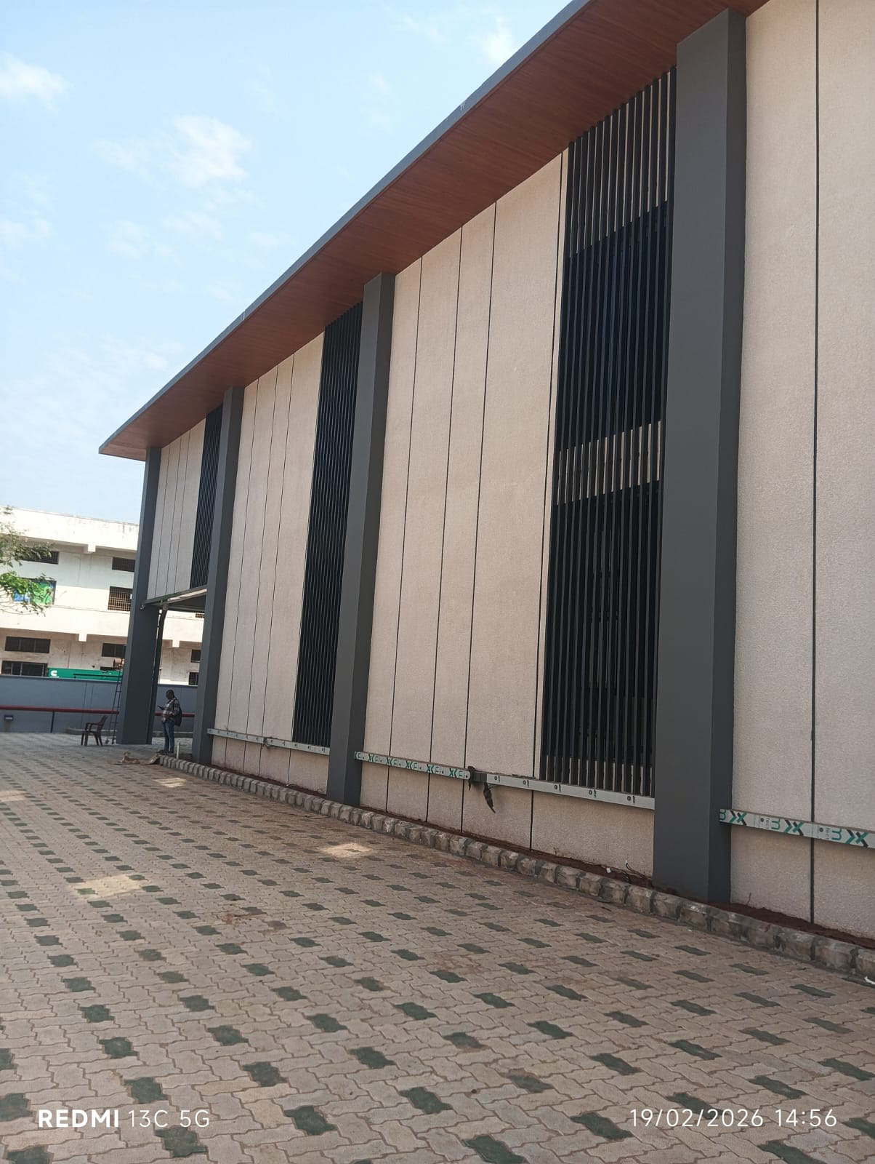
Notes:
1. About us, compay name, estazblished, services offered, how can u refer us, clients,

Slide 10
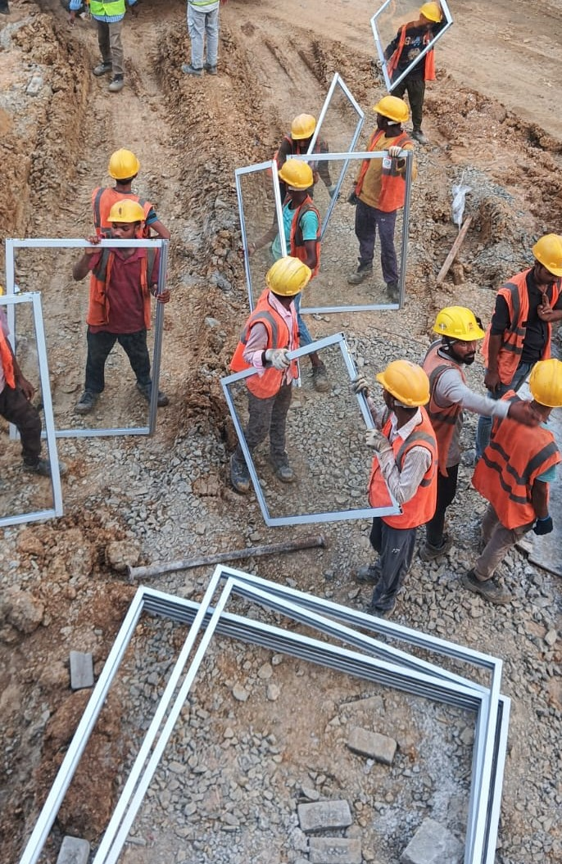
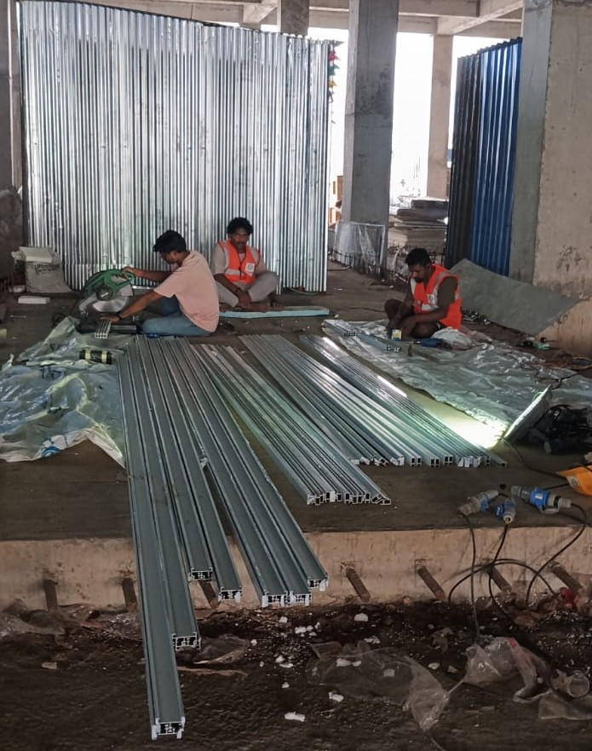
Aluminium partitioning

Slide 11
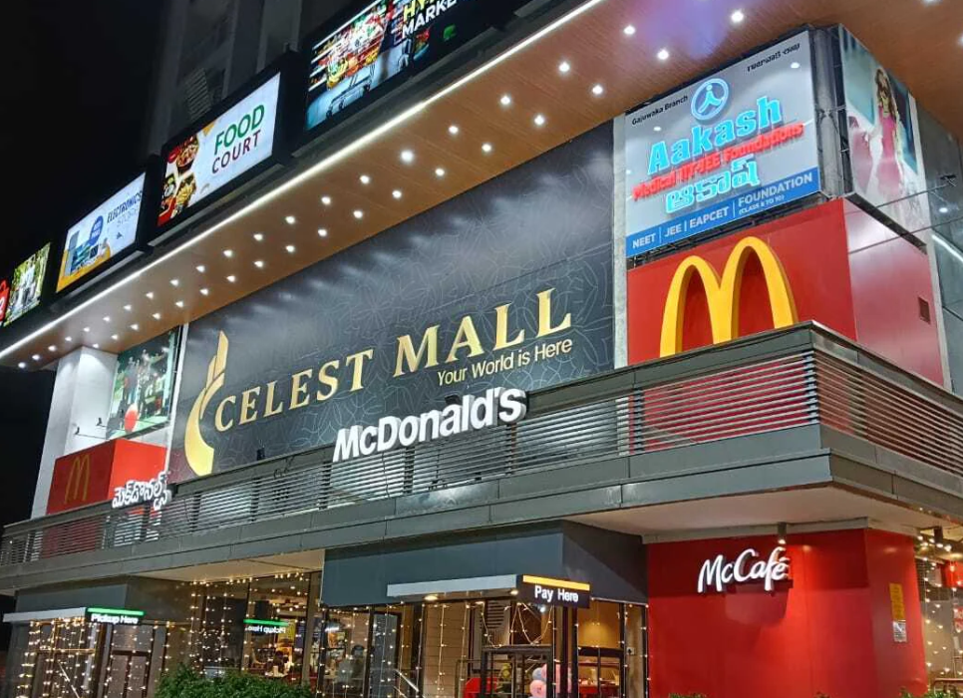
Best works
Notes:
1. About us, compay name, estazblished, services offered, how can u refer us, clients,

Slide 12
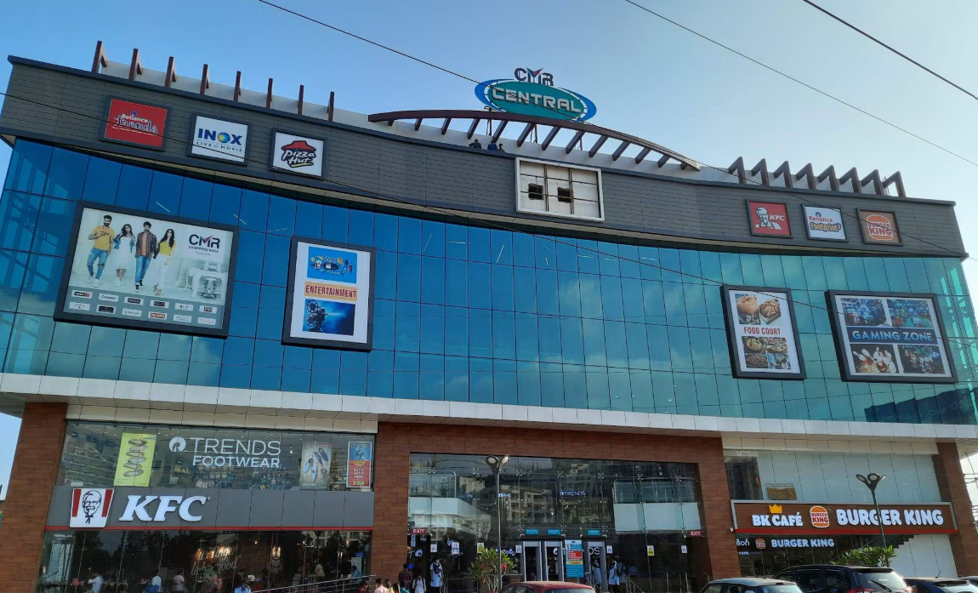

Slide 13
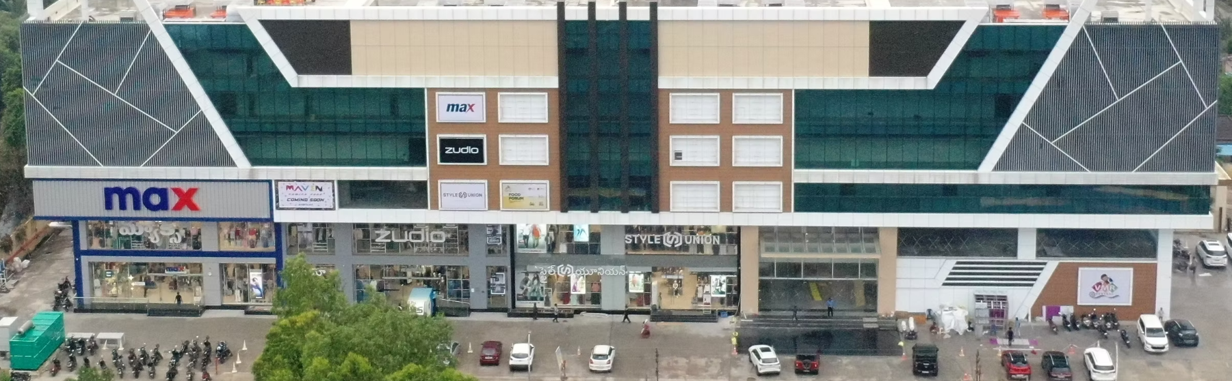

Slide 14
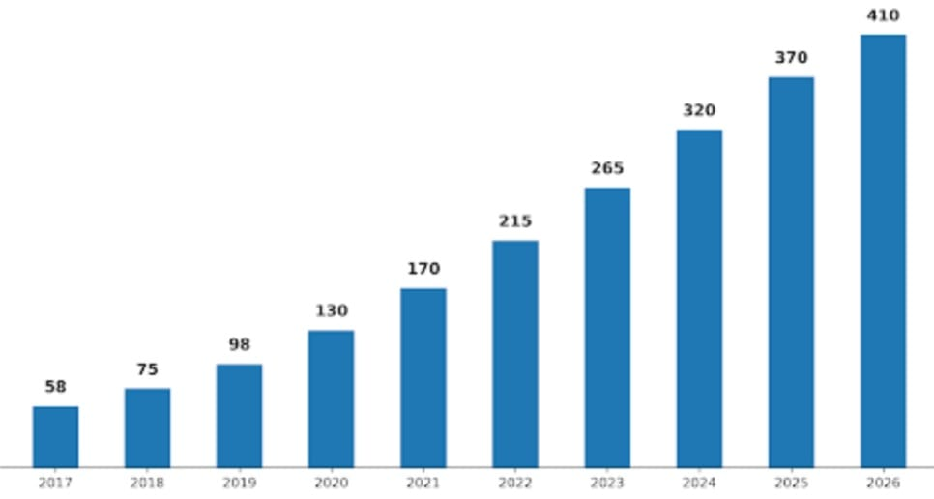
My clients (commercial)
Notes:
1. About us, compay name, estazblished, services offered, how can u refer us, clients,

Slide 15
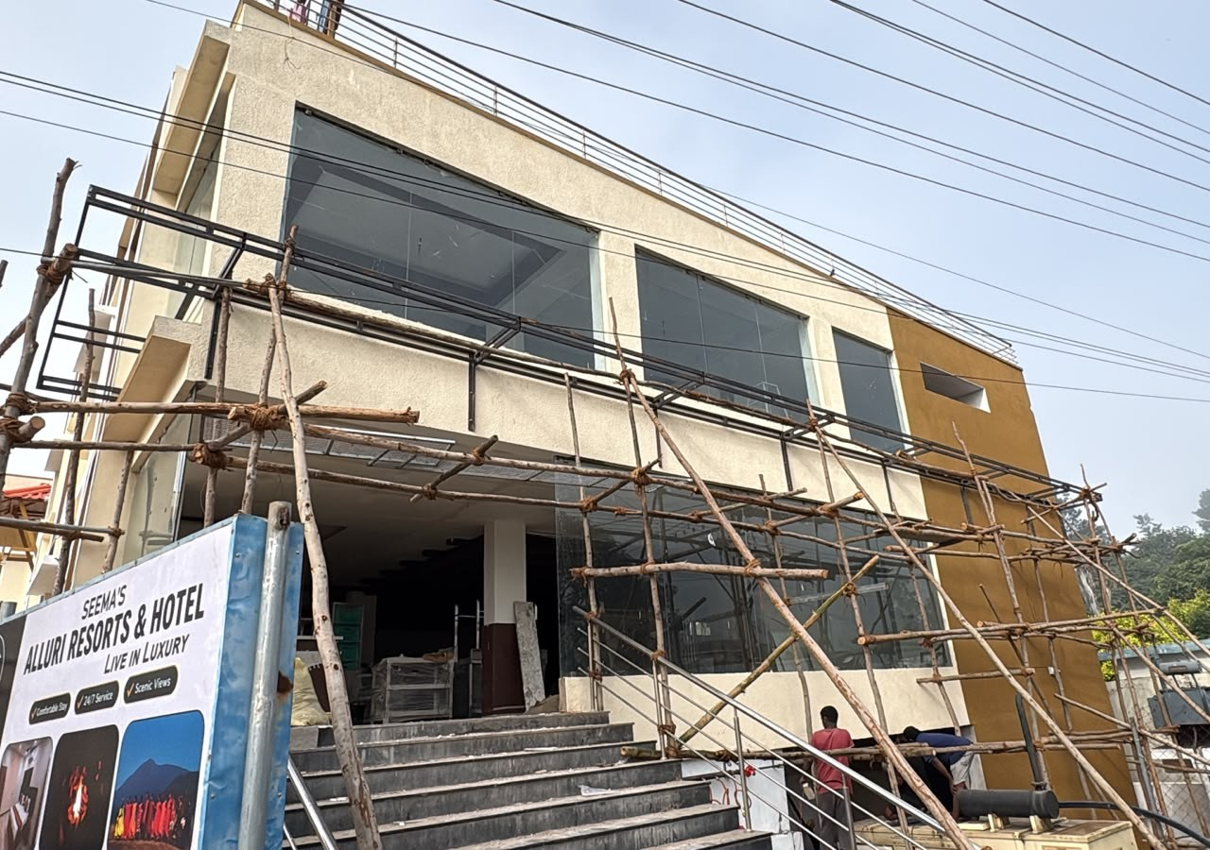
On-Going Work

Slide 16


Slide 17
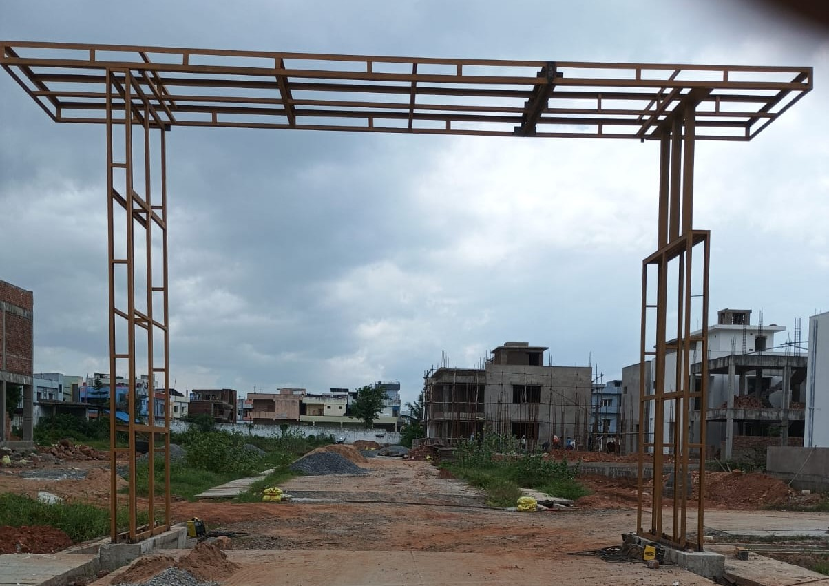

Slide 18
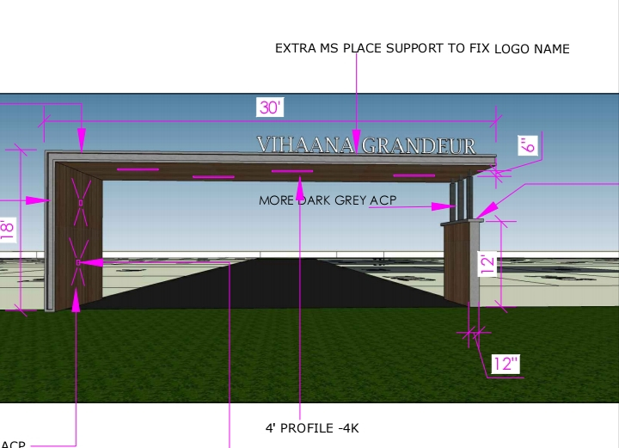

Slide 19
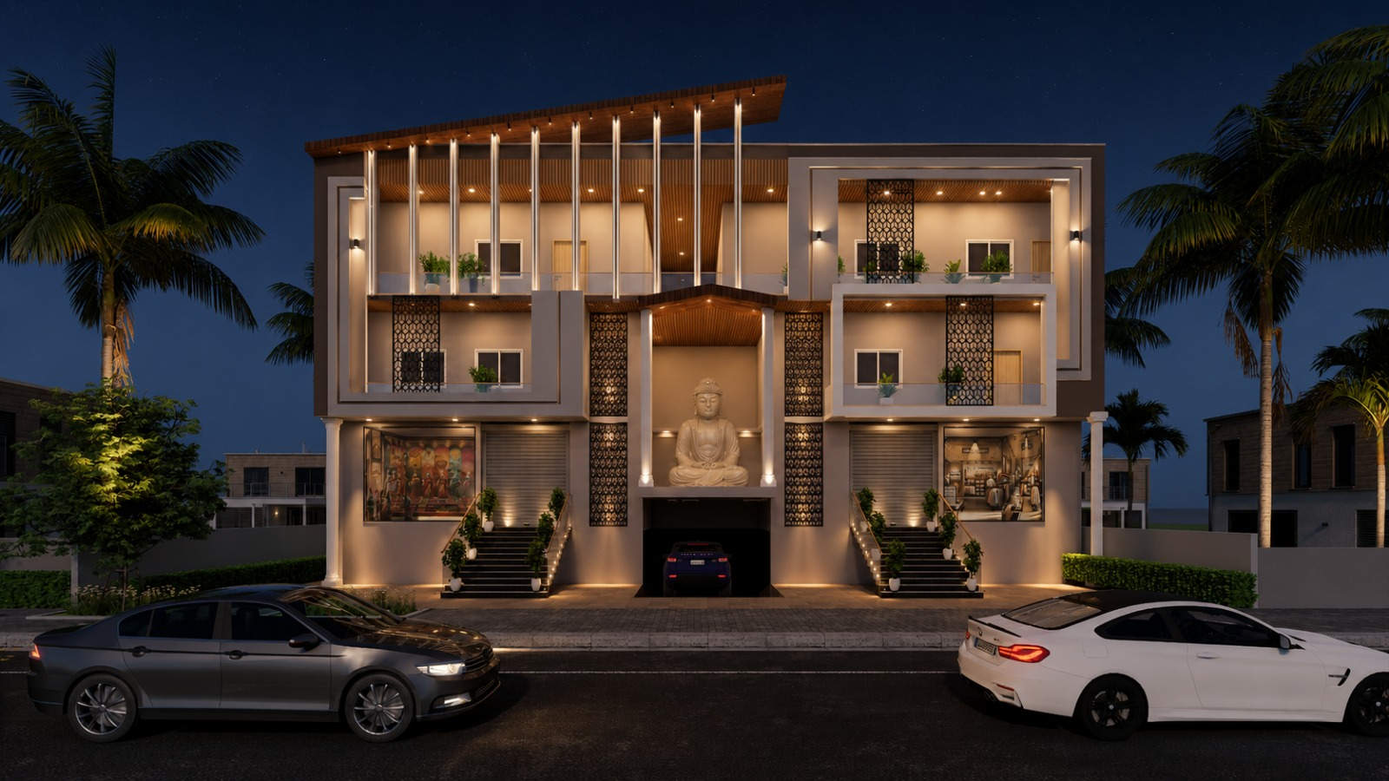
Next Works

Slide 20
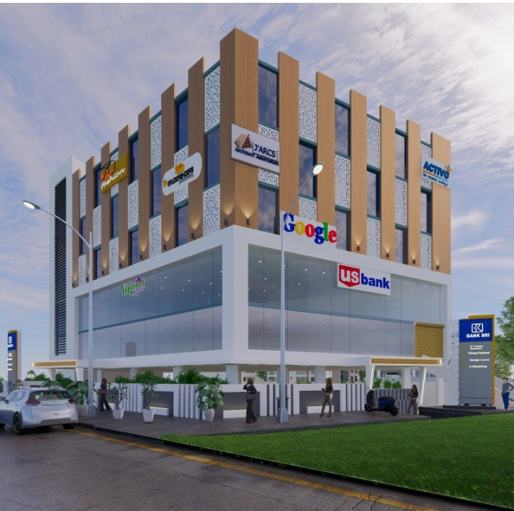

Slide 21
Referrals
Direct referrals
  Upcoming showrooms
  New office space
  Hotels and restaurants
  Hospitals
  Shopping malls
  Convention centres
  Banks
  Architectures
Indirect referrals
  Aluminium showrooms
  Glass showrooms
Notes:
1. About us, compay name, estazblished, services offered, how can u refer us, clients,

Slide 22
How you can refer me?
If u visit any office.... Just refer me
If u visit any showroom..... Pl comment...
Hotel.... Comment on their elevation cleanliness
Aluminium and glass showrooms....
Notes:
1. About us, compay name, estazblished, services offered, how can u refer us, clients, 9912999949

Slide 23


