Slide 1
SDLC
Software Development Life Cycle

Slide 2
Agenda:
• Introduction
• SDLC Overview
• SDLC Phases
• SDLC Flow
• SDLC Model
• Waterfall Model
• Agile Model
• Conclusion

Slide 3
Introduction:
• SDLC process is used by the software industry to design, develop and test high quality software.
It aims to produce the quality software that meets or exceeds customer expectations, reaches completion within time and budget
• ISO/IEC 12207 is an international standard for software life-cycle processes. It aims to be the standard that defines all the tasks required for developing and maintaining software.

Slide 4
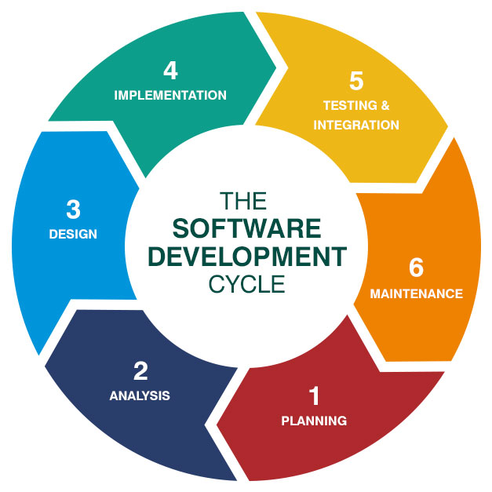
SDLC Phases:

Slide 5
SDLC Phases
Planning and Requirements Analysis
Defining Requirements
Designing the Software
Building or Developing the Software
Testing the Software
Deployment and Maintenance

Slide 6
1. Planning & Requirement Analysis
Requirement analysis is the most important and fundamental stage in SDLC
It is performed by the senior members of the team with inputs from all the stakeholders and domain experts or SMEs in the industry.
Planning for the quality assurance requirements and identification of the risks associated with the project is also done at this stage.

Slide 7
1. Planning & Requirement Analysis
Requirements Analysis:
• Business Requirements
• Stakeholder Requirements
• Solution Requirements
Functional Requirements
Non-functional Requirements
• Transition Requirement

Slide 8
2. Defining Requirements
Once the requirement analysis is done the next step is to clearly define and document the software requirements and get them approved from the project stakeholders.
This is done through ‘SRS’ – Software Requirement Specification document which consists of all the product requirements to be designed and developed during the project life cycle.
• Enterprise Analysis
• Business Analysis Planning & Monitoring
• Elicitation
• Requirements Analysis
• Requirements Management & Communication
• Solution Assessment & Validation

Slide 9
3. Designing the Software
• Based on the requirements specified in SRS, usually more than one design approach for the product architecture is proposed and documented in a DDS - Design Document Specification.
• DDS is reviewed by all the stakeholders and based on various parameters as risk assessment, design modularity , budget and time constraints , the best design approach is selected for the software.

Slide 10
4. Developing the Software
• In this stage of SDLC the actual development starts and the product is built. The programming code is generated as per DDS during this stage.
• Developers have to follow the coding guidelines defined by their organization and programming tools like compilers, interpreters, debuggers etc are used to generate and implement the code.

Slide 11
5. Testing the Software
• This stage is usually a subset of all the stages as in the modern SDLC models, the testing activities are mostly involved in all the stages of SDLC
• However this stage refers to the testing only that stage of the software where defects are reported, tracked, fixed and retested, until the software reaches the quality standards defined in the SRS.

Slide 12
6. Deployment and Maintenance
• Once the software is tested and no bugs or errors are reported then it is deployed.
• Then based on the feedback, the software may be released as it is or with suggested enhancements in the target segment.
• After the software is deployed then its maintenance starts.

Slide 13
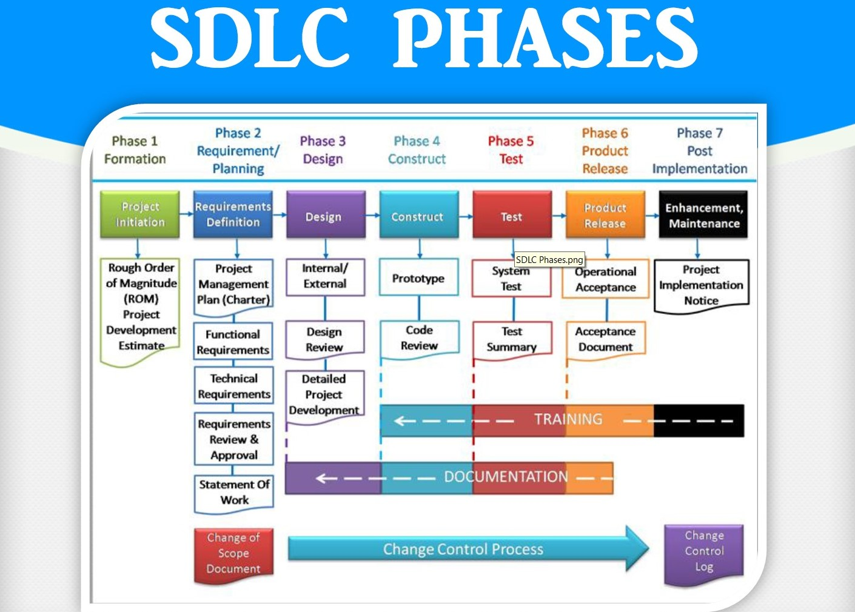

Slide 14
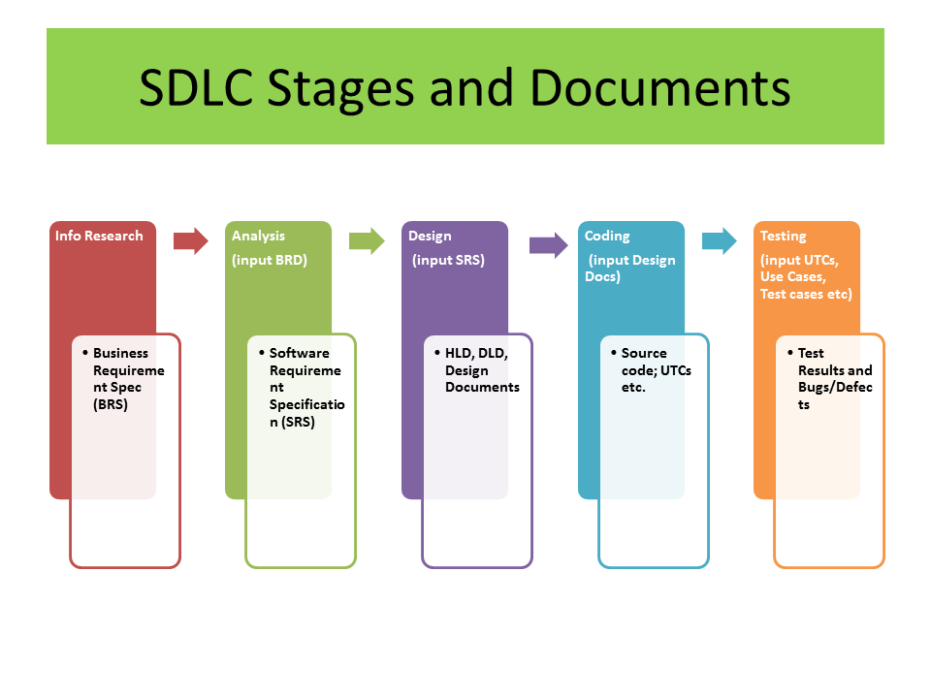

Slide 15
SDLC Models
To help understand and implement the SDLC phases various SDLC models have been created by software development experts, universities, and standards organizations.
Reasons for Using SDLC Models
• Provides the base for project planning, estimating & scheduling.
• Provides framework for standard set of terminologies, activities & deliverables.
• Provides mechanism for project tracking & control.

Slide 16
Advantages of Choosing an Appropriate SDLC:
• Increased development speed
• Increased product quality
• Improved tracking & control
• Improved client relations
• Decreased project risk
• Decreased project management overhead
SDLC Models:
• Waterfall Model
• Iterative Model
• Spiral Model
• Agile Model
• V – Model
• Big Bang Model

Slide 17
Waterfall Model:
• Oldest and most well-known SDLC model.
• Systems that have well-defined and understood requirements are a good fit for the Waterfall Model.
• Easy to understand, easy to use • Provides structure to inexperienced staff
Agile Model:
• Agile model believes that every project needs to be handled differently and the existing methods need to be tailored to best suit the project requirements.

Slide 18
Conclusion:
• Project Management – Lead to an endeavor.
• Planning is a map, a guide, especially for a team. (Relatively simple and helpful techniques)
• SDLC is mostly about people, process, time management & communication.
• Risks are inevitable, planning helps to avoid stupid ones (Experience counts).
• Assessing the scope of work, timing, risks and resources will lead to the project success.

