Slide 1



WhatsApp-Integrated Smart Taxi Booking System
SOA Project Review-2
Under the Guidance of K. Venkateswari
Professor,
Department of Computer Science and Engineering,
KLH CSE Bowrampet Campus
Team Members Name: G. Tanay Tej
Roll Number: 2420030560
Name: G. Manikanta
Roll Number: 2420030366 Name: I. Vishnu Vardhan Roll Number: 2420030513
Date
SOA Project Review-1
1

Slide 2
Outline of Project Work
Focus
  Introduction
    Literature Survey
      Challenges
        Research Objectives
          Conclusion & Future Work
            References
Publications Details
2

Slide 3
Problem Statement
Problem Statement:-
Traditional taxi booking systems often require users to install dedicated applications, create accounts, and navigate multiple screens to book a ride. This can be inconvenient for users who prefer simple and familiar communication platforms. Additionally, the lack of seamless real-time communication between passengers, drivers, and administrators can lead to delays and inefficient ride management.
The WhatsApp-Integrated Smart Taxi Booking and Real-Time Ride Management System aims to solve these challenges by providing a convenient taxi booking service through WhatsApp. The system enables users to book rides, share pickup and destination details, receive driver information, track ride status, and get booking updates through WhatsApp. It also helps drivers manage ride requests and allows administrators to efficiently monitor users, drivers, and bookings. The proposed system improves accessibility, communication, and overall efficiency in taxi booking and ride management.

Slide 4
Objectives
To provide easy taxi booking through WhatsApp without requiring a separate
mobile application.
To automate driver assignment based on driver availability and location.
To enable real-time ride tracking and provide live ride status updates.
To improve communication between passengers, drivers, and administrators through WhatsApp notifications.
To manage taxi bookings efficiently, including booking, acceptance, cancellation,
and ride completion.
To provide fare estimation and trip details for better transparency.
To develop an admin dashboard for managing users, drivers, vehicles, and ride records.
To improve overall convenience, efficiency, and accessibility of taxi transportation services.

Slide 5
Literature Survey
Authors | Title of the Paper | Methodology | Inferences | Limitation/Future work
Correia et al. [1] | A Generic Data-Driven Recommendation System for Large-Scale Regular and Ride-Hailing Taxi Services, Electronics, 2020 | Real-time taxi and customer data collection Demand prediction • Taxi-to-region matching Route planning | Improves taxi allocation using real-time information. Helps match available taxis with customer demand. Supports efficient ride-hailing operations. | Focuses mainly on taxi recommendation and allocation. Does not provide WhatsApp-based booking. Future work can integrate conversational booking channels.
Agarwal et al. [2] | The Impact of Ride-Hail Surge Factors on Taxi Bookings, Transportation Research Part C, 2022 | Machine-learning-based demand prediction Analysis of ride-hailing and taxi booking data Driver guidance and demand estimation | Improved demand prediction can reduce vacant taxi time. Better information can improve taxi utilization and trip efficiency. | Focuses on pricing and demand prediction. Does not address direct user communication through messaging platforms. Future work can explore integrated booking and communication systems.
Chen et al. [3] | Real-Time Spatial–Intertemporal Pricing and Relocation in a Ride-Hailing Network, Operations Research, 2024 | Real-time demand and supply analysis Dynamic pricing Optimization using taxi network data | Real-time decision-making improves the balance between drivers and passengers. Dynamic strategies can improve ride-hailing efficiency under changing demand. | Primarily focuses on pricing and vehicle relocation. Does not include WhatsApp-based interaction or complete ride management. Future work can combine real- time management with conversational booking.
5

Slide 6
Problem Gap Identification
Existing taxi systems mainly depend on mobile apps or websites.
Limited integration of WhatsApp for direct taxi booking.
Real-time communication between passengers and drivers can be improved.
Lack of a simple, app-free booking experience.
The proposed system addresses these gaps through WhatsApp booking, driver assignment, and real-time ride management.

Slide 7
Innovation, Creativity, and Novelty
WhatsApp-based taxi booking without requiring a separate app.
Real-time ride tracking and status updates.
Automated driver assignment based on availability and location.
Instant WhatsApp notifications for booking and ride updates.
Provides a simple, convenient, and user-friendly taxi booking experience.

Slide 8
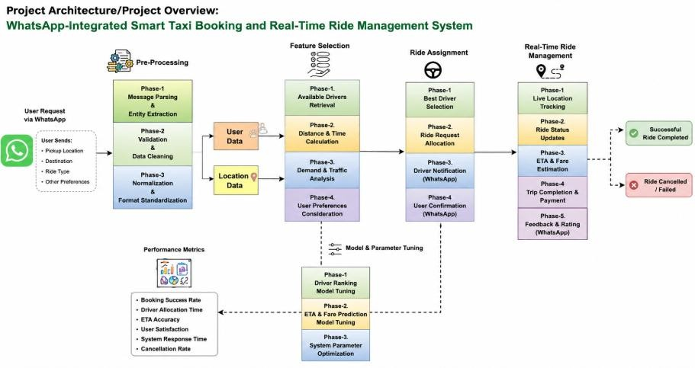
Feasibility and Project Plan

Slide 9
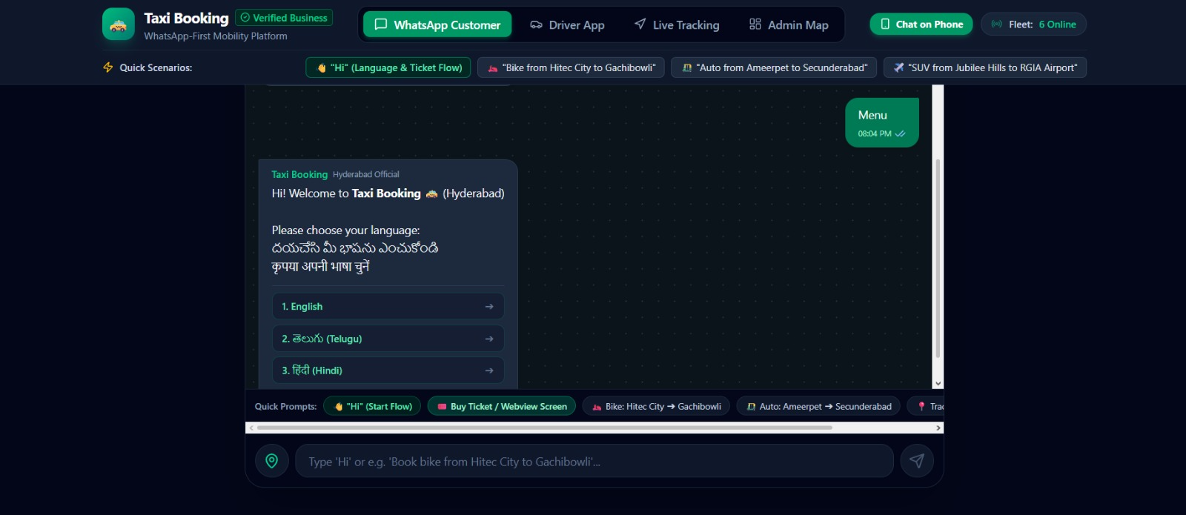
Frontend Implementation

Slide 10
