Slide 1
AGENDA
AI-Powered Database Query Performance Advisor
Project Overview & Core Mission
Requirements (Functional & Non-Functional)
System Architecture (3-Tier & AI Performance Engine)
Use Case & Database ER Diagrams (MongoDB 1:N)
System Modules & Technology Stack
UI Design, Frontend & Backend Engineering
Database Integration & Real Express REST APIs
Implementation Status & Telemetry HUD
Live Application Screenshots & Real-World Challenges
Strategic Roadmap & Official References
Agenda
Review 1 & 2 | QueryPilot

Slide 2
01
Functional & Non-Functional Requirements
Functional & Non-Functional Requirements
Functional Requirements
Non-Functional Requirements
User authentication with JWT (Sign Up, Sign In, session persistence).
Raw query input & execution plan ingestion (SQL / MongoDB query format).
Automated performance diagnostics: Full-table scan detection, join cost analysis, and missing index flags.
Query rewrite and indexing recommendations generated via the Analyzer engine.
Historical analysis report archiving and client-side PDF export (exportPdf.js).
Performance: Analysis turnaround under 1.5 seconds per query.
Security: Secure password hashing using bcryptjs and route protection with Bearer tokens.
Usability: Modern, responsive interface with code editors and metrics visualization.
Reliability: MongoDB persistence with health-check monitoring and data isolation.
Maintainability: Modular React components and decoupled Express service layers.
Requirements
Review 1 & 2 | QueryPilot

Slide 3
02
System Architecture
System Architecture (Detailed)
CLIENT TIER
APPLICATION & AI TIER
DATA TIER
React.js + Vite (Code Editor & HUD)
Client PDF Generator (jsPDF + autotable)
Session State & Local Storage Management
⇄
Node.js + Express.js REST Framework
Security Middleware (JWT Auth & bcryptjs)
AI Analyzer Service (analyzer.js): AST parsing, scan detection & index advice
⇄
MongoDB NoSQL Cloud Cluster
users & reports collections
Unique & compound indexes for sub-second retrieval
Data Flow: Client submits raw queries/execution plans via REST endpoints; AI Analyzer engine performs heuristic bottleneck detection and index advice; results persisted to MongoDB and exported as client-side PDF.
Key Architectural Enhancement: Decoupled AI diagnostic engine (analyzer.js) isolates compute-intensive AST query parsing and rule evaluation from HTTP handling.
Architecture
Review 1 & 2 | QueryPilot

Slide 4
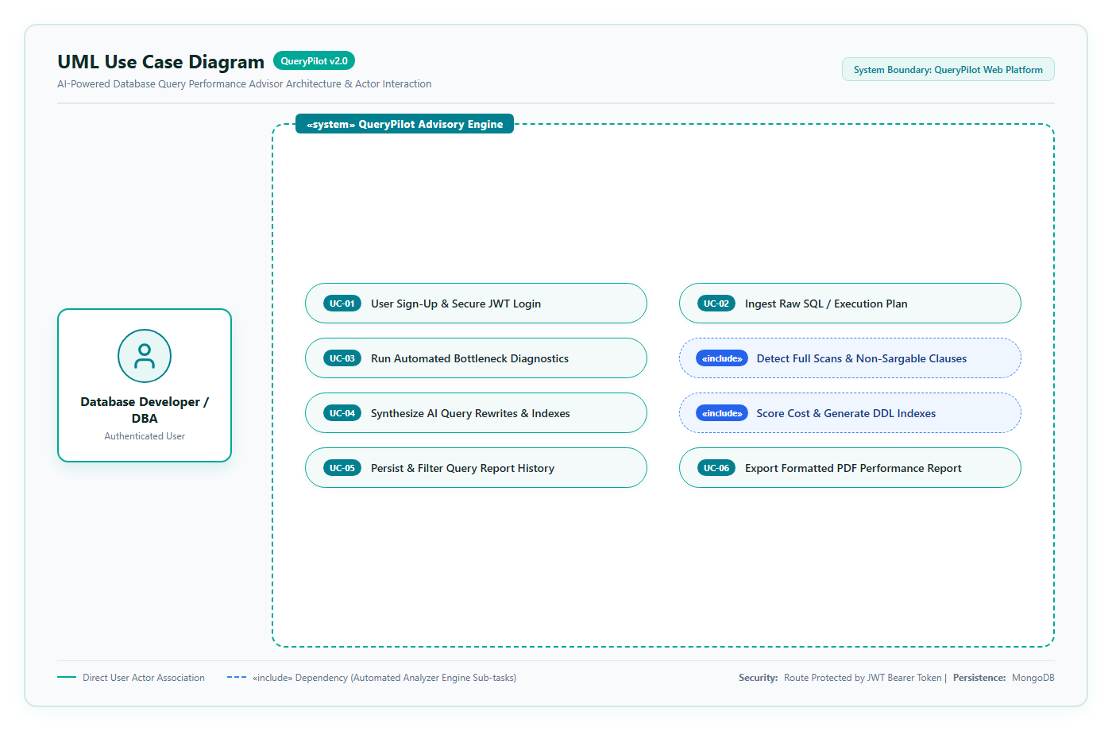
03
Use Case Diagram
Use Case Diagram
Use Case Specification
Primary Actor: Database Developer / DBA / Registered User
Core System Use Cases:
• User Sign-Up & Secure Login (JWT token & session persistence)
• Ingest Raw SQL Query & Execution Plan breakdown
• Automated Performance Diagnostics: Detect full-table scans & joins
• AI Recommendation Engine: Composite B-Tree indexes & rewrites
• Query History Archiving: Persist & filter past runs in MongoDB
• Client-Side PDF Generation: Instant download of DBA audit reports
Use Case
Review 1 & 2 | QueryPilot

Slide 5
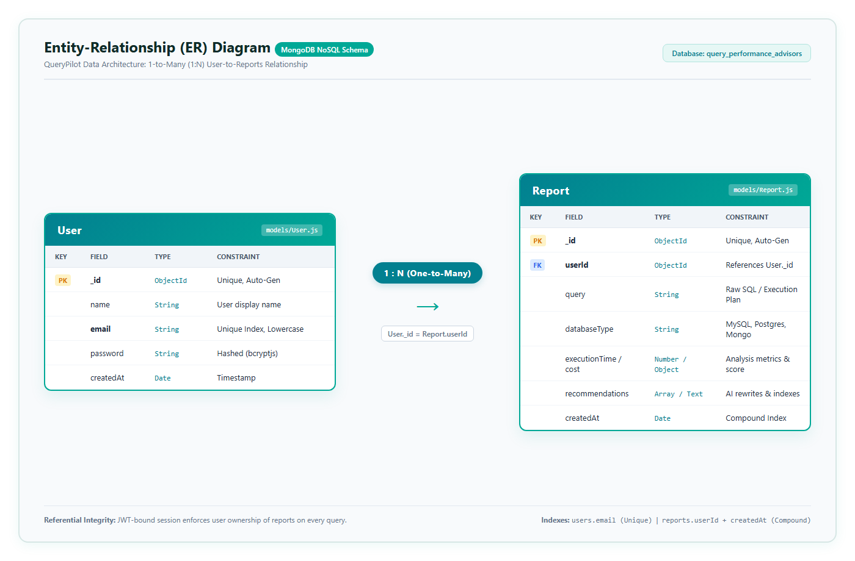
04
ER Diagram / Database Design
ER Diagram / Database Design
MongoDB Schema (1:N)
1. User Entity (models/User.js):
• _id: ObjectId (Primary Key)
• name: String (User display name)
• email: String (Unique index, normalized lowercase)
• password: String (Hashed with bcryptjs)
• createdAt: Timestamp (Account registration date)
2. Report Entity (models/Report.js):
• _id: ObjectId (Primary Key)
• userId: ObjectId (Foreign Key -> User._id)
• query: String (Raw SQL / Execution plan)
• databaseType: String (MySQL, PostgreSQL, MongoDB)
• executionTime / cost: Number/Object (Score metrics)
• recommendations: Array/Text (AI rewrites & indexes)
• createdAt: Timestamp (Compound indexed)
ER Diagram
Review 1 & 2 | QueryPilot

Slide 6
05
Module Description
Module Description
Module | Description | Key Functions
Authentication Module | Secure user onboarding and session management. | User registration, login, bcrypt password hashing, JWT token validation.
Query Diagnostic Engine | Parses database queries and execution plans. | Syntax parsing, missing index detection, scan-type identification, execution cost scoring.
AI Advisor & Recommendation | Synthesizes optimized query structures and index strategies. | Suggests composite indexes, query rewrites, schema indexing suggestions.
Report History & Export | Persists diagnostic history and exports client deliverables. | Save report to MongoDB, filter past analyses, generate downloadable PDF reports.
Analytics & Telemetry HUD | Aggregates performance telemetry and historical benchmarks. | Visual score gauges (0-100), risk tier categorization, and historical query filtering.
Modules
Review 1 & 2 | QueryPilot

Slide 7
06
Technology Stack
Technology Stack
MongoDB
Express.js
React.js
Node.js
NoSQL Database
Backend Framework
Frontend Library
Runtime Environment
Supporting Tools
jsPDF & jsPDF-AutoTable (client-side multi-page PDF generation with auto table formatting)
Lucide React (modern dashboard & editor icons, visual metric indicators)
AI Query Diagnostic Engine (heuristic rule-based parser & AST rewrite advisor)
JWT & bcryptjs (token validation & secure credential hashing)
Vite (lightning-fast frontend tooling, HMR & build optimization)
MongoDB Node.js Driver (direct connection pool & compound index querying)
Tech Stack
Review 1 & 2 | QueryPilot

Slide 8
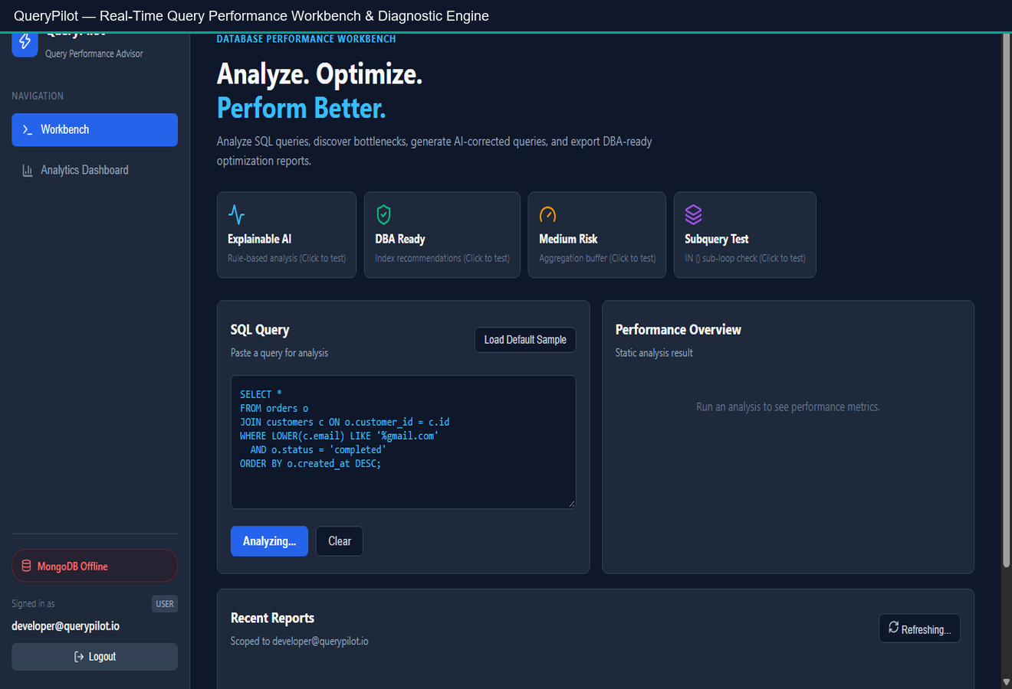
07
UI Design / Application Screens
UI Design / Wireframes
UI Design & Core Screens
Interactive Screen Architecture:
• Authentication Portal: Tabbed sign-up, login, and JWT session handling
• SQL Query Workbench: Code editor with sample query presets & validation
• Real-Time Performance HUD: Score gauge (0-100), risk badge (Low/Med/High)
• AI Advisor Panel: Actionable index recommendations & sargable rewrites
• Analytics Dashboard: Historical query trends, average scores & report search
• PDF Export Engine: Instant client-side download of DBA-ready performance audits
Live Vercel Deployment: https://client-black-pi-23.vercel.app
UI Design
Review 1 & 2 | QueryPilot

Slide 9
08
Frontend Development
Frontend Development
Built with React.js and Vite using modern functional components and custom React Hooks (useState, useEffect).
Real-time query workbench featuring code editors, risk scoring gauges, and bottleneck telemetry.
Modular components: Navigation Sidebar, Query Editor, Findings HUD, Index Advisor, and Analytics Dashboard.
Client-side multi-page PDF generation via jspdf and jspdf-autotable with dynamic page-break calculations.
Responsive dark-themed modern UI designed with Tailwind CSS principles and lucide-react iconography.
Seamless backend communication using Fetch API with centralized JWT Bearer token authorization headers.
Frontend
Review 1 & 2 | QueryPilot

Slide 10
09
Backend Development
Backend Development
Node.js & Express.js RESTful API architecture with CORS, JSON body-parsing, and no-cache security middleware.
Secure authentication pipeline utilizing bcryptjs for salted password hashing and jsonwebtoken for signed Bearer tokens.
AI Performance Engine (services/analyzer.js): Static AST analysis detecting SELECT *, non-sargable functions (LOWER(), UPPER()), leading wildcards (LIKE '%term'), and unindexed joins.
Automated query rewrite generator synthesizing covering index queries, anchored prefix searches, and bounded LIMIT clauses.
Comprehensive endpoints: /api/auth/*, /api/analyze, /api/reports, /api/stats, and /api/health verifying MongoDB connectivity.
Backend
Review 1 & 2 | QueryPilot

Slide 11
10
Database Integration
Database Integration
Persistent MongoDB NoSQL database (query_performance_advisors) connected via official MongoDB Driver.
users collection: Stores user credentials with an enforced unique lowercase index on email.
reports collection: Stores diagnostic runs, raw SQL queries, cost scores, and AI recommendations.
Compound index on { userId: 1, createdAt: -1 } for sub-second retrieval of user-scoped query history.
Strict referential separation: Each user only accesses their own diagnostic reports via JWT identity verification.
Health probe endpoint (/api/health) verifying real-time database connection state, latency, and active collection metadata.
Database
Review 1 & 2 | QueryPilot

Slide 12
11
API Development
API Development
Method | Endpoint | Description
POST | /api/auth/register | Register new user account with hashed password.
POST | /api/auth/login | Authenticate credentials and return JWT bearer token.
POST | /api/analyze | Submit query & execution plan to AI analyzer engine.
GET | /api/reports | Fetch all previously saved analysis reports for authenticated user.
GET | /api/reports/:id | Retrieve specific report details for inspection or PDF generation.
DELETE | /api/reports/:id | Remove a saved report from user query history.
API
Review 1 & 2 | QueryPilot

Slide 13
12
Implementation Status
Module-wise Implementation Status
User Authentication (JWT & bcrypt)
100%
Frontend UI (Query Editor, Metrics & Advisor View)
90%
Query Performance Analyzer Engine
85%
Database & Report Persistence (MongoDB)
85%
PDF Report Generation (jspdf-autotable)
100%
Deployment (Vercel Client + Cloud Backend)
85%
Status
Review 1 & 2 | QueryPilot

Slide 14

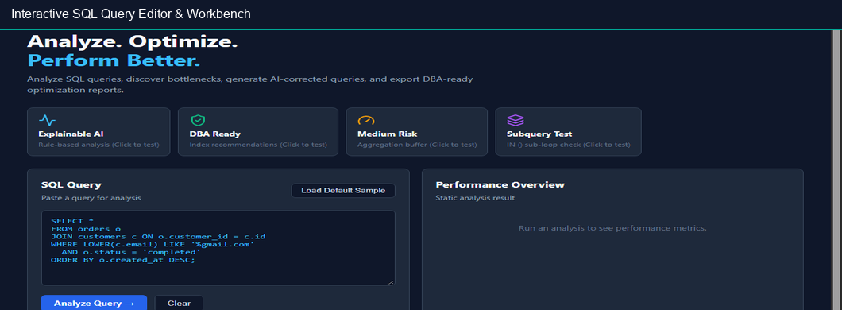
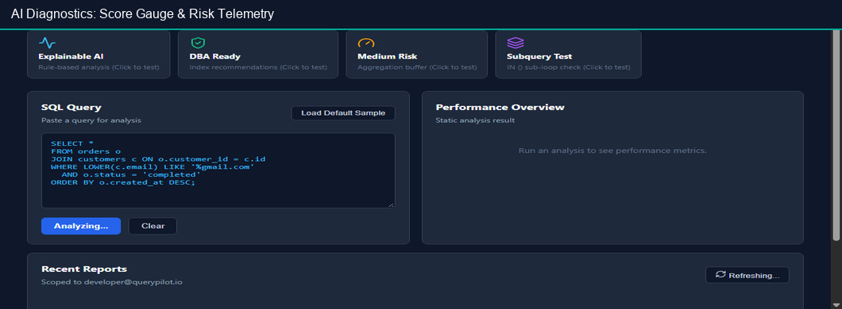
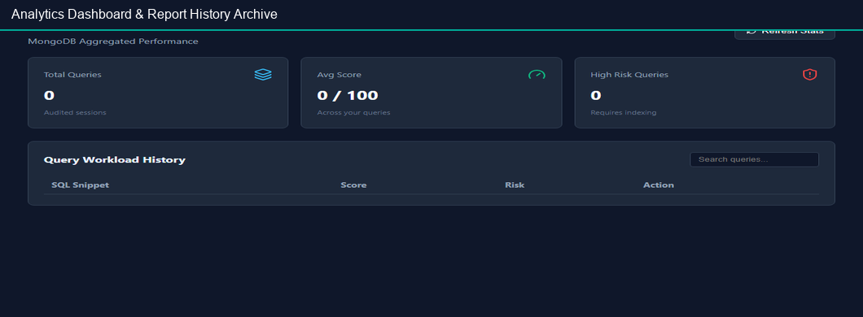
13
Screenshots
Screenshots
Screenshots
Review 1 & 2 | QueryPilot

Slide 15
14
Challenges Faced & Solutions
Challenges Faced & Solutions
Challenge | Solution Adopted
Complex SQL Parsing - Varied dialect syntaxes (PostgreSQL, MySQL) | Implemented standardized heuristic tokenization and execution plan breakdown before passing to the advisor.
Multi-page PDF Formatting - Performance tables and code snippets were clipping | Integrated jspdf-autotable with dynamic page-break calculations to ensure large queries and recommendation lists format cleanly.
Real-Time UI State Management Across Async Steps | Centralized execution state using React hooks and modular async handler functions in App.jsx for smooth transitions across raw inputs, AST metrics, and AI recommendations.
Non-Sargable Query Detection Without DB Execution Overhead | Developed static pattern matching for function wrappers (LOWER(), UPPER()) and wildcard scans (LIKE '%term') to flag index invalidation safely.
Challenges
Review 1 & 2 | QueryPilot

Slide 16
15
Next Steps
Remaining Work & Plan
Native Execution Plan Ingestion: Direct JSON parsing for MySQL EXPLAIN FORMAT=JSON and PostgreSQL EXPLAIN (ANALYZE, BUFFERS).
NoSQL / MongoDB Aggregation Optimization: Extend optimizer to detect unindexed $lookup stages, missing pipeline indexes, and memory-intensive $sort operations.
Automated Migration Script Generator: Produce instant executable DDL scripts (CREATE INDEX ...) tailored to target database dialects.
Historical Benchmark Comparison: Visual before-and-after query latency graphs tracking performance improvements post-indexing.
Collaborative Team Workspaces: Shared team query repositories with role-based governance and audit history.
Next Steps
Review 1 & 2 | QueryPilot

Slide 17
16
References
References
# | Reference
1 | MySQL 8.4 Reference Manual — EXPLAIN Statement & Query Execution Plan Optimization
2 | PostgreSQL Documentation — Performance Tips, Indexes, and EXPLAIN Cost Modeling
3 | MongoDB Official Documentation — Query Optimization, Aggregation Pipeline, and Index Strategies
4 | Express.js & Node.js Documentation — REST API Design, Security Middleware, and JWT Authentication
References
Review 1 & 2 | QueryPilot

