Slide 1
ASUP Hadoop Environment Statistics
Mania Abdi
ATG Intern
January 2020

Slide 2
Introduction
ASUP traces are 4-month long Hadoop jobs that were executed on ASUP Hadoop cluster.
Cluster specifications
The cluster is accessed by multiple users across the company,
The number of distinct users was 178 in the overall 4 months.
Jobs specifications
Jobs are mostly Hive queries executed on MapReduce framework,
There are some Sqoop jobs that were responsible for transferring data from JDBC databases to Hive databases,
The job failure rate is %0.09.

Slide 3
Completed work
Clean up the traces
the dataset was in the raw json format and it was converted to csv format. Example of information that contains in the csv files are:
Extract the workflow information that is generated by Hive compiler for each query in the form of directed acyclic graph (DAG),
The job utilization information e.g. memory usage, CPU usage,
Input/output paths and their sizes,
The user who access the query,
The job runtime statistics e.g. number of mappers/reducers, the runtime of each phase,
Selectivity of Hive query e.g. number of records that were read and written.
Please find the cleaned up version of the traces here.

Slide 4
Completed work
These information that were extracted from the traces
Cluster utilization statistics
How many jobs where submitted to the cluster?
How was the cluster utilization in terms of memory and CPU?
Represent cluster utilization in terms of timeseries.
Query similarities
Regularized and vectorized Hive queries based on SQL keywords,
Found similarity among queries using cosine similarity method,
Cluster queries based on the cosine similarity metric.
Job execution statistics:
The correlation between the number of mappers and the input size,
The correlation between the runtime, the input sizes, number of inputs.

Slide 5
Completed work
These information that were extracted from the traces
I/O statistics
Data sharing among different users represented as timeseries,
The spatial locality among object (implemented using the stack counter),
The temporal locality among object (implemented as correlation matrix),
The MRC based on different algorithm (LRU, LFU, Min).
DAGs statistics
DAG statistics such as number of jobs and their dependencies,
In/out degree of each job in the DAG,
The structure of each workflow.
Please find the source code for these evaluation in here.

Slide 6
Modeling Intermediate data

Slide 7
Intermediate data statistics
The first month of the trace.
Total number of jobs: ~400K
Total amount of data read: 11.39 PB
Total amount of intermediate data: 540.39 TB
Scan
Intermediate data
Fiter
Object size | Total bytes written | N. of objects (jobs) | % of objects
< 1KiB | 8 MB | 371108 | 96.46
< 1MiB | 1.26 GB | 3652 | 0.95
< 1GiB | 1.6 TB | 8011 | 2.08
< 1 TB | 191.21 TB | 1873 | 0.49
> 1 TB | 350 TB | 102 | 0.03
Write

Slide 8
Modeling Query submission

Slide 9
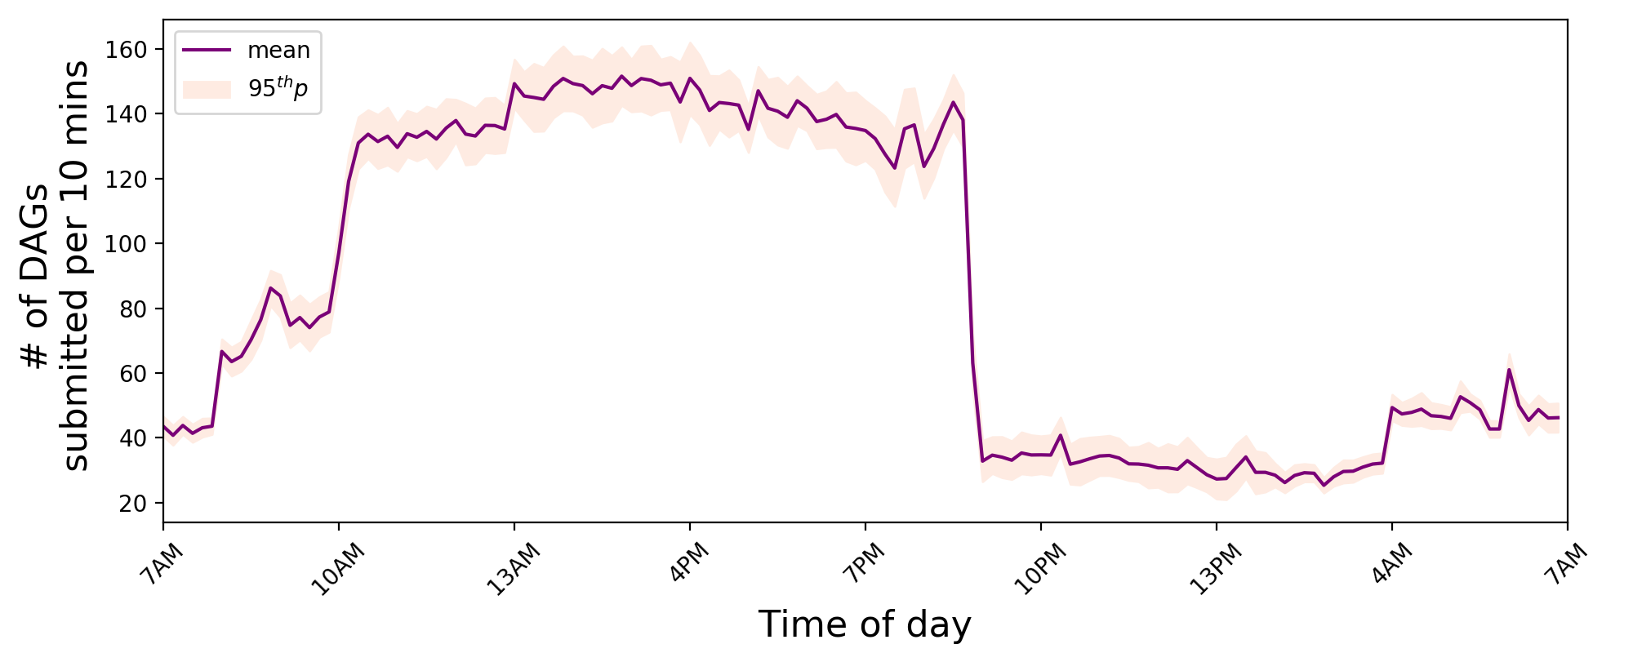
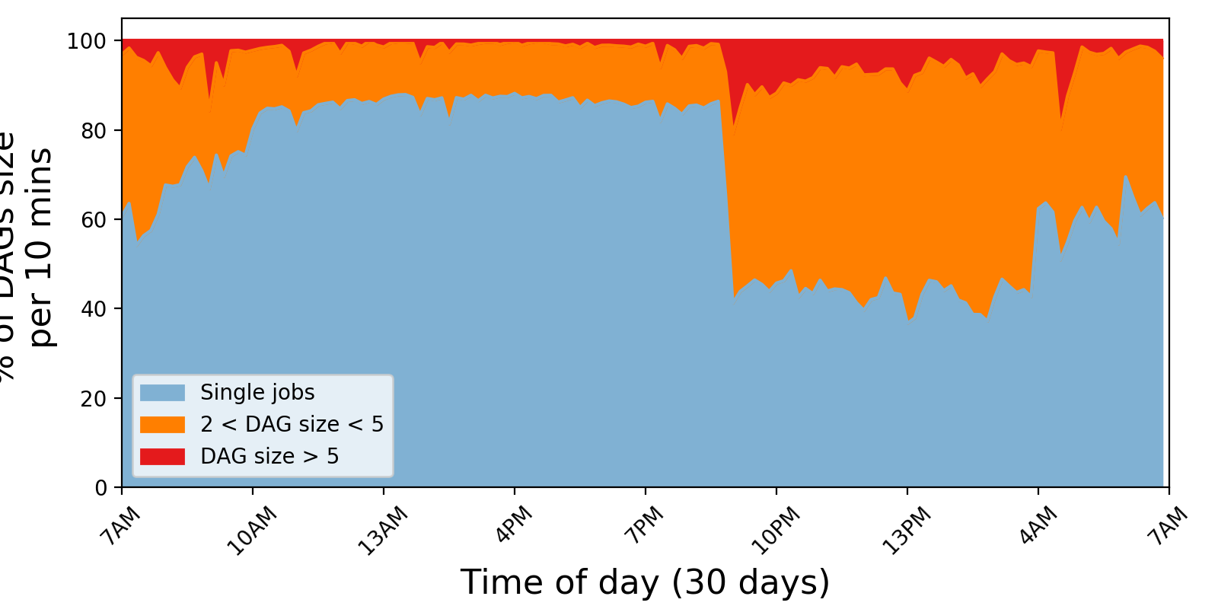
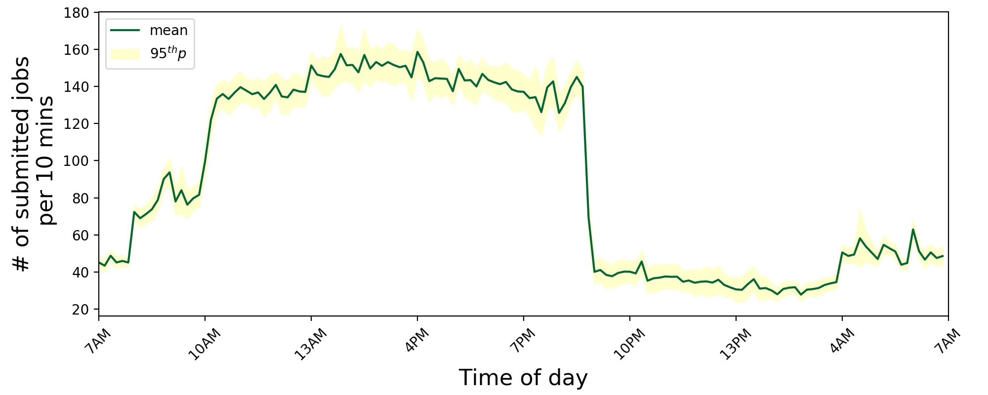
Workload behavior
Query submission rate per hour for a sample week
The workload has diurnal query submission pattern.
The first month of trace, bin 10 minutes

Slide 10
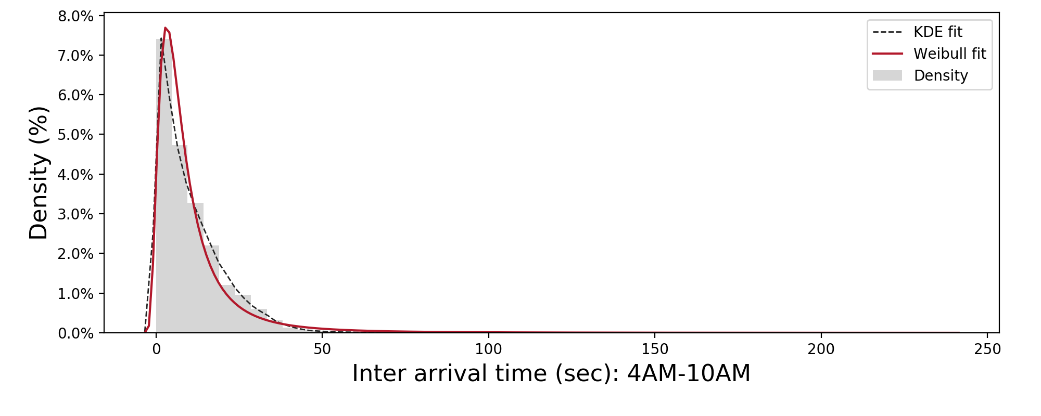
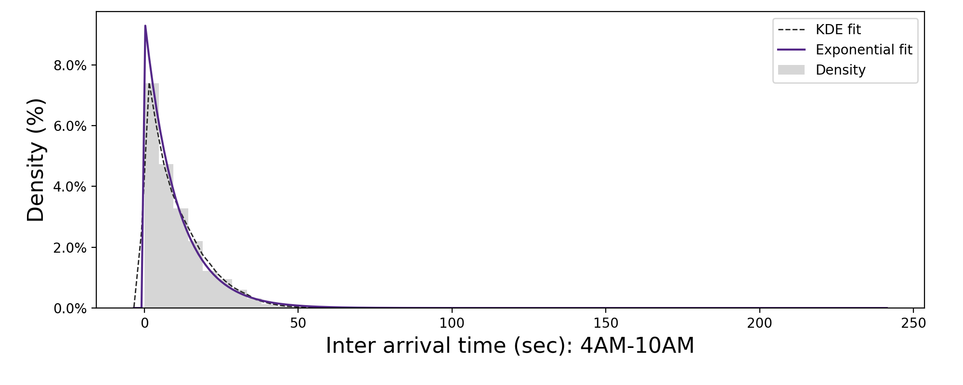
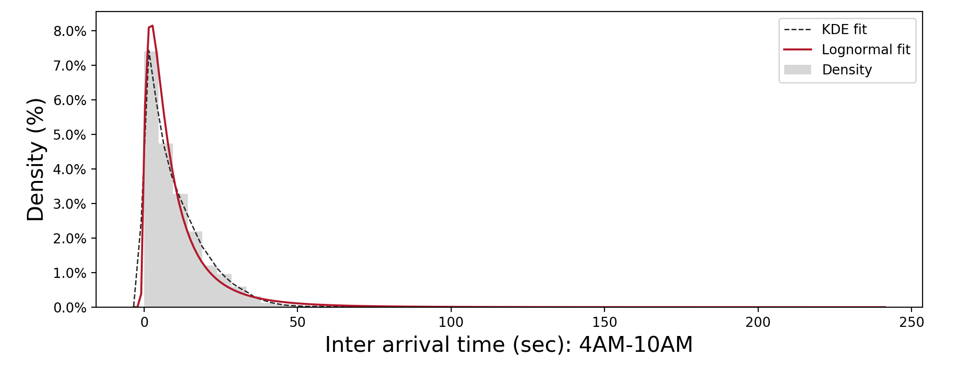
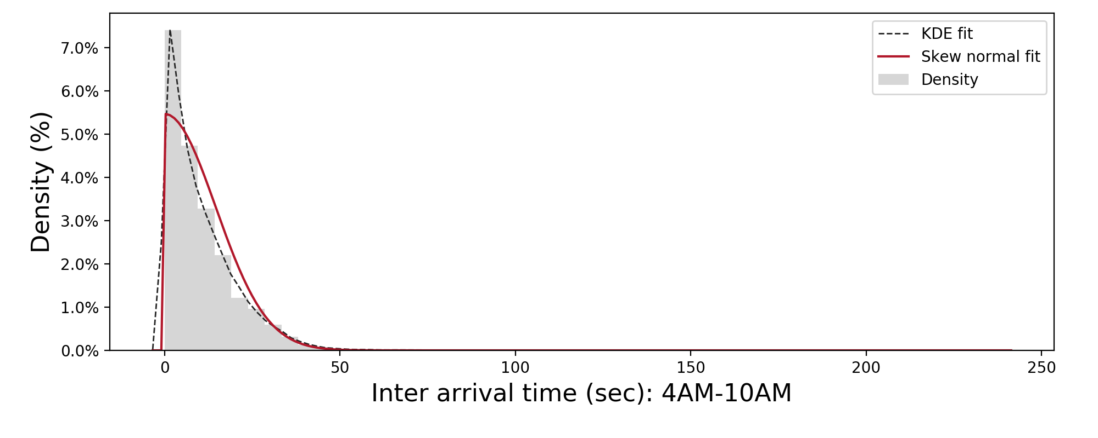
Query submission modeling
4AM-10AM: 30 days, binned for 10 minutes

Slide 11
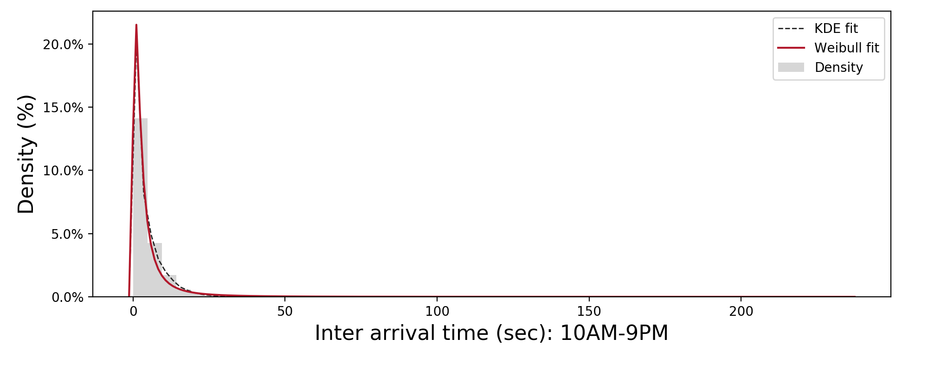
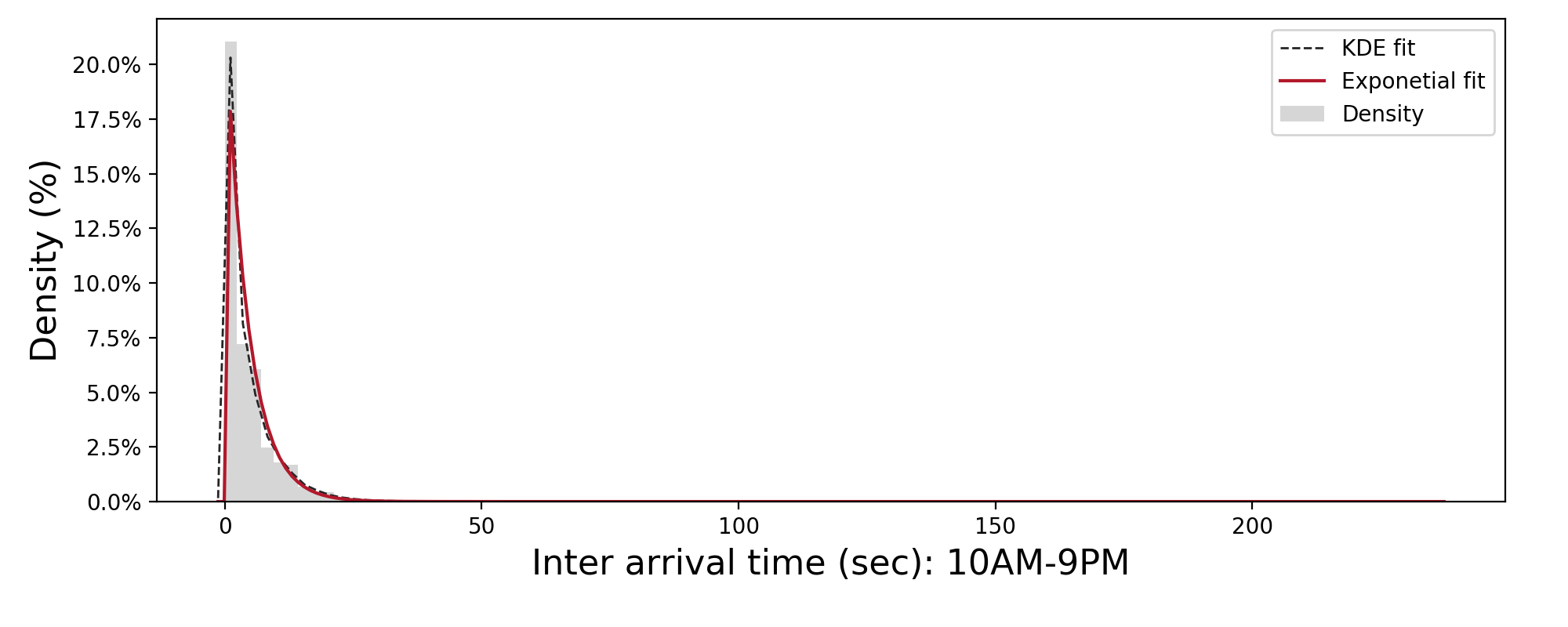
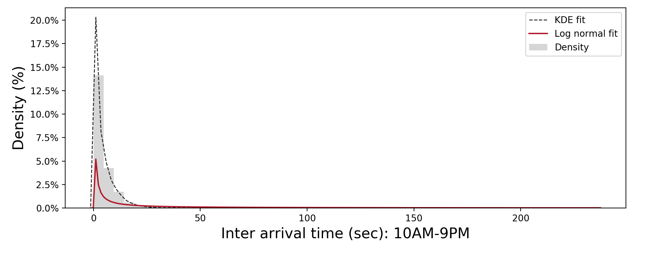
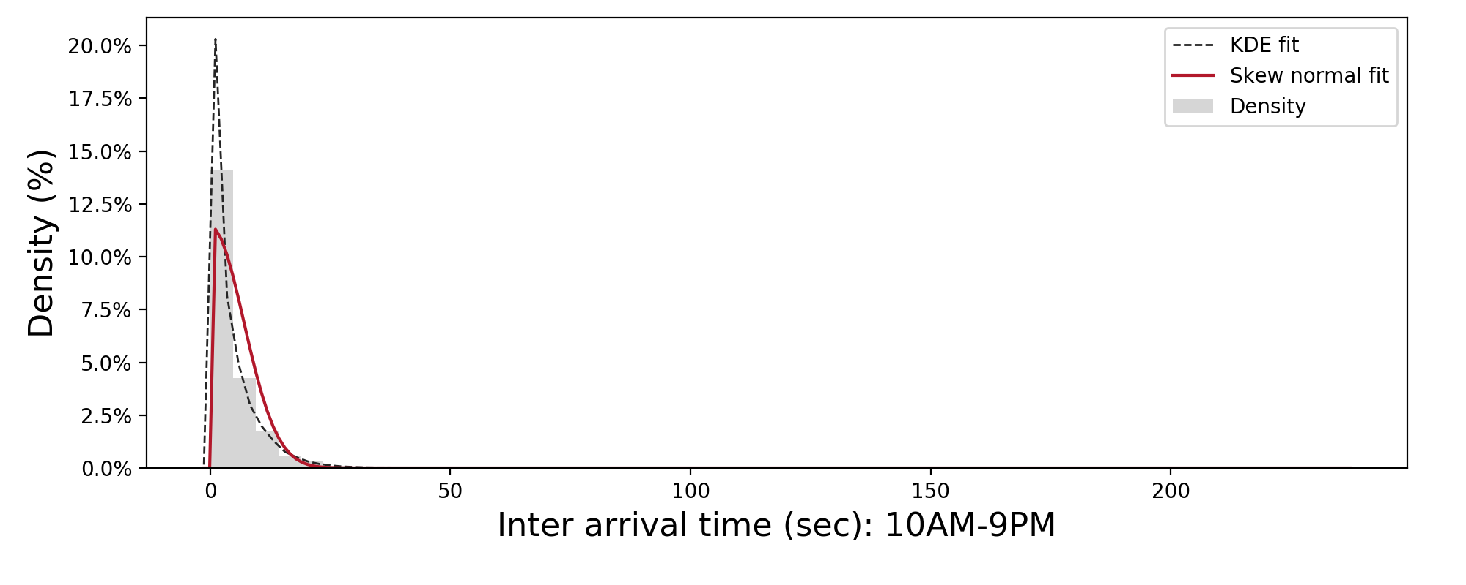
Query submission modeling
10AM-9PM: 30 days, binned for 10 minutes

Slide 12
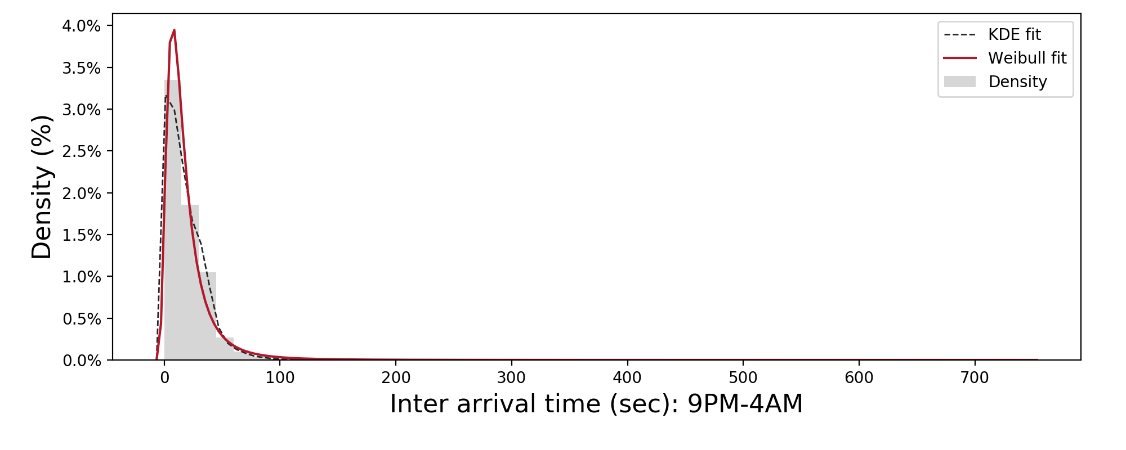
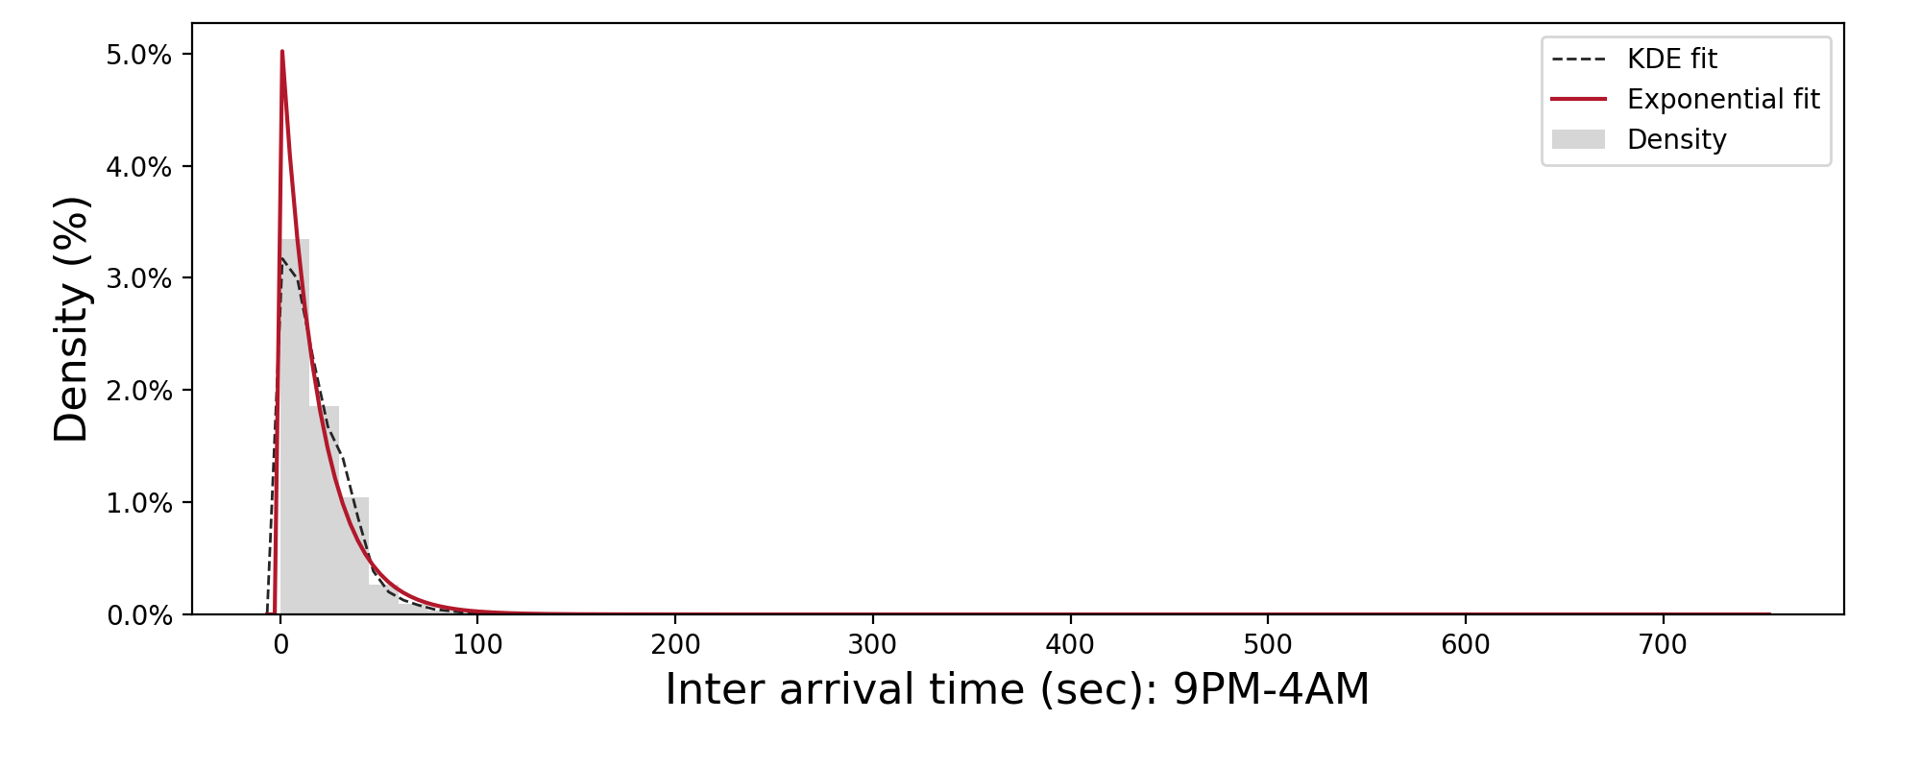
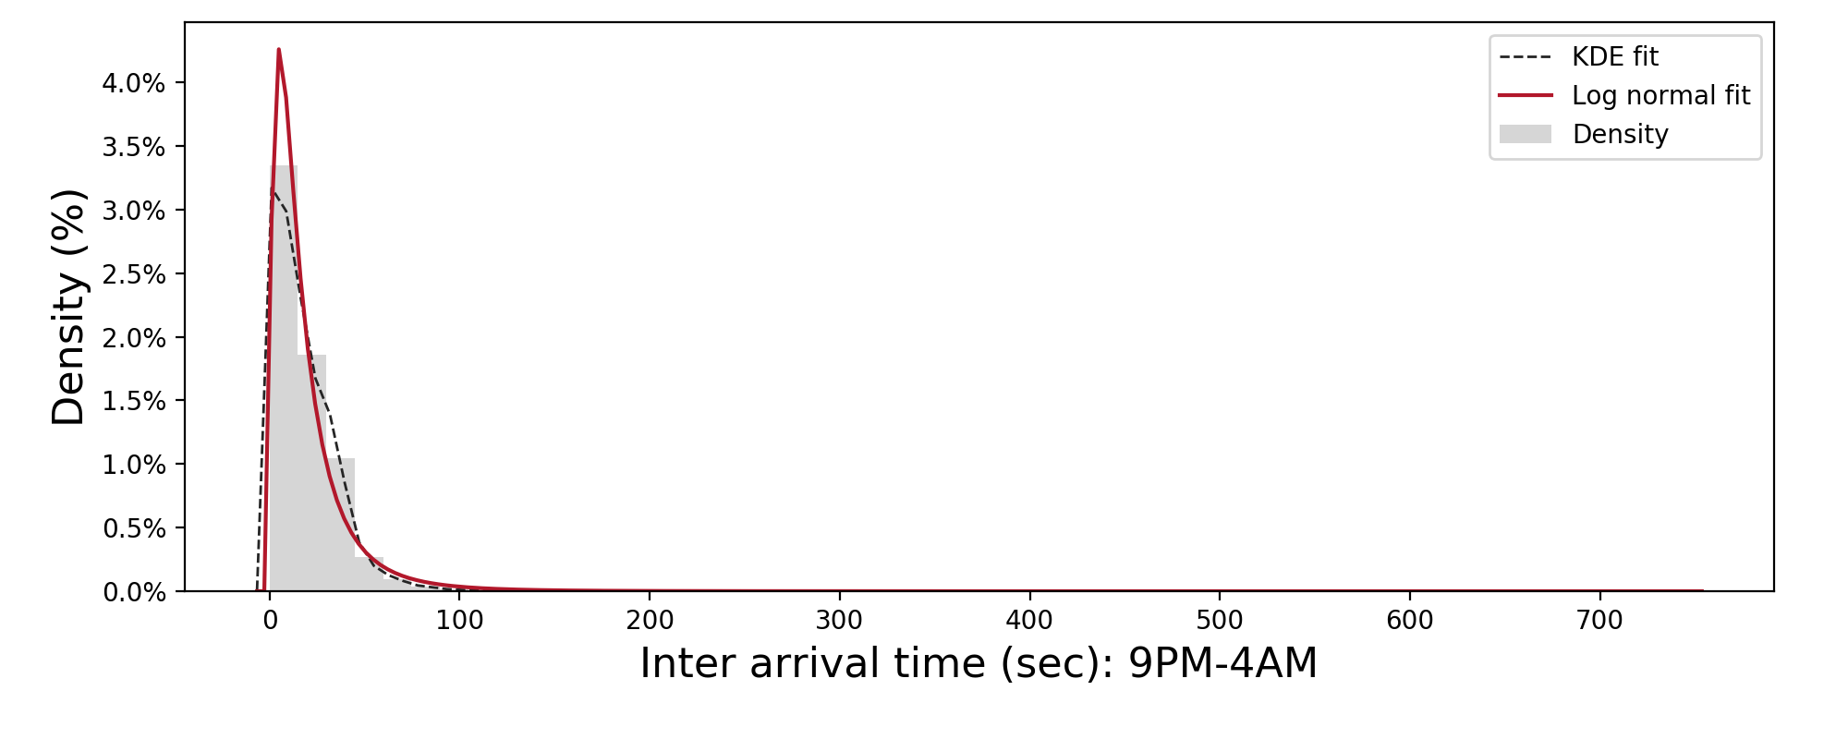
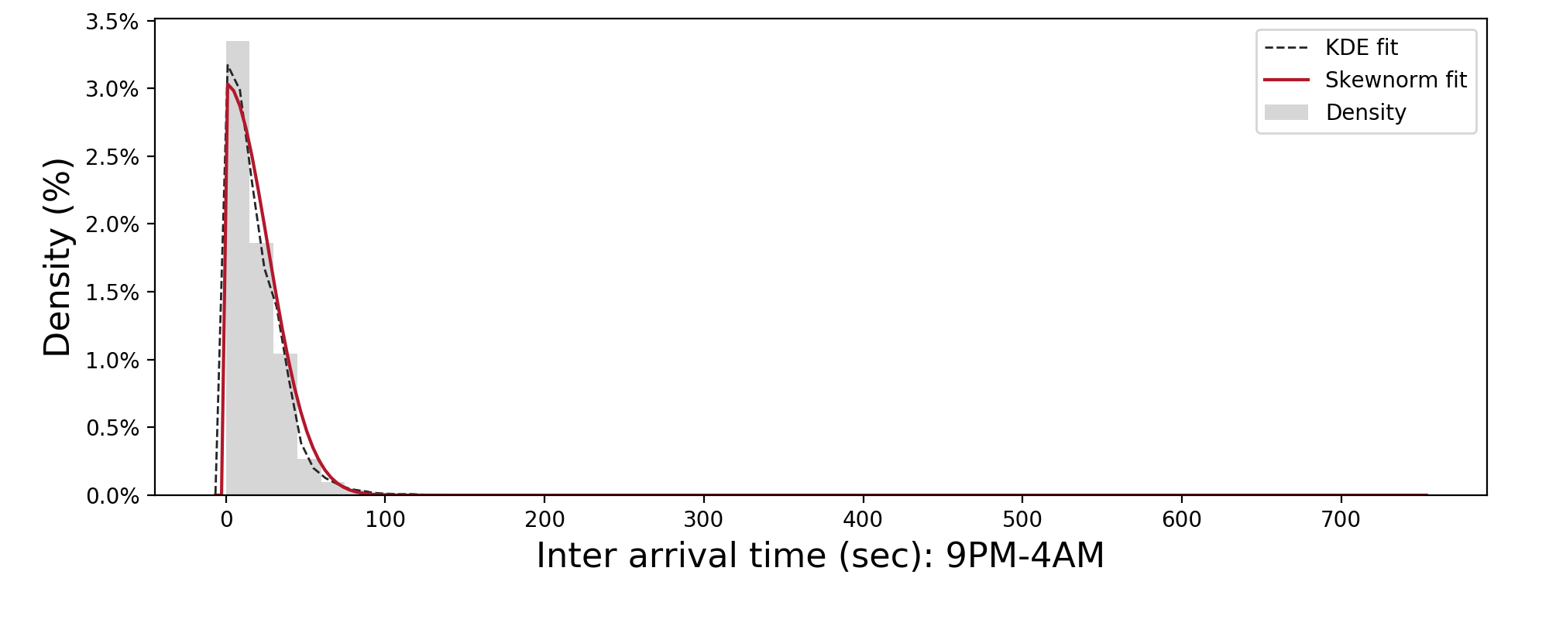
Query submission modeling
4AM-10AM: 30 days, binned for 10 minutes

Slide 13
WORKLOAD GENERATOR
Get start time and length of trace in minute as input
Select # of submitted DAGs for each 10 minutes bin randomly from the values observed for it within the one month.
Generate DAGs (currently single job) with the fitted interarrival model.
For each bin, randomly assign DAG sizes based on the observed empirical distribution.

Slide 14
Next Steps
Model DAG structure
Model inputs access pattern
Assign inputs to each job
Assign input size and output size to each job

Slide 15
Evaluations

Slide 16
Workload behavior
Job submission rate per hour for a sample week
The workload has diurnal query submission pattern.
The first month of trace
Binned for one month

Slide 17
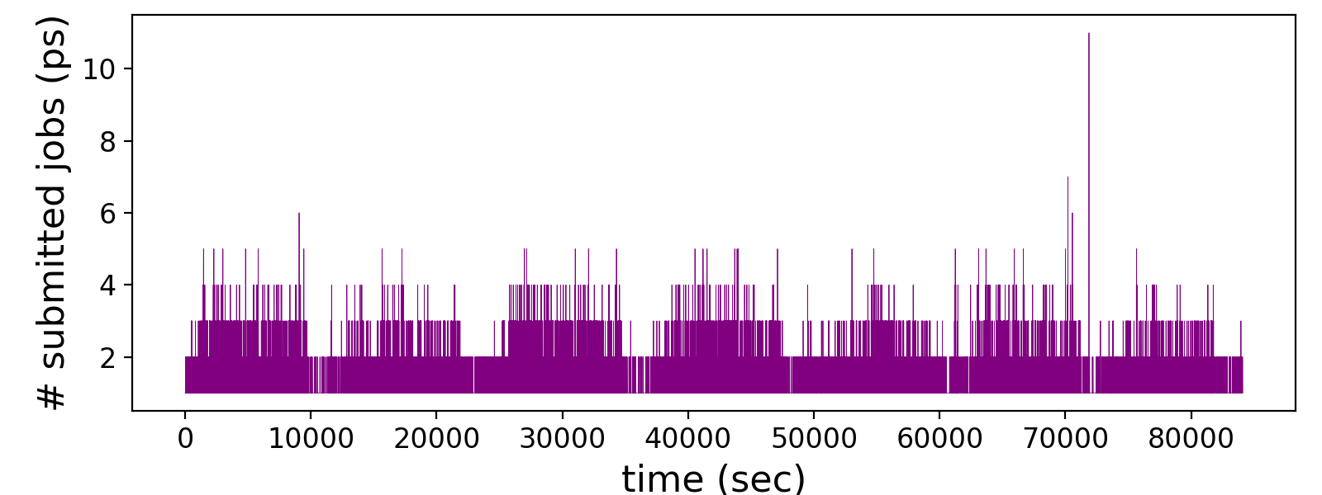
Cluster Statistics
Job submission rate per second for a sample week

Slide 18
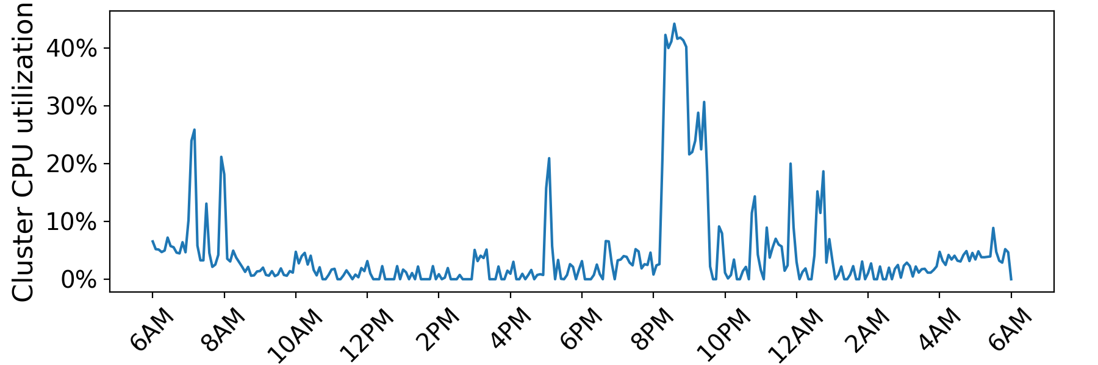
Cluster Utilization
Average cluster utilization for a sample day

Slide 19
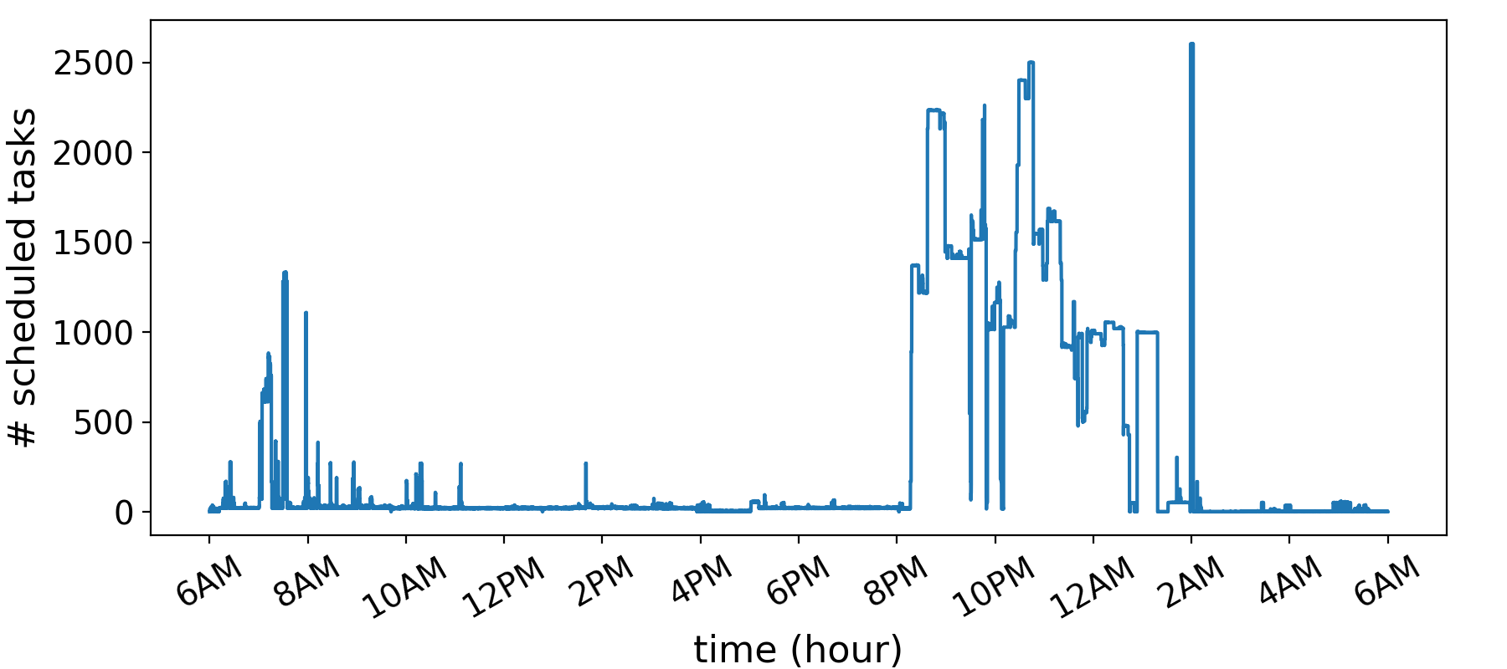
Cluster Utilization
# of running tasks (mappers + reduces) for a sample day

Slide 20
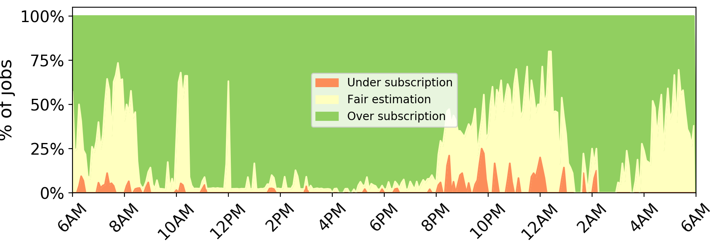
Cluster utilization
Time series of CPU utilization for a sample day

Slide 21
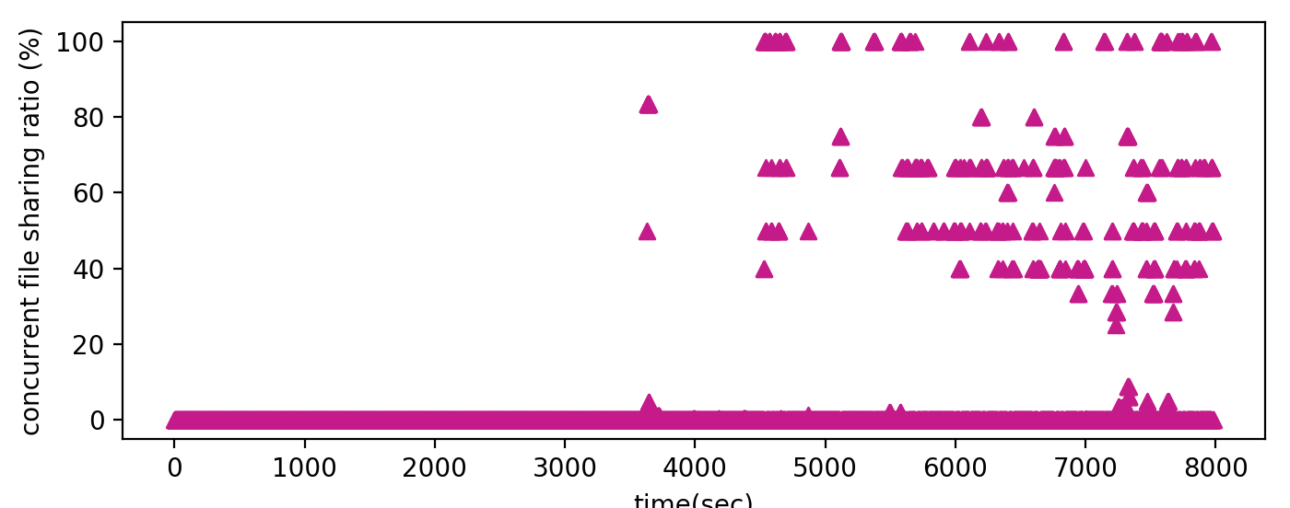
I/O Statistics
Time series of percentage of objects shared by different users.

Slide 22
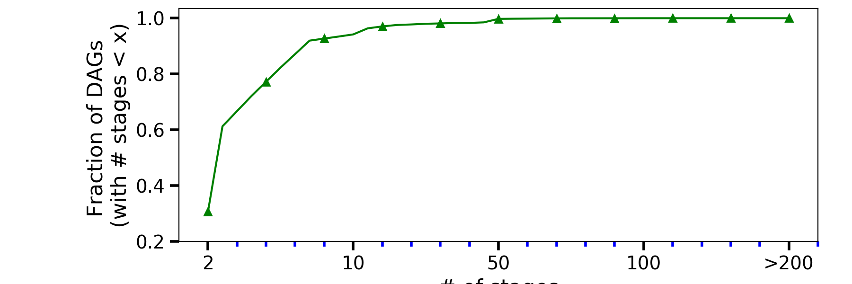
DAG Statistics
Cumulative distribution of number of stages (nodes) in DAGs submitted to the ASUP cluster.
Number of nodes

Slide 23
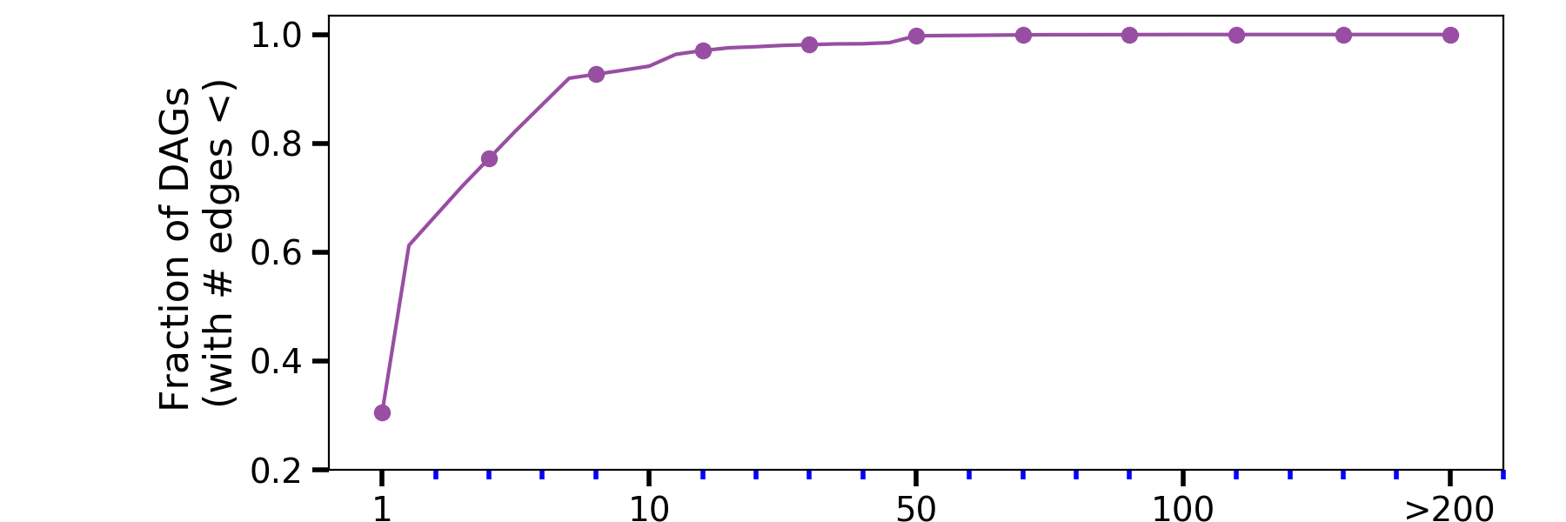
DAG Statistics
Cumulative distribution of number of edges in DAGs submitted to the ASUP cluster.
Number of edges

Slide 24
Next Steps
Build a workload generator based on ASUP traces:
Capture query statistics and I/O statistics and DAG structure.
Build a workload generator that generates queries using DAGs.

Slide 25
Thank You

