Slide 2
Introduction
Rain Alarm project is a simple but a very useful that detects rain (rain water) and automatically triggers an alarm or buzzer using arduino.
Water is a basic need in everyone’s life .Saving water and proper usage of water is very important.here is easy project which will give the alarm when there is rain. So that we can make some actions for rain water harvesting and also save the rain water for using later.
Through rain water harvesting we can increase the levels of underground water by using underwater recharge technique.

Slide 3
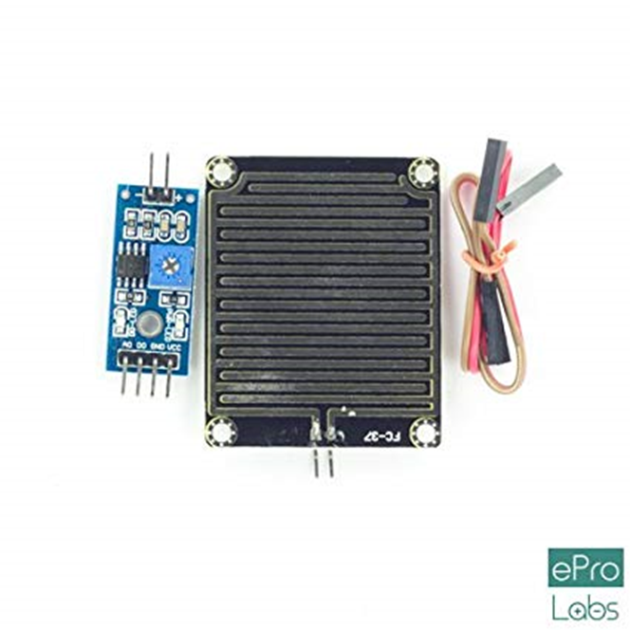
OBJECTIVES
Arduino UNO
Arduino USB Cable
Rain sensor
Alarm(Buzzer)
LED(Light Emitting Diode)
Jumpers(Pin connectors)

Slide 4
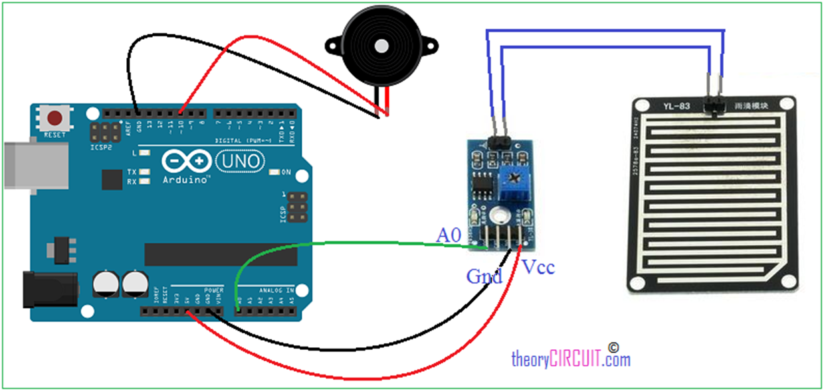
Rain water detector will detect the rain and an alert.
Rain water detector is used in the irrigation field , communication and automobiles .
CIRCUIT DIAGRAM

Slide 5

BLOCK DIAGRAM

Slide 6
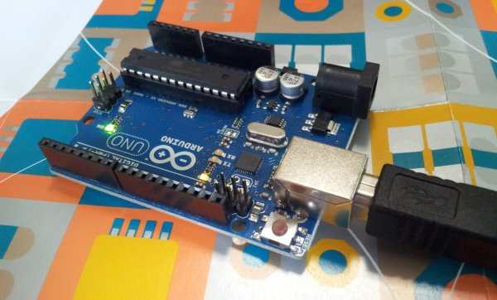
Arduino

Slide 7


Slide 8
