Slide 1

Angular

Slide 2

Installation
Angular js vs Angular
Architecture
Written in TypeScript.
Mobile support(Hybrid mobile app support).
Binding syntax is soo easy.
Everything is component based easy and manageable file structure.
Component specific styling is possible.
Dependency Injection is more optimized and easy to work with.
New features added in the Routing, easy to implement it.
Notes:
Notes to presenter:
Description of what you learned in your own words on one side.
Include information about the topic
Details about the topic will also be helpful here.
Tell the story of your learning experience. Just like a story there should always be a beginning, middle and an end.
On the other side, you can add a graphic that provides evidence of what you learned.
Feel free to use more than one slide to reflect upon your process. It also helps to add some video of your process.

Slide 3
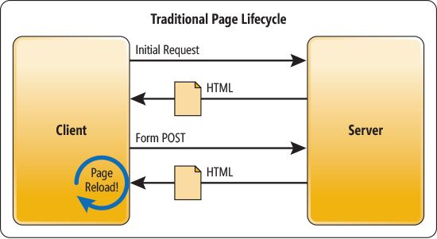
Installation
Why Angular is so popular?
SPA
It is easy to use
Provides MVC Architecture
It is compatible for both desktop & mobile applications
Two-way data binding
Availability of different third party library, modules and packages
Very good testing abilities
It is flexible and extensible
Notes:
Notes to presenter:
Description of what you learned in your own words on one side.
Include information about the topic
Details about the topic will also be helpful here.
Tell the story of your learning experience. Just like a story there should always be a beginning, middle and an end.
On the other side, you can add a graphic that provides evidence of what you learned.
Feel free to use more than one slide to reflect upon your process. It also helps to add some video of your process.

Slide 4
Installation
Installation
Visual Studio Code – Download
- Nodejs Download? Why nodejs needed for Angular? Typescript. Browser does not understand Typescript JS. We need to compile them into plain JavaScript for that we need Node and NPM to compile them into js file.
Most of the Angular packages or libraries are distributed as different NPM packages
Installing Angular CLI - npm install –g @angular/cli
ng new <projectname>
Choose Angular routing, style mechanism = CSS | LESS |SASS
Notes:
Notes to presenter:
Description of what you learned in your own words on one side.
Include information about the topic
Details about the topic will also be helpful here.
Tell the story of your learning experience. Just like a story there should always be a beginning, middle and an end.
On the other side, you can add a graphic that provides evidence of what you learned.
Feel free to use more than one slide to reflect upon your process. It also helps to add some video of your process.

Slide 5
Installation
Typescript
> npm install –g typescript only one time in you machine
Super set of javascript
Ultimately it compiles to javascript only because browser can only understand javascript.
Angular cli does this job for us to automatic compilation of typescript files to javascript while we execute ng serve command
Object oriented programming is possible
With it, We can use any of the JS library also we can simply use javascript code in it.
It supports Static features, modules and interface.
Notes:
Notes to presenter:
Description of what you learned in your own words on one side.
Include information about the topic
Details about the topic will also be helpful here.
Tell the story of your learning experience. Just like a story there should always be a beginning, middle and an end.
On the other side, you can add a graphic that provides evidence of what you learned.
Feel free to use more than one slide to reflect upon your process. It also helps to add some video of your process.

Slide 6
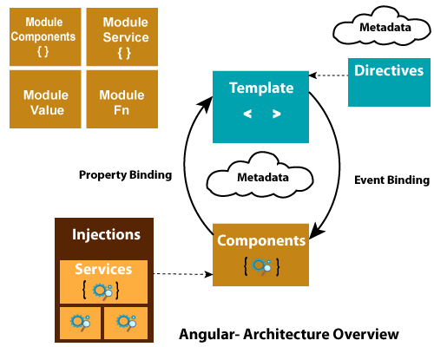


Angular Architecture
Notes:
Notes to presenter:
What did you think at first?
What obstacles did you encounter along the way?
How did you overcome those obstacles?
What images can you add to support your process?
This SmartArt allows you add images and text to help outline your process. If a picture is worth a thousand words, then pictures and words should help you communicate this reflection on learning perfectly! You can always click on Insert>SmartArt to change this graphic or select the graphic and click on the Design contextual menu to change the colors.
Feel free to use more than one slide to reflect upon your process. It also helps to add some video of your process.

Slide 7
Installation
File Structure
Git ignore = For ignore the file when commiting.
Angular.json = Configuration option for the build,serve and test tools
Package.json = Have all dependencies we used in the project
> app
> assets
> environments
main.ts = Entry point of the application, compiles the application JIT compiler. It Bootstrap the application root module (app module).
Polifills.ts = scripts for the browser support
Style.css = globally available in the entire project
Notes:
Notes to presenter:
Description of what you learned in your own words on one side.
Include information about the topic
Details about the topic will also be helpful here.
Tell the story of your learning experience. Just like a story there should always be a beginning, middle and an end.
On the other side, you can add a graphic that provides evidence of what you learned.
Feel free to use more than one slide to reflect upon your process. It also helps to add some video of your process.

Slide 8
Installation
How angular application actually works
Execution starts from angular.json file
It specifies which index.html and main.ts file needs to be executed
main.ts contains the code to bootstrap and start of the angular application
Main.ts calls the AppModule file
App module file contains all the component required for the application
App module calls the App Component file. It has, - selector, - template, - style url
All the components are related to this root component
<app-root> selector by default is present in the index.html
Selector is nothing but the custom HTML element.
Notes:
Notes to presenter:
Description of what you learned in your own words on one side.
Include information about the topic
Details about the topic will also be helpful here.
Tell the story of your learning experience. Just like a story there should always be a beginning, middle and an end.
On the other side, you can add a graphic that provides evidence of what you learned.
Feel free to use more than one slide to reflect upon your process. It also helps to add some video of your process.

Slide 9
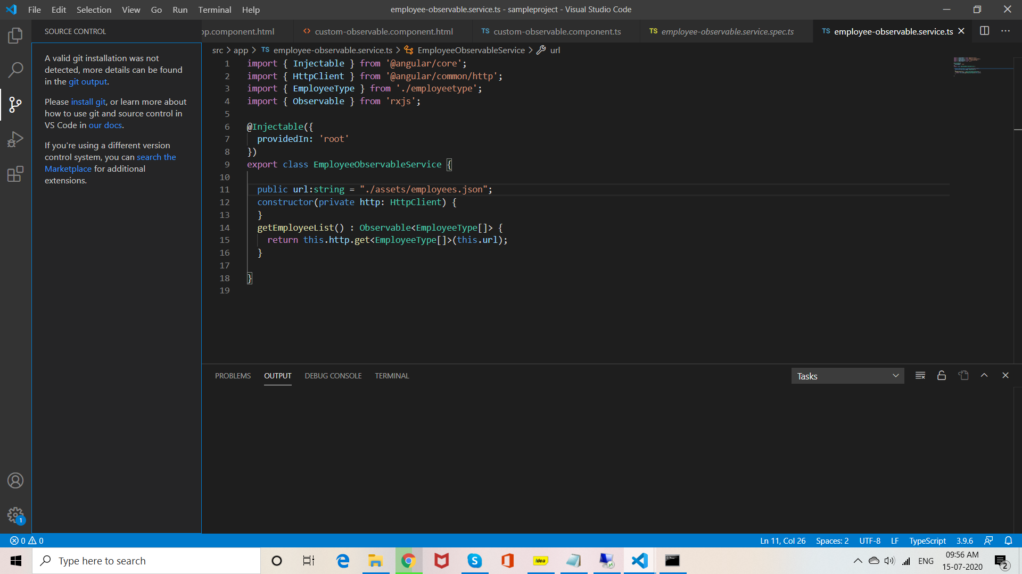
Installation
GIT
Notes:
Notes to presenter:
Description of what you learned in your own words on one side.
Include information about the topic
Details about the topic will also be helpful here.
Tell the story of your learning experience. Just like a story there should always be a beginning, middle and an end.
On the other side, you can add a graphic that provides evidence of what you learned.
Feel free to use more than one slide to reflect upon your process. It also helps to add some video of your process.

Slide 10
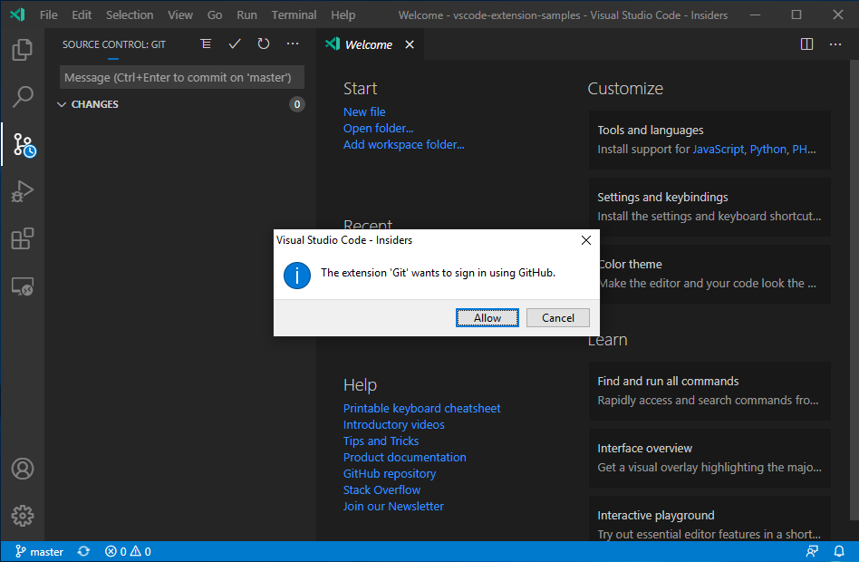
Installation
GIT
Notes:
Notes to presenter:
Description of what you learned in your own words on one side.
Include information about the topic
Details about the topic will also be helpful here.
Tell the story of your learning experience. Just like a story there should always be a beginning, middle and an end.
On the other side, you can add a graphic that provides evidence of what you learned.
Feel free to use more than one slide to reflect upon your process. It also helps to add some video of your process.

Slide 11
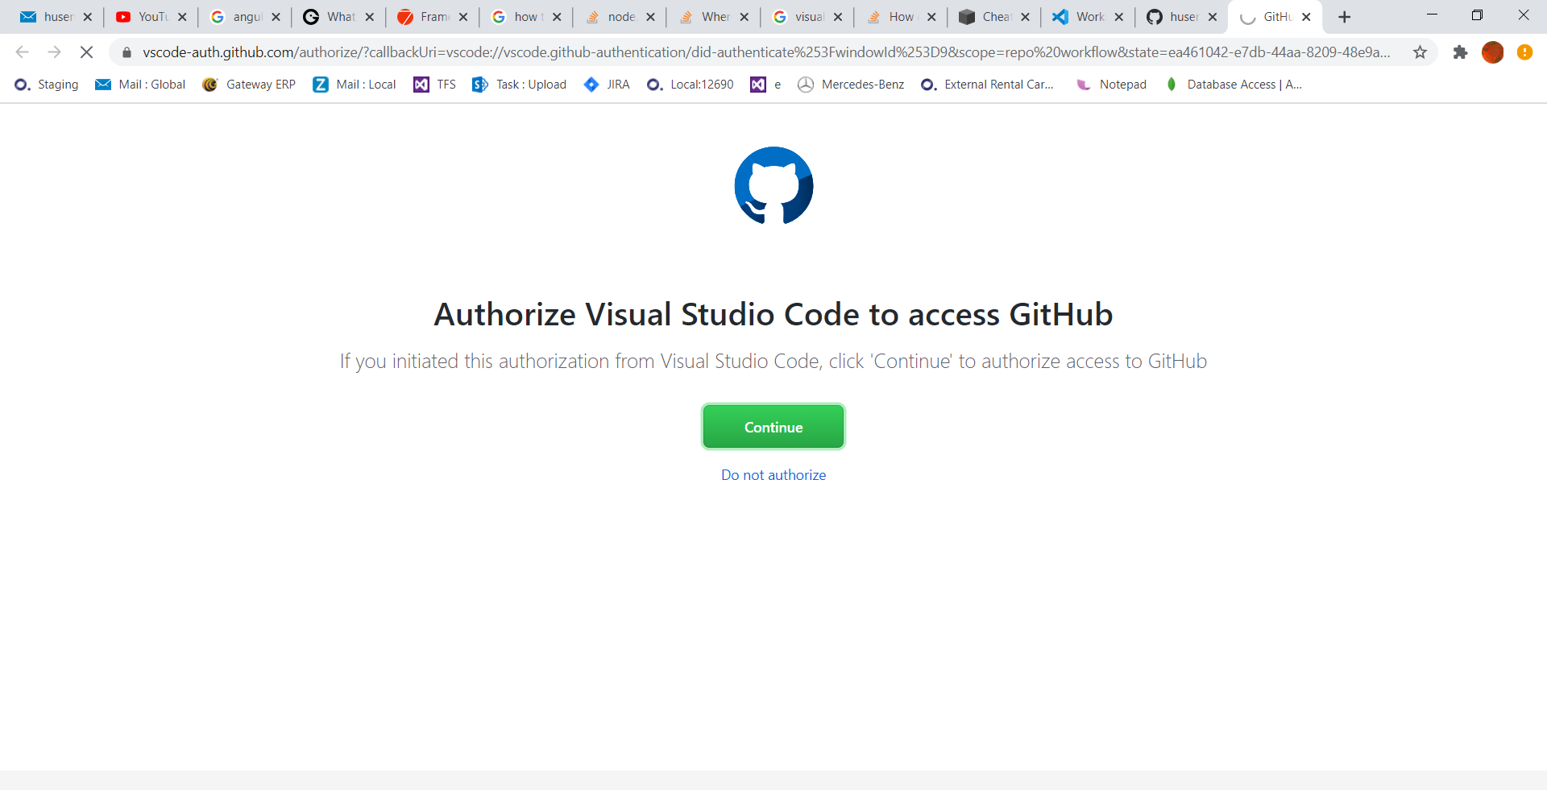
Installation
GIT
Notes:
Notes to presenter:
Description of what you learned in your own words on one side.
Include information about the topic
Details about the topic will also be helpful here.
Tell the story of your learning experience. Just like a story there should always be a beginning, middle and an end.
On the other side, you can add a graphic that provides evidence of what you learned.
Feel free to use more than one slide to reflect upon your process. It also helps to add some video of your process.

Slide 12
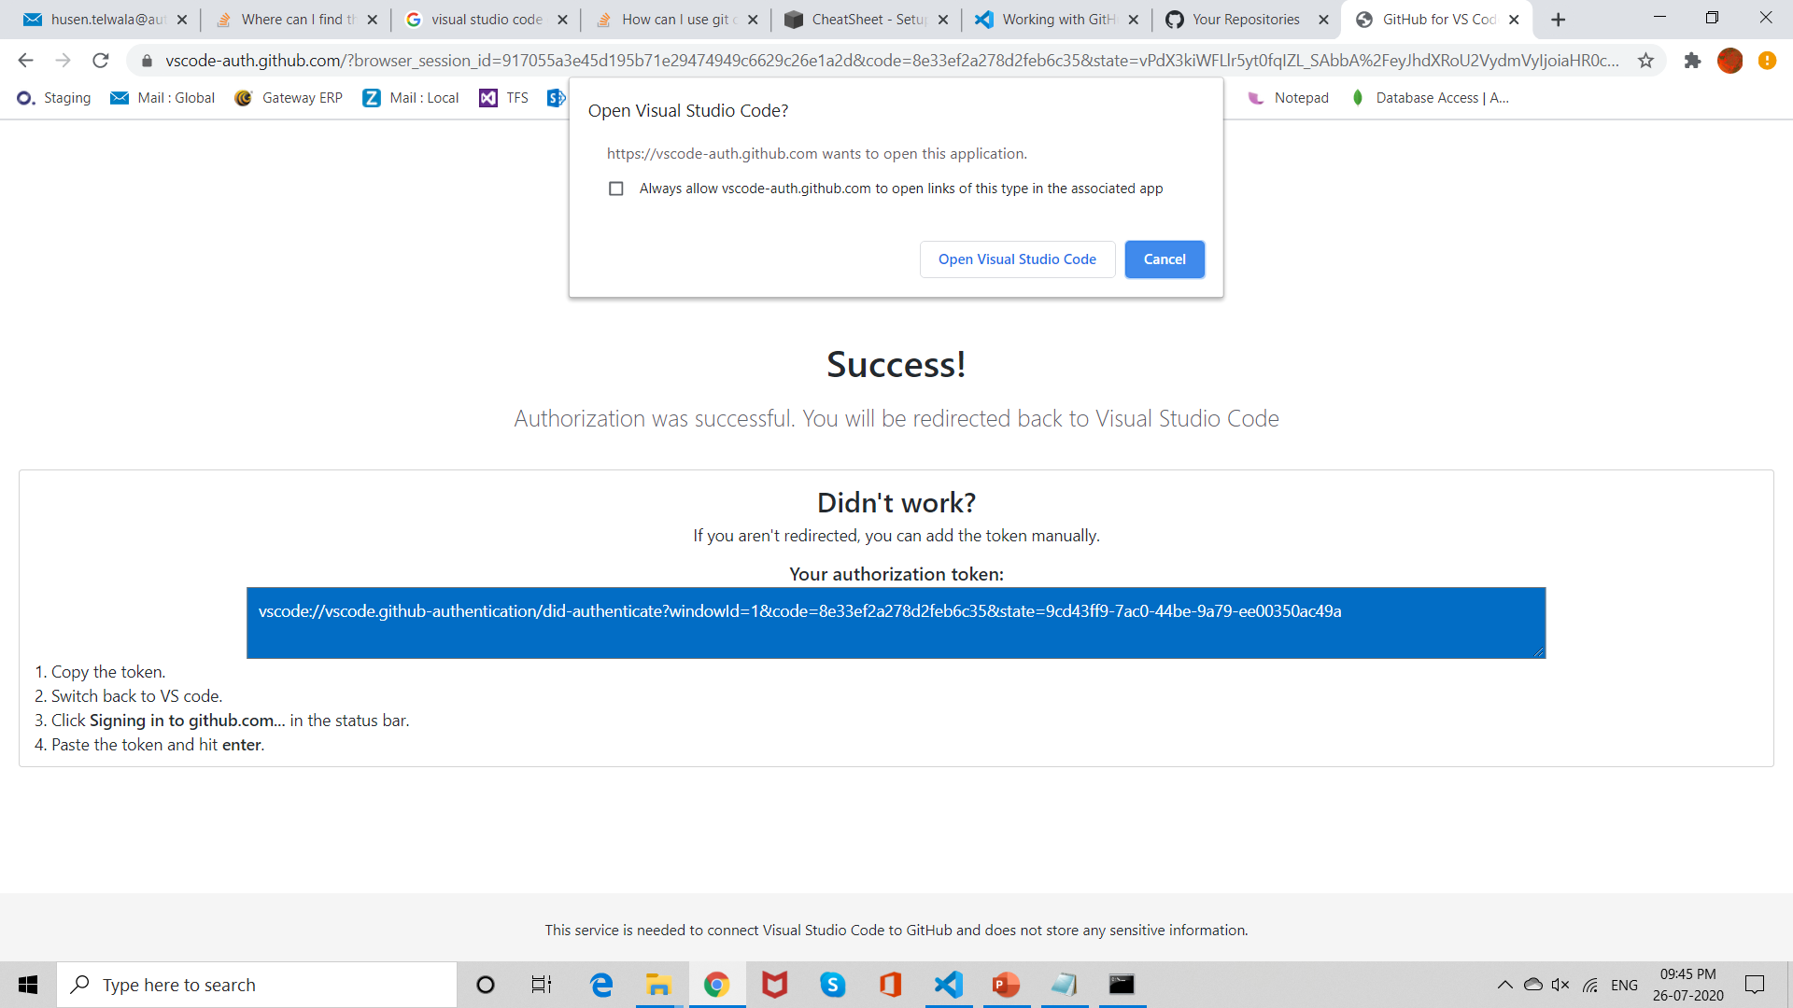
Installation
GIT
Notes:
Notes to presenter:
Description of what you learned in your own words on one side.
Include information about the topic
Details about the topic will also be helpful here.
Tell the story of your learning experience. Just like a story there should always be a beginning, middle and an end.
On the other side, you can add a graphic that provides evidence of what you learned.
Feel free to use more than one slide to reflect upon your process. It also helps to add some video of your process.

Slide 13
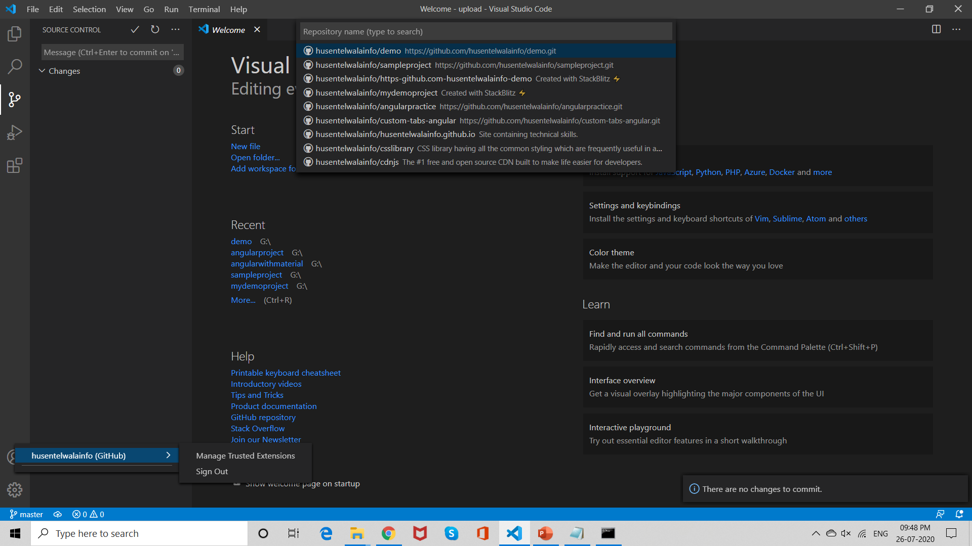
Installation
GIT
Notes:
Notes to presenter:
Description of what you learned in your own words on one side.
Include information about the topic
Details about the topic will also be helpful here.
Tell the story of your learning experience. Just like a story there should always be a beginning, middle and an end.
On the other side, you can add a graphic that provides evidence of what you learned.
Feel free to use more than one slide to reflect upon your process. It also helps to add some video of your process.

Slide 14
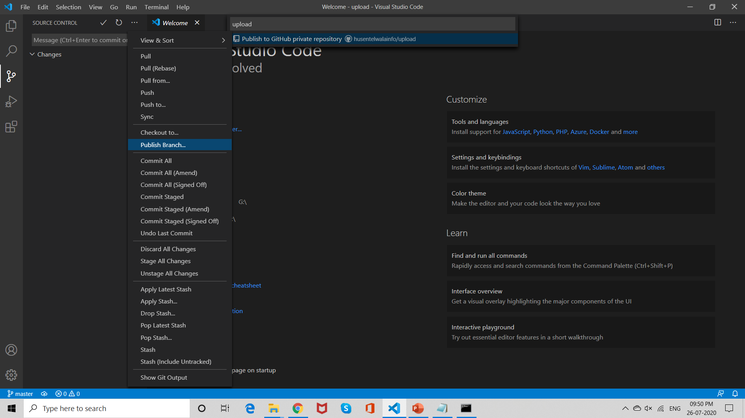
Installation
GIT
Notes:
Notes to presenter:
Description of what you learned in your own words on one side.
Include information about the topic
Details about the topic will also be helpful here.
Tell the story of your learning experience. Just like a story there should always be a beginning, middle and an end.
On the other side, you can add a graphic that provides evidence of what you learned.
Feel free to use more than one slide to reflect upon your process. It also helps to add some video of your process.

