Slide 1

Binding
Name Course

Slide 2
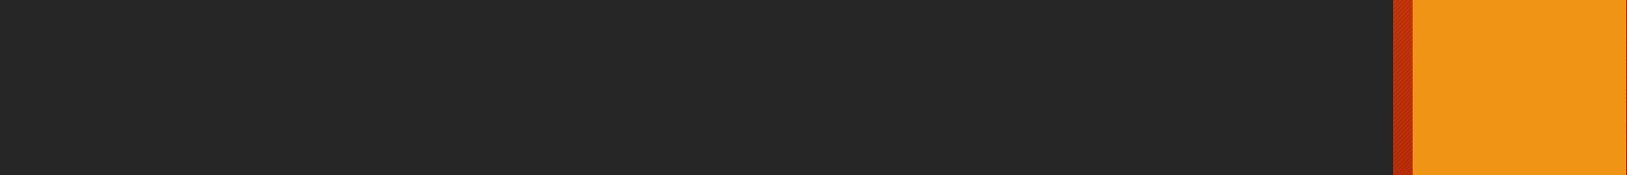
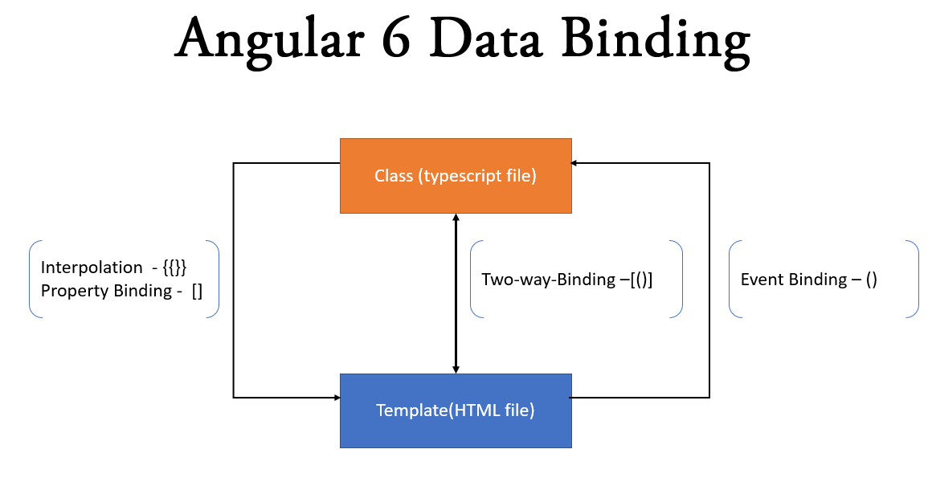
Installation
Types of Binding
Interpolation {{ }}
Property Binding
Style Binding
Class Binding
Attribute Binding
Event Binding
Two way Binding
Notes:
Notes to presenter:
Description of what you learned in your own words on one side.
Include information about the topic
Details about the topic will also be helpful here.
Tell the story of your learning experience. Just like a story there should always be a beginning, middle and an end.
On the other side, you can add a graphic that provides evidence of what you learned.
Feel free to use more than one slide to reflect upon your process. It also helps to add some video of your process.

Slide 3
Installation
Interpolation {{ }}
Calculation string concatenation can be performed.
To display any value from the component to template
Any built in javascript method can be used directly.
Angular Filter can be used.
Assignment not possible
Global javascript variable are not accessible through interpolation.
Notes:
Notes to presenter:
Description of what you learned in your own words on one side.
Include information about the topic
Details about the topic will also be helpful here.
Tell the story of your learning experience. Just like a story there should always be a beginning, middle and an end.
On the other side, you can add a graphic that provides evidence of what you learned.
Feel free to use more than one slide to reflect upon your process. It also helps to add some video of your process.

Slide 4
Installation
Property Binding []
Difference between HTML attribute and Property
Attributes defined by HTML
Properties defined by DOM(The HTML DOM is a Programming Interface for JavaScript.)
Attributes initialize DOM properties at the time of page load and then they are done
Attributes values cannot change once they are initialized
Properties values however can change.
Template binding works with only properties, not attributes.
Notes:
Notes to presenter:
Description of what you learned in your own words on one side.
Include information about the topic
Details about the topic will also be helpful here.
Tell the story of your learning experience. Just like a story there should always be a beginning, middle and an end.
On the other side, you can add a graphic that provides evidence of what you learned.
Feel free to use more than one slide to reflect upon your process. It also helps to add some video of your process.

Slide 5
Installation
Property Binding[]
Property binding flows a value in one direction, from a component's property into a target element property.
Why needed if we can bind through interpolation as well? - Because it’s works well for string type not for all other data types
Remember to use camelCase if any property having more than one word.
Can be declared with : Element, Component and Directive
Notes:
Notes to presenter:
Description of what you learned in your own words on one side.
Include information about the topic
Details about the topic will also be helpful here.
Tell the story of your learning experience. Just like a story there should always be a beginning, middle and an end.
On the other side, you can add a graphic that provides evidence of what you learned.
Feel free to use more than one slide to reflect upon your process. It also helps to add some video of your process.

Slide 6
Installation
Class Binding[]
From Component as per the variable value: Example: [class]=“StyleVariable”
Based on a condition we can add the class Example of conditional class: [class.classname]=“true/false”
Two classes can not be used together with [class]
For Multiple classes we can use [ngClass] directive: Custom HTML attribute that angular provides.
Notes:
Notes to presenter:
Description of what you learned in your own words on one side.
Include information about the topic
Details about the topic will also be helpful here.
Tell the story of your learning experience. Just like a story there should always be a beginning, middle and an end.
On the other side, you can add a graphic that provides evidence of what you learned.
Feel free to use more than one slide to reflect upon your process. It also helps to add some video of your process.

Slide 7
Installation
Style Binding[]
Example for direct usage in template: [style.color]="'red'"
Example From Component as per the variable value: [style]=“StyleVariable”
Use camelCase for more than one word:
Example: [style.backgroundColor]="'red'"
Based on a condition we can add the style Example: [style.color]="isRedText ? '#FF0000' : '#000000'"
Both style and [style] can not be used together
For Multiple styles we can use [ngStyle] directive: Custom HTML attribute that angular provides.
Notes:
Notes to presenter:
Description of what you learned in your own words on one side.
Include information about the topic
Details about the topic will also be helpful here.
Tell the story of your learning experience. Just like a story there should always be a beginning, middle and an end.
On the other side, you can add a graphic that provides evidence of what you learned.
Feel free to use more than one slide to reflect upon your process. It also helps to add some video of your process.

Slide 8
Installation
Event Binding()
Example for usage in template: (click)=“functionName()“
It can be use without handler function as well: (click)=“variablename=‘Value’”
Notes:
Notes to presenter:
Description of what you learned in your own words on one side.
Include information about the topic
Details about the topic will also be helpful here.
Tell the story of your learning experience. Just like a story there should always be a beginning, middle and an end.
On the other side, you can add a graphic that provides evidence of what you learned.
Feel free to use more than one slide to reflect upon your process. It also helps to add some video of your process.

Slide 9
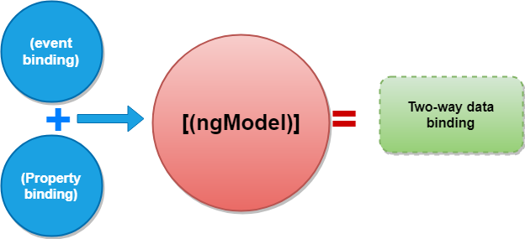
Installation
Two way Binding [()]
It means To the class to template view and to the template view to class
Example: [(ngModel)]="firstname"
Notes:
Notes to presenter:
Description of what you learned in your own words on one side.
Include information about the topic
Details about the topic will also be helpful here.
Tell the story of your learning experience. Just like a story there should always be a beginning, middle and an end.
On the other side, you can add a graphic that provides evidence of what you learned.
Feel free to use more than one slide to reflect upon your process. It also helps to add some video of your process.

