Slide 1

Directives

Slide 2
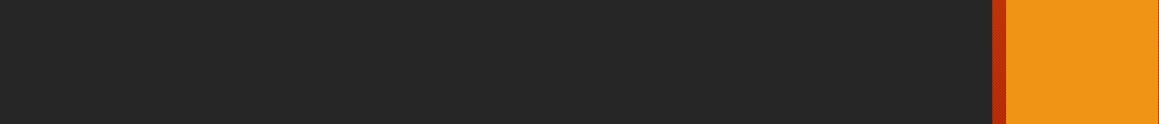
Installation
Types of Directives
Purpose: To add/remove HTML elements
Types of Structural Directives.
- *ngIf : Based on some Condition show/hide the HTML elements. - [ngSwitch] : Comparing multiple possible conditions of an expression. - *ngFor: When fetching an array value or object array values
*ngIf : can use else block with <ng-template> syntax Example: <div *ngIf=“condition">
Notes:
Notes to presenter:
Description of what you learned in your own words on one side.
Include information about the topic
Details about the topic will also be helpful here.
Tell the story of your learning experience. Just like a story there should always be a beginning, middle and an end.
On the other side, you can add a graphic that provides evidence of what you learned.
Feel free to use more than one slide to reflect upon your process. It also helps to add some video of your process.

Slide 3
Installation
[ngSwitch]
When we are Comparing multiple possible conditions of an expression and displaying element based on that.
Syntax: [ngSwitch]=“expression” *ngSwitchCase=“’condition’” *ngSwitchDefault
Notes:
Notes to presenter:
Description of what you learned in your own words on one side.
Include information about the topic
Details about the topic will also be helpful here.
Tell the story of your learning experience. Just like a story there should always be a beginning, middle and an end.
On the other side, you can add a graphic that provides evidence of what you learned.
Feel free to use more than one slide to reflect upon your process. It also helps to add some video of your process.

Slide 4
Installation
*ngFor []
When fetching an array value.
Syntax: *ngFor="let country of countries“
Can fetch Array and Object value.
Note: Multiple Directive template Binding not possible in one HTML element
Notes:
Notes to presenter:
Description of what you learned in your own words on one side.
Include information about the topic
Details about the topic will also be helpful here.
Tell the story of your learning experience. Just like a story there should always be a beginning, middle and an end.
On the other side, you can add a graphic that provides evidence of what you learned.
Feel free to use more than one slide to reflect upon your process. It also helps to add some video of your process.

