Slide 1

Service & DI
Name Course

Slide 2
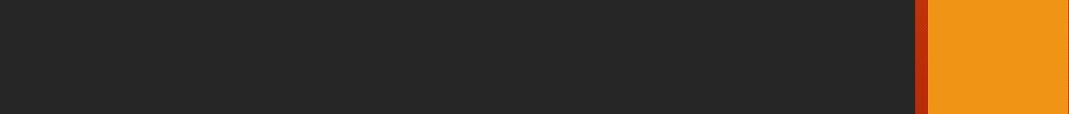
Installation
Purpose?
Code optimization, Do not repeat the code
Component class only responsible to control view’s logic
Share Data across all the component
Service having specific purposes
Share common application level logic, Data Fetch, Sorting, Searching, Pagination
Share Database connection and authentication
Notes:
Notes to presenter:
Description of what you learned in your own words on one side.
Include information about the topic
Details about the topic will also be helpful here.
Tell the story of your learning experience. Just like a story there should always be a beginning, middle and an end.
On the other side, you can add a graphic that provides evidence of what you learned.
Feel free to use more than one slide to reflect upon your process. It also helps to add some video of your process.

Slide 3
Installation
Dependency Injection
DI is a coding pattern in which a class receives its dependencies from external sources rather than creating them itself.
Angular providing them to components as requested. Three Simple Steps to create service and it’s DI:
1. Define Service class
2. Register With Injector
3. Declare as Dependency wherever it used.
Notes:
Notes to presenter:
Description of what you learned in your own words on one side.
Include information about the topic
Details about the topic will also be helpful here.
Tell the story of your learning experience. Just like a story there should always be a beginning, middle and an end.
On the other side, you can add a graphic that provides evidence of what you learned.
Feel free to use more than one slide to reflect upon your process. It also helps to add some video of your process.

Slide 4
Installation
Step
1. Define
> ng generate service <service name>
Create Method, method name should be whatever the service is responsible.
2. Register It can be register in any component but it should be register at the app module because app component is under the app module and it’s a root component of all the components.
> providers:[sevice class name]
Notes:
Notes to presenter:
Description of what you learned in your own words on one side.
Include information about the topic
Details about the topic will also be helpful here.
Tell the story of your learning experience. Just like a story there should always be a beginning, middle and an end.
On the other side, you can add a graphic that provides evidence of what you learned.
Feel free to use more than one slide to reflect upon your process. It also helps to add some video of your process.

Slide 5
Installation
Steps
3. Declare as Dependency wherever it used Rule: Dependency is always specified in the constructor only.
> import the service > constructor(private variablename: ServiceClassname)
Notes:
Notes to presenter:
Description of what you learned in your own words on one side.
Include information about the topic
Details about the topic will also be helpful here.
Tell the story of your learning experience. Just like a story there should always be a beginning, middle and an end.
On the other side, you can add a graphic that provides evidence of what you learned.
Feel free to use more than one slide to reflect upon your process. It also helps to add some video of your process.

