Slide 1

HTTP & Observables
Name Course

Slide 2

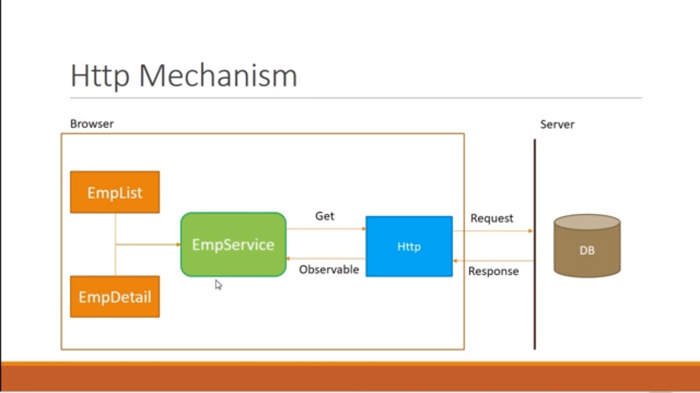
Installation
HTTP Call
Notes:
Notes to presenter:
Description of what you learned in your own words on one side.
Include information about the topic
Details about the topic will also be helpful here.
Tell the story of your learning experience. Just like a story there should always be a beginning, middle and an end.
On the other side, you can add a graphic that provides evidence of what you learned.
Feel free to use more than one slide to reflect upon your process. It also helps to add some video of your process.

Slide 3
Installation
Purpose?
For Fetching data from the web server
Observables provide support for passing messages between parts of your application. They are used frequently in Angular and are the recommended technique for event handling, asynchronous programming, and handling multiple values.
It is not executed until a consumer subscribes to it
An observable can deliver multiple values of any type
Observables are used extensively within Angular
Npm install rxjs (Reactive extension to work with obserables)
Observables helps you manage asynchronous data.
Observables are more advanced than Promises.
Notes:
Notes to presenter:
Description of what you learned in your own words on one side.
Include information about the topic
Details about the topic will also be helpful here.
Tell the story of your learning experience. Just like a story there should always be a beginning, middle and an end.
On the other side, you can add a graphic that provides evidence of what you learned.
Feel free to use more than one slide to reflect upon your process. It also helps to add some video of your process.

Slide 4
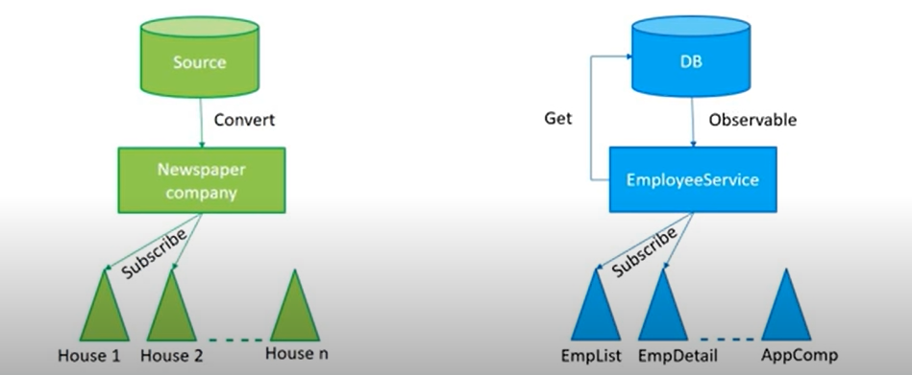
Installation
What is Observables exactly?
It’s a sequence of items that arrive asynchronously over time
An Observable is nothing but HTTP Response that arrives asynchronously
As a HTTP Response we get back an obserable
Obserable cann’t readily use in our application we need to convert it as per our data-type requirement though it’s not compulsory we can write any[] with observable if type is unknown.
Notes:
Notes to presenter:
Description of what you learned in your own words on one side.
Include information about the topic
Details about the topic will also be helpful here.
Tell the story of your learning experience. Just like a story there should always be a beginning, middle and an end.
On the other side, you can add a graphic that provides evidence of what you learned.
Feel free to use more than one slide to reflect upon your process. It also helps to add some video of your process.

Slide 5
Installation
Steps
HTTP Get Request from service - HttpClientModule import in app.module and in import array. - import { HttpClient } from @angular/common/http; in service. - Define in constructor - create get method and pass URL.
Receive an observable and cast it as per our data type. - getEmployees() : Observable<EmployeeType[]> - return this.http.get<EmployeeType[]>(this.url) - create datatype: export interface EmployeeType { } - import { Observable } from 'rxjs';
Subscribe to the observable wherever it needed.
Assign it to local variable
Notes:
Notes to presenter:
Description of what you learned in your own words on one side.
Include information about the topic
Details about the topic will also be helpful here.
Tell the story of your learning experience. Just like a story there should always be a beginning, middle and an end.
On the other side, you can add a graphic that provides evidence of what you learned.
Feel free to use more than one slide to reflect upon your process. It also helps to add some video of your process.

Slide 6
Installation
Error Handling
Using Pipe method catch the exception -> .pipe(catchError(this.httpCallErrorHandling) -> import { catchError } from 'rxjs/operators’;
Create custom method for error Handling That method must have HttpErrorResponse as a parameter -> httpCallErrorHandling(error: HttpErrorResponse) -> import { HttpErrorResponse } from '@angular/common/http’;
Throw the error using throwError method -> return throwError(error.message); -> import { throwError } from 'rxjs';
Notes:
Notes to presenter:
Description of what you learned in your own words on one side.
Include information about the topic
Details about the topic will also be helpful here.
Tell the story of your learning experience. Just like a story there should always be a beginning, middle and an end.
On the other side, you can add a graphic that provides evidence of what you learned.
Feel free to use more than one slide to reflect upon your process. It also helps to add some video of your process.

