Slide 1

Routing
Name Course

Slide 2

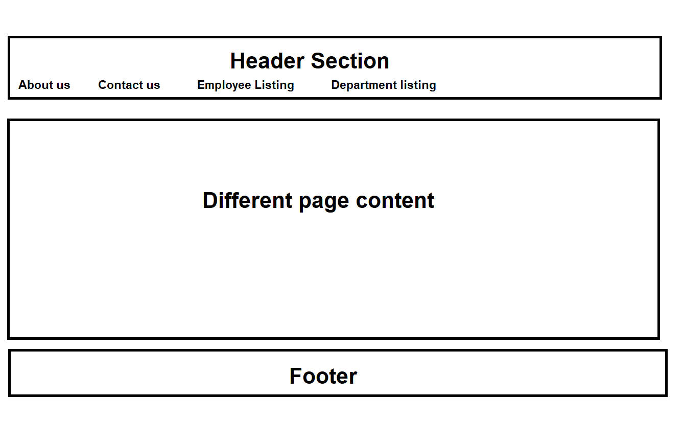
Installation
Purpose?
Notes:
Notes to presenter:
Description of what you learned in your own words on one side.
Include information about the topic
Details about the topic will also be helpful here.
Tell the story of your learning experience. Just like a story there should always be a beginning, middle and an end.
On the other side, you can add a graphic that provides evidence of what you learned.
Feel free to use more than one slide to reflect upon your process. It also helps to add some video of your process.

Slide 3
Installation
Creating Routing
Two way for creating Routing 1. When creating new project. 2. Adding routing file at the later stage. - <base href=“/”> in index file required - create our custom routing file and import required classes for routing work. - import your custom routing file in the app.module - declare it in the import array. <router-outlet> is required for displaying the component which navigated through route.
Notes:
Notes to presenter:
Description of what you learned in your own words on one side.
Include information about the topic
Details about the topic will also be helpful here.
Tell the story of your learning experience. Just like a story there should always be a beginning, middle and an end.
On the other side, you can add a graphic that provides evidence of what you learned.
Feel free to use more than one slide to reflect upon your process. It also helps to add some video of your process.

Slide 4
Installation
Points to remember
<router-outlet> directive is used to display views for a given route
<base href=“/”> in index file
app-routing.module file will have all the route information
Import that file into app.module file in imports []
Configure the route in app-routing.module file in routes[] { path: ’urlpath’, component: <componentname> }
Make sure to import all the component before declare it in routes[]
Always use routerLink directive instead of href for giving links.
Notes:
Notes to presenter:
Description of what you learned in your own words on one side.
Include information about the topic
Details about the topic will also be helpful here.
Tell the story of your learning experience. Just like a story there should always be a beginning, middle and an end.
On the other side, you can add a graphic that provides evidence of what you learned.
Feel free to use more than one slide to reflect upon your process. It also helps to add some video of your process.

Slide 5
Installation
Features
routerLinkActive routerLinkActive=“<css class name>”
ie: <a routerLink="employeedetails" routerLinkActive="activelink">
Wildcard route { path:'**', component: PageNotFoundComponent} always should be last route.
Notes:
Notes to presenter:
Description of what you learned in your own words on one side.
Include information about the topic
Details about the topic will also be helpful here.
Tell the story of your learning experience. Just like a story there should always be a beginning, middle and an end.
On the other side, you can add a graphic that provides evidence of what you learned.
Feel free to use more than one slide to reflect upon your process. It also helps to add some video of your process.

Slide 6
Installation
Features
Redirecting to default route
- using component { path:'', component: EmployeeListingHttpComponent }, - using redirectTo { path:'', redirectTo: '/employeelisting', pathMatch:'full’ },
Need to mension another property when using redirectTo which is, pathMatch: full
Notes:
Notes to presenter:
Description of what you learned in your own words on one side.
Include information about the topic
Details about the topic will also be helpful here.
Tell the story of your learning experience. Just like a story there should always be a beginning, middle and an end.
On the other side, you can add a graphic that provides evidence of what you learned.
Feel free to use more than one slide to reflect upon your process. It also helps to add some video of your process.

Slide 7
Installation
Route Parameter Steps
Create Parameterize route in route file: { path:'singleempdetails/:id', component: SingleEmployeeDetailsComponent },
Pass parameter - import { Router } from '@angular/router’; - Create local variable in constructor - Call it like: this.router.navigate(['/singleempdetails', id])
Fetch the parameter
- import { ActivatedRoute } from '@angular/router’;
- Construct in the local variable
- this.employeeid = parseInt(this.activatedroute.snapshot.paramMap.get('id'));
Notes:
Notes to presenter:
Description of what you learned in your own words on one side.
Include information about the topic
Details about the topic will also be helpful here.
Tell the story of your learning experience. Just like a story there should always be a beginning, middle and an end.
On the other side, you can add a graphic that provides evidence of what you learned.
Feel free to use more than one slide to reflect upon your process. It also helps to add some video of your process.

Slide 8
Installation
ParamMap
Angular decides about initialize a new component or re-use it If initialization not happened ngOnInit method will not call So updated paramater will not get. ParamMap is an api provides us the get method and gives us the updated parameter once URL changes Two Steps: import { ParamMap } from '@angular/router'; this.activatedroute.paramMap.subscribe((params: ParamMap) => {
this.employeeid = parseInt(params.get('id'));
});
Notes:
Notes to presenter:
Description of what you learned in your own words on one side.
Include information about the topic
Details about the topic will also be helpful here.
Tell the story of your learning experience. Just like a story there should always be a beginning, middle and an end.
On the other side, you can add a graphic that provides evidence of what you learned.
Feel free to use more than one slide to reflect upon your process. It also helps to add some video of your process.

Slide 9
Installation
relativeTo
Example: this.router.navigate([id],{relativeTo: this.activatedRoute});
this.router.navigate(['../', this.employeeid - 1],{relativeTo: this.activatedroute});
Child Route
{ path:'employeedetails', component: EmployeeDetailsUsingHttpComponent, children: [ { path: 'aboutemployee', component: AboutUsComponent} ] }, In the parent component HTML file: <router-outlet></router-outlet>
Notes:
Notes to presenter:
Description of what you learned in your own words on one side.
Include information about the topic
Details about the topic will also be helpful here.
Tell the story of your learning experience. Just like a story there should always be a beginning, middle and an end.
On the other side, you can add a graphic that provides evidence of what you learned.
Feel free to use more than one slide to reflect upon your process. It also helps to add some video of your process.

Slide 10
Installation
Use of canActivate
Three steps - Use property canActivate in the route array canActivate:[guard class name]
- Create one authentication guard file ng g guard <guard name>
- Return true/false from the route guard.
canActivate(): boolean {
return false;
}
Notes:
Notes to presenter:
Description of what you learned in your own words on one side.
Include information about the topic
Details about the topic will also be helpful here.
Tell the story of your learning experience. Just like a story there should always be a beginning, middle and an end.
On the other side, you can add a graphic that provides evidence of what you learned.
Feel free to use more than one slide to reflect upon your process. It also helps to add some video of your process.

