Slide 1

Animation
Name Course

Slide 2

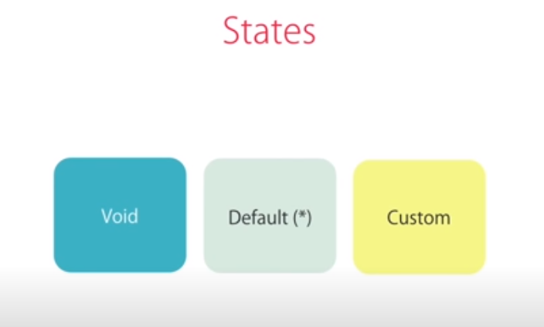
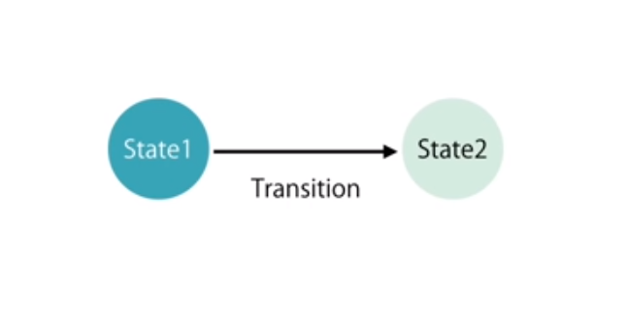
Installation
Steps
@angular/animations available
Every Animation has three states mainly
While traversing from one state two other Transition happens and we can use animation there.
Notes:
Notes to presenter:
Description of what you learned in your own words on one side.
Include information about the topic
Details about the topic will also be helpful here.
Tell the story of your learning experience. Just like a story there should always be a beginning, middle and an end.
On the other side, you can add a graphic that provides evidence of what you learned.
Feel free to use more than one slide to reflect upon your process. It also helps to add some video of your process.

Slide 3
Installation
Void State and Default state
Void Happens when - If Element is added in the DOM: Void null state to current state
Default Happens when - Removed from the DOM: Current state to void null state
void => * * => void
Notes:
Notes to presenter:
Description of what you learned in your own words on one side.
Include information about the topic
Details about the topic will also be helpful here.
Tell the story of your learning experience. Just like a story there should always be a beginning, middle and an end.
On the other side, you can add a graphic that provides evidence of what you learned.
Feel free to use more than one slide to reflect upon your process. It also helps to add some video of your process.

Slide 4
Installation
Steps
Import BrowserAnimation import { BrowserAnimationsModule } from '@angular/platform-browser/animations';
polyfills.js : for Older browser support Uncomment import 'web-animations-js'; line.
npm install --save web-animations-js
import { trigger, state, style, animate, transition, } from '@angular/animations’; In the component
Declare animations property in the component.
Declare the animation name with the element <div @animationname>
Notes:
Notes to presenter:
Description of what you learned in your own words on one side.
Include information about the topic
Details about the topic will also be helpful here.
Tell the story of your learning experience. Just like a story there should always be a beginning, middle and an end.
On the other side, you can add a graphic that provides evidence of what you learned.
Feel free to use more than one slide to reflect upon your process. It also helps to add some video of your process.

Slide 5
Installation
Steps
Example: trigger('fadeeffect', [
transition('void => *', [
style({ opacity:0, backgroundColor:”yellow” }),
animate(2000)
]),
transition('* => void', [
style({ opacity:1 }),
])
])]
Use it like:
<html-element @fadeeffect></html-element>
- Default to void step is optional
Notes:
Notes to presenter:
Description of what you learned in your own words on one side.
Include information about the topic
Details about the topic will also be helpful here.
Tell the story of your learning experience. Just like a story there should always be a beginning, middle and an end.
On the other side, you can add a graphic that provides evidence of what you learned.
Feel free to use more than one slide to reflect upon your process. It also helps to add some video of your process.

