Slide 1

Air Quality Analysis Group-9
Presenters
Anuja Sawant
Shravani Vakkantula
Venkata Mani Babu Karri
Noah Holliday

Slide 2
Agenda
Introduction
Data preprocessing
Handling NaN values
Feature selection
Class Resampling
Methods
Multinomial Logistic Regression
Ridge Regression
Random Forest
Support Vector Machine
Results
Conclusion & Future Work

Slide 3
Introduction
Air quality is a critical aspect of public health and the environment.
In recent years, the issue of air pollution has become a major concern.
Adverse effects of air pollution on human health and the environment are well documented.
Our study aims to investigate machine learning based technique for air quality prediction
Data Set Details
Records: 29,532
Columns: 16
Attributes: City, Date, PM2.5, PM10, NO, NO2, NOx, NH3, CO, SO2, O3, Benzene, Toluene, Xylene, AQI, AQI_Bucket

Slide 4
Background
Referenced Literature
Prediction of Air Quality Index Using Machine Learning Techniques: A Comparative Analysis. Journal of Environmental and Public Health.
Air quality index prediction using K-nearest neighbor technique. Bulletin of PG University of Ploiesti, Series Mathematics, Informatics, Physics, LXII.
Air quality index-A comparative study for assessing the status of air quality. Research Journal of Engineering and Technology.

Slide 5
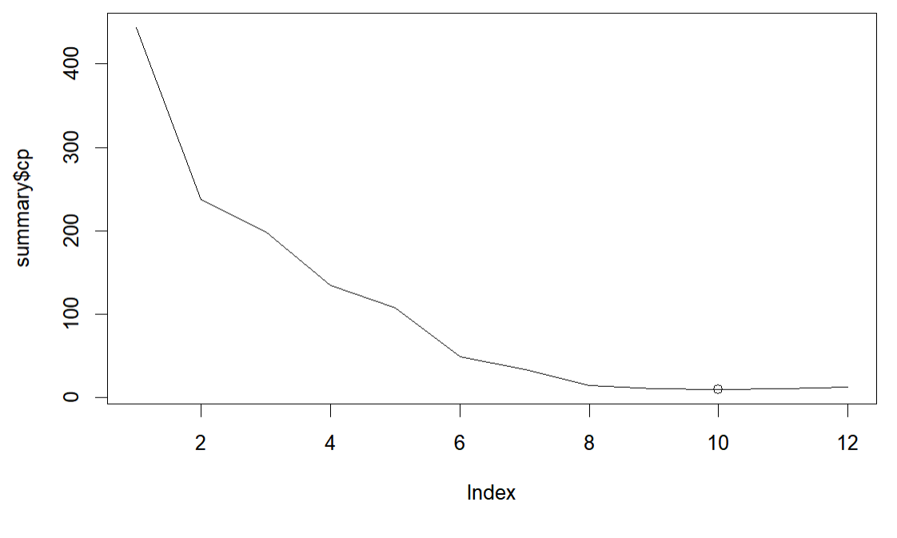
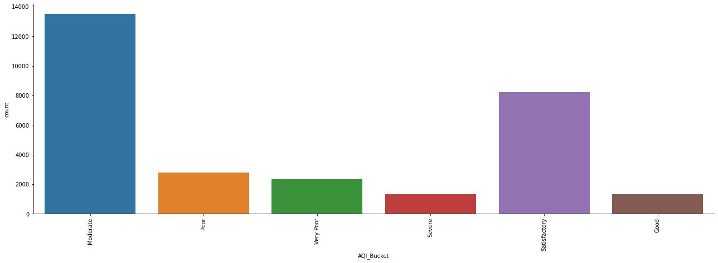
Data Preprocessing
Handling NaN values
Fill nan values
Features Replaced with median
Class Replace with Moderate
Feature selection
Regsubsets approach to minimize the CP value'
Removed PM2.5 and Benzene
Notes:
Data preprocessing is a crucial step in any data analysis project. It involves cleaning, transforming, and preparing the data for analysis. The quality of the analysis heavily depends on the quality of the data, and therefore, data preprocessing is essential to ensure that the data is accurate, consistent, and complete.

Slide 6
Methods:
Four models were produced for Prediction
Multinomial Logistic Regression
Ridge Regression
Random Forest
Support Vector Machines

Slide 7
Multinomial Logistic Regression
The first method we used to predict the AQI_Bucket class is Multinomial Logistic Regression.
Multinomial Logistic Regression is an extended version of Logistic Regression used when we have more than two classes.
It returns probability score for each class and returns the class the with highest probability as output.
Cross Validation is applied using trainControl() function and the best value of decay is identied.
Two models have been tested on the data. For Model one the most relevant predictor variables are used and for model all the predictor variables are used.
Model 2 outperformed Model 1 in overall performance. Model 1 Accuracy: 64.40% and Model 2 Accuracy: 74.75

Slide 8
Ridge Regression
Hyperparameter tuning
lambda Values Ranging from 1.25 to 100 (equation: 10^seq(2, -2, by = -.1))
Cross Validation was applied on model with finalized Hyperparameters
Model 1 is performed using all predictor variables resulting in 67% accuracy
Model 2 is performed using relevant predictor variables resulting in around 61% accuracy.

Slide 9

Random Forest
Tunning of Hyperparameters
Ntree Values Ranging from 50 to 500 with incremental steps of 50
Mtry Values Ranging from 2 to 10 with incremental steps of 2
Cross Validation was applied on model with finalized Hyperparameters
Was achieved through the train() function from the caret package
The Random Forest made its prediction through majority vote.
Two models were created
One Containing All Parameters, 81.5% accuracy
One Containing the Statistically Significant Parameters to minimize the CP Value, 76.59% accuracy

Slide 10
Support Vector Machine
Hyperparameter tuning
Hyperparameters were trained using grid search with caret package
Best C value – 0.1
Best Gamma value - 1
Experiment-1 was performed using all the predictor variables resulting in 78.36% accuracy
Experiment-2 was performed using relevant predictor variables resulting in 72.38% accuracy
Experiment-3 was performed using relevant predictor variables with kfolds resulting in average 72.05% accuracy
Notes:
The SVM hyperparameters were tuned using grid search with the caret package in R.
The best combination of hyperparameters was found to be a cost value of 0.1 and a gamma value of 1.
The performance of the SVM model was evaluated using various metrics, such as accuracy, precision, recall, and F1 score.
Using SVM we carried out 3 experiment
Exp-1
The SVM model was tuned using two functions, svm_accuracy_ntree() and svm_accuracy_mtry().
The SVM model predicted the AQI bucket with an overall accuracy of 78.36%.
Exp-2
Only the relevant predictor variables identified by feature selection techniques were considered, and 'PM2.5' and 'Benzen' variables were excluded from the model.
The resulting model exhibited an accuracy of 72.38%, which was lower compared to experiment-1.
Exp-3
K-fold cross-validation on the same dataset.
The SVM model with a radial kernel achieved a mean accuracy of 72.05% in predicting AQI categories based on pollutant measurements

Slide 11
Results
Models Most Statistically Relevant Predictor Variables
Models With All Predictor Variables
Model Type | F1 Score [Good, Satisfactory, Moderate, Poor, Very Poor, Severe] | Accuracy
Multinomial Logistic Regression | [0.64606, 0.7530, 0.7337, 0.53996, 0.61426, 0.74918] | 0.644
Ridge Regression | [NA, 0.5942, 0.7311,0.0588,0.31805,0.58841] | 0.6152
Random Forest | [0.75170, 0.68079, 0.7916, 0.8243, 0.48989, 0.62968] | 0.7659
SVM | [0.7564, 0.7904, 0.45770, 0.53366, 0.59852, 0.61152] | 0.7239
Model Type | F1 Score [Good, Satisfactory, Moderate, Poor, Very Poor, Severe] | Accuracy
Multinomial Logistic Regression | [0.67831, 0.8152, 0.8291, 0.68477, 0.82943, 0.82703] | 0.7475
Ridge Regression | [NA, 0.6462, 0.7733, 0.1747, 0.65188, 0.66667] | 0.6757
Random Forest | [0.69919, 0.8628, 0.8221, 0.63544, 0.76263, 0.83985] | 0.815
SVM | [0.61997, 0.8006, 0.8393, 0.61570, 0.70286, 0.66281] | 0.7836

Slide 12
Conclusion & Future Work
In this analysis, we have demonstrated that while the model performance achieved was modest, it is feasible to train prediction models to report on air quality
Class resampling could be applied to handle the imbalance class
Removing outliers that had extreme amounts of particulates
Approach to handle null values could be revised to a Bayesian Replacement Approach

Slide 13
References
Nigam, S., & Kumar, N. (2016, May). Air Quality index – a comparative study for assessing the status of air quality Researchgate. Retrieved May 6, 2023, from https://www.researchgate.net/profile/Navneet-Kumar-18/publication/292643438_Air_Quality_Index_-_A_Comparative_Study_for_Assessing_the_Status_of_Air_Quality/links/56b092c708ae9c1968b774c8/Air-Quality-Index-A-Comparative-Study-for-Assessing-the-Status-of-Air-Quality.pdf
Dragomir, E. G. (n.d.). Air Quality index prediction using K-nearest neighbor technique - unde.ro. Retrieved May 6, 2023, from http://bmif.unde.ro/docs/20101/pdf_final_12%20EDragomir.pdf
Gupta, N. S., Mohta, Y., Heda, K., Armaan, R., Valarmathi, B., & Arulkumaran, G. (2023, January 30). Prediction of air quality index using Machine Learning Techniques: A Comparative Analysis. Journal of Environmental and Public Health. Retrieved May 6, 2023, from https://doi.org/10.1155/2023/4916267
Tripathi, T. (2022, May 25). Final notebook data analytics internship. Retrieved May 6, 2023, from https://www.kaggle.com/code/tishyatripathi/final-notebook-data-analytics-internship/input
Holllla. (2023, March 14). Air Quality index prediction using MLR. Kaggle. Retrieved May 6, 2023, from https://www.kaggle.com/code/holllla/air-quality-index-prediction-using-mlr/notebook
Jean-Yves Sgro, P. D., & Kristen Malecki, P. D. (2022, July 7). Chapter 5 working with tabular data in R: Tabular Data Analysis with R and Tidyverse: Environmental Health. Retrieved May 6, 2023, from https://static-bcrf.biochem.wisc.edu/courses/Tabular-data-analysis-with-R-and-Tidyverse/book/5-workingwithtabulardata.html
Yeon, J., & Wilber, J. (n.d.). Random Forest. Retrieved May 6, 2023, from https://mlu-explain.github.io/random-forest/

Slide 14
Thank You
Group-9

