Slide 1
Digital portfolio
Student Name :B. Manibharathi
Register No And NmId:astvu20520524u18019
Department :B. Sc. Computer science
College :Indo-american college, cheyyar.
University :Thiruvalluvar university

Slide 2
Project Title :
Digital portfolio Website

Slide 3
Agenda:
1.Problem Statement
2.Project Overview
3.End Users
4.Tools and Technologies
5.Portfolio design and Layout
6.Features and Functionality
7.Results and Screenshots
8.Conclusion
9.Github Link

Slide 4
Problem statement :
In today’s digital world, individuals need a professional online presence to showcase their skills, achievements, and projects. Traditional resumes are often limited in presenting creativity and interactivity.

Slide 5
Project overview :
This project is a personal portfolio website designed to showcase an individual’s skills, background, and projects in a professional and interactive way. The website is structured into four main sections — Home, About, Projects, and Contact — to provide visitors with a complete understanding of the developer’s profile.

Slide 6
End users:
Recuiters
Professor’s
Clients
Network people
The owner of the portfolio
(used to organize thier achievement properly)

Slide 7
Tools And Techniques:
1. HTML5 – For structuring the content of the website. 2. CSS3 – For styling, layout, responsive design, and animations. 3. JavaScript – For interactivity (navbar highlighting, fade-in effects, smooth scrolling). 4. Text Editor / IDE – (e.g., VS Code, Sublime Text, or Notepad++) for writing code. 5. Web Browser – (e.g., Chrome, Edge, Firefox) for testing and running the website.

Slide 8

Potfolio Design And layout :
●Section includes home ,about ,project and contact
●Home menu contains information about me
●About menu containsmy photo and my personal information
●Project my portfolio contains2 Project
(digital portfolio and service based
application)
●Contact it includes name ,email and
message it wasBuilt using Javascript for dynamic Website.

Slide 9
Features And Functionality :
1. Fixed Navigation Bar – Easy movement between sections. 2. Responsive Design – Works well on mobile, tablet, and desktop. 3. Fade-in Animations – Sections appear smoothly while scrolling. 4. Projects Showcase – Big images with hover effects. 5. Contact Form – Users can send messages directly.

Slide 10
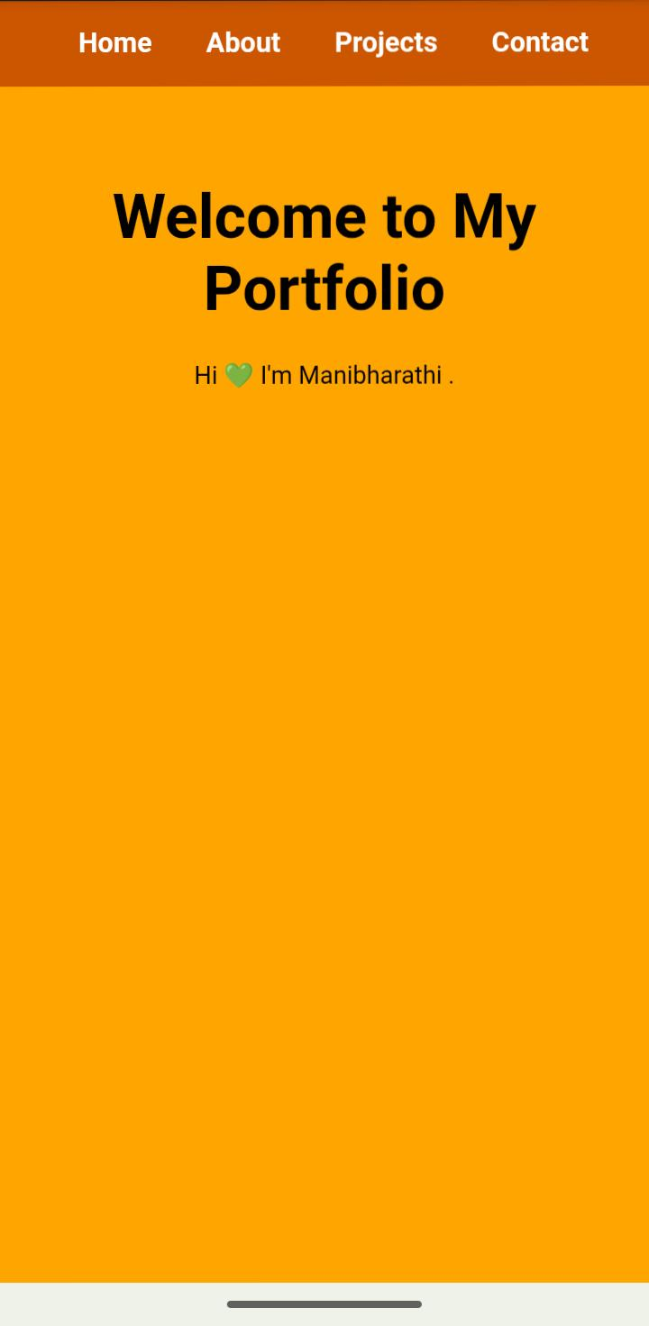
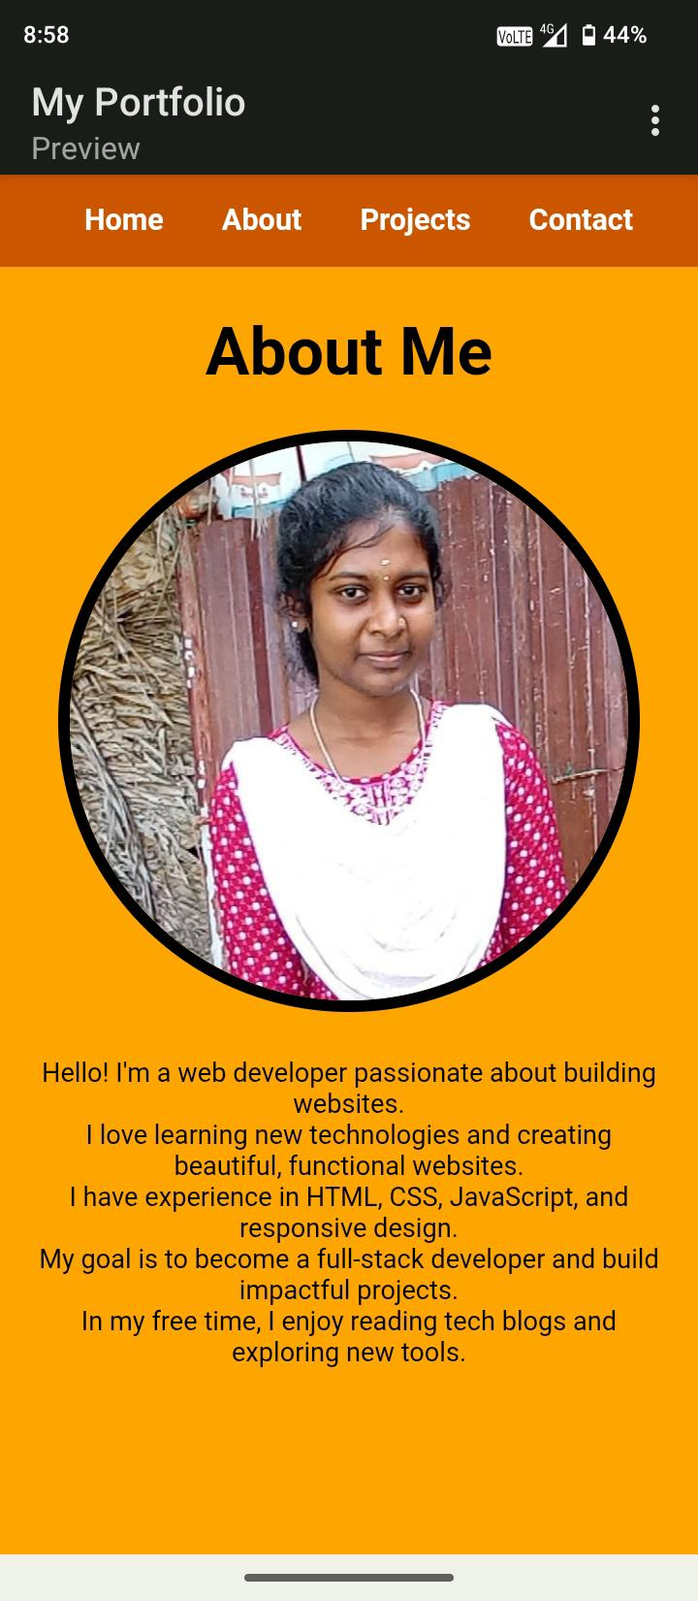
Results And Screenshot :

Slide 11
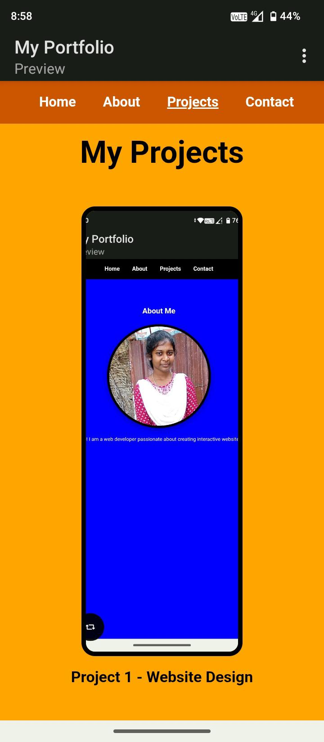
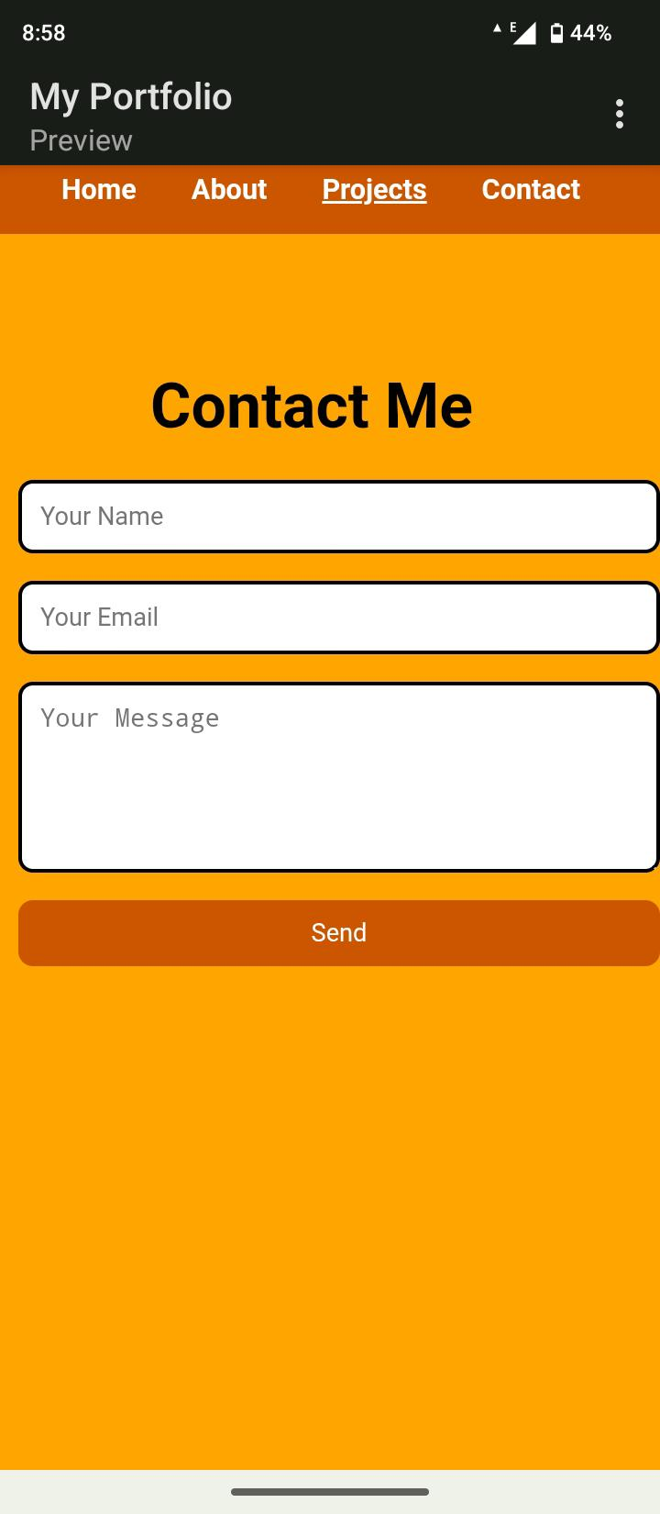
Results And Screenshot :

Slide 12
Conclusion :
●Built using HTML,CSS and Javascript.
●Clean and userfriendly design.
●Responsive layout(Workson mobile phone and desktops)
●Organized section (home,about,projects and contact).
●Acts as an online resume/portfolio.
●Showcases academicPlus technical achie.

