Slide 1
Arunai engineering college
Code: 5104
DEPARTMENT OF INFORMATION TECHNOLOGY

Slide 2
BATCH NO: 02
PRESENTED BY:
T. Akshaya
G.Deepika
S.Mahalakshmi
N.Niruba
Guided by
Mrs.Haripriya

Slide 3
IMAGE RECOGNITION WITH IBM CLOUD VISUAL RECOGNITION
INTRODUCTION
THE PROBLEM
IBM WATSON
HOW IT WORKS
PRICING
CONTEXT
CONCLUSION

Slide 4

INTRODUCTION
IBM Watson Visual recognition is a powerful tool that can enhance image analysis workflow.
This cloud based service uses deep learning algorithms to identify objects, faces and scenes in image.

Slide 5
THE PROBLEM:
We live in a visual world yet capturing useful information from images has historically required human vision which can be slow and costly.

Slide 6
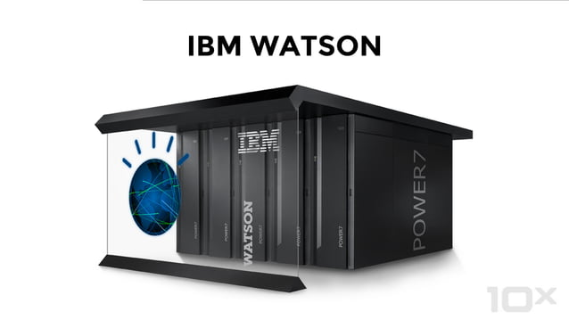

Slide 7
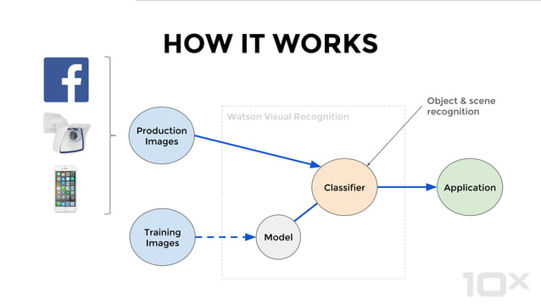

Slide 8


Slide 9


Slide 10
CONCLUSION :
Image recognition technology has transformed the way we process and analyze digital images and videos making it possible to identify objects, diagnose diseases and automate workflows accurately and efficiently.

