Slide 1
AI CHATBOT TO SUGGEST THERAPY TO TREAT MENTAL ILLNESS
SUBMITTED BY
Dinesh Varma A
A22101PIT6187
MSC
Department of INFORMATION TECHNOLOGY
GUIDE
Mr. SivaKumar

Slide 2
AGENDA
Abstract
Existing system
Drawbacks
Proposed system
Advantages
Software requirements
Interface and Constraints
Gantt chart and Hardware requirements & algorithms
Architecture diagram
DFD Diagram
Use-Case Diagram
ER- Diagram
Class Diagram and Sequence Diagram
Modules
Output
Future Enhancement
Conclusion

Slide 3
ABSTRACT
AI Chatbot can be described as software that can chat with people using artificial intelligence . These software are used to perform tasks such as quickly responding to users,and using Cognitive Therapy and positive Psychology techniques to help users manage their mental health.

Slide 4
EXISTING SYSTEM
ETHICAL CONSIDERATIONS: DEVELOPERS ARE PAYING MORE ATTENTION TO ETHICAL CONSIDERATIONS, INCLUDING PRIVACY, DATA SECURITY, AND ENSURING THAT CHATBOTS PROVIDE ACCURATE INFORMATION AND SUPPORT. COMPLIANCE WITH REGULATIONS SUCH AS GDPR AND HIPAA IS ESSENTIAL FOR PROTECTING USERS' CONFIDENTIALITY AND RIGHTS.
PERSONALIZED THERAPY EXPERIENCES: THEY OFFER TAILORED INTERVENTIONS BASED ON USERS INPUT AND FEEDBACK, AIMING TO MIMIC THE SUPPORT PROVIDED BY HUMAN THERAPISTS.GES, AND COMMUNICATION STYLES, LEADING TO POTENTIAL MISUNDERSTANDINGS OR INSENSITIVITY IN THEIR INTERACTIONS WITH USERS FROM DIFFERENT COMMUNITIES.

Slide 5

DRAWBACK
01
02
03
04
Not supported in mobile view
Limited Understanding
Inflexibility and Lack of Adaptability
Technical Issues

Slide 6
PROPOSED SYSTEM
User Interface Design:
Develop an intuitive and user-friendly interface for the chatbot, allowing users Assessment and Screening:
Implement an initial assessment
Module to gather information about the user's mental health history, symptoms, and needs.
Data Privacy and Security:
Prioritize user privacy and data security throughout the chatbot's design and implementation.
Continuous Monitoring and Improvement:
Establish mechanisms for monitoring user interactions, feedback, and outcomes to evaluate the chatbot's effectiveness and user satisfaction . Personalized Support and Interventions:
Utilize :
AI algorithms to provide personalized recommendations and interventions based on the user's assessment results and ongoing interactions.

Slide 7
MERITS
Accessibility
Scalability
Cost-Effective
Continuous Monitoring

Slide 8
SOFTWARE REQUIREMENTS
PYTHON 3.11
HTML
CSS
JAVASCRIPT
FLASK
Gradio

Slide 9
INTERFACES AND CONSTRAINTS
Interfaces:
Text-Based Interfaces
Web-Based Interfaces
Constraints:
limited objective data
clinical decisions or diagnose mental health conditions without human oversight presents a difficult ethical issue.
Limitations of Technology

Slide 10
HARDWARE REQUIREMENTS
Processor : intel core i3 or higher/processor
RAM : 4GB or higher(recommended)
HARD DISK : 50 GB or higher(recommended)

Slide 11
ALGORITHM
Sentiment Analysis:
Natural Language Processing (NLP): To analyze the sentiment of the user's input, helping the chatbot understand the user's emotional state.
Text Classification:
NLP: To categorize user inputs into different types of mental health issues or responses.
Algorithms: Logistic Regression, Decision Trees, Random Forest, or deep learning models.
Response Generation:
Language Models: To generate appropriate responses based on the user's input.
Algorithms: GPT-3 (Generative Pre-trained Transformer 3), which is part of the Gemini API, can be used for this purpose

Slide 12
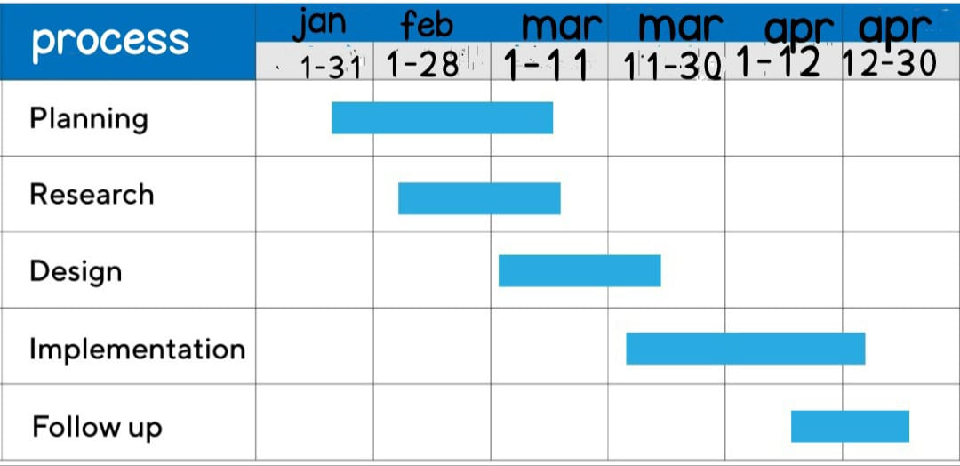
GANTT CHART

Slide 13
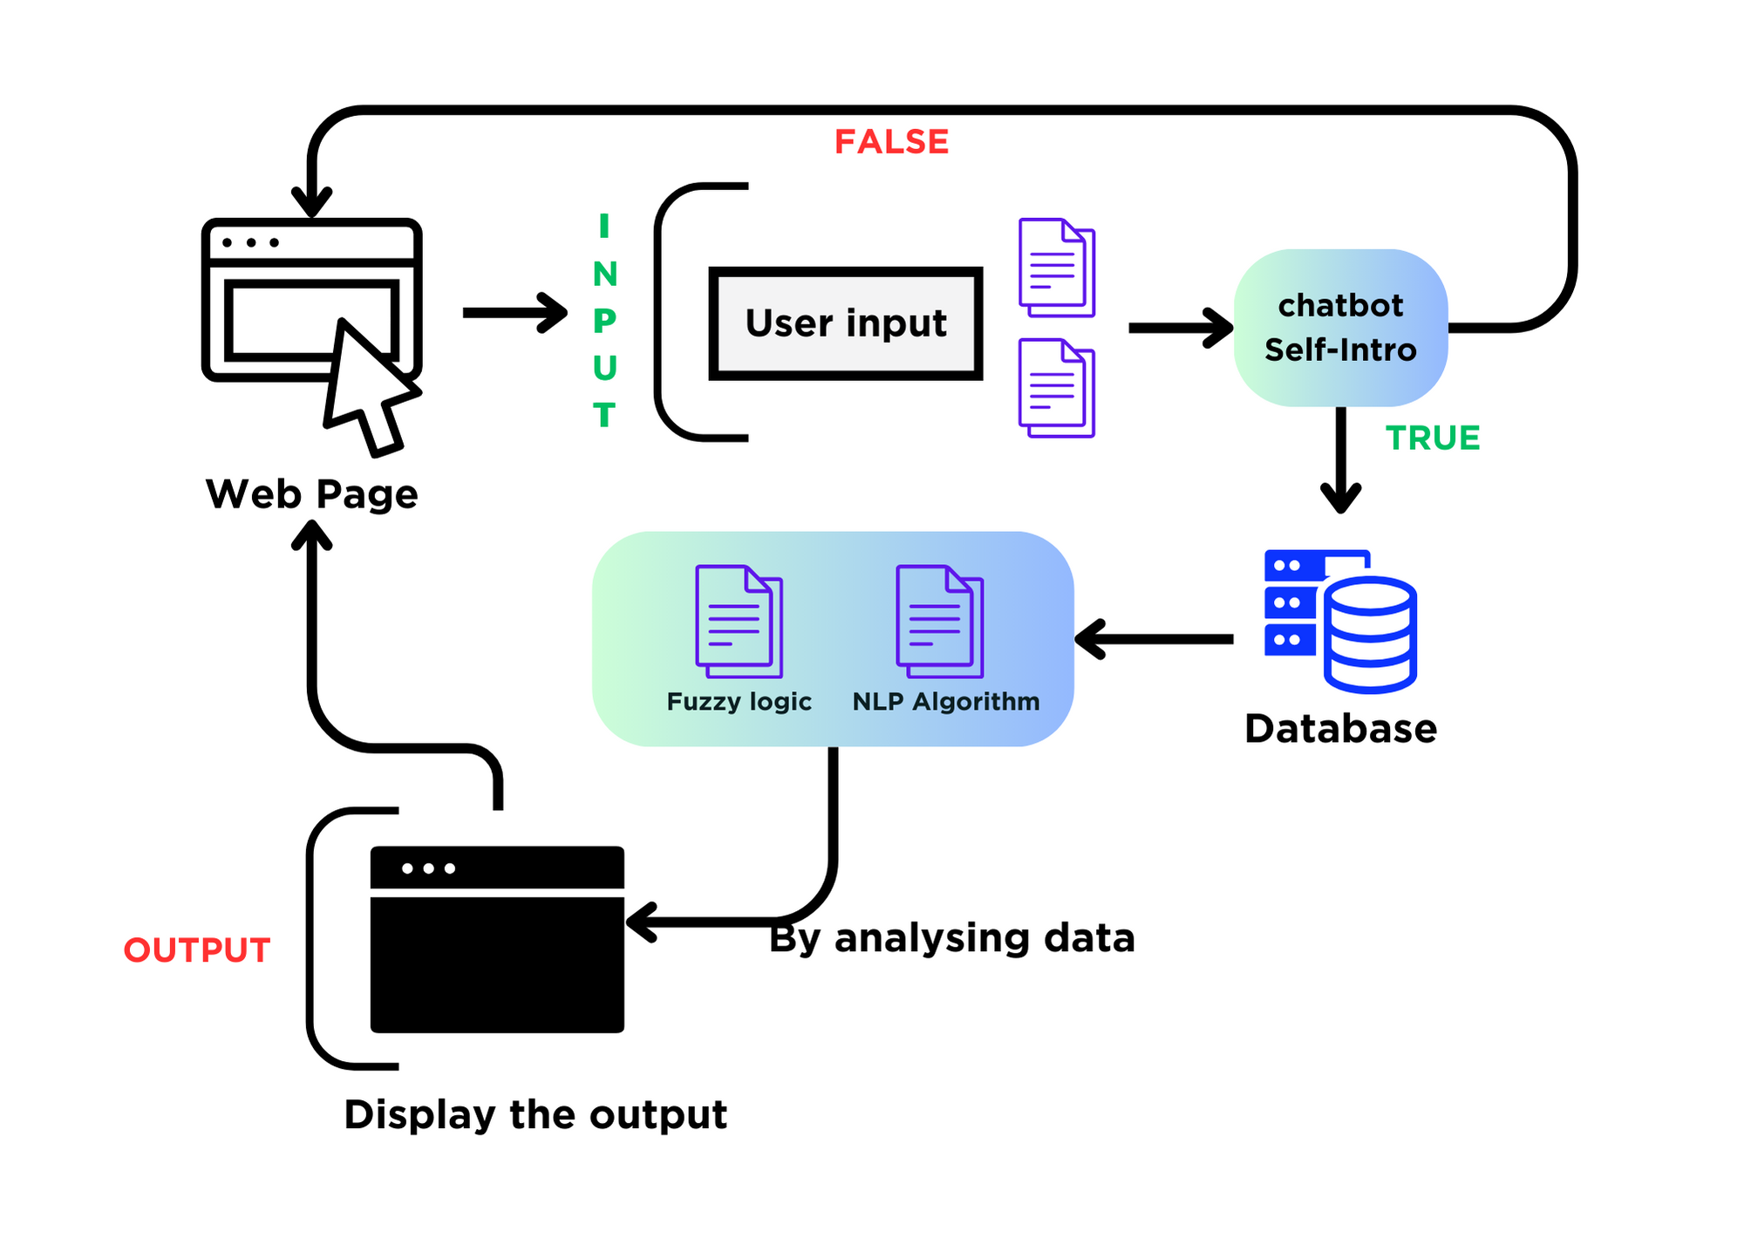
BUSINESS FLOW DIAGRAM

Slide 14
DATA FLOW DIAGRAM

Slide 15
Level 0
Chatbot
User
Chat with text message
Data related to chatbot
Database
Store to database

Slide 16
Level 1
User Input
Chatting with chatbot
Store to database
Fuzzy logic
Pattern matching
NLP Algorithm
By analysing data
Display output

Slide 17





USE CASE DIAGRAM
Open Site
Start chat
Response to
Ask Questions
ADMIN
USER
Close Site

Slide 18





ENTITY RELATIONSHIP DIAGRAM
DL
NLP
USER NAME
EMAIL
AGE
ALGORITHM
GENDER
AI
Diagnosed by
USER
SERVER
PROBLEM SOLVING
SOLUTIONS

Slide 19
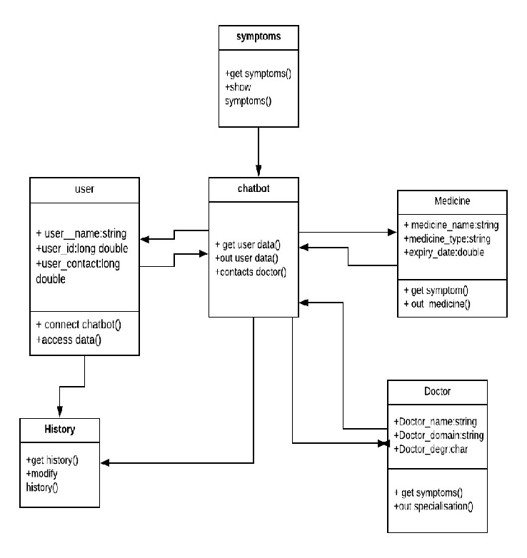
CLASS DIAGRAM

Slide 20
SEQUENCE DIAGRAM
User Interface
Server
NLP
Ask Question
Input
Input
Identifying the issues & giving output
Get Response
Display the results
Output

Slide 21
MODULES
User Interface Module: This module handles user interactions with the chatbot. It includes components for text input/output, voice input/output (if applicable), and user interface design elements to facilitate smooth communication.
Natural Language Processing (NLP) Module: NLP is crucial for understanding and generating human-like responses. This module employs techniques such as intent recognition, entity extraction, sentiment analysis, and context understanding to interpret user messages accurately.
Diagnosis and Assessment Module: This module assesses users mental health status based on their input. It utilizes established assessment tools and protocols to identify symptoms, assess severity, and screen for potential mental health conditions.

Slide 22
Treatment Recommendation Module: Based on the diagnosis and assessment results, this module suggests appropriate treatment strategies and interventions. It may recommend self-help resources, coping techniques, psychoeducation materials, or referral to professional services based on evidence-based guidelines.
Psychoeducation Module: This module provides users with information about mental health conditions, symptoms, treatment options, and coping strategies. It offers educational content tailored to users' needs and preferences to enhance their understanding and self-management skills.
Crisis Intervention Module: In cases of crisis or emergency, this module provides immediate support and assistance. It includes predefined protocols for handling crisis situations, such as suicide risk assessment, de-escalation techniques, and referral to emergency services.

Slide 23
User Profiling and Personalization Module: This module creates and maintains user profiles to capture individual preferences, history, and progress. It personalizes interactions by adapting responses, recommendations, and interventions to each user's unique characteristics and needs.
Privacy and Security Module: Ensuring user privacy and data security is paramount in mental health care. This module implements robust encryption, access controls, and compliance measures to protect sensitive user information and comply with relevant regulations.
Integration and Collaboration Module: This module facilitates integration with external systems and services, such as electronic health records (EHR) systems, telehealth platforms, and crisis hotlines. It enables seamless collaboration with human professionals and other resources to provide comprehensive care.

Slide 24
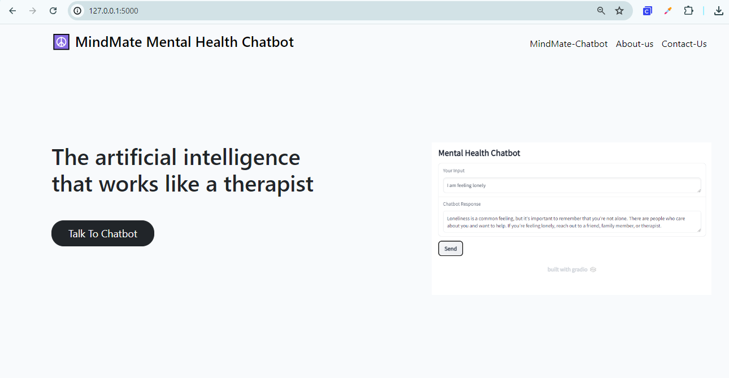
OUTPUT
HOME:

Slide 25
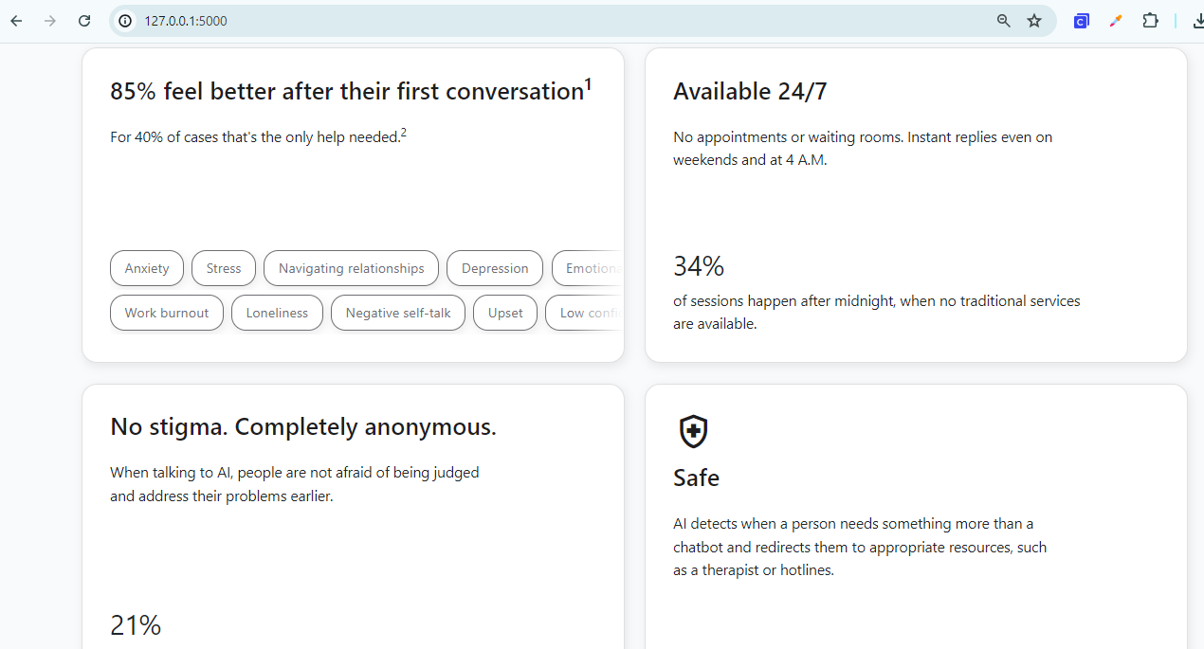

Slide 26
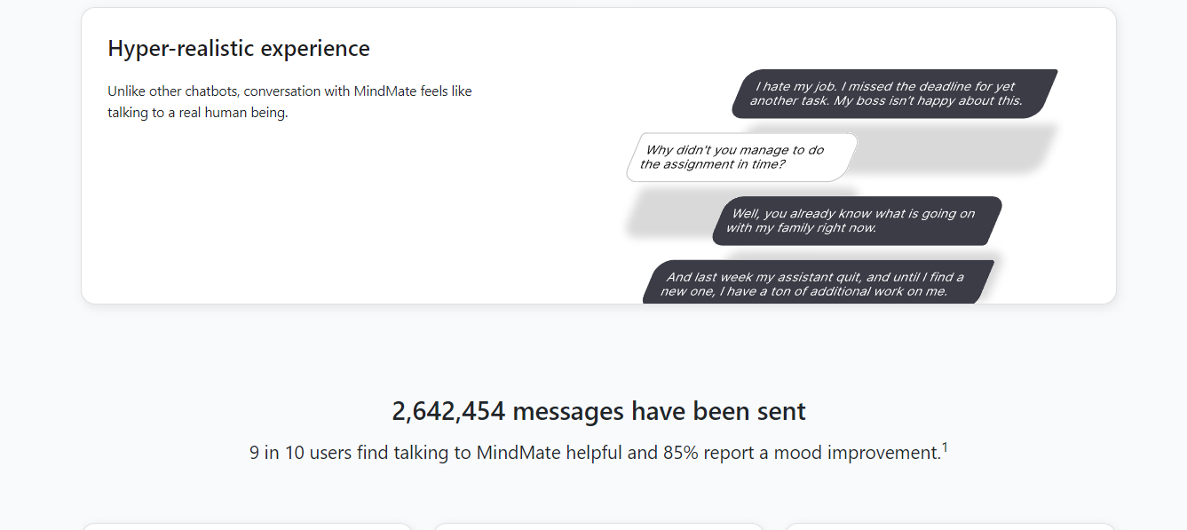

Slide 27
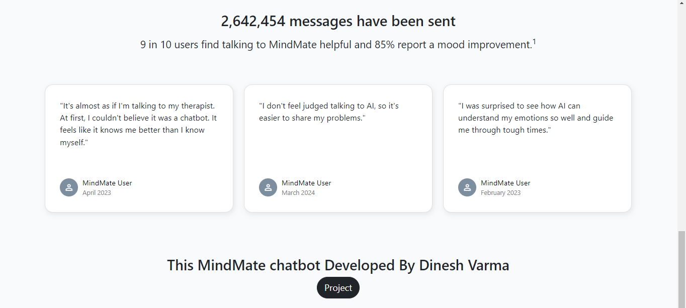

Slide 28


Login Gateway:
Register Gateway

Slide 29
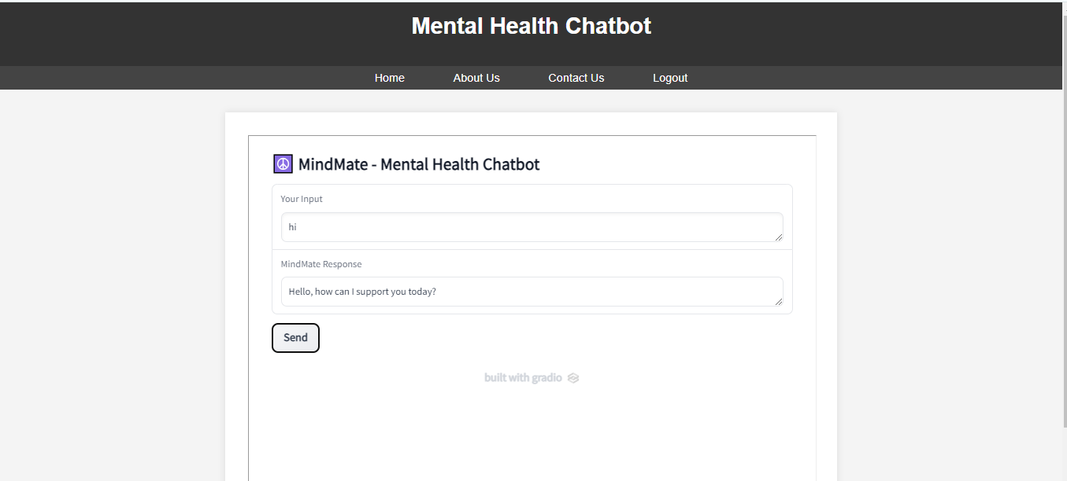
MindMate-mental health chatbot:

Slide 30
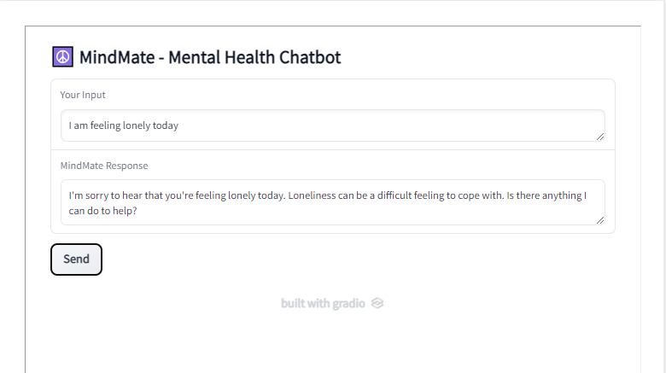

Slide 31
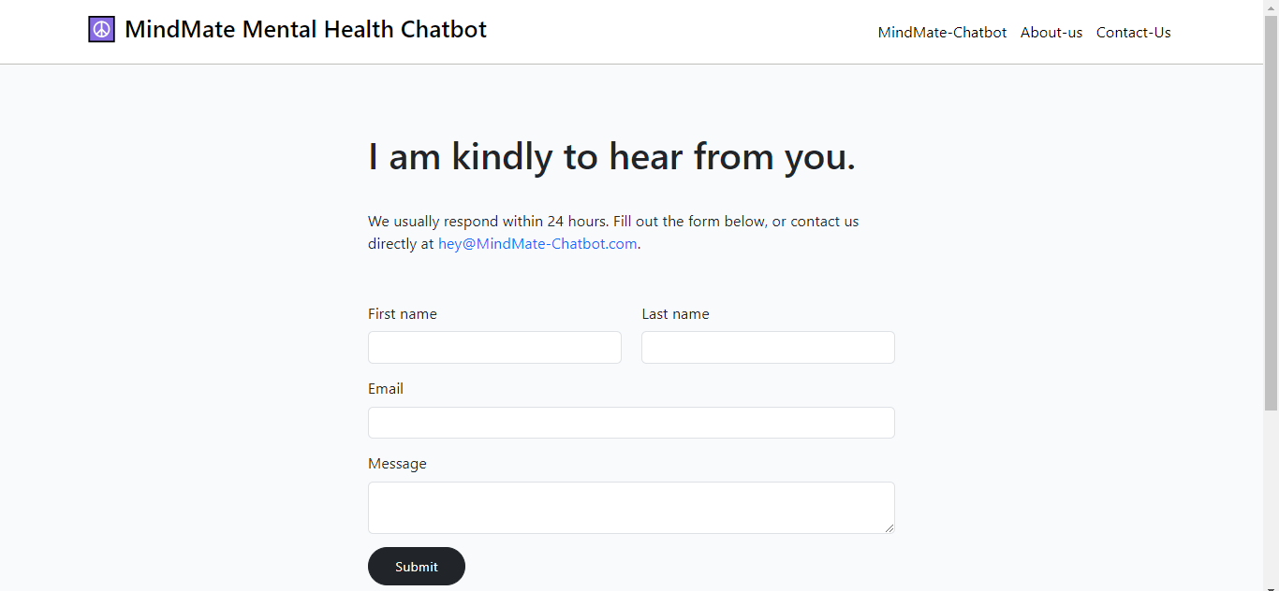
Contact-us

Slide 32
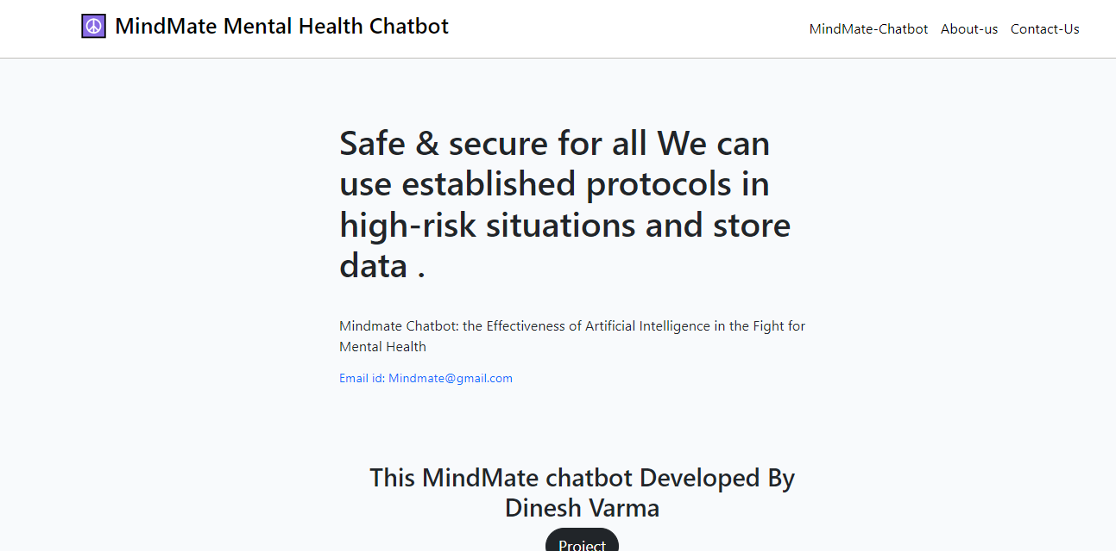
About-us

Slide 33
FUTURE ENHANCEMENT
Advanced Natural Language Processing (NLP)
Emotion Recognition
Personalization
Integration with Wearable Devices
Crisis Intervention
Monitoring and Feedback

Slide 34
CONCLUSION
AI-INFUSED CHATBOTS OFFER PROMISING AVENUES FOR ADDRESSING THE CHALLENGES OF TREATING MENTAL ILLNESS BY PROVIDING ACCESSIBLE, PERSONALIZED, AND SCALABLE SUPPORT TO INDIVIDUALS IN NEED.HOWEVER, IT'S CRUCIAL TO ACKNOWLEDGE THE LIMITATIONS AND ETHICAL CONSIDERATIONS ASSOCIATED WITH AI CHATBOTS FOR MENTAL ILLNESS TREATMENT. WHILE THEY CAN OFFER VALUABLE SUPPORT, THEY ARE NOT A REPLACEMENT FOR PROFESSIONAL DIAGNOSIS OR THERAPY.

