Slide 1
AML - End Term
Spam Filters
Abdulllah Shad - D22001
Manikandan Raja - D22029
Ranjith N - D22042

Slide 2
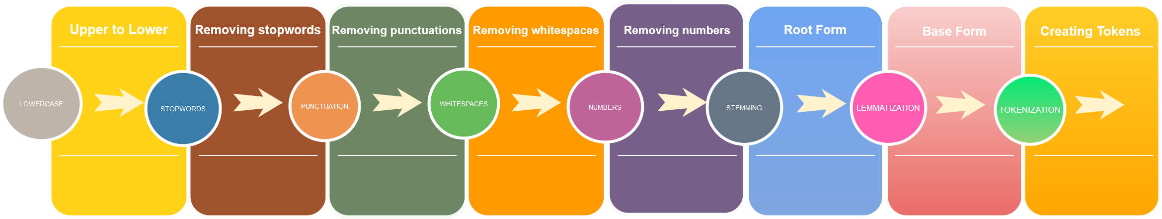
TEXT PRE-PROCESSING PIPELINE

Slide 3

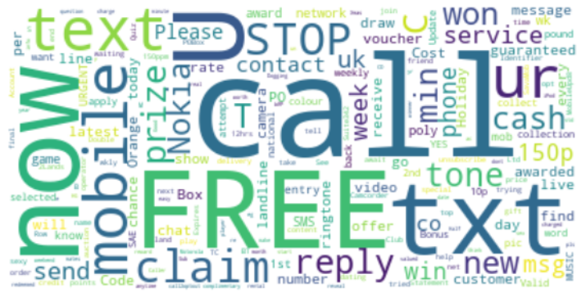
WORD CLOUDS INTERPRETATION
HAM
SPAM
Majority of spam messages contain words like ‘FREE’, ‘CALL’, ‘WON’, ‘CLAIM’ etc, which are commonly seen in real life spam messages.
Majority of ham messages contain normal words used in day to day messages.

Slide 4
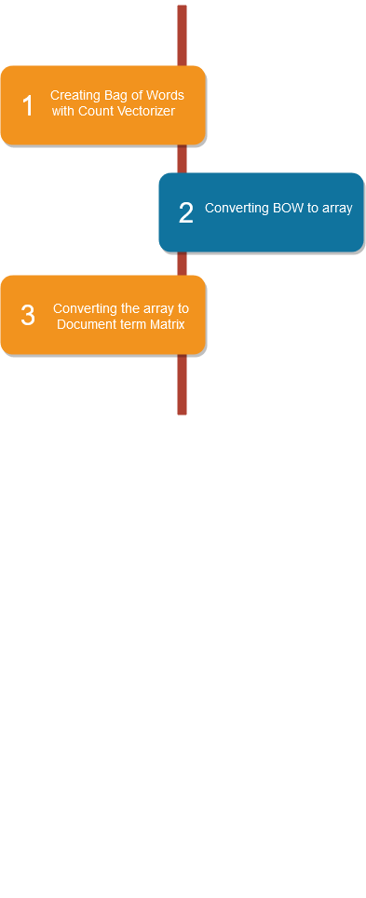
VECTORIZATION PIPELINE
TF

Slide 5
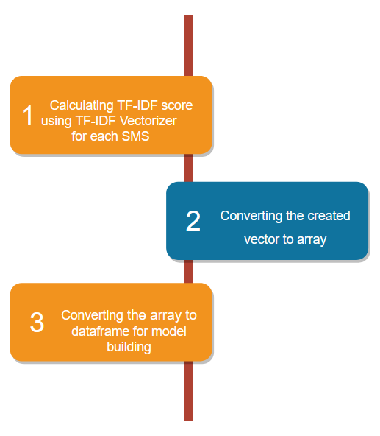
VECTORIZATION PIPELINE
TF-IDF

Slide 6
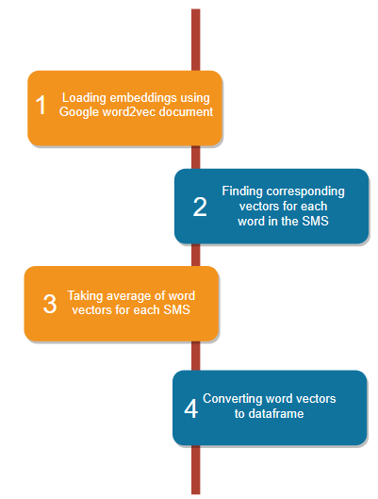
VECTORIZATION PIPELINE
DOC2VEC

Slide 7
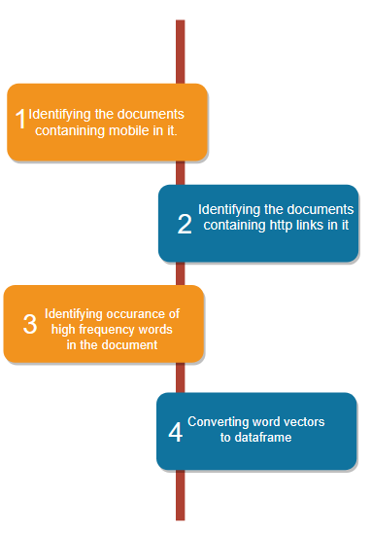
VECTORIZATION PIPELINE
HEURISTIC APPROACH (Occurrence of mobile number, http link and high frequency words)

Slide 8
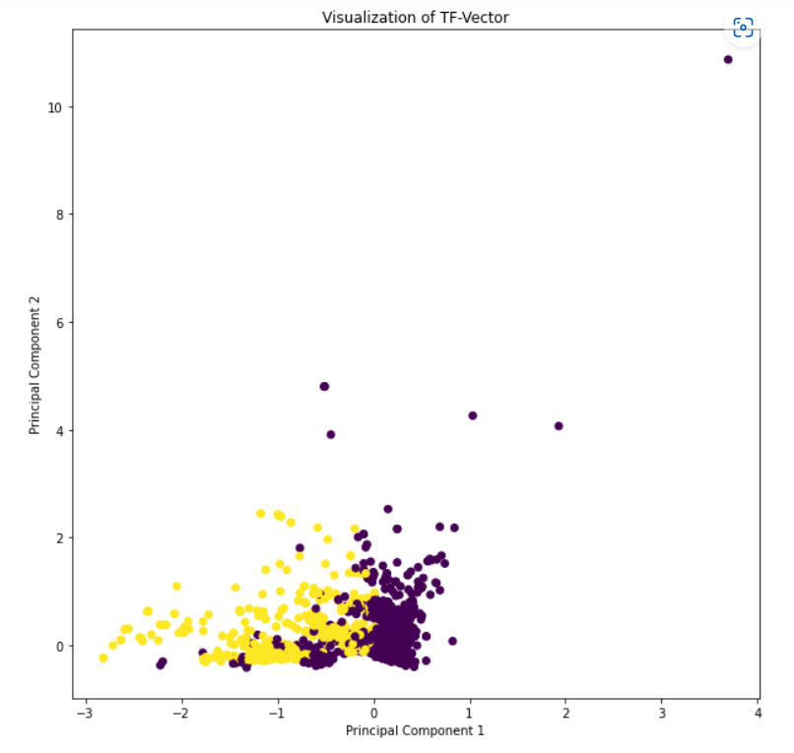
DIMENSION REDUCTION USING PCA
TF VECTOR
Attained 95% variance with 2000 components using PCA

Slide 9
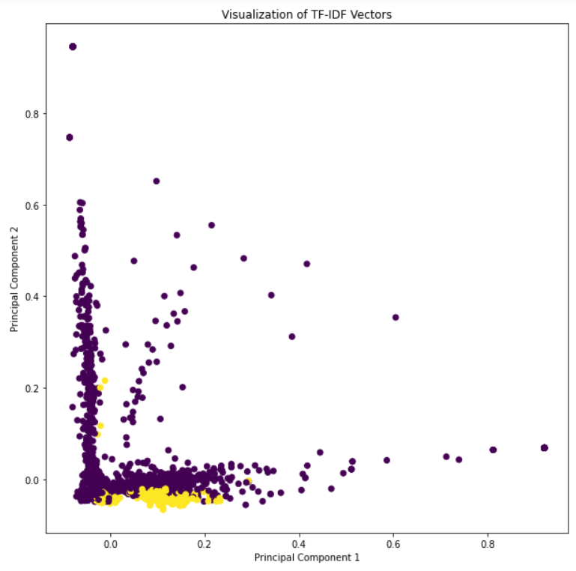
DIMENSION REDUCTION USING PCA
TF-IDF VECTOR
Attained 95% variance with 2800 components using PCA

Slide 10
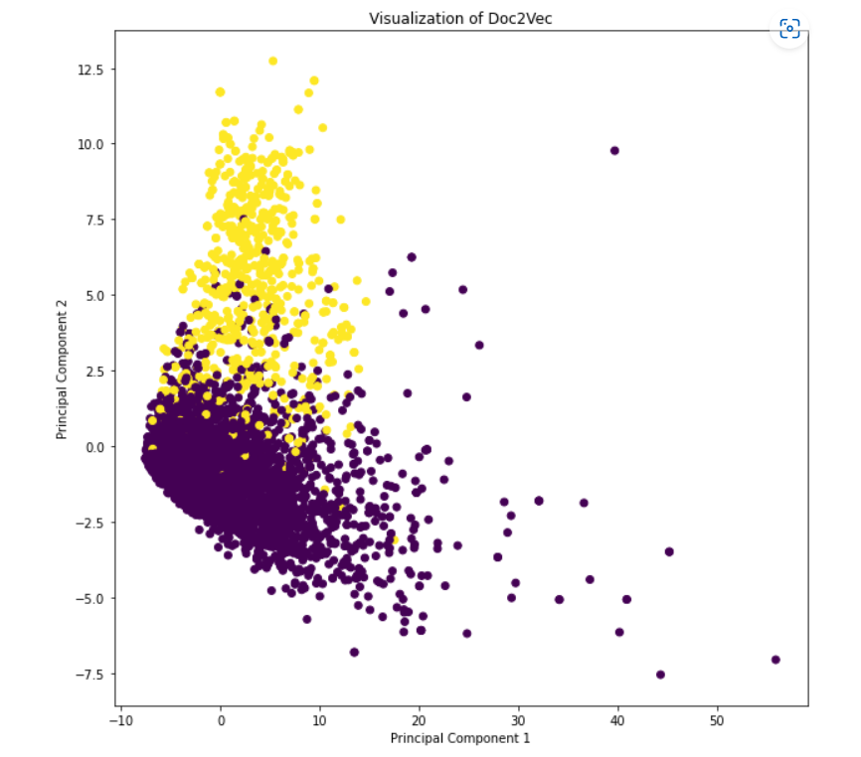
DIMENSION REDUCTION USING PCA
DOC2VEC VECTOR
Attained 95% variance with 190 components using PCA

Slide 11
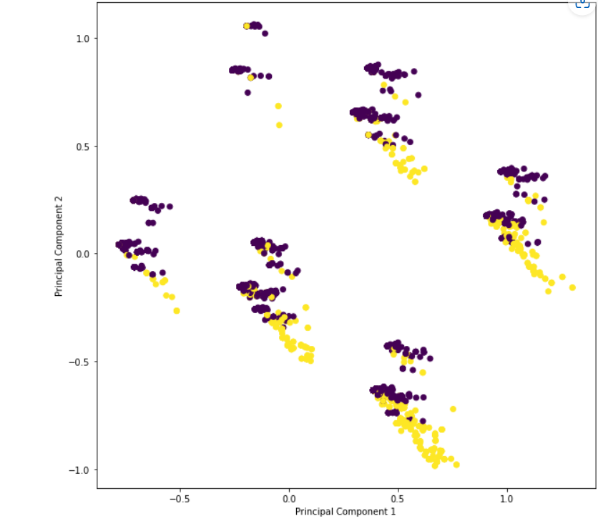
DIMENSION REDUCTION USING PCA
HF VECTOR
Attained 95% variance with 18 components using PCA

Slide 12
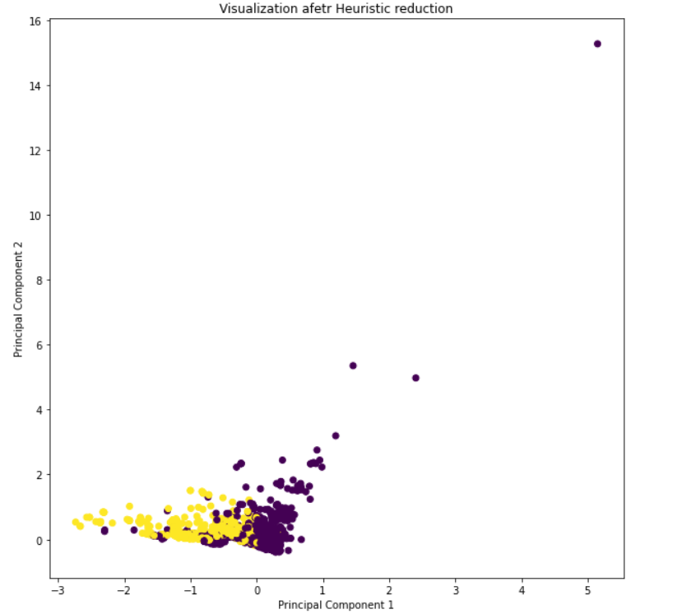
DIMENSION REDUCTION USING HEURISTIC METHODS
TF VECTOR
Attained 95% variance with 126 components using Heuristic methods

Slide 13
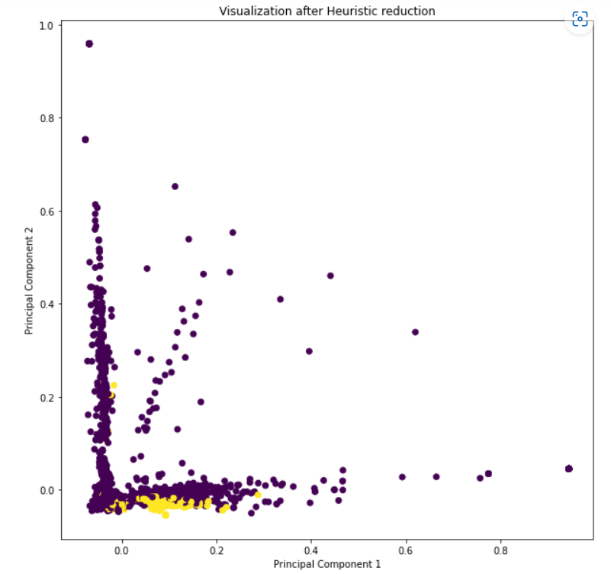
DIMENSION REDUCTION USING HEURISTIC METHODS
TF-IDF VECTOR
Attained 95% variance with 127 components using Heuristic methods

Slide 14
MODEL FITTING
LOGISTIC REGRESSION
TF VECTOR
Aim - To develop an SMS Spam filter which can correctly classify spam and ham SMS.
Experiment : Fitting a logistic regression model on TF-vector created after text pre-processing.
Observations and conclusion : The resulting confusion metric is shown in the right.
Error Metrics –
1. Recall = 0.85
2. Precision = 1
3. Accuracy = 0.97
4. F1 score = 0.92
Logistic Regression
TF | Predicted
Actual |  | 1 | 0
 | 1 | 772 | 0
 | 0 | 18 | 102

Slide 15
LOGISTIC REGRESSION
LOGISTIC REGRESSION
TF-IDF VECTOR
TF-IDF | Predicted
Actual |  | 1 | 0
 | 1 | 768 | 4
 | 0 | 53 | 67
Aim - To develop an SMS Spam filter which can correctly classify spam and ham SMS.
Experiment : Fitting a logistic regression model on TF-IDF vector created after text pre-processing.
Observations and conclusion : The resulting confusion metric is shown in the right.
Error Metrics –
1. Recall = 0.56
2. Precision = 0.94
3. Accuracy = 0.94
4. F1 score = 0.70

Slide 16
LOGISTIC REGRESSION
LOGISTIC REGRESSION
HF VECTOR
HF | Predicted
Actual |  | 1 | 0
 | 1 | 771 | 1
 | 0 | 26 | 94
Aim - To develop an SMS Spam filter which can correctly classify spam and ham SMS.
Experiment : Fitting a logistic regression model on HF vector created after text pre-processing.
Observations and conclusion : The resulting confusion metric is shown in the right.
Error Metrics –
1. Recall = 0.78
2. Precision = 0.98
3. Accuracy = 0.97
4. F1 score = 0.87

Slide 17
LOGISTIC REGRESSION
LOGISTIC REGRESSION
DOC2VEC VECTOR
Logistic Regression
DocToVec | Predicted
Actual |  | 1 | 0
 | 1 | 764 | 6
 | 0 | 13 | 106
Aim - To develop an SMS Spam filter which can correctly classify spam and ham SMS.
Experiment : Fitting a logistic regression model on DOC2VEC vector created after text pre-processing.
Observations and conclusion : The resulting confusion metric is shown in the right.
Error Metrics –
1. Recall = 0.89
2. Precision = 0.95
3. Accuracy = 0.98
4. F1 score = 0.93

Slide 18
DECISION TREE
TF VECTOR
Decision Tree
TF | Predicted
Actual |  | 1 | 0
 | 1 | 763 | 9
 | 0 | 22 | 98
Aim - To develop an SMS Spam filter which can correctly classify spam and ham SMS.
Experiment : Fitting a DT model on TF vector created after text pre-processing.
Observations and conclusion : The resulting confusion metric is shown in the right.
Error Metrics –
1. Recall = 0.82
2. Precision = 0.91
3. Accuracy = 0.96
4. F1 score = 0.86

Slide 19
DECISION TREE
TF-IDF VECTOR
Decision Tree
TF-IDF | Predicted
Actual |  | 1 | 0
 | 1 | 744 | 28
 | 0 | 24 | 96
Aim - To develop an SMS Spam filter which can correctly classify spam and ham SMS.
Experiment : Fitting a DT model on TF-IDF vector created after text pre-processing.
Observations and conclusion : The resulting confusion metric is shown in the right.
Error Metrics –
1. Recall = 0.80
2. Precision = 0.77
3. Accuracy = 0.94
4. F1 score = 0.78

Slide 20
DECISION TREE
HF VECTOR
Decision Tree
HF | Predicted
Actual |  | 1 | 0
 | 1 | 762 | 10
 | 0 | 23 | 97
Aim - To develop an SMS Spam filter which can correctly classify spam and ham SMS.
Experiment : Fitting a DT model on HF vector created after text pre-processing.
Observations and conclusion : The resulting confusion metric is shown in the right.
Error Metrics –
1. Recall = 0.81
2. Precision = 0.91
3. Accuracy = 0.96
4. F1 score = 0.85

Slide 21
DECISION TREE
DOC2VEC VECTOR
Decision Tree
DocToVec | Predicted
Actual |  | 1 | 0
 | 1 | 741 | 29
 | 0 | 27 | 92
Aim - To develop an SMS Spam filter which can correctly classify spam and ham SMS.
Experiment : Fitting a DT model on DOC2VEC vector created after text pre-processing.
Observations and conclusion : The resulting confusion metric is shown in the right.
Error Metrics –
1. Recall = 0.77
2. Precision = 0.76
3. Accuracy = 0.94
4. F1 score = 0.76

Slide 22
RANDOM FOREST
TF VECTOR
Random Forest
TF | Predicted
Actual |  | 1 | 0
 | 1 | 772 | 0
 | 0 | 24 | 96
Aim - To develop an SMS Spam filter which can correctly classify spam and ham SMS.
Experiment : Fitting a Random Forest model with max depth of100 and class weight of 0.89:0.11 on TF vector created after text pre-processing.
Observations and conclusion : The resulting confusion metric is shown in the right.
Error Metrics –
1. Recall = 0.80
2. Precision = 1
3. Accuracy = 0.97
4. F1 score = 0.89

Slide 23
RANDOM FOREST
TF-IDF VECTOR
Random Forest
TF-IDF | Predicted
Actual |  | 1 | 0
 | 1 | 765 | 7
 | 0 | 23 | 97
Aim - To develop an SMS Spam filter which can correctly classify spam and ham SMS.
Experiment : Fitting a Random Forest model with max depth of 25 and class weight of 0.84:0.86 on TF-IDF vector created after text pre-processing.
Observations and conclusion : The resulting confusion metric is shown in the right.
Error Metrics –
1. Recall = 0.81
2. Precision = 0.93
3. Accuracy = 0.96
4. F1 score = 0.86

Slide 24
RANDOM FOREST
HF VECTOR
Random Forest
HF | Predicted
Actual |  | 1 | 0
 | 1 | 965 | 1
 | 0 | 49 | 100
Aim - To develop an SMS Spam filter which can correctly classify spam and ham SMS.
Experiment : Fitting a Random Forest model with max depth of 10 and class weight of 0.8:0.2 on HF vector created after text pre-processing.
Observations and conclusion : The resulting confusion metric is shown in the right.
Error Metrics –
1. Recall = 0.65
2. Precision = 0.99
3. Accuracy = 0.95
4. F1 score = 0.78

Slide 25
RANDOM FOREST
DOC2VEC VECTOR
Random Forest
DocToVec | Predicted
Actual |  | 1 | 0
 | 1 | 766 | 4
 | 0 | 31 | 88
Aim - To develop an SMS Spam filter which can correctly classify spam and ham SMS.
Experiment : Fitting a Random Forest model max depth of 20 and class weight of 0.8:0.2 on DOC2VEC vector created after text pre-processing.
Observations and conclusion : The resulting confusion metric is shown in the right.
Error Metrics –
1. Recall = 0.74
2. Precision = 0.93
3. Accuracy = 0.96
4. F1 score = 0.82

Slide 26
ADA BOOST CLASSIFIER
TF VECTOR
AdaBoost
TF | Predicted
Actual |  | 1 | 0
 | 1 | 769 | 3
 | 0 | 19 | 101
Aim - To develop an SMS Spam filter which can correctly classify spam and ham SMS.
Experiment : Fitting a ADA Boost classifier with n_estimators as 500 on TF vector created after text pre-processing.
Observations and conclusion : The resulting confusion metric is shown in the right.
Error Metrics –
1. Recall = 0.84
2. Precision = 0.97
3. Accuracy = 0.975
4. F1 score = 0.9

Slide 27
ADA BOOST CLASSIFIER
TF-IDF VECTOR
AdaBoost
TF-IDF | Predicted
Actual |  | 1 | 0
 | 1 | 760 | 12
 | 0 | 17 | 103
Aim - To develop an SMS Spam filter which can correctly classify spam and ham SMS.
Experiment : Fitting a ADA Boost classifier with n_estimators as 200 on TF-IDF vector created after text pre-processing.
Observations and conclusion : The resulting confusion metric is shown in the right.
Error Metrics –
1. Recall = 0.85
2. Precision = 0.89
3. Accuracy = 0.97
4. F1 score = 0.88

Slide 28
ADA BOOST CLASSIFIER
HF VECTOR
AdaBoost
HF | Predicted
Actual |  | 1 | 0
 | 1 | 769 | 3
 | 0 | 23 | 97
Aim - To develop an SMS Spam filter which can correctly classify spam and ham SMS.
Experiment : Fitting a ADA Boost classifier with n_estimators as 50 on HF vector created after text pre-processing.
Observations and conclusion : The resulting confusion metric is shown in the right.
Error Metrics –
1. Recall = 0.81
2. Precision = 0.97
3. Accuracy = 0.97
4. F1 score = 0.88

Slide 29
ADA BOOST CLASSIFIER
DOC2VEC VECTOR
AdaBoost
DocToVec | Predicted
Actual |  | 1 | 0
 | 1 | 762 | 8
 | 0 | 12 | 107
Aim - To develop an SMS Spam filter which can correctly classify spam and ham SMS.
Experiment : Fitting a ADA Boost classifier with n_estimators as 500 on DOC2VEC vector created after text pre-processing.
Observations and conclusion : The resulting confusion metric is shown in the right.
Error Metrics –
1. Recall = 0.90
2. Precision = 0.93
3. Accuracy = 0.98
4. F1 score = 0.91

Slide 30
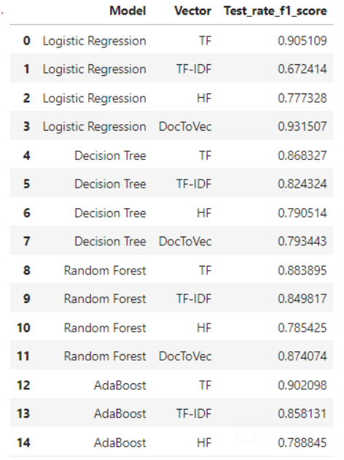
Models Fitted on Test data with F1_Score

Slide 31
FINAL MODEL SELECTION AND CONCLUSION
From all the models tested on test data, we are choosing Logistic Regression model fitted on DocToVec vector as our final model. This model is giving the highest F1 score and precision.
Since we are creating a spam classifier our objective is to maximize the precision of spam class and our final model is doing that.
Logistic Regression
DocToVec | Predicted
Actual |  | 1 | 0
 | 1 | 764 | 6
 | 0 | 13 | 106
Error Metrics –
1. Recall = 0.89
2. Precision = 0.95
3. Accuracy = 0.98
4. F1 score = 0.93

Slide 32
Thank You

